Slide 1
Introduction to
Artificial Intelligence (AI)
Computer Science cpsc502, Lecture 6
Sep, 27, 2011
Notes:
Lecture 6

Slide 2
Today Sept 27
Finish R&R systems in deterministic environments
Logics
Propositional, Definite Clause Logic: Syntax Semantics + Two different proof Procedures
Reasoning with individuals and relations
Full Propositional Logics and First-Order Logics

Slide 3
R&Rsys we'll cover in this course
Environment
Deterministic
Stochastic
Problem
Arc Consistency
SLS
Constraint Satisfaction
Vars +
Constraints
Search
Static
Belief Nets
Var. Elimination
Query
Logics
Approx. Inference
Search
Temporal. Inference
Sequential
Decision Nets
STRIPS
Var. Elimination
Planning
Search
Markov Processes
Representation
Value Iteration
Reasoning
Technique
Notes:
R&R Sys Representation and reasoning Systems
Each cell is a R&R system
STRIPS actions prec
The SCSP extends the classical CSP by
including both decision variables, that an agent can set, and stochastic
variables that follow a probability distribution and can model uncer-
tain events beyond the agent’s control. So far, two approaches to solving
SCSPs have been proposed; backtracking-based procedures that extend
standard methods from CSPs, and scenario-based methods that solve
SCSPs by reducing them to a sequence of CSPs.onditions and effects Stanford Research Institute Problem Solver

Slide 4
What you already know for sure about logic...
From programming: Some logical operators
If ((amount > 0) && (amount < 1000)) || !(age < 30)
...
You know what they mean in a “procedural” way
Logic is the language of Mathematics. To define formal structures (e.g., sets, graphs) and to proof statements about those
We are going to look at Logic as a Representation and Reasoning System that can be used to formalize a domain (e.g., an electrical system, an organization) and to reason about it
Notes:
There are many different, but equivalent, axiomatizations of Peano arithmetic. While some axiomatizations, such as the one just described, only describe the successor operation, other axiomatizations directly describe the arithmetical operations. One such axiomatization begins with the following axioms that describe a discrete ordered semiring.[7]
∈x, y, z ∈ N. (x + y) + z = x + (y + z), i.e., addition is associative.
∀x, y ∈ N. x + y = y + x, i.e., addition is commutative.
∀x, y, z ∈ N. (x · y) · z = x · (y · z), i.e., multiplication is associative
∀x, y ∈ N. x · y = y · x, i.e., multiplication is commutative.
∀x, y, z ∈ N. x · (y + z) = (x · y) + (x · z), i.e., the distributive law.
∀x ∈ N. x + 0 = x ∧ x · 0 = 0.
∀x ∈ N. x · 1 = x.
∀x, y, z ∈ N. x < y ∧ y < z ⊃ x < z.
∀x ∈ N. ¬ (x < x).
∀x, y ∈ N. x < y ∨ x = y ∨ x > y.
∀x, y, z ∈ N. x < y ⊃ x + z < y + z.
∀x, y, z ∈ N. 0 < z ∧ x < y ⊃ x · z < y · z.
∀x, y ∈ N. x < y ⊃ ∃z ∈ N. x + z = y.
0 < 1 ∧ ∀x ∈ N. x > 0 ⊃ x ≥ 1..
∀x ∈ N. x ≥ 0.

Slide 5
Logic: A general framework for representation & reasoning
Let's now think about how to represent an environment about which we have only partial (but certain) information
What do we need to represent?
Notes:
Everything we can express in natural language ?
Def1. Meaning: a representation that expresses the linguistic input in terms of objects, actions, events, time, space… beliefs, attitudes...relationships

Slide 6
Why Logics?
“Natural” to express knowledge about the world
(more natural than a “flat” set of variables & constraints)
“Every 502 student will pass the final”
It is easy to incrementally add knowledge
It is easy to check and debug knowledge
Provide language for asking complex queries
Well understood formal properties
Notes:
Def1. Meaning: a representation that expresses the linguistic input in terms of objects, actions, events, time, space… beliefs, attitudes...relationships
exists x Isa(x, midterm)
courseOf(x, 322)
Isa(322, course)
forall z Student(z) AND registred(z,322) -> pass(z,x.t) AND (t > Now)

Slide 7
Ambitious Plan for today

Slide 8
Logics in practice
Agent is told (perceives) some facts about the world
Agent is told (already knows / learns) how the world works
Agent can answer yes/no questions about whether other facts must be true

Slide 9
Using Logics to make inferences…
Begin with a task domain.
Distinguish those things you want to talk about (the ontology).
Choose symbols in the computer to denote propositions
Tell the system knowledge about the domain.
Ask the system whether new statements about the domain are true or false.

Slide 10
Propositional Logic
A very simple form of Logics: Propositional
The primitive elements are propositions: Boolean variables that can be {true, false}
The goal is to illustrate the basic ideas: syntax, semantics, proof procedure
This is a starting point for more complex logics (e.g., first-order logic)
Boolean nature can be exploited for efficiency. So more complex logics are often mapped in propositional form for inference
Notes:
We'll be looking at problems that could still be represented using CSPs. Why use propositional logic
Propositional logic is the simplest logic – illustrates basic ideas
Logic can be extended to infinitely many “variables” (using logical quantification)

Slide 11
Propositional logic: Complete Language
The proposition symbols p₁, p₂ … etc are sentences
If S is a sentence, ¬S is a sentence (negation)
If S₁ and S₂ are sentences, S₁ ∧ S₂ is a sentence (conjunction)
If S₁ and S₂ are sentences, S₁ ∨ S₂ is a sentence (disjunction)
If S₁ and S₂ are sentences, S₁ ⇒ S₂ is a sentence (implication)
If S₁ and S₂ are sentences, S₁ ⇔ S₂ is a sentence (biconditional)
Notes:
Propositional logic is the simplest logic – illustrates basic ideas

Slide 12
Electrical Environment
/down
/ up
Notes:
1 Begin with a task domain.
Electrical environment
2 Distinguish those things you want to talk about (the ontology).
Lights switches
3Choose symbols in the computer to denote propositions
sw₃_up: switch is up
live_outside: there is power in the building
4Tell the system knowledge about the domain.
sw₃_up and live_w₃ -> live_w₄
5 Ask the system whether new statements about the domain are true or false.
live_l₂
l₂_broken: light l₂ is broken
sw₃_up: switch is up
power: there is power in the building
unlit_l₂: light l₂ isn't lit
lit_l₁: light l₁ is lit
Conclusion l₂_broken
Rules
l₂_broken ← sw₃_up
∧ power ∧ unlit_l₂.
sw₃_up.
power ← lit_l₁.
unlit_l₂.
lit_l₁.

Slide 13
Propositional Definite Clauses Logic
Propositional Definite Clauses: our first logical representation and reasoning system.
(very simple!)
Only two kinds of statements:
that a proposition is true
that a proposition is true if one or more other propositions are true
Why still useful?
Adequate in many domains (with some adjustments)
Reasoning steps easy to follow by humans
Inference linear in size of your set of statements
Similar formalisms used in cognitive architectures
Notes:
To define this RSS, we'll need to specify:
syntax
semantics
proof procedure

Slide 14
Propositional Definite Clauses: Syntax
Definition (atom)
An atom is a symbol starting with a lower case letter
Definition (body)
A body is an atom or is of the form b₁ ∧ b₂ where b₁
and b₂ are bodies.
Definition (definite clause)
A definite clause is an atom or is a rule of the form h ← b where h is an atom and b is a body. (Read this as ``h if b.'')
Definition (KB)
A knowledge base is a set of definite clauses

Slide 15
Propositional Definite Clauses Semantics: Interpretation
Semantics allows you to relate the symbols in the logic to the domain you're trying to model. An atom can be…..
Definition (interpretation)
An interpretation I assigns a truth value to each atom.
If your domain can be represented by four atoms (propositions):
So an interpretation is just a…………………………..
Notes:
Let’s sai that your domain can be described by 4 propositions

Slide 16
PDC Semantics: Body
We can use the interpretation to determine the truth value of clauses and knowledge bases:
Definition (truth values of statements): A body b₁ ∧ b₂ is true in I if and only if b₁ is true in I and b₂ is true in I.
 | p | q | r | s
I₁ | true | true | true | true
I₂ | false | false | false | false
I₃ | true | true | false | false
I₄ | true | true | true | false
I₅ | true | true | false | true

Slide 17
PDC Semantics: definite clause
Definition (truth values of statements cont’): A rule h ← b is false in I if and only if b is true in I and h is false in I.
 | p | q | r | s
I₁ | true | true | true | true
I₂ | false | false | false | false
I₃ | true | true | false | false
I₄ | true | true | true | false
….. | …. | ….. | …. | ....
In other words: ”if b is true I am claiming that h must be true, otherwise I am not making any claim”
Notes:
May seem bizarre/counterintuitive but
Does not make any claim of causation or relevance
It is equivalent to state: ”if b is true I am claiming that h must be true, otherwise I am not making any claim”

Slide 18
PDC Semantics: Knowledge Base
Definition (truth values of statements cont’): A knowledge base KB is true in I if and only if every clause in KB is true in I.

Slide 19
Models and Satisfiability
Definition (model)
A model of a set of clauses (a KB) is an interpretation in which all the clauses are true.
Definition (satisfiability)
A set of clauses (a KB) is satisfiable if it has at least one model

Slide 20
Example: Models
 | p | q | r | s
I₁ | true | true | true | true
I₂ | false | false | false | false
I₃ | true | true | false | false
I₄ | true | true | true | false
I₅ | true | true | false | true
Which interpretations are models?
Notes:
is a model of KB
not a model of KB
is a model of KB
is a model of KB
not a model of KB

Slide 21
Logical Consequence
Definition (logical consequence)
If KB is a set of clauses and G is a conjunction of atoms, G is a logical consequence of KB, written KB ⊧ G, if G is true in every model of KB.
we also say that G logically follows from KB, or that KB entails G.
In other words, KB ⊧ G if there is no interpretation in which KB is true and G is false.

Slide 22
Example: Logical Consequences
 | p | q | r | s
I₁ | true | true | true | true
I₂ | true | true | true | false
I₃ | true | true | false | false
I₄ | true | true | false | true
I₅ | false | true | true | true
I₆ | false | true | true | false
I₇ | false | true | false | false
I₈ | false | true | false | true
… | …. | … | … | …
Which of the following is true?
KB ⊧ q, KB ⊧ p, KB ⊧ s, KB ⊧ r
Notes:
KB ⊧ q, KB ⊧ p, KB ⊭ s, KB ⊭ r

Slide 23
One simple way to prove that G logically follows from a KB
Collect all the models of the KB
Verify that G is true in all those models
Any problem with this approach?
The goal of proof theory is to find proof procedures that allow us to prove that a logical formula follows form a KB avoiding the above

Slide 24
Soundness and Completeness
If I tell you I have a proof procedure for PDCL
What do I need to show you in order for you to trust my procedure?
KB ⊦ G means G can be derived by my proof procedure from KB.
Recall KB ⊧ G means G is true in all models of KB.
Definition (soundness)
A proof procedure is sound if KB ⊦ G implies KB ⊧ G.
Definition (completeness)
A proof procedure is complete if KB ⊧ G implies KB ⊦ G.

Slide 25
Bottom-up Ground Proof Procedure
One rule of derivation, a generalized form of modus ponens:
If “h ← b₁ ∧ … ∧ b_{m}” is a clause in the knowledge base, and each b_{i} has been derived, then h can be derived.
You are forward chaining on this clause.
(This rule also covers the case when m=0. )
Notes:
It starts form known facts (facts that have been already established)
Contrast this with top-down which starts form the query (what you want to prove) and finds
Clauses to support the query

Slide 26
Bottom-up proof procedure
KB ⊦ G if G ⊆ C at the end of this procedure:
C :={};
repeat
select clause “h ← b₁ ∧ … ∧ b_{m}” in KB such that b_{i} ∈ C for all i, and h ∉ C;
C := C ∪ { h }
until no more clauses can be selected.
Notes:
KB a set of definite clauses
C is a set of atoms
Output : set of atoms that are logical consequences of KB

Slide 27
Bottom-up proof procedure: Example
z ← f ∧ e
q ← f ∧ g ∧ z
e ← a ∧ b
a
b
r
f
C :={};
repeat
select clause “h ← b₁ ∧ … ∧ b_{m}” in KB such that b_{i} ∈ C for all i, and h ∉ C;
C := C ∪ { h }
until no more clauses can be selected.
r? q? z?

Slide 28
Top-down Ground Proof Procedure
Key Idea: search backward from a query G to determine if it can be derived from KB.
Notes:
Single inference rule that yields a complete inference algorithm when coupled with any complete search algorithm
"SL resolution with Definite clauses".
For SL http://en.wikipedia.org/wiki/SLD_resolution (not really critical for this lecture)

Slide 29
Top-down Proof Procedure: Basic elements
Notation: An answer clause is of the form:
yes ← a₁ ∧ a₂ ∧ … ∧ a_{m}
Express query as an answer clause (e.g., query a₁ ∧ a₂ ∧ … ∧ a_{m} )
yes ←
Rule of inference (called SLD Resolution)
Given an answer clause of the form:
yes ← a₁ ∧ a₂ ∧ … ∧ a_{m}
and the clause:
a_{i} ← b₁ ∧ b₂ ∧ … ∧ b_{p}
You can generate the answer clause
yes ← a₁ ∧ … ∧ a_{i-1} ∧ b₁ ∧ b₂ ∧ … ∧ b_{p} ∧ a_{i+1} ∧ … ∧ a_{m}
Notes:
Answer clause means the antecedent are true
SLD Resolution of this answer clause on atom a_{i}

Slide 30
Rule of inference: Examples
Rule of inference (called SLD Resolution)
Given an answer clause of the form:
yes ← a₁ ∧ a₂ ∧ … ∧ a_{m}
and the clause:
a_{i} ← b₁ ∧ b₂ ∧ … ∧ b_{p}
You can generate the answer clause
yes ← a₁ ∧ … ∧ a_{i-1} ∧ b₁ ∧ b₂ ∧ … ∧ b_{p} ∧ a_{i+1} ∧ … ∧ a_{m}
yes ← b ∧ c. b ← k ∧ f.
yes ← e ∧ f. e.
Notes:
Answer clause means the antecedent are true
SLD Resolution of this answer clause on atom a_{i}

Slide 31
(successful) Derivations
An answer is an answer clause with m = 0. That is, it is the answer clause yes ← .
A (successful) derivation of query “?q₁ ∧ … ∧ q_{k} “ from KB is a sequence of answer clauses γ₀ , γ₁ ,…,γ_{n}
such that
γ₀ is the answer clause yes ← q₁ ∧ … ∧ q_{k}
γ_{i} is obtained by resolving γ_{i-1} with a clause in KB, and
γ_{n} is an answer.
An unsuccessful derivation…..

Slide 32
Example: derivations
a ← e ∧ f. a ← b ∧ c. b ← k ∧ f.
c ← e. d ← k. e.
f ← j ∧ e. f ← c. j ← c.
Query: a (two ways)
yes ← a.
yes ← a.
Query: b (k, f different order)
yes ← b.
Notes:
Query: a
γ₀ : yes ← a γ₄ : yes ← e
γ₁ : yes ← e ∧ f γ₅: yes ←
γ₂ : yes ← f
γ₃ : yes ← c
Query: ?b
γ₀ : yes ← b
γ₁ : yes ← k ∧ f

Slide 33
Successful Derivation: When by applying the inference rule you obtain the answer clause yes ← .
a ← e ∧ f. a ← b ∧ c. b ← k ∧ f.
c ← e. d ← k. e.
f ← j ∧ e. f ← c. j ← c.
Query: a (two ways)
yes ← a.
yes ← a.
Notes:
Sound and complete
When it has derived the answer, you can read a bottom-up proof in the
opposite direction. Every top-down derivation corresponds to a bottom-up
proof, and every bottom-up proof has a corresponding top-down derivation.
This equivalence can be used to show the soundness and completeness
of the derivation procedure.

Slide 34
Search Graph
Prove: ?← a ∧ d.
a ← b ∧ c. a ← g.
a ← h. b ← j.
b ← k. d ← m.
d ← p. f ← m.
f ← p. g ← m.
g ← f. k ← m. h ← m. p.
Heuristics?
Notes:
Node selection heuristics?
Number of atoms
Heuristics for selecting atoms
Often you want to select the atom that results in the fewest neighbors as this reduces the branching factor of the search

Slide 35
Systematic Search in different R&R systems
Constraint Satisfaction (Problems):
State: assignments of values to a subset of the variables
Successor function: assign values to a “free” variable
Goal test: set of constraints
Solution: possible world that satisfies the constraints
Heuristic function: none (all solutions at the same distance from start)
Planning (forward) :
State possible world
Successor function states resulting from valid actions
Goal test assignment to subset of vars
Solution sequence of actions
Heuristic function empty-delete-list (solve simplified problem)
Logical Inference (top Down)
State answer clause
Successor function states resulting from substituting one atom with all the clauses of which it is the head
Goal test empty answer clause
Solution start state
Heuristic function number of atoms in given state
Notes:
Allows useful general-purpose algorithms with more power than standard search algorithms

Slide 36
Today Sept 27
Finish R&R systems in deterministic environments
Logics
Propositional Definite Clause Logic: Syntax Semantics + Two different proof Procedures
Reasoning with individual and relations
Full Propositional Logics and First-Order Logics

Slide 37
Ambitious Plan for today

Slide 38
Representation and Reasoning in Complex domains
In complex domains expressing knowledge with propositions can be quite limiting
It is often natural to consider individuals and their properties
up_s₂
up_s₃
ok_cb₁
ok_cb₂
live_w₁
connected_w₁_w₂
up( s₂ )
up( s₃ )
ok( cb₁ )
ok( cb₂ )
live( w₁)
connected( w₁ , w₂ )
There is no notion that
up_s₂
up_s₃
live_w₁
connected_w₁_w₂
Notes:
the propositions up s2, up s3,
ok s2 have no internal structure. There is no notion that the proposition
up s2 and up s3 are about the same relation, but with different individuals,
or that up s2 and ok s2 are about the same switch. There is no notion
of individuals and relations.
An alternative is to explicitly represent the individual switches s1,
s2, s3, and the properties or relations, up and ok. Using this representation,
“switch s2 is up” is represented as up(s2). A binary relation, like
connected to, can be used to relate two individuals, such as connected to(w1, s1)

Slide 39
What do we gain….
By breaking propositions into relations applied to individuals?
Express knowledge that holds for set of individuals (by introducing )
live(W) <- connected_to(W,W1) ∧ live(W1) ∧ wire(W) ∧ wire(W1).
We can ask generic queries (i.e., containing )
? connected_to(W, w₁)
Notes:
Economy of symbols: 10 individuals and 1 binary relation can express….
connected_to(X,Y)
1000 wires

Slide 40
Datalog: a relational rule language
It expands the syntax of PDCL….
A variable is a symbol starting with an upper case letter
A constant is a symbol starting with lower-case letter or a sequence of digits.
A term is either a variable or a constant.
A predicate symbol is a symbol starting with lower-case letter.

Slide 41
Datalog Syntax (cont’)
An atom is a symbol of the form p or p(t₁ …. t_{n}) where p is a predicate symbol and t_{i} are terms
A definite clause is either an atom (a fact) or of the form:
h ← b₁ ∧… ∧ b_{m}
where h and the b_{i} are atoms (Read this as ``h if b.'')
A knowledge base is a set of definite clauses
Notes:
The notions of a definite clause, fact, rule, query and knowledge base
are the same as for propositional definite clauses

Slide 42
Datalog: Top Down Proof
Extension of TD for PDCL.
How do you deal with variables?
Example:
in(alan, r123).
part_of(r123,cs_building).
in(X,Y) <- part_of(Z,Y) & in(X,Z).
Query: in(alan, cs_building).
yes <- in(alan, cs_building).
Notes:
A proof can use any instance of a clause containing variables
But every time a clause is reused in the same proof the variable are renamed
Simple cases, just for illustration

Slide 43
Datalog: queries with variables
in(alan, r123).
part_of(r123,cs_building).
in(X,Y) <- in(X,Z). & part_of(Z,Y)
Query: in(alan, X1).
Yes(X1) <- in(alan, X1).

Slide 44
Ambitious Plan for today

Slide 45
Today Sept 27
Finish R&R systems in deterministic environments
Logics
Propositional Definite Clause Logic: Syntax Semantics + Two different proof Procedures
Reasoning with individual and relations
Full Propositional Logics and First-Order Logics

Slide 46
Full Propositional Logics
DEFs.
Literal: an atom or a negation of an atom
Clause: is a disjunction of literals
Conjunctive Normal Form (CNF): a conjunction of clauses
INFERENCE:
Convert all formulas in KB and in CNF
Apply Resolution Procedure (at each step combine two clauses containing complementary literals into a new one)
Termination
No new clause can be added
Two clause resolve into an empty clause
Notes:
KB entails alpha iff KB and (not alpha) is unsatisfiable

Slide 47
Propositional Logics: Satisfiability (SAT problem)
Does a set of formulas have a model? Is there an interpretation in which all the formulas are true?
(Stochastic) Local Search Algorithms can be used for this task!
Evaluation Function: number of unsatisfied clauses
WalkSat: One of the simplest and most effective algorithms:
Start from a randomly generated interpretation
Pick an unsatisfied clause
Pick an proposition to flip (randomly 1 or 2)
To minimize # of unsatisfied clauses
Randomly
Notes:
KB entails alpha iff KB and (not alpha) is unsatisfiable

Slide 48
Full First-Order Logics (FOLs)
We have constant symbols, predicate symbols and function symbols
So interpretations are much more complex (but the same basic idea – one possible configuration of the world)
constant symbols => individuals, entities
predicate symbols => relations
function symbols => functions
INFERENCE:
Semidecidable: algorithms exists that says yes for every entailed formulas, but no algorithm exists that also says no for every non-entailed sentence
Resolution Procedure can be generalized to FOL
Notes:
KB entails alpha iff KB and (not alpha) is unsatisfiable

Slide 49
Also Do exercises 5.A and 12.A,B,C http://www.aispace.org/exercises.shtml
TODO for next Tue
Thurs class is canceled – I’ll be visiting SAP labs in France for a workshop on Business Intelligence
This week Focus on
Complete the assignment!
Study carefully handout on Probability (critical for the rest of the lectures!)

Slide 50
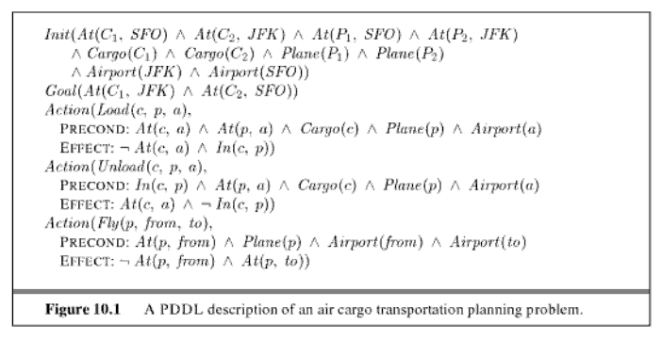
Expressiveness of the language
Notes:
Planning Domain definition Language
Courtesy Sebastian Thrun P. Norvig

Slide 51
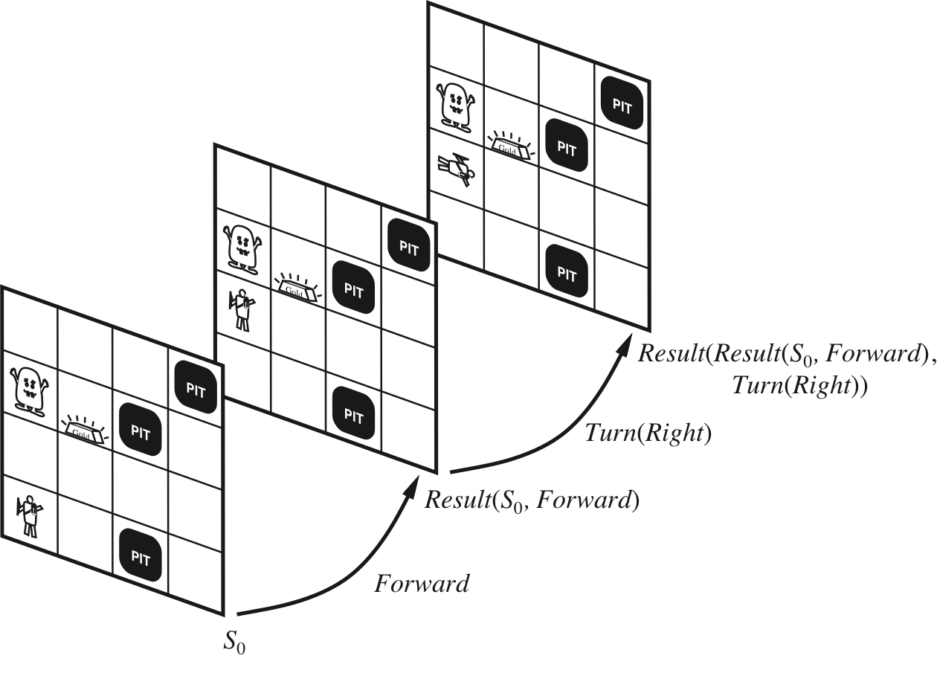
Planning with Structured Rep
Situation Calculus First-order Logic

Slide 52
Situation Calculus
Convenient to have more expressive lang. “Move all the cargo from SFO to JFK”
Use existing mechanisms for logical proof
Strong foundation for studying planning
Still, less used in practice than other techniques

Slide 53
Situation Calculus
Possibility Axioms (for each action)
SomeFormula(s) ⇒Poss(a, s)
Alive(Agent, s) ∧ Have(Agent, Arrow, s) ⇒ Poss(Shoot, s)
Successor-state Axiom (for each fluent)
Poss(a, s) ⇒(fluent is true ⇔ a made it true ∨ it was true and a left it alone)
Poss(a, s) ⇒ (Holding(Agent, g, Result(s, a)) ⇔ a = Grab(g) ∨ (Holding(Agent, g, s) ∧ a ≠ Release(g)))

Slide 54
CS 221: Artificial Intelligence
(Some) Slide credit: Peter Norvig and Sebastian Thrun
Dan Klein, Stuart Russell, Andrew Moore

Slide 55
Soundness & completeness of proof procedures
A proof procedure X is sound …
A proof procedure X is complete….
BottomUp for PDCL is
We proved this in general even for domains represented by thousands of propositions and corresponding KB with millions of definite clauses !

Slide 56
Can you think of a proof procedure for PDCL….
a ← e ∧ g.
b ← f ∧ g. c ← e.
f ← c ∧ e.
e.
d.
That is sound but not complete?
That is complete but not sound?

Slide 57
Completeness of Bottom Up (proof summary)
If KB ⊧ G then KB ⊦ G
Suppose KB ⊧ G .
Then G is true
Thus G is true
Thus
Thus G is proved by…..
Thus
Notes:
If KB ⊧ g then KB ⊦ G
Suppose KB ⊧ G .
Then G is true in all models of KB.
Thus G is true in the minimal model
Thus G ⊆ C
Thus g is generated by the bottom up algorithm.
Thus KB ⊦ G.

Slide 58
Sampling a discrete probability distribution

Slide 59
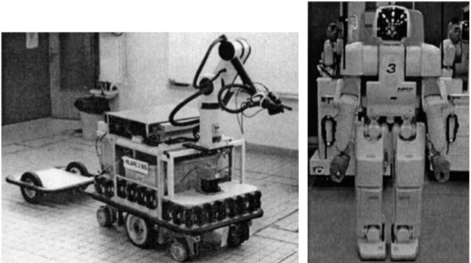
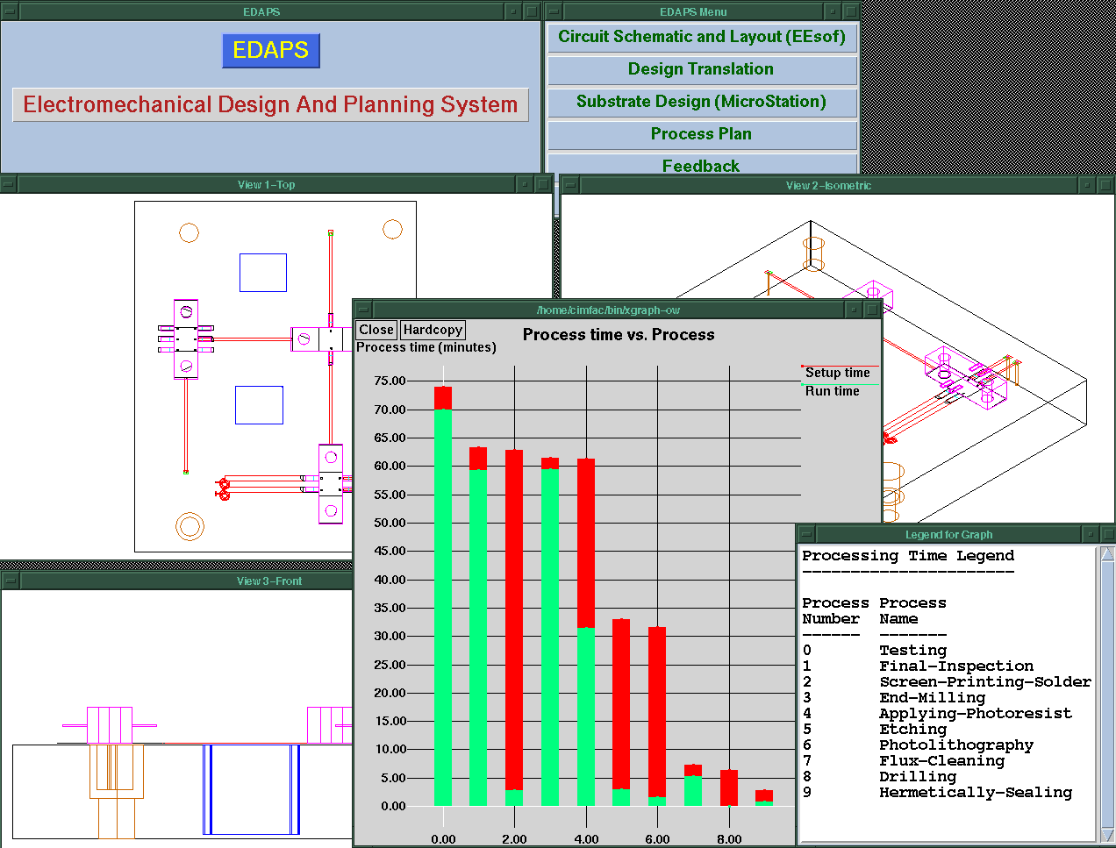

Now, do you know how to implement a planner for….
Emergency Evacuation?
Robotics?
Space Exploration?
Manufacturing Analysis?
Games (e.g., Bridge)?
Generating Natural language
Product Recommendations ….
★
Q
✦
9

A
◻
North
A
✦
7

K
◻
★
9
J
★
6

5
★
5

3
West
East

2

6

8

Q
South
Notes:
We don't have to worry about searching forwards
Particularly effective in domains for which we can get a reliable estimate of k
STanford Research Institute Problem Solver

Slide 60
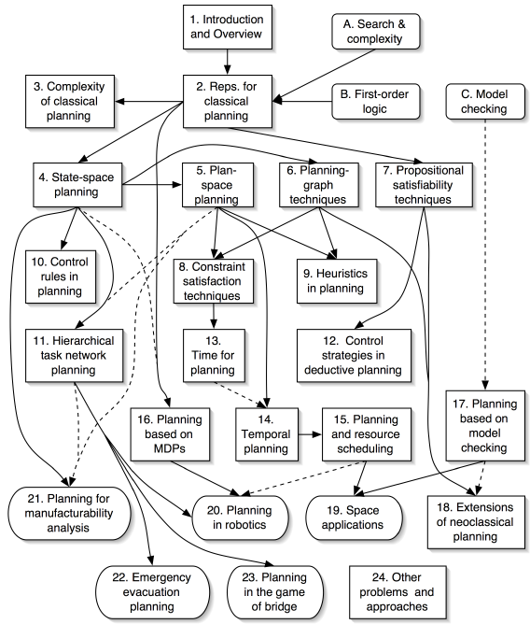
No ☹, but you (will) know the key ideas ☺!
Ghallab, Nau, and Traverso Automated Planning: Theory and Practice Morgan Kaufmann, May 2004 ISBN 1-55860-856-7
Web site:
http://www.laas.fr/planning
Notes:
Add also dialog managers and text planner as applications
of HTN and for dialogue also MDPs

Slide 61
Logics in AI: Similar slide to the one for planning
Propositional Definite Clause Logics
Semantics and Proof Theory
Propositional Logics
First-Order Logics
Satisfiability Testing (SAT)
Description Logics
Hardware Verification
Production Systems
Product Configuration
Ontologies
Cognitive Architectures
Semantic Web
Video Games
Summarization
Tutoring Systems
Information Extraction

Slide 62
Logics as a R&R system
formalize a domain
reason about it

Slide 63
Propositional (Definite Clauses) Logic: Syntax
We start from a restricted form of Prop. Logic:
Only two kinds of statements
that a proposition is true
that a proposition is true if one or more other propositions are true
Notes:
We'll be looking at problems that could still be represented using CSPs. Why use propositional logic
Propositional logic is the simplest logic – illustrates basic ideas
Logic can be extended to infinitely many “variables” (using logical quantification)

Slide 64
Bottom-up proof procedure: Example
z ← f ∧ e
q ← f ∧ g ∧ z
e ← a ∧ b
a
b
r
f
C :={};
repeat
select clause “h ← b₁ ∧ … ∧ b_{m}” in KB such that b_{i} ∈ C for all i, and h ∉ C;
C := C ∪ { h }
until no more clauses can be selected.
r? q? z?

