Slide 1


Networks of Centres of Excellence Annual Meeting 2011 Communications Workshop Government Relations
Centre for Commercialization of Research (CCR)
December 5, 2011
Fairmont Chateau Laurier, Ottawa, Ontario
oce-ontario.org
OCE’s Centre of Commercialization of Research is supported by the federal government through a Networks of Centres of Excellence Program
Ontario Centres of Excellence (OCE) is funded by the Government of Ontario. OCE is a member of the Ontario Network of Excellence (ONE).

Slide 2
Overview
Government Relations Definition
Meaningful Influence
Developing a Good Working Relationship
Environmental Scan
Vision and Priorities of the Government
Developing a Rapport
Engagement Planning
Tools of Engagement

Slide 3
Government Relations
Working Definition of Government Relations:
Government Relations - systematic effort to influence the actions and policies of government to help achieve particular objectives or protect particular interests….in public and in a way that reflects well on you and the decision-makers involved.

Slide 4
Public Service (Non-Elected)
Values to Guide our Actions (Public Service Commission)
In serving Parliament and Canadians, we are guided by and proudly adhere to the following values:
Integrity in our actions
Fairness in our decisions
Respect in our relationships; and
Transparency in our communications
Political impartiality of public servants

Slide 5
Parliamentarians (Elected)
Main functions of an MP
Constituency Work – “ombudsman” role
Represent their constituents’ views through debates, policy initiatives, short statements, raise issues during question period and appeal to ministers on policy
Private members business
Parliamentary Committees
Caucus
Partisan considerations
Oversight role – i.e. Review of auditor’s report

Slide 6
Meaningful Influence
Meaningful Influence:
Definition of influence – “Producing an effect without the direct exercise of command”
In government relations, meaningful influence depends on trust and it has to be earned.

Slide 7
Meaningful Influence
How?
Building relationships – political and non-elected
Showing respect – listening and respecting confidences
Reaching your goal and the government’s as well – serving the public interests as well as your own
Helping government achieve political gains based on good public policy
Tell the truth
Engaging and communicating with the broadest possible group – build relationships widely
Keep opposition parties informed
Simple, time consuming and effective

Slide 8
Meaningful Influence
Avoid these traps
There are no secrets
Every email, document sent to government is “public record”
Everything you say and do in dealings with government must stand the light of public scrutiny
Can you can live with your comments on the front page of the Globe & Mail, Vancouver Sun or Calgary Herald?
Never assume you’ll be given the benefit of the doubt
Media is all too willing to put the worst interpretation on events – constantly watching for “scandal”

Slide 9
Meaningful Influence
Influence & Ethics
Legal reforms like the Lobbyist Registry (most provinces also have a registry) and clearer conflict of interest laws and guidelines bring hidden relationships into the light of day
Public servants and elected officials are likely not to work with you if things just don’t look right
Important to maintain high level of ethics and integrity

Slide 10
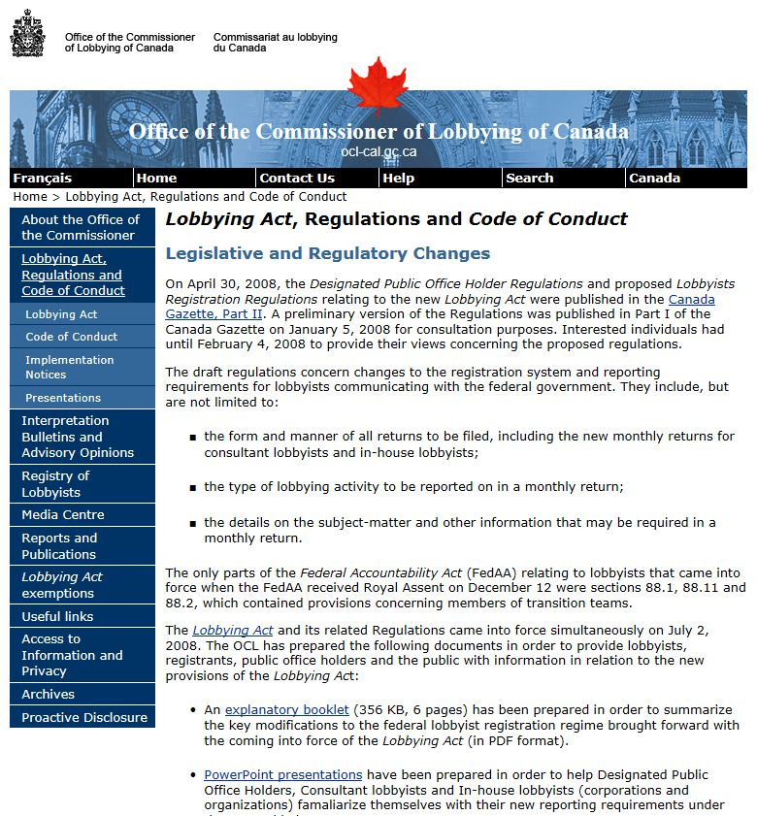
Federal Lobbyist Registration Act

Slide 11
Developing a working relationship with Government
Environmental Scan
Federally/Provincially
Governments speaking about the economy, jobs, innovation, impact
Federal election spring 2011 resulted in new landscape
Elections held recently in a number of provinces – NFLD, PEI, Ontario, Manitoba, Sask. New leaders in BC and Alberta
Internationally
Economic instability

Slide 12
Environmental Scan - Federal
Federally
Last Budget focused on a low tax plan for jobs and growth
Government will invest in the key drivers of economic growth—innovation, investment, education and training
Impact of Jenkins Report
Treasury Board Review
Impact of recent international events (Europe) on government’s course of action

Slide 13
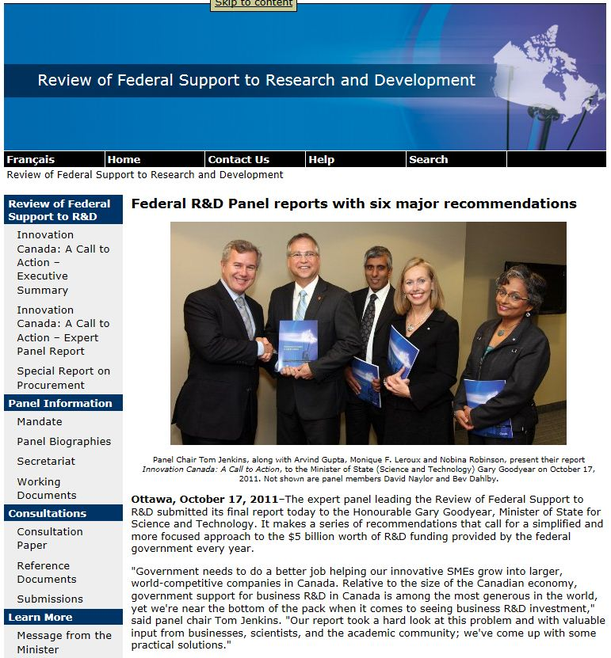
Jenkins Panel

Slide 14
Environmental Scan Provincial
Provincially
Ontario
Focus for next four years is strengthening Ontario’s economy and creating jobs by seizing opportunities
Innovation referenced as an opportunity
Drummond Report
Other provinces
New Premiers – new directions
New MLAs/MPPs

Slide 15
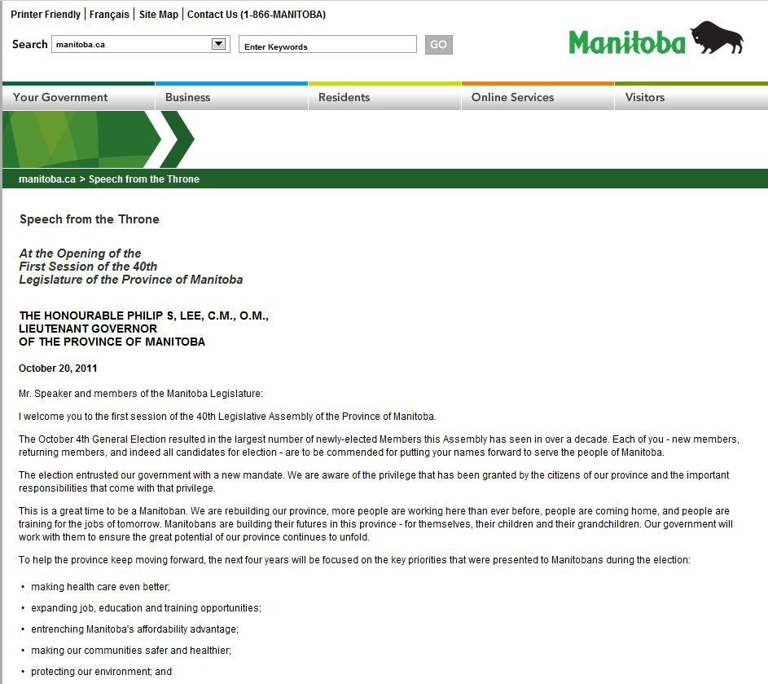
Manitoba Speech from the Throne

Slide 16
Assess Priorities of Government
Assess vision and priorities of Government
Be a student of government
Where does your organization fit
Clearly message the value of your institution as it relates to those priorities
Assess what might be helpful to government
Try to show alignment with government
Know the key government players
Know the key stakeholders

Slide 17
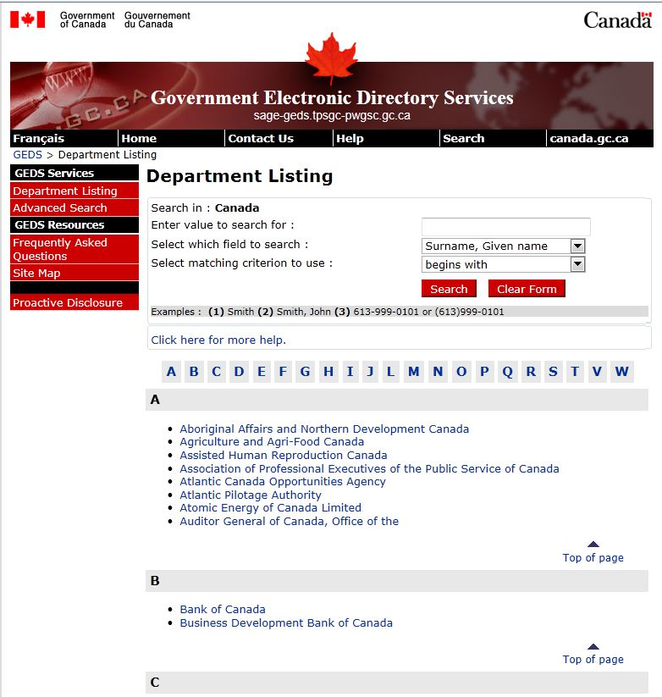
Searches available

Slide 18
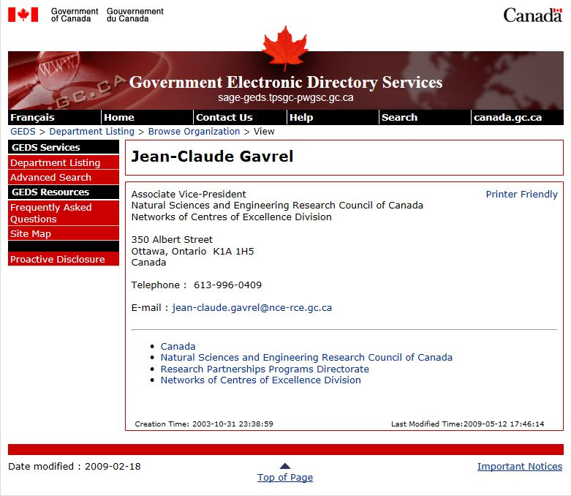

Slide 19
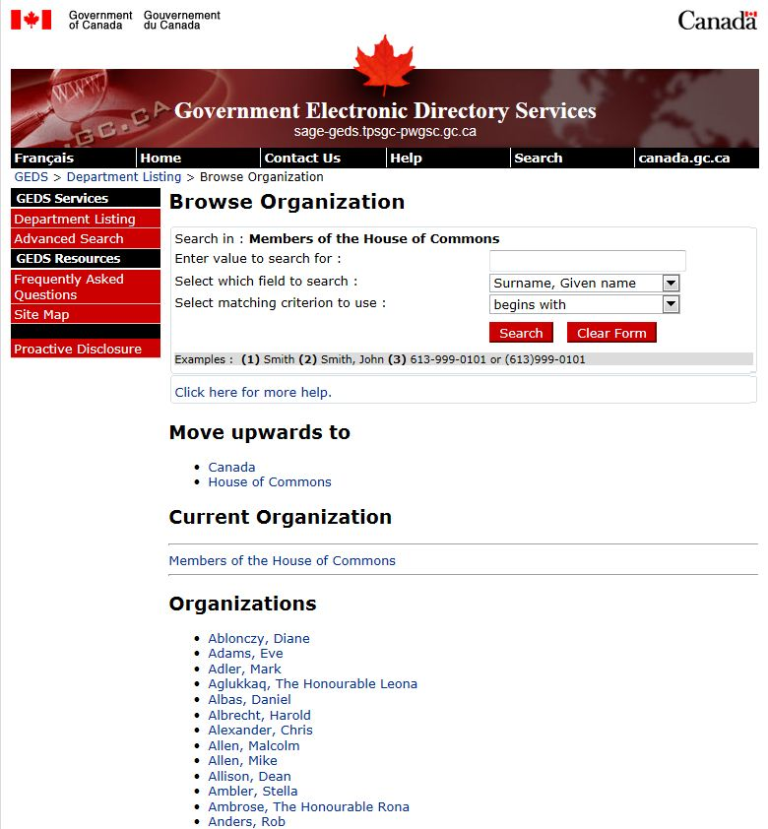

Slide 20
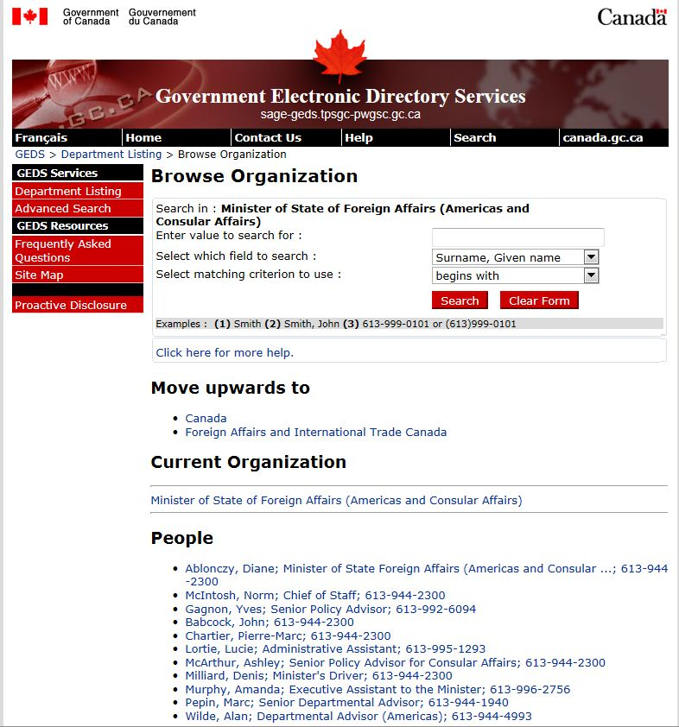

Slide 21
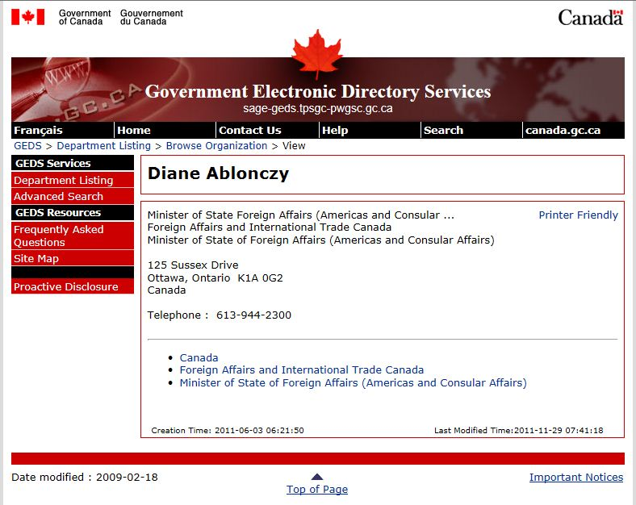

Slide 22
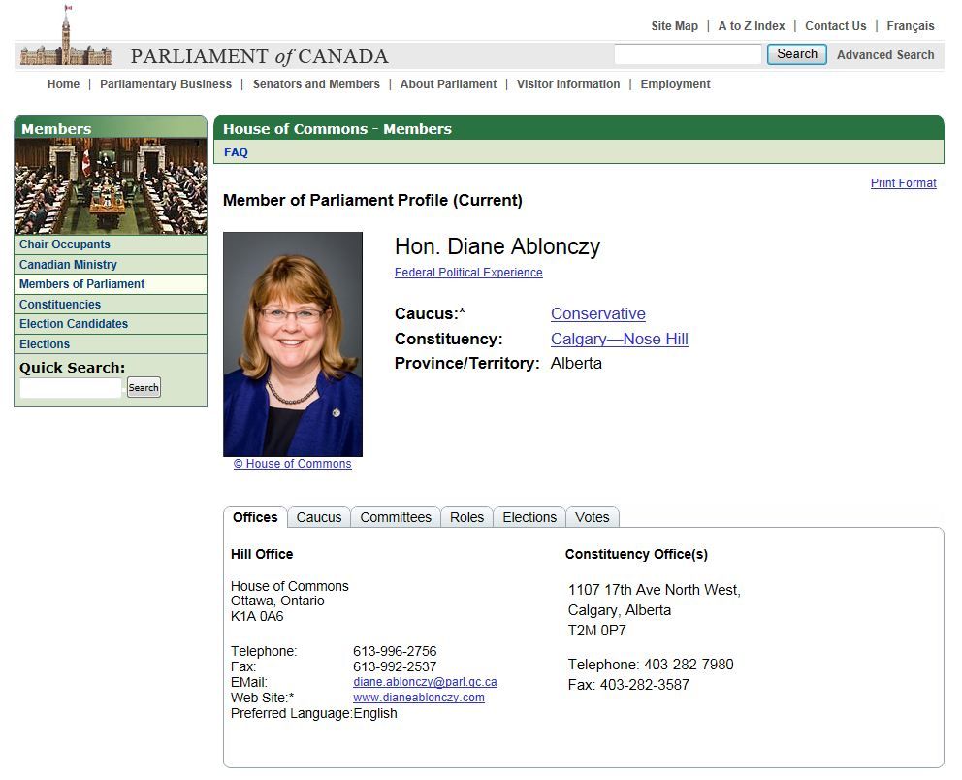

Slide 23
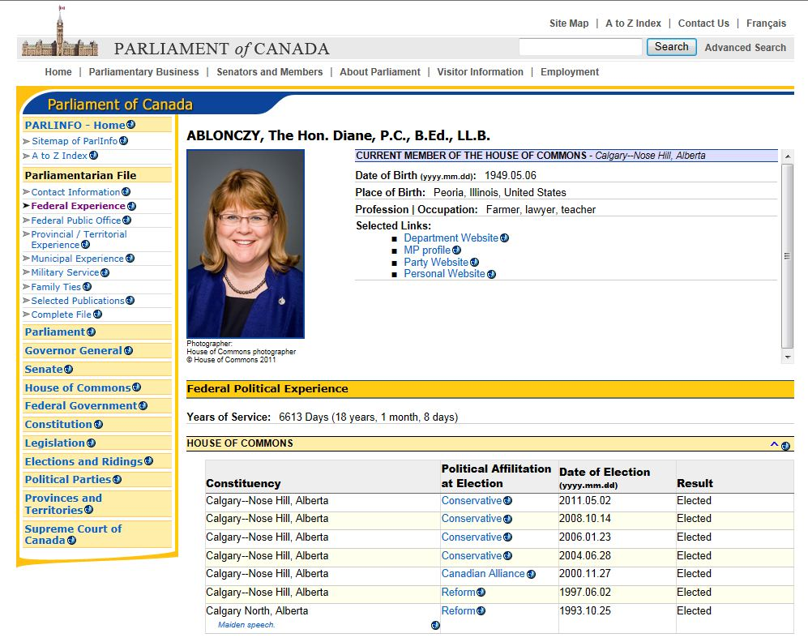

Slide 24
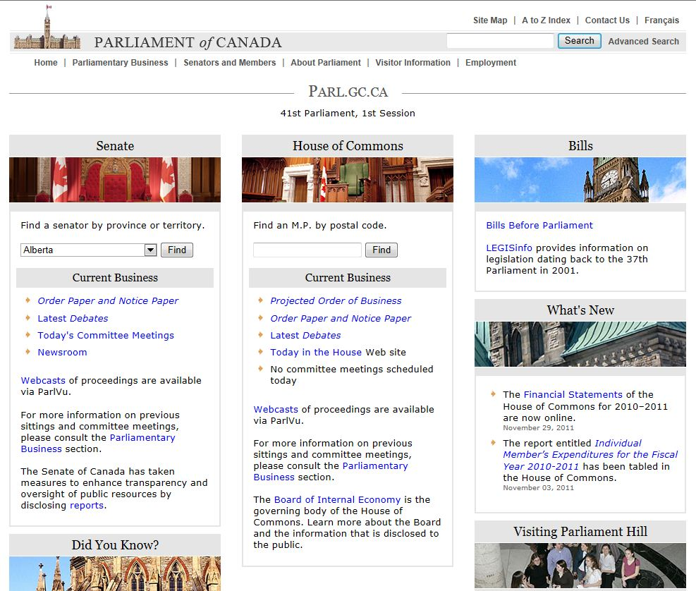

Slide 25
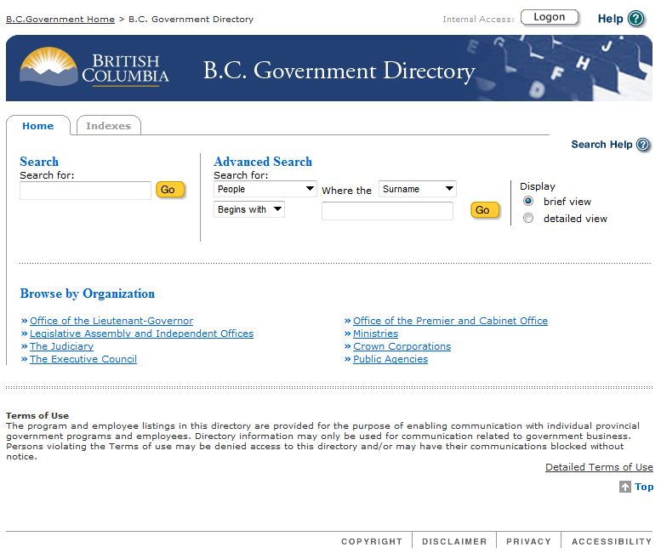

Slide 26
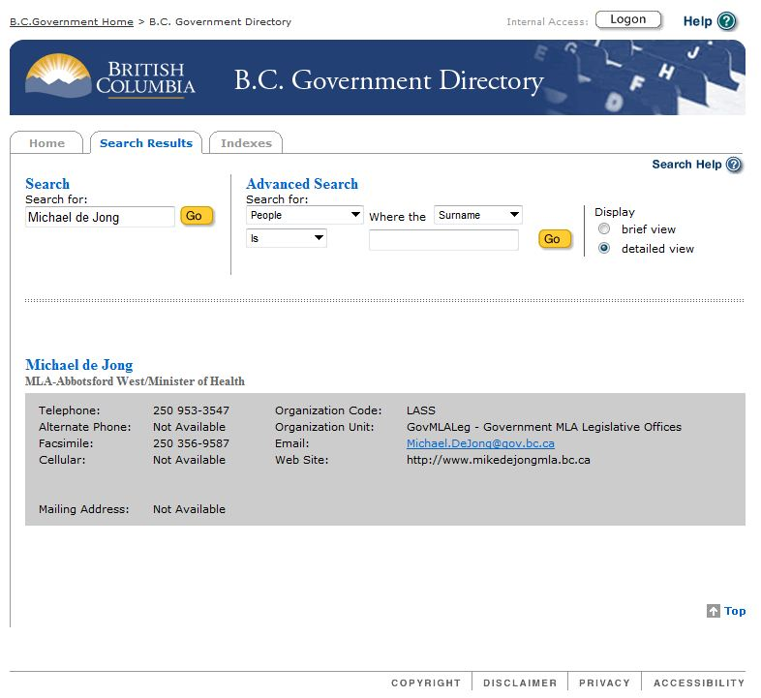

Slide 27
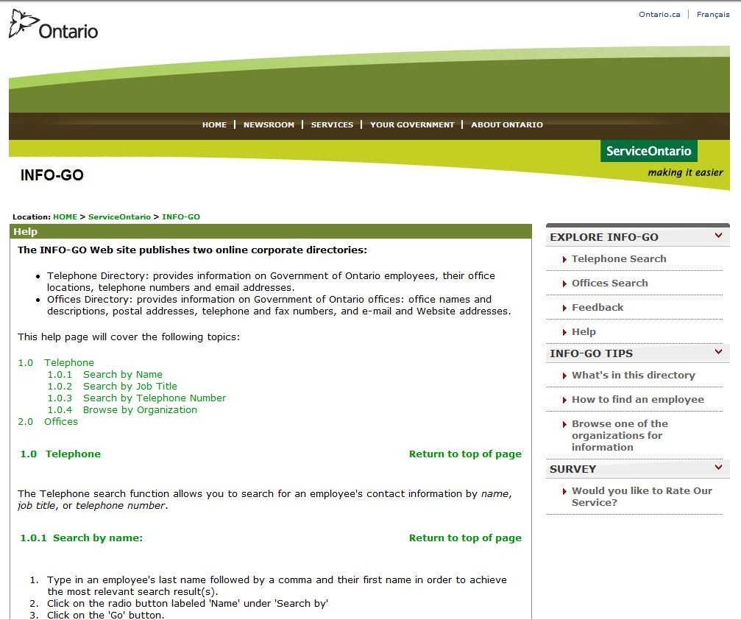

Slide 28
Developing a Rapport
Good Government Relations is simply good communications
Proactive approach
Don’t wait for a crisis
Anticipate
Does government know your organization/field
Never assume people in government understand a problem the same way you do
Be part of government’s vision
How can you help them reach their goals?

Slide 29
Developing a Rapport
Ensure what you’re asking government to do is in the public interest
It’s good for me, but is it good for the community?
Focus on the benefit to government/public – specific things the government values that will result from the way you operate your program or service
Trusted relationships/ two-way relationships

Slide 30
Developing a Rapport
Recognize details that cannot be shared
Government officials may say things informally that they would not ordinarily put in writing, but can help manage and strengthen your relationship
Anticipate what may be expected/required
Provide feedback from intelligence gained from field
Provide a platform to assist the government in telling their story

Slide 31
Engagement Planning
Develop your engagement plan
Objectives
Target Audience
Tactics and Tools
Measurement
Training your colleagues to be GR Ready

Slide 32
Engagement Planning
Tools and Tactics include
Briefings
Value of Face to Face relationship building
Who are the Players?
Government
Ministers, DM, ADM, Committee Members
Academic community
Individual local MPs or MLAs/MPPs –
know affiliation/riding/issues/interests/geography/ membership on committees
Provide timely, fact-based briefings
Consider tours of your organization or companies you support

Slide 33
Engagement
Events, tours, workshops
Announcables
Golden GR opportunities
Opportunity for government and your organization to be seen in positive light
Engage full range of stakeholders
Protocol for contacting other ministers
Photos
Video footage
Householder content
Web posts, blogs
Stakeholders as Advocates
Third party endorsements
Other levels of government
Educate your team on good government relations practices

Slide 34
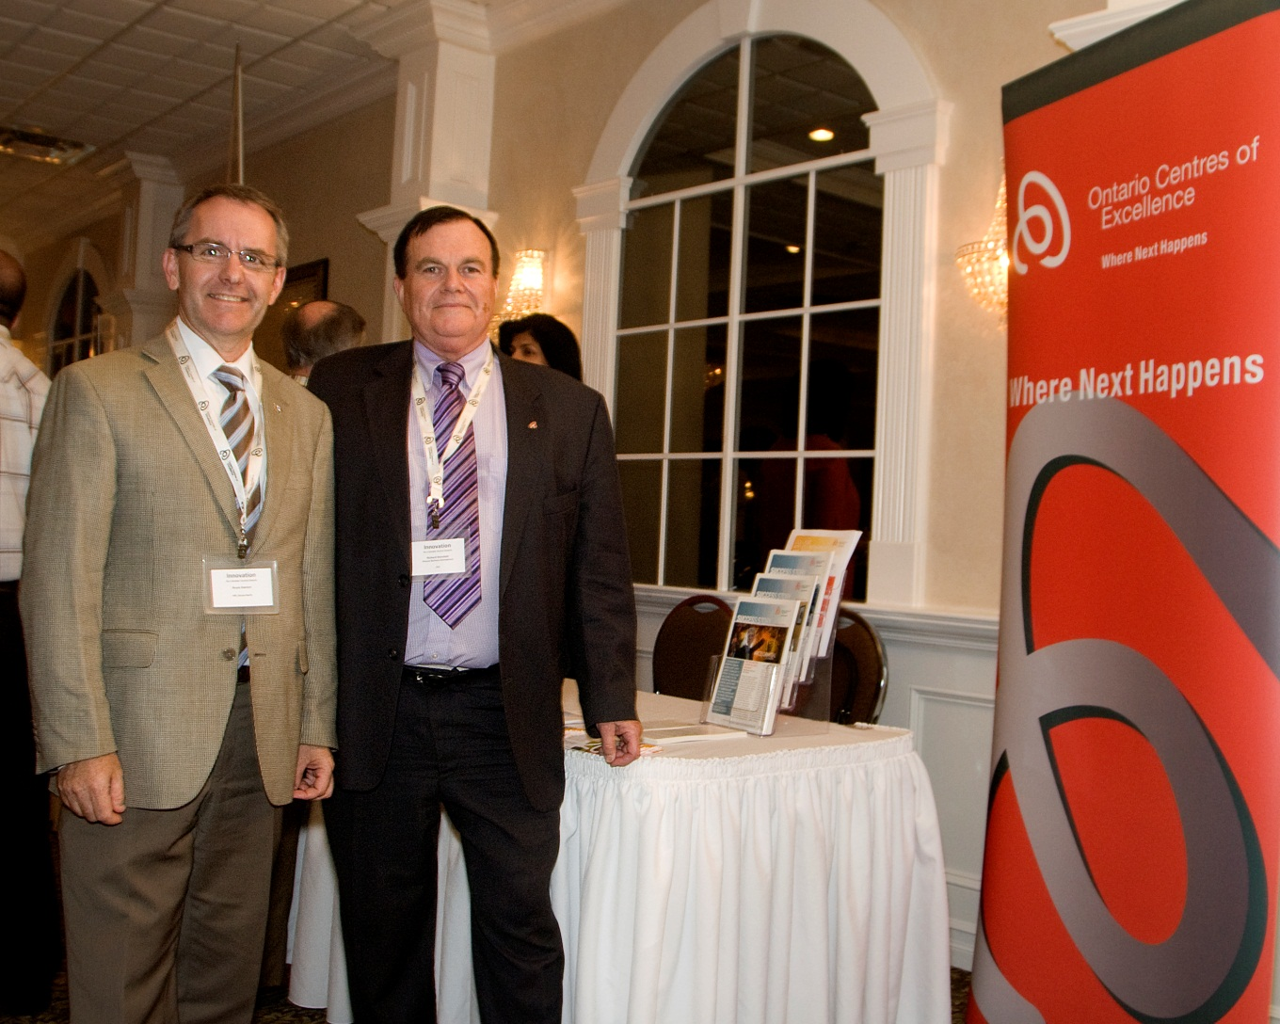
Innovation for a Greater Central Ontario event

Slide 35
Centre for Commercialization of Research (CCR)
oce-ontario.org
OCE’s Centre of Commercialization of Research is supported by the federal government through a Networks of Centres of Excellence Program
Ontario Centres of Excellence (OCE) is funded by the Government of Ontario. OCE is a member of the Ontario Network of Excellence (ONE).

