Slide 1

The Canadian Stroke Strategy: major successes, lessons learned, and the path ahead

Slide 2
Overview
What is Canadian Stroke Strategy?
What we have accomplished to date?
Why has it worked?
What still needs to be done?

Slide 3
Canadian Stroke Strategy
Regional/Provincial Implementation of Best Practice
Prevention
Treatment
Rehabilitation
Reengagement
National Platforms to Provide Support
Public Awareness
Best Practices and Standards of Care
Professional Development
Information/Evaluation
Coordinated Research

Slide 4




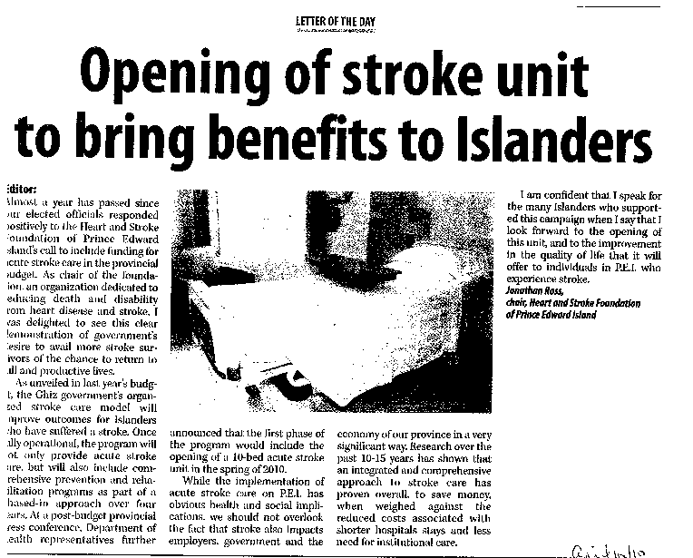
What have we accomplished?
Nationally
Best Practices and Related Resources
Quality of Stroke Care Report
Economic Analyses
Networking and Communications
Health Systems Research
Provincially
Provincial strategies adopted in 6 provinces
Regional/pilot implementation in 2 provinces
Project implementation in 2 provinces

Slide 5

Why has it worked?
Strong, complementary partnership
Committed champions
A simple concept
A working, measurable example
Early consensus
A “strategy of strategies”
A good business case
Dedicated staff… but not forever
Good timing
No federal funding

Slide 6
What Still Needs to be Done?
Improved public awareness about response to stroke
Professional education across the continuum
Continued advocacy at the provincial level
Continued dialogue between provinces
Another Quality of Care study…make it routine
Break down the barriers to Telestroke
More resources for those living with the effects of stroke
Tell our story!!

