Slide 1
Data Representation Also called Encoding
Murdocca Chapter 2

Slide 2
Objectives
Understand HOW information is encoded into the memory of a computer.
Understand the LIMITATIONS of the encoding.

Slide 3
Why (Data) Representation First ?
How to encode data in a digital computer.
More generally, encoding also encompasses instruction encoding : Program storage
Everything ultimately is a bit, 0 and 1.
Fixed size – finite
“Bits have no intrinsic meaning – the interpretation of the value is determined by the way hardware and software use the bits”(Comer)
Fundamental encoding problem : Mapping the infinite analog world we live in onto the finite digital implementation of a computer.
Notes:
Null quote from Comer’s book, page 30
Instruction encoding will come later.
The text covers typical numerical and character representations. What other forms of data are there ? What other data encoding schemes can you think of ? JPEG!
Linda Null: Computer arithmetic is introduced as it is a field of major study in computer architecture. The basic focus I on the implementation of arithmetic functions which can be realized in software, firmware or hardware.

Slide 4
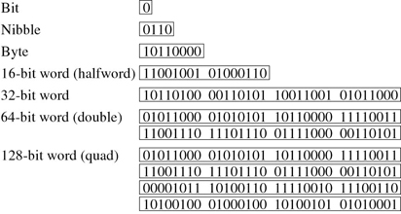
Fixed Length → Range
Figure 4-2 Murdocca
Q: Formulate the range, given the number of bits
Most Significant Bit (MSB)
Least Significant Bit (LSB)
Notes:
Question: Are these numbers ? Characters ? Code ? Images ?
All of the above. Depends on how we want to interpret them!
What is the formula for range, given number of bits ?

Slide 5
Fixed Length → Overflow
Fixed Length Decimal example: Odometer
The conditions for overflow will differ depending on the kind of encoding but all representations are vulnerable to overflow
9
9
9
9
9

Slide 6
Data Types in a Couple of Programming Languages
Java: http://java.sun.com/docs/books/tutorial/java/nutsandbolts/datatypes.html
C: http://www.space.unibe.ch/comp_doc/c_manual/C/CONCEPT/data_types.html
Python:
http://pathfinder.scar.utoronto.ca/~dyer/csca57/book_P/node16.html
BASIC: http://msdn.microsoft.com/en-us/library/ms172580(VS.80).aspx
Notes:
So, we’re talking about data representations in the computer.
Before we cover that, let’s just peek at a couple of programming languages and see their needs for data types.
Actually, their needs rely on the implementation of the computer … There’s a circular dependency here.
But we will cover that more in Programming Languages….
Aside: I’m using this on the next slide to relate the importance of learning the different encoding schemes presented in the text.
Namely, that 1’s complement, signed magnitude are not generally used (except as part of floating point)
Hide, when printing. More just for conversation.
Will also only work if you have Internet connection.

Slide 7
Murdocca’s Formal Approach
Numbers |  | Encoding | HLL Languages
 |  |  | Java | C/C++
Fixed Point
 | Unsigned | Radix 2 (Binary) |  | unsigned int
 | Signed | Signed Magnitude
 |  | 1’s Complement
 |  | 2’s Complement | int | signed int
 |  | Excess/Bias
Floating Point |  | IEEE 754 Single-Precision | float | float
 |  | IEEE 754 Double-Precision | double | double
 |  | IEEE 754 Single-Extended
 |  | IEEE 754 Double-Extended
Mantissa
Checksums
Exponent
Notes:
Murdocca gives a complete and formal introduction to the mathematics of numerical encoding. But it can seems like a lot to learn, when in reality, very few encodings are currently in use.

Slide 8
Unsigned Number Representation
N.B. Using Murdocca’s language, fixed point with zero-length fraction
If an n-bit sequence of binary digits is interpreted as an unsigned integer A, its value is
Exercise: Convert 10110₂ to decimal
Exercise: Convert 147₁₀ to binary
Using division-remainder method
Question: What is the range of a n-bit unsigned number ?
Notes:
Keyword: IF … INTERPRETED
Note the use of radix operators. Review other notations.

Slide 9
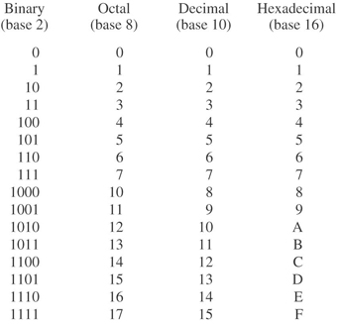
Binary Representations
Notes:
Binary and Decimal are some binary numbers that you should know off by heart
Octal but most importantly hexadecimal are other representations that are 1) binary in nature 2) used only for notational convenience.
Binary represents computer’s language
Decimal represents our language.
Hexadecimal is binary-friendly, but still binary. You won’t see hex numbers in a computer.

Slide 10
Unsigned Overflow
1001 (9)
+ 0011 (3)
1100 (12)
1001 (9)
- 0011 (3)
0110 (6)
1001 (9)
+ 0111 (7)
1 0000 (16)
1 0011 (3)
+ 0111 (9)
1100 (-6)

Slide 11
Signed Number Representations
N.B. Using Murdocca’s language, fixed point with zero-length fraction
Signed Magnitude
1’s Complement
2’s Complement
Exercise: Express -7 as a 4-bit signed integer in all three encodings.
Question: Why is 2’s complement used ?
Question: Compare the ranges of unsigned and signed n-bit numbers.
Notes:
When we talk about signed integers in programming languages, we are invariably talking about 2’s complement.
Let’s just practice each a bit (I’m assuming that you read the text!) but we’ll really use the first two when we cover floating point numbers.
Exercise: 1111
Question: Both Signed Magnitude and 1’s complement have 2 zeros (positive and negative) and complicate basic arithmetic operations (complicate the hardware needed to implement these operations). 2’s complement has one zero and addition and subtraction work as expected; it’s just hard to understand intuitively – it’s a mathematical construct.

Slide 12
Diminished Radix Complement
X_{r} – Y_{r} = X_{r} + (-Y_{r}) + carry
where –Y_{r} = (r^{d}-1) – Y
and d = r-1
Try it : Nine’s complement (Radix = 10)
Example: 167 - 52
Try it: 1’s complement (Radix = 2)
Example: 11 – 7 (Use 4-bit length)
DRC shortcut: Replace each 1 by a 0 and each 0 by a 1 (including sign bit).
+7 = 00000111 -7 = 11111000
Diminished radix complement
Diminished radix
Notes:
Diminished Radix Complement is a fancy way of say “the negative value” (-Y)
Nine’s complement: 167 – 52.
999 – 52 = 947 ➔ 167 +947 = 114 (Remember fixed length) + carry = 115
One’s complement: 11 – 7 = 1011 – 0111.
1111 – 0111 = 1000 → 1011 + 1000 = 0011 (Remember fixed length) + 1 carry = 0100
Shortcut: Convince yourself by trial-and-error.
The shortcut is important because it eliminates the subtraction needed to find the negative value, replacing it with a NOT operation. Subtraction of X-Y can now be implemented by an ADD unit and a OR unit. So a processor can have a ADD unit that is used for both addition and subtraction!
But remember, 1’s complement has two zeros. So that would be complicated for the hardware implementation of if (x == 0)
…. Next slide

Slide 13
2’s Complement - Radix Complement
X_{r} – Y_{r} = X_{r} + (-Y_{r})
where –Y_{r} = r^{d} – Y for Y != 0 and 0 for Y=0
and d = number of digits
Example: 9 – 3 (Use 4 bit number)
Example: 6 – 3 (Use 4 bit number)
Short cut for finding binary radix complement (Y_{r})
Flip-and-add: Complement positive equivalent (1 replaced by 0; each 0 by 1) then add 1.
+7 = 00000111 -7 = 11111001
“… allows us to simplify subtraction by turning into addition but it also gives us a method to represent negative numbers” (Null & Lobur)
Radix complement
Notes:
If you do the previous slide: 2’s complement is NOT a DIMINISHED radix complement, but a RADIX complement
Diminished Radix Complement is a fancy way of say “the negative value” (-Y)
Analogy: Odometer
Example: 6 – 3 = 0110 – 0011
2⁴ – 0011 = 10000 (notice: 5 digits) – 0011 = 0011 =→ 0110 + 0011 = 0011
So what about this 5 digits: What are the hardware implications ? Lead into shortcut!
Redo same example with shortcut.
Example: 9 – 3 …. Trick question: 9 is outside the range of 2’s complement. Remember that the MSB is effectively the sign bit and the magnitude must use d-1 bits (not d) So what is the range ???
Quote: Why is subtraction = addition so good (Hardware consequence)
At same time, a representation for negative values based on NOT logic and addition

Slide 14
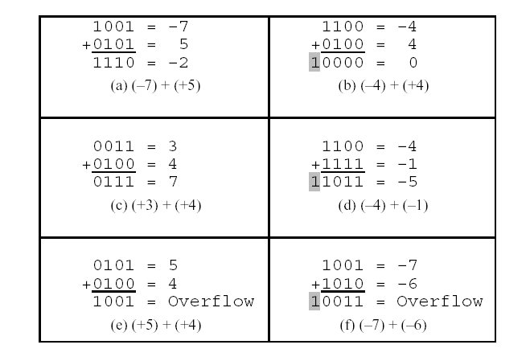
Two’s Complement Overflow - Addition
Notes:
Redo same examples as if unsigned numbers. Carry is important then.

Slide 15
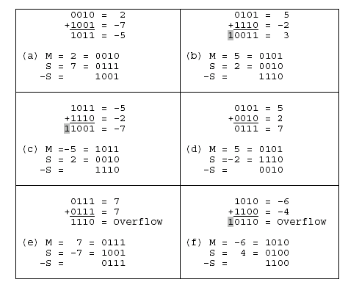
Two’s Complement Overflow - Subtraction

Slide 16
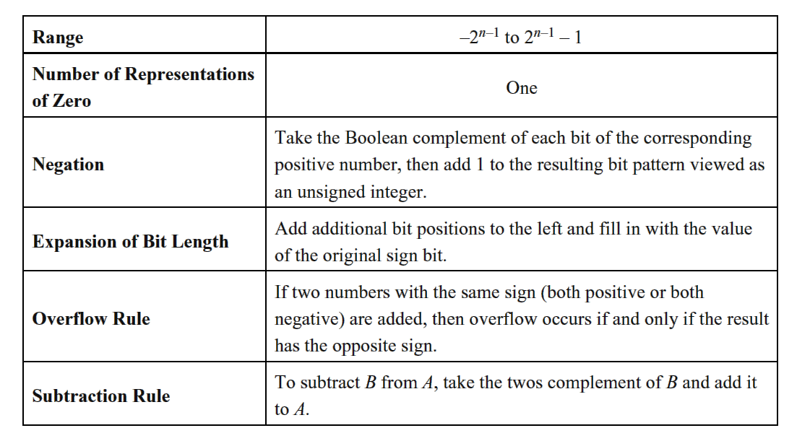
Two’s complement representation and arithmetic

Slide 17
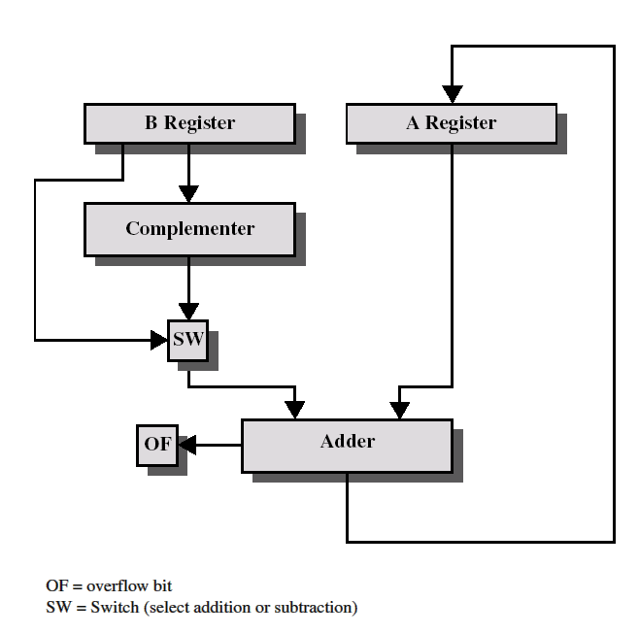
Block diagram for addition/subtraction
CF

Slide 18
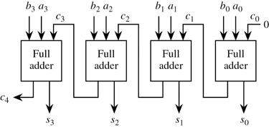
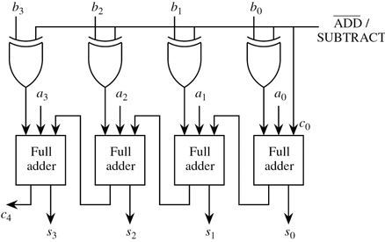
Adders
Murdocca, Figure 3-2
Ripple-Carry Adder
Murdocca, Figure 3-6
Addition/Subtraction Unit

Slide 19
Multiplication
Complex operation whether performed in hardware or software
Iterative :
Problem ?
Simple: Generate partial products and sum them to produce the final product
Binary digits 0 and 1: 0 * n = 0 and 1 * n = n
The multiplication of two n-bit binary numbers results in a product of up to 2n bits in length
Notes:
Problem: Execution time is variable. Linear dependent on the multiplier (m)
Do a sample old-fashioned multiplication!
Try 11 * 13 = 1011b * 1101b = 1000 1111b = 143! (Use 13 as multiplier, 11 as multiplicand to be consistent with next slide)
Notice: You either add or you don’t, depending on whether the current bit in the multiplier is 1 or 0
Notice: Result is twice the width of the original input numbers (You need extra working space inside a computer to perform a multiplication)
Notice: The number of additions is always 4 or more generally, the number of bits in the number. It is fixed (unlike the linear approach)
Now apply this logic in hardware! Next slide

Slide 20
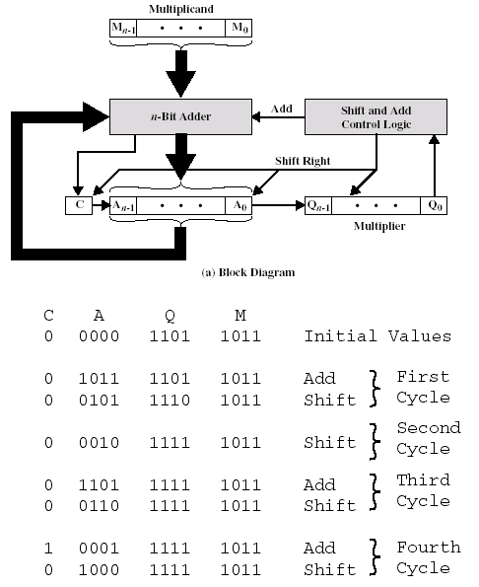
Notes:
Now when we do it with pen and paper, we need a double-length register and a double-length adder. Notice above however that there is only a n-bit adder, ie. a single-bit adder! It’s an ingenious way of economizing whereby the multiplier register serves two purposes:
its bits get shifted out on the right to decide whether to add the multiplicand again (if bit is 0, do NOT add the multiplicand, if bit is 1, add the multiplicand, using simplified binary multiplication).
Its upper bits are shifted in from the temporary register to contain the current lower bits of the result.

Slide 21
Computer Architecture: Arithmetic
Booth’s Algorithm : Increase speed of a multiplication when there are consecutive ones or zeros in the multiplier.
Based on shifting of multiplier from right-to-left
If at boundary of a string of 0’s, add multiplicand to product (in proper column)
If at boundary of a string of 1’s, subtract multiplicand to product (in proper column)
If within string, just shift.
Notes:
The computer architecture shown so far is simple and straightforward. But there are considerable study areas in the field of computer architecture as it pertains to computer arithmetic. New algorithms, new hardware implementations for fast addition, subtraction, multiplication and division as well as FPP are under work.
Fast carry look ahead
Residue Arithmetic
Booth’s algorithm:
The book shows the weakness of this algorithm (if the multiplier is made up of alternating bits, you end up adding and subtracting more than in the simplifier version)
The book then shows the modified.

Slide 22
Murdocca Example: Booth
Figure 3-19
0 1 0 1 0 1 (21)
0 0 1 1 1 0 (14)
0 0 0 0 0 0 0 0 0 0 0 0
- 0 0 0 0 0 0 1 0 1 0 1 0 (1st transition)
1 1 1 1 1 1 0 1 0 1 1 0
+ 0 0 0 1 0 1 0 1 0 0 0 0
0 0 0 1 0 0 1 0 0 1 1 0
Notes:
So the number of additions is reduced.
Why do we subtract ? 01110 = 10000 – 00001 … So we add a bigger number and subtract the extra. But we do it in the opposite order because we are scanning from right to left.
The text has further modifications of the Booth algorithm (which further reduces the number of additions) as well as an array multiplier (which uses parallelism in order to reduce the impact of wider buses). You are left to consider these yourselves.

Slide 23
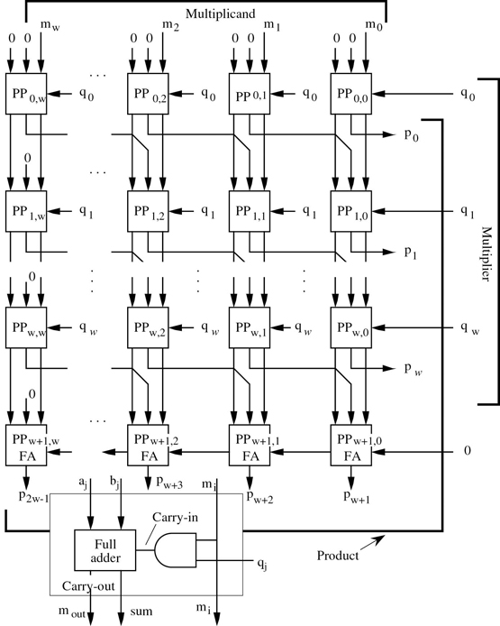
Array Multiplier
Murdocca,
Figure 3-23
Notes:
The serial method we used for multiplying two unsigned integers in Section 3.1.1 requires only a small amount of hardware, but the time required to multiply two numbers of length w grows as w². We can speed the multiplication process so that it completes in just 2wsteps by implementing the manual process shown in Figure 3-10 in parallel. The general idea is to form a one-bit product between each multiplier bit and each multiplicand bit, and then sum each row of partial product elements from the top to the bottom in systolic (row by row) fashion.
The structure of a systolic array multiplier is shown in Figure 3-23. A partial product (PP) element is shown at the bottom of the figure. A multiplicand bit (m_{i}) and a multiplier bit (q_{j}) are multiplied by the AND gate, which forms a partial product at position (i, j) in the array. This partial product is added to the partial product from the previous stage (b_{j}) and any carry that is generated in the previous stage (a_{j}). The result has a width of 2w and appears at the bottom of the array (the high-order wbits) and at the right of the array (the low-order w bits).

Slide 24
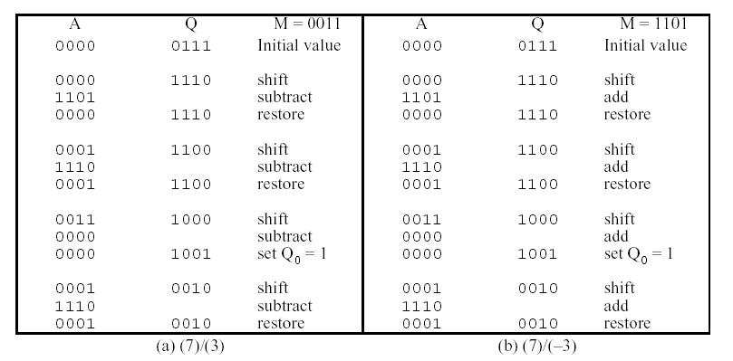
Division is somewhat more complex than multiplication; based on the same general principles

Slide 25
Floating-point representation
(Significand = fraction = mantissa)
Accuracy – How close a number is to its true value.
Precision – How much information we have about a value
Number of digits ( 1.65 versus 1.650 )
Higher precision can allow a value to be more accurate but not necessarily so
0.3 * 0.4 = ? 0.1 with single, 0.12 with double
1 and 1.0 and 1.000 have same accuracy
Number of bits in
Significand : Precision
Exponent: Range
Notes:
Linda Null, page 64: Mantissa is widely accepted when referring to the fractional part, but some people object because mantissa also refers to the fractional part of a logarithm (not a floating point number). IEEE introduce significand to refer to the fractional part of a floating point number combined with the implied binary point and implied 1.

Slide 26
Normalization
1011.0 * 2⁰ = 1.0110 * 2³ = .10110 * 2⁴
With floating point, different numbers can be represented with different values of exponents
Defies easy implementation of arithmetic, comparisons
Normalization: The exponent is set such that the most significant digit of the significand is nonzero
There is one bit to the left of the radix point
+- .1bbbbbb…bbbx2^(+-E)
In binary, the MSB is always one.
All normalized numbers have a significand, s, in the range
Can be
Hidden
Notes:
Simplification: Don’t store 1 or .
What is the effect ? Another bit for exponent (range) or significand (precision)

Slide 27
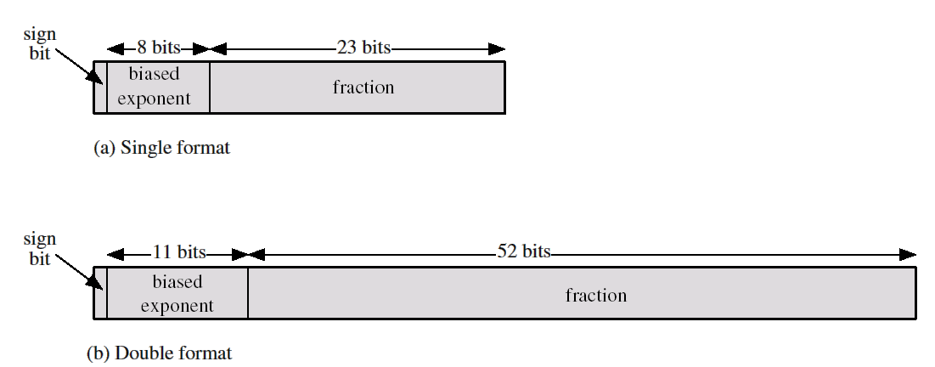
IEEE 754 Standard
Significand – an unsigned value in binary
32-bit single precision
64-bit double precision format
Exponent – signed value in excess/bias representation.
A fixed value (bias) is subtracted from exponent to get true exponent
For k number of bits in exponent, the bias is
If k = 8, bias = 127, true exponent= -127 to 128
Notes:
Linda Null, page 68: Until the 1980’s, the number of bits allocated to the exponent and mantissa were arbitrary, resulting in numerous incompatible representations across various manufacturers’ systems. In 1985, IEEE published a floating point standard.
The sign bit along with the normalized signficand is a form of “signed magnitude”.
Why is bias representation used in the exponent ?
Murdocca, page 39: This representation simplifies making comparisons between numbers since the bit patterns for negative numbers have numerically smaller values than the bit patterns for positive numbers. This is important for representation the exponents of floating point number in which exponents of two numbers are compared in order to make them equal for addition and subtraction.
This is true even though the exponents are eventually shifted to make them equal for addition/subtraction. They first have to be compared.

Slide 28
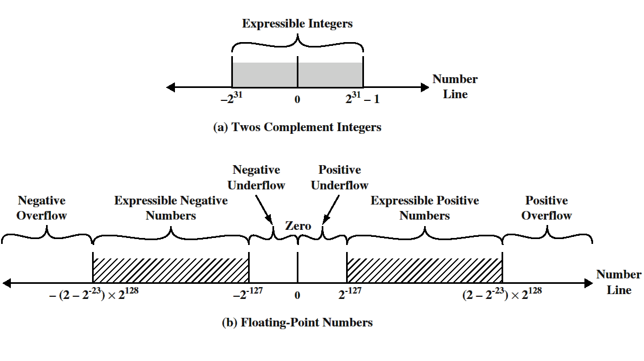
Ranges in typical 32-bit formats
Hole at Zero
Due to Normalization
Notes:
In floating point, there are 5 ranges:
Negative numbers less than –(2-2^(-23))x2^128, called negative overflow
Negative numbers greater than 2^(-127), called negative underflow
Zero
Positive numbers less than 2^(-127), called positive underflow
Positive numbers greater than (2-2^(-23))x2^128, called positive overflow

Slide 29
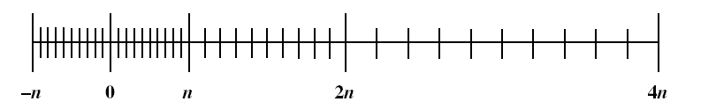
Floating Point Density
The possible values get closer together near the origin and farther apart as you move away.
Many calculations produce results that are not exact and have to be rounded to the nearest value that the notation can represent
Trade-off between range and precision (number of bits in the exponent and number of bits in the significand.
To increase both range and precision use more bits

Slide 30
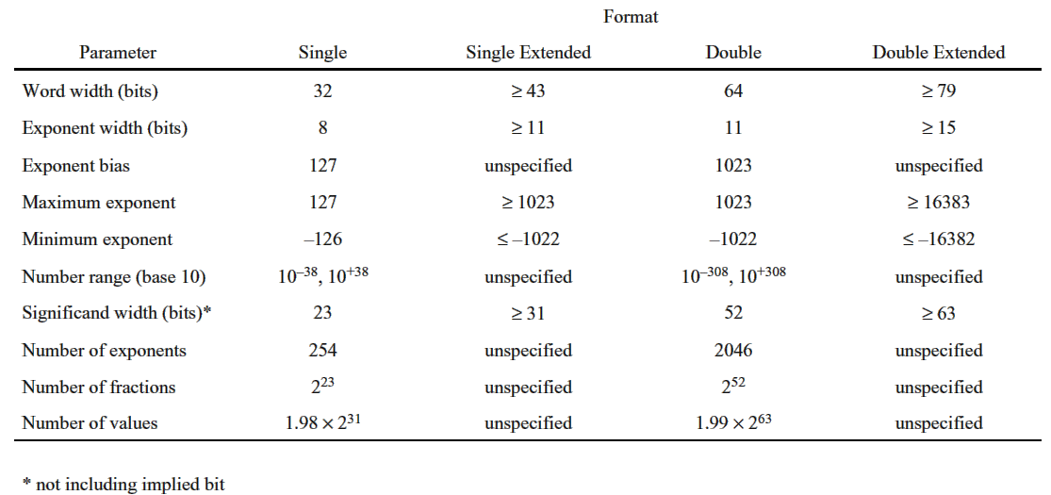
IEEE 754 Format parameters

Slide 31
Floating-point arithmetic
Addition/subtraction: both operands must be arranged to have the same exponent value. This might require shifting the radix point of one of the operands to achieve alignment
Process:
Check for zeros
Align significands (adjusting exponents)
Add or subtract significands
Normalize result

Slide 32
Floating Point Overflow
Exponent:
Overflow: a positive exponent exceeds the maximum possible exponent value
Underflow: a negative exponent is less than the minimum possible exponent value, e.g.
–200 is less than –126
Significand
Underflow: in the process of aligning the significands, digits may flow off the right end of the significand; some form of rounding is required
overflow: addition of two significands of the same sign may result in a carry out of the most significant bit. This can be fixed by realigning

Slide 33
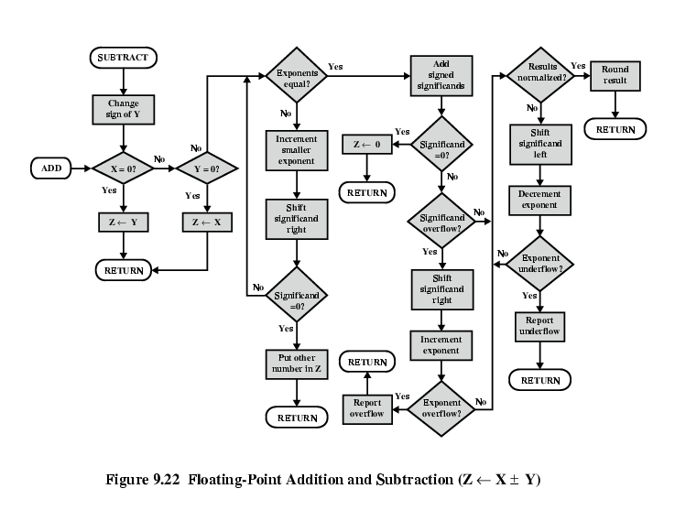

Slide 34
Multiplication/division
Check for zero
Add/subtract exponents
Multiply/divide significands (watch sign)
Normalize
Round
All intermediate results should be in double length storage

Slide 35
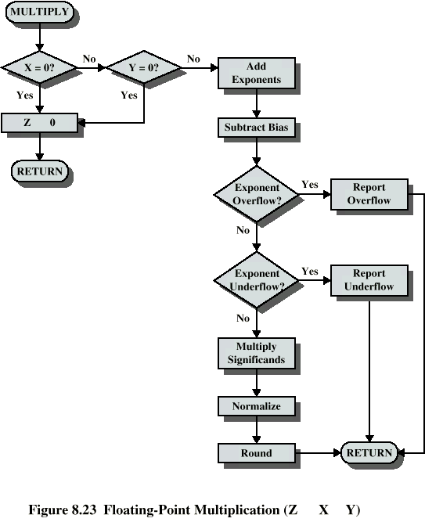

Slide 36
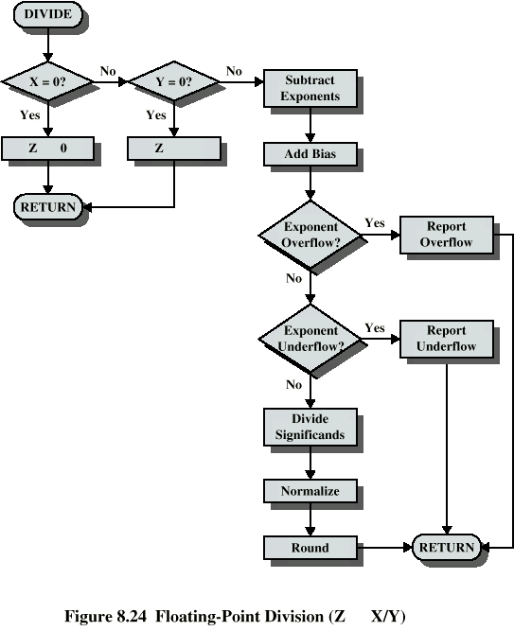

Slide 37
Precision considerations
Guard bits: Prior to a floating-point operation, the significand and exponent are loaded into ALU registers.
In the case of significand, the length of the register is almost always greater than the length of the significand plus an implied bit.
The register contains additional bits, called guard bits which are used to pad out the right end of the significand with 0s.
Notes:
TBD

Slide 38
Rounding
Rounding: the result of any operation on the significands is generally stored in a longer register. When the result is put back into the floating-point format, the extra bits must be disposed of.
IEEE standard includes 4 alternative approaches:
Round to the nearest representable number
Round toward
Round toward
Round toward 0 (truncation)
Notes:
TBD

Slide 39
Rounding
Round to nearest: the representable value nearest to the infinitely precise result should be delivered.
If the two nearest representable numbers are equally near, then the one with its least significant bit 0 shall be delivered.
Round toward zero: extra bits are ignored.
The magnitude of the truncated value is always less than or equal to the more precise original value
Notes:
TBD

Slide 40
Intermediate calculations
Implementations may use higher-precision for intermediate calculations
Resort to published precision when storing values back to variables
Using different/higher precision for intermediate results may cause portability problems
Java requires/mandates that intermediate results are written back to memory to force uniformity across platforms

Slide 41
Programming Implications
Not associative
(a + b) + c != a + (b + c)
Not distributive
a * (b + c) != ab + ac
Caution: Don’t test for equality. Test for nearness
float x;
if ( x < epsilon ) … (epsilon = 1.0 * 10⁻²⁰)
Notes:
Taken from Linda Null, page 71
Do the examples with a=0.1, b=0.2 and c=0.3
TBD: Test it!

Slide 42
Case Study: Ariane Rocket
June 4, 1996: ESA’s unmanned Ariane 5 exploded 40 seconds after liftoff
Cause: Floating point conversion error in the inertial reference system
float horiztonal_velocity; …
int temp = (int) horizontal_velocity; // 16 bits
But horizontal_velocity > 32k !
Notes:
Murdocca covers the x and y cases. There is another in the Linda Null book.
The conversion process failed. The rocket tried to make an abrupt course correction for a wrong turn that it had never taken, and the guidance system shut down. Control reverted to a backup unit installed in the rocket in case of just such a failure, but the backup system was running the same flawed software.
It seems obvious that a 64-bit floating point number could be much larger than 32K, so why did the programmers do this? They decided the velocity value would never get large enough to be a problem. Why ? It had never gotten too large BEFORE. But this rocket was faster than all previous rockets, resulting in a larger velocity value than the programmers expected. $500 million cargo spread across Eurpose.

Slide 43
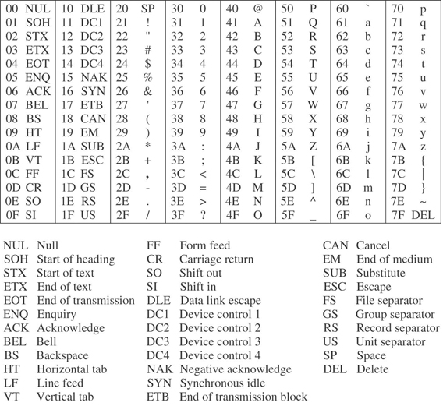
Character Encoding
ASCII
EBCDIC
Notes:
The American Standard Code for Information Interchange (ASCII) is summarized in Figure 2-12, using hexadecimal indices. The representation for each character consists of seven bits, and all 2⁷ possible bit patterns represent valid characters. The characters in positions 00–1F and position 7F are special control characters that are used for transmission, printing control, and other non-textual purposes. The remaining characters are all printable, and include letters, numbers, punctuation, and a space. The digits 0-9 appear in sequence, as do the upper- and lower-case letters³. This organization simplifies character manipulation. In order to change the character representation of a digit into its numerical value, we can subtract (30)₁₆ from it. In order to convert the ASCII character ‘5,’ which is in position (35)₁₆, into the number 5, we compute (35 – 30 = 5)₁₆. In order to convert an upper-case letter into a lower-case letter, we add (20)₁₆. For example, to convert the letter ‘H,’ which is at location (48)₁₆in the ASCII table, into the letter ‘h,’ which is at position (68)₁₆, we compute (48 + 20 = 68)₁₆
A problem with the ASCII code is that only 128 characters can be represented, which is a limitation for many keyboards that have a lot of special characters in addition to upperand lower-case letters. The Extended Binary Coded Decimal Interchange Code (EBCDIC) is an eight-bit code that is used extensively in IBM mainframe and midrange computers such as the AS/400. Since seven-bit ASCII characters are frequently represented in an eight-bit modified form (one character per byte), in which a 0 or a 1 is appended to the left of the seven-bit pattern, the use of EBCDIC does not place a greater demand on the storage of characters in a computer. For serial transmission, however (see Chapter 9), an eight-bit code takes more time to transmit than a seven-bit code, and for this case the wider code does make a difference.
The EBCDIC code is summarized in Figure 2-13. There are gaps in the table that can be used for application-specific characters. The fact that there are gaps in the upper- and lower-case sequences is not a major disadvantage because character manipulations can still be done as for ASCII, but using different offsets.

Slide 44
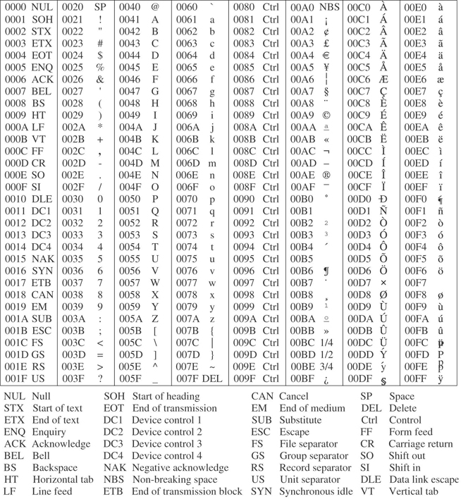
UNICODE
Notes:
The ASCII and EBCDIC codes support the historically dominant (Latin) character sets used in computers. There are many more character sets in the world, and a simple ASCII-to-language-X mapping does not work for the general case, and so a new universal character standard was developed that supports a great breadth of the world's character sets, called Unicode.
Unicode is an evolving standard. It changes as new character sets are introduced into it, and as existing character sets evolve and their representations are refined. In version 4.0 of the Unicode standard, there are 96,382 distinct coded characters that cover the principal written languages of the Americas, Europe, the Middle East, Africa, India, Asia, and Pacifica.
The Unicode Standard uses a 16-bit code set in which there is a one-to-one correspondence between 16-bit codes and characters. Like ASCII, there are no complex modes or escape codes. While Unicode supports many more characters than ASCII or EBCDIC, it is not the end-all standard. In fact, the 16-bit Unicode standard is a subset of the 32-bit ISO 10646 Universal Character Set (UCS-4).
Glyphs for the first 256 Unicode characters are shown in Figure 2-14, according to Unicode version 4.1. Note that the first 128 characters are the same as in ASCII.

Slide 45
Next Lecture
Read Murdocca, Chapter 4
Instruction Set Architecture

