Slide 1
Introduction to
Artificial Intelligence (AI)
Computer Science cpsc502, Lecture 2
Sep, 13, 2011
Notes:
Lecture 2

Slide 2
R&Rsys we'll cover in this course
Environment
Deterministic
Stochastic
Problem
Arc Consistency
Constraint Satisfaction
Vars +
Constraints
Search
Static
Belief Nets
Var. Elimination
Query
Logics
Approx. Inference
Search
Temporal. Inference
Sequential
Decision Nets
STRIPS
Var. Elimination
Planning
Search
Markov Processes
Representation
Value Iteration
Reasoning
Technique
Notes:
R&R Sys Representation and reasoning Systems
Each cell is a R&R system
STRIPS actions prec
The SCSP extends the classical CSP by
including both decision variables, that an agent can set, and stochastic
variables that follow a probability distribution and can model uncer-
tain events beyond the agent’s control. So far, two approaches to solving
SCSPs have been proposed; backtracking-based procedures that extend
standard methods from CSPs, and scenario-based methods that solve
SCSPs by reducing them to a sequence of CSPs.onditions and effects Stanford Research Institute Problem Solver

Slide 3
Today Sept 13
Uninformed Search
Informed Search
….
….
Notes:
Introductions?

Slide 4
Simple Planning Agent
Deterministic, goal-driven agent
Agent is given a goal (subset of possible states)
Environment changes only when the agent acts
Agent perfectly knows:
what actions can be applied in any given state
the state it is going to end up in when an action is applied in a given state
The sequence of actions and their appropriate ordering is the solution
Notes:
AI agents can be very complex and sophisticated
Let’s start from a very simple one
GOAL: study search, a basic method underlying many intelligent agents

Slide 5
Three examples
Solving an 8-puzzle
Vacuum cleaner world
A delivery robot planning the route it will take in a bldg. to get from one room to another (see textbook)
Notes:
As we have seen

Slide 6
Example 2: 8-Puzzle?
Possible start state
Goal state
Notes:
Restate / justify that the following is true
Environment changes only when the agent acts
Agent can perfectly predict effect of its actions
Agent is given a goal

Slide 7
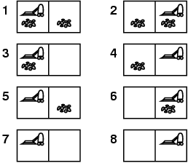
Example: vacuum world
Possible start state
Goal state

Slide 8
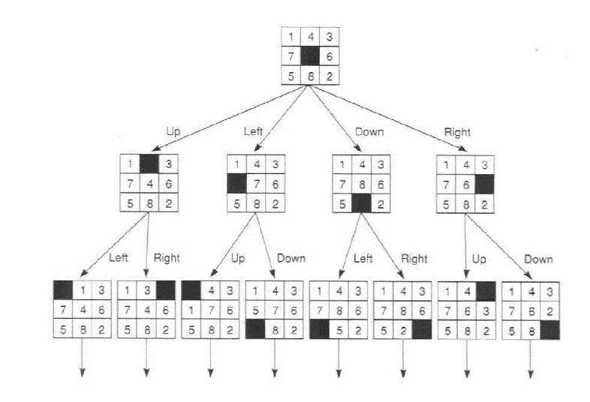
How can we find a solution?
Define underlying search space. A graph where nodes are states and edges are actions.
Notes:
How can we find a sequence of actions and their appropriate ordering that lead to the goal?

Slide 9
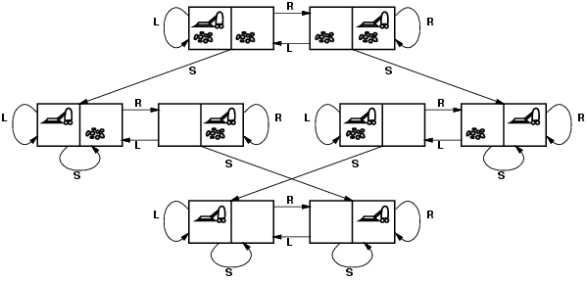
Vacuum world: Search space graph
states? Where it is dirty and robot location
actions? Left, Right, Suck
Possible goal test? no dirt at all locations
Notes:
States if the world had n locations?
Some simplifications wrt real world
Discrete location
Discrete dirt
Reliable cleaning
Room never gets messed up once cleaned

Slide 10
Search: Abstract Definition
How to search
Start at the start state
Consider the effect of taking different actions starting from states that have been encountered in the search so far
Stop when a goal state is encountered
To make this more formal, we'll need review the formal definition of a graph...

Slide 11
Search Graph
A graph consists of a set N of nodes and a set A of ordered pairs of nodes, called arcs.
Node n₂ is a neighbor of n₁ if there is an arc from n₁ to n₂. That is, if ⟨ n₁, n₂ ⟩ ∈ A.
A path is a sequence of nodes n₀, n₁,..,n_{k} such that ⟨ n_{i-1}, n_{i} ⟩ ∈ A.
A cycle is a non-empty path such that the start node is the same as the end node
A directed acyclic graph (DAG) is a graph with no cycles
Given a set of start nodes and goal nodes, a solution is a path from a start node to a goal node.
Notes:
Many problem solving problems tasks can be transformed into the problem of finding paths in a graph. Searching in a graph is an appropriate level of abstraction that allows one to study search independently from the task domain

Slide 12
Examples for graph formal def.
a
b
c
d
e
f
g
h
i
j
k
l
n
Notes:
OLD example
Search Space:
neighbors(o103, [ts, l2d3, o109])
neighbors(ts, [mail])
neighbors(mail, [])
neighbors(o109, [o111, o119])
neighbors(o111, [])
neighbors(storage, [])
.
.
.
Goal: is_goal(r123)
Start: is_start(o103).

Slide 13
Graph Searching
Generic search algorithm: given a graph, start node, and goal node(s), incrementally explore paths from the start node(s).
Maintain a frontier of paths from the start node that have been explored.
As search proceeds, the frontier expands into the unexplored nodes until (hopefully!) a goal node is encountered.
The way in which the frontier is expanded defines the search strategy.
For most problems, we can never actually build the whole graph
Notes:
For most problems, we can never actually build the whole tree

Slide 14
Generic Search Algorithm
Input: a graph, a start nodes, Boolean procedure goal(n) that tests if n is a goal node
frontier:= [<s>: s is a start node];
While frontier is not empty:
select and remove path <n_{o},….,n_{k}> from frontier;
If goal(n_{k})
return <n_{o},….,n_{k}>;
For every neighbor n of n_{k}
add <n_{o},….,n_{k}, n> to frontier;
end
Notes:
Show simplestExample in AIspace USE FINE STEP

Slide 15
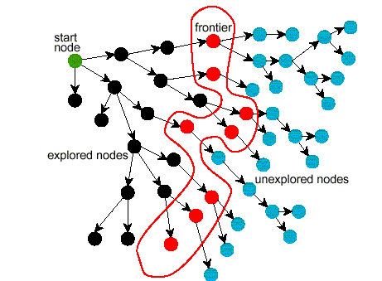
Problem Solving by Graph Searching
Ends of frontier
Notes:
MAKE TRANSPARENCY

Slide 16
Branching Factor
The forward branching factor of a node is the number of arcs going out of the node
The backward branching factor of a node is the number of arcs going into the node
If the forward branching factor of any node is b and the graph is a tree, How many nodes are n steps away from the root?

Slide 17
Comparing Searching Algorithms: will it find a solution? the best one?
Def. (complete): A search algorithm is complete if, whenever at least one solution exists, the algorithm is guaranteed to find a solution within a finite amount of time.
Def. (optimal): A search algorithm is optimal if, when it finds a solution , it is the best solution
Notes:
Lecture slides DO NOT contain everything that is said in class, but you are still responsible for this content
So, make sure you bring yourself up-to-date if you miss a class

Slide 18
Let’s look at two basic search strategies
Depth First and Breath First Search:
To understand key properties of a search strategy
They represent the basis for more sophisticated (heuristic / intelligent) search
Notes:
AI agents can be very complex and sophisticated
Let’s start from a very simple one, the deterministic, goal-driven agent for which: he sequence of actions and their appropriate ordering is the solution

Slide 19

Depth-first Search: DFS
Depth-first search treats the frontier as a stack
It always selects one of the last elements added to the frontier.
Example:
the frontier is [p₁, p₂, …, p_{r}]
neighbors of last node of p₁ (its end) are {n₁, …, n_{k}}
What happens?
p₁ is selected, and its end is tested for being a goal.
New paths are created attaching {n₁, …, n_{k}} to p₁
These “replace” p₁ at the beginning of the frontier.
Thus, the frontier is now [(p_{1,} n₁), …, (p_{1,} n_{k}), p₂, …, p_{r}] .
p₂ is only selected when all paths extending p₁ have been explored.
Notes:
LIFO queue
The deepest in the current frontier

Slide 20
Depth-first search: Illustrative Graph --- Depth-first Search Frontier
Notes:
The longest path is expanded

Slide 21
Depth-first Search: Analysis of DFS
Is DFS complete?
Is DFS optimal?
What is its time complexity?
What is its space complexity?
Notes:
Show AI space: Depth-first search isn't guaranteed to halt on graphs with cycles.
Space complexity is linear

Slide 22
Depth-first Search: Analysis of DFS
Is DFS complete?
Depth-first search isn't guaranteed to halt on infinite graphs or on graphs with cycles.
However, DFS is complete for finite trees.
Is DFS optimal?
What is the time complexity, if the maximum path length is m and the maximum branching factor is b ?
The time complexity is ? ?: must examine every node in the tree.
Search is unconstrained by the goal until it happens to stumble on the goal.
What is the space complexity?
Space complexity is ? ? the longest possible path is m, and for every node in that path must maintain a fringe of size b.
Notes:
Show AI space: Depth-first search isn't guaranteed to halt on graphs with cycles.
Space complexity is linear

Slide 23
Depth-first Search: When it is appropriate?
Appropriate
Space is restricted (complex state representation e.g., robotics)
There are many solutions, perhaps with long path lengths, particularly for the case in which all paths lead to a solution
Inappropriate
Infinite / cycles
There are shallow solutions
Notes:
Show AI space: Depth-first search isn't guaranteed to halt on graphs with cycles.
Space complexity is linear
Ordering heuristic is weak

Slide 24
Why DFS need to be studied and understood?
It is simple enough to allow you to learn the basic aspects of searching (When compared with breadth first)
It is the basis for a number of more sophisticated / useful search algorithms
Notes:
Show AI space: Depth-first search isn't guaranteed to halt on graphs with cycles.
Space complexity is linear

Slide 25
Breadth-first Search: BFS
Breadth-first search treats the frontier as a queue
it always selects one of the earliest elements added to the frontier.
Example:
the frontier is [p₁,p₂, …, p_{r}]
neighbors of the last node of p₁ are {n₁, …, n_{k}}
What happens?
p₁ is selected, and its end tested for being a path to the goal.
New paths are created attaching {n₁, …, n_{k}} to p₁
These follow p_{r} at the end of the frontier.
Thus, the frontier is now [p₂, …, p_{r}, (p₁, n₁), …, (p₁, n_{k})].
p₂ is selected next.

Slide 26
Illustrative Graph - Breadth-first Search

Slide 27
Breadth Search: Analysis of BFS
Is BFS complete?
Is BFS optimal?
What is its time complexity?
What is its space complexity?
Notes:
Show AI space: Depth-first search isn't guaranteed to halt on graphs with cycles.
Space complexity is linear

Slide 28


Analysis of Breadth-First Search
Is BFS complete?
Yes (we are assuming finite branching factor)
In fact, BFS is guaranteed to find the path that involves the fewest arcs (why?)
What is the time complexity, if the maximum path length is m and the maximum branching factor is b?
The time complexity is ? ? must examine every node in the tree.
The order in which we examine nodes (BFS or DFS) makes no difference to the worst case: search is unconstrained by the goal.
What is the space complexity?
Space complexity is ? ?
Notes:
we must store the whole frontier in memory

Slide 29
Using Breadth-first Search
When is BFS appropriate?
space is not a problem
it's necessary to find the solution with the fewest arcs
although all solutions may not be shallow, at least some are
there may be infinite paths
When is BFS inappropriate?
space is limited
all solutions tend to be located deep in the tree
the branching factor is very large

Slide 30
Iterative Deepening (sec 3.6.3)
How can we achieve an acceptable (linear) space complexity maintaining completeness and optimality?
 | Complete | Optimal | Time | Space
DFS
BFS
Key Idea: let’s re-compute elements of the frontier rather than saving them.
Notes:
Why not 0 2 4?
So far all search strategies that are guaranteed to halt use exponential space.
Increase the depth-bound when the search fails unnaturally (depth-bound was reached).

Slide 31
Iterative Deepening in Essence
Look with DFS for solutions at depth 1, then 2, then 3, etc.
If a solution cannot be found at depth D, look for a solution at depth D + 1.
You need a depth-bounded depth-first searcher.
Given a bound B you simply assume that paths of length B cannot be expanded….
Notes:
Why not 0 2 4?
So far all search strategies that are guaranteed to halt use exponential space.
Increase the depth-bound when the search fails unnaturally (depth-bound was reached).

Slide 32
depth = 1
depth = 2
depth = 3
. . .
Notes:
For b= 10, k = 5. BSF 111,111 and ID = 123,456 (only 11% more nodes)
The larges b the better, but even with b = 2 the search ID will take only ~4 times as much as BFS
Problem. When the branching factor is 1 at depth K, iterative deepening will
Have searched k + (k-1) + (k-2) +….1 =k(k+1)/2
Iterative deepening is good when there is a large search space and the depth of the solution is not known.

Slide 33
(Time) Complexity of Iterative Deepening
Complexity of solution at depth m with branching factor b
Total # of paths at that level
#times created by BFS (or DFS)
#times created by IDS
Notes:
If IDS returns a solution of length k why there cannot be a solution of length k-2?

Slide 34
(Time) Complexity of Iterative Deepening
Complexity of solution at depth m with branching factor b
Total # of paths generated
b^{m} + 2 b^{m-1} + 3 b^{m-2} + ..+ mb =
b^{m} (1+ 2 b⁻¹ + 3 b⁻² + ..+m b^{1-m} )≤
Notes:
How many times you create the nodes at that level
For b= 10 and d = 5. BSF 111,111 and ID = 123,456 (only 11% more nodes)
Iterative deepening is good when there is a large search space and the depth of the solution is not known.

Slide 35
Search with Costs
Sometimes there are costs associated with arcs.
Define optimality…..
Design an optimal search strategy……
Notes:
Cost can be negative!

Slide 36
Today Sept 13
Uninformed Search
Informed Search
….
….

Slide 37
Heuristic Search
Uninformed/Blind search algorithms do not take into account the goal until they are at a goal node.
Often there is extra knowledge that can be used to guide the search: an estimate of the distance from node n to a goal node.
This is called a heuristic
Notes:
Examples of h(n):
actual distance from a location, # of atoms to be resolved,
in eight puzzle:
number of tiles that are out of place
sum of the manhattan distance of each tile from its location (ACC did not metion this)
ACC: in the assignment for this module, it came up the question of whether h should be > 0, The book says so, and it makes sense because it is a cost.

Slide 38
More formally
Definition (search heuristic)
A search heuristic h(n) is an estimate of the cost of the shortest path from node n to a goal node.
h can be extended to paths: h(⟨n₀,…,n_{k}⟩)=h(n_{k})
h(n) uses only readily obtainable information (that is easy to compute) about a node.
Notes:
Lecture slides DO NOT contain everything that is said in class, but you are still responsible for this content
So, make sure you bring yourself up-to-date if you miss a class

Slide 39
More formally (cont.)
Definition (admissible heuristic)
A search heuristic h(n) is admissible if it is never an overestimate of the cost from n to a goal.
There is never a path from n to a goal that has path length less than h(n).
another way of saying this: h(n) is a lower bound on the cost of getting from n to the nearest goal.
Notes:
Lecture slides DO NOT contain everything that is said in class, but you are still responsible for this content
So, make sure you bring yourself up-to-date if you miss a class

Slide 40
Example Admissible Heuristic Functions
Search problem: robot has to find a route from start location to goal location on a grid (discrete space with obstacles)
Final cost (quality of the solution) is the number of steps
If no obstacles, cost of optimal solution is…
Notes:
the distance between two points is the sum of the (absolute) differences of their coordinates
``Manhattan distance'‘(L₁ distance), the distance between two points is the sum of the (absolute) differences of their coordinates

Slide 41
Example Admissible Heuristic Functions
If there are obstacle, the optimal solution without obstacles is an admissible heuristic
G
Notes:
the distance between two points is the sum of the (absolute) differences of their coordinates

Slide 42
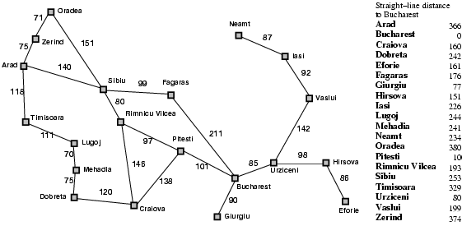
Example Admissible Heuristic Functions
Similarly, If the nodes are points on a Euclidean plane and the cost is the distance, we can use the straight-line distance from n to the closest goal as the value of h(n).
Notes:
this also makes sense if there are obstacles, or for other reasons not all adjacent nodes share an arc

Slide 43
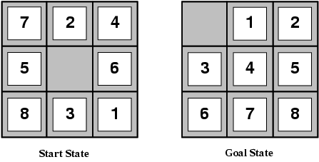
Example Heuristic Functions
In the 8-puzzle, we can use the number of misplaced tiles
Notes:
Which one is better?
E.g., for the 8-puzzle:
h₁(n) = number of misplaced tiles
h₂(n) = total Manhattan distance
(i.e., no. of squares from desired location of each tile)
h₁(S) = ? 8
h₂(S) = ? 3+1+2+2+2+3+3+2 = 18

Slide 44
Example Heuristic Functions
Another one we can use the number of moves between each tile's current position and its position in the solution
1
2
3
4
5
6
7
8
1
2
3
4
5
6
7
8
Notes:
Which one is better?
E.g., for the 8-puzzle:
h₁(n) = number of misplaced tiles
h₂(n) = total Manhattan distance
(i.e., no. of squares from desired location of each tile)
h₁(S) = ? 8
h₂(S) = ? 3+1+2+2+2+3+3+2 = 18

Slide 45
How to Construct a Heuristic
You identify relaxed version of the problem:
where one or more constraints have been dropped
problem with fewer restrictions on the actions
Robot: the agent can move through walls
Driver: the agent can move straight
8puzzle: (1) tiles can move anywhere
(2) tiles can move to any adjacent square
Result: The cost of an optimal solution to the relaxed problem is an admissible heuristic for the original problem (because it is always weakly less costly to solve a less constrained problem!)
Notes:
Overall, a cost-minimizing search problem is a constrained optimization problem
e.g., find a path from A to B which minimizes distance traveled, subject to the constraint that the robot can't move through walls
e.g., find a path from A to B which minimizes distance traveled, allowing the agent to move through walls
Later Another trick for constructing heuristics: if h₁(n) is an admissible heuristic, and h₂(n) is also an admissible heuristic, then max(h₁(n),h₂(n)) is also admissible.

Slide 46
How to Construct a Heuristic (cont.)
You should identify constraints which, when dropped, make the problem extremely easy to solve
this is important because heuristics are not useful if they're as hard to solve as the original problem!
This was the case in our examples
Robot: allowing the agent to move through walls. Optimal solution to this relaxed problem is Manhattan distance
Driver: allowing the agent to move straight. Optimal solution to this relaxed problem is straight-line distance
8puzzle: (1) tiles can move anywhere Optimal solution to this relaxed problem is number of misplaced tiles
(2) tiles can move to any adjacent square….
Notes:
Admissible heuristics can also be derived from the solution cost of a subproblem
Put 1 2 3 4 in place (substantially more accurate than manhattan distance)

Slide 47
Another approach to construct heuristics
Solution cost for a subproblem
Original Problem
SubProblem
 | 1 | 3
8 | 2 | 5
7 | 6 | 4
 | 1 | 3
@ | 2 | @
@ | @ | 4
Current node
1 | 2 | 3
8 |  | 4
7 | 6 | 5
1 | 2 | 3
@ |  | 4
@ | @ | @
Goal node
Notes:
Substantially more accurate than Manhattan distance in some cases
So the two can be combined as described before

Slide 48
Heuristics: Dominance
If h₂(n) ≥ h₁(n) for all n (both admissible)
then h₂ dominates h₁
h₂ is better for search (why?)
8puzzle: (1) tiles can move anywhere
(2) tiles can move to any adjacent square
(Original problem: tiles can move to an adjacent square if it is empty)
search costs for the 8-puzzle (average number of paths expanded):
d=12 IDS = 3,644,035 paths A*(h₁) = 227 paths A*(h₂) = 73 paths
d=24 IDS = too many paths A*(h₁) = 39,135 paths A*(h₂) = 1,641 paths
Notes:
Data are averaged over 100 instances of the 8-puzzle, for various solutions

Slide 49
Combining Heuristics
How to combine heuristics when there is no dominance?
If h₁(n) is admissible and h₂(n) is also admissible then
h(n)= ………………… is also admissible
… and dominates all its components
Notes:
max (h₁(n) , h₂(n) )

Slide 50
Combining Heuristics: Example
In 8-puzzle, solution cost for the 1,2,3,4 subproblem is substantially more accurate than Manhattan distance in some cases
So…..
Notes:
Substantially more accurate than Manhattan distance in some cases
So the two can be combined as described before
L2 6
subp

Slide 51
Best-First Search
Idea: select the path whose end is closest to a goal according to the heuristic function.
Best-First search selects a path on the frontier with minimal h-value (for the end node).
It treats the frontier as a priority queue ordered by h. (similar to ?)
This is a greedy approach: it always takes the path which appears locally best

Slide 52
Analysis of Best-First Search
Complete no: a low heuristic value can mean that a cycle gets followed forever.
Optimal: no (why not?)
Time complexity is O(b^{m})
Space complexity is O(b^{m})
Notes:
Misleading heuristic demo (sample Aispace problem)
Search with cost example (USE FINE STEP!)

Slide 53
A* Search Algorithm
A* is a mix of:
lowest-cost-first and
best-first search
A* treats the frontier as a priority queue ordered by f(p)=
It always selects the node on the frontier with the ………….. estimated …………….distance.
Notes:
Lowest estimated total cost

Slide 54
Analysis of A*
Let's assume that arc costs are strictly positive.
Time complexity is O(b^{m})
the heuristic could be completely uninformative and the edge costs could all be the same, meaning that A* does the same thing as BFS
Space complexity is O(b^{m}) like BFS, A* maintains a frontier which grows with the size of the tree
Completeness: yes.
Optimality: yes.
Notes:
Complete it is always testing shorter underestimate of the total cost
So it is not missing anything

Slide 55
Optimality of A*
If A* returns a solution, that solution is guaranteed to be optimal, as long as
When
the branching factor is finite
arc costs are strictly positive
h(n) is an underestimate of the length of the shortest path from n to a goal node, and is non-negative
Theorem
If A* selects a path p, p is the shortest (i.e., lowest-cost) path.

Slide 56
Why is A* optimal?
Assume for contradiction that some other path p' is actually the shortest path to a goal
Consider the moment when p is chosen from the frontier. Some part of path p' will also be on the frontier; let's call this partial path p''.
p''
p
p'

Slide 57
Why is A* optimal? (cont’)
p''
p
p'
Because p was expanded before p'',
Because p is a goal, Thus
Because h is admissible, cost(p'') + h(p'') ≤ cost(p') for any path p' to a goal that extends p''
Thus for any other path p' to a goal.
This contradicts our assumption that p' is the shortest path.
Notes:
Because p was expanded before p'', f(p) ≤ f(p'').
Because p is a goal, h(p)=0. Thus cost(p) ≤ cost(p'') + h(p'').
Because h is admissible, cost(p'') + h(p'') ≤ cost(p') for any path p' to a goal that extends p''
Thus cost(p) ≤ cost(p') for any other path p' to a goal.
This contradicts our assumption that p' is the shortest path.

Slide 58
Branch-and-Bound Search
What is the biggest advantage of A*?
What is the biggest problem with A*?
Possible Solution:
Notes:
A search strategy often not covered in AI, but widely used in practice
Uses a heuristic function: like A*, can avoid expanding some unnecessary paths
Depth-first: modest memory demands
in fact, some people see ``branch and bound'' as a broad family that includes A*
these people would use the term ``depth-first branch and bound'‘

Slide 59
Branch-and-Bound Search Algorithm
Follow exactly the same search path as depth-first search
treat the frontier as a stack: expand the most-recently added path first
the order in which neighbors are expanded can be governed by some arbitrary node-ordering heuristic
Notes:
Branch and bound (BB) is a general algorithm for finding optimal solutions of various optimization problems, especially in discrete and combinatorial optimization. It consists of a systematic enumeration of all candidate solutions, where large subsets of fruitless candidates are discarded en masse, by using upper and lower estimated bounds of the quantity being optimized.

Slide 60
Branch-and-Bound Search Algorithm
Keep track of a lower bound and upper bound on solution cost at each path
lower bound: LB(p) = f(p) = cost(p) + h(p)
upper bound: UB = cost of the best solution found so far.
if no solution has been found yet, set the upper bound to ∞.
When a path p is selected for expansion:
if LB(p) ≥UB, remove p from frontier without expanding it (pruning)
else expand p, adding all of its neighbors to the frontier

Slide 61
Branch-and-Bound Analysis
Completeness: no, for the same reasons that DFS isn't complete
however, for many problems of interest there are no infinite paths and no cycles
hence, for many problems B&B is complete
Time complexity: O(b^{m})
Space complexity: O(mb)
Branch & Bound has the same space complexity as DFS
this is a big improvement over A*!
Optimality: yes.
Notes:
Particularly applicable when there are many paths to the goal

Slide 62
Other A* Enhancements
The main problem with A* is that it uses exponential space. Branch and bound was one way around this problem. Are there others?
Iterative deepening A*
Memory-bounded A*

Slide 63
Other A* Enhancements
The main problem with A* is that it uses exponential space. Branch and bound was one way around this problem. Are there others?
Iterative deepening A*
Memory-bounded A*

Slide 64
Cycle Checking
You can prune a path that ends in a node already on the path. This pruning cannot remove an optimal solution.
The time is ………………… in path length.
Notes:
Using depth-first methods, with the graph explicitly stored, this can be done in constant time.??

Slide 65
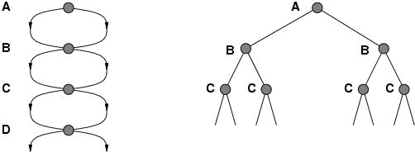
Repeated States / Multiple Paths
Failure to detect repeated states can turn a linear problem into an exponential one!

Slide 66
Pruning Cycles
Repeated States
Notes:
CYCLES
You can prune a path that ends in a node already on the path. This pruning cannot remove an optimal solution.
The time is linear in path length.
REPEATED STATES
Failure to detect repeated states can turn a linear problem into an exponential one!
(if the new path is longer – more costly). You can prune a path to node n that you have already found a path to
Problem: what if a subsequent path to n is shorter than the first path to n ?
You can remove all paths from the frontier that use the longer path. (as these can’t be optimal) OR
You can change the initial segment of the paths on the frontier to use the shorter path. Can be computationally costly

Slide 67
Search in Practice
 | Complete | Optimal | Time | Space
DFS | N | N | O(b^{m}) | O(mb)
BFS | Y | Y | O(b^{m}) | O(b^{m})
IDS(C) | Y | Y | O(b^{m}) | O(mb)
LCFS | Y | Y | O(b^{m}) | O(b^{m})
BFS | N | N | O(b^{m}) | O(b^{m})
A* | Y | Y | O(b^{m}) | O(b^{m})
B&B | N | Y | O(b^{m}) | O(mb)
IDA* | Y | Y | O(b^{m}) | O(mb)
MBA* | N | N | O(b^{m}) | O(b^{m})
BDS | Y | Y | O(b^{m/2}) | O(b^{m/2})

Slide 68
Search in Practice (cont’)
Informed?
Many paths to solution, no ∞ paths?
Large branching factor?
Notes:
Uninformed: IDS
Informed:
Infinite path (in practice paths so long that cannot be kept in memory)

Slide 69
Sample A* applications
An Efficient A* Search Algorithm For Statistical Machine Translation. 2001
The Generalized A* Architecture. Journal of Artificial Intelligence Research (2007)
Machine Vision … Here we consider a new compositional model for finding salient curves.
Factored A*search for models over sequences and trees International Conference on AI. 2003…. It starts saying… The primary challenge when using A* search is to find heuristic functions that simultaneously are admissible, close to actual completion costs, and efficient to calculate… applied to NLP and BioInformatics
Notes:
title: An Efficient A* Search Algorithm For Statistical Machine Translation authors: Och, Franz Josef (RWTH Aachen University, Aachen Germany), Ueffing, Nicola (RWTH Aachen University, Aachen Germany), Ney, Hermann (RWTH Aachen University, Aachen Germany) venue: Workshop On Data-Driven Methods In Machine Translation year: 2001
Journal of Artificial Intelligence Research 29 (2007) 153-190 Submitted 10/06; published 06/07 The Generalized A* Architecture
Pedro F. Felzenszwalb pff@cs.uchicago.edu
Department of Computer Science University of Chicago Chicago, IL 60637
David McAllester mcallester@tti-c.org Toyota Technological Institute at Chicago Chicago, IL 60637
vision
Here we consider a new compositional model for finding salient curves.
Dan Klein and Chris Manning. 2003b. Factored A*
search for models over sequences and trees. In Proceedings
of the International Joint Conference on
Artificial Intelligence (IJCAI).
The primary challenge when using A* search is to find heuristic
functions that simultaneously are admissible, close to actual
completion costs, and efficient to calculate. In this paper,
we describe a family of tree and sequence models in
which path costs are either defined as or bounded by a combination
of simpler component models, each of which scores
some projection of the full structure. In such models, we can
exploit the decoupled behavior over each projection to give
sharp heuristics for the combined space. While we focus
on models of trees and sequences within NLP applications,
the approach can be applied more generally (and already has
been, in the case of biological sequencemodels). All the concrete
cases we consider here involve search over spaces which
are equivalent to dynamic programming lattices, though this
detail, too, is somewhat peripheral to the basic ideas.

Slide 70
Class Forum: Piazza
Join the class asap via the signup link below.
http://www.piazza.com/ubc.ca/fall2011/cpsc502
You need a ubc.ca or cs.ubc.ca email address to sign up. If you do not have one, please send an email to rjoty@cs.ubc.ca

Slide 71
Do all the “Graph Searching exercises” available at http://www.aispace.org/exercises.shtml Please, look at solutions only after you have tried hard to solve them!
TODO for this Thurs
Read Chp 4 of textbook
Join piazza (the class discussion forum)
Notes:
I'll show some pictures of cool applications in that class, and will give you an opportunity to discuss the applications that you discovered

Slide 72
Lecture Summary
Search is a key computational mechanism in many AI agents
We will study the basic principles of search on the simple deterministic planning agent model
Generic search approach:
define a search space graph,
start from current state,
incrementally explore paths from current state until goal state is reached.
The way in which the frontier is expanded defines the search strategy.

Slide 73
Example1: Delivery Robot
Notes:
explicit state or features
Restate / justify that the following is true
Environment changes only when the agent acts
Agent can perfectly predict effect of its actions
Agent is given a goal

Slide 74
How can we find a solution?
How can we find a sequence of actions and their appropriate ordering that lead to the goal?
Define underlying search space. A graph where nodes are states and edges are actions.
b4
o113
r113
o107
o109
o111
r107
r109
r111
Notes:
How can we find a sequence of actions and their appropriate ordering that lead to the goal?

Slide 75
Examples of solution
Start state b4, goal r113
Solution <b4, o107, o109, o113, r113>
b4
o113
r113
o107
o109
o111
r107
r109
r111
Notes:
Check CIspace
There are many other solutions! But of lesser quality

Slide 76
Consistency
Wait, how do we know parents have better f-vales than their successors?
Couldn’t we pop some node n, and find its child n’ to have lower f value?
YES:
What can we require to prevent these inversions?
Consistency:
Real cost must always exceed reduction in heuristic
Like admissibility, but better!
B
h = 0
h = 8
3
g = 10
G
A
h = 10

Slide 77
Optimality
Tree search:
A* is optimal if heuristic is admissible (and non-negative)
UCS is a special case (h = 0)
Graph search:
A* optimal if heuristic is consistent
UCS optimal (h = 0 is consistent)
Consistency implies admissibility
In general, most natural admissible heuristics tend to be consistent, especially if from relaxed problems

