Slide 1



«TMEC @ The Academia»
Laurent SIMON, PhD.
HEC Montréal - MosaiC
Annual Meeting NCE
Plenary: How to improve innovation : the Technological-Managerial-Entrepreneurial culture
Ottawa, Dec. 6th. 2011.

Slide 2

Who are we ?
A collaborative research partnership
with the business community
A platform to share knowledge, business and organizational insights and best practices
Laurent SIMON, HEC Montréal, 2011

Slide 3
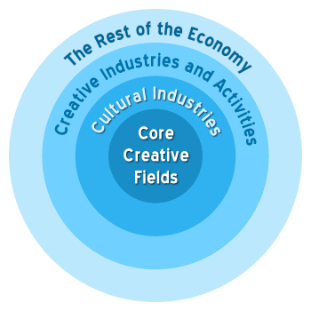
What for ?
Explore and understand the creative economy
Productive efficacy ➔ Creative intensity
+
Mastery of the management of creation in an innovative society
Laurent SIMON, HEC Montréal, 2011

Slide 4

… and what else ?
A prospective space for a redesign of management education and training
Laurent SIMON, HEC Montréal, 2011

Slide 5

Fifteen steps to a
Technological-Managerial-Entrepreneurial Culture
Laurent SIMON, HEC Montréal, 2011

Slide 6
FAITES VOUS DES AMIS
1
MAKE SOME FRIENDS
Laurent SIMON, HEC Montréal, 2011

Slide 7
POSEZ LA QUESTION
2
ASK THE QUESTION
Laurent SIMON, HEC Montréal, 2011

Slide 8
ALLEZ JOUER DEHORS
3
GO OUT AND PLAY
Laurent SIMON, HEC Montréal, 2011

Slide 9
INVITEZ VOS AMIS
4
INVITE YOUR FRIENDS
Laurent SIMON, HEC Montréal, 2011

Slide 10
EXPLOREZ DE NOUVEAUX
TERRAINS DE JEUX
5
EXPLORE NEW PLAYGROUNDS
Laurent SIMON, HEC Montréal, 2011

Slide 11
FAITES-VOUS DE NOUVEAUX AMIS
6
MAKE SOME NEW FRIENDS
Laurent SIMON, HEC Montréal, 2011

Slide 12
INVITEZ-LES À LA MAISON
7
INVITE THEM HOME
Laurent SIMON, HEC Montréal, 2011

Slide 13
REPOSEZ LA QUESTION
8
ASK THE QUESTION AGAIN
Laurent SIMON, HEC Montréal, 2011

Slide 14
ÉCOUTEZ, DISCUTEZ, DÉBATTEZ…
9
LISTEN, DISCUSS, DEBATE…
Laurent SIMON, HEC Montréal, 2011

Slide 15
RACONTEZ DES HISTOIRES
10
TELL STORIES
Laurent SIMON, HEC Montréal, 2011

Slide 16
CONCRÉTISEZ, DESSINEZ, FABRIQUEZ
11
MAKE IT CONCRETE, DRAW, BUILD
Laurent SIMON, HEC Montréal, 2011

Slide 17
MONTREZ
12
SHOW
Laurent SIMON, HEC Montréal, 2011

Slide 18
ESSAYEZ, FAITES ESSAYEZ, JOUEZ
13
TRY, MAKE PEOPLE TRY, PLAY
Laurent SIMON, HEC Montréal, 2011

Slide 19
AMÉLIOREZ
14
IMPROVE
Laurent SIMON, HEC Montréal, 2011

Slide 20
RECOMMENCEZ
15
START AGAIN
Laurent SIMON, HEC Montréal, 2011

Slide 21

laurent.simon@hec.ca http://mosaic.hec.ca/eng
Laurent SIMON, HEC Montréal, 2011

Slide 22

What we do (redux)
Les «écoles»
→ L’ École d’été en Management de la Création et de l’innovation, Montréal-Barcelone
→ École d’automne : CreaSXB – Créativité, Science et Cités (Strasbourg, 15-19 nov. 2010)
+ Semaine de la créativité Liège (nov. 2011), CreaSXB (sept. 2011)
+ Aalto, Osaka, Lyon, Rio / Sao Paulo…
Laurent SIMON, HEC Montréal, 2011

Slide 23
A team, a context, a network, a community…
Professors from different fields in management and economics
MSc. / PhD. Students
Connections…
Hybrid financing: - Members
Partners
Participants
Clients
Public financing (research)
Institutional support (Fondation HEC, …)
Laurent SIMON, HEC Montréal, 2011

Slide 24


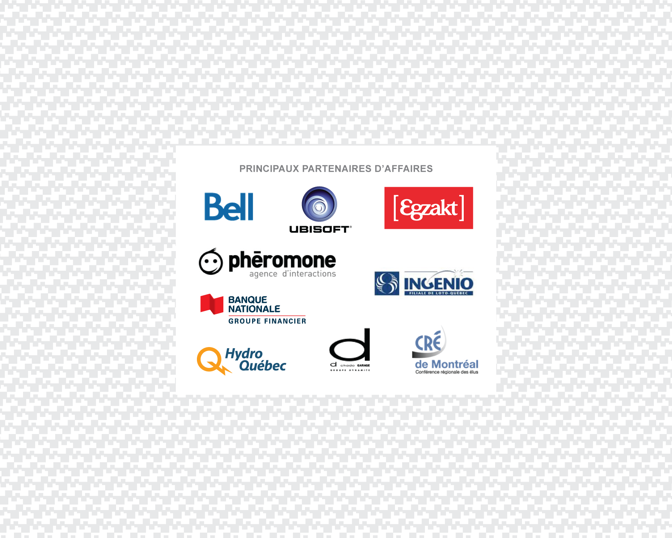

Our partners and sponsors
Laurent SIMON, HEC Montréal, 2011

Slide 25







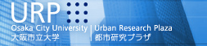


Our international academic partners
Laurent SIMON, HEC Montréal, 2011

Slide 26

A unique «hub» @ HEC Montréal…
… to act and implement changes in the creative society
http://mosaic.hec.ca/eng
laurent.simon@hec.ca

Slide 27
A few references
Cohendet P., Llerena P. and Simon L. «The innovative firm: Nexus of communities and creativity», Revue d’Économie Industrielle, n0 129-130, 2010 pp 139-170.
Bach L., Cohendet P., Pénin J. and Simon L. «Creative industries and the IPR dilemma between appropriation and creation: some insights from the videogames industries» Management International, vol.14, n3, 2010, pp 59-72.
Cohendet P., Grandadam D. and Simon L. « The Anatomy of the Creative City», Industry and Innovation vol.7, n1, 2010, pp 91 – 111
Cohendet, P., L. Simon, « Playing across the Playground: Paradoxes of knowledge creation in the video-game firm», Journal of Organizational Behaviour, juin 2007, pp. 587-605.
Cohendet P. et Pawlak É. «Diversity of entrepreneurs and diversity of clusters in nanotechnologies», International Journal of Technology Management, vol.46, No.3/4, 2009, pp. 386 – 40
Cohendet P., Grandadam D. and Simon L. «Réseaux, communautés et projets dans les processus créatifs», Management International, vol.13, no 1, 2008, p. 29-44
Cohendet P., S. Zapata «Innovation and Creativity: Is there economic significance to the creative city?» Management International, vol.13, Juin 2009, pp. 23-36
Simon, L. «Underground, upperground et middle-ground : les collectifs créatifs et la capacité créative de la ville», Management International, juin 2009. Vol 13, pp. 37-51.

