Slide 1

Social Media Campaign
NCE Annual Meeting
Sarah Stewart
Communications Officer
Canadian Stroke Network

Slide 2
Why use Social Media?
Generate awareness around the event
Encourage networking
Promote discussion about session topics
Engage non-attendees
Extend the life of the event.
Notes:
Who used/ followed the social media for this event?
Social media allows us to:
share information about the event and even promote the event for you – just by talking about it
It enhances the networking experience by enabling people who might not normally chat with one another at a conference to interact.
Allows participants to ask questions, and continue the conversation long after the session has ended.
And by creating a digital record of the event, it extends the life of the event long after the booths have been packed up and everyone goes back to work.

Slide 3
Event Marketing
Websitehttp://www.nce-rce.gc.ca/AnnualMeeting-ReunionAnnuelle/2011/index_eng.asp
Email
To this we added:
Facebook page
Twitter account
Notes:
Created a twitter account and NCE facebook page to spread the word and amp up the hype for the NCE annual meeting.

Slide 4

twitter
users send & receive real time posts of up to 140 characters (tweets) which are displayed on the user's profile page & received by followers *
* My 140 character description of Twitter. Ironically, Twitter does not have an official 140 character description of its own. #fail
Notes:
Everyone here is familiar with twitter, right?
Twitter is what’s referred to as a “micro-blogging” website, where users can set-up accounts and talk to one another.
It basically allows them to have online conversations with other people who share the same interests.

Slide 5
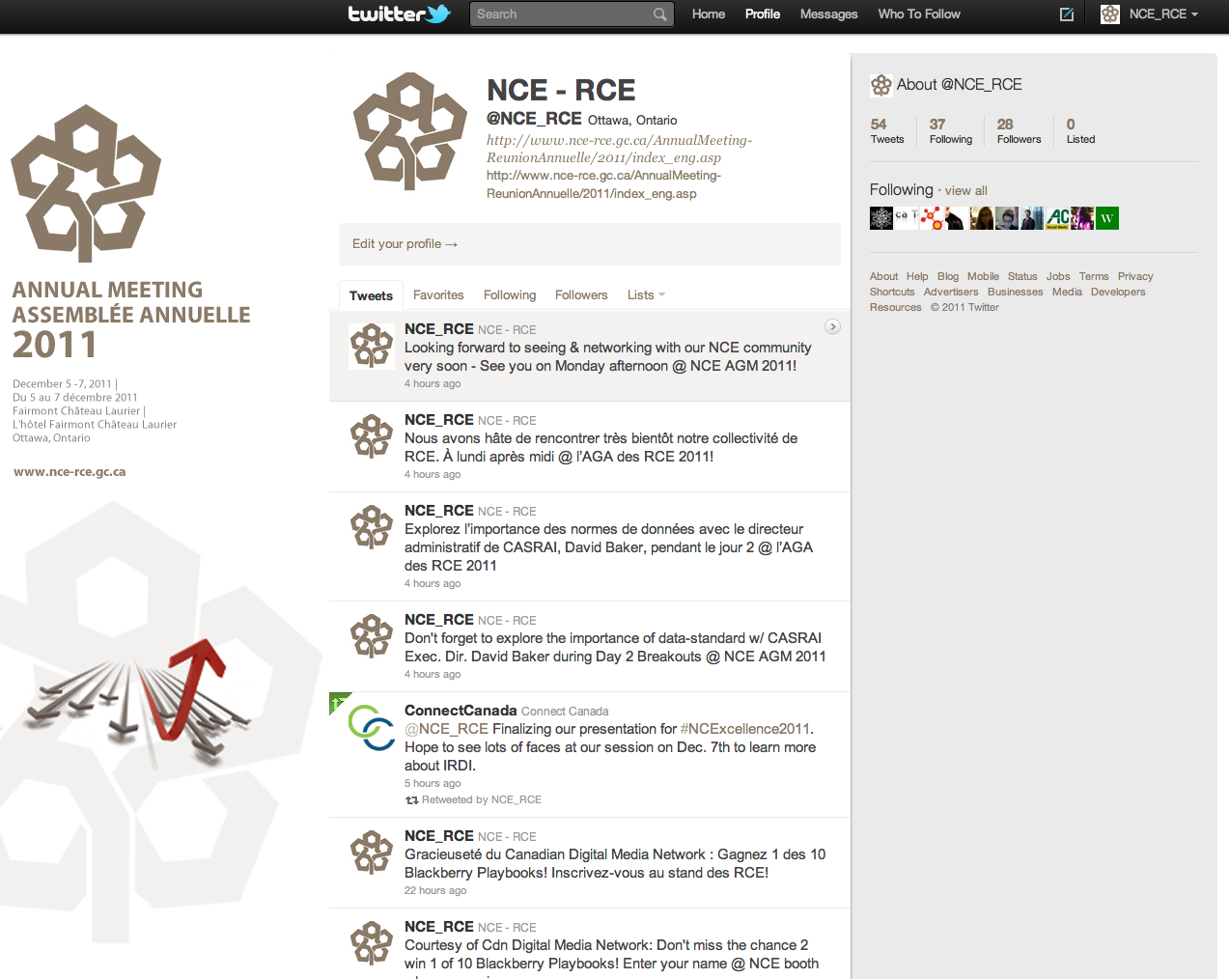
Notes:
Our twitter page

Slide 6
The Leg Work
22 scheduled general tweets
Hashtag: #NCExcellence2011
Notes:
Alex at the NCE created an list of tweets promoting the meeting. These tweets provided information about the meeting, such as information and and links to registration, links to the program and some program and speaker highlights.
In the last week and a half before the meeting a few more tweets were written to engage the audience and attempt to generate conversation. These tweets were questions. This effort had little success. Not overly successful. Got a few responses. From Cathy but also from ConnectCanada.
Lori created a unique hashtag for the event, NCExcellence that was added to the end of the tweets we sent out and for others to use.
Again, not super successful. ConnectCanada was the only follower to ever use the hashtag.

Slide 7
The Audience
Following 37
Primarily from NCE
30 followers
Notes:
We wanted our tweets to reach a specific audience; the delegates. In this case we weren’t trying to generate any media attention or get the word out to the public. Therefore we had a much smaller audience then we would for our Congress. Any person who followed us, we would follow back. As you can see not all of our followers chose to follow us.
The purpose of the account was to get information out to delegates.

Slide 8
Building the Conversation
54 tweets sent
From scheduled list
Answering questions
Retweeted
5 retweets from followers
13 mentions
Notes:
We planned & scheduled tweets so that it would look like we were having an ongoing discussion. Messages were scheduled for the week on each Monday and I would check the page regularly for any questions or required retweets.
I tried not to overload with two many tweets at the beginning, with a plan to schedule more tweets the week before the meeting. Since we weren’t getting much pick-up, I thought we might be able to generate more conversation in the week before the meeting. So I saved a lot of tweets for then, including the tweets asking questions to our followers. Ie. What are you looking forward to most?
Sent tweets about speakers, registration, sessions, etc.
If someone tweeted to us, we replied. If they mentioned us we retweeted. Over the month we had 13 mentions – half of which came from Cathy. The remaining mentions were split between 3 other followers.
As you can see, we tweeted a lot over the month, but we didn’t get many tweets back and were unsucessful generating any conversation, except with Cathy. This is probably because we only had about a month to build our online presence. For our Congress we are tweeting all year about program updates, location, registration, even website updates. With the NCE meeting we didn’t have enough time to build much, but we’ve created a solid base if the tools are continued to be used.

Slide 9


Slide 10
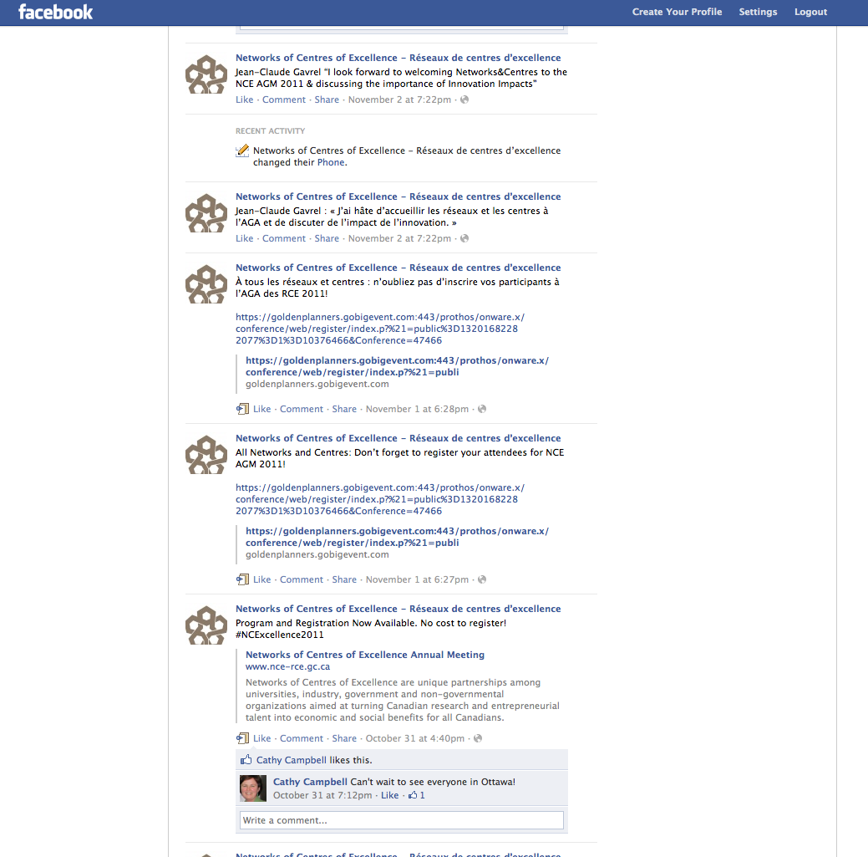
Notes:
Our facebook page had very little action. Any hits we did have on that page came from Cathy.
There are multiple reasons for this. Facebook is a more personal space, twitter has become much more popular for spreading a message and marketing. Because it is immediate and you can create hashtags or mentions that make your topic easier to search for.
NEXT

Slide 11
Final Notes
Notes:
Lori final remarks
Questions:
Do you have any suggestions for how we can continue to build NCE social media?
Did you follow our tweets? If so, why didn’t you use it?
What could we have done to make you engage with NCE social media?

Slide 12
Lessons Learned
Timing
Social media campaign needs to begin MUCH sooner. (suggest beginning SM campaign for 2012 meeting now)
Visibility
Twitter feed should be included on NCE home page, and links should be on all material.
Quality Information*
Don’t tweet just for tweet’s sake. Tweet info people want immediate access to (link to registration, link to program, etc.)
Having a low feedback rate doesn’t necessarily indicate ineffectiveness. An organization’s twitter page can become a great “go-to” space for links to useful information.

Slide 13
Going Forward
Is there any value in using SM for 2012 campaign?
Network involvement?
Suggestions?

Slide 14
thank you
Notes:
And on that note, I’d be happy to take your questions.

