Slide 1
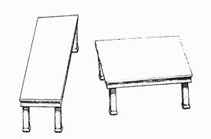
HIDING THE BODIES

Slide 2
Wheezes
Switching Endpoints
Surrogate Outcomes 90%?
NNT inappropriate
LOCF
Relative Risks
Short term trials
Miscoding
Splitting Hazards
Co-administration
Choice of Comparator & Dose
Ecological fallacy
Publication Strategies
www.davidhealy.org

Slide 3
FLUOXETINE – PAROXETINE - SERTRALINE ADULT TRIALS
Occurrence of suicidal acts
screening
Healy
BMJ
2006
Run-in/wash out
randomization
drug
pbo
Start
treatment
Stop
treatment
follow-up

Slide 4
FLUOXETINE – PAROXETINE - SERTRALINE ADULT TRIALS
Reporting of suicidal acts
screening
Vioxx
Avandia
Run-in/wash out
randomization
drug
pbo
Start
treatment
Stop
treatment
follow - up

Slide 5
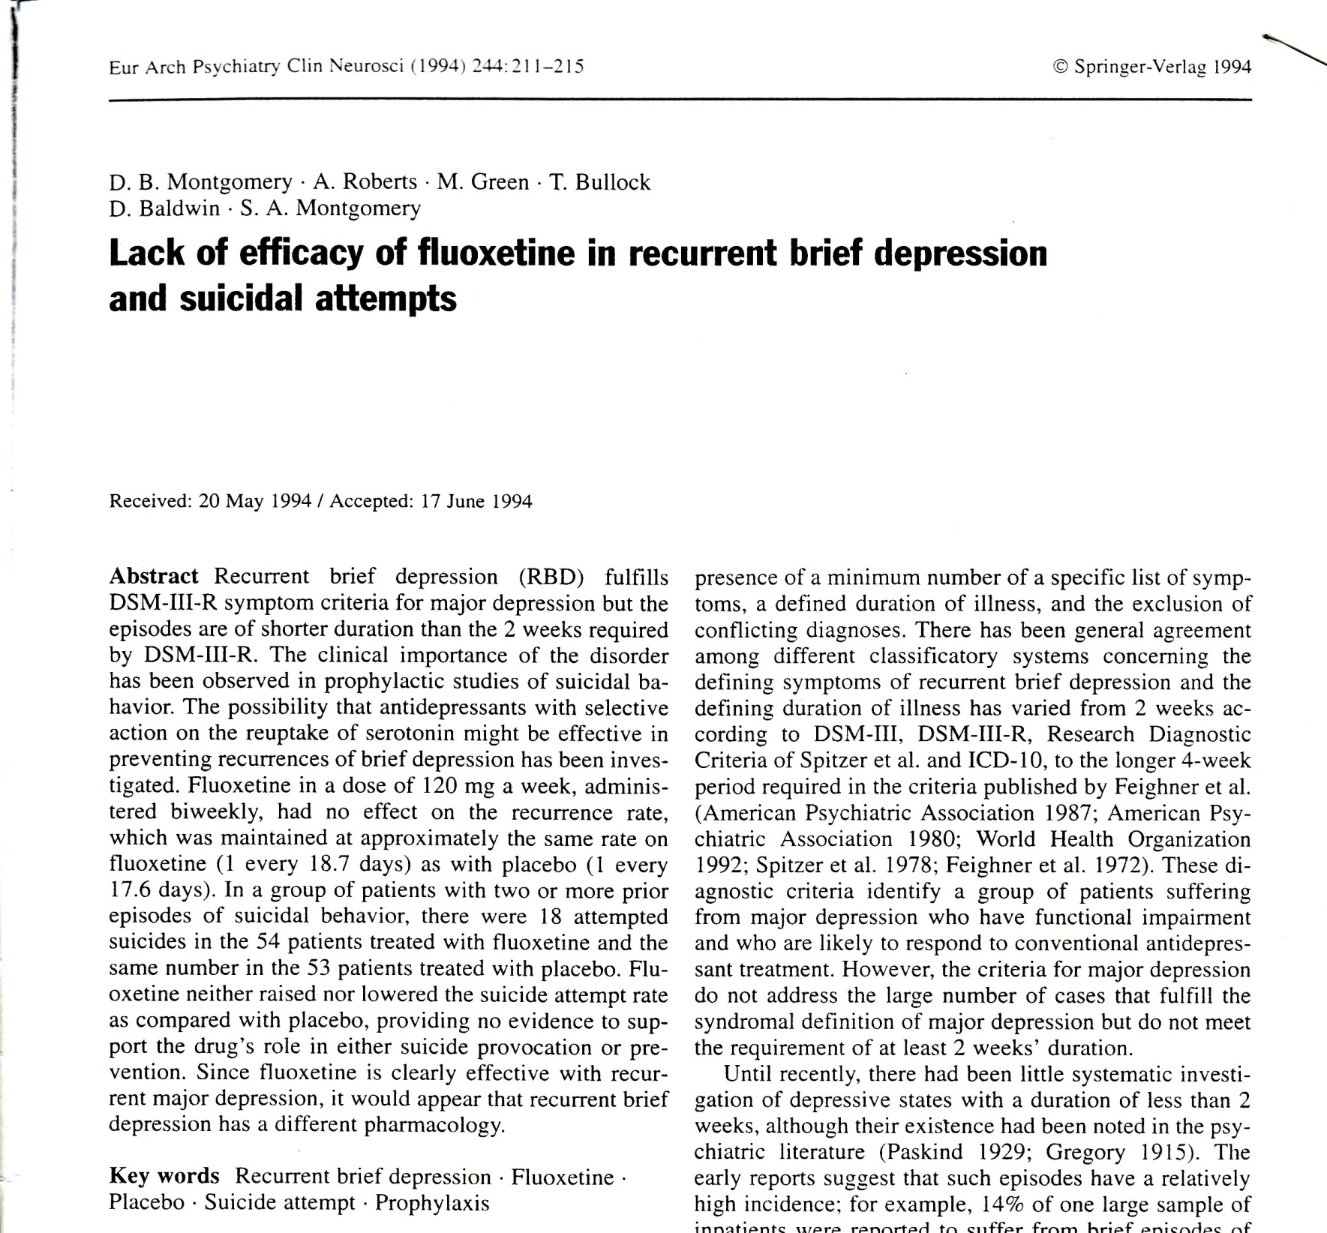

Slide 6
Paroxetine in treatment of intermittent brief depression [Montgomery et al 1993]
PAR PLC
n = 18 n = 18
overall response [%] 38.0 50
depressive episodes [n] 16.5 15.4
mean MADRS score 29.7 26.8
mean duration [days] 4.6 5.4
suicide attempts / year 7.3 2.3

Slide 7
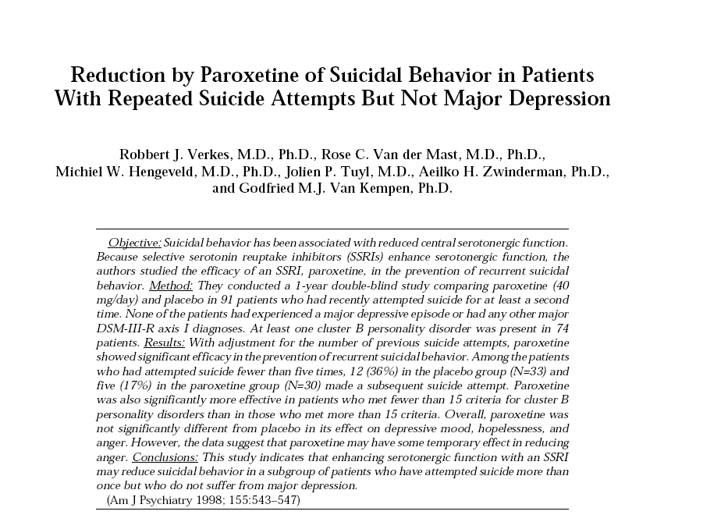

Slide 8
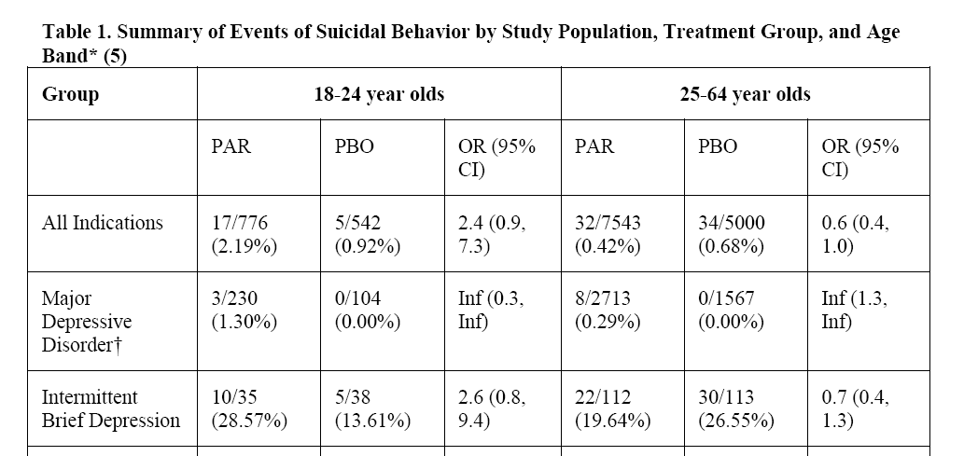
GSK - 2006
Paroxetine Suicidal Acts 11 v 0 Placebo Suicidal Acts

Slide 9
GSK - 2006
Paroxetine 43 v 35 Placebo
RR – 0.74

Slide 10
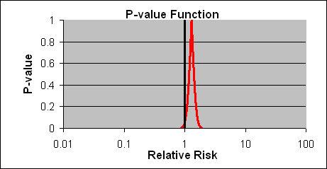
DOUBT IS OUR PRODUCT
Drug A
P=.04
Notes:
10
The p-value function tells us more. Here you get an idea of the direction, magnitude and precision of the effect estimate for drug A. Small increased risk, RR<2, very precise. The null p-value is .04.

Slide 11
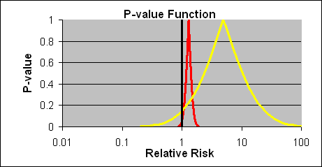
DOUBT IS OUR PRODUCT
Drug A
Drug B
P=.09
P=.04
Notes:
11
Now you see the p-value function for drug b. What can we see. Also an increased risk (direction is shifter to the right). But the shift is much larger than for drug A (RR=8-9). Less precision, wide CI means data compatiblel with a broader range if effects, from small to large. But these data are most compatible with large effects. P=.09, not sig.

Slide 12
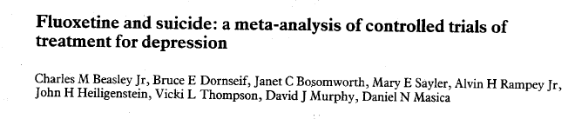
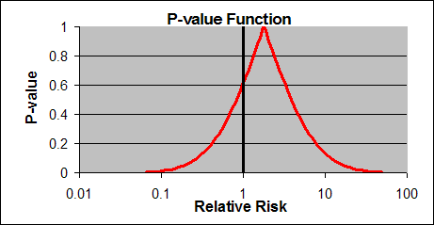
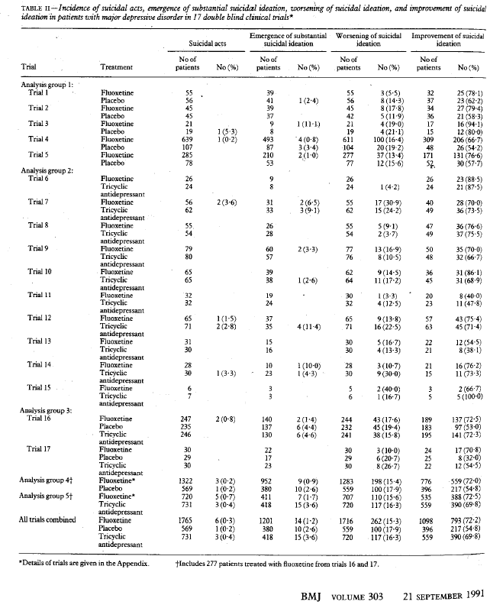


RR=1.9 (0.2, 16)
Notes:
In these Lilly trials, fluox caused more suicides than it prevented. Function is shifted to the right=bad. Imprecise, data compatible with no difference. Equally compatible with 4-5-fold increase.
Random error: substantial
Systematic error: the pbo case is misclassified

Slide 13
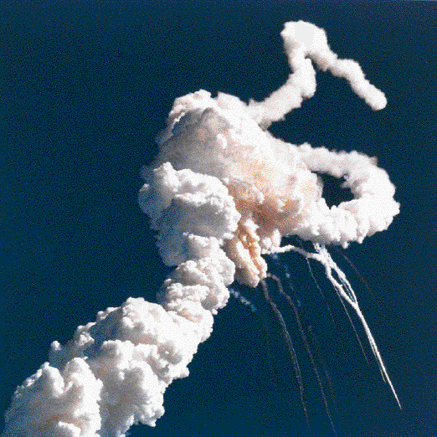
SAFE TRAVEL:
SPACE SHUTTLE
Mixed Messages

Slide 14
THE SPIN NO DATA CAN OVERCOME

Slide 15
April 15, 1991 Memo to Leigh Thompson
“Upcoming TV appearance”
Section I. “MESSAGE GOALS, the three points .. are:
2. “It’s in the disease, not the drug.”
Section III “If pressed, or as a postscript to the above,
then make the point that absolutely no evidence
indicates PROZAC as a cause of such behavior
(violence and suicide).”, and “Prozac defense…
There is simply no medical or scientific merit to
the argument.”
Exhibit 123

Slide 16
RANDOMIZED CONTROLLED TRIALS
Bias 1: Suicidal Acts
screening
Run-in/wash out
randomization
drug
pbo
Start
treatment
Stop
treatment
follow-up

Slide 17
RANDOMIZED CONTROLLED TRIALS
Bias 2: Suicidal Acts
screening
Run-in/wash out
randomization
drug
pbo
Start
treatment
Stop
treatment
follow-up

Slide 18
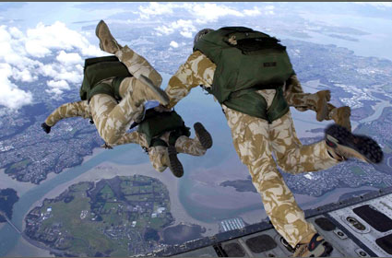
EVIDENCE BASED MEDICINE

Slide 19
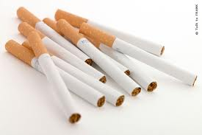


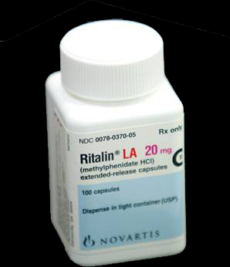
EVIDENCE BASED MEDICINE

Slide 20
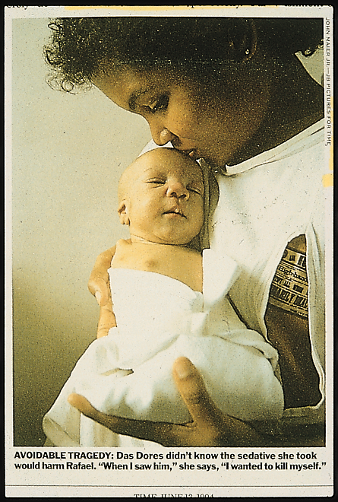
Thalidomide
Randomized
Controlled
Trials

Slide 21
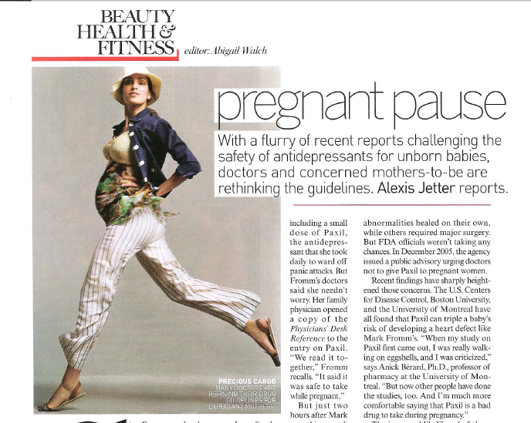

Slide 22


Alle Ding' sind Gift, und nichts ohn' Gift;
allein die Dosis macht, daß ein Ding kein Gift ist.

Slide 23
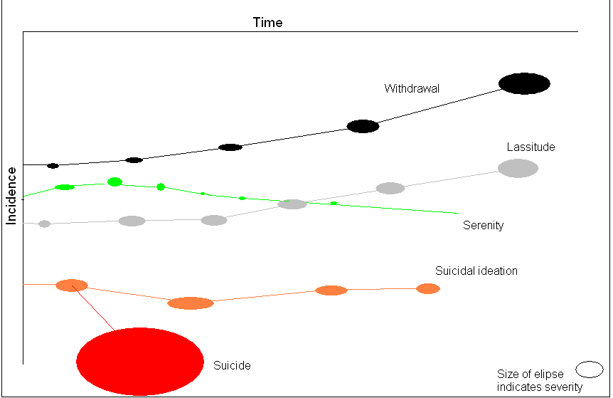

Slide 24
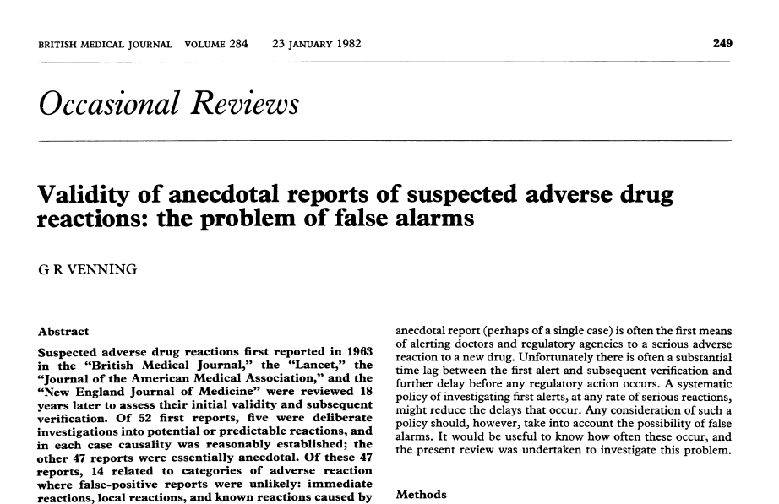

Slide 25
Objective v Subjective
Certainty v Uncertainty
Mechanical v Thoughtful
Autopilot v Professional
Risky Doctor v Risky Drug

Slide 26
RCTS
Are not a gold standard
Do not demonstrate Cause and Effect
Should never replace good evidence
Significance testing should be about credibility

Slide 28
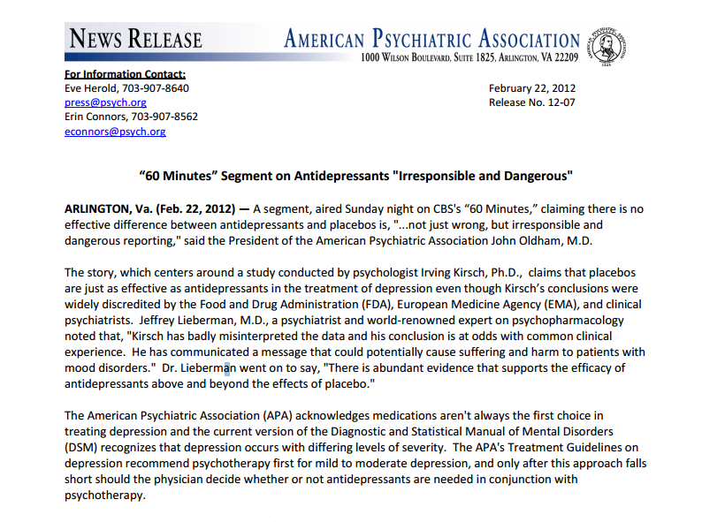

Slide 29
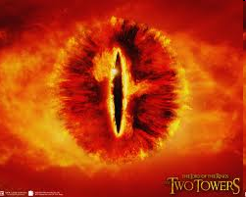
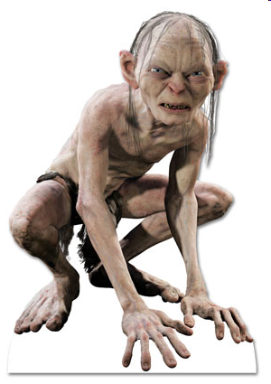
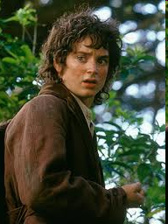
LORD
OF
THE
RINGS

Slide 30
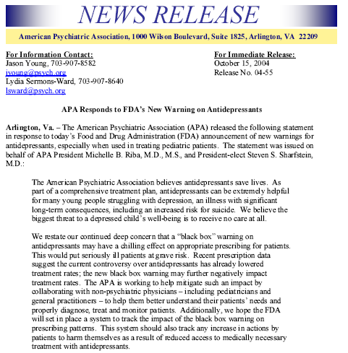
“The American Psychiatric Association believes that antidepressants save lives.”
Notes:
30
Medical authorities deny the allegation.

Slide 31
“The American Psychiatric Association believes that psychiatrists save lives.”
Notes:
31
Medical authorities deny the allegation.

Slide 32


