Slide 1
Lesson 3 ¡Hola!/¿Qué Tal?
Objectivo: To learn how to greet people in Spanish and say how you are feeling.
Tip: Try to memorise the phrases shown on the computer.

Slide 2
Introduction:
We need to learn how to greet people in Spanish.
So how do we do it?....
We start with ‘Hola’ which means….
Hello
Hola has a silent ‘h’ so pronounce it without the ‘h’.

Slide 3
Basic Greetings:
We can simply greet people with basic greetings such as ‘Goodbye’ or informal greetings such as ‘See you later’.
Lets look on the next few slides and see what basic greetings we can add to our sentences.
Please copy out the following phrases on the next slide.

Slide 4
Hello = Hola

Slide 5
Goodbye = Adiós

Slide 6
See you later = Hasta luego

Slide 7
See you tomorrow = Hasta Mañana

Slide 8
See you soon = Hasta Pronto

Slide 9
Greetings throughout the day:
In Spanish, just like English, we can greet people throughout the day. Here are some phrases that you will need to know. Try to make sense of the sentences on the next slide.

Slide 10

Buenos Días = Good Morning

Slide 11

Mediodia = Midday

Slide 12
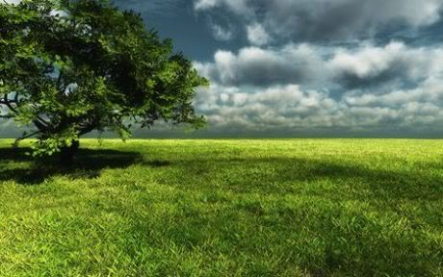
Buenas Tardes = Good Afternoon

Slide 13
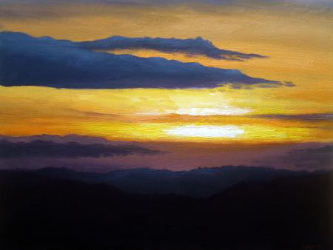
Buenas Tardes = Good Evening

Slide 14
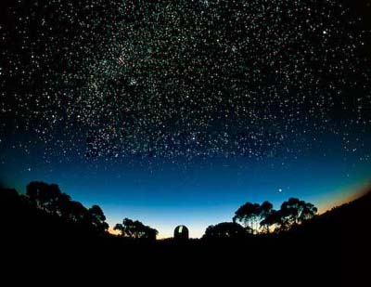
Buenas Noches = Good Night

Slide 15
Other Greetings:
Once we have said ‘Hello’, we can start to ask how somebody is feeling. Follow the phrases on the next screen and write the translations.
We can ask how someone is by using the phrase ‘Qué Tal?’. This means ‘How are you?’

Slide 16
What am I saying?
¡Hola! Qué Tal?
We start with ‘Hola’ which means….
Hello
What does ‘Qué Tal?’ mean?
How are you
So basically this sentence is saying:
Hello. How are you?

Slide 17
Replying:
When someone asks us that question in Spanish we can reply with many different responses.
Lets look at some of them together:

Slide 18
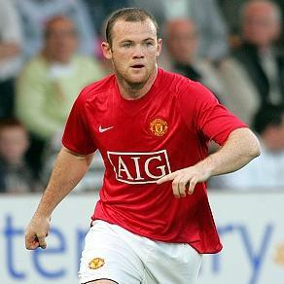
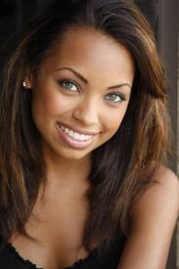
Bien = Well
Example sentence:
!Hola! Qué Tal?
Bien, gracias.
Which means?...

Slide 19
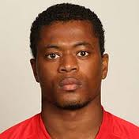
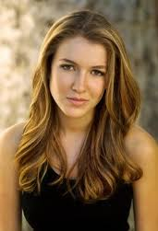
Muy Bien = Very Well
Example sentence:
!Hola! Qué Tal?
Muy bien, gracias.
Which means?...

Slide 20
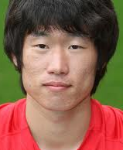

Fenómenal = Fantastic
Example sentence:
Fenómenal gracias.
!Hola! Qué Tal?
Which means?...

Slide 21
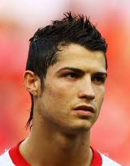
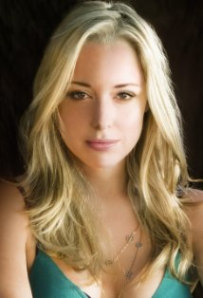
Estupendo = Great
Example sentence:
!Hola! Qué Tal?
Estupendo, gracias.
Which means?...

Slide 22
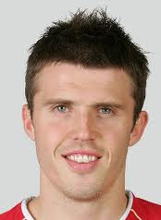
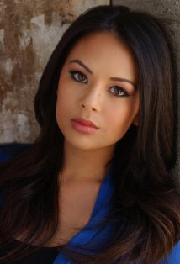
Regular = Ok
Example sentence:
!Hola! Qué Tal?
Regular, gracias.
Which means?...

Slide 23
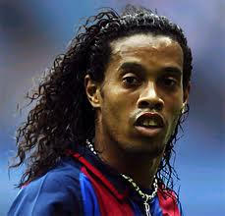
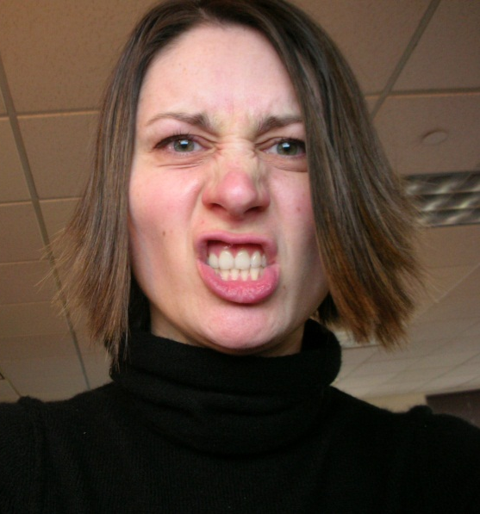
Mal = Bad
Example sentence:
!Hola! Qué Tal?
Mal!
Which means?...

Slide 24
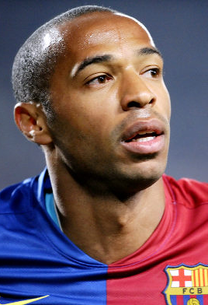
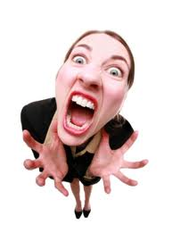
Muy Mal = Very Bad
Example sentence:
!Hola! Qué Tal?
Muy mal!
Which means?...

Slide 25
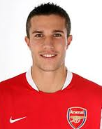
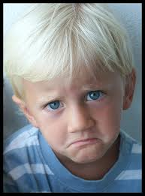
Fatal = Terrible
Example sentence:
!Hola! Qué Tal?
Fatal!
Which means?...

Slide 26
Greetings – Matching Game:
http://www.spanishrevision.co.uk/ks3/spanish_beginners/greet4.htm
In this activity you will have to match the English words we have learnt with the Spanish.
Your score:
<2 = Poor score. I will help you.
2 ≤ 4 = Average. You may need a little guidance.
>5 = You are right on track, well done.

Slide 27
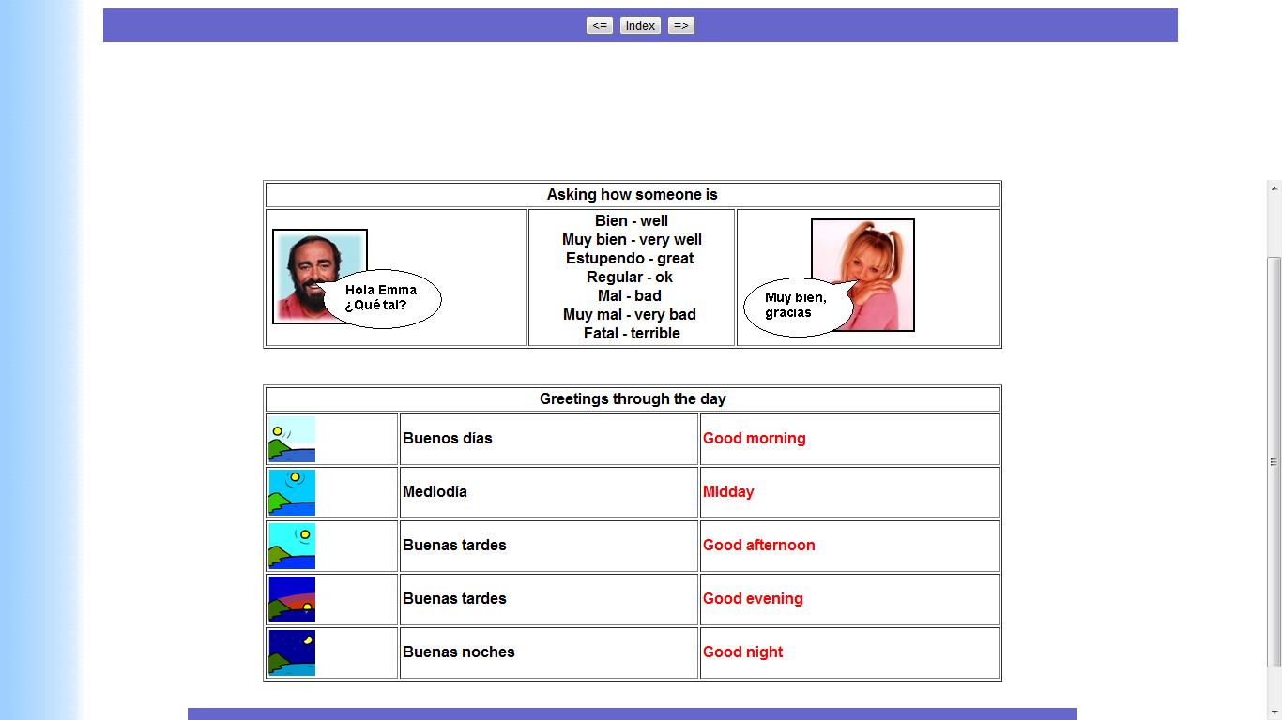
Asking how someone is (Copying phrases):
© www.Spanish.co.uk
Please copy out these phrases onto a piece of paper if you haven’t already got them.

Slide 28
Greetings throughout the day:
Please copy out these phrases onto a piece of paper if you haven’t already got them.
© www.Spanish.co.uk

Slide 29
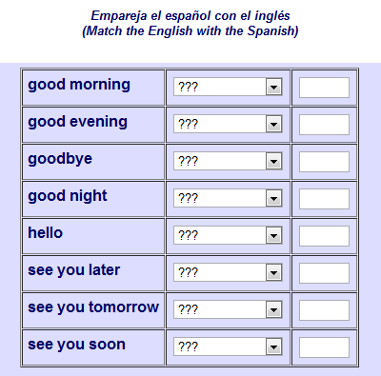
Homework:
Please write down these phrases on a piece of paper and translate them into Spanish.
Don’t worry, come and find me if you need help ☺
Homework due Friday 2nd March 2012.
© www.Spanish.co.uk

Slide 30
Have you met the lesson objective?
Can you greet people in Spanish and say how you are feeling?

Slide 31
Fun activities to finish:
Crossword –
http://www.spanishrevision.co.uk/ks3/spanish_beginners/greetingsx.htm
Hangman -
http://www.spanishrevision.co.uk/ks3/spanish_beginners/greetings_hangman.htm

Slide 32
Task 6 – Student Feedback
You may not be aware, but end of each lesson you will have to provide feedback to the teacher about how you thought the lesson went. This will help to improve other lessons and your suggestions will be used!
Please answer the questions on the next slide:

Slide 33
Questions for you:
How did you find the work in the lesson?
Easy, Medium, Hard?............
How was the lesson overall and what did you learn?
Well I thought the lesson was…………and I learnt that…
What could we have done better to improve the lesson?
Well you could ……………to improve the lesson.
Any other feedback/suggestions:
I would like to suggest that…………………..

Slide 34
Would you like to rate the lesson?....
Rate the lesson out of 10 to help the teacher.

