Slide 1
The Developers Group
Microsoft News
ASP .NET MVC v2 Released for .NET 3.5 & VS2008
VS2010 & .NET 4 release next month
UK Tech Days
5 days of developer focussed events simultaneously with
5 days of IT pro focussed events
http://www.microsoft.com/uk/techdays/registration.aspx
Mix10 is running until today, started Monday
Major announcements:
Silverlight 4
Windows Phone 7
IE 9
ASP.NET
Don’t miss the next meeting!!

Slide 2

The Developers Group
Mix10 News – Silverlight 4 (1)
Considered to be “mature” release
Silverlight deployment at nearly 60% on Internet connected devices
The technology to build the Silverlight Winter Olympics player and infrastructure is being open-sourced
Silverlight 4 Release Candidate (developer release) now available
Allows full screen video on separate monitor
“Pivot” will be included – manipulation, filtering and exploration of large image datasets
eBay adopting Silverlight – list a product by showing its barcode to your webcam!
Took only 8 weeks to build from start to finish
Tooling available for VS2010 and Expression Blend 4
Full release “within a month”
Documentation for release candidate now available
Silverlight coming to Xbox – no timescales though

Slide 3
The Developers Group
Mix10 News – Silverlight 4 (1)
Beta of Silverlight for Symbian is now available (for S60 5th Edition)!
Roughly equivalent to Silverlight 2 buts it’s a good start!
Lots of new features in Silverlight 4:
Tooling
Printing API
Right-click event handling
Webcam/microphone access
Mouse wheel support
RichTextArea Control
ICommand support
Clipboard API
HTML Hosting with WebBrowser
Elevated trust applications
Local file access
COM interop
Notification (“toast”) API
Network authentication
Cross-domain Networking changes
Keyboard access in full screen mode
Text trimming
ViewBox
Right-to-left, BiDi and complex script
Offline DRM
H.264 protected content
Silverlight as a drop target
Data binding
IDataErrorInfo and Async Validation
DependencyObject Binding
StringFormat, TargetNullValue, FallbackValue
Managed Extensibility Framework (MEF)
DataGrid enhancements
Fluid UI support in items controls
Implicit theming
Google Chrome support
…taken from (and explained in) Tim Heuer’s blog:
http://timheuer.com/blog/archive/2009/11/18/whats-new-in-silverlight-4-complete-guide-new-features.aspx

Slide 4
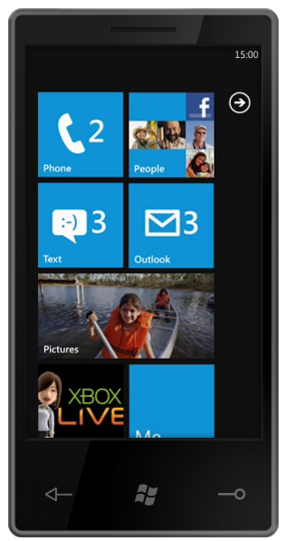
The Developers Group
Mix10 News – Windows Phone 7 (1)
Major changes to the UI – very configurable, fast
Initial release targeted at consumers - very good for media
The primary development environments for Windows Phone 7 are XNA for games and Silverlight for everything else
Not “Silverlight-Lite” – just “Silverlight”, including IIS Smooth Streaming & Deep Zoom
Silverlight is currently a “super set” of Silverlight 3.0
VS2010 has Win Phone 7 optimised controls templates and emulator
Emulator is VM running the actual OS
If you have a multi-touch screen the emulator supports it too
Emulator integrates with Expression Blend 4

Slide 5
The Developers Group
Mix10 News – Windows Phone 7 (2)
Windows Phone 7 specific versions of design and dev tools are free
CTP versions available now
Applications distributed via Windows Marketplace
Support for offering trial versions built in
No (generally available) native code development
One exception is that MS are working with Adobe to port Flash!
Tightly controlled hardware platform. Developers can expect availability of features such as
Hardware graphics acceleration
Multitouch
GPS
Accelerometer
Two standard resolutions (800x480 & 480x320)

Slide 6

The Developers Group
Mix10 News – IE 9
IE 9 Platform Preview now available
Plus several demos
Will be updated about once every 8 weeks
New script engine: "Chakra“
Runs on separate core from host IE process
HTML 5
CSS 3
SVG
Support for host (PC) hardware acceleration
New Developer Tools

Slide 7
The Developers Group
Mix10 News – ASP.NET
Controls now emit clean markup
Makes using CSS much easier
Smaller and more easily managed ViewState
Can use semantic URLs “out of the box”
Lots of new controls
Improvements in client-side processing through jQuery
Contributing to jQuery project
ASP.NET MVC 2
Built into VS2010
Improved tooling support

Slide 8

The Developers Group
Mix10 News – VS2010
Multiple monitor support
Better & faster Intellisense
Multiple, selectable configuration files
Easier publishing to server, including DB deployment
Lots of navigation, completion, selection and editing improvements
Searching within classes using Intellisense
Box select
New visualisations
Auto generate sequence diagrams, etc.

Slide 9
The Developers Group
Mix10 News – OData
Open Data Protocol
New data protocol to help standardise querying of web based services
Permits arbitrary queries
Linq provider available
First class libraries available for lots of platforms
Palm Pre
iPhone
All lists in Sharepoint 2010 can be exposed as OData feeds
More and more MS products will support OData either as providers or consumers
“Dallas” – Azure based marketplace for OData

Slide 10
The Developers Group
Resources
ASP.NET MVC 2
http://bit.ly/aspnetmvc2
Silverlight for Symbian
http://www.silverlight.net/getstarted/devices/symbian/
Silverlight 4
http://silverlight.net/getstarted/silverlight-4
Windows Phone 7
http://developer.windowsphone.com/windows-phone-7-series/
IE 9 Platform Preview & demos
http://ie.microsoft.com/testdrive/Default.html
ASP.NET 4
http://www.asp.net/
Visual Studio 2010
http://www.microsoft.com/visualstudio/en-us/
Odata
http://www.odata.org/
Mix10 (session videos)
http://www.microsoft.com/presspass/events/mix/videoGallery.aspx
Channel 9 (Mix10 follow-up interviews)
http://channel9.msdn.com/

