Slide 1

Superluminal Neutrinos?
Susan Cartwright
Department of
Physics and Astronomy
Introduction
The OPERA result
SN 1987A
Interpretations

Slide 2
Introduction
The speed of light, c, plays a fundamental role in relativity and Lorentz transformations
Violation of Lorentz invariance is, however, common in quantum gravity theories
therefore observation of such violation may place important constraints on candidate theories of quantum gravity
Lorentz invariance has been extensively tested using photons and charged fermions
and stringent upper limits set
Recent measurements by the OPERA experiment suggest that neutrinos may travel at v > c
Is this real? Does it agree with other measurements? If real, what does it mean?

Slide 3
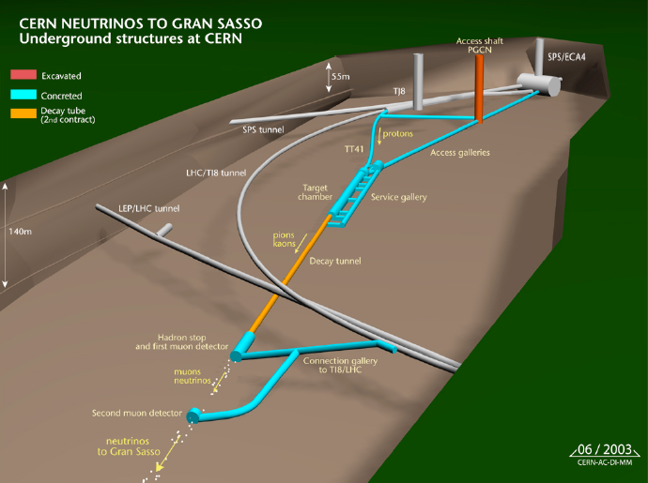
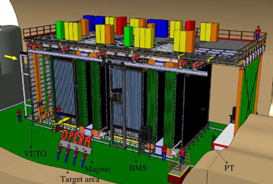
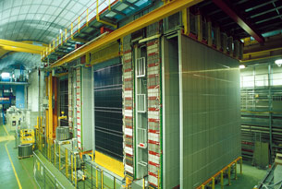
The Opera Result
Neutrino beams and neutrino oscillations
The OPERA result:
Baseline measurement
Time measurement
The MINOS result

Slide 4
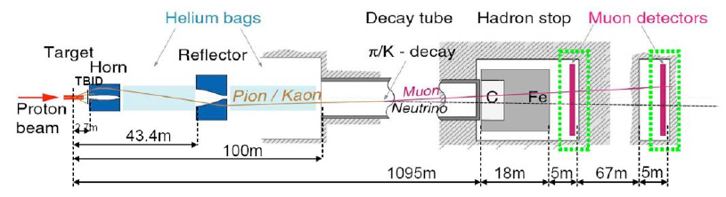
Neutrino beams
Neutrino beams are produced by pion decay in flight
Take high-intensity proton beam
Collide with target—protons interact producing pions
Collimate pions using magnets and allow to decay in flight: π⁺ → μ⁺ + ν_{μ}
Stop other particles with beam dump
Nearly pure ν_{μ} beam

Slide 5
Neutrino oscillations
Neutrinos are produced in three “flavours” associated with the three charged leptons
ν_{e}, ν_{μ}, ν_{τ}
However they are known to change flavour in flight (neutrino oscillation)
mass eigenstates ≠ flavour eigenstates
This phenomenon is sensitive to the difference in the squared masses of the mass eigenstates
Δm²₁₂ = 7.6×10⁻⁵ eV², Δm²₂₃ = 2.4×10⁻³ eV²
Δm²₁₃ is either the sum or difference of these
OPERA experiment designed to study ν_{μ}→ν_{τ} oscillations

Slide 6
The OPERA result
Bottom line: neutrinos travelling from CERN to Gran Sasso (731 km) arrive (60.7±6.9±7.4) ns earlier than expected
β – 1 = (2.48±0.28±0.30)×10⁻⁵
6σ effect (statistical & systematic errors in quadrature)
Measurement method: v = Δd/Δt
measure baseline
calculate expected time of flight for v = c
measure (average) time of flight
compare with above calculation

Slide 7
Requirements
Accurate knowledge of CERN-Gran Sasso baseline
60.7 ns is only 18 m
Accurate relative timing
propagation through electronics, etc., has to be taken into account
clocks at CERN and Gran Sasso need to be synchronised to high precision
better than “standard” GPS accuracy
need sharp enough features in the data to provide reference points for comparison

Slide 8
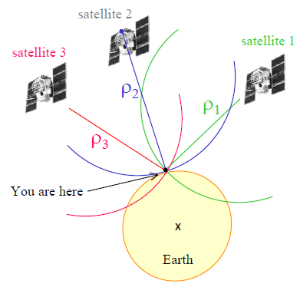
Baseline measurement
E. Calais Purdue University
Principles
measure arrival times of signals from ≥4 GPS satellites simultaneously
calculate “pseudoranges” c(t_{r} – t_{e})
decode navigation signal and determine satellite positions
solve simultaneous equations to get position in ECEF (Earth-centred Earth-fixed) frame
refer this to a standard geodetic reference frame to convert to/combine with latitude/longitude/height coordinates

Slide 9
Baseline measurement
Practice
can’t use GPS underground!
establish GPS benchmarks outside tunnel and transport position using conventional surveying techniques
OPERA say this is dominant error source (20 cm)
coordinates referred to ETRF2000
this is the standard International Terrestrial Reference Frame adjusted to make the Eurasian continental plate stationary
yes, we are at the point where continental drift is significant!
the accuracy of this system is of order a few mm
tidal and Earth rotation effects considered
Earth rotation effect (“Sagnac effect”) is significant (66 cm) and is corrected for

Slide 10
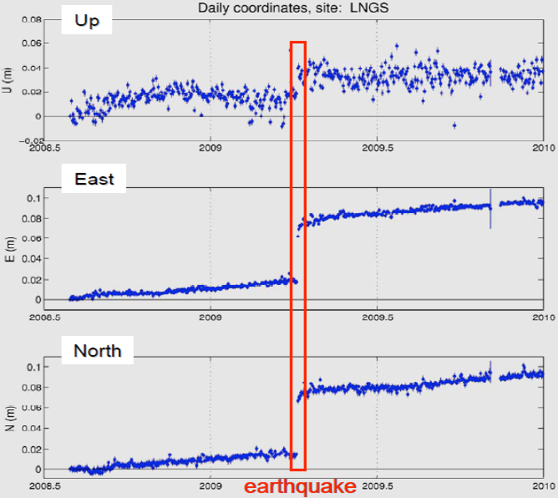
Measurement is clearly capable of detecting changes of a few cm

Slide 11
Baseline measurement
Conclusions
this is not really “state of the art” stuff
better accuracies are routinely achieved, e.g. in VLBI radio astronomy
GPS benchmarks were resurveyed in June 2011
this is not a single-point failure mode
the conventional survey was only done once
but has internal checks (Pythagoras rules OK)
Personal opinion: this is probably OK

Slide 12
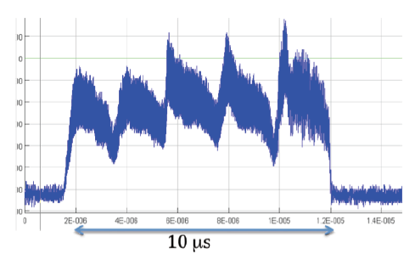
Time structure of the beam
Duty cycle of 6 s
each cycle contains two 10.5 μs extractions separated by 50 ms
500 kHz (2 μs) PS frequency produces 5-peak structure
SPS RF (5 ns) also visible
Nice sharp rise and fall
Mean ν_{μ} energy 17 GeV

Slide 13
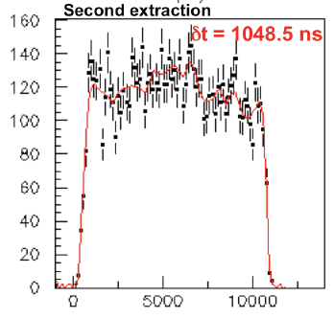
Principle of measurement
Not event-by-event
this has uncertainty of 10.5 μs from width of distribution
Construct time distribution of all neutrino events and compare with average bunch structure from beam
unbinned maximum likelihood fit for best time shift compared to 2006 set-up
blind analysis, as real shift not known
sub-bunch structure washed out, so sensitivity mostly from rise/fall

Slide 14
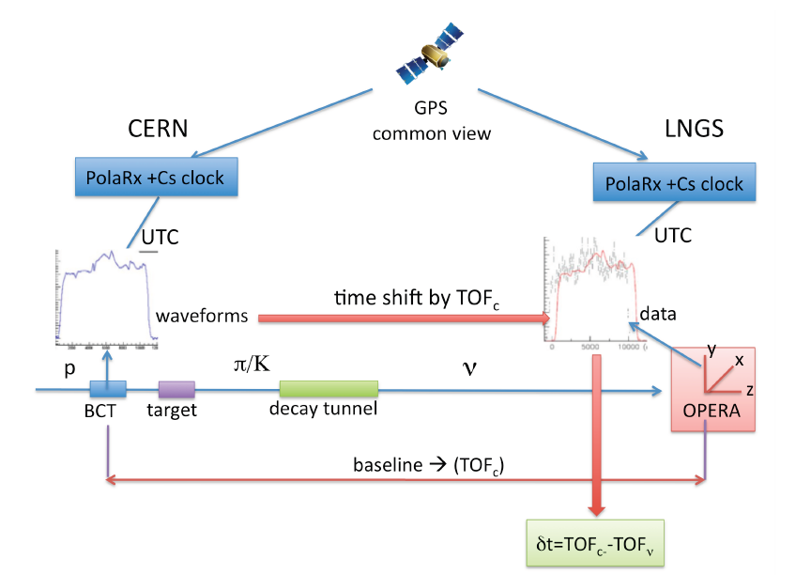
Schematic of TOF measurement

Slide 15
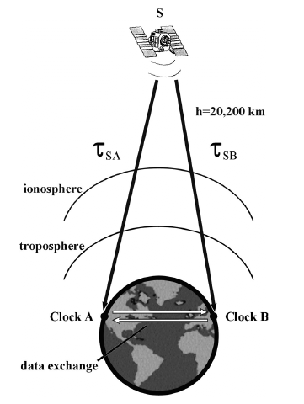
Common view GPS
Both stations use the same GPS satellite as reference
much more accurate than standard GPS time stamp
works best for shortish baselines (“<1000 km”)
reduces systematics from atmospheric conditions
2σ precision of 10 ns (single-channel) or <5 ns (multichannel) quoted
not sure which one OPERA used
M Lombardi et al., Cal. Lab. Int. J. Metrology, pp26-33, (July-September 2001).

Slide 16
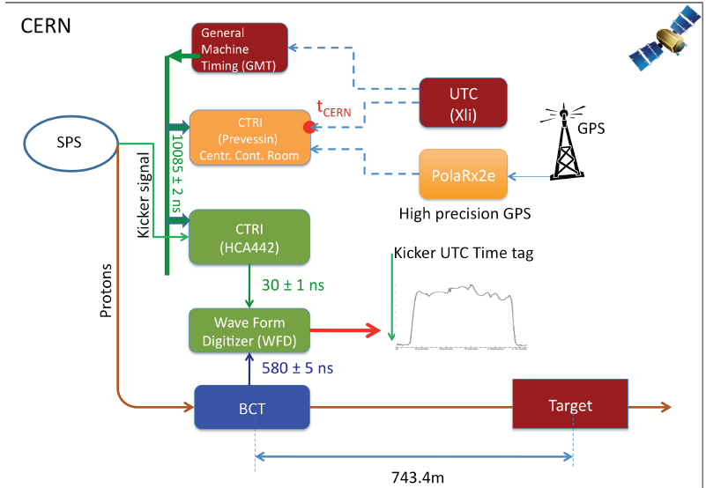
Timing chains

Slide 17
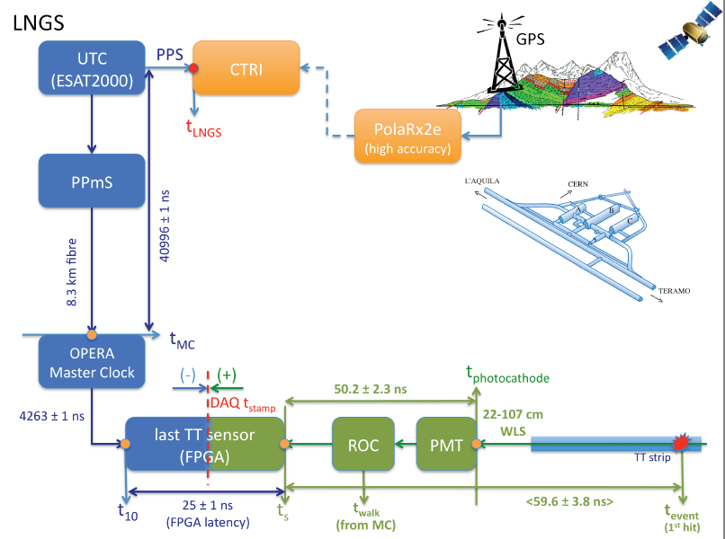
Timing chains
There are some quite large corrections to the raw GPS timestamps, but they seem to be well-known

Slide 18
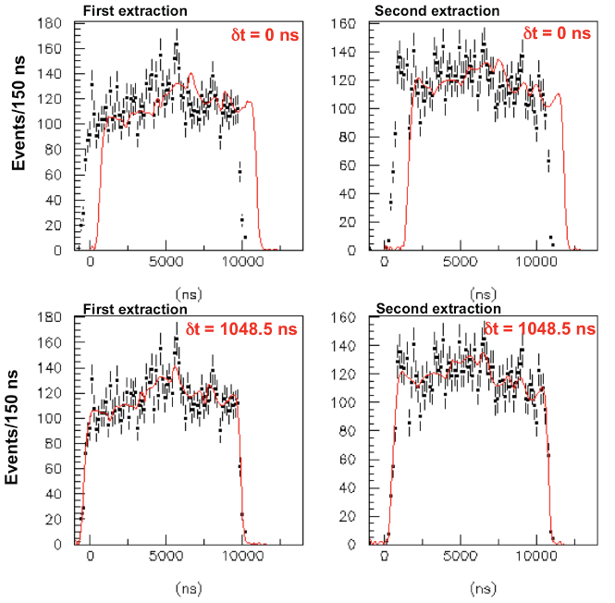
Results
Shift wrt 2006 reference is 1048.5±6.9 ns
Calculated shift is 987.8 ns
Dividing data into sub-samples gives consistent results

Slide 19
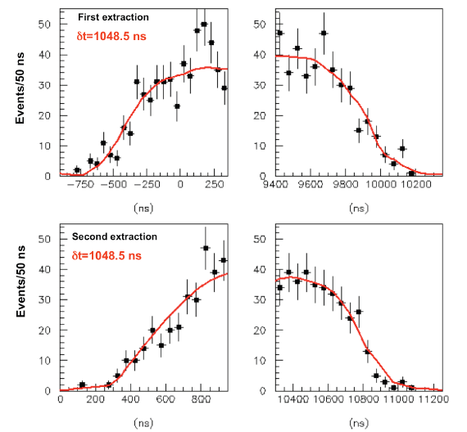
Effect of 60 ns shift
Visually, looks as though most of the signal comes from trailing edge.
Error of ±6.9 ns isn’t ridiculous—if I squash the two second extraction plots together and fit a Gaussian, the mean is ±14 ns, and that’s bound to be less precise than fitting predefined shape.

Slide 20
Conclusion
The GPS synchronisation looks sound
I’m inclined to believe the fit
Corrections for delays inside the experiment are large
possible scope for systematic errors here
if there is a simple error, my guess is that it’s in these corrections
which are difficult to check without crawling all over the equipment

Slide 21
MINOS measurement (2007)
Essentially identical baseline (734 km)
Lower energy beam (mean 3 GeV)
Standard GPS timing (jitter of 100 ns)
Result: δt = −126±32±64 ns, β – 1 = (5.1±2.9) × 10⁻⁵
this is obviously compatible with both the OPERA result and (at 1.8σ) zero
no distortion of energy spectrum or time structure
P. Adamson et al., Phys. Rev. D76 (2007) 072005

Slide 22
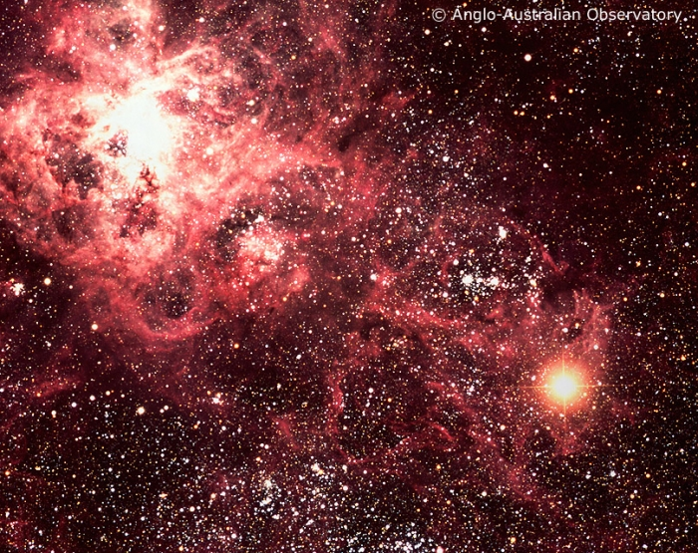
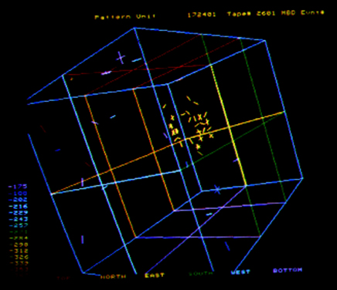
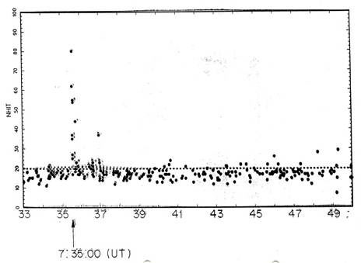
Supernova 1987a
Supernova 1987A
The timeline
The neutrinos
Comparison with the OPERA result

Slide 23
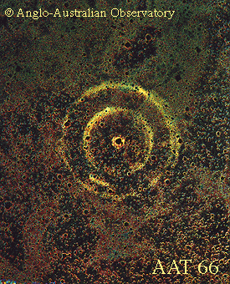
Supernova 1987A
Type II supernova (core collapse of massive star) in Large Magellanic Cloud
satellite galaxy of Milky Way
distance 156000 light years (±3%)
measured using wide variety of methods: well established
includes geometric measurement from SN1987A echo
Neutrinos observed by IMB & Kamiokande-II experiments
IMB events were time-stamped
K-II events weren’t but are at consistent clock time

Slide 24
SN 1987A timeline
Time (UT; 1987 February) | Event
23rd 02:20 | Sk −69 202 at magnitude 12
23rd 07:35:41.374 – 07:35:46.956 | IMB neutrinos (K-II neutrinos at similar, but less precisely known, time)
23rd 10:38 | Visual magnitude 6.5 (McNaught)
24th 05:31 | Discovery image (Ian Shelton)
Neutrinos arrive not more than 3^{h} before the light
This gives β − 1 ≤ 2×10⁻⁹
Note that neutrinos are expected to precede light by ~1^{h}, because of delay between core collapse and envelope expansion

Slide 25
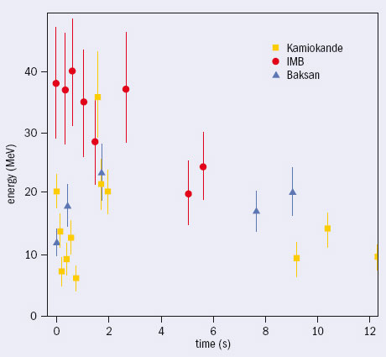
SN 1987A Neutrinos
Energies ~20 MeV
Detected neutrinos mostly ν̄_{e} from inverse β: ν̄_{e} + p → e⁺ + n
some perhaps ν_{e} from elastic scattering
Note that oscillation lengths are very small compared to 156000 ly
neutrino flavours should have more or less randomised en route

Slide 26
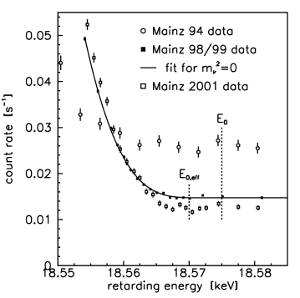
Comparison of OPERA and SN1987A
If we were to interpret OPERA result as a negative m² we’d get −1.4×10¹⁶ eV²!!
SN1987A data require m² > −1.6×10⁶ eV²
tritium β-decay experiments also (now) inconsistent with very negative m²
Mainz (2004) report m² = (−0.6±3.0) eV²
result also inconsistent with neutrino oscillation results at similar energies
Therefore, if real, must affect all flavours but depend on energy
Lorentz non-invariant

Slide 27
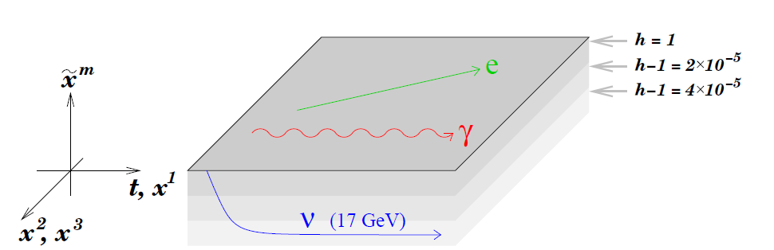
Interpretation
Tachyons (not)
Known physics: group velocity
Known physics: result is wrong
Extra dimensions
Some toy models

Slide 28
Interpretation and Comment
Theoretical opinions include
it’s wrong, and we think we can prove it (Cohen and Glashow)
it may be right, but is understandable in terms of known physics (Mecozzi and Bellini)
it’s the extra dimensions what done it (various)
it’s a new interaction (various)
Constraints
SN1987A
neutrino oscillation results
β – 1 < 4×10⁻⁵ for ν_{μ}, ν̄_{μ} at 80 GeV (Kalbfleisch et al., PRL 43 (1979) 1361)
observation of high-energy atmospheric neutrinos

Slide 29
Tachyons (not)
Superluminal particles are technically allowed by Einstein
E² = p²c² + m²c⁴ where m² < 0
β² – 1 = |m²|/E²
this means that lower energy tachyons travel faster
(zero energy ⇒ infinite velocity!)
severe conflict with supernova results
would give β²(20 MeV) = 1 + (17 GeV)²/(20 MeV)² = 720000
SN neutrinos travel at 850c, arrive about 155 816 years before SN light...
Therefore, “conventional” tachyon is ruled out

Slide 30
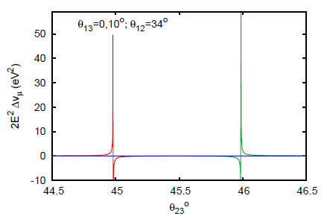
“Known physics”
Use distinction between phase velocity and group velocity
interference between mass eigenstates can produce group velocity >c, even though signal propagation <c
this is not inconsistent with relativity or Lorentz invariance
analysis by Indumathi et al. suggests this effect would occur in very narrow parameter window
expect spectral distortion (not observed)
washes out over long distances
SN1987A OK
Indumathi et al., hep-ph/1110.5453

Slide 31
“It must be wrong”
Cohen and Glashow, hep-th/1109.6562
Argument of Cohen and Glashow:
superluminal neutrino will radiate Z bosons by process analogous to Cherenkov radiation
if E > 2m_{e}c²/(β_{ν}² – β_{e}²)^{1/2}, this leads to e⁺e⁻ pair production as shown
we know electrons aren’t superluminal
many tests of this, both lab-based and astrophysical
so conclude that the effective threshold for this process is 2m_{e}/(β² – 1)^{1/2} = 140 MeV if β – 1 = 2.5×10⁻⁵
implies severe shape distortion of OPERA spectrum (not seen)
inconsistent with observations of high-energy atmospheric ν_{μ}
e⁻
e⁺
Z
ν

Slide 32
“It’s those extra dimensions”
Gruber, hep-th/1109.5687
Principle
on our (3+1)-dimensional brane, photons propagate at speed of light c
neutrinos explore part of the (D – 4)-dimensional bulk, in which maximum speed >c
Problems
energy dependence
why don’t electrons/muons do it (as members of same electroweak doublet)?
plead that effect is related to electroweak symmetry breaking...somehow...
violation of null energy condition T_{MN}ξ^{M}ξ^{N} ≥ 0
(ρ + P ≥ 0, energy density is non-negative)

Slide 33
“It’s those extra dimensions”
This does seem to be a genuine problem:
“To summarize: While it is easy to construct local models where extra-dimensional metrics...allow superluminal propagation, the null energy condition makes it hard to embed these local models into a compactification with reasonable properties, for example the existence of four-dimensional gravity. The difficulties tend to arise especially at the location in the extra dimension where the propagation speed is the fastest. Efforts to escape these difficulties, for example by supposing that the propagation speed is unbounded above, or that it is bounded but the maximum is not attained, have not led me so far to viable constructions which avoid explicit violations of the null energy condition.”

Slide 34
Results from toy models
Cacciapaglia, Deandra, Panizzi, hep-ph/1109.4980
Relate superluminal motion to existence of a Majorana mass term for neutrino
neatly avoids problem of non-observation in charged lepton sector
natural result is Lorentz violating effect described by E² – p² ± E^{α+2}/M^{α} = 0 (in units where c = 1)
the exponent α and the mass scale M are parameters
problem
for large α can satisfy SN1987A bound, but neutrino energy spectrum at MINOS or OPERA should be distorted (it isn’t)
for small α the spectra are OK, but the supernova bound hurts
Maybe not power law? Try other options?

Slide 35
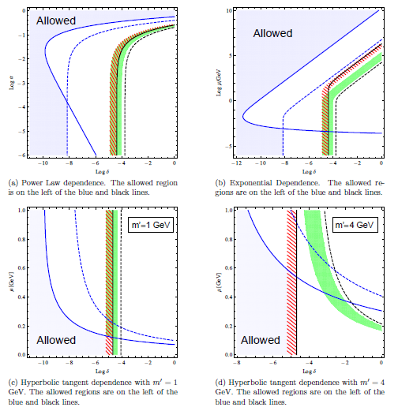
duration of SN1987A neutrino burst
neutrino-photon delay time (10^{h} assumed, generous)
OPERA result
MINOS “result”
MINOS bound
Fermilab bound
You need a “step” between SN1987A and MINOS/OPERA

Slide 36
Conclusion
The experiment was carefully done
if there is an error, it’s subtle and/or deep in the fine detail of experimental set-up
The result is consistent with other measurements at GeV energies
MINOS, and Fermilab high-energy
It is not remotely consistent with SN1987A
need energy dependence
but not too much or spectra at GeV energies get distorted, which isn’t seen
There are no convincing theoretical explanations
First priority must be to establish/refute effect with a different experiment—probably MINOS

Slide 37
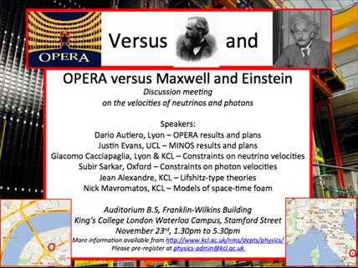
Want to know more?

