Slide 1
Draw a picture that contains
A house
A tree
A river
A pond
A snake

Slide 2
Today you will…
Learn about
Learn how to
The assumptions of the psychodynamic approach
Features of the unconscious mind
Use theoretical concepts to explain behaviours
Discuss the validity of psychological theories

Slide 3
We are learning how to... | We are learning about
Apply psychological ideas Analyse behaviour in terms of latent motives | The psychodynamic approach Anxiety disorders

Slide 4
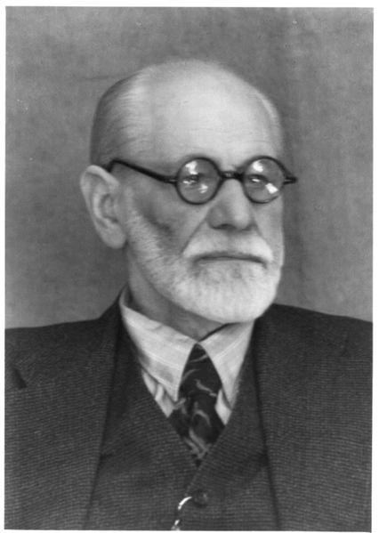
Sigmund Freud
We are animals, driven by basic biological motives
The emergence of society required us to bring our animal impulses under control
Psychology involves understanding how our instincts are channeled to produce civilised behaviour – and what can go wrong with this process.

Slide 5
Assumptions of psychodynamic approach
All behaviour is driven by unconscious thought processes
These thoughts can be manifested in different ways
Our experience as children affects how we develop as adults

Slide 6
What your picture says about you
House = representation of yourself
Pond = your mind
Tree = your relationship with the opposite sex
River = relationship with your mother
Snake = your libido (sex drive)

Slide 7
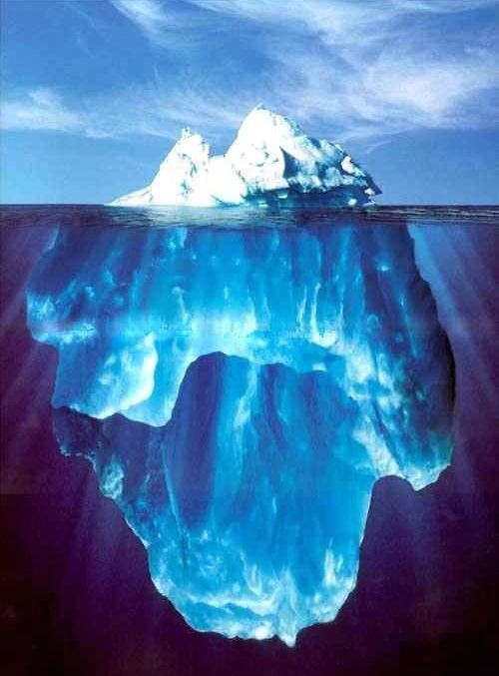
The Unconscious
The conscious. The small amount of mental activity we know about.
Thoughts
Perceptions
Memories
Stored knowledge
Fears
Unacceptable sexual desires
Violent motives
Irrational wishes
Immoral urges
Selfish needs
Shameful experiences
Traumatic experiences
The preconscious. Things we could be aware of if we wanted or tried.
The unconscious. Things we are unaware of and can not become aware of.
Bad
Worse
Really Bad

Slide 8


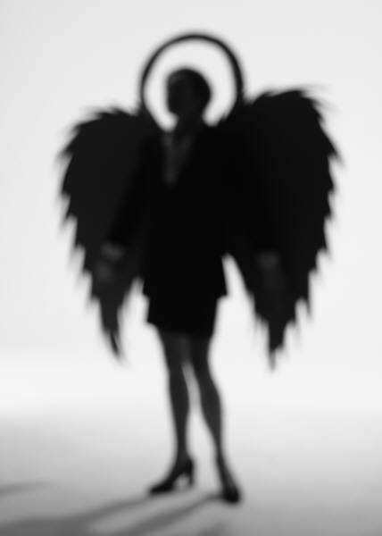
The Psyche (Personality)
I WANT
I WILL
I SHOULD
Id:
Instincts
Ego:
Reality
Superego:
Morality

Slide 9
In groups of 3
You need to assign yourselves the roles of Id, Ego and Superego – together you represent a person’s psyche
Each of you needs to think about your own role, and how you influence personality
Discuss how your personality would be different depending on whether Id, Ego or Superego was ‘in charge’

Slide 10
How would each respond if…
Your mum has baked a cake and left it on the kitchen table
You work in a shop – someone has overpaid you and apparently not noticed
You’ve just met your best friend’s boyfriend and really fancy him

Slide 11
Healthy Psyche
OK Guys – I’m in charge. Anything you want has to go through me.
OK.
OK.
Ego
Id
Superego

Slide 12


Psychotic
Sex! Food! Drink! Drugs! NOW!
Who turned out the lights?
Id
Ego
Superego

Slide 13
Neurotic
Listen up! I’m in charge, and you are not here to enjoy yourselves. Get ready for a double-size portion of anxiety with a side order of guilt!
No fun.
>whimper<
Superego
Id
Ego

Slide 14
Motives
We have two sets of motives:
Latent motives – the unconscious forces that drive our behaviour
Manifest motives – the lies we tell ourselves to protect us from the truth
Ego defence mechanisms turn latent motives into manifest ones

Slide 15
Ego defence mechanisms
Reaction formation | Behaving in ways directly opposite to unconscious impulses, feelings. | Manifestly liking your boss when really you hate them.
Displacement | Transferring impulses and feelings to an originally neutral or innocent target. | Kicking the cat instead of kicking your boss (the target changes).
Sublimation | Redirection of threatening impulses to something socially acceptable | Playing football instead of punching your boss (the activity changes).

Slide 16
Explaining anxiety disorders
Phobia
OCD
Unconscious fears are too unpleasant for the conscious mind to deal with
These are displaced onto a different target which presents a less threatening problem
The phobic stimulus is not the real cause of anxiety
The id generates unacceptable aggressive or sexual impulses.
The ego disguises their true nature.
The superego reacts to them with guilt and anxiety
The ego causes compulsive behaviours to compensate.

Slide 17
Homework
Analyse the example case studies and suggest
What the underlying cause of the anxiety might be
How ego defence mechanisms have resulted in the manifest behaviours
Don’t forget these important points:
Everything is a product of the unconscious
Ego defence mechanisms can (in theory) produce a very wide range of behaviours

