Slide 1
Tricks to multiplicaation
tables.
Magic 9
x9
x9
Mark Symmonds – Chatsworth International School, Singapore

Slide 2
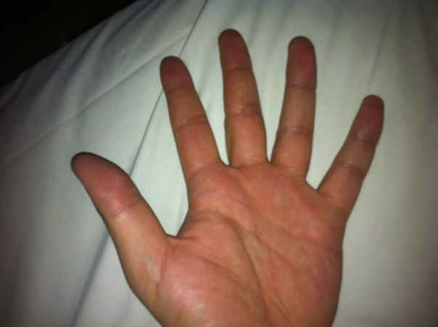
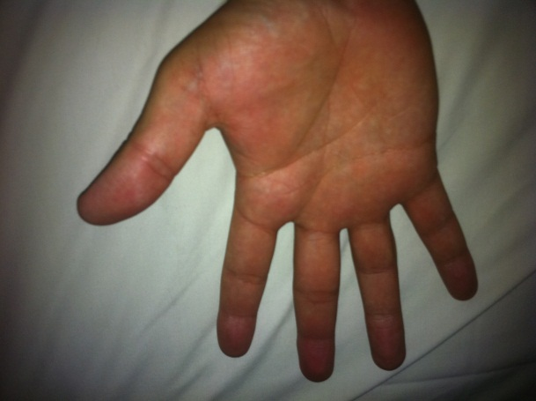
Lets first look at an easy way to work out
the first ten calculations in the 9 x table…
To do this we will need to use our ten fingers
Open your hands so you are looking at your
fingers like this…

Slide 3
Open your hands so you are looking at your
fingers like this…
Just like when we count, start from
the left.
1, 2, 3, 4, 5, 6…

Slide 4
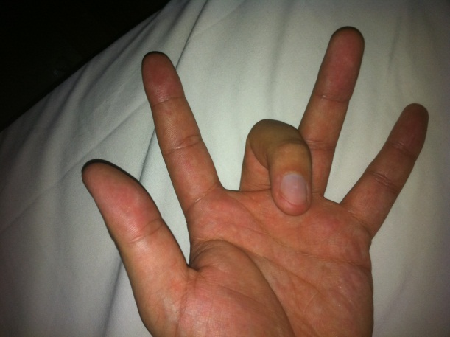
So…
Lets work out 3 x 9.
As we are looking for 3 multiplied by 9 we count across to our 3rd finger and move it down.
2
3
1

Slide 5
Marker finger as you are looking
for 3 multiplied by 9
To the left are the tens
To the right are the units

Slide 6
Lets work out 3 x 9.
3 x 9 =
Marker Finger
1 x 9 = 9
2 x 9 = 18
3 x 9 = 27
4 x 9 = 36
5 x 9 = 45
1
4
5
6
2
3
2
7
1
To the left are the tens
To the right are the units

Slide 7
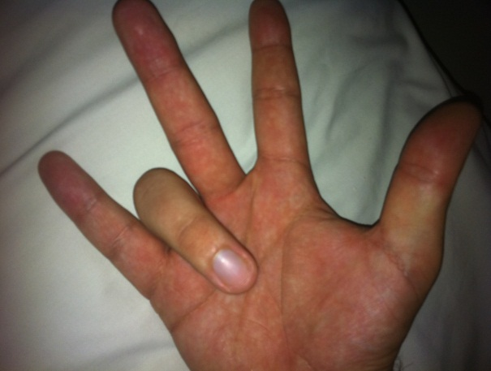
Lets work out 7 x 9.
7 x 9 =
Marker Finger
1 x 9 = 9
2 x 9 = 18
3 x 9 = 27
4 x 9 = 36
5 x 9 = 45
6 x 9 = 54
7 x 9 = 63
8 x 9 = 72
9 x 9 = 81
10 x 9 = 90
3
1
2
4
2
5
6
3
1
To the left are the tens
To the right are the units

Slide 8
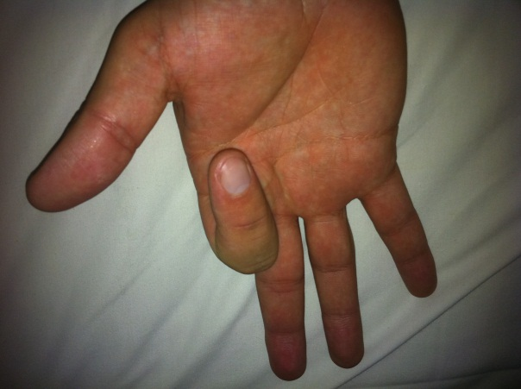
Lets work out 9 x 9.
9 x 9 =
1 x 9 = 9
2 x 9 = 18
3 x 9 = 27
4 x 9 = 36
5 x 9 = 45
6 x 9 = 54
7 x 9 = 63
8 x 9 = 72
9 x 9 = 81
10 x 9 = 90
Marker Finger
7
8
3
4
2
5
6
1
1
To the left are the tens
To the right are the units

Slide 9
Are there any patterns you notice when
looking at the nine times table?
1 x 9 = 9
2 x 9 = 18
3 x 9 = 27
4 x 9 = 36
5 x 9 = 45
6 x 9 = 54
7 x 9 = 63
8 x 9 = 72
9 x 9 = 81
10 x 9 = 90
11 x 9 = 99
12 x 9 = 108

Slide 10
What do you notice about the amount you
are multiplying by 9 and the tens digit of the answer?
The tens digit is always one less than the number you are dividing!
Remember there are no tens digit in 1 x 9 as the answer is 0 tens and 9 units!
2
x
9
=
1
8
3
x
9
=
2
7
4
x
9
=
3
6
10
x
9
=
9
0
This pattern only works up until
10 x 9

Slide 11
All the answers add up to 9…
9 added to nothing equals 9
1 x 9 = 9
2 x 9 = 18
3 x 9 = 27
4 x 9 = 36
5 x 9 = 45
6 x 9 = 54
7 x 9 = 63
8 x 9 = 72
9 x 9 = 81
10 x 9 = 90
11 x 9 = 99
12 x 9 = 108
9
x
1
=
9
9
x
2
=
1
8
9
+
=
9
x
3
=
2
7
9
+
=
9
x
7
=
6
3
9
+
=

Slide 12
So far we have learnt…
If you add both the digits of the answer together they will always equal 9.
4 x 9 = 36
So if we take 7 x 9…
The tens column in the answer is always one less than the one you are multiplying.
We know the answer will start with?
6
And the two digits added together make nine so 6 and what make 9?
3
So we know that the answer is 63.

Slide 13
So do larger numbers multiplied by 9
always equal 9?
9
x
21
=
1
8
9
1
8
+
+
=
9
+
=

Slide 14
So do even larger number multiplied by 9
always equal 9?
9
x
350
=
3
1
5
0
+
9
+
+
=

Slide 15
Why don’t you test super big numbers and
see when multiplied by 9 if they add up to 9.
So do EVEN larger number multiplied by 9
always equal 9?
9
x
1981
=
1
7
8
2
9
2
7
+
+
+
+
=
+
9
=

Slide 16
Extension Group
How can we work out multiplying 99 by
a number?
We know… 100 x 5 = 500
So to multiply by 99 it would just be one set less.
So in this case just 5 less than 500
Which is 495.
So…
99 x 5 = 495

Slide 17
99 x 20 =
We know… 100 x 20 =
2000
so…
20 less than 2000 is?
1980
so…

Slide 18
99 x 55 =
We know… 100 x 55 =
5500
so…
55 less than 5500 is?
5445
so…

Slide 19
99 x 123 =
We know… 100 x 123 =
12300
so…
123 less than 12300 is?
12177
so…

Slide 20
On your mini whiteboards show me if you
can use the same logic for multiplying by…
999
And once you’ve mastered that try
9,999

