Slide 1


Collisional-Radiative Modeling of EBIT Spectra of High-Z Ions
Yuri Ralchenko
National Institute of Standards and Technology
Gaithersburg, MD 20899
ADAS Workshop, October 6-8 2011
Supported in part by the Office of Fusion Energy Sciences,
U.S. Department of Energy

Slide 2
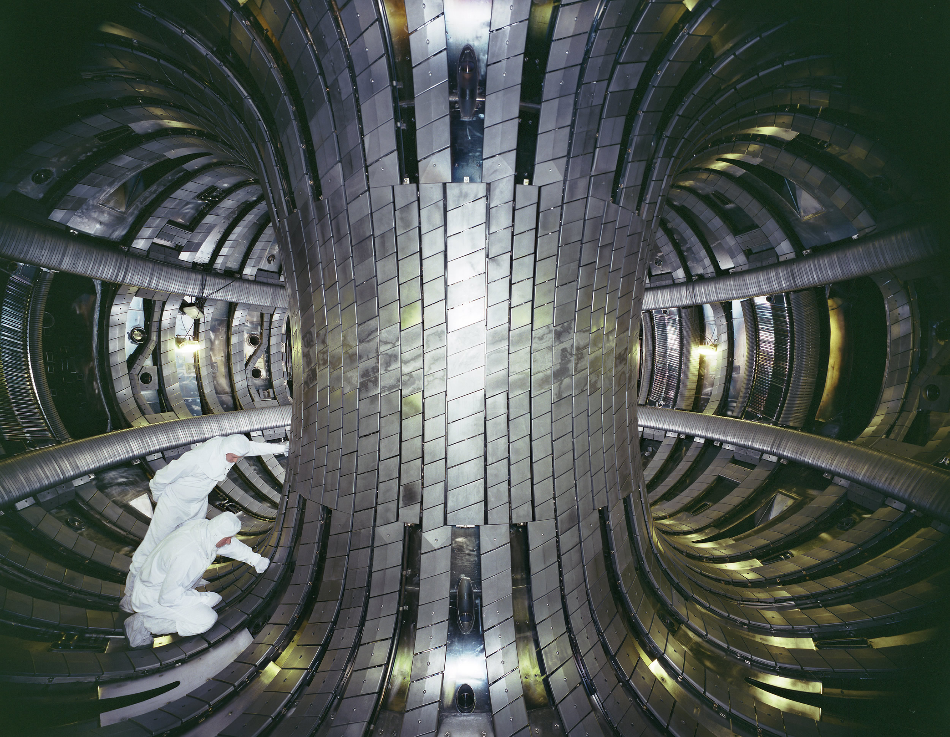
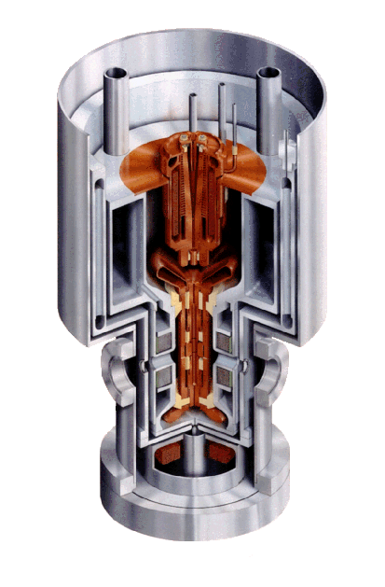
Electron
Beam
Ion
Trap

Slide 3
NIST EBIT: main characteristics
Many operate, a few under construction
“Table-top” device
Low electron density
N_{e} ~ 10¹² cm⁻³
Monoenergetic electrons
E_{beam} = 1-30 keV
Width ~ 60 eV
Localized volume
Continuous operation
~Any ion of any element
Effective injection of heavy ions (W, Hf, Ta, Au…)

Slide 4
Physical processes in EBIT
Important
Radiative
Electron-impact excitation, deexcitation, ionization
Radiative recombination
Charge exchange
Relative velocity and density of neutrals are not well known
Not so much…
Three-body recombination
Dielectronic recombination (may be accidentally important)

Slide 5
Collisional-Radiative Modeling of High-Z Plasmas
Non-Maxwellian time-dependent CR code NOMAD
Yu. Ralchenko and Y. Maron, JQSRT 71, 609 (2001)
Various options for atomic data input
Account of plasma effects
Used for diagnostics of various plasmas (laser-produced, astrophysical, fusion, EBIT)
Atomic data from Flexible Atomic Code (FAC)
M.F. Gu, Can. J. Phys. 86, 675 (2008)
Relativistic model potential; Dirac equation; QED corrections
Distorted wave approximation; Coulomb-Born
Well suited for highly-charged high-Z ions
Consistency: all relevant parameters in one run
Typical model for EBIT:
7-8 ions
~10³ levels/ion
Several million transitions

Slide 6
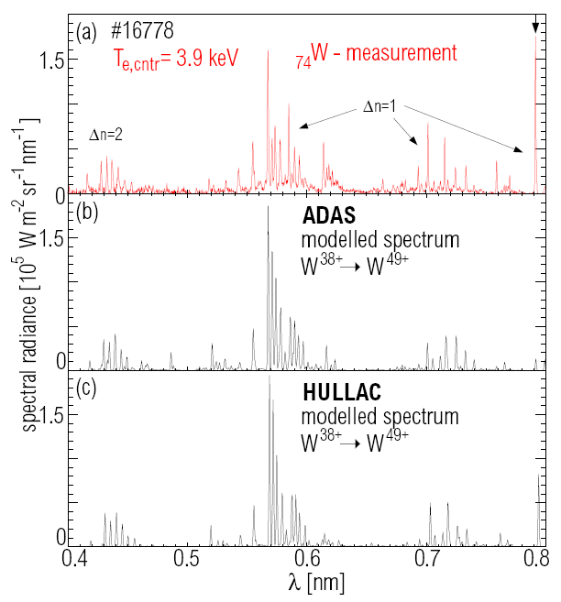
W spectra from ASDEX Upgrade tokamak (4 keV)
T. Pütterich,
Ph.D. thesis (2005);
R. Neu et al,
Nuclear Fusion
45, 209 (2005)
7.93 Å in W⁴⁶⁺
3d¹⁰-3d⁹4s
E2 line? M3 line?

Slide 7
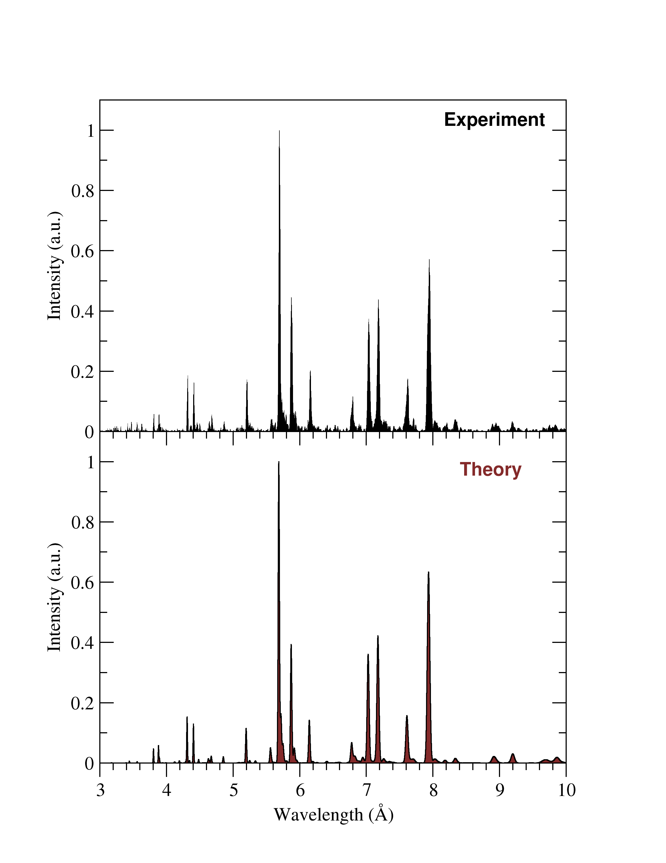
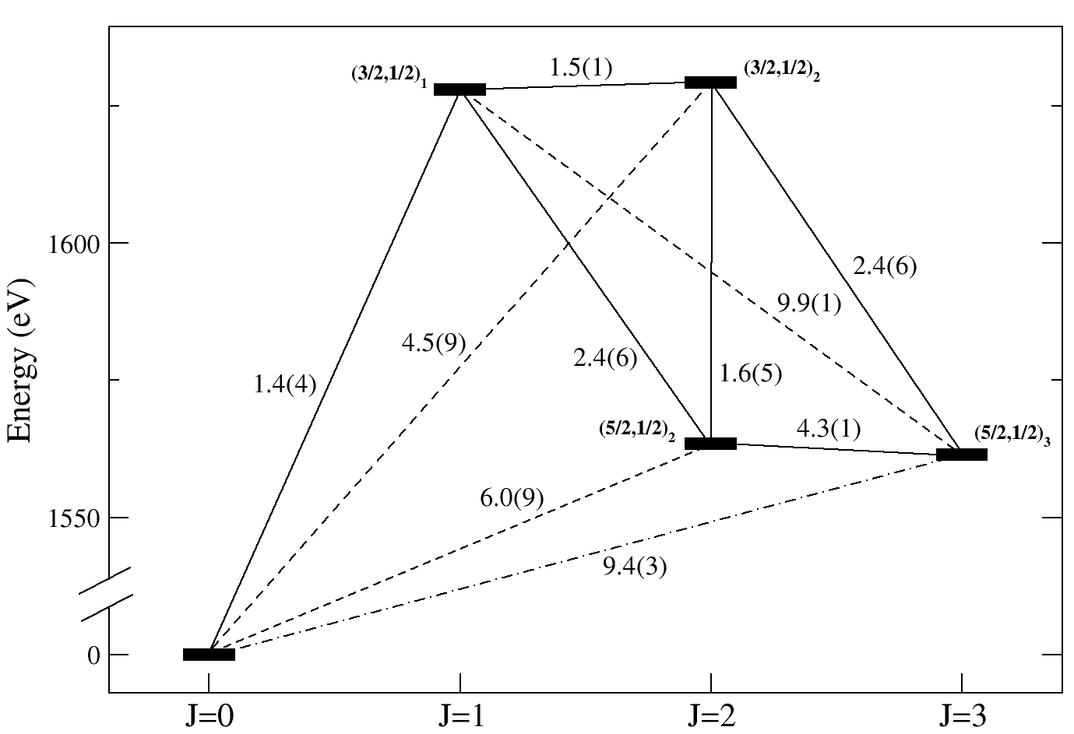
EBIT X-ray measurements (E_{b} ≈ 4 keV)
Mainly Ni-like W⁴⁶⁺
3-4
3d¹⁰-3d⁹4s
3d⁹4s
E2
M3
3d¹⁰
M1
E2
M3
Line intensity: I=N·A·E
I(E2):I(M3) = 4:3
S. Loch et al, 2006:
Can M3 survive in fusion plasmas?..
Yu. Ralchenko et al, Phys. Rev. A 74, 042514 (2006)

Slide 8
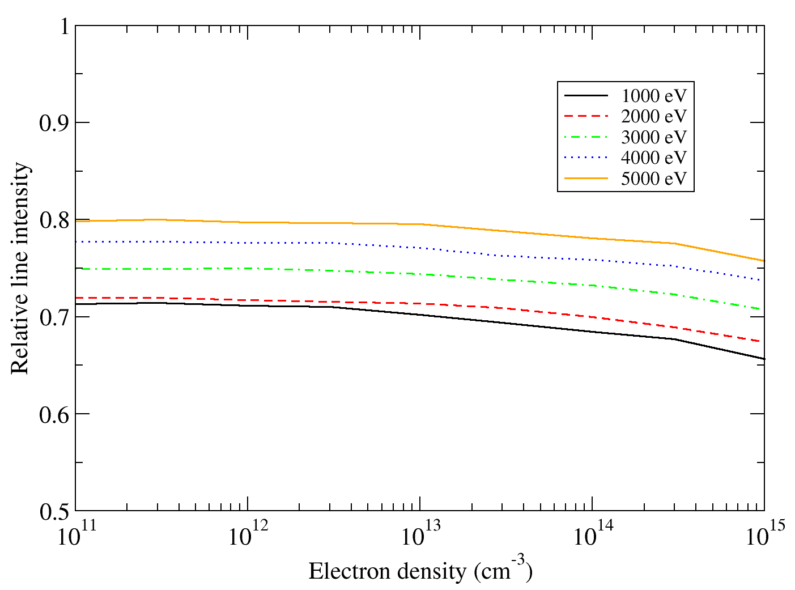
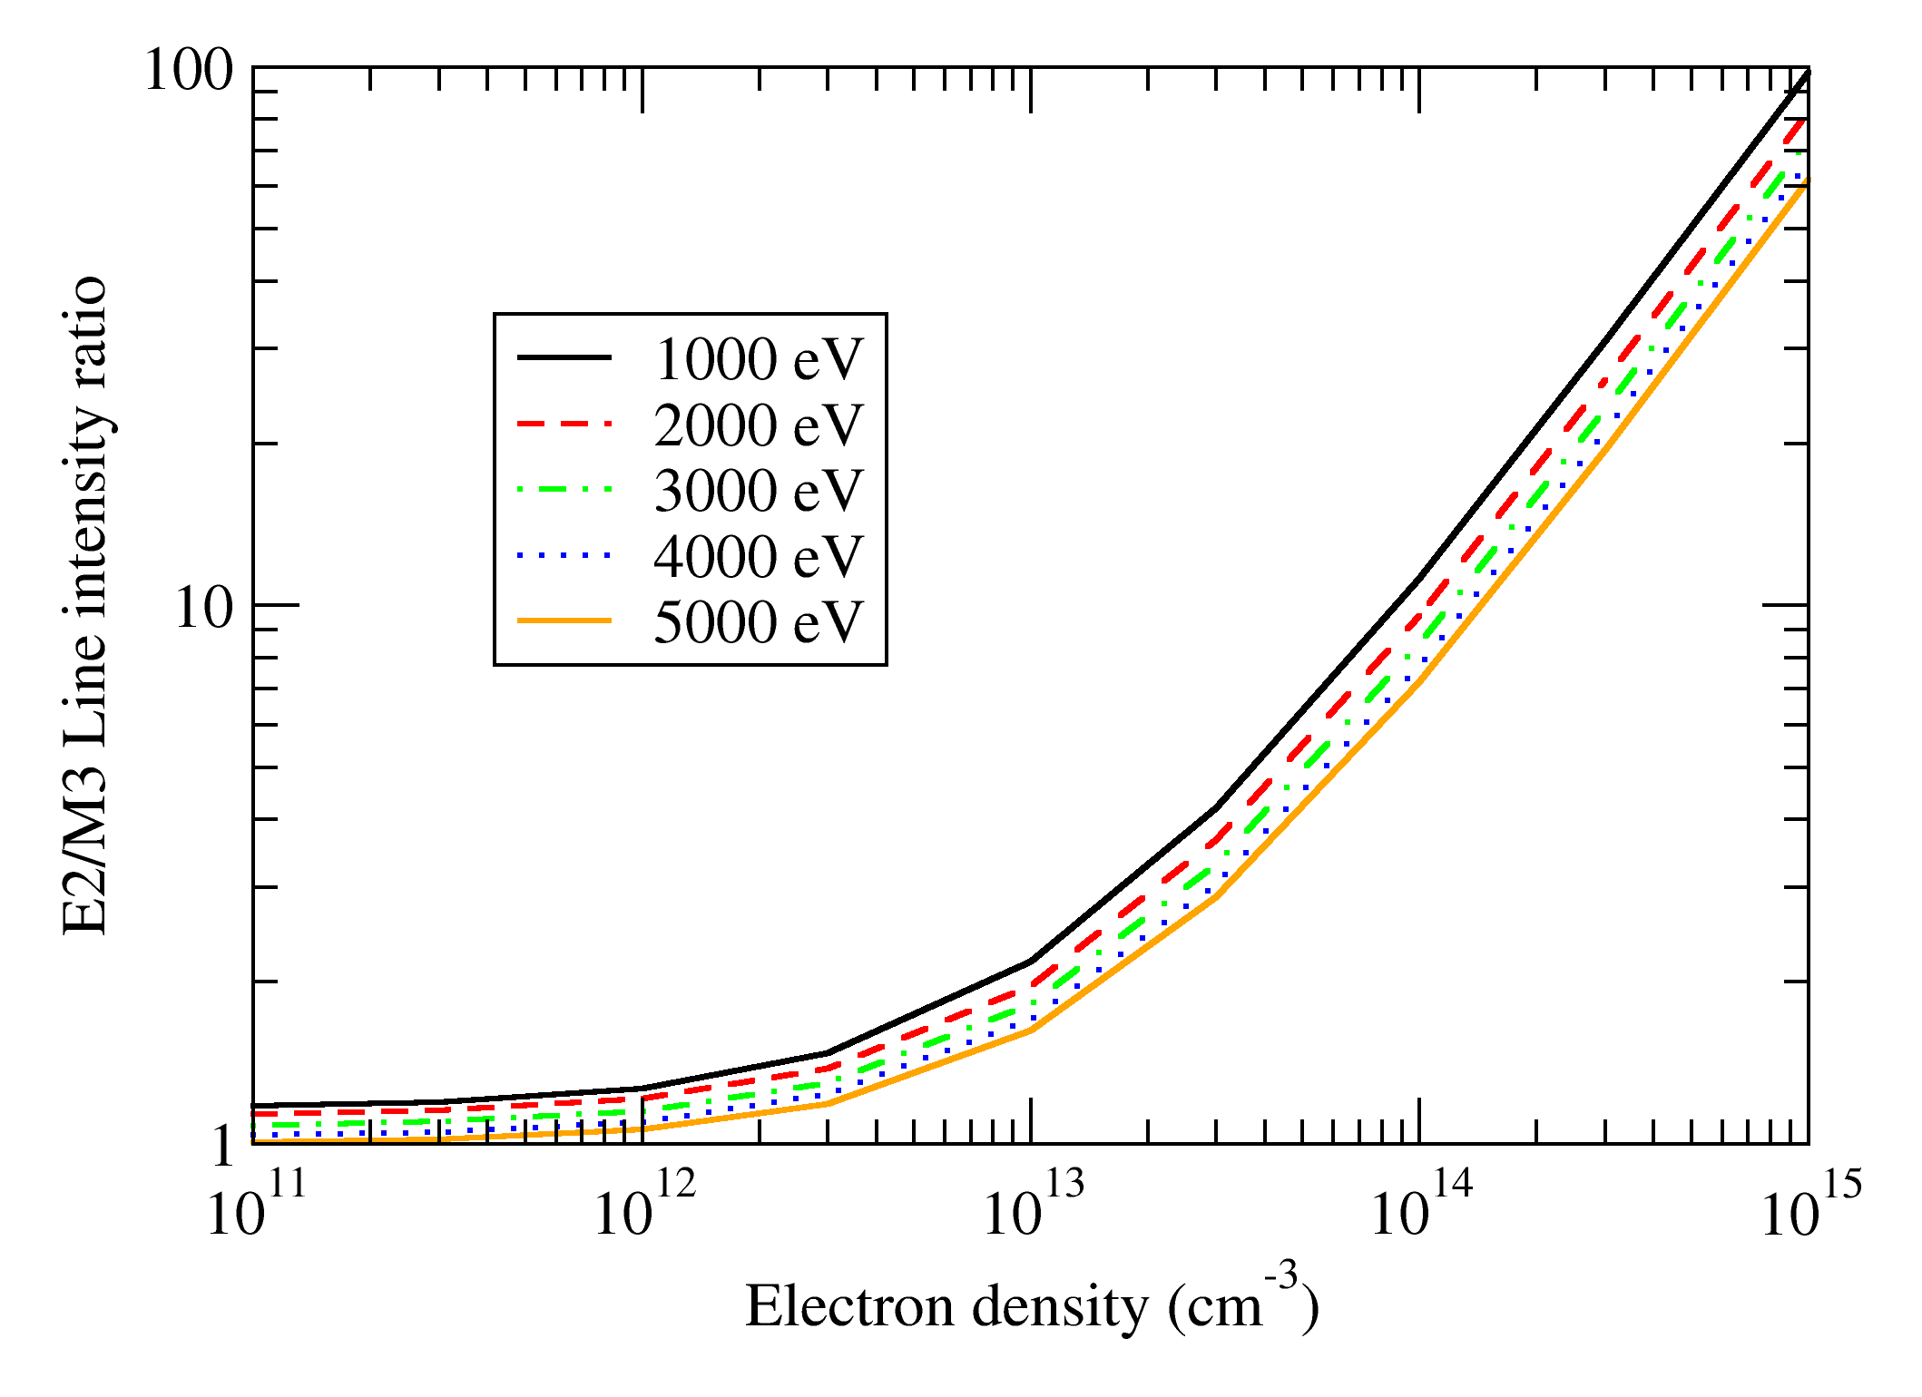
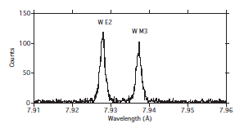
E2/M3 ratio is sensitive to density
E2+M3
E2/M3
E2 and M3 were recently resolved in
Clementson et al, PRA 81, 012505 (2010)

Slide 9
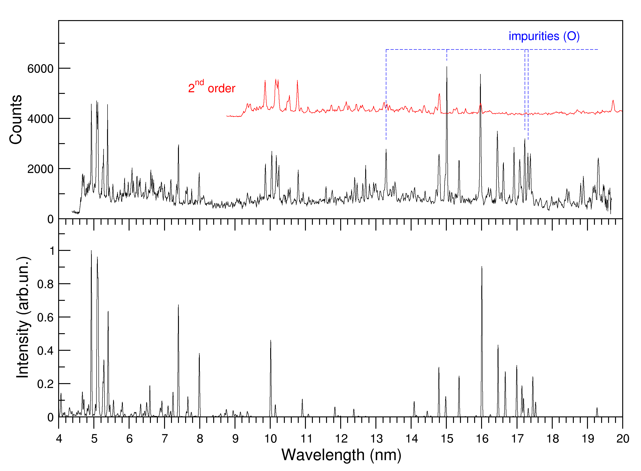
Experiment vs theory (W, E_{beam} = 8.8 keV)
Ions included:
[Ca]-[F]
6600 levels
Charge exchange
the only free parameter
EXP
W⁵⁸⁺
W⁵⁵⁺
W⁵⁶⁺
W⁵⁷⁺
THEO
n=3-n=3
transitions
E1 and M1
W⁵⁹⁺
W⁶⁰⁺
W⁶¹⁺
W⁶²⁺
W⁵⁴⁺
Ionization balance and T_{e} diagnostics
J.Phys. B 41, 021003 (2008)

Slide 10
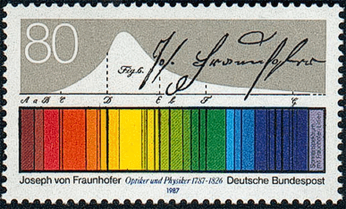
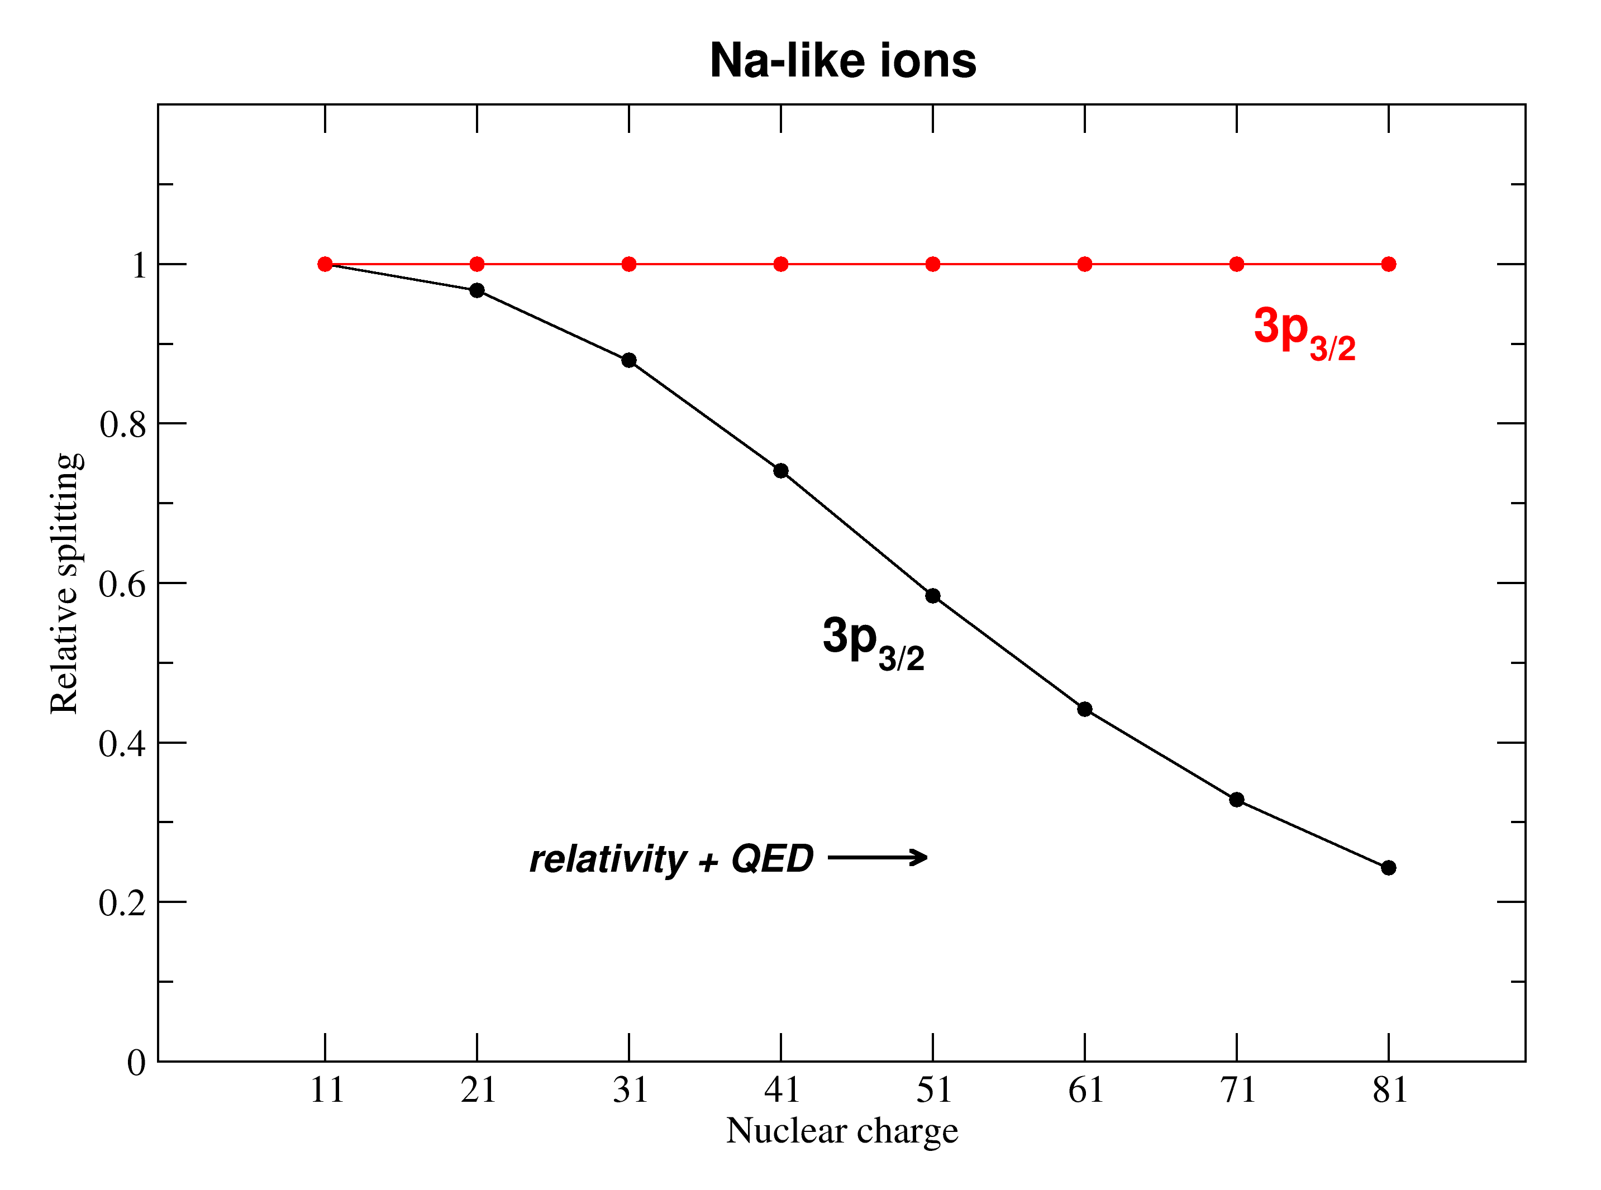
Na-like doublet in highly-charged ions
2
1
D₂
5896 Å
D₁
5890 Å

Slide 11
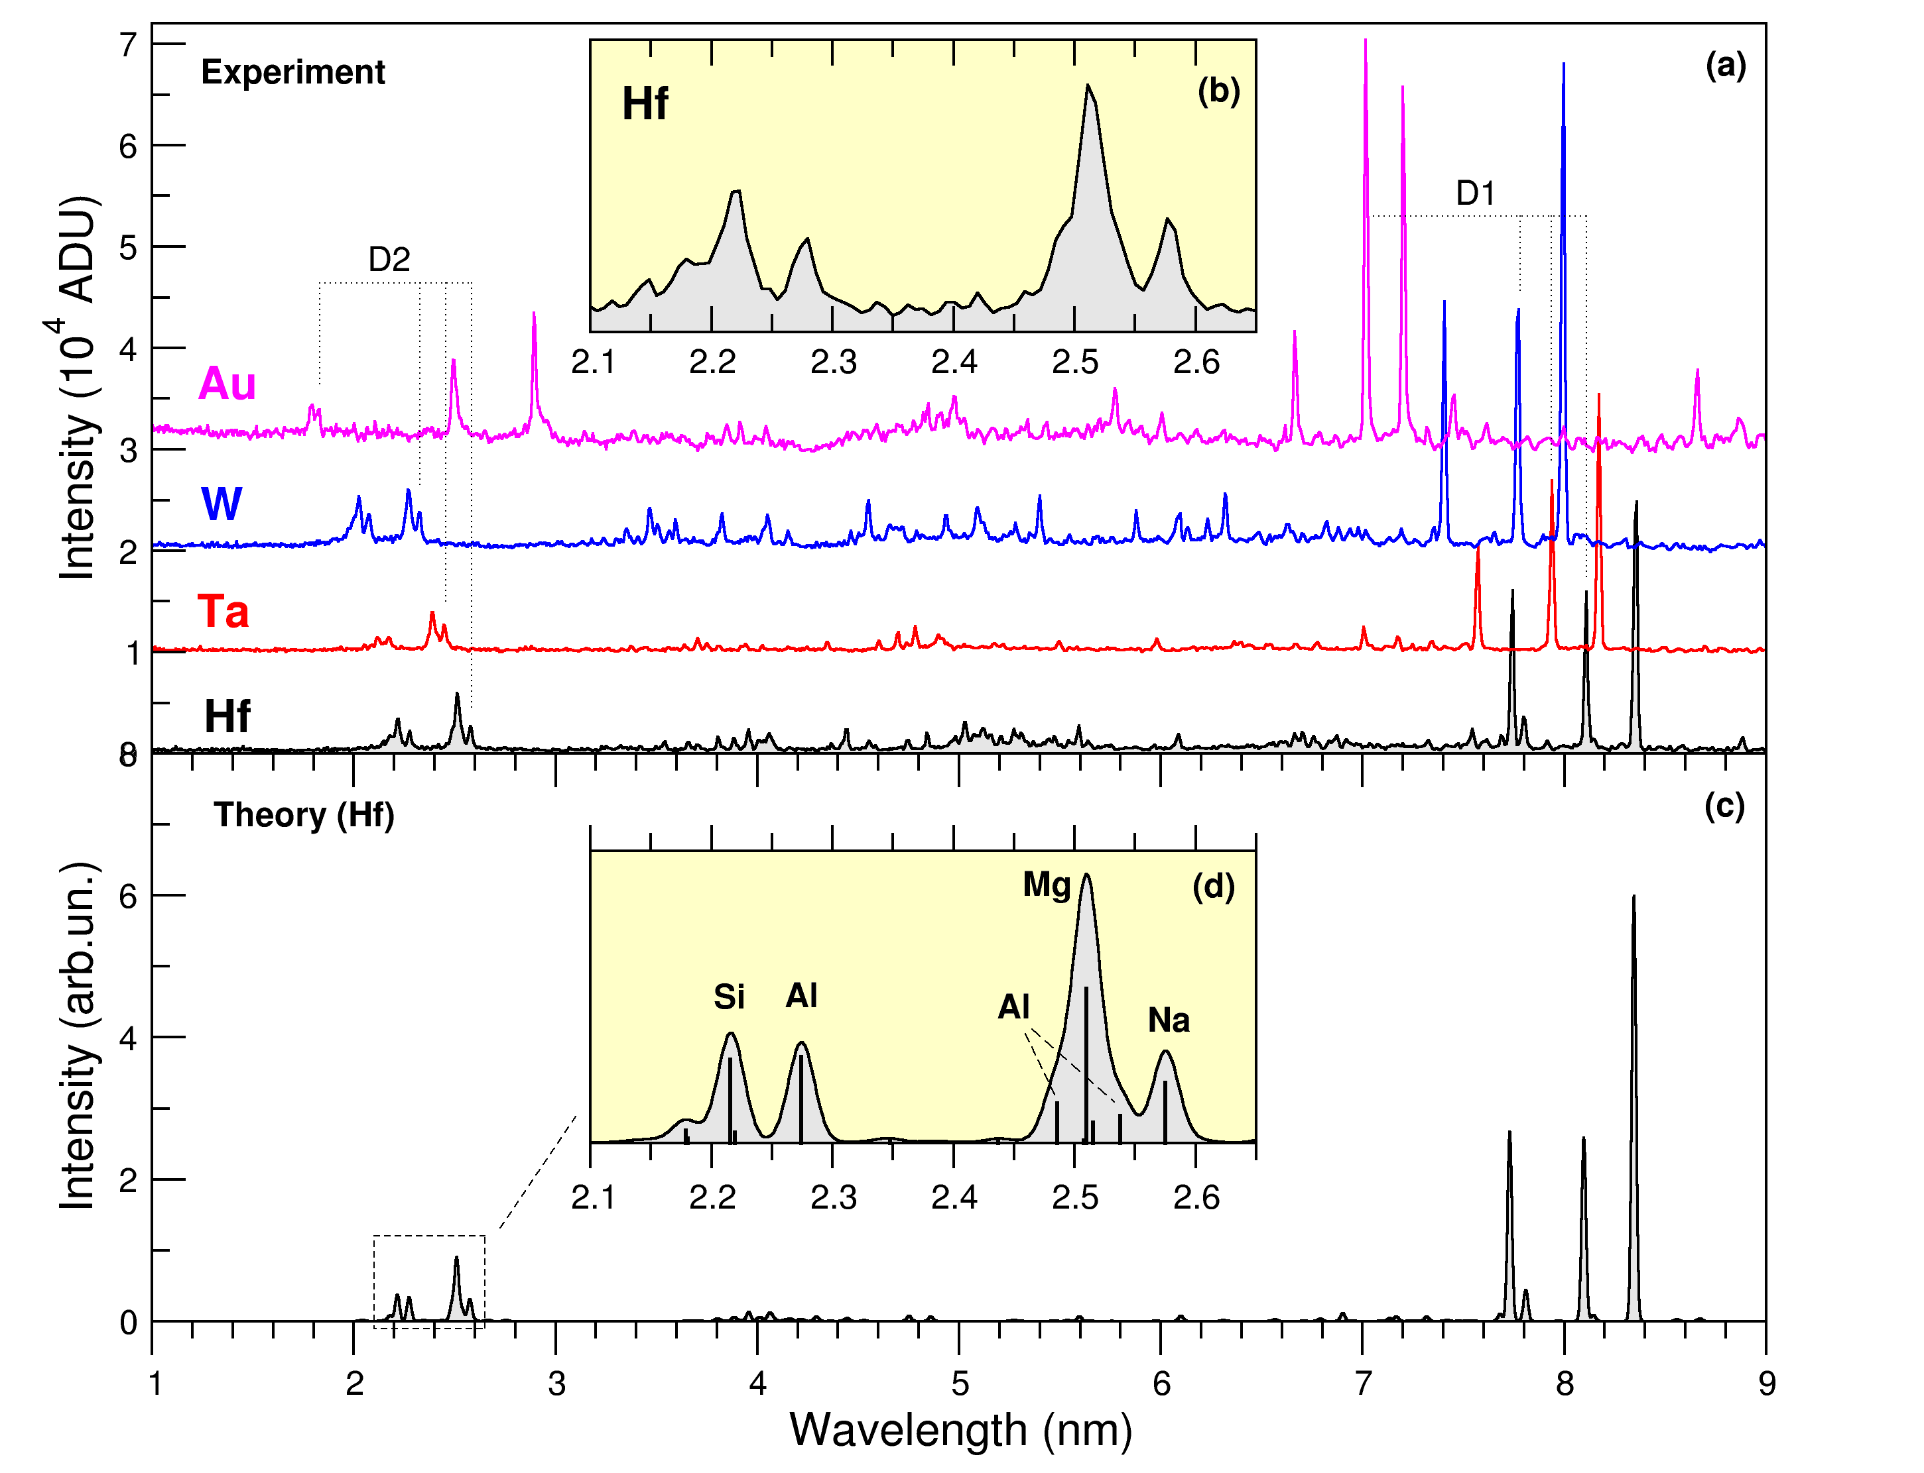
D-doublet in Na-like W, Hf, Ta, and Au
J.D. Gillaspy et al,
Phys. Rev. A 80,
010501 (2009)
E_{b} ≈ 12 keV
Calculated spectrum
is convolved with the
spectrometer
efficiency curve

Slide 12
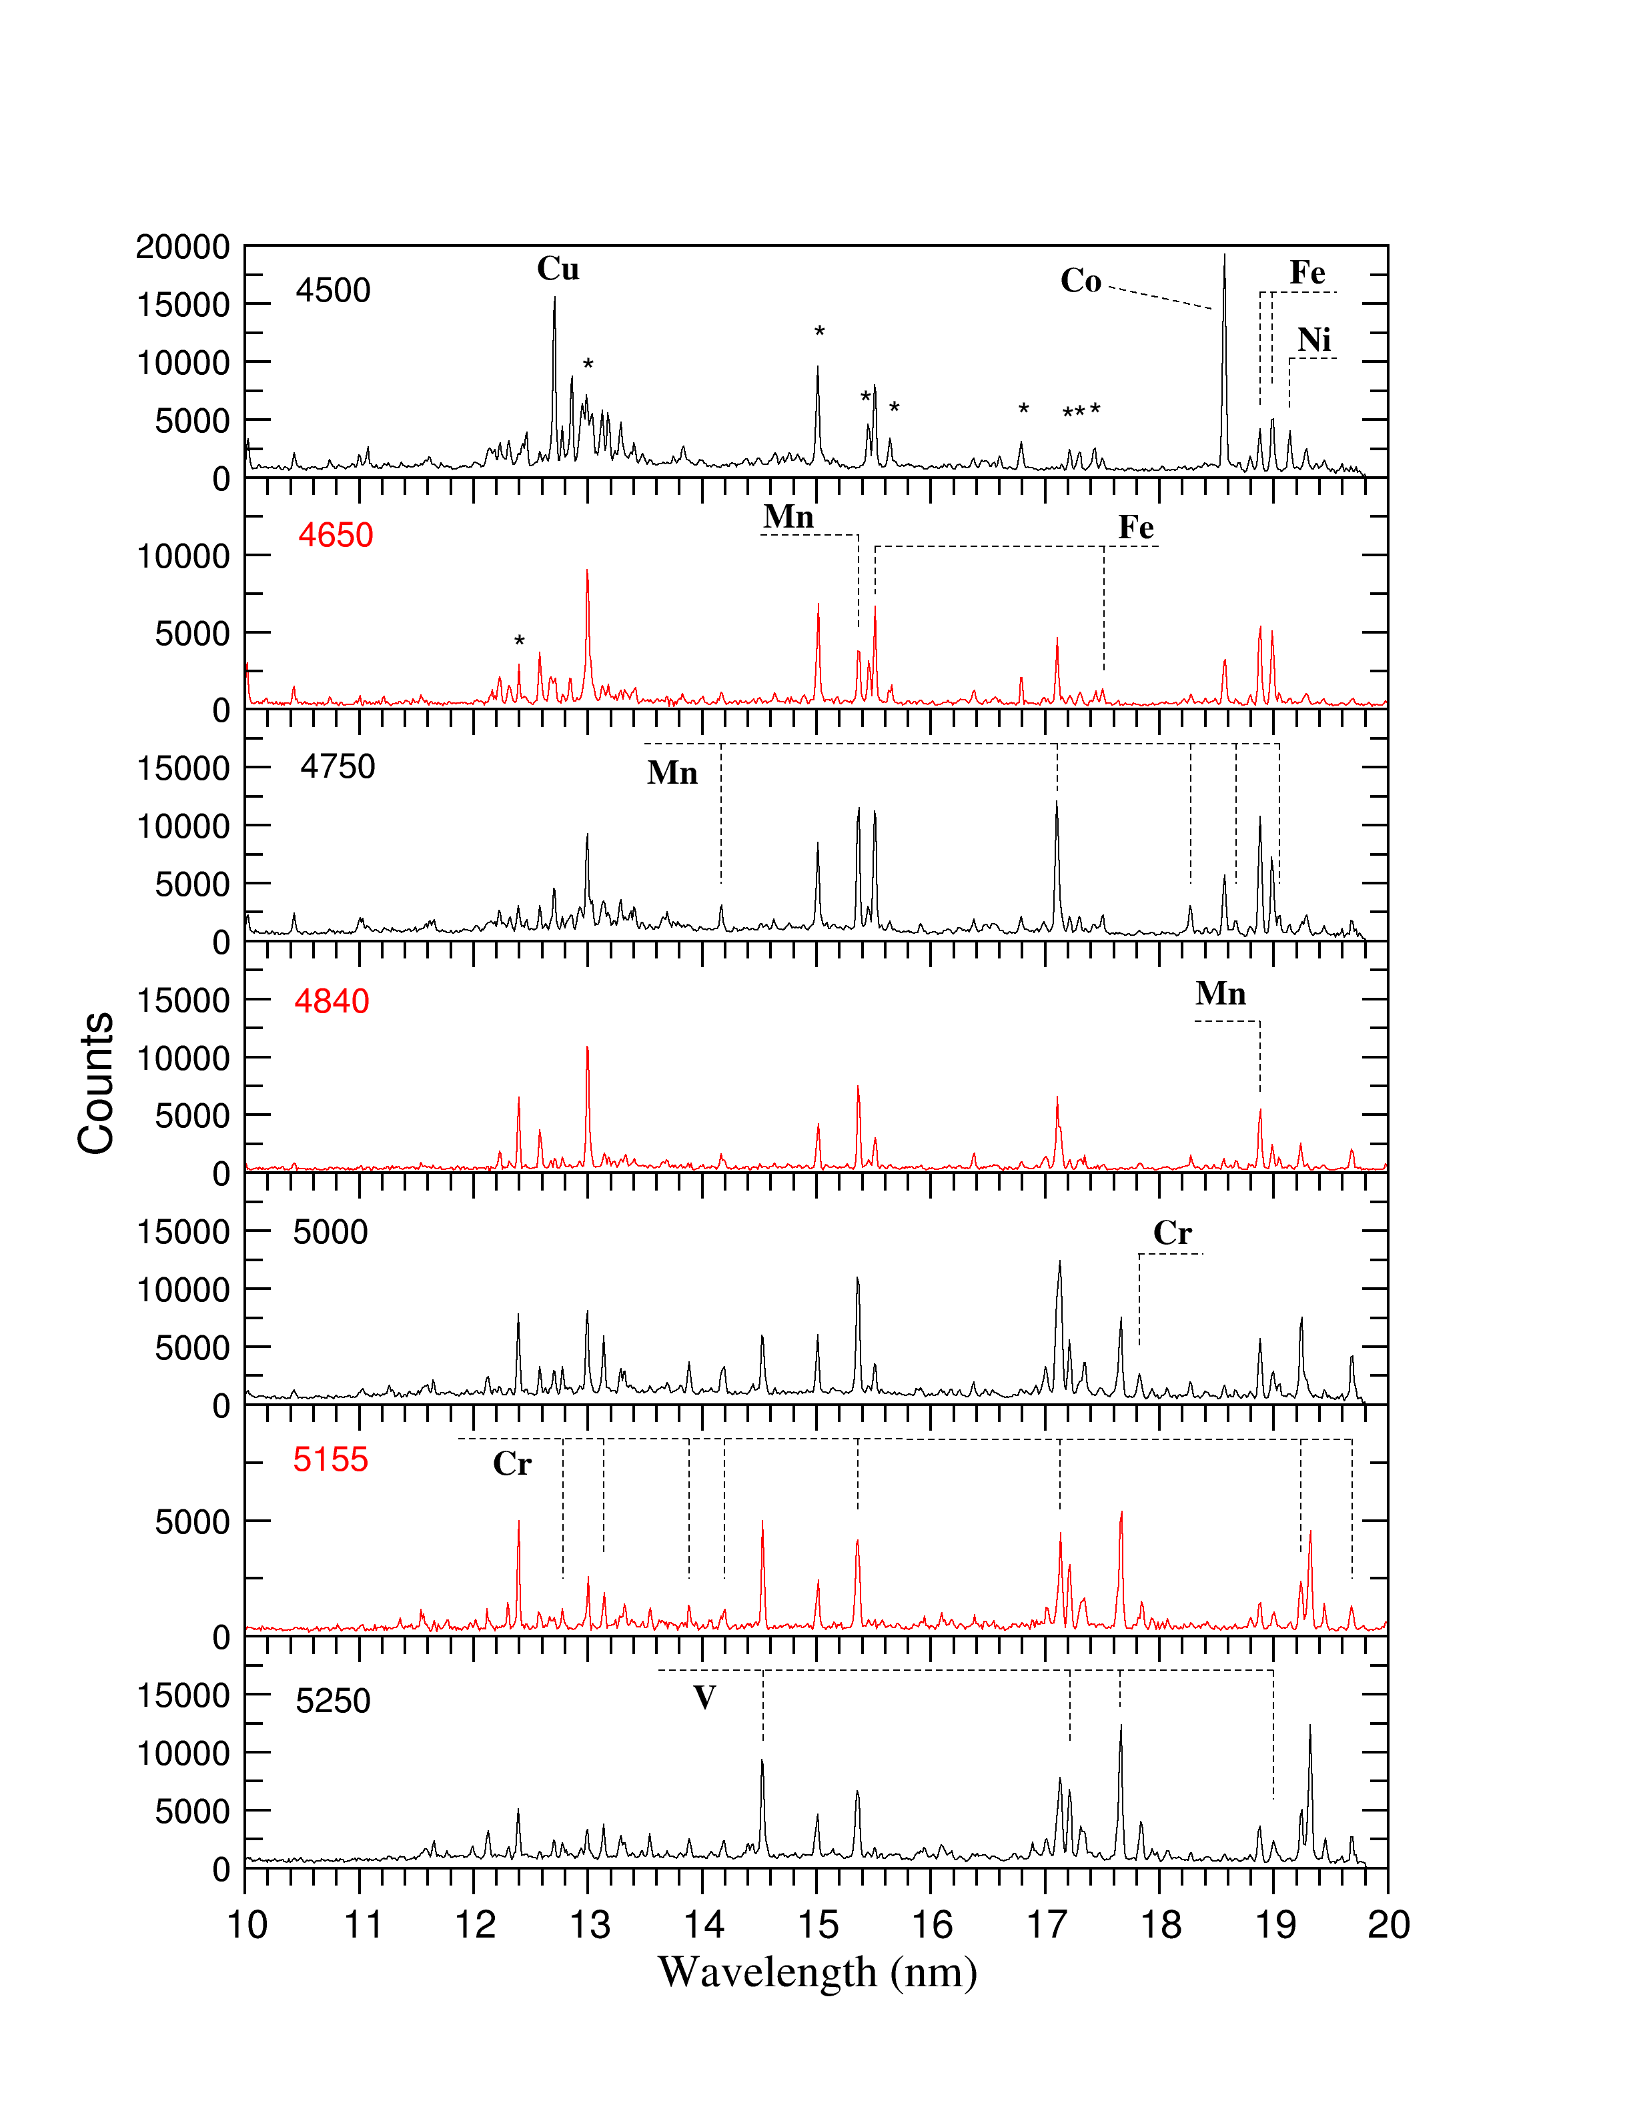
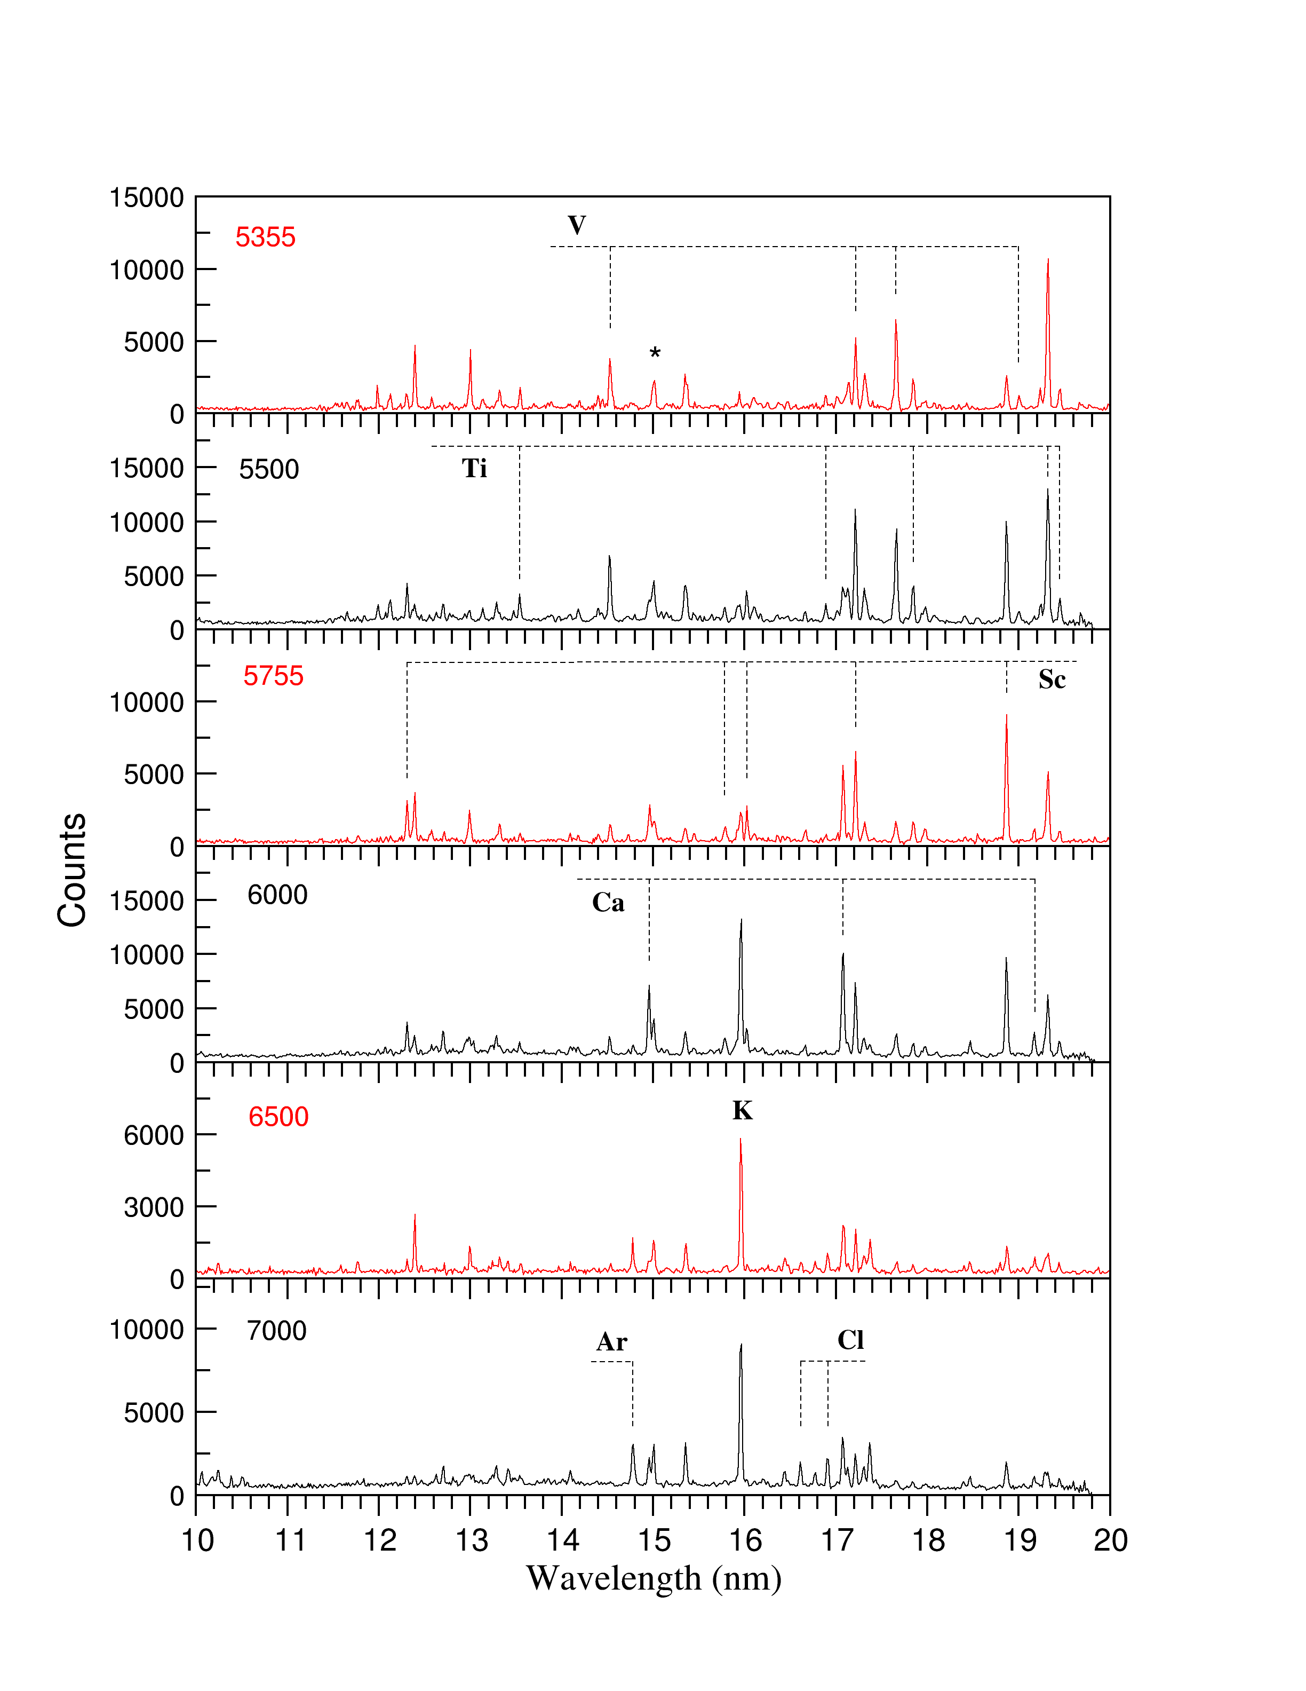
(Only!) M1 Lines in 3d^{n} Ions of W
Co 3d⁹ 4180 eV
Fe 3d⁸ 4309 eV
Mn 3d⁷ 4445 eV
Cr 3d⁶ 4578 eV
V 3d⁵ 4709 eV
Ti 3d⁴ 4927 eV
Sc 3d³ 5062 eV
Ca 3d² 5209 eV
K 3d 5347 eV
Yu.Ralchenko et al, Phys. Rev. A 83, 032517 (2011)

Slide 13
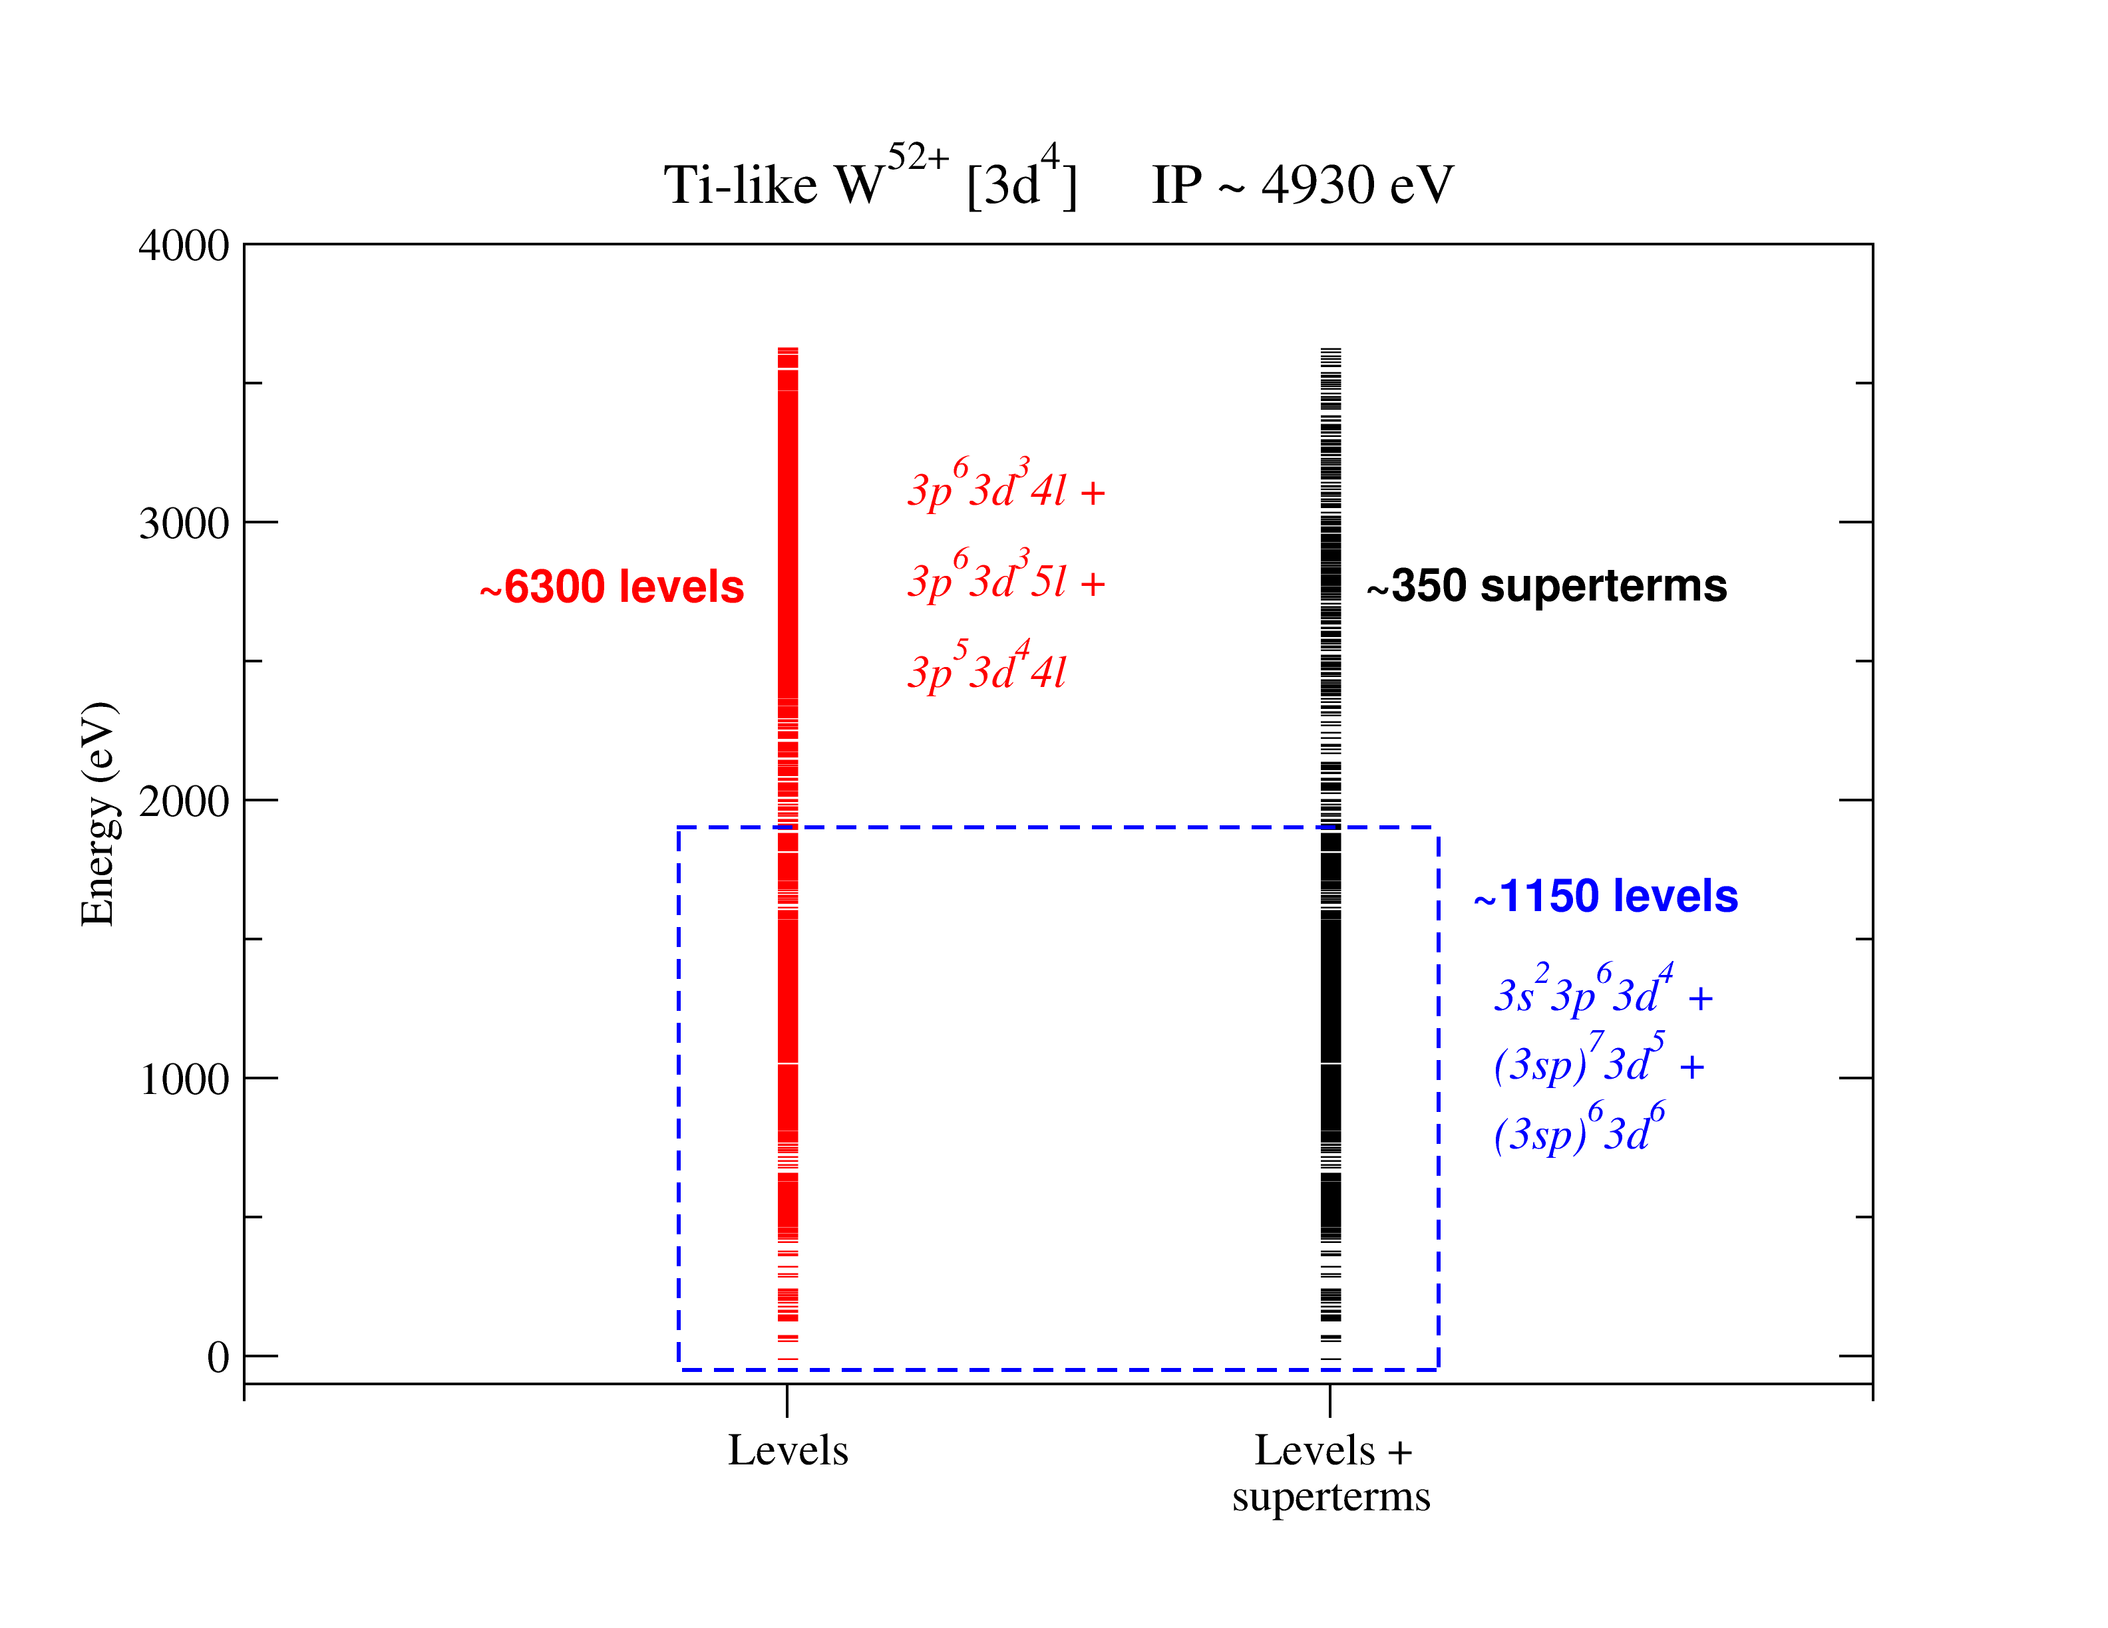
Level grouping
Problem
too many levels per ion (~10⁴)
Consider 3d^{n-1}kl:
Provides sufficiently
dense representation

Slide 14
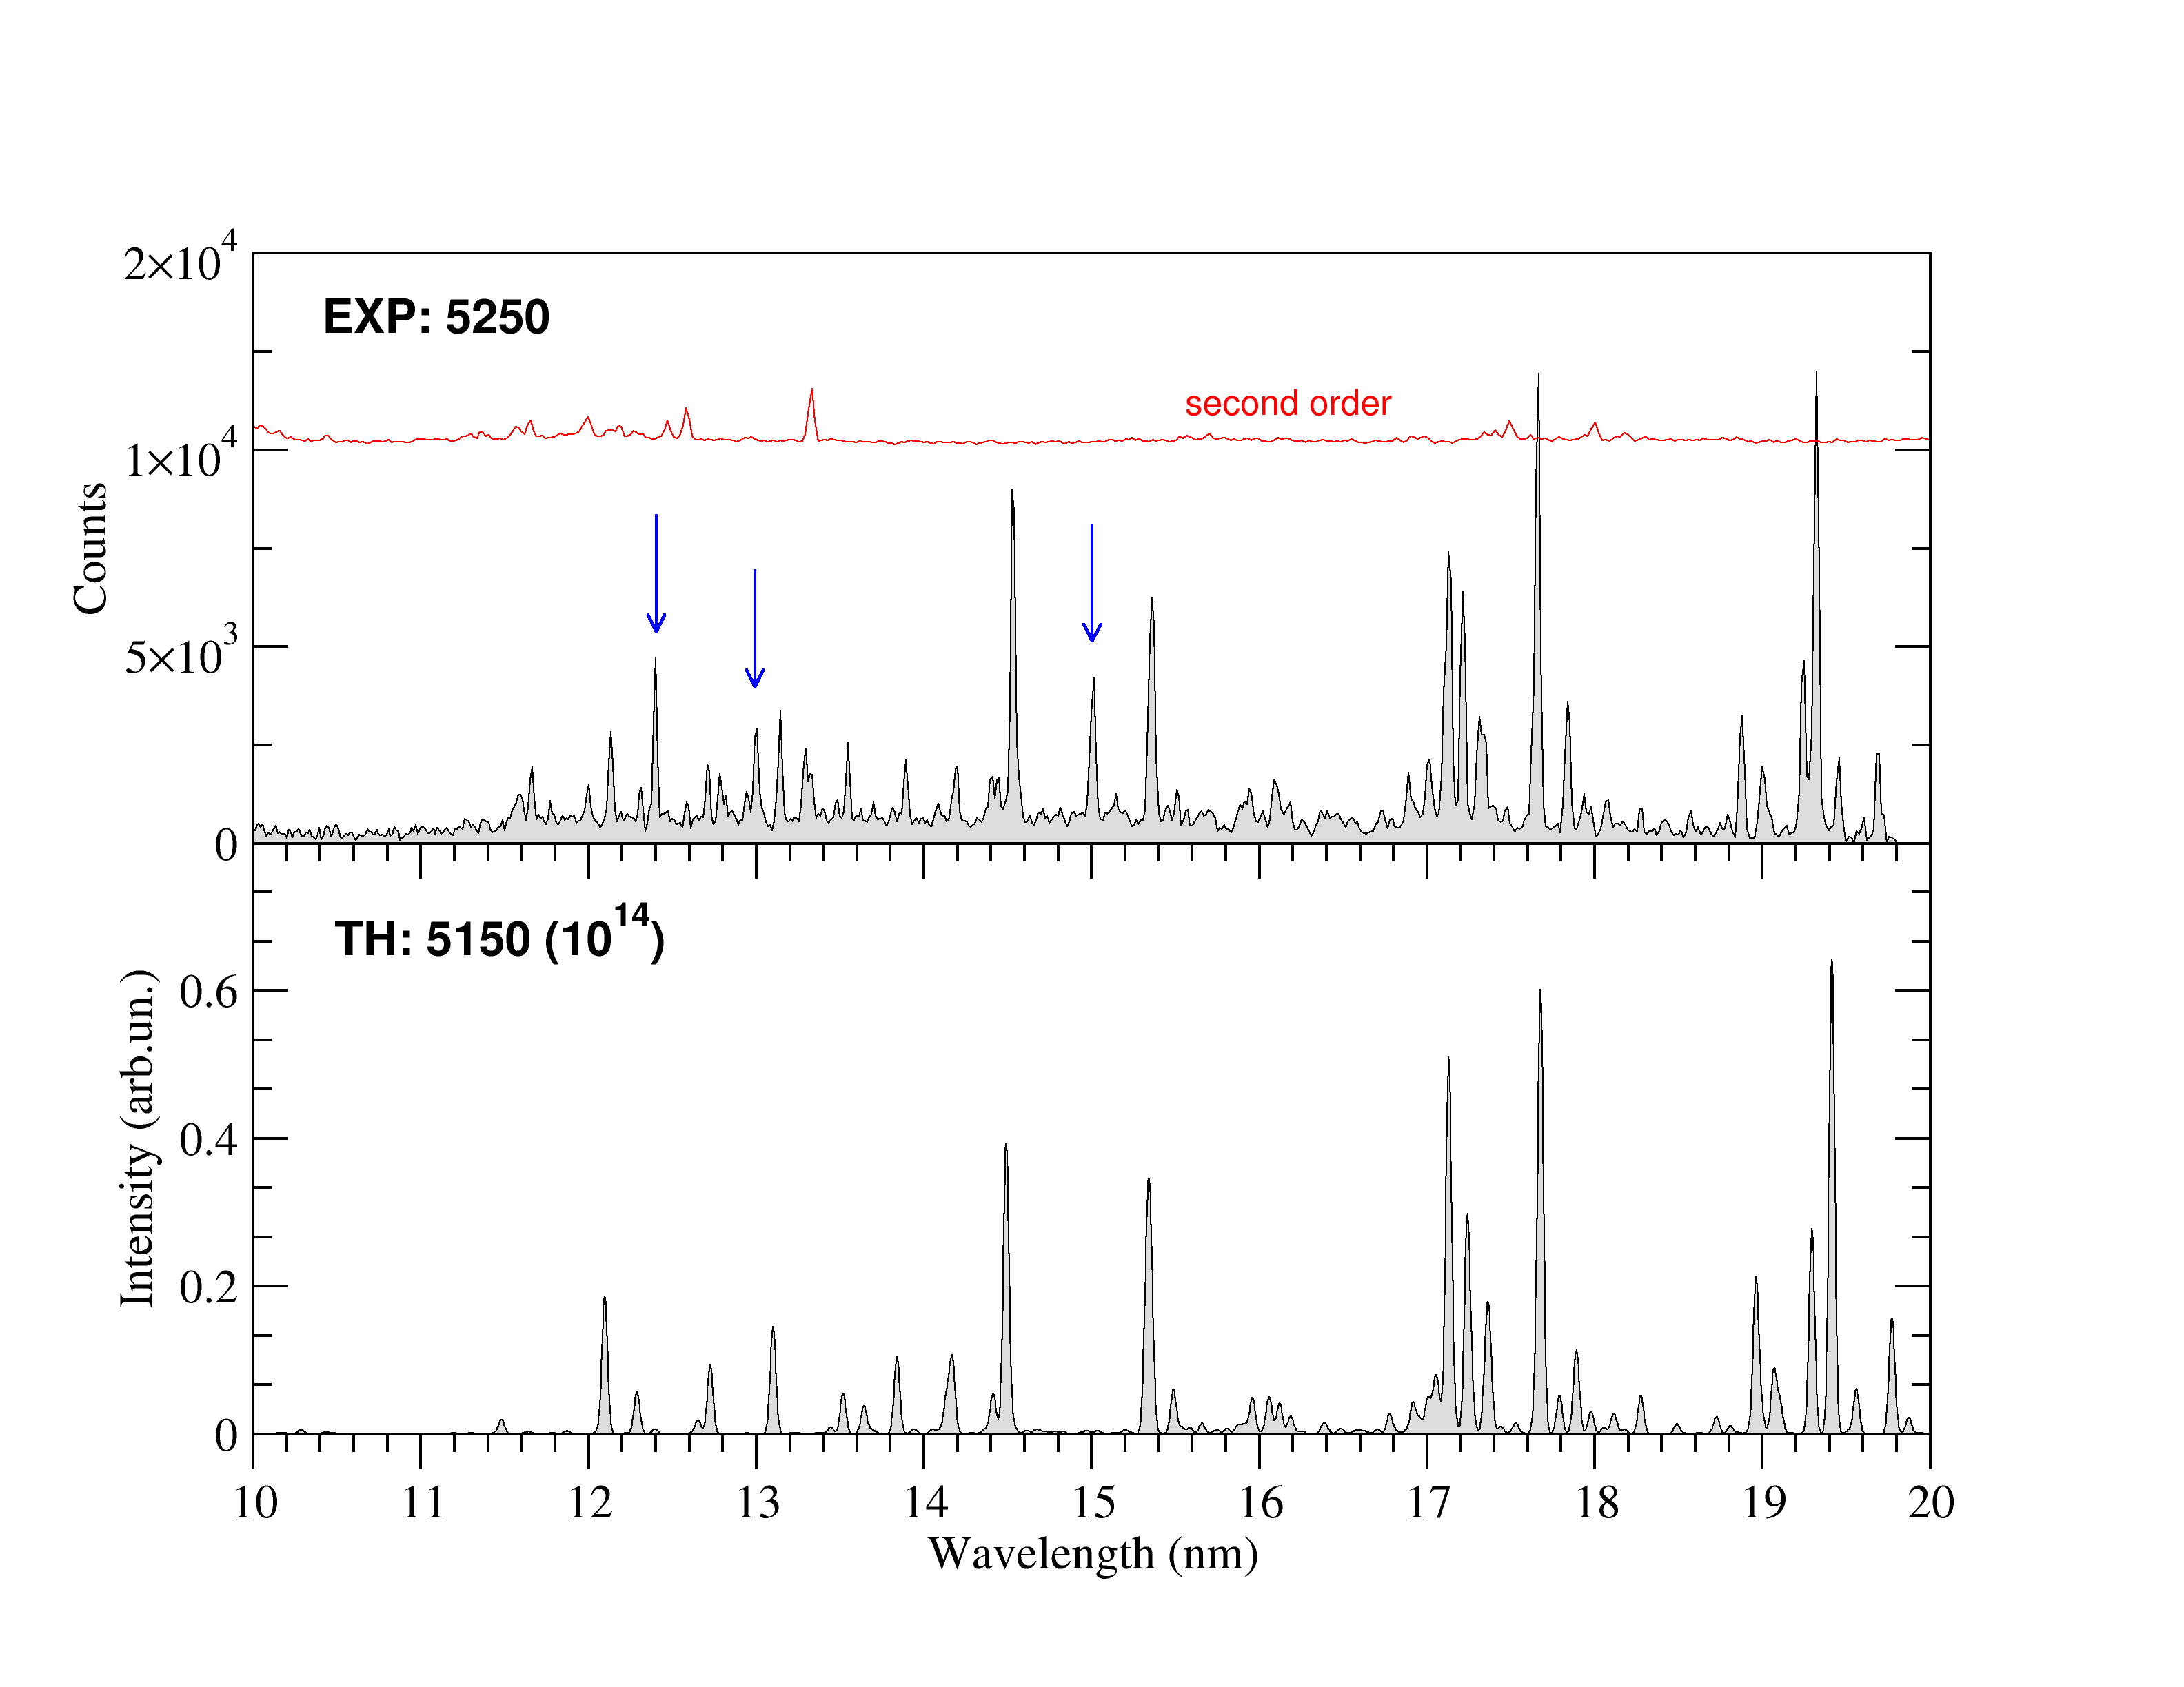
Theory vs Experiment (E = 5.25 keV)
V
Ti
Cr
V
Cr
V
Cr

Slide 15
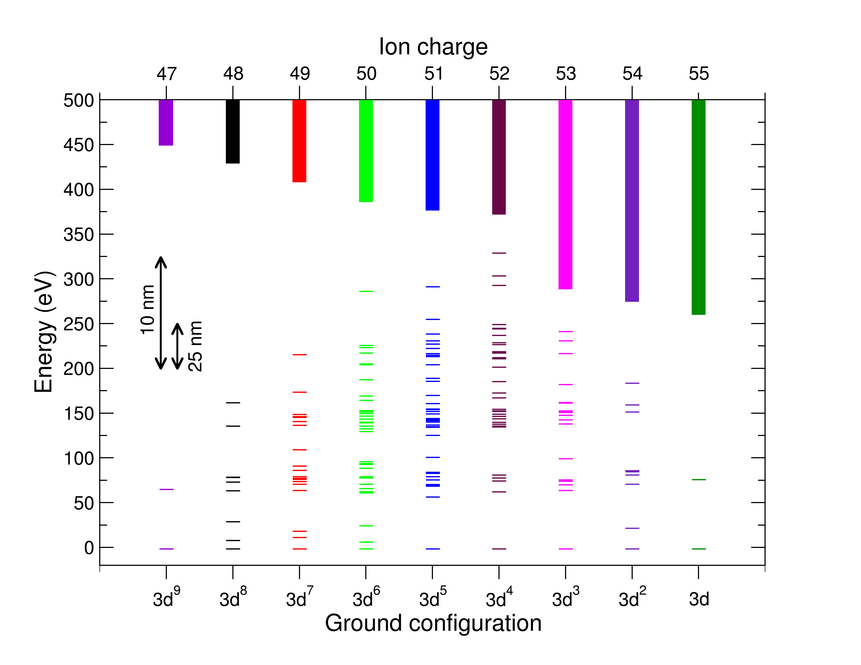
Why only M1 lines?..
3p⁵3d^{n+1} is too far
Branching ratios
…but allowed lines
appear at higher densities

Slide 16
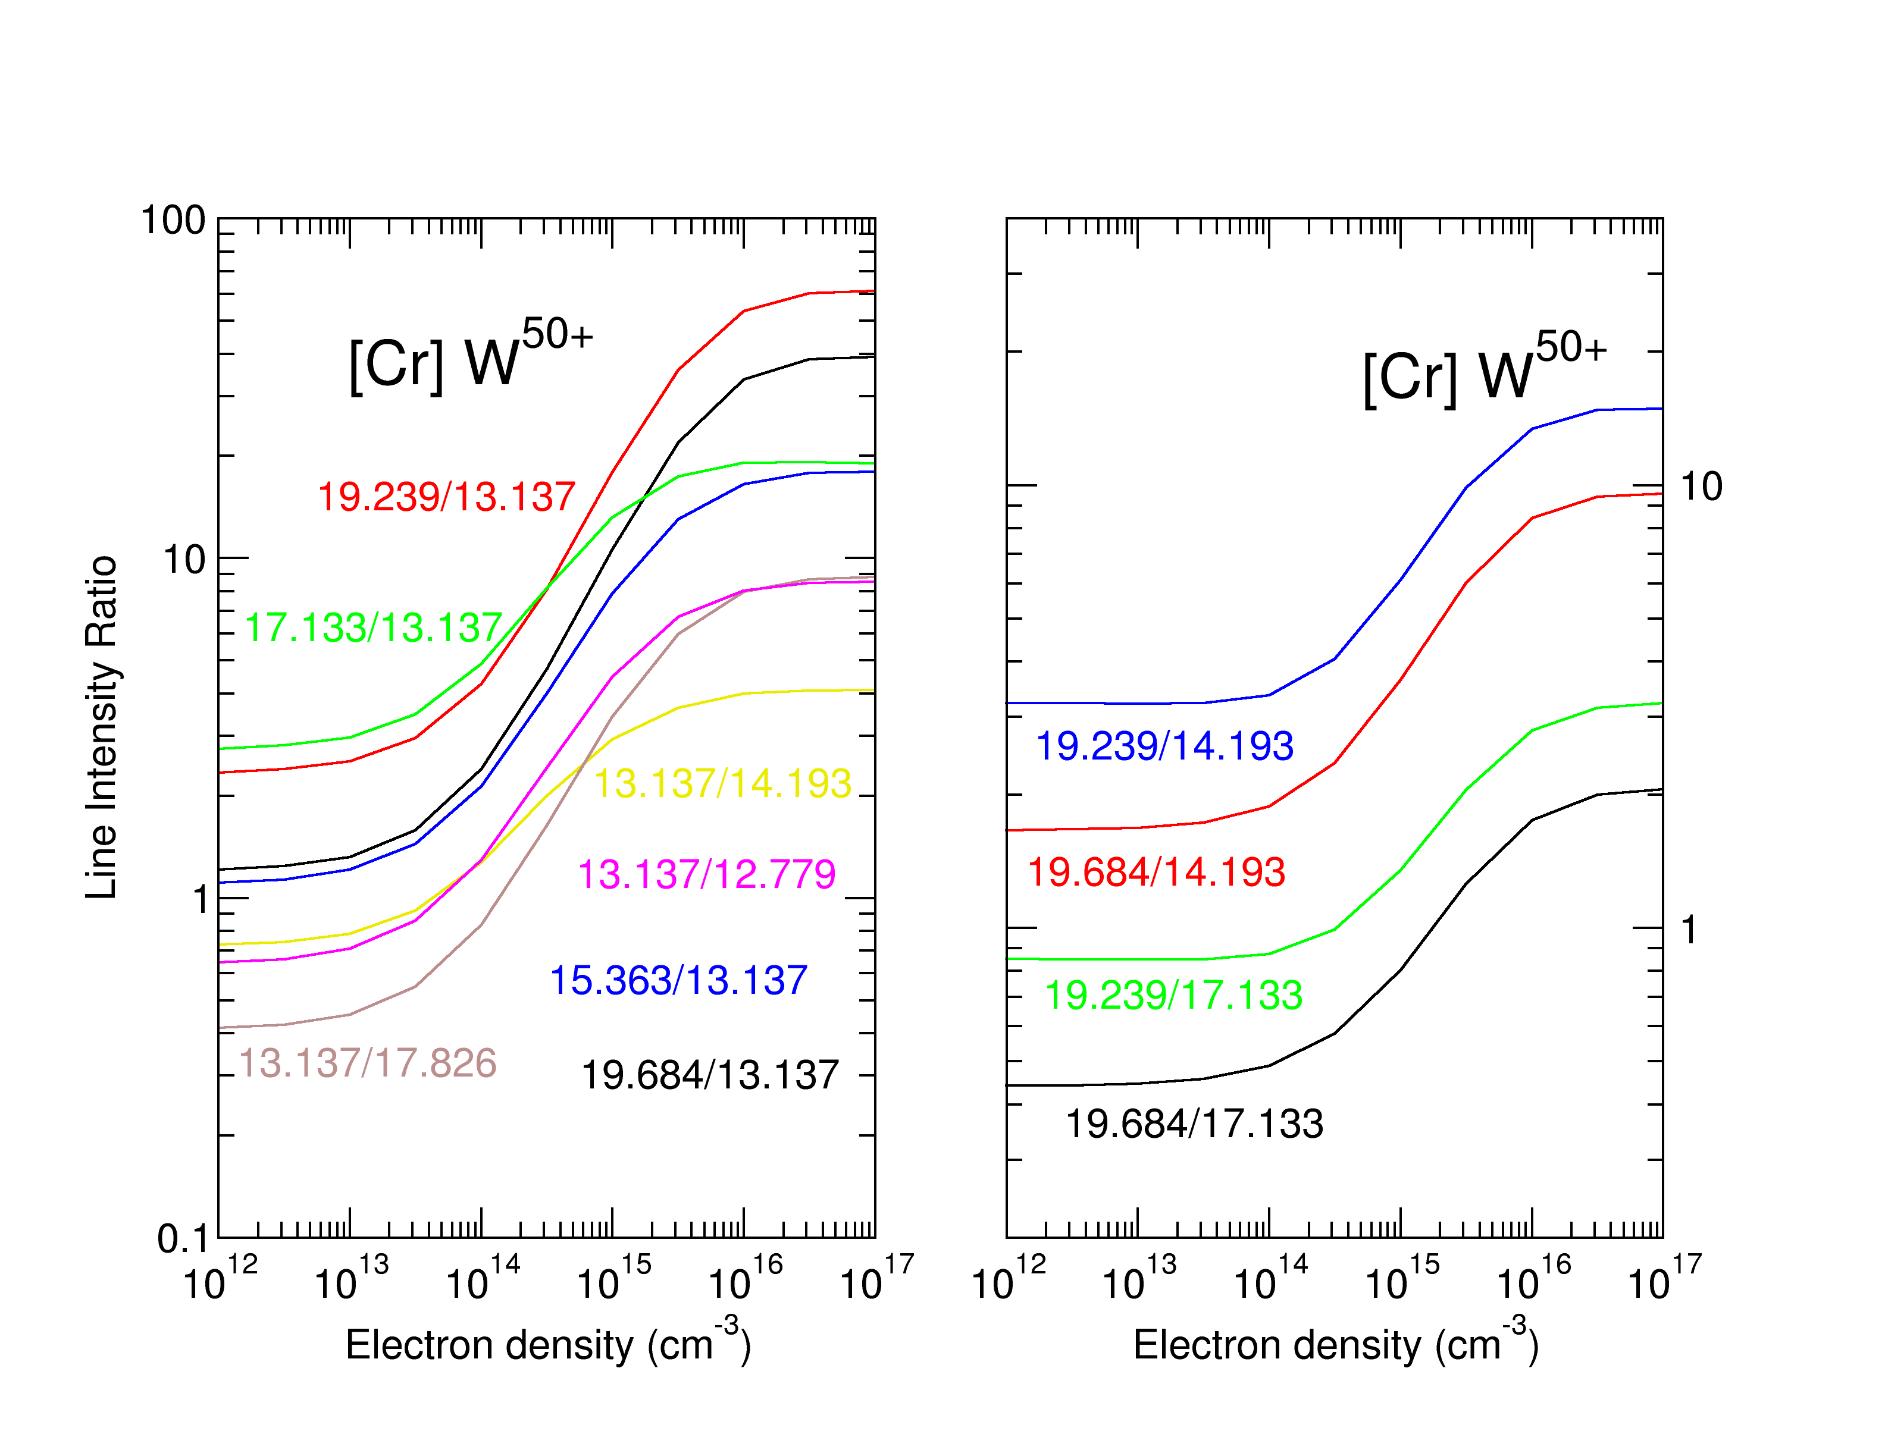
Density-Sensitive Ratios for Fusion Plasmas: Cr-like Ion

Slide 17
Conclusions: CR modeling in EBITs
(Quasi-)Monoenergetic electrons
Low density
E_{b} ~ IP; in many cases cascades dominate
Ratios of EUV lines in highly-charged high-Z ions are rather insensitive to beam energy
Charge exchange important for ionization balance
CR modeling is an essential tool for reliable identification of newly measured spectral lines
Good test for CR models to be applied in (magnetic) fusion

