Slide 1


The Forensic Ergonomics of Distraction Errors: A Computer Simulation Derek J. Smith, CEng, CITP Chief Designer, High Tower Consultants Limited http://www.smithsrisca.co.uk smithsrisca@btinternet.com

Slide 2
As presented to the 2010 Annual Conference of the Institute of Ergonomics and Human Factors at Keele University Wednesday 14th April 2010 Downloadable from ….. http://www.smithsrisca.co.uk/PPTs/IEHF10-keele.ppt

Slide 3

ABOUT THE AUTHOR
During the 1980s Derek Smith worked for British Telecom, Cardiff, where he specialised in the design and operation of very large CA-IDMS "semantic network" databases. Since 1991 he has taught psycholinguistics and cognitive neuropsychology to Psychology and Speech and Language Therapy undergraduates at University of Wales Institute, Cardiff.
He is currently working in association with International Software Products, Toronto, on "Konrad”, an artificial intelligence project using a CA-IDMS platform.

Slide 4
SECTION 1 THE PROBLEMS OF HIERARCHICAL COGNITIVE CONTROL

Slide 5
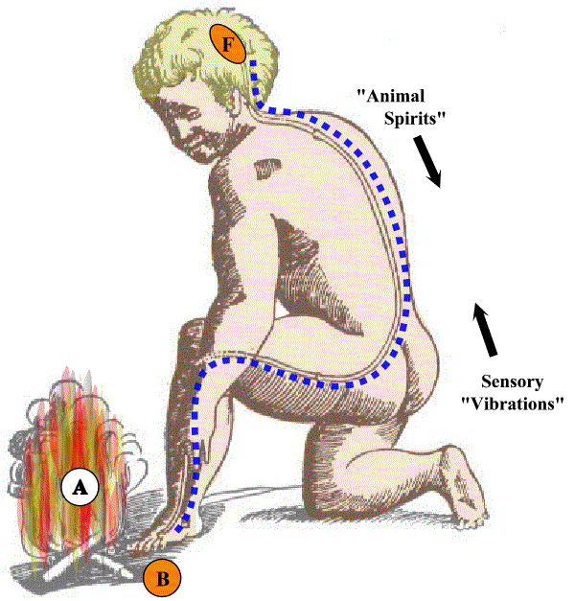
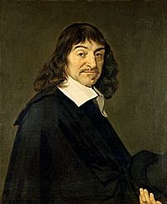
DESCARTES ON THE NERVOUS SYSTEM
This image is from Rene Descartes' Treatise of Man (1662), and speculates as to how biological information processing might be vertically differentiated.
NOTE THE PRIMITIVE BIOLOGICAL REAL-TIME CONTROL HIERARCHY.

Slide 6
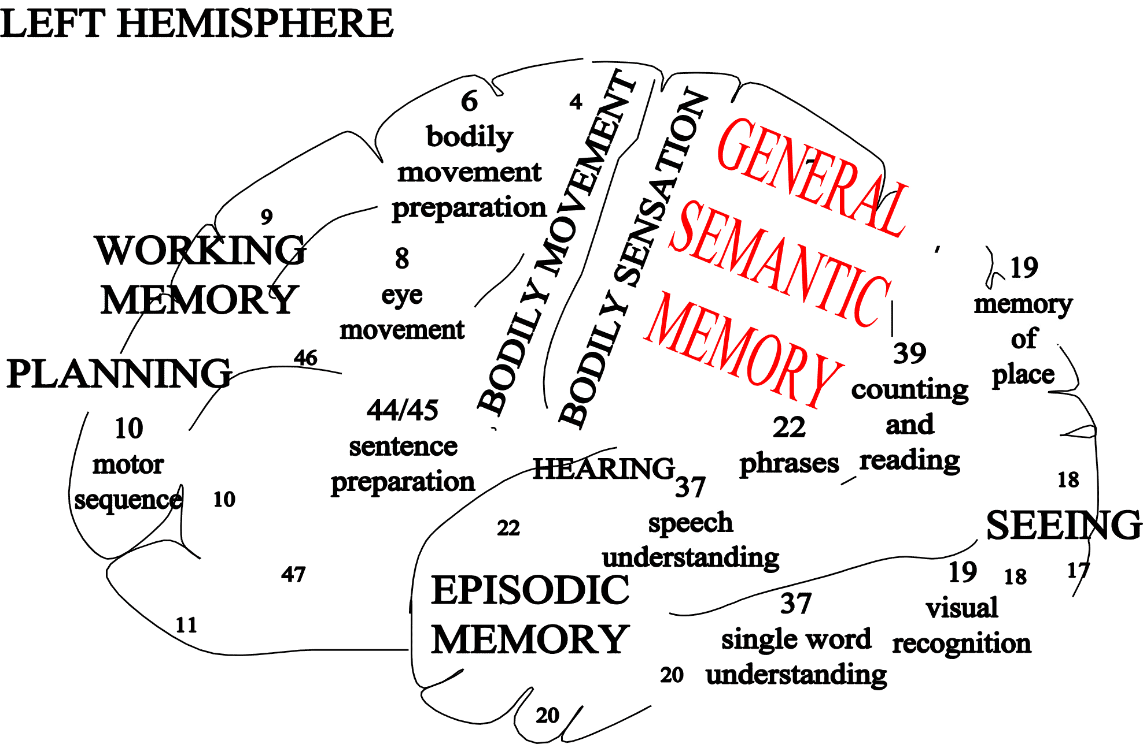
By the mid-20th century, neuropsychologists had a reasonable idea where many elements of higher cognition were located.

Slide 7
BUT THE PICTURE REMAINS HAZY FOR THE HIGHEST OF THE HIGHER FUNCTIONS
DIRECTABLE
PHENOMENAL AWARENESS???
SUBJECTIVITY AND SELF???
THE WILL???
AESTHETIC APPRECIATION???
??????????????????

Slide 8
HIERARCHICAL MODELS
Neuropsychological theory has been routinely held back over the years by the fact that there has never been a universally accepted graphical method to help us analyse the flow of mental information during cognition. Instead, different authors have presented their conclusions in different ways and at different levels of detail, to suit the thrust of their argument at the time.
Here are some typical hierarchically structured diagrams, identical in intent, if not in detail. NOTE THE UNDERLYING A-SHAPE .....

Slide 9

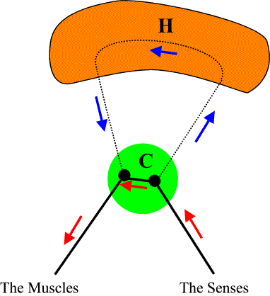
WILLIAM JAMES’ (1890) HIERARCHICAL MODEL
Higher Cognitive Functions
Click for additional explanation
Praxis
Aesthesis

Slide 10

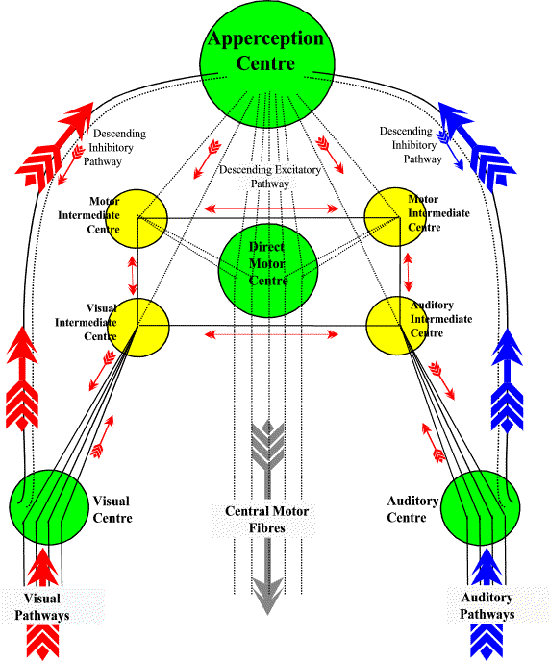
WUNDT'S (1902) HIERARCHICAL MODEL
Higher Cognitive Functions
Click for additional explanation
Visual
Aesthesis
Auditory
Aesthesis
Praxis

Slide 11
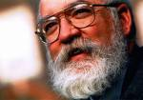
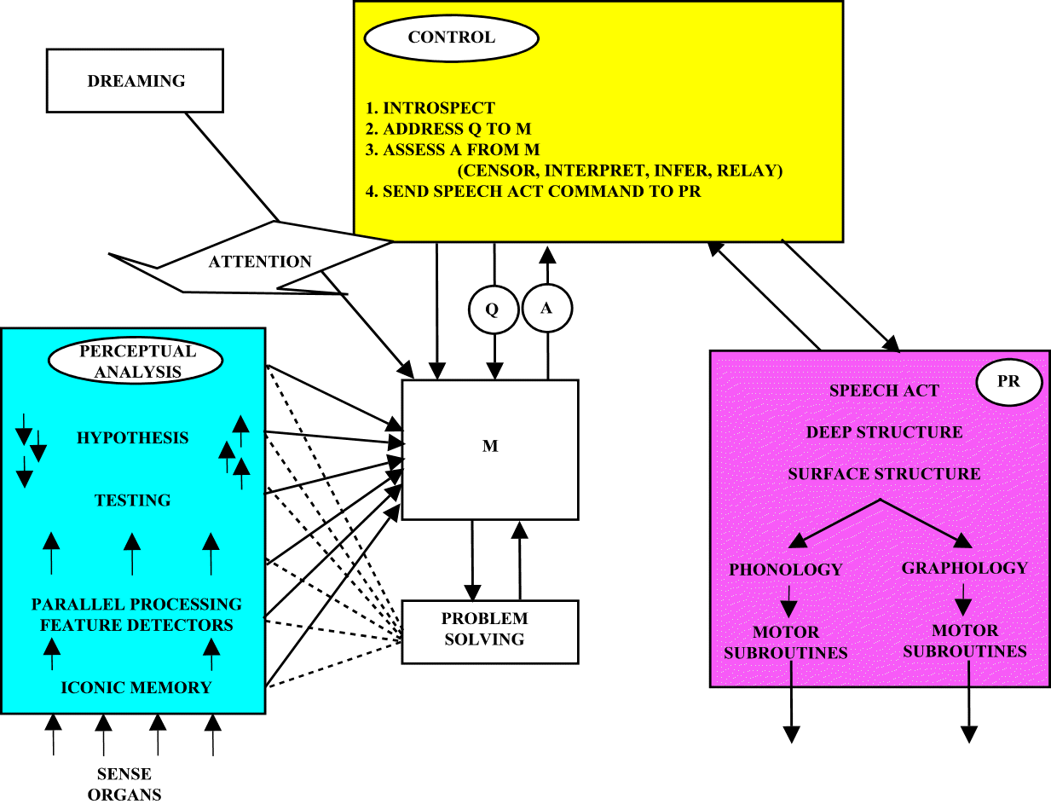
DENNETT'S (1978) HIERARCHICAL MODEL
Higher Cognitive Functions
Click for additional explanation
Aesthesis
Praxis

Slide 12
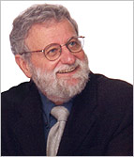
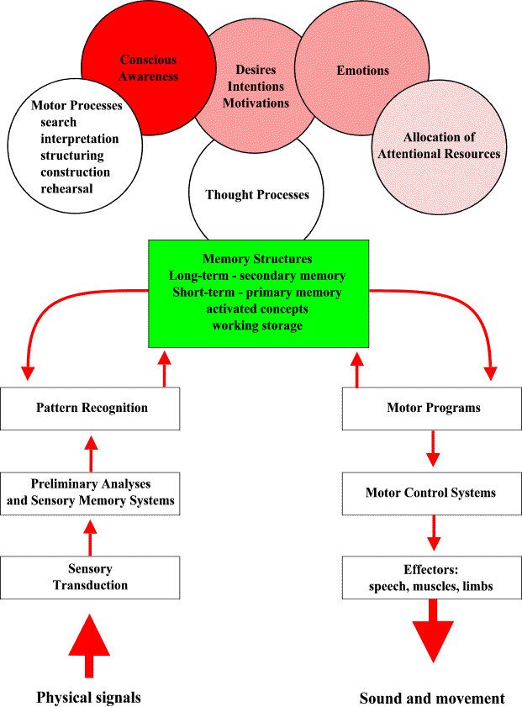
NORMAN’S (1990) HIERARCHICAL MODEL
Higher Cognitive Functions
Click for additional explanation
Aesthesis
Praxis

Slide 13

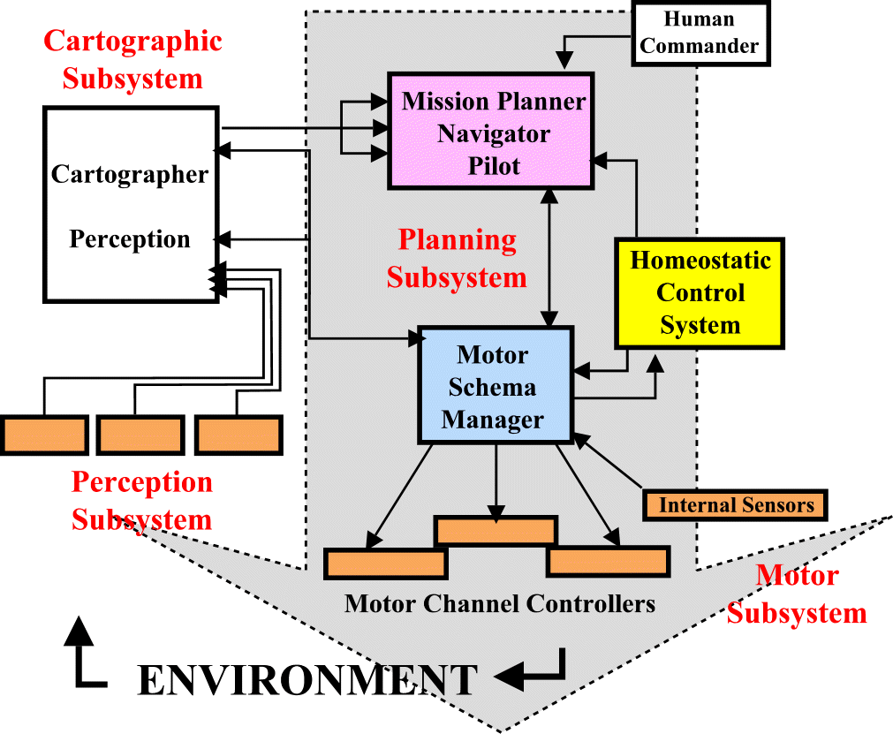
ARKIN’S (1990) HIERARCHICAL MODEL
Higher Cognitive Functions
Click for additional explanation
Aesthesis
Praxis

Slide 14
AND COGNITIVE ERGONOMICS’ VERY OWN .....

Slide 15
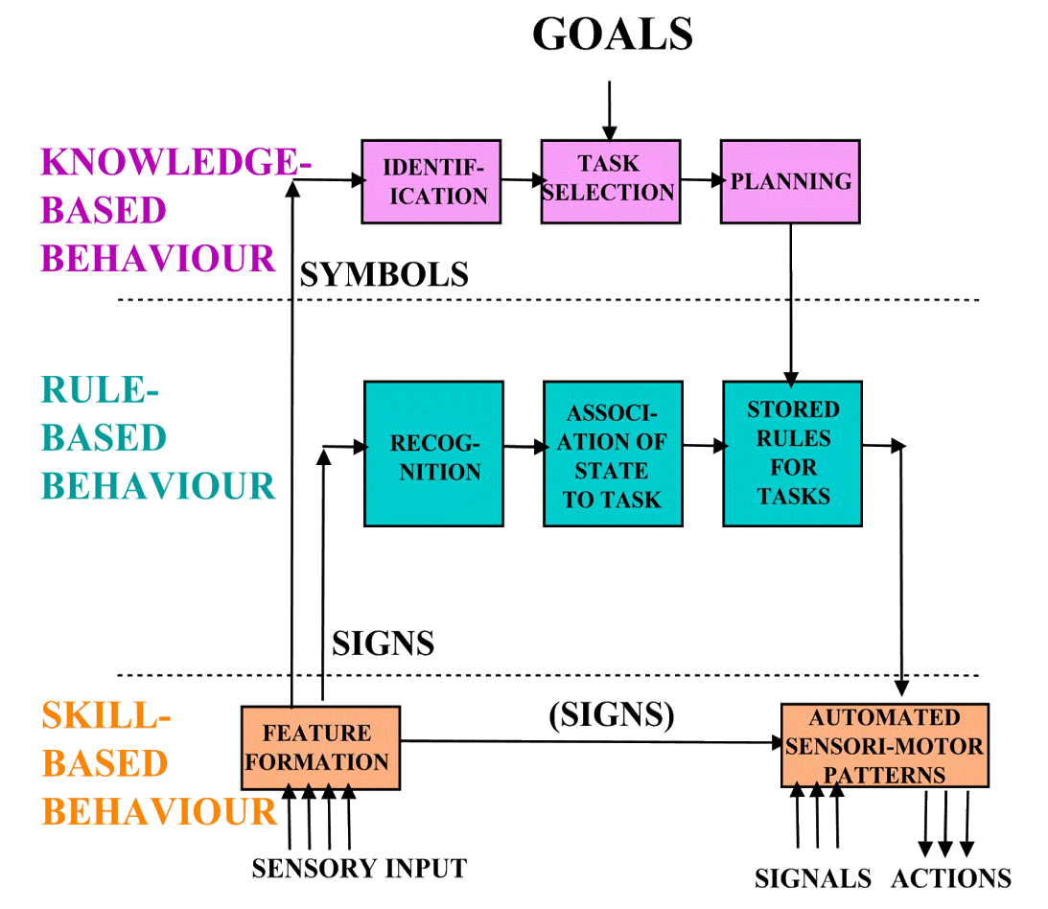
RASMUSSEN’S (1983) HIERARCHICAL MODEL
Higher Cognitive Functions
Click for additional explanation
Aesthesis
Praxis

Slide 16
SO HERE ARE SOME OF OUR PROBLEMS .....
(1) Cognition takes place so quickly that the interesting parts are over before they can be attended to. Moreover, much of it – not least problem solving and sentence construction - is carried out subconsciously and therefore not available for conscious report or introspection.
(2) There is no consensus as to the functional components of our cognitive architecture.
(3) Because mental data are never entirely objective they are of dubious scientific value.

Slide 17
..... AND HERE IS OUR MISSION
(1) Guided by what is known about the biological nervous system, to show how complex mental functions can be built up from simple components in a computer simulation of a mind.
(2) To install some sort of "cognitive tracking" device within said simulation, so that we can study it in slow motion after the event (specifically, by having it record its actions to a hard copy time-stamped objective record).
(3) To use this device to make cognitive modelling more ergonomist-friendly than it has been in the past.

Slide 18
SECTION 2 INTRODUCING PROJECT KONRAD

Slide 19
INTRODUCING PROJECT KONRAD
Konrad is a machine consciousness project. It models the end-to-end flow of biological cognition, with especial emphasis on the semantic network nature of the mind's long-term memory system.
Mental Associations
Philosophically speaking, it is Humean "Associationism" brought up to date.

Slide 20
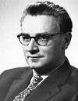
INTRODUCING PROJECT KONRAD
The project is an entrepreneurial academic collaboration between the author and International Software Products, Toronto, and is so named as a tribute to the German engineer Konrad Zuse, one of the pioneers of digital computing.

Slide 21
INTRODUCING PROJECT KONRAD
The application platform is the CA-IDMS (Release 17) network database [visit manufacturer's website].
Network databases store each content item individually, with addressing pointers to and between each fragment.
For more on the explanatory potential of network databases as models of cognition, see Smith (2005a; 2005b).

Slide 22
INTRODUCING PROJECT KONRAD
As is normal for all databases, a Data Analysis exercise produces a blueprint document called the Logical Data Model which is then computer-encoded as a Database Schema.
More than 250 mental domain entity types were identified during Konrad’s Data Analysis. Fortunately, internal similarities and repetitions in the real world allow the 250 logical entity types to be implemented as only seven different physical record types.

Slide 23
INTRODUCING PROJECT KONRAD
Here are the seven physical record types in Konrad's Schema.
(1) Processing Module
(2) STM
(3) MTM
(4) LTM)
(5) Hard-wired automatism ["Instinct“]
(6/7) "Bill of Materials" and "Superchief" records to cope with memories made up of other memories.
DATABASE AREA 2
A REALM OF FUNCTIONALLY SPECIFIED INFORMATION PROCESSORS, AND THEIR ASSOCIATED INFORMATION TYPES.
AREA 2 FDPX-REC
Functionally
Discrete
Processor
AREA 2 MTEV-REC
Medium-Term Event
FDPXs
MAINTAIN
MANY
LTMs
<NO AM>
MTEVs
CONSOLIDATE
INTO MANY
LTMs
<NO AM>
AREA 2 KML-REC
Innate Read-Only
Memory
AREA 2 LTM-REC
Long-Term Memory
Primary Trace
LTMs ARE
CLUSTERED
UNDER
LTMSs
<NO AM>
LTMR
LINKS
LTMs
<NO AM>
LTM
OCCURS IN
LTMRs
<NO AM>
FDPXs
RECEIVE MANY
STEVs
<NO AM>
AREA 2 LTMR-REC
Long-Term Memory
Recursive Analysis
AREA 2 STEV-REC
Short-Term Event
AREA 2 LTMS-REC
Long-Term Memory
Superchief

Slide 24
INTRODUCING PROJECT KONRAD
The Processing Module (FDPX) and Long-Term Memory (LTM) records set up the basic cognitive architecture. 21 "occurrences" of the FDPX-REC are identified, containing between them a total of 36 functionally (but not physiologically) different types of LTM-REC.
These 21 modules are the building blocks of Konrad's machine mind, and "animal spirits" of an electronic sort flow between them.

Slide 25
INTRODUCING PROJECT KONRAD
Here are the 10 LTM-within-FDPX building blocks of cognition so far simulated, laid out as a cognitive processing hierarchy. Note the industry standard A-Shape.
A fully captioned copy of the 21-module diagram is provided in the Conference Pack (or can be downloaded from http://www. smithsrisca.co.uk/IEHF10/Cartesian.ppt).

Slide 26
INTRODUCING PROJECT KONRAD
Each module [FDPX, grey boxes] manages its own long-term storage [LTM, blue boxes].
Neurotransmission takes place as pulsed short-term events [STM, pink arrows].
Modules also maintain a medium-term record of recent activity [MTM, yellow boxes].

Slide 27
INTRODUCING PROJECT KONRAD
BASIC DESIGN PRESUMPTION
Konrad presumes that biological LTM exists primarily to store associations, and simulates this by storing two keys on every LTM record. The A-Key is received from a precursor STM pulse and positions the LTM record itself. The B-Key is copied from the LTM record onto an output STM pulse so that the process can be repeated in the next module .

Slide 28
INTRODUCING PROJECT KONRAD
STM records are deleted as soon as they have triggered the necessary activity downstream. [They don’t have to be, but it is truer to life.]
MTM records will eventually form new LTM in a process akin to “consolidation” in biological nervous systems [this process not yet operational].

Slide 29
INTRODUCING PROJECT KONRAD
BASIC PHILOSOPHY
No module “knows” anything about anything. It exists just to turn inputs into outputs according to the key-paired associations stored within it.
However, the architecture as a whole is designed to be greater than the sum of its parts in a systems sense.

Slide 30
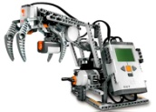
INTRODUCING PROJECT KONRAD
Here is the database defined by the Schema. It holds the memory network.
THE KONRAD2 DATABASE
And here is the promised Print Out
SELECTIVELY MASKED OUT BY SUBSCHEMAS
OTHER THAN <UNMASKED>
COMMANDS
FILE
(Input H01234T
VSAM Dataset)
KONRAD2
MAIN
LOG A/B/C/[D/E]
COMMANDS
PRINTLOG
SEMIOTICS
TEXT-TO-SPEECH
SEMIOTICS
GUI
FILE
DOWNLINE
LINGUISTIC
INTERFACE
PC DISPLAY
Here is the input file. It preloads the memory network and then tests it.
FROM MAINFRAME
CONSOLE
COMMAND
USED FOR EXCEPTION
HANDLING ONLY
KINESICS
KINESICS
GUI
FILE
DOWNLINE
ROBOTIC
INTERFACE
PC DISPLAY
FROM MAINFRAME
RUN NO
LANGUAGE TO RESPOND IN
SERVO VECTORS
JCL
COMMAND
This is the Main Update Program. It does the "thinking".

Slide 31
INTRODUCING PROJECT KONRAD THE PRINT OUT
Each posting line contains an item number, timing data, step identifier, physical (logical) record type, and both DB and External Keys. Comment lines are inserted to aid the explanatory narrative.
P 0151 00001226 224A3-- MTEV(MOTB) 01011268(001) 0000 MOTB-RECSENSORS{SEEK NEXT INPUT{{00248641
P 0151 00001229 224A4-- STEV(MOTO) 01010520(001) 0000 MOTO-RECSENSORS{SEEK NEXT INPUT{{00248641
P 0151 00001233 224A5-- STEV(MOTE) 01012613(001) 0000 MOTE-RECSENSORS{SEEK NEXT INPUT{{00248641
C ** COMMENT ** 224A5-- No KEY DUPLICATE LTM(MOTM) found, so no 'depth' to MOTM MOTOR COMPOSITION for this ACTEME
Item
No
Time
(thou)
Step
Id
Rec
Types
DB
Key
Error
Status
External
Key Prefix
External
Key Body
External
Key Timestamp

Slide 32
INTRODUCING PROJECT KONRAD THE PRINT OUT
The report as a whole thus provides a permanent record of an act of machine cognition which actually ran in milliseconds. cognition thus becomes visible in slow motion after the event, as promised.
A sample of Print Out is included in the Conference Pack, and full-length originals are available for download from ..... http://www.smithsrisca.co.uk/IEHF10/PRTFILE-A.pdf
And
http://www.smithsrisca.co.uk/IEHF10/PRTFILE-B.pdf

Slide 33
INTRODUCING PROJECT KONRAD THE PRINT OUT
P 0151 00001226 224A3-- MTEV(MOTB) 01011268(001) 0000 MOTB-RECSENSORS{SEEK NEXT INPUT{{00248641
P 0151 00001229 224A4-- STEV(MOTO) 01010520(001) 0000 MOTO-RECSENSORS{SEEK NEXT INPUT{{00248641
P 0151 00001233 224A5-- STEV(MOTE) 01012613(001) 0000 MOTE-RECSENSORS{SEEK NEXT INPUT{{00248641
C ** COMMENT ** 224A5-- No KEY DUPLICATE LTM(MOTM) found, so no 'depth' to MOTM MOTOR COMPOSITION for this ACTEME
You can calculate the processing time for any given Database
operation by subtracting successive timestamps [msec]
Given 5 or 6 database operations per module, and 10 modules per attentional cycle, the “round number” execution times are as follows .....
150 msec per cycle
15 msec per module
2-3 msec per database operation
Comments and deliberate synchronisation delays add roughly as much again.

Slide 34
SECTION 3 HAND-EYE COORDINATION IN A MACHINE WITH NEITHER HANDS NOR EYES

Slide 35
The following conducted tour will guide you through the processes of initiating and then distracting a repetitive fine control movement
You may care to monitor progress within each processing cycle on the hierarchy diagram included in the Conference Pack.
The Conference Pack also includes a single page SYSOUT print summarising the motor output sequence of many processing cycles .

Slide 36
THE MEMORY PRE-LOAD PHASE
During the preload phase, Konrad’s initially empty mind is loaded (a) with its FDPX modular architecture, and (b) with the LTM appropriate to the substantive task which will follow.

Slide 37
THE MEMORY PRE-LOAD PHASE
Because the LTM records include the pre-learned associative key pairings, this preload establishes the all-important associative network.
This facility makes Konrad an ideal experimental subject, because its “prior experience” is totally controllable.

Slide 38
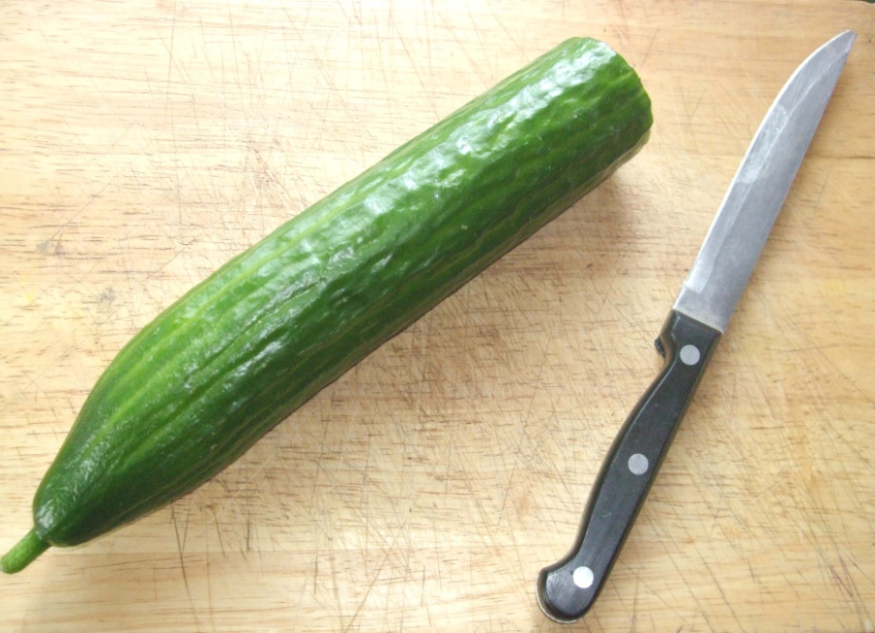
THE VISUAL INPUT PHASE
After the preload, the eyes scan a simulated visual scene, one item at a time.

Slide 39
THE VISUAL INPUT PHASE
As in biological systems, sensory information is twice transcribed subcortically [once in the brain-stem and again in the thalamus].
In its “third sensory” form it is then physically recognised in PEMM, the Perceptual Memory Module, and conceptually cross-referenced in CONM, the Conceptual Memory Module.
CONM
PEMM
TSP2
TSP1

Slide 40
THE VISUAL INPUT PHASE
In addition, each object’s coordinates and movement vectors are noted by TTRK, the Tactical Tracking Module.
This allows the system to maintain a military style “big board” tactical display on which threats can be tracked and evaluated in real-time. Ongoing behaviour can be forcibly interrupted (red arrow) if circum-stances demand it.
CONM
PEMM
TTRK
TSP2
TSP1

Slide 41
THE TRUTH JUDGEMENT PHASE
Each new visual input helps DRAN, the Dramatic Analysis Module, interpret what is going on.
DRAN then asks PPAN, the Propositional Analysis Module, to note simple existential propositions .....
E.g., A cucumber is at hand; A knife is at hand
PPAN
DRAN
CONM
TTAC
PEMM
TTRK
TSP2
TSP1

Slide 42
THE TRUTH JUDGEMENT PHASE
As more and more elements are scanned, increasingly complex relational truthS are submitted to PPAN for judgement as <TRUE> or <FALSE>.
E.g., The cucumber is on the table
PPAN
DRAN
CONM
TTAC
PEMM
TTRK
TSP2
TSP1

Slide 43
VISUAL SCANNING
Unless and until a significant PROPOSITIONAL TRUTH is identified, each cycle produces only a simple “re-sampling” of the sensory environment. This is shown in the Print Out as .....
SENSORS{SEEK NEXT INPUT
This allows our eyes to move to their next fixation point, our head to tilt to hear better, and so on.
PPAN
DRAN
CONM
TTAC
BREL
PEMM
TTRK
MOT1
TSP2
TSP1

Slide 44
THE AUDITORY INSTRUCTION PHASE
The processing cycle is then repeated in the auditory modality for the "spoken" words making up the task instruction.
E.g.,
<SLICE><THIS><.>
PPAN
DRAN
CONM
TIMES
THREE
TTAC
BREL
PEMM
TTRK
MOT1
TSP2
TSP1

Slide 45
THE CONTINUOUS BEHAVIOUR PHASE
Each new auditory input helps DRAN and PPAN interpret what is going on, until eventually a single AGENT-ACTION-PATIENT-INSTRUMENT propositional cognition emerges.
E.g., <SELF><SLICE><current of focal attention><[with]KNIFE>
[Here Konrad follows the work of linguistic theorists such as Kenneth Burke (e.g., Burke, 1945).]
PPAN
CONM
TTAC
PEMM
TTRK
TSP2
TSP1

Slide 46
THE CONTINUOUS BEHAVIOUR PHASE
This sentence-structured cognition generates a PRAXEME, our name for what mental philosophers refer to as a “psychological act”.
The host science at this point is known as “Pragmatics” [more].
DRAN

Slide 47
THE CONTINUOUS BEHAVIOUR PHASE
This PRAXEME is then passed to TTAC, the Tactical Action Module, where it activates a stack of identically keyed ACTEMES, collectively encoding the sequential actions making up a MOTOR SCHEMA.
However, because there are many schemas to choose from, the output needs to be validated in some way, so .....
DRAN
TTAC
BREL

Slide 48
THE CONTINUOUS BEHAVIOUR PHASE
..... BREL, the Behavioural Release Module, then “ticks these out” safely one by one (in the same way that biology’s Anterior Cingulate Gyrus seems to control impulsivity in human behaviour).
DRAN
TTAC
BREL
CLICK FOR STROOP
BLUE
GREEN
RED
YELLOW
RED
BLACK
GREEN
YELLOW
BLUE

Slide 49
THE CONTINUOUS BEHAVIOUR PHASE
Note that the output stream has now become time-extensive. Each spatially located set of ACTEMEs will, if activated one at a time, generate a sequence of motor actions.
Readers familiar with Lashley’s (1950) paper “The Problem of Serial Order in Behaviour” will appreciate the value of this mechanism.
DRAN
TTAC
BREL

Slide 50
THE CONTINUOUS BEHAVIOUR PHASE
The essence of safe HAND-EYE COORDINATION is that the SEEK NEXT INPUT facility now has to be focally directed to the “attentional patient” of the MOTOR SCHEMA at hand, thus .....
<SELF><SLICE><current of focal attention><[with]KNIFE>
DRAN
TTAC
BREL

Slide 51
THE CONTINUOUS BEHAVIOUR PHASE
Each ACTEME is passed to MOT1, the Upper Motor Neuron Module, where it accesses a stack of identically keyed FINAL MOTOR OUTPUT (MOTO) instructions.
Each MOTO directly commands a unit of composed multiple joint muscle contraction.
BREL
MOT1

Slide 52
THE CONTINUOUS BEHAVIOUR PHASE
FINAL MOTOR OUTPUT is quality assured by two complementary streams of EFFERENCE COPY.
BREL
MOT1

Slide 53
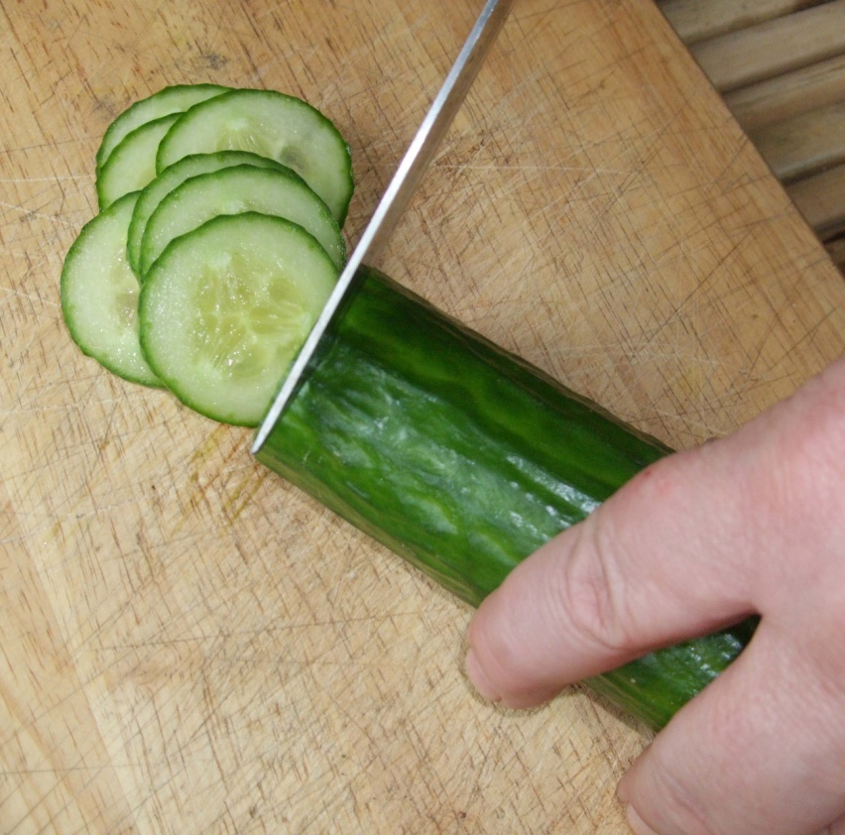
THE CONTINUOUS BEHAVIOUR PHASE
Put all the steps together and the cucumber duly gets sliced!
PPAN
DRAN
CONM
REPEAT
UNTIL
TTAC
BREL
PEMM
TTRK
MOT1
TSP2
TSP1

Slide 54
THE CARELESS INTERRUPTION PHASE
..... unless, part way through the slicing, an external auditory INTERRUPTION is received, whereupon REAFFERENCE suddenly fails to match up with EFFERENCE COPY and the smooth repetition of the target behaviour is disturbed.
E.g., <NICE><DAY><TODAY><.>
Metaphorically speaking, the system has suddenly to “slam its brakes on” .....
PPAN
DRAN
CONM
TTAC
BREL
PEMM
TTRK
MOT1
TSP2
TSP1

Slide 55

THE CARELESS INTERRUPTION PHASE
..... Hopefully in time to prevent injury!

Slide 56
THE CARELESS INTERRUPTION PHASE
Readers may care to compare the two full-length output files previously mentioned. Version A shows the simulation running to end without the careless interruption, and Version B shows the effects of the interruption. The two prints are essentially the same until External Command #000157 is received.
It is hoped that detailed comparison of prints like these will improve both our theoretical understanding of distraction errors and our practical ability to avoid them.

Slide 57
STATE OF PLAY, APRIL 2010
Programming of Konrad began in August 2007 and the Conference Pack shows progress to date. Features include …..
LTM storage capacity is effectively limitless.
Research "subjects" can be built to order, pre-loaded with controlled past experience. There are no practice or fatigue effects unless so required, allowing “impossible research” to be conducted. Konrad can also be deliberately “brain damaged” without ethical consequence, allowing it to act as its own control in intact-versus-impaired group comparison designs.

Slide 58
CALL FOR COLLABORATION
IEHF colleagues with “impossible research” issues of their own may be interested in research collaborations. Konrad will be pleased to cooperate if it can. The necessary contact details are in your Conference Pack.

Slide 59
THE END

Slide 60
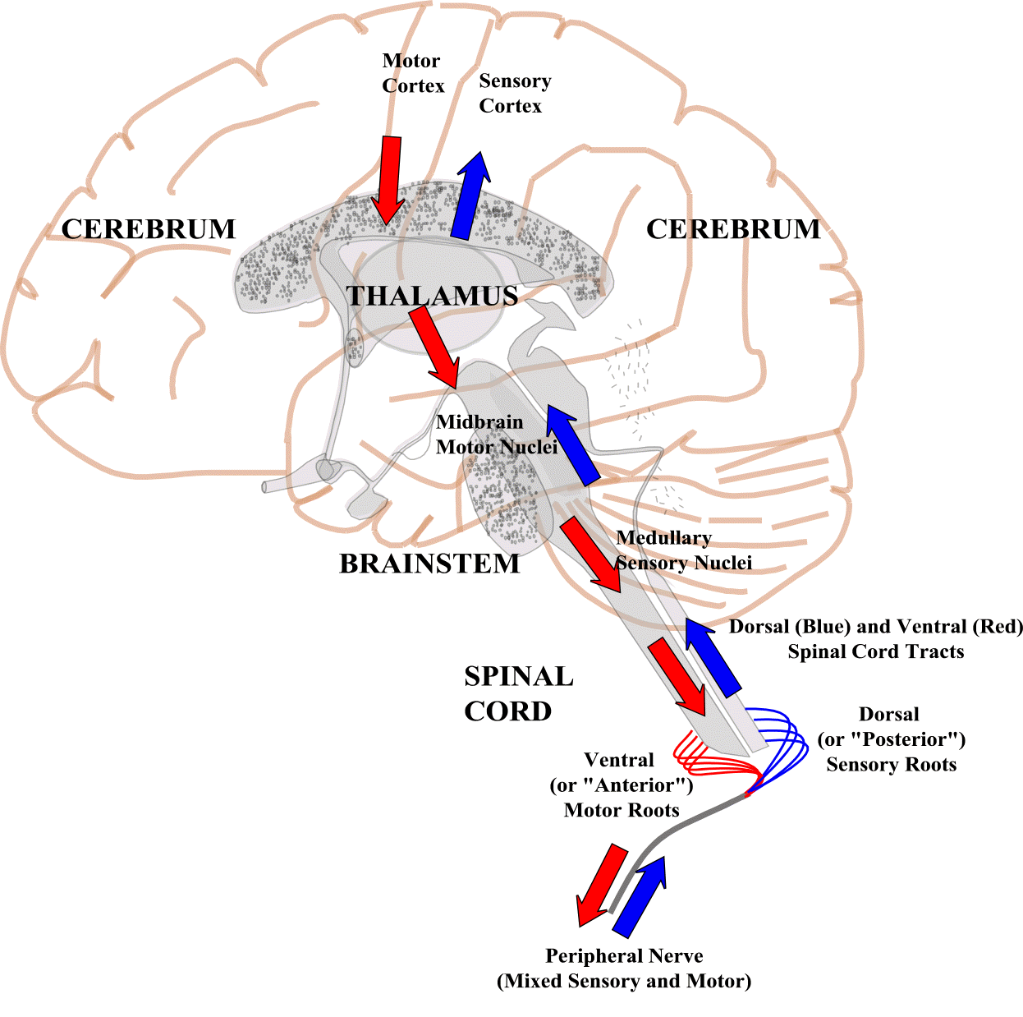

ANY QUESTIONS?
DATABASE AREA 2
A REALM OF FUNCTIONALLY SPECIFIED INFORMATION PROCESSORS, AND THEIR ASSOCIATED INFORMATION TYPES.
AREA 2 FDPX-REC
Functionally
Discrete
Processor
AREA 2 MTEV-REC
Medium-Term Event
FDPXs
MAINTAIN
MANY
LTMs
<NO AM>
MTEVs
CONSOLIDATE
INTO MANY
LTMs
<NO AM>
AREA 2 KML-REC
Innate Read-Only
Memory
AREA 2 LTM-REC
Long-Term Memory
Primary Trace
LTMR
LINKS
LTMs
<NO AM>
LTM
OCCURS IN
LTMRs
<NO AM>
LTMs ARE
CLUSTERED
UNDER
LTMSs
<NO AM>
FDPXs
RECEIVE MANY
STEVs
<NO AM>
AREA 2 LTMR-REC
Long-Term Memory
Recursive Analysis
AREA 2 STEV-REC
Short-Term Event
THE KONRAD2 DATABASE
SELECTIVELY MASKED OUT BY SUBSCHEMAS
OTHER THAN <UNMASKED>
AREA 2 LTMS-REC
Long-Term Memory
Superchief
COMMANDS
FILE
(Input H01234T
VSAM Dataset)
COMMANDS
KONRAD2
MAIN
PRINTLOG
LOG A/B/C/[D/E]
SEMIOTICS
SEMIOTICS
GUI
FILE
TEXT-TO-SPEECH
FROM MAINFRAME
DOWNLINE
LINGUISTIC
INTERFACE
PC DISPLAY
CONSOLE
COMMAND
USED FOR EXCEPTION
HANDLING ONLY
KINESICS
KINESICS
GUI
FILE
FROM MAINFRAME
DOWNLINE
ROBOTIC
INTERFACE
PC DISPLAY
JCL
COMMAND
RUN NO
LANGUAGE TO RESPOND IN
SERVO VECTORS

Slide 61
ADDITIONAL READING
Burke, K. (1945). A Grammar of Motives. New York: Prentice-Hall.
Lashley, K.S. (1950). The problem of serial order in behaviour. In Jeffress, L.A. (Ed.), Cerebral Mechanisms in Behavior: The Hixon Symposium. London: Wiley.
Smith, D.J. (2005a). On database keys, with an application to the Praxisproblem. In Callaos, N., Lesso, W., and Palesi, M. (Eds.), The 9th World Multi-Conference on Systemics, Cybernetics, and Informatics, (Volume IV). Orlando, FL: IIIS. [PLAY POWERPOINT]
Smith, D.J. (2005b). The problem of context in sentence production - Surely a case to re-convene the Data Base Task Group? In Chu, H.-W., Savoie, M.J., Sanchez, B., and Hong, S.-M. (Eds.), The 3rd International Conference on Computing, Communications, and Control Technologies, (Volume III). Orlando, FL: IIIS. [PLAY POWERPOINT]

Slide 62
Copyright Notice: This material was written and published in Wales by Derek J. Smith (Chartered Engineer), Chief Designer, High Tower Consultants Limited. It forms part of a multifile e-learning resource, and subject only to acknowledging Derek J. Smith's rights under international copyright law to be identified as author may be freely downloaded and printed off in single complete copies solely for the purposes of private study and/or review. Commercial exploitation rights are reserved. The remote hyperlinks have been selected for the academic appropriacy of their contents; they were free of offensive and litigious content when selected, and will be periodically checked to have remained so. Copyright © 2010, High Tower Consultants Limited. Publication was by PowerPoint presentation on 14th April 2010. This online version, complete with activated hyperlinks, comes to you for follow-up private study.

