Slide 1


Grand unification of AGN activity across the universe
Nikos Fanidakis
and
C.M. Baugh, R.G. Bower, S. Cole, C. Done, C. S. Frenk
9th Hellenic Astronomical Conference, Athens, Greece September 20-24, 2009

Slide 2
Outline
Hierarchical evolution of galaxies
Essential ingredients and modelling of AGN
Results:
Luminosity functions
The optical – radio plane of AGN
Conclusions

Slide 3
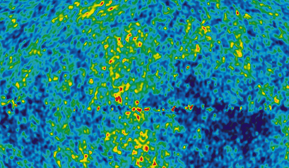
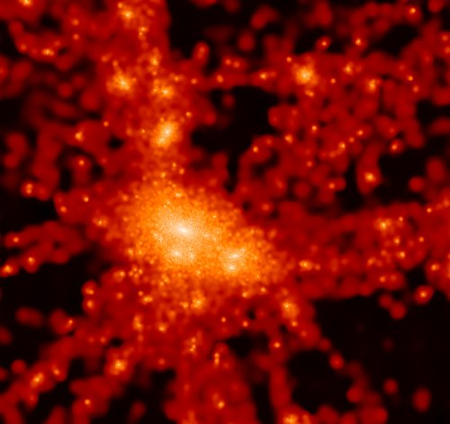
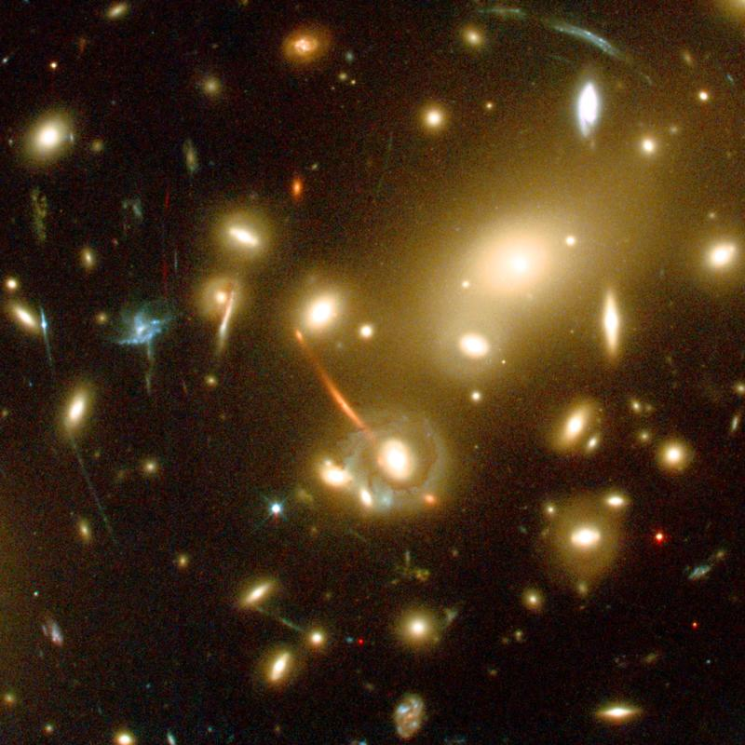
The idea of hierarchical galaxy formation
Hierarchical cosmology
Initial quantum fluctuations
gravity
Small structures
mergers
Big structures

Slide 4
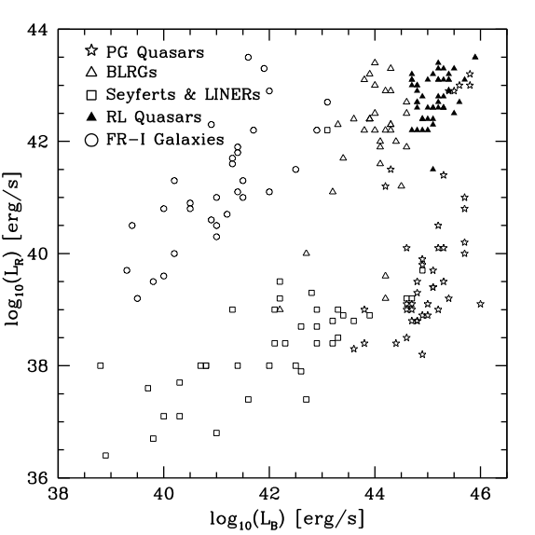
AGN on the optical-radio plane
Observational facts
AGN can be divided into two classes:
Radio-loud objects (strong jets).
Radio-quiet objects (no jets).
AGN form two distinct sequences on the L_{Β} –L_{Radio} plane:
Upper sequence: giant ellipticals with M_{SMBH}>10⁸M
Lower sequence: ellipticals and spirals with M_{SMBH}<10⁸M
Spin paradigm: the BH spin is believed to determine the radio loudness of an AGN.
Data: Sikora et al. 2007

Slide 5
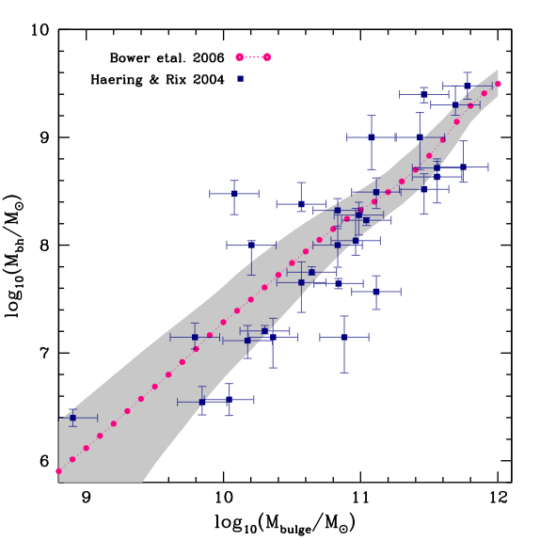
Essential ingredients
I. SMBH mass
SMBH growth in accordance with the M_{bh}-M_{bulge} relation.
Channels of SMBH growth:
Quasar mode (cold gas accretion)
Radio mode (hot gas accretion)
BH binary mergers
Quasar mode dominates BH growth
z = 0
Notes:
Results form semi-analytics

Slide 6
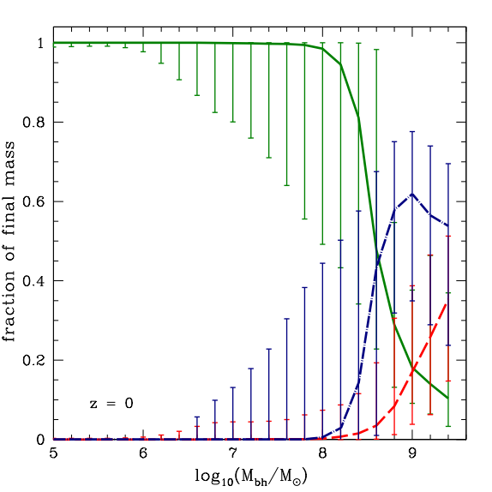
Essential ingredients
I. SMBH mass
SMBH growth in accordance with the M_{bh}-M_{bulge} relation.
Channels of SMBH growth:
Quasar mode (cold gas accretion)
Radio mode (hot gas accretion)
BH binary mergers
Quasar mode dominates BH growth
Quasar mode
Radio mode
BH mergers
z = 0
Notes:
Results form semi-analytics

Slide 7
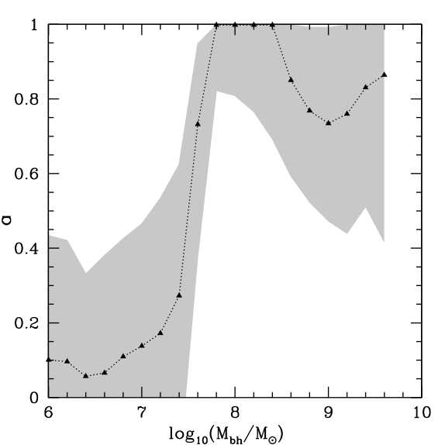
Essential ingredients
II. SMBH spin
BH spin evolves during:
Accretion of gas
BH binary mergers
Accretion dominates below ~10⁸M -- low spins.
Mergers dominate above ~10⁸M -- high spins.
z = 0

Slide 8
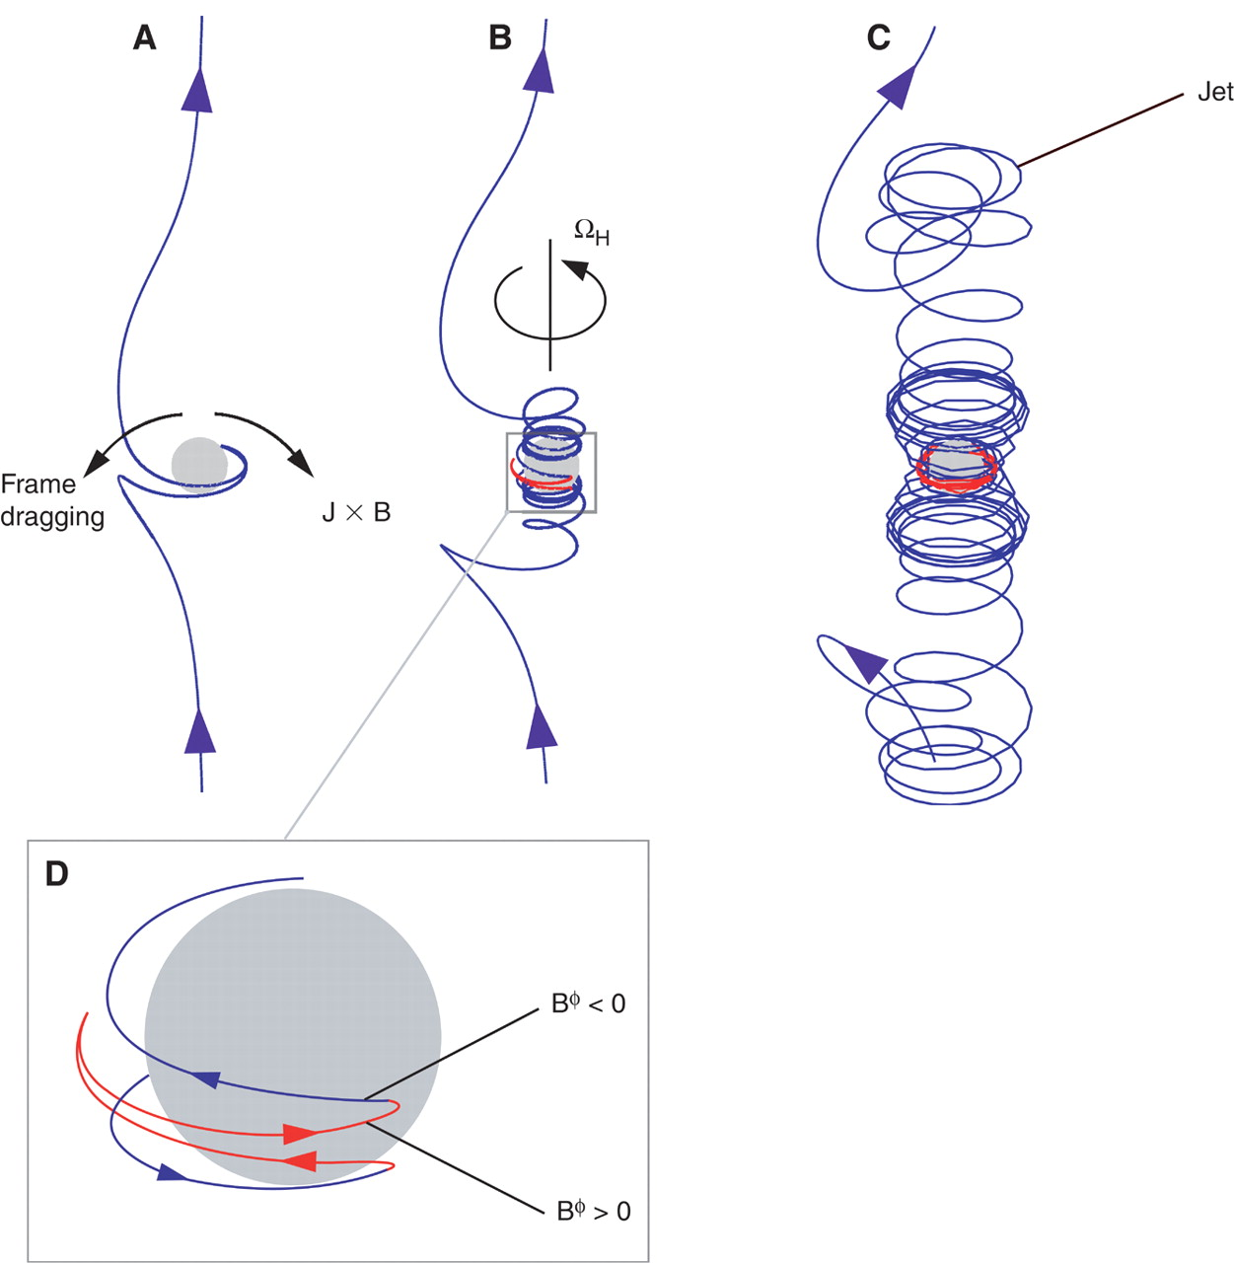
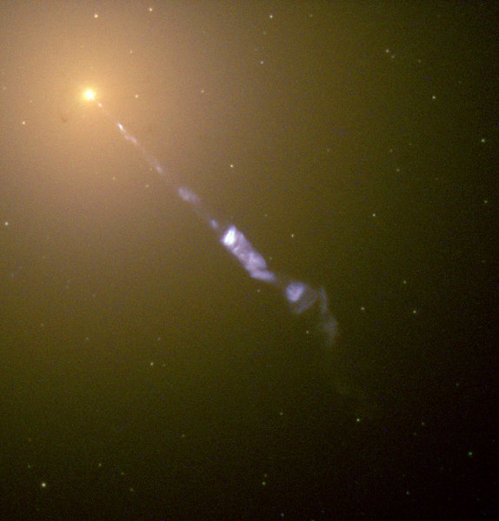
Modelling AGN: Radio jets
Jet formation:
Twisted magnetic lines collimate outflows of plasma.
The jet removes energy from the disk/BH.
The plasma trapped in the lines accelerates and produces large-scale flows.
The jet power increases proportionally to the BH spin:
Image source: Narayan+05
Blandford & Znajek 1977
M87

Slide 9
Modelling AGN: Accretion disks
Disk geometry depends on
the accretion rate!
Thin disk
Meier 2002
ADAF
Mahadevan 1997
Meier 2002

Slide 10
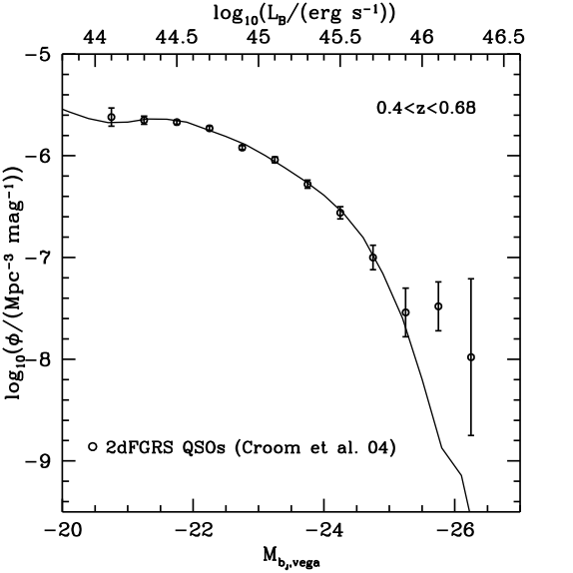
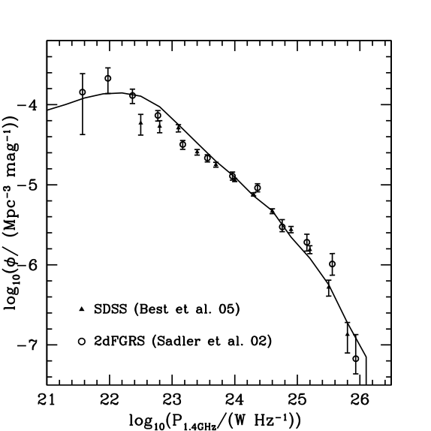
Results I: luminosity functions
Quasar luminosity function
Radio luminosity function

Slide 11
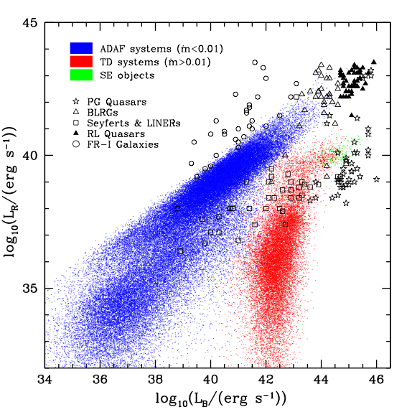
Results III: AGN radio loudness
AGN form two distinct populations:
Those powered by ADAFs
Those powered by thin disks
BHs in Seyferts accrete in the 0.01-1 regime. Those in radio galaxies below 0.01.
Radio-loud objects host rapidly rotating BHs.

Slide 12
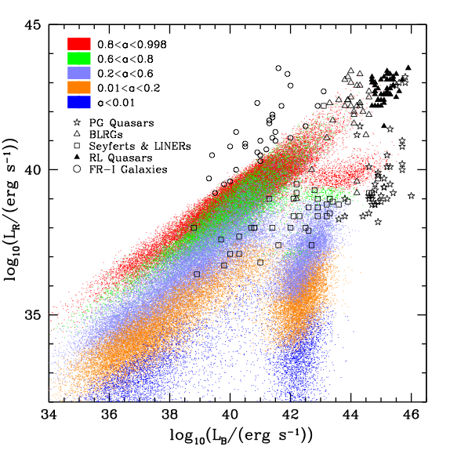
Results III: AGN radio loudness
AGN form two distinct populations:
Those powered by ADAFs
Those powered by thin disks
BHs in Seyferts accrete in the 0.01-1 regime. Those in radio galaxies below 0.01.
Radio-loud objects host rapidly rotating BHs.

Slide 13
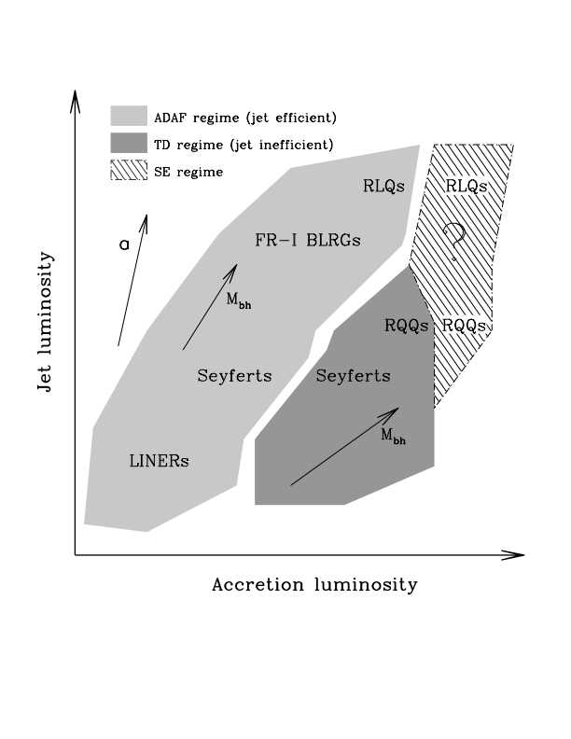
Results III: AGN radio loudness
AGN form two distinct populations:
Those powered by ADAFs
Those powered by thin disks
BHs in Seyferts accrete in the 0.01-1 regime. Those in radio galaxies below 0.01.
Radio-loud objects host rapidly rotating BHs.

Slide 14
Conclusions
We have developed a model for understanding the AGN activity in hierarchical cosmological models.
We find that in the present universe SMBHs have a bimodal distribution of spins.
Giant ellipticals are found to host massive SMBHs (M_{BH}>10⁸M_{sun}) that rotate rapidly, which confirms the spin paradigm.
In our model the radio properties of an AGN seem to be determined by the spin and accretion rate characterising the central SMBH.

Slide 15
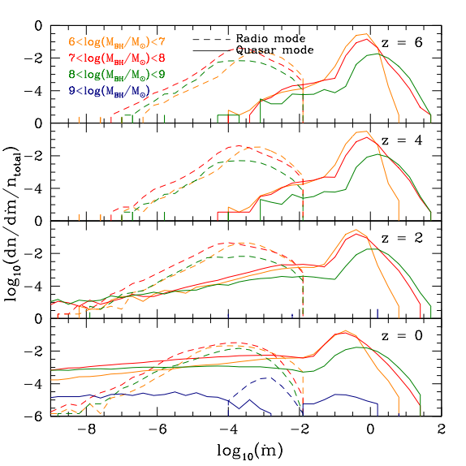
Essential ingredients
III. Accretion rates
BHs accrete more efficiently at high redshifts.
BHs in the radio mode accrete at:
Accretion rates peak at 0.01 in the quasar mode at z=0.

Slide 16
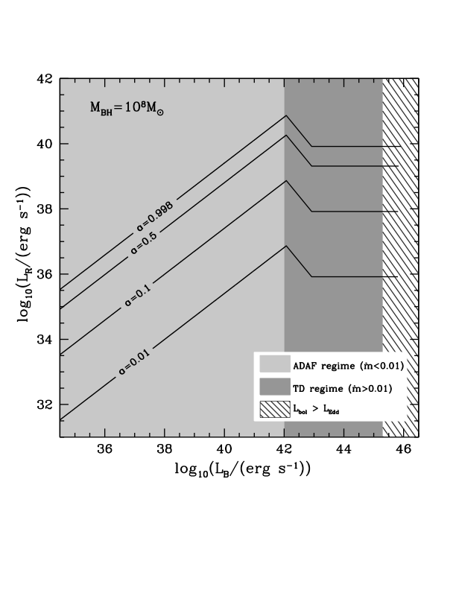
The optical-radio plane
The position of the objects on the optical-radio plane depends on:
the accretion rate
the BH spin
the BH mass
The jet strength is strongly affected by the accretion regime (ADAF/thin-disk)

Slide 17
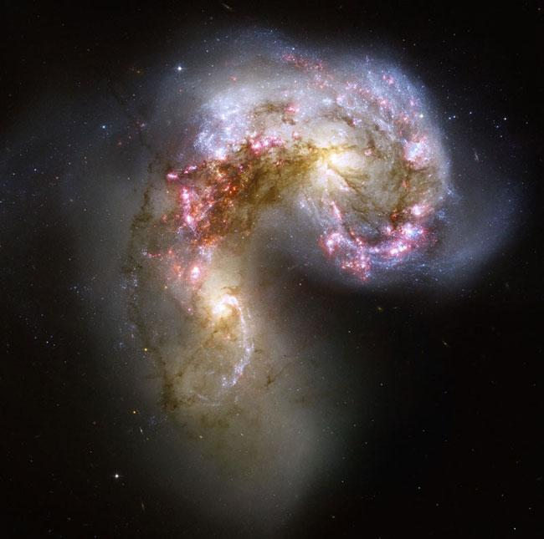
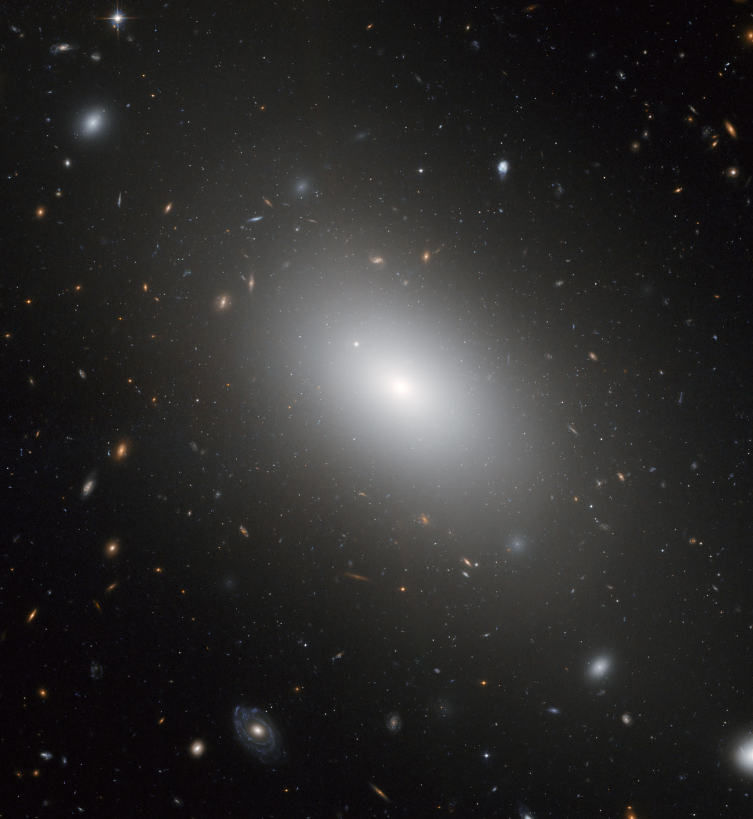
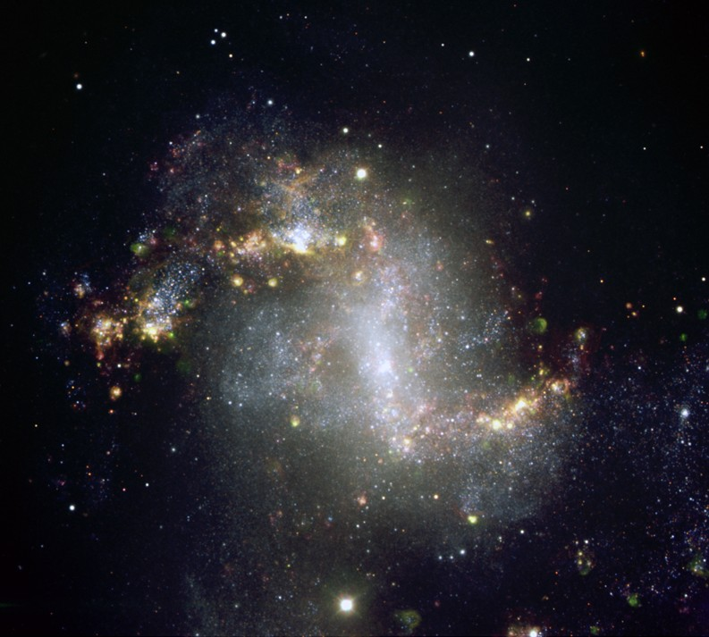
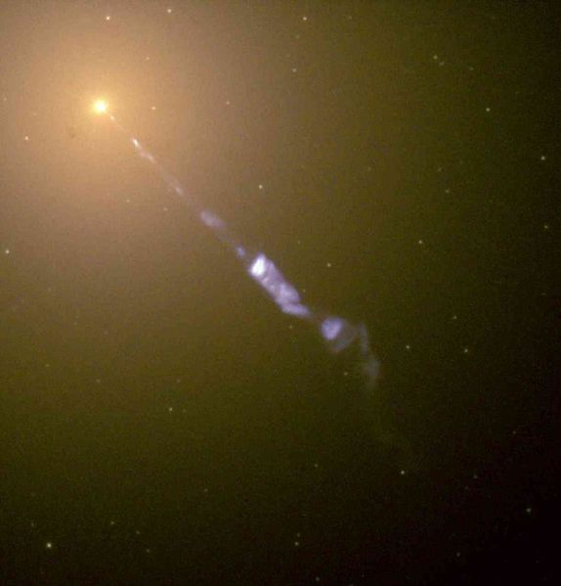
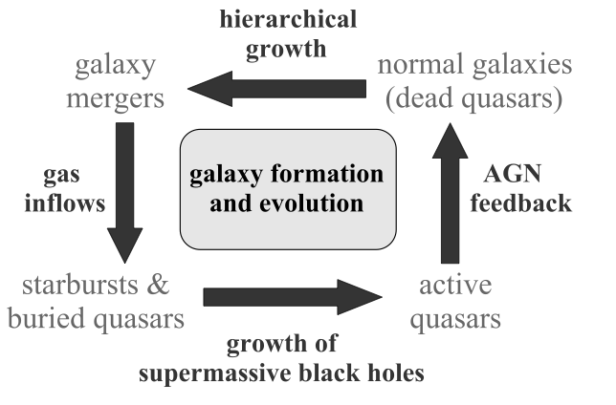
Hierarchical evolution of galaxies
Image source: Hopkins+06

