Slide 1
Quantum enhanced metrology
R. Demkowicz-Dobrzański¹, K. Banaszek¹, U. Dorner², I. A. Walmsley², W. Wasilewski¹, B. Smith², J. Lundeen², M. Kacprowicz³, J. Kołodyński¹
¹Faculty of Physics, Warsaw University, Poland
²Clarendon Laboratory, University of Oxford, United Kingdom
³Institute of Physics, Nicolaus Copernicus University, Toruń, Poland

Slide 2
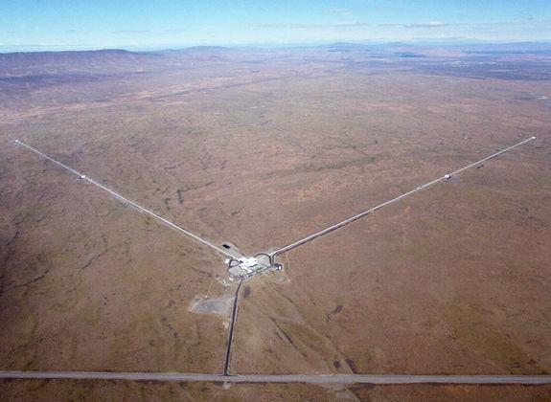
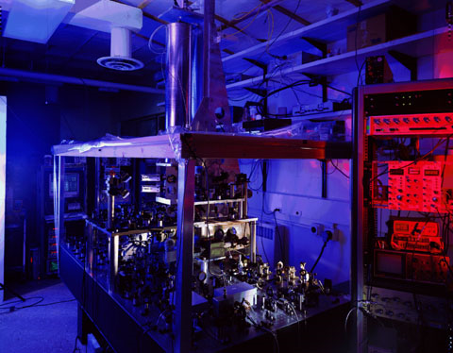
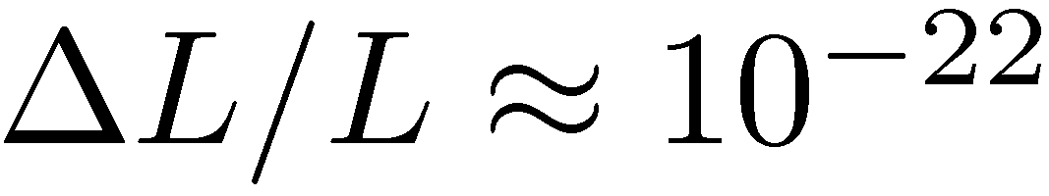
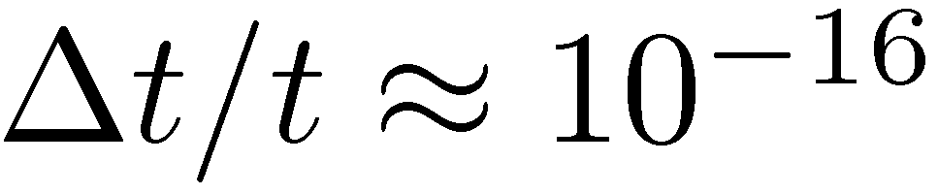
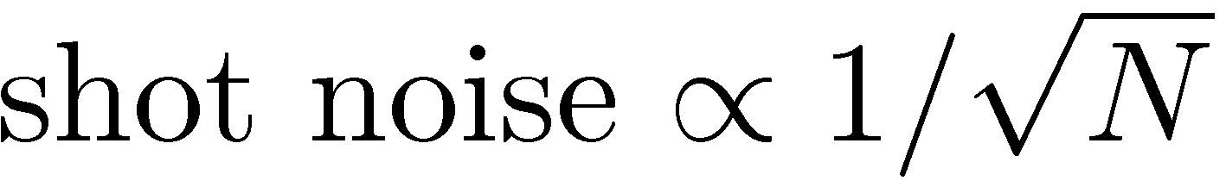
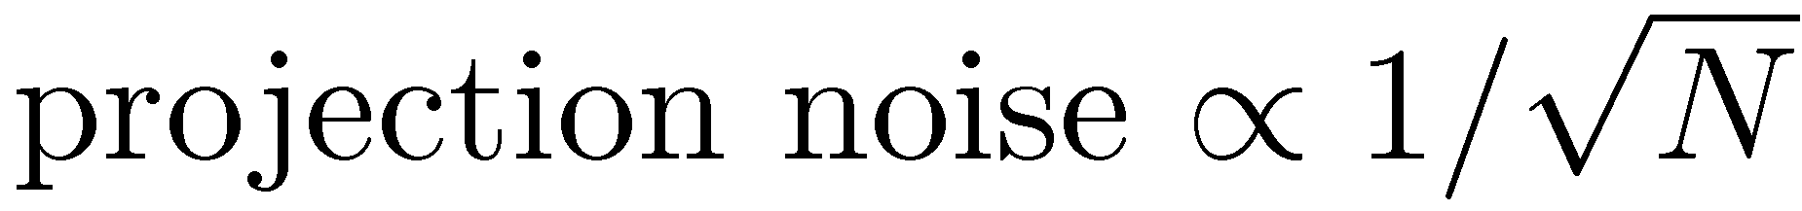
Interferometry at its (classical) limits
LIGO - gravitational wave detector
NIST - Cs fountain atomic clock
Michelson interferometer
Ramsey interferometry
Precision limited by:
Notes:
4km arms. Technical noise suppressed to the level that fundamental limitations such as the shot noise limits the precission.
LiGO can measure distance change of the order of 1/1000 diameter of a proton. NIST – the clocks losses one second in 60 mln years.
Mathematically the same problem.

Slide 3
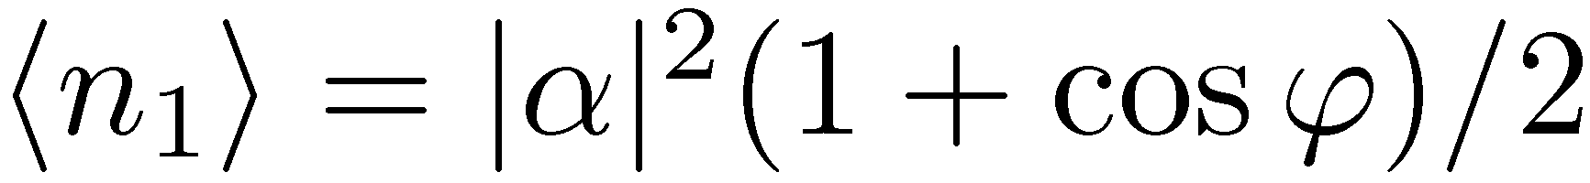

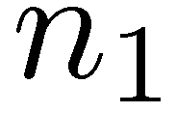
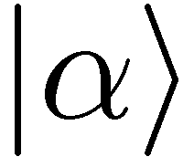
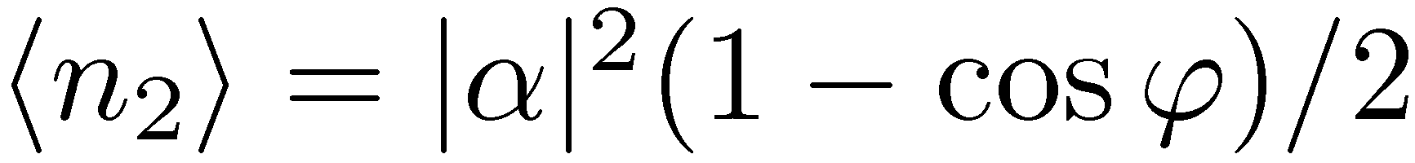
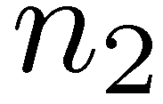
Classical phase estimation
detecting n₁ and n₂
+
knowing theoretical dependence of n₁, n₂ on ϕ
we can estimate ϕ

Slide 4
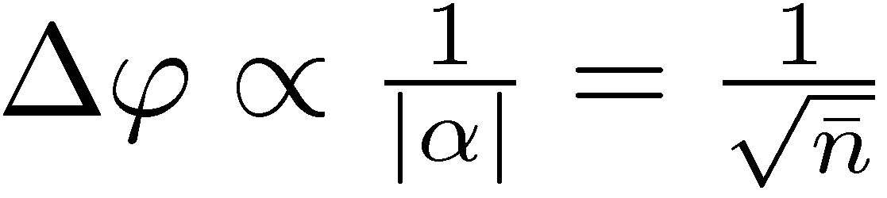
Classical phase estimation
n₁ and n₂ are subject to shot noise
each measurement yields a bit different ϕ
Shot noise scaling

Slide 5
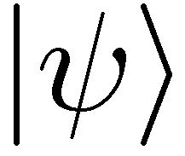
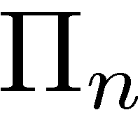
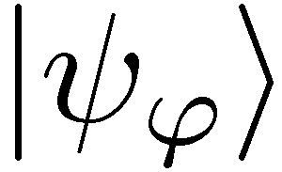
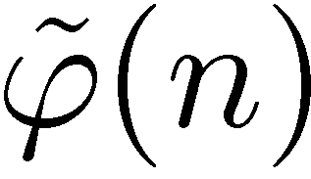
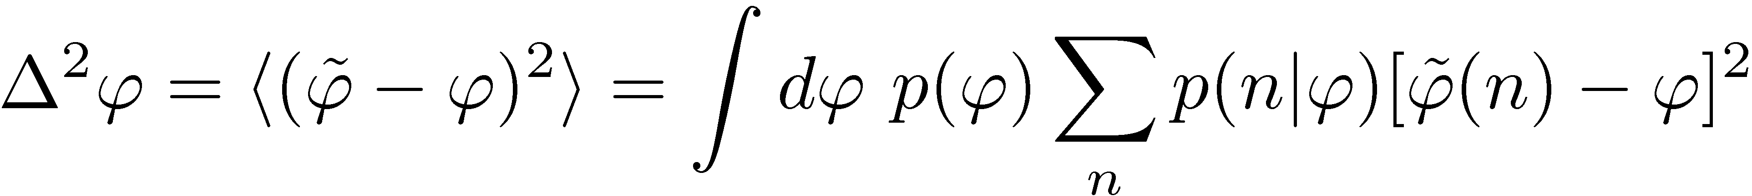
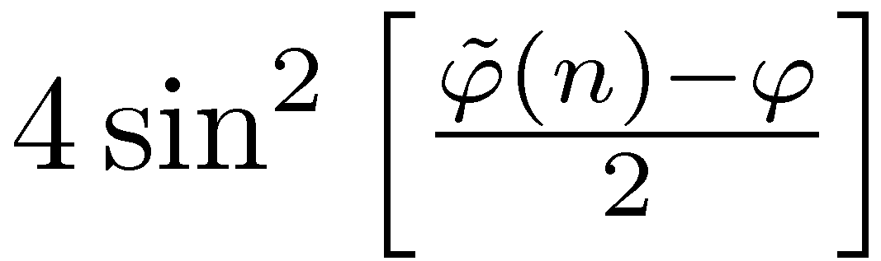
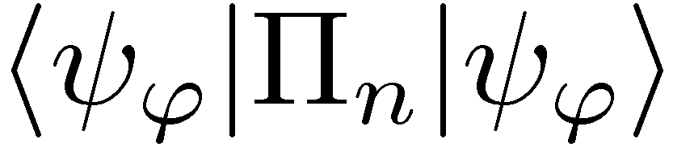
Quantum phase estimation
state preparation
sensing
measurement
estimation
a priori knowledge
In general a very hard problem!
Notes:
Most general input state (with given contraints: energy, number of particles), the most general quantum measurement

Slide 6
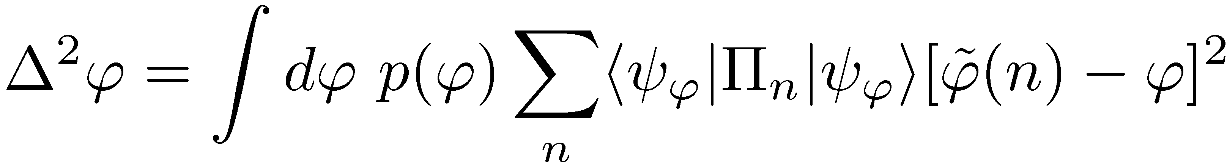
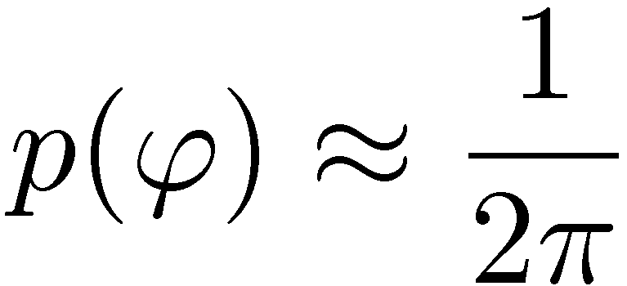
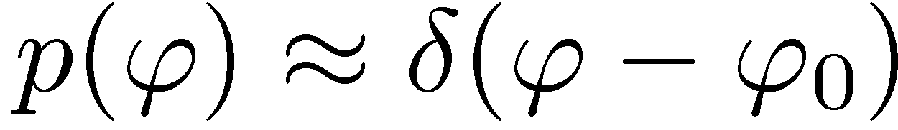
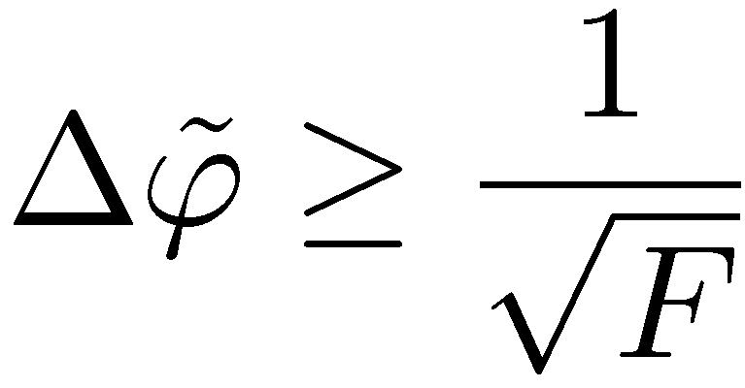
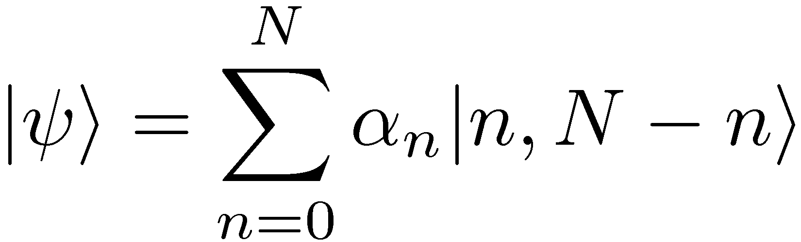
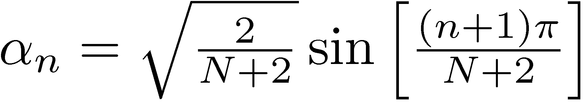
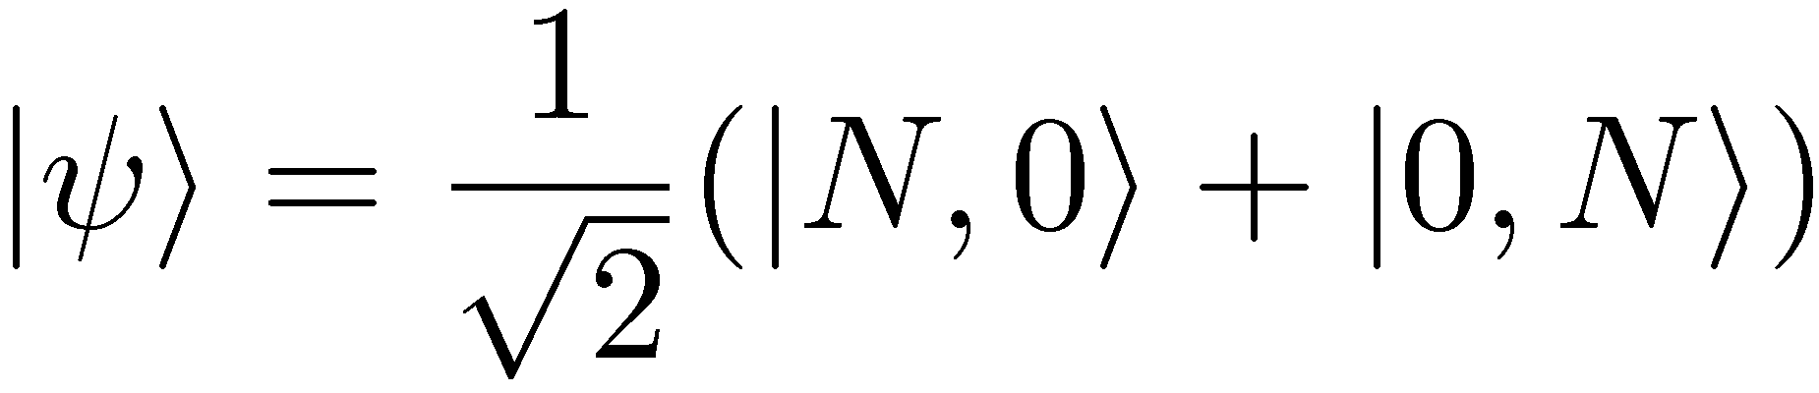
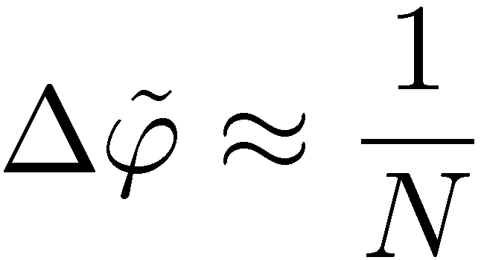
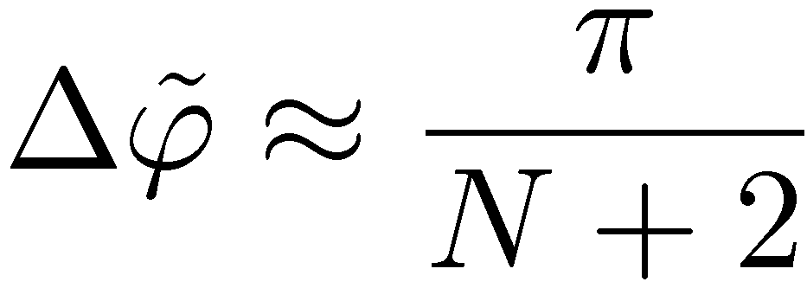
Local approach
Global approach
we want to sense small fluctuations around a known phase
no a priori knowledge about the phase
Tool: Fisher Information, Cramer-Rao bound
Tool: Symmetry implies a simple structure of the optimal measurement
Optimal state:
The optimal N photon state:
J. J. . Bollinger, W. M. Itano, D. J. Wineland, and
D. J. Heinzen, Phys. Rev. A 54, R4649 (1996).
D. W. Berry and H. M. Wiseman, Phys. Rev. Lett. 85, 5098 (2000).
Heisenberg scaling
Notes:
Two particular cases allowing for an analytical solution. First useful e.g. LIGO, atomic clocks, the second in calibration of unknown device

Slide 7
In reality there is loss…

Slide 8
Phase estimation in the presence of loss
state preparation
measurement
estimation
sensing + loss

Slide 9

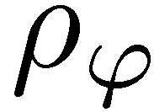
Phase estimation in the presence of loss
state preparation
measurement
estimation
sensing + loss
no analytical solutions for the optimal states and precission
calculating Fisher information not trivial (symmetric logarithmic derrivative)
phase sensing and loss commute (no ambiguity in ordering)
in the global approach the optimal measurements is not altered – the solution is obtained by solving an eigenvalue problem (fast)
effective numerical optimization procedures yielding global minima
R. Demkowicz-Dobrzanski, et al. Phys. Rev. A 80, 013825 (2009)
U. Dorner, et al.., Phys. Rev. Lett. 102, 040403 (2009)
Notes:
The loss can include both the inefficiency of detectors, loss in the sample or in the fibers etc…

Slide 10
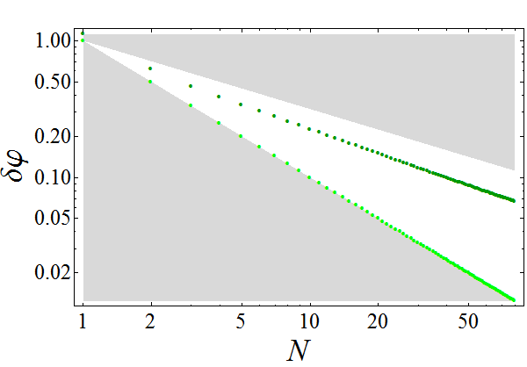
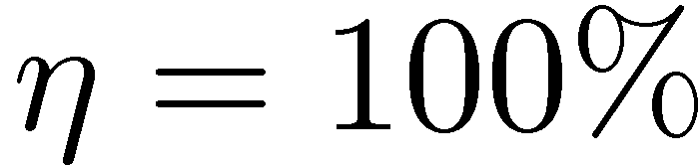
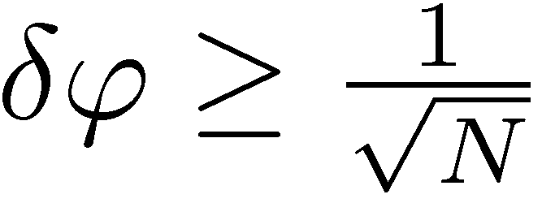
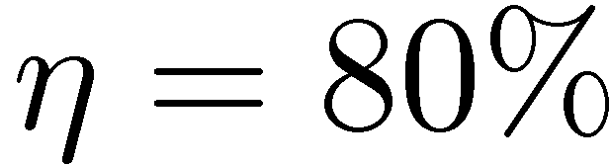
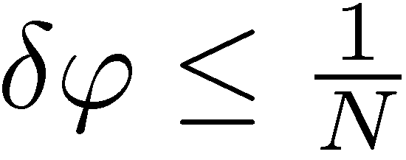
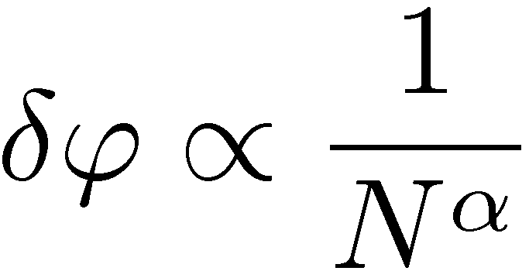
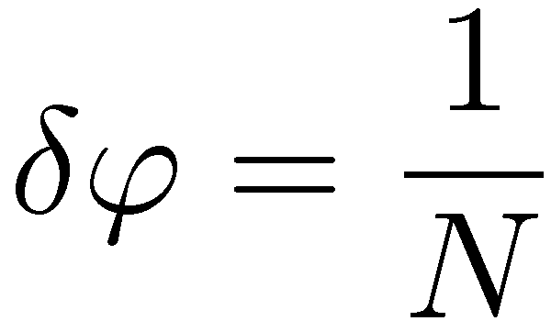
Estimation uncertainty with the number of photons used (local approach)
What is the scaling?
Heisenberg scaling

Slide 11
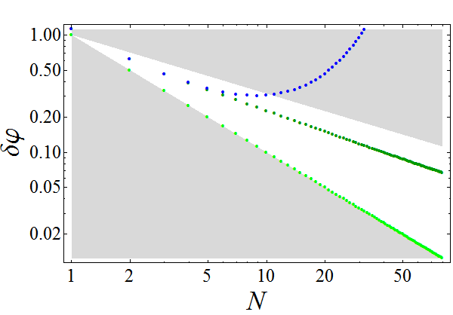
Estimation uncertainty with the number of photons used (local approach)
NOON state
What is the scaling?
Heisenberg scaling

Slide 12
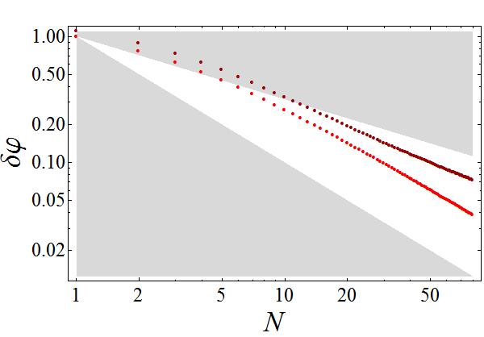
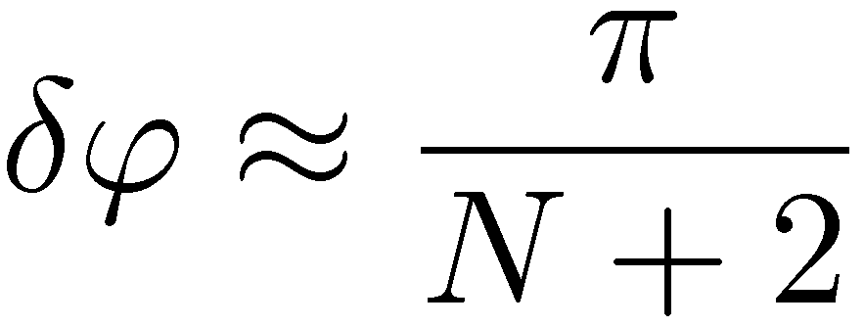
Estimation uncertainty with the number of photons used (global approach)
What is the scaling?

Slide 13
Do quantum states provide beter scaling exponent in the presence of loss?
Notes:
Numerical consideration njot sufficient

Slide 14
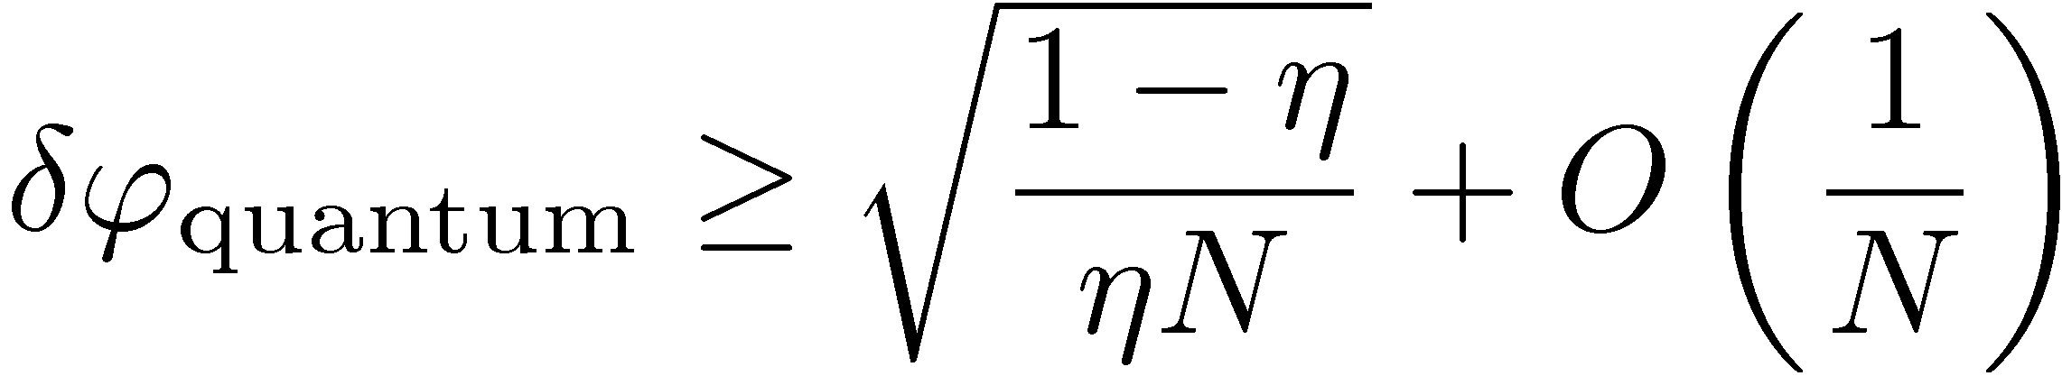
Fundamental bound on uncertainty in the presence of loss (global approach)
state preparation
measurement
estimation
sensing + loss
J. Kolodynski and R.Demkowicz-Dobrzanski, Phys. Rev. A 82, 053804 (2010)
the same bound can be derived in the local approach:
S. Knysh, V. N. Smelyanskiy, and G. A. Durkin, Phys. Rev. A, 83, 021804 (2011)
B. M. Escher, R. L. de Matos Filho, and L. Davidovich, Nature Physics, 7, 406 (2011).
Notes:
Global approach in the presence of loss is mathematically simpler hence we were able to bound the ucertainty. For large N we have shot noise scaling

Slide 15
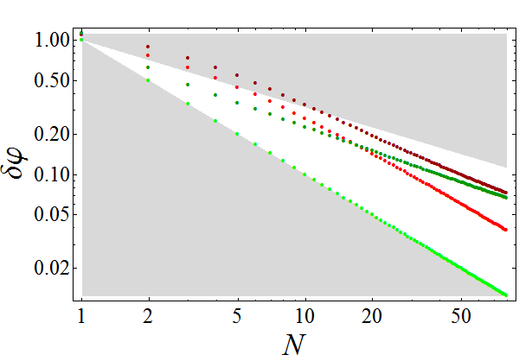
Fundamental bound on uncertainty in the presence of loss (global approach)
local approach:
global approach:

Slide 16
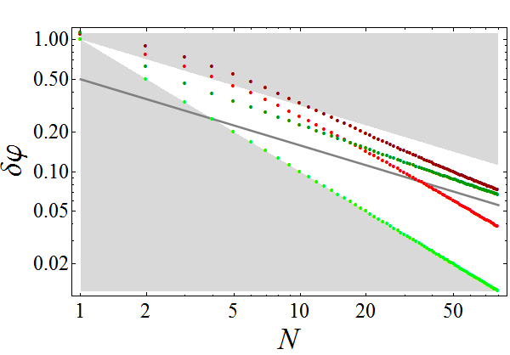
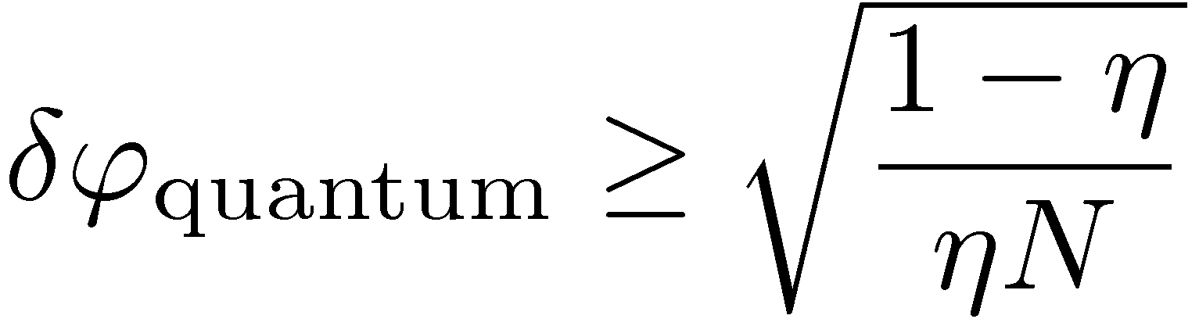
Fundamental bound on uncertainty in the presence of loss (global approach)
local approach:
global approach:
analytical bound for
J. Kolodynski and R.Demkowicz-Dobrzanski, Phys. Rev. A 82, 053804 (2010)

Slide 17
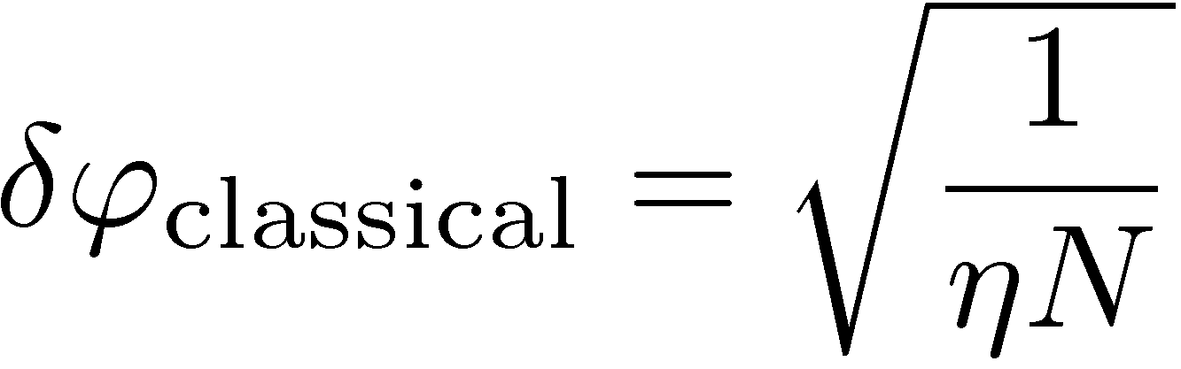
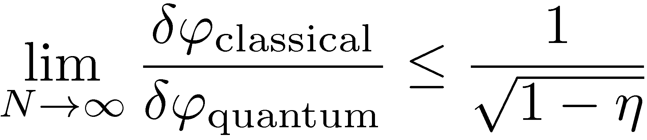

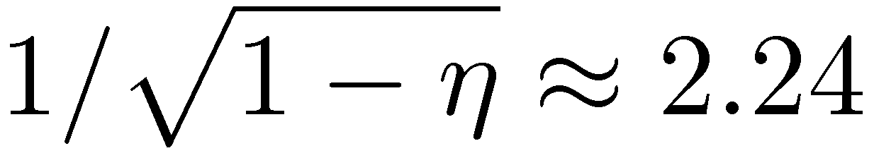
Fundamental bound on asymptotic quantum gain in phase estimation
Example:
even for moderate loss quantum gain degrades quickly
Notes:
For 20% loss, we cannot get more than 2.24 reduction in uncertainty

Slide 18
Summary
Asymptotically, loss renders quantum phase estimation uncertainty scaling classical and destroys the Heisenberg scaling.
Quantum states can be practically useful only for very small degree of loss (loss <1% implies gain> 10) or small number of probes
Neither adaptive measurements, nor photon distinguishability can help
K. Banaszek, R. Demkowicz-Dobrzanski, and I. Walmsley, Nature Photonics 3, 673 (2009)
V. Giovannetti, S. Lloyd, and L. Maccone, Nature Photonics, 5, 222 (2011).
U. Dorner, et al. Phys. Rev. Lett. 102, 040403 (2009)
R. Demkowicz-Dobrzanski et al Phys. Rev. A 80, 013825 (2009)
M. Kacprowicz, R. Demkowicz-Dobrzanski, W. Wasilewski, and K. Banaszek, Nature Photonics 4, 357(2010)
J. Kolodynski and R.Demkowicz-Dobrzanski, Phys. Rev. A 82, 053804 (2010)
S. Knysh, V. N. Smelyanskiy, and G. A. Durkin, Phys. Rev. A, 83, 021804 (2011)
B. M. Escher, R. L. de Matos Filho, and L. Davidovich, Nature Physics, 7, 406 (2011).

