Slide 1
The Economic Naturalist Writing Assignment DEE 2011
London: September 2011
Dr Wayne Geerling, School of Economics & Finance, La Trobe University

Slide 2
“Most students who take introductory economics seem to leave the course without really having learned even the most important basic economic principles” (Frank, 2006)
“When students are given tests designed to probe their knowledge of basic economics 6 months after taking the course, they do not perform significantly better than others who never took an introductory course” (Hansen, Salemi and Siegfried, 2002)

Slide 3
Description of Project
Addresses a question: Why do students who take Economics at an introductory level often leave the subject without understanding even the most basic economic principles?
Evaluates an alternative pedagogical device pioneered by Robert Frank: “The Economic Naturalist Writing Assignment”
Use evidence from my own classroom

Slide 4
Wherein lies the problem?
1. Too many concepts
2. Dismal science
3. Design of programs

Slide 5
1. Concepts
Most courses try to cover too many concepts
The idea that less is better in teaching economics is not new
Getting Economists to agree on a list of threshold concepts: new dilemma
Begin with a well articulated short list of principles: illustrate & apply
Students practice the principle: solve/pose/answer
Notes:
Frank, 2007
Becker, 2004
Frank, 2007
Frank, 2006

Slide 6
2. Dismal Science
Perception that the science is boring, inaccurate & gloomy
Slow to adopt innovative approaches to teaching
Traditionally:
Chalk & talk
Teacher-centred
Passive student learning
Reinforces notion of “dismal science”
Use of technology: “PowerPoint karaoke”, “Death by PowerPoint” or “Killing me Microsoftly”
Notes:
Becker, 2001, 2003; Becker and Watts, 1996, 2001

Slide 7
3. Programs
Economics programs usually designed with graduates & PhD students in mind: miniscule % of total 1st year
Diverse structure of offerings in economics:
Single or double degree
Major in a business-related degree
Majority of students who study economics: 1 or 2 semesters
Embed threshold concepts & engage students
Different way of presenting/assessing: not about different streams or content per se
Notes:
Figures vary considerably across universities
USA: 2% of students who take an introductory economics subject major in economics
UK: 60-70% - old uni’s which offer BEc/joint degree
0-20% - new/modern uni’s (no BEc)
QUT: no BEc: 10% - first or second major
Waikato: “ 13%

Slide 8
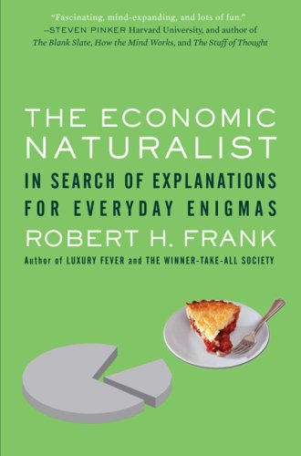

Slide 9
Economic Naturalist
Analogy with biology
Students develop own question: Grandma test
Maximum of 500 words
Narrative theory of learning: storytelling
Internalise knowledge
Re-orientate introductory classes: practice Economics

Slide 10
Economics of Everyday Life
New subject in 2010
1. Think like an Economist
2. Explain the intuitive logic of Economics
3. Apply economic reasoning to comprehend and solve problems in everyday life
4. Better understand the complexities of human behaviour
Adopted Frank’s writing assignment
Submit essay proposal

Slide 11
Impact on Student Learning
Allows students to make real-life connections
Promotes critical thinking skills & deeper learning
Lessens reliance on formalism; discourages rote learning
Consider various hypotheses rather than simple black/white dichotomies
Look for the counter-intuitive (Freakonomics)

Slide 12
Examples from the Classroom
Does McDonald’s three minute Drive-Thru Service lead to better outcomes for society?
The Market is Amoral: Should you buy the last can of coke on the shelf?
Why are designer denim shorts so expensive?
How has the contraceptive pill contributed to the split in the relationship market in Western societies?
Why are mobile phone calls more expensive than landline calls?
Why does a 600 ml bottle of coke cost so much more per litre than a 2 litre bottle?

Slide 13
The Market is Amoral
What do we mean by amoral?
Amoral NOT immoral
Scarcity: water/diamond paradox
Demand creates supply
How do markets work: who feeds Paris?
Moving on to coca cola...
MWP >P
Only 1 can left. 2 people wish to purchase same can
Altruism or self-interest?

Slide 14
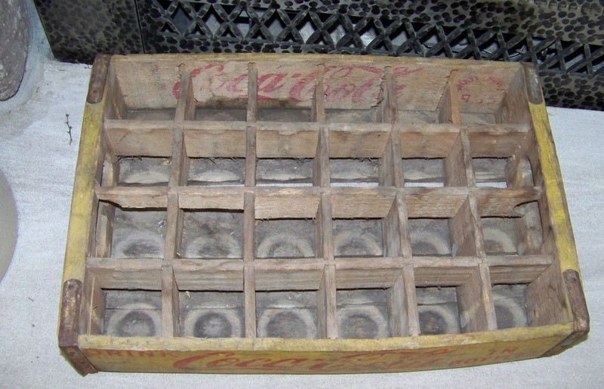

Slide 15


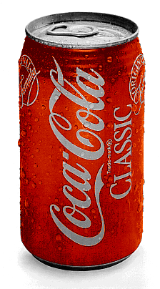

Slide 16
Altruism
Both sacrifice for the other
Information asymmetry: MWP?
Signalling could overcome problem
Danger of separating equilibrium
Negative externality imposed on seller
All parties lose (including 2 customers)
Market would collapse
Buy the coke unless...
You get more benefit from seeing someone else get it

Slide 17
Final Remarks
Test the hypothesis of Frank
Promotes greater student engagement & comprehension of material
Encourage students to apply economics in unconventional settings
Problem-based rather than content-based learning/assessment
Supplement assessment techniques in later years: apply techniques v reproduce proofs
Develop intuitive understanding of Economics

