Slide 1
Sharing lessons through effective modelling
Hilary Dexter University of Manchester
Tom Franklin Franklin Consulting

Slide 2
Workshop Outline
Introduction
What is modelling
An example of modelling
Exercise 1: Modelling a problem
Feedback
Exercise 2: Building a scenario and identifying solutions
Feedback and concluding comments

Slide 3
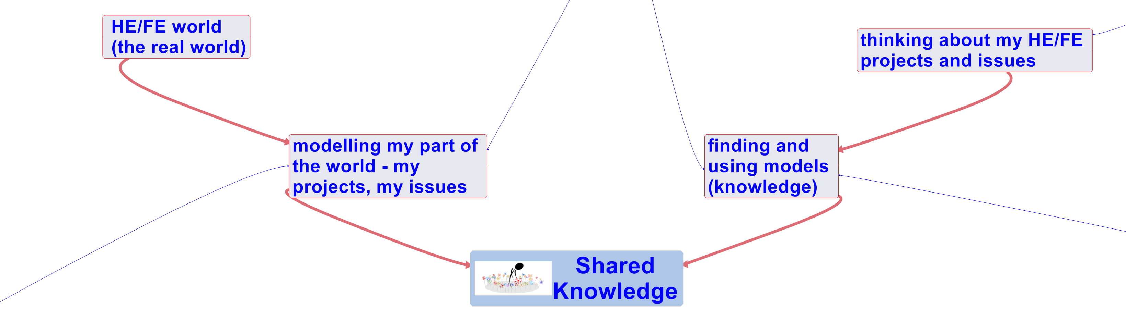
Modelling and shared knowledge
What is a model?
A model is an abstraction, which allows people to concentrate on the essentials of a (complex) problem by keeping out non-essential details.
Modelling is about building representations of things in the ‘real world’ and allowing ideas to be investigated
What is a modelling language?
What is a modelling medium?

Slide 4
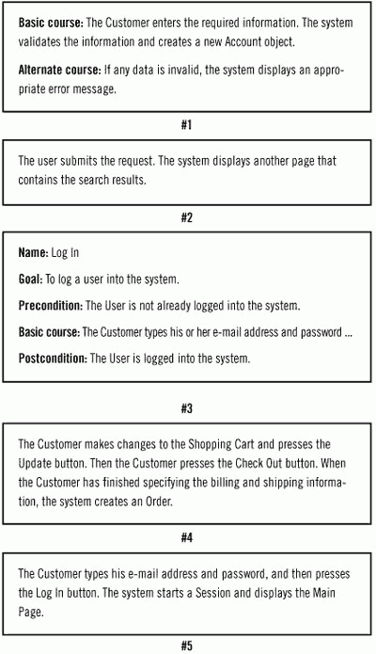
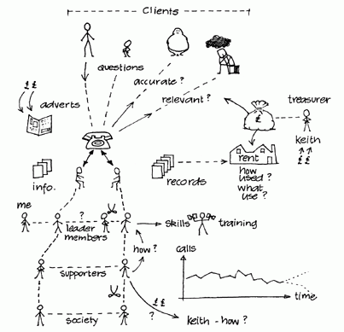
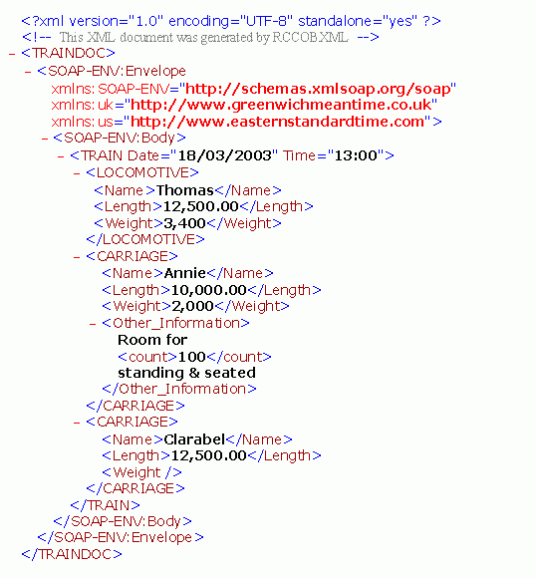
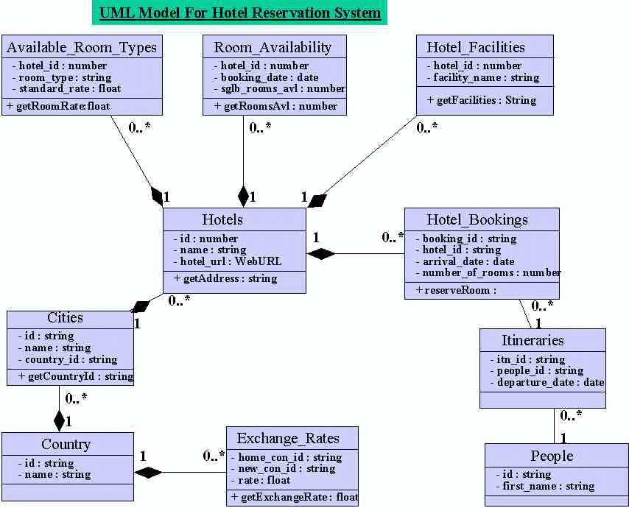
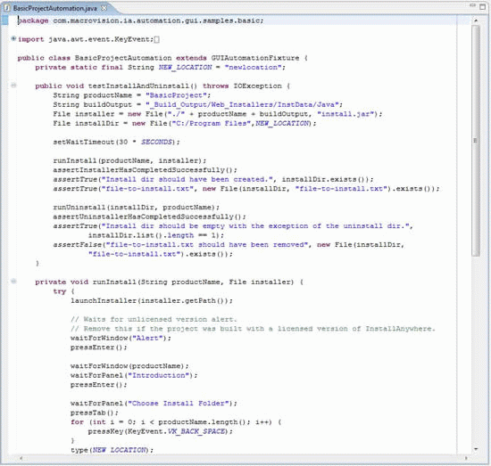
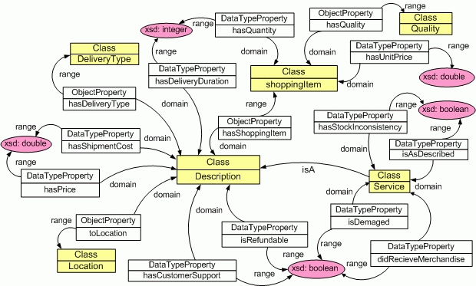
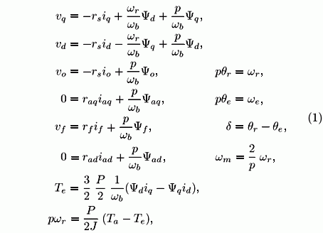
What is a modelling Language?
Text - descriptions of the issues and their context. These documents may be completely free of any structure or may conform to an agreed template.
Rich pictures - attempt to encapsulate the real situation through a cartoon representation. They are often used to describe a domain of interest, workflow or interactions between people.
Visual modelling notation - allows us to draw our systems of interest with a graphic language – a vocabulary of icons, shapes and lines. Examples are UML, SysML, BPMN and Archimate.
Markup languages - for describing data structures. Most widely used of these languages is XML from which have been derived many others, such as RSS, Atom, SOAP, and XHTML.
Mathematical notation - describes a system by a set of variables and a set of equations that establish relationships between the variables.
Ontology languages - a formal description of the meaning of the information stored in a system – it provides a shared vocabulary which can be used to model a domain i.e. the type of objects and/or concepts that exist and their properties and relations. Examples: RDF, OWL and OBO
Programming languages: Modelling in code e.g. the Java Modeling Language (JML)

Slide 5
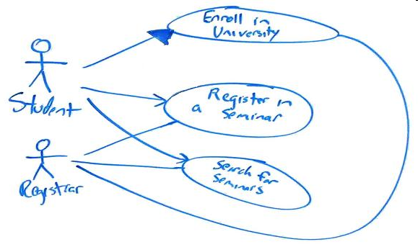
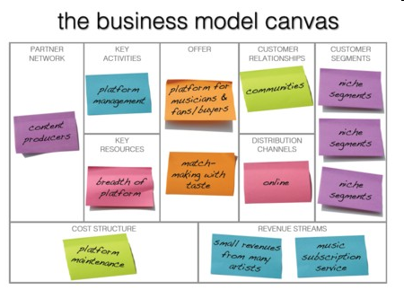
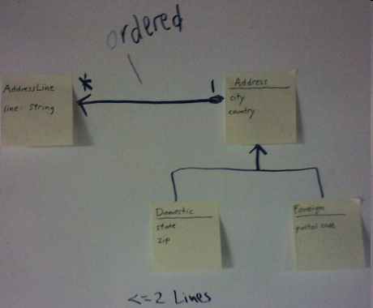
What is a modelling medium?
Models may be created on paper, in electronic text or graphics documents, in computer visual modelling tools, on whiteboards (photographed), on smartboards (snapshots) or with cards and post-its. The medium does not determine the modelling language. For example, if you have used a white board to concept map, label and comment things, a snapshot of the board will deliver a modelling output that is a mixture of visual notation (rich picture or boxes and lines) and accompanying text.

Slide 6
An example of modelling
Induction process
Motivation
High drop out rate of students
Different experience for distance and part-time students
Notes:
Based on work that we did for the University of Bolton

Slide 7
Induction process at
Bolton university
Notes:
Slightly simplified version of the model that we produced of the induction process at Bolton. I will explain the parts of the model and why they are there

Slide 8
Induction process at
Bolton university

Slide 9
Quality issues for
The induction process at Bolton university
Notes:
Issues and process improvement aspects

Slide 10
Induction process at
Bolton university

Slide 11
Student context for
The induction process at Bolton university
Notes:
About the students

Slide 12
Induction process at
Bolton university

Slide 13
Induction components for
The induction process at Bolton university
Notes:
The context for induction

Slide 15
Induction process at
Bolton university

Slide 16
Providers of
The induction process at Bolton university
Notes:
The roles (people) that are involved in the provision of induction

Slide 17
Induction process at
Bolton university

Slide 18
Delivery channels for
The induction process at Bolton university
Notes:
Ways in which induction is delivered

Slide 19
Exercise 1
Consider a problem that you are currently interested in (such as induction)
Outline some of the key aspects using the cards provided

Slide 20
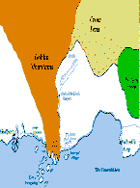
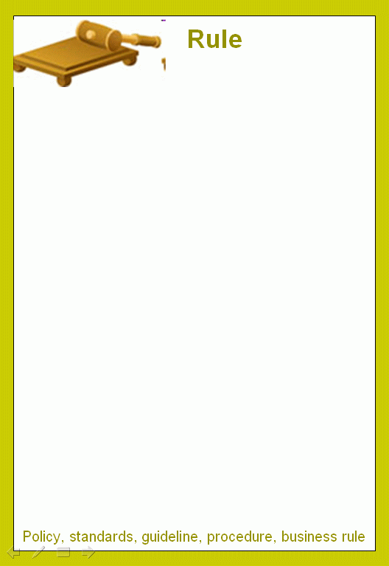





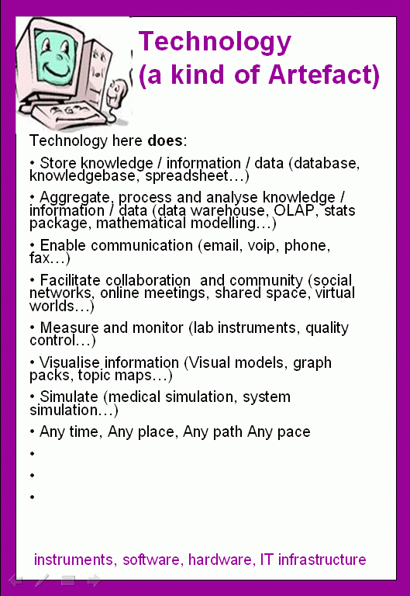
domain
role
artefact
[Topic, area of interest,
discipline, environment]
[set of responsibilities, position, job]
[things in the domain, resources,
outputs, documents]

Slide 21
Exercise 2
Process enhancement
Improving student induction – modelling the aspects

