Slide 1
Rhyming Words
The ot family

Slide 2
Choose a letter to make a word.
__ot
n
h
p
r
c

Slide 3

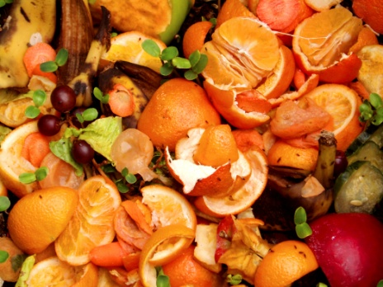
Try to spell the ot family words
not
cot
hot
pot
rot

Slide 4
Match the pictures to the words
hot
cot
pot
rot
not

Slide 5
Rhyming Words
The op family

Slide 6
Choose a letter to make a word.
__op
h
c
p
t
m

Slide 7

Try to spell the op family words
mop
cop
pop
top
hop

Slide 8
Match the pictures to the words
cop
pop
mop
top
hop

Slide 9
Rhyming Words
The ob family

Slide 10
Choose a letter to make a word.
__ob
c
j
s
r
m

Slide 11
Try to spell the ob family words
rob
mob
sob
job
cob

Slide 12
Match the pictures to the words
mob
rob
job
cob
sob

Slide 13
Rhyming Words
The od family

Slide 14
Choose a letter to make a word.
__od
c
r
p

Slide 15
Try to spell the od family words
pod
cod
rod

Slide 16
Match the pictures to the words
cod
pod
rod

Slide 17
Rhyming Words
The og family

Slide 18
Choose a letter to make a word.
__og
j
f
d

Slide 19

Try to spell the og family words
jog
dog
fog

Slide 20
Match the pictures to the words
dog
fog
jog

Slide 21
Rhyming Words
The ox family

Slide 22
Choose a letter to make a word.
__ox
b
f

Slide 23
Try to spell the ox family words
box
ox
fox

Slide 24
Match the pictures to the words
box
ox
fox

Slide 25
Rhyming Words
The oy family

Slide 26
Choose a letter to make a word.
__oy
b
t

Slide 27
Try to spell the oy family words
toy
boy

Slide 28
Match the pictures to the words
boy
toy

Slide 29
Rhyming Words
The ow family

Slide 30
Choose a letter to make a word.
__ow
c
b

Slide 31
Try to spell the ow family words
cow
bow

Slide 32
Match the pictures to the words
bow
cow

