Slide 1
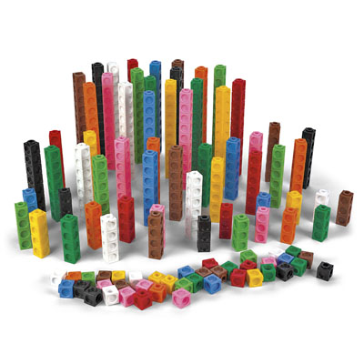
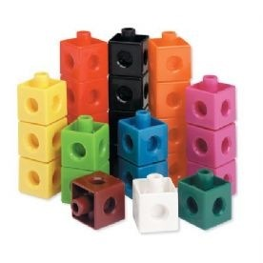
Doubling using multilink cubes
Year 1 Summer Term

Slide 2
Start off with 1 cube
Build a tower the same as the one you have already.
Put them on top of each other.
How many do you have now?

Slide 3
Start off with 2 cubes
Build a tower the same as the one you have already.
Put them on top of each other.
How many do you have now?

Slide 4
Start off with a tower with 3 cubes
Build a tower the same as the one you have already.
Put them on top of each other.
How many do you have now?

Slide 5
Start off with a tower of 4 cubes
Build a tower the same as the one you have already.
Put them on top of each other. How many do you have now?

Slide 6
Start off with a tower of 5 cubes
Build a tower the same as the one you have already.
Put them on top of each other.
How many do you have now?

Slide 7
Start off with a tower of 6 cubes
Build a tower the same as the one you have already.
Put them on top of each other.
How many do you have now?

Slide 8
Start off with a tower of 7 cubes
Build a tower the same as the one you have already.
Put them on top of each other.
How many do you have now?

Slide 9
Start off with a tower of 8 cubes
Build a tower the same as the one you have already.
How many do you have altogether now?
What is double 8?

Slide 10
Start off with a tower of 9 cubes
Build a tower the same as the one you have already.
How many do you have altogether now?
What is double 9?

Slide 11
Start off with a tower of 10 cubes
Build a tower the same as the one you have already.
How many do you have altogether now?
What is double 10?

Slide 12
Start off with a tower of 15 cubes
Build a tower the same as the one you have already.
How many do you have altogether now?
What is double 15?

Slide 13
Now go and build some towers and double them on your own!

