Slide 1

A c t i o n!
A c t i o n!
A c t i o n!

Slide 2

SC Global 2001
At SC2001, we will create SC Global, the first truly global technical conference on the Grid: A multi-national and multi-cultural meeting place for communication and discussion of ideas relating to high-end computing and communications and their impacts on science and society.

Slide 3
Introductions
At each site, please me know:
  your name
  your organization
  your role in SC Global (talk, BOF, panel, participant)
  location – home or Denver?
  has your organization ever been to SC
  you are going to give a talk today (do you want a serious or a fun question thrown at you)

Slide 4
Making the Most of your Presentation
Cameras should be adjusted optimally
Speaker maintains eye contact, speaks clearly, and provides high energy
Use only pretested visual aids (dppt)
Be aware of physical cues from whole audience
Pause if technology fails, or if other events temporarily disrupt the event. Be sure to inform your “virtual” audience what is happening
“There is nothing worse than an empty chair hanging on a wall.”
…an inspirational AG phrase from Mary Fritsch

Slide 5
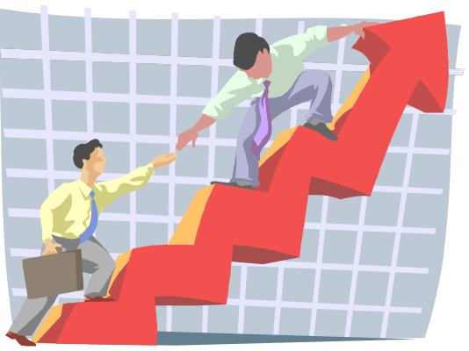
Be a Smooth Operator (on or off camera)
The idea is to:
  field an inquiry
  answer with assistance, not
  necessarily instant information
  try not to pass the buck
  follow up, closure
Embrace the AG concept (community). Be ready. Never say I don’t know, but instead I will find out.
Have a canned response if you must.
Know all your standard points of contacts, hubs of information, general URLs, basic SC2001 overview and information.

Slide 6

Working without a Net
During the SCGlobal event make sure you have easy access to your node operator, site producer, and network administrator.
Stay connected via mud, email, pagers, floor point of contacts.
Be assertive, stay constructive – ask for help when you need it.

Slide 7
Several Types of Events
http://www.mcs.anl.gov/scglobal/prelim_program.htm
Primarily Discussion
  Birds of Feather sessions (BOFs)
Primarily Lecture
  Talks
  Workshops
  Tutorials
Other
  Panels
  Art

Slide 8
Simple Facilitation Tools
Each event has a Production Plan, developed by the Producer in collaboration with the speaker or moderator and the SC Global Production Manager.
Is there anyone that is providing content for SCGlobal that does not yet have or does not know the location of their site’s Production Plan?

Slide 9
Cheat Sheets
Access Grid Presentation Pointers
Your audience:
Remember that your “virtual” audience is very much real – and in some cases will vastly outnumber the audience which is physically in the same room as you are.
Remember possible cultural differences - know who you are speaking to when possible.
Reduce and try to completely eliminate all “detractors” (pauses filled with “um…” etc).
Invite audience participation and interactivity when possible (with explicit statements of how it will be moderated – speak to the crew at your AG node for details on how to moderate your particular session)
Be sure to look for physical cues from your audience, as the microphones may not be open at all participating sites (ie, you may not be able to hear them gasping in surprise, or shuffling papers)
The camera/microphone:
Pretend you are speaking to one person. Perhaps place something on top of the camera to look at if you find this helpful.
Maintain confidence - maintain camera “eye contact”.
You may need to work with the technical staff to ensure the camera is placed well; check with them if you have any questions.
Speak clearly and slowly.
Work with your technical staff to learn appropriate microphone use.
Use high-energy delivery.
Pause if technology fails, or if other events temporarily disrupt the event – be sure to inform your “virtual” audience what is happening, or wait for their “return” before continuing with your talk.
Be animated in your delivery - you don’t have the luxury of in-room body language - But stay in camera range please! (Remember your virtual audience sees you in a frame).
The presentation and questions:
In general, avoid patterned clothing, especially busy, detailed patterns.
Choose solid, bright colors that will translate well over the AG technology.
If possible, seat yourself or stand under bright light.
Ensure there are no lights behind you or any source of lighting such as a window.
Be sure to talk with your production team on how remote questions and answers will be handled at the end of the presentation.

Slide 10
On the Spot
  will tell us their hardest lessoned learned in node oping
  will tell us what they would love to do to better with their AG node (assuming time and money were not an issue)
  will explain how the AG is different from typical video conferencing
  will give us an overview of their organization
  will discuss their least favorite subject in college
  will tell us which AG node they would like to visit and why
  will run through an outline of their production plan
  will give us some gossip on their company (or at least discuss its simple management structure, their boss, heirarchy in place)
  will tell us about the best vacation they ever had
  will tell us about the weather there this week
  will tell us about their first job they ever had
  will tell us about his favorite cuisine

Slide 11
A Simple Plan
Denver
HUB

Slide 12
And We’re Off
“Welcome. We have a wonderful collection of speakers with us from all around the world, who will be sharing their knowledge and expertise with you today. I would like to start things out with Mary Fritsch here in Denver. She will give us an overview of Security Policies and Clearances at Argonne National Laboratory.”

Slide 13
Speaker Clarified-Has the Floor
Denver
HUB

Slide 14
Mary Fritsch - ANL
Hello everyone, as Mary said my name is Mary Barthel, and I work for Argonne National Laboratory (ANL). Today, however, I am coming to you live from the SC2001 convention floor Booth #352. I wanted to discuss the current security policies in place at Argonne. Basically, in light of current affairs security has been stepped up quite a bit at ANL. Previously, badges and gate passes were rarely visible, and cars were cleared by a windshield sticker only….. 911 system….on showroom floor security for ANL booth continues…

Slide 15
Denver MC Has the Floor
Denver
HUB

Slide 16
MC Fields Questions (usually alphabetic by site)
Denver
HUB

Slide 17
Speak Up
This is a checklist to help everyone remember the basics “after” they have presented.
Did they speak up?
Did they look enthusiastic (or fake it)?
Did they look confident?
Did they repeat their Name/Company
Did they thank audiences for their questions?

Slide 18
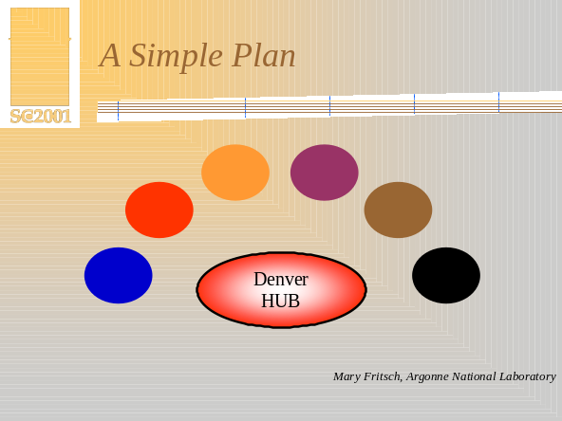
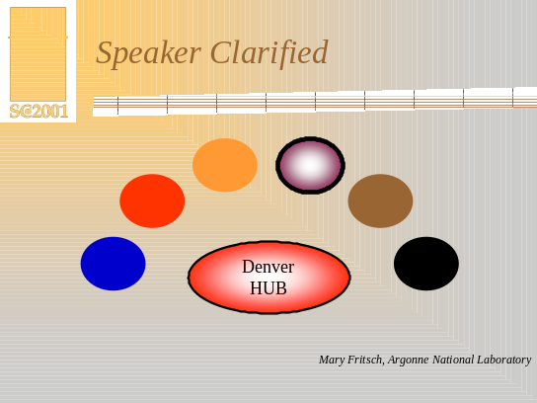
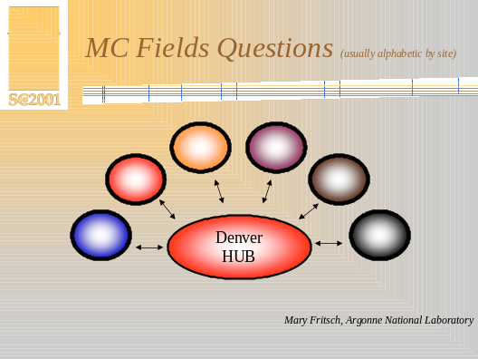

Slide 19

Production Plans-Content
Access Center - Washington, DC USA
Albuquerque High Performance Computing Center - University of New Mexico - Albuquerque, New Mexico USA
Antarctica
Arctic Region Supercomputing Center, University of Alaska-Fairbanks - Fairbanks, Alaska USA
Argonne National Laboratory - Argonne, Illinois USA
Beijing University of Aeronautics and Astronomics - Beijing, China
Boston University, Boston, Massachusetts USA
CINECA - Bologna, Italy
Denver Convention Center (SC01 Hub Site)
Florida International University - Miami, Florida USA
Johnson and Johnson - Raritan, New Jersey USA
Juelich Research Center, Juelich Germany
Lawrence Berkeley National Laboratory
Lawrence Livermore National Laboratory - Livermore, California USA
Los Alamos National Laboratory - Los Alamos, New Mexico USA
National Institute of Advanced Industrial Science and Technology, Tsukuba Japan
NCSA, Urbana-Champaign, Illinois USA
Ohio Supercomputing Center - (don't know state?), Ohio USA
Pittsburgh Supercomputing Center
Sheridan College/University of Toronto - Toronto Canada
The University of Montana - Missoula, Montana USA
TRACE Center at University of Wisconsin-Madison - Madison, Wisconsin USA
University of Chicago - Chicago, Illinois USA
University of Florida - Gainesville, Florida USA
University of Manchester - Manchester UK
University of New Mexico, Albuquerque, NM
University of Stuttgart - Stuttgart, Germany
University of Sydney, Sydney, Australia
University of Washington, Hit Lab

Slide 20

Possible Halloween Cruise
Wednesday, Oct 31
It will only be scary if you aren’t prepared!
check website –
11am Central Standard Time/ UTC 1700
domestic, germany, italy and england
11pm Central Standard Time/UTC 0500
asia and australia

Slide 21

Thanks and Questions

