Slide 1
Status of Data Handling For Analysis
Adam Lyon (FNAL/CD/DØ)
February 2004 Collaboration Meeting
Outline:
The SAM Project
Current Operations
Future plans
Some Tips
Shifters needed
Won't mention reprocessing, specific remote issues

Slide 2
What is SAM? More than just a file server!
Data handling system for Run II DØ
SAM manages file storage
  Data files are stored in tape systems at FNAL and elsewhere (most use ENSTORE at FNAL)
  Files are cached around the world for fast access
SAM manages file delivery
  Users at FNAL and remote sites retrieve files out of file storage. SAM handles caching for efficiency
  You don't care about file locations
SAM manages file cataloging
  SAM DB holds meta-data for each file. You don't need to know the file names to get data
SAM manages analysis bookkeeping
  SAM remembers what files you ran over, what files you processed, what applications you ran, when you ran them and where
Designed for PETABYTE (10¹⁵) sized experiment datasets (that's us)!
Notes:
SAM stands for "Sequential data access via meta-data"

Slide 3
Who is working on Data Handling?
SAM Project Co-leaders
  Wyatt Merritt (DØ), Rick St. Denis (CDF)
SAM Project Technical Leaders
  Sinisa Veseli (DØ), Rob Kennedy (CDF)
SAM Contributors:
  CCF: Andrew Baranovski, Gabriele Garzoglio, Igor Terekhov
  CEPA: Carmenita Moore, Steve White (0.5 FTE)
  CDF: Randy Herber, Art Kreymer, Stefan Stonjek (GS)
  DØCA: Lauri Loebel Carpenter, Robert Illingworth, Adam Lyon
Others: D0-primary (Joe Boyd, …);
DB Support (Julie Trumbo, Steve Kovich, …)
Notes:
CCF stands for Computing and Communications Fabric (SAM part is under "Middleware Applications")
CEPA stands for Computing and Engineering for Physics Applications

Slide 4
SAM-GRID Projects What are all those people doing?
Active Subprojects: C++ API, DBServer, JIM, H Stream Reco for CDF, Caching, Chains&Links, CDF DFC, Test Harness, Linux deploy of DBServers, Config Man
Planned Subprojects: Request system, Autodest, Further monitoring (MIS)
Related Subprojects: d0tools, SBIR II, Condor mods, workflow packages for CDF & D0, Authorization & Accounting
Recently completed Subprojects: Python API, V5.1 Schema Design, Batch Adapter, D0 Online dcache TDP, 1st Gen Monitoring Tools, Data Dimensions Grammar
Lots of people are working very hard.
SAM being used by CDF and MINOS. CMS examining components.

Slide 5
Current SAM Configuration
(user facilities) at FNAL
central-analysis
  The d0mino station; very large central cache [10 TB]; efficient for pick events; will disappear
cab
  Main analysis farm; 167 nodes; station runs on d0mino; will eventually merge with cabsrv1
cabsrv1
  "New Experimental Cab"; 160 nodes; station runs on linux server; newer machines (faster CPU, more memory, more cache disk, GB ethernet, "better" PBS); will grow
clued0
  Desktop cluster; 60 nodes; will grow
New Linux Fileservers
  50 TB for central cache! Are present, but not being used yet.

Slide 6
Experimentation
There are many station parameters to tune
  Maximum parallel transfers
  Maximum concurrent enstore requests
  Configuration of cache disks
  …
We're moving away from d0mino to Linux
  How robust are these linux machines?
  How many "pmasters" can they run?
  How many concurrent file transfers can they handle?
Running test harness on a small cluster to explore SAM parameter space

Slide 7
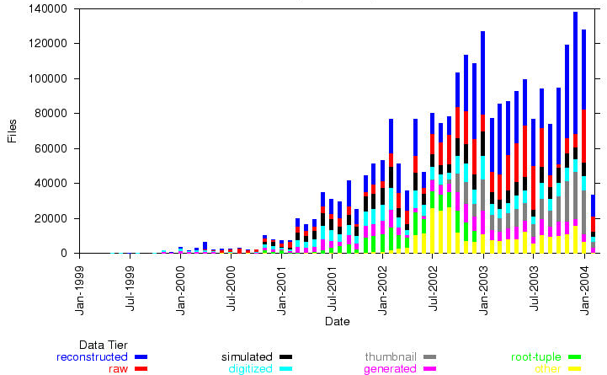
Sam Statistics Files delivered by month
1999
2000
2001
2002
2003
Run II Begins

Slide 8
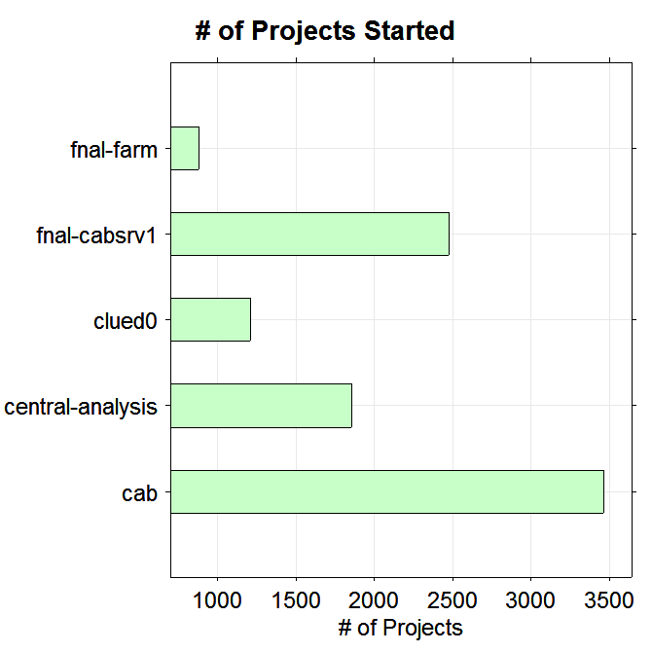
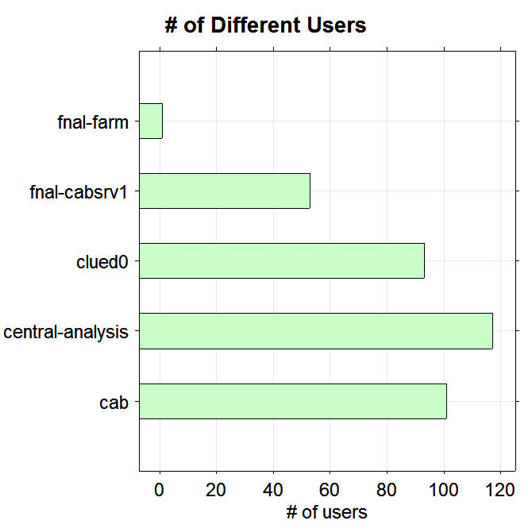
SAM Statistics How much is SAM being used?
Data from early January 6 until February 24
9000 Projects!
233 Different Users!

Slide 9
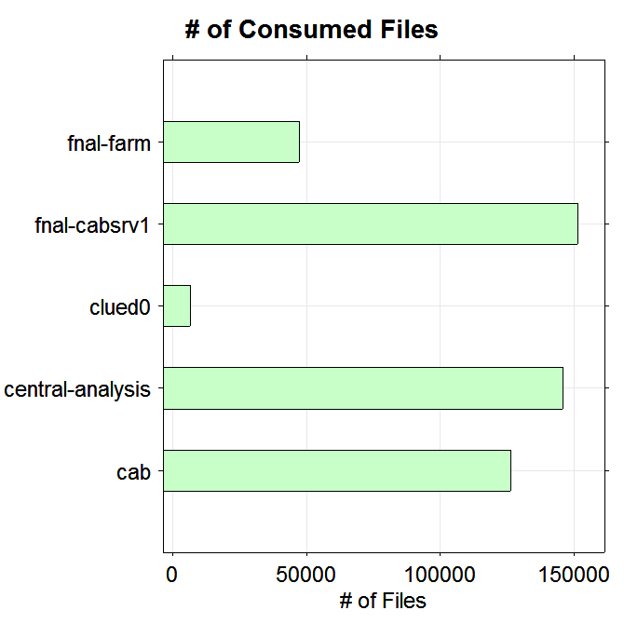
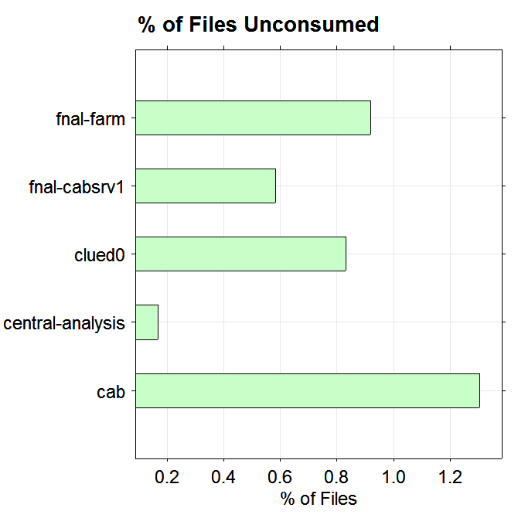
SAM Statistics How much data has been analyzed?
~500K Files!
~1%

Slide 10
Problems
SAM relies on a working hardware and software
… but SAM can recover from unforeseen problems (losing all projects is extremely rare)
Software Problems
  Rare bugs in sam_station and sam_user_api
  Problems with PBS
  Nameserver saturation
  (fixed, will be better in new RECO)
  Missed UDP packets (fixed in latest release)
Pilot Error
  Calibration group filling up DB "forward archive"
  Vendor bungled DB RAID Array upgrade
Hardware Problems
  CRC Errors (linux disks only)
  NOACCESS Tapes
  Cannot access SAM DB (d0ofprd1 == d0ora2)
    Failover problems
    RAID Array Nightmare
    Network quarantine
    Nightmare weeks ~ 15% efficiency loss, but we doubled computing capacity too!
  CAB/Clued0 machines problems

Slide 11
Reducing problems
"Watcher scripts" look for nodes going down and automatically alerts SAM stations accordingly
(Robert Illingworth)
  CAB, CABSRV1 and Clued0 are watched
  Stops SAM from retrieving files from a down node
    Prevents data delivery errors
  Restarts stagers on nodes that came back to life
    Prevents "Cannot deliver files to node" errors
  Greatly reduces shifter load
samTV displays health of FNAL SAM stations
(See http://www-clued0.fnal.gov/~sam/samTV/current (click))
(cdf)

Slide 12
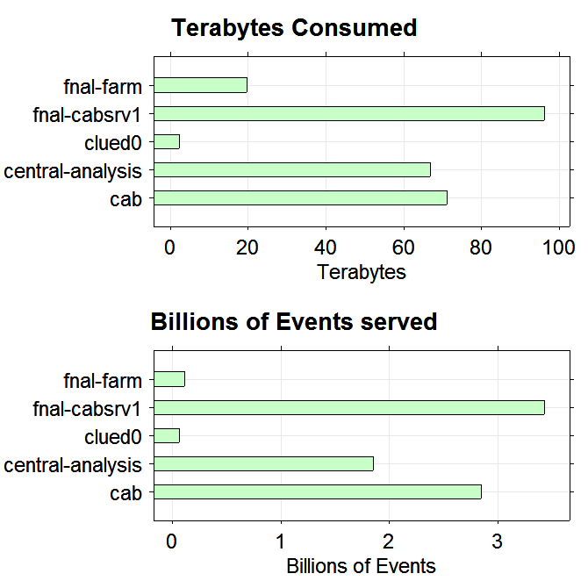
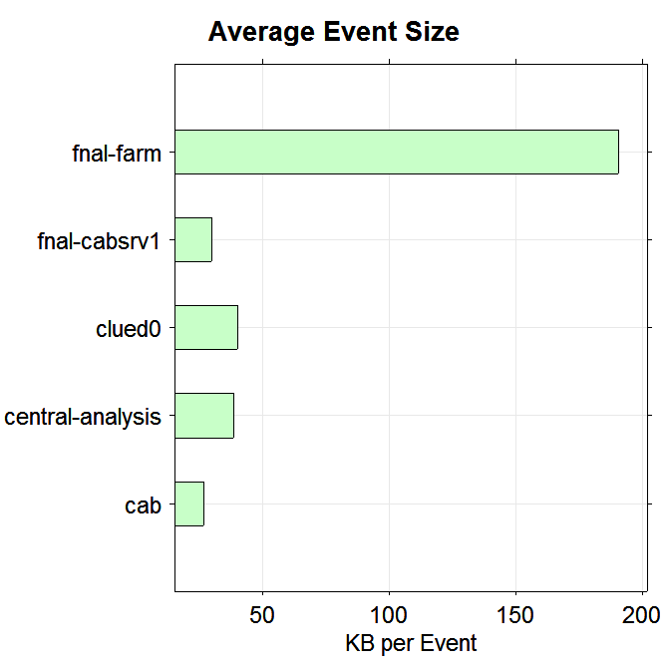
SAM Statistics How much data has been analyzed?
Data from early January 6 until February 24
256 TB!
Raw
Thumbnails + …
8.3 Billion Events!

Slide 13
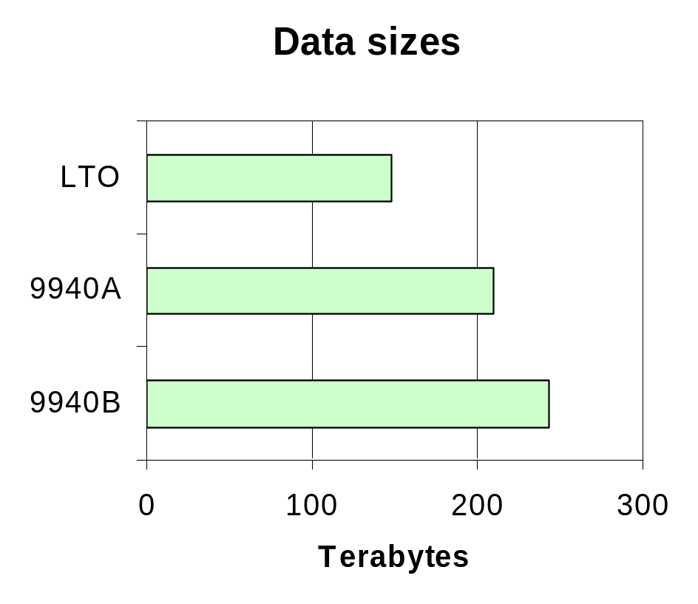
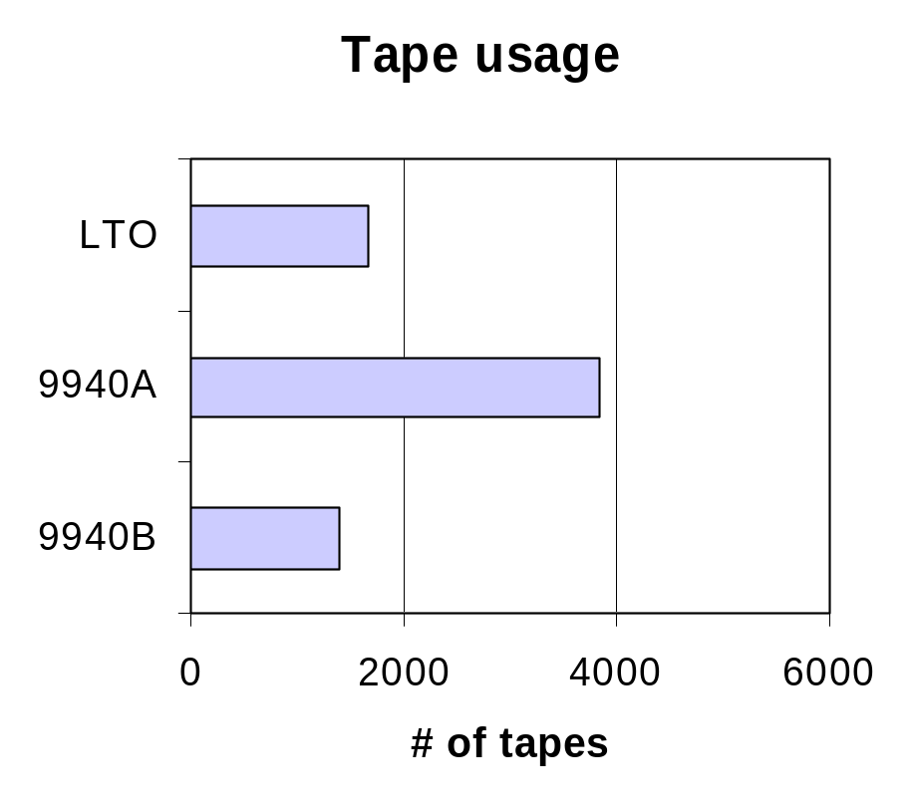
ENSTORE Statistics We do not lose data!
0.6 Petabytes in tape storage!
Only 5 files unrecoverable (5 GB total; 8ppm loss) !!!
One of them was RAW file

Slide 14
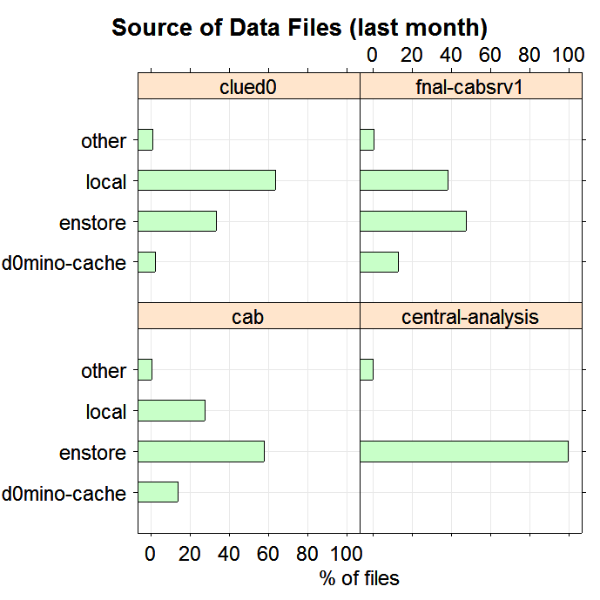
SAM Statistics How often do we use tapes?
Local cache:
  Used for repeat file accesses
  Can see the larger local cache on cabsrv1
  All files on Clued0 are routed through head node with large cache
    Prevents DAB and Trailer network overload
D0mino (central) cache:
  Looks like we're not using it enough
  Can we decrease our tape usage?
Notes:
Note that d0mino use of its cache disk is not counted as a file transfer, so it does not show up at all on the plot (should be local)

Slide 15
Future central caching schemes
The new linux file servers will have huge SAM caches
How do we fill them?
Manual population
  Physics Groups decide how to populate central cache
  Requires management (see how well we've done so far?)
  Popular files may not be cached
Automatic population
  Route all files through head node(s) with big caches (long cache lifetime)
  Popular files automatically live a long time in the cache
  Files that turn unpopular automatically leave
  Head nodes are bottlenecks; first access to file may be slow but subsequent accesses should be fast
Need to experiment to determine best scheme

Slide 16
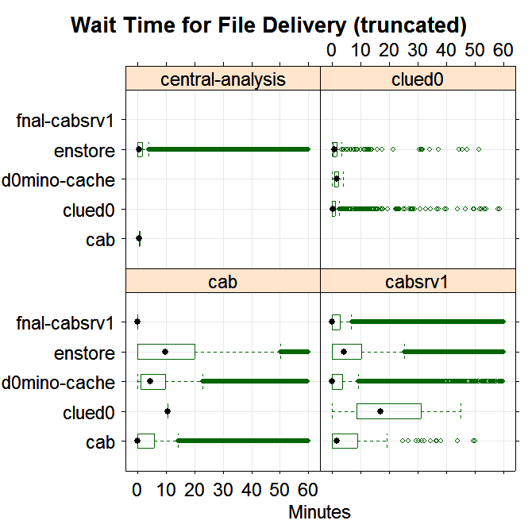
SAM Statistics How long do we wait for data?
Time between
Request Next File and
Open File
For CAB and CABSRV1
  50% of enstore transfers occur within 10 minutes.
  75% within 20 minutes
  95% within 1 hour
For CENTRAL-ANALYSIS and CLUED0
  95% of enstore transfers within 10 minutes
Station | CAB | CABSRV1 | CLUED0 | CA
% no wait | 30% | 40% | 38% | 18%
Notes:
Influenced by:
Transfer throttle on stager
Transfer throttle on station
Network speed & load
Enstore queue length, tape transfer time, network access to enstore
Influenced by:
Transfer throttle on stager
Transfer throttle on station
Network speed & load
Enstore queue length, tape transfer time, network access to enstore

Slide 17
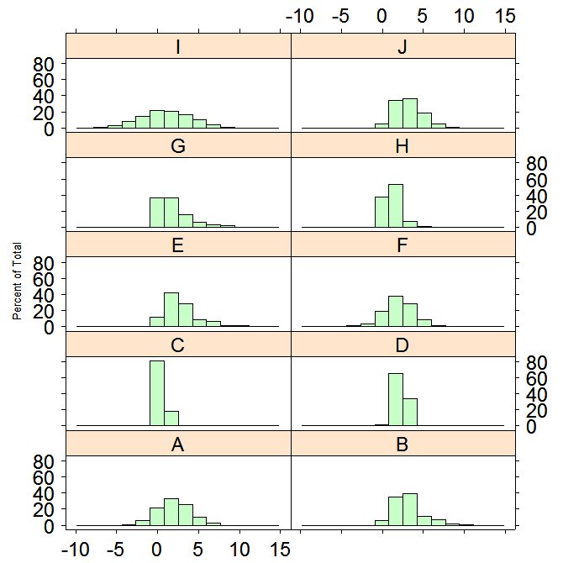
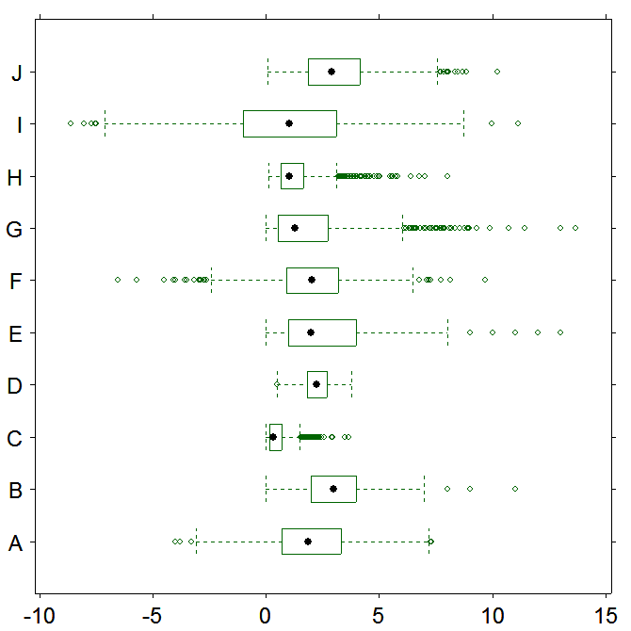
Box and Whisker Plots

Slide 18
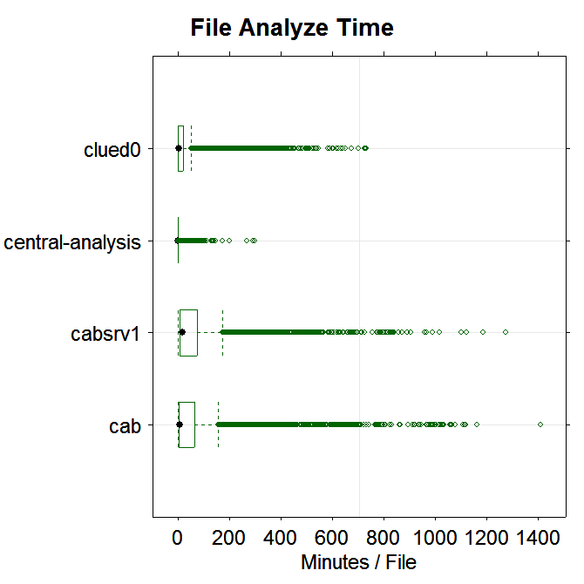
SAM Statistics Processing time per file

Slide 19
Status Where are we now and what's coming soon
Aside from rare glitches, SAM is stable and survives heavy pounding
Storing files into SAM seems to be more problematic than reading from SAM
  Need monitoring (none right now)
  Better handling of meta-data
  Better documentation
Better documentation needed
Working to move "pmaster" onto worker nodes
More efficient SAM DB Schema coming soon
DB Servers Rewrite nearly complete - more efficient and easier to add functionality

Slide 20
SAM Tips and Reminders
Support model
  Send SAM problems to d0sam-admin@fnal.gov
  d0sam-users@fnal.gov are for announcements
  Shifters are "first responders" on 16 hrs / day
  SAM on-call experts backup the shifters
  Helpdesk (x2345) /d0-primary for hardware problems
  Helpdesk open only during FNAL business hours
  Always cc:d0-primary@fnal.gov
Don't copy directly from /pnfs - won't work!
Create catch-up datasets after your project is done
SAM delivers files to all projects that ask for them (files are not "load balanced" among projects)

Slide 21
Shifters Will work for data
You can help by becoming a SAM shifter
SAM shifters now get full shift credit
First line of defense in SAM monitoring
SAM "Helpdesk"
Shifts aren't as scary as they look…
  There are plenty of experts (some are on call) to help you
  While the documentation is somewhat disorganized, there's a wealth of information
  SAM shifters can't break the detector ($$$)
Send mail to Daria Zieminska if you are interested (daria@indiana.edu)

Slide 22
EXTRA SLIDES FOLLOW

Slide 23
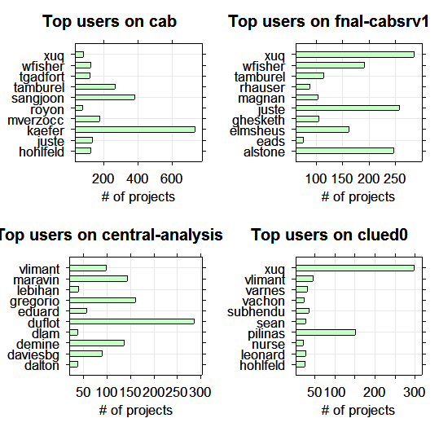
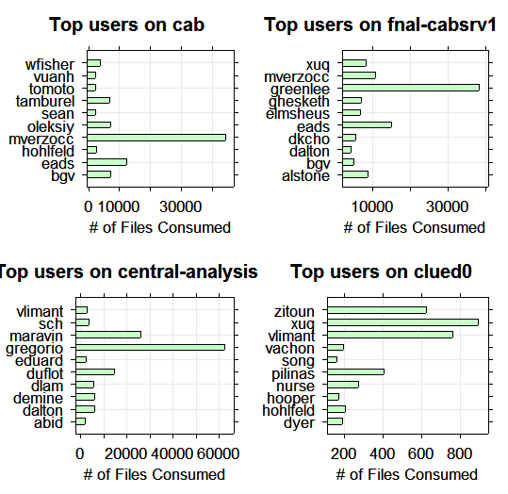
Top Users (Jan 6, 2004 - Feb 24, 2004)
Top users by # of projects
Top users by consumed files

Slide 24
SAM Grows
Started at DØ
CDF is beginning to use it (still testing)
  SAM will completely replace their data handling system
MINOS
  Will use SAM for their data handling
  Have interesting use cases (must synchronize use of multiple files).
CMS
  Examining SAM components

Slide 25
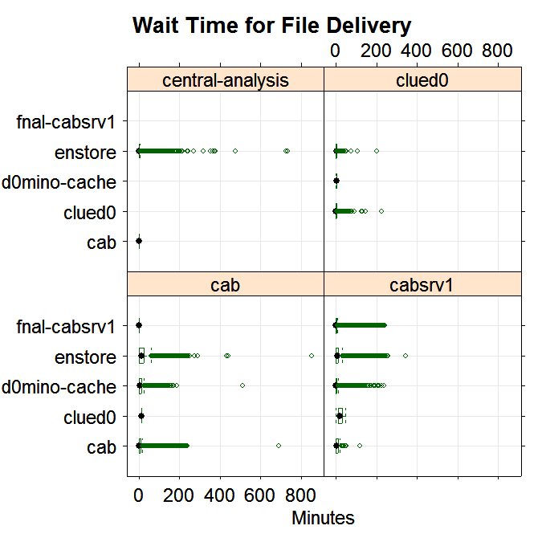
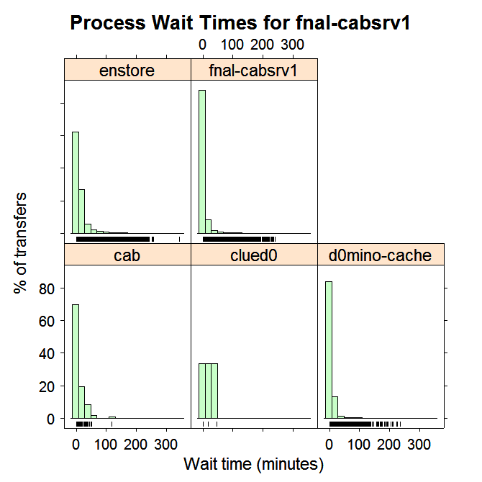
SAM Statistics Process wait times
File Source

Slide 26
Some SAM buzzwords
Dataset Definition
  A set of requirements to obtain a particular set of files
  e.g. data_tier thumbnail and run_number 181933
  Datasets can change over time
    More files that satisfy the dataset may be added to SAM
Snapshot
  The files that satisfy a dataset at a particular time (e.g. when you start an analysis job)
  Snapshots are static
Project
  The running of an executable over files in SAM
  Consists of the dataset definition, the snapshot from that dataset definition, and application information
  Bookkeeping data is kept - how many files did you successfully process, where did your job run, how long did it take

Slide 27
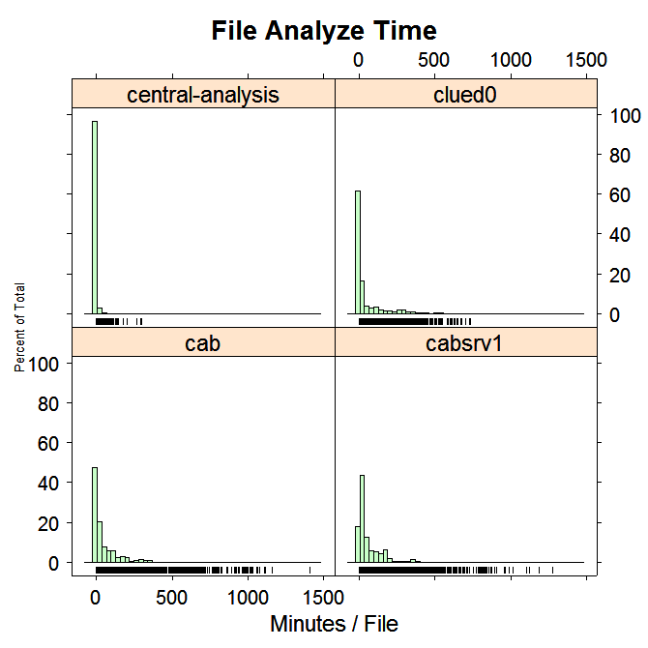
SAM Statistics Processing time per file

Slide 28
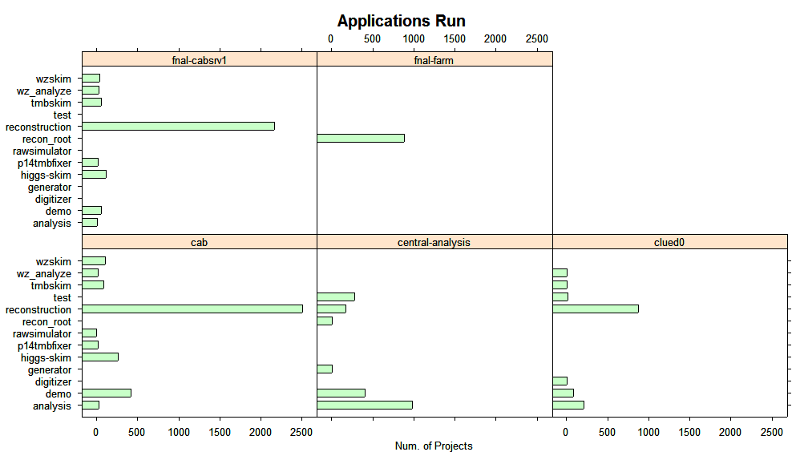
SAM Statistics What are people doing?

