Slide 1
Silicon dE/dx and Particle ID
Ingyin Zaw, Andy Foland, Josh Rosaler
Harvard University
B Physics Analysis Kernel Meeting
Aug. 20, 2004

Slide 2
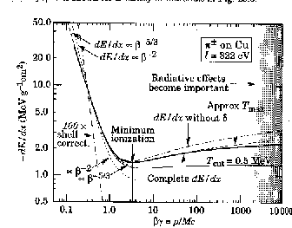

Silicon dE/dx (Reminder)
Silicon is a solid
  Pro: Landau widths of individual hits reduced; little environmental interference
  Con: Density effect kicks in immediately
    Fermi plateau 6% above minI
    No crossover region
There are only 8 possible layers
  L00 is too scary to reasonably contemplate -> only 7 layers
  Central ISL -> only 6 layers
  Scarcity of hits limits resolution
Experimentally, need to:
  Calibrate charge deposition
  Find optimal estimator given charge deposited in each layer
  Demonstrate Universal Curve

Slide 3
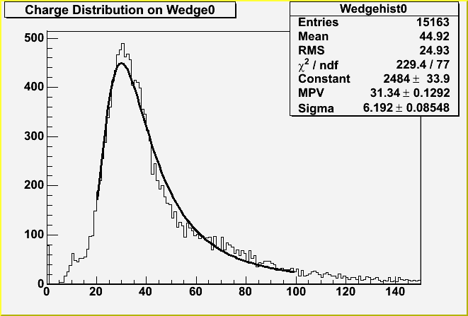

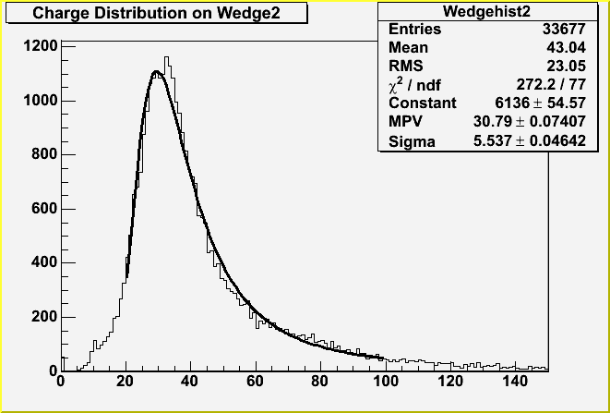

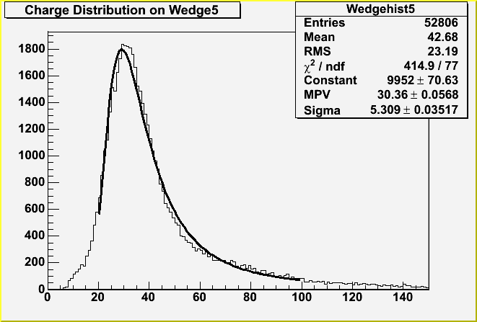
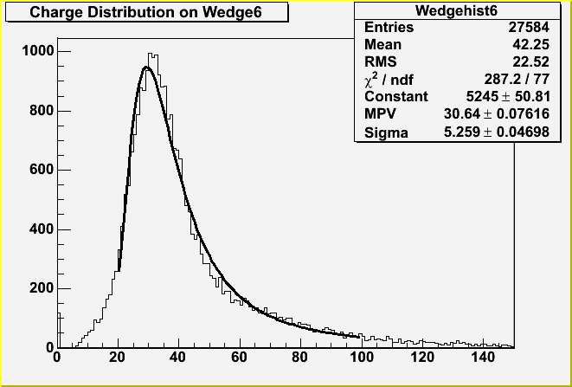
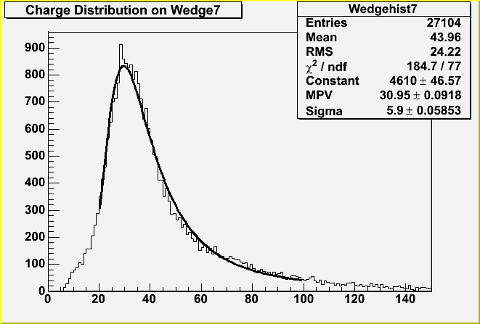
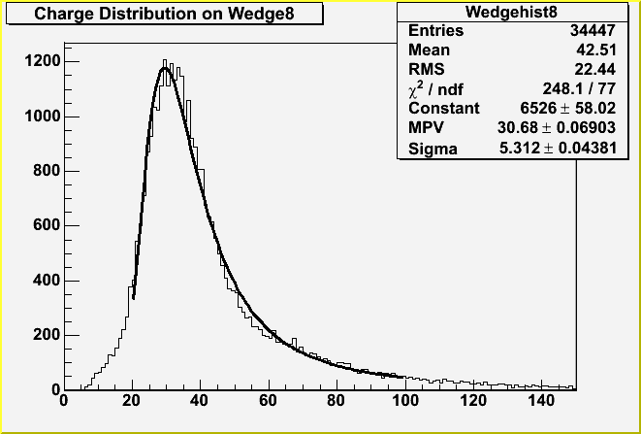

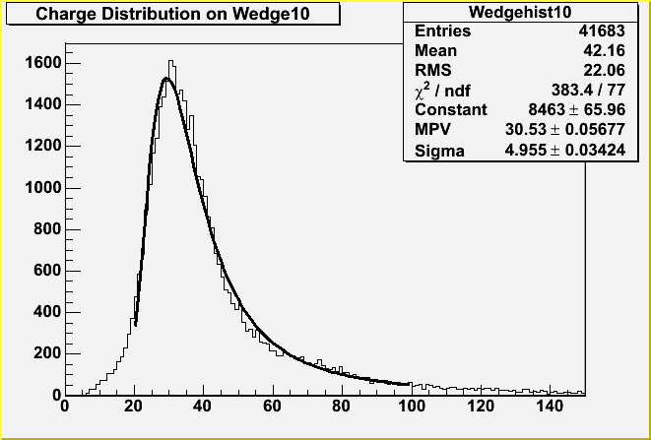
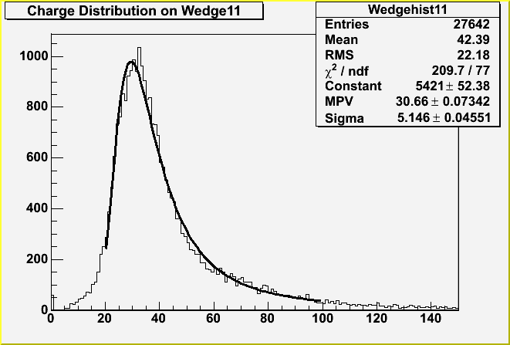
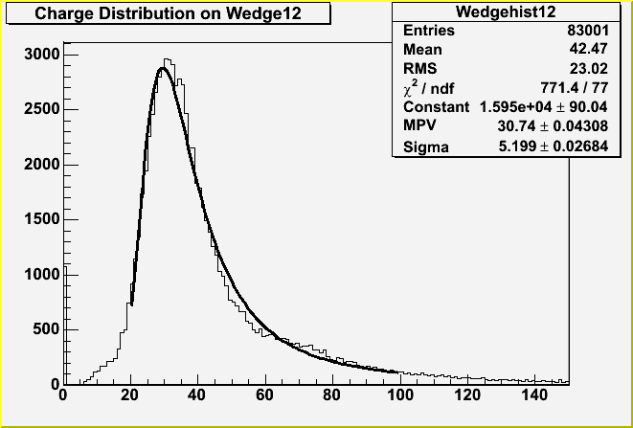
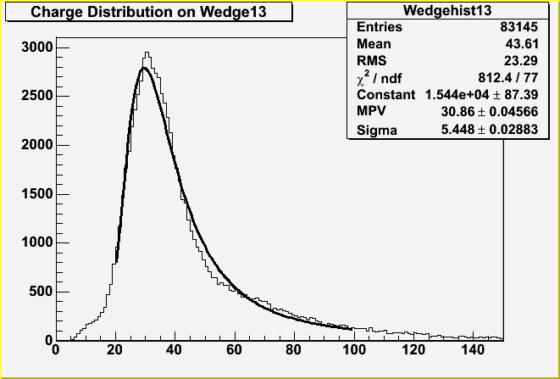
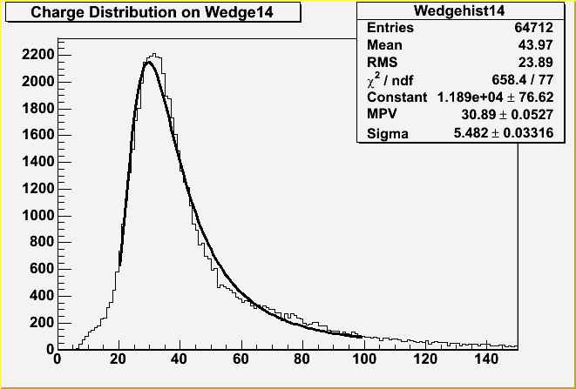
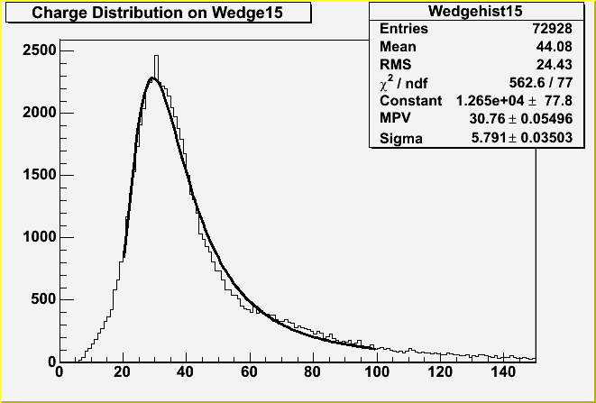

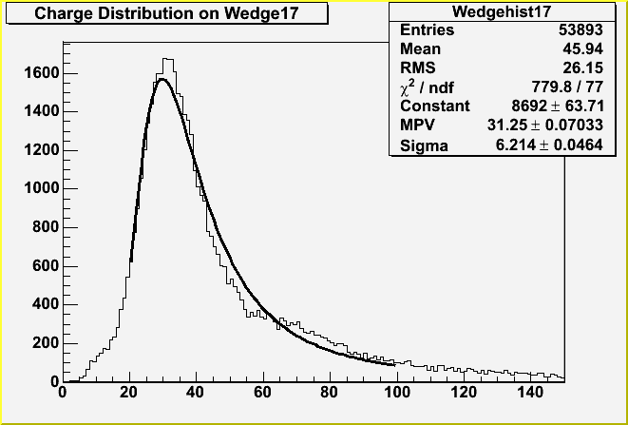
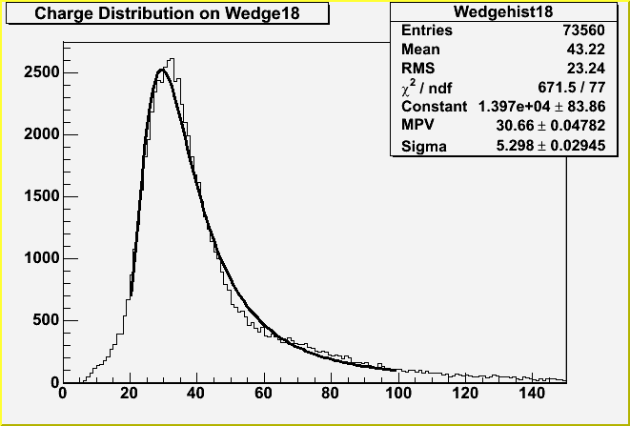
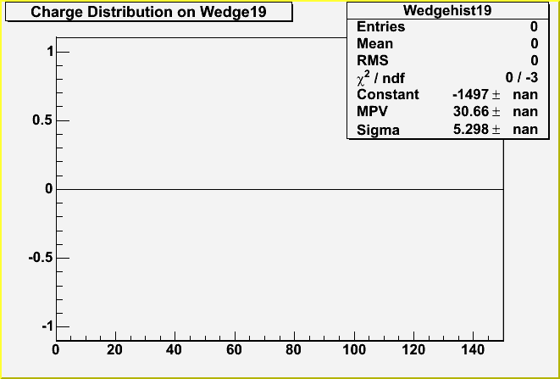
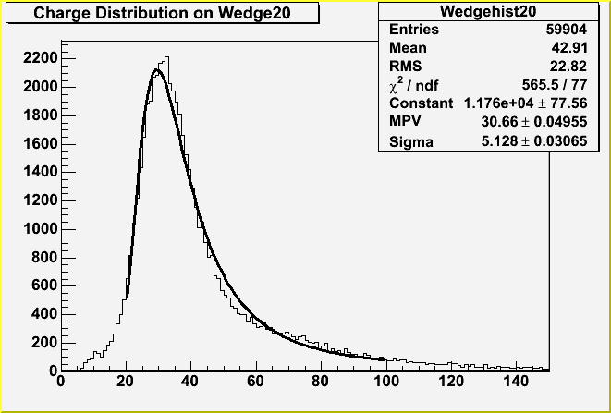

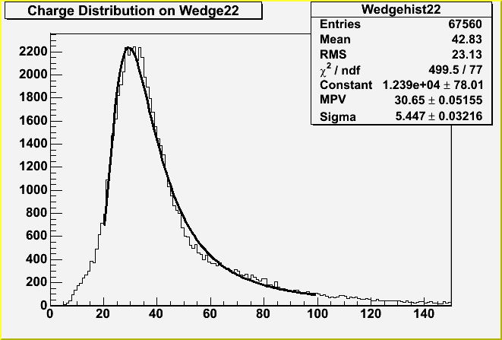
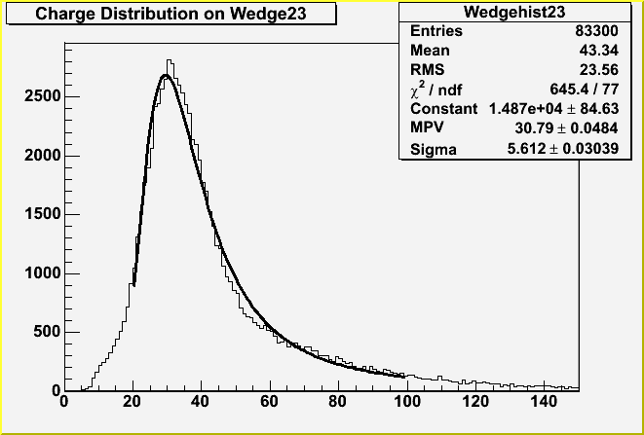
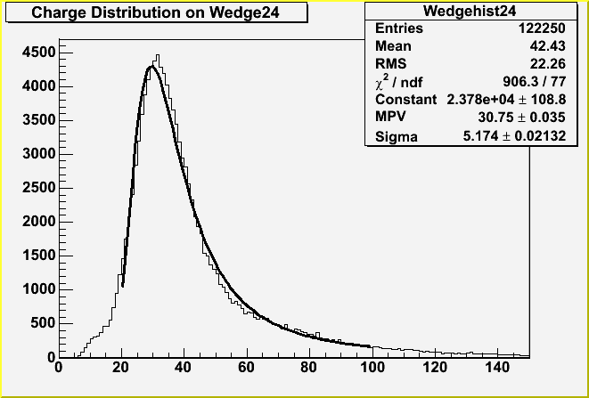
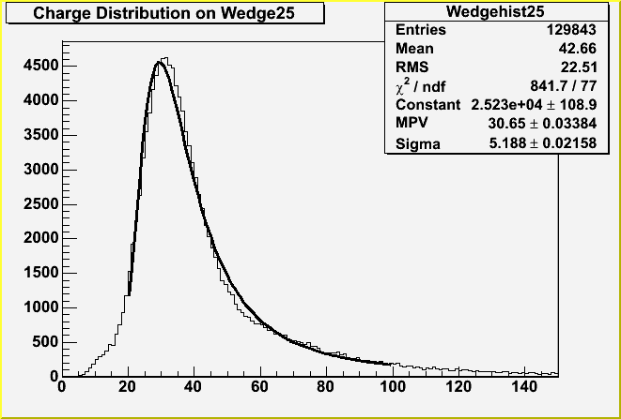


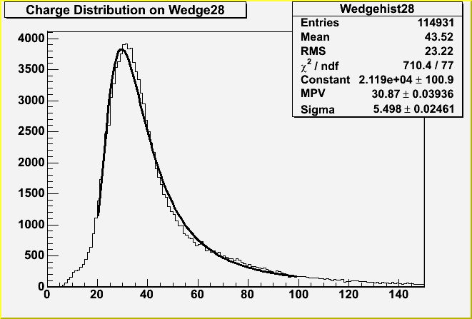
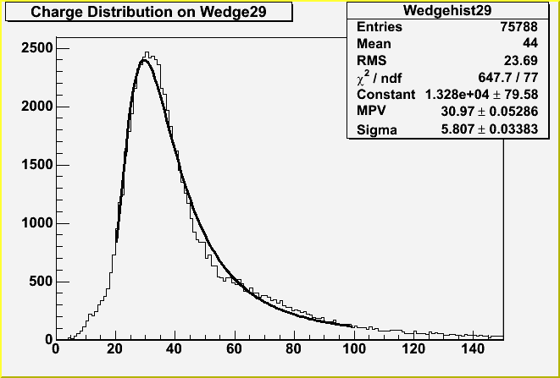
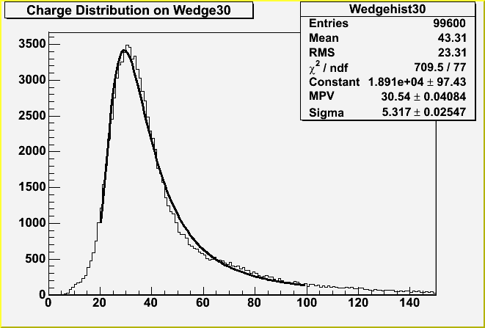
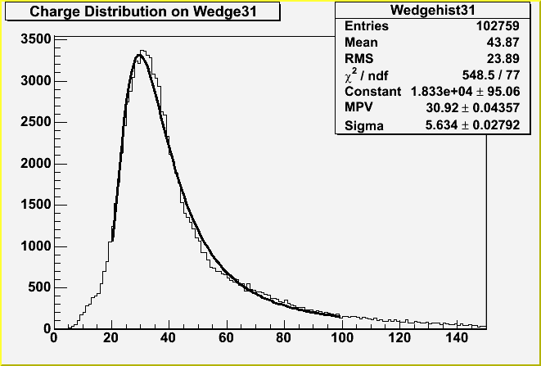

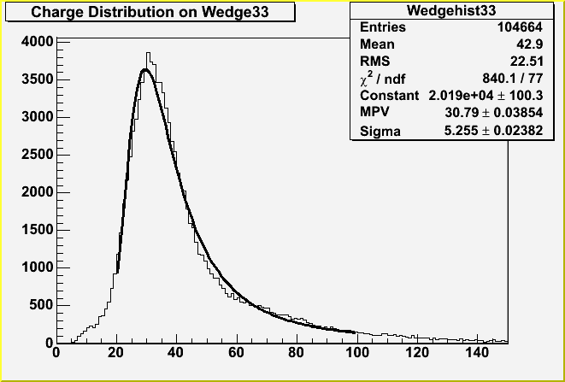
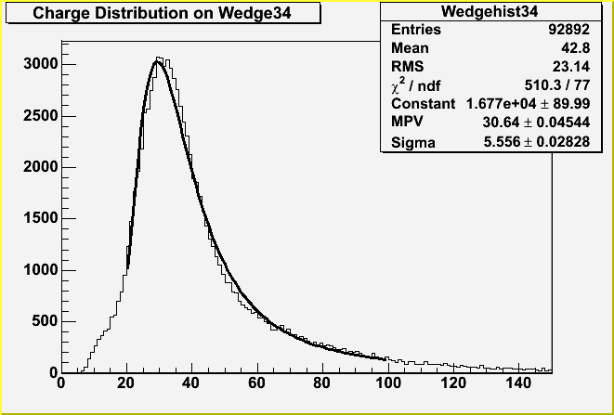

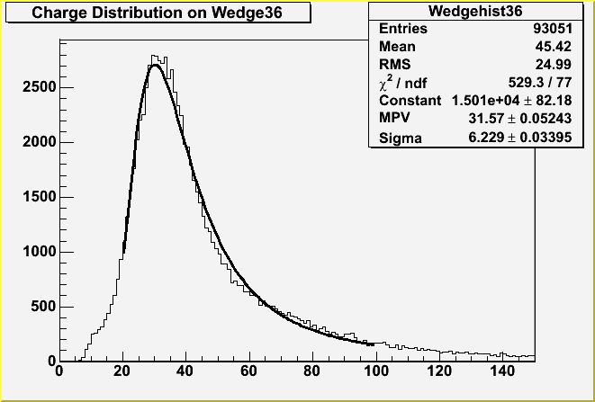
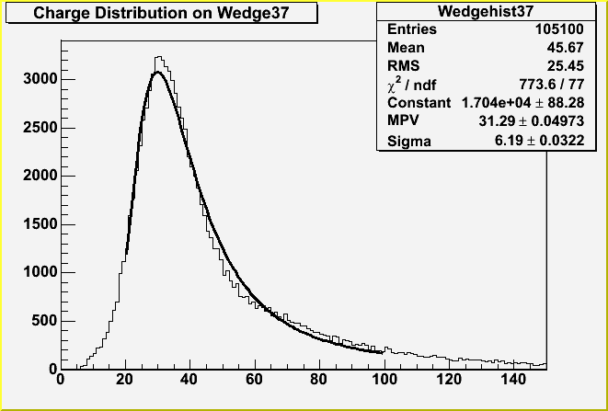
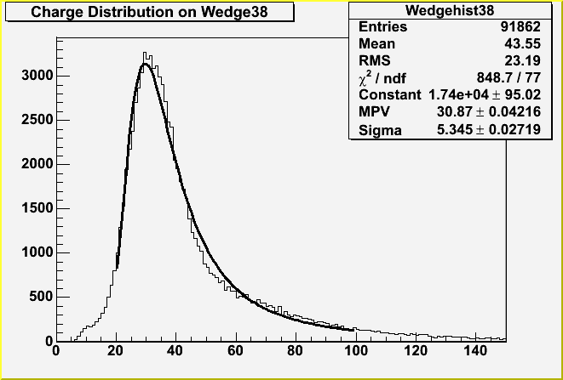
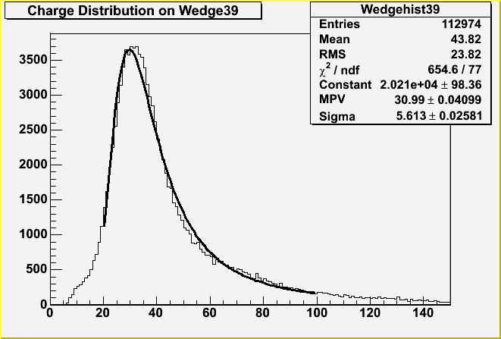






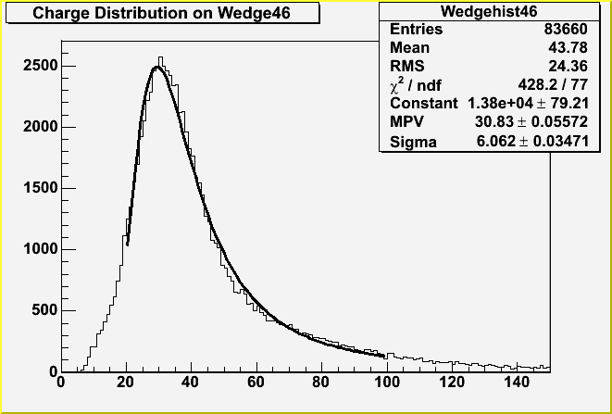

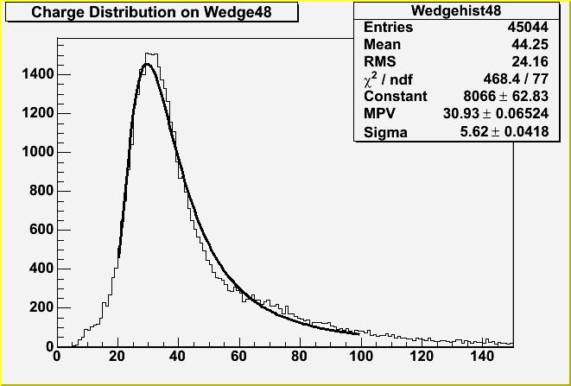
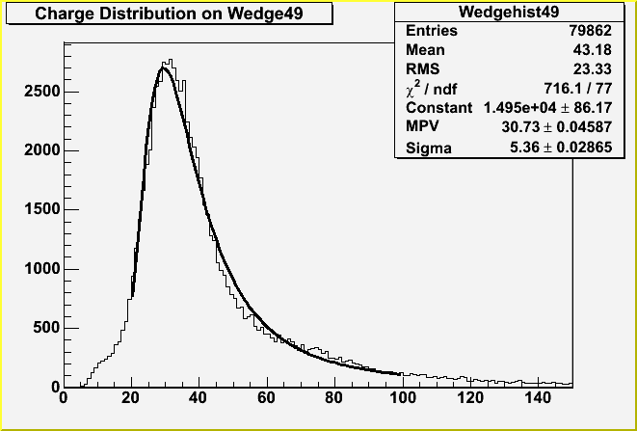





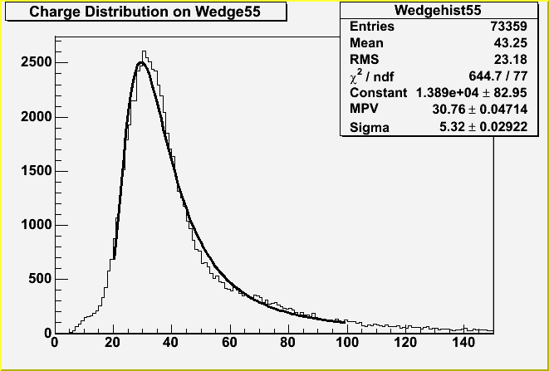
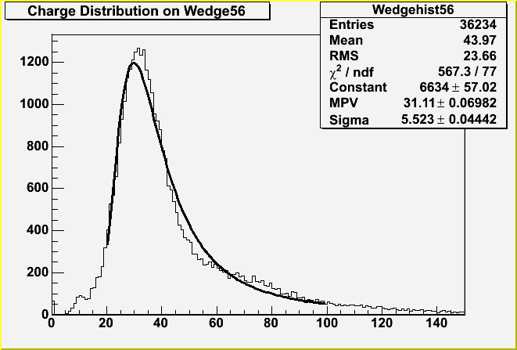




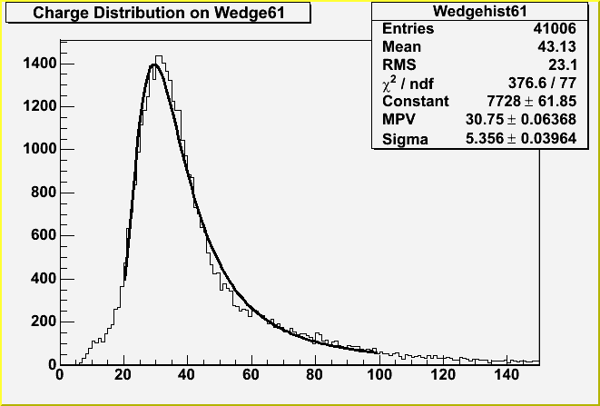

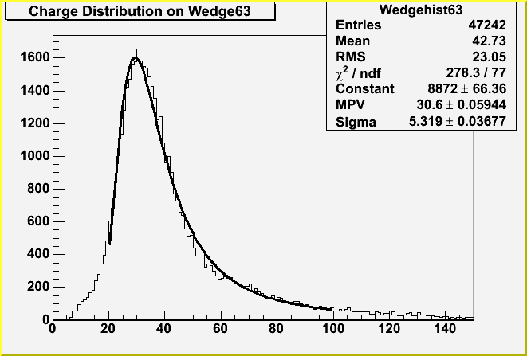


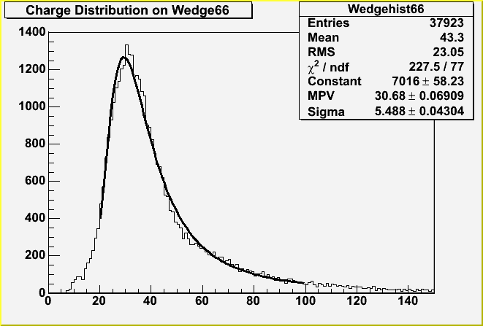
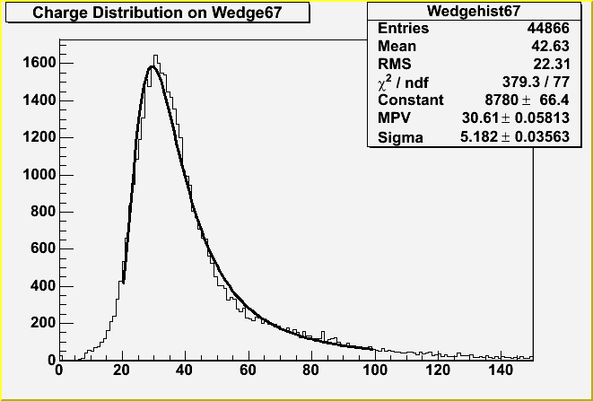
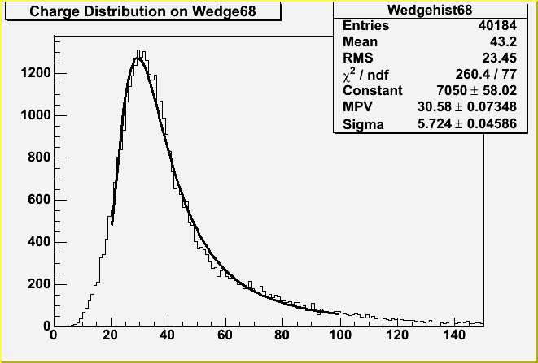

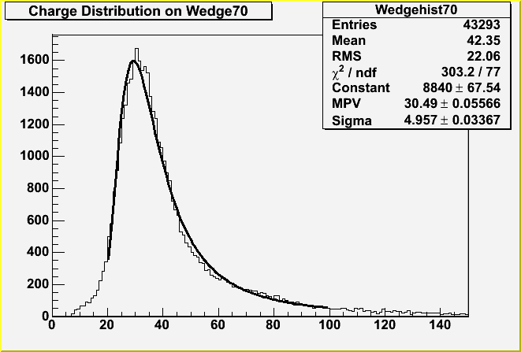
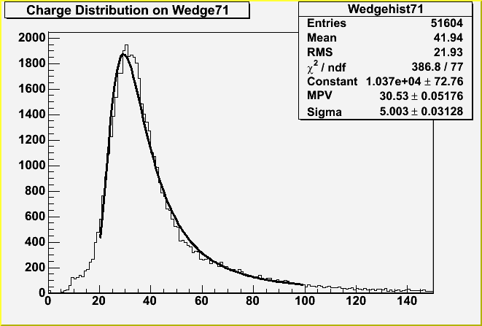

Slide 4
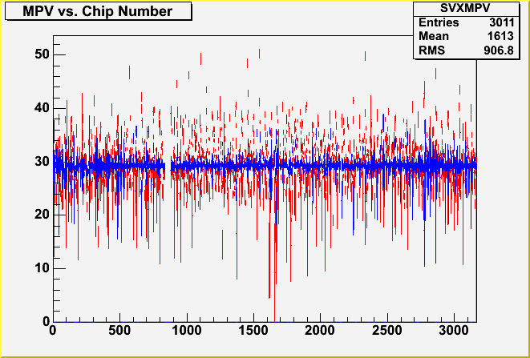
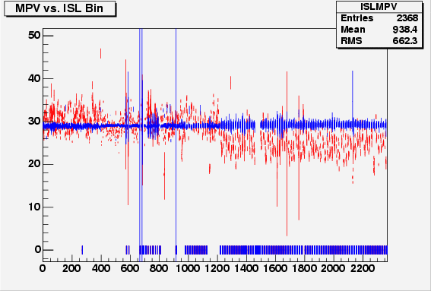
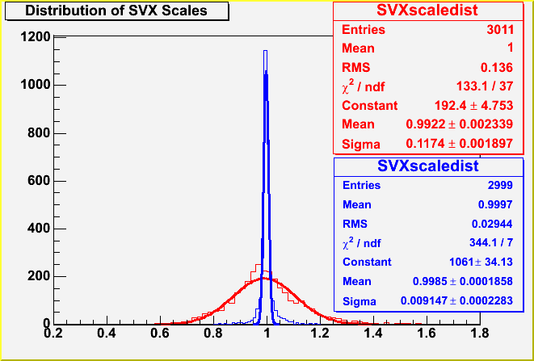
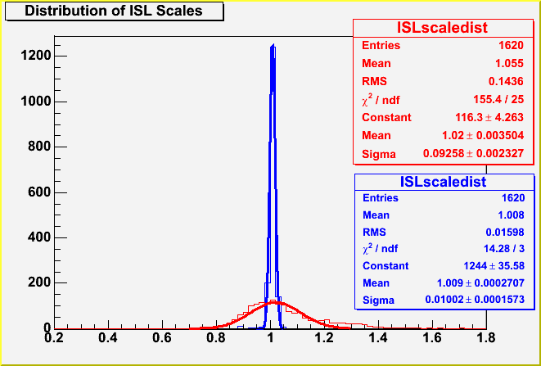
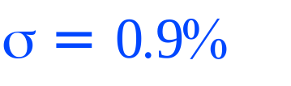
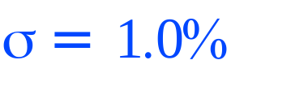
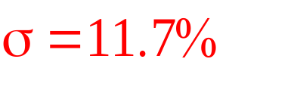

Chip by Chip Calibration
SVX
ISL
Line up most probable values (MPV) for each chip.

Slide 5




A Tale of Two Versions
We did the calibration in 4.11.2 and 5.3.1
In 4.11.2:
  ISL was only calibrated by bulkhead, layer, and side
In 5.3.1:
  Twice as much data
  Calibrated ISL chip-by-chip
Compared SVX chip scales in the two versions
  They are the same up to fitting errors.
mean = 0.997
σ = 0.029

Slide 6


Per-track dE/dx
Simplest approach
  Average the φ and z sides on a layer (since they see intrinsically the same deposition)
  Form the average of all clusters on the track
Hopefully mean is then proportional to track MPV
  Two problems
    Landau distribution formally has no mean
    This estimator has large high-side tails
    Poor resolution even in the core

Slide 7

“Slowing Power”
Instead of averaging the charge depositions for each hit, average the recipricals
Slowing power = 1/<1/x_{i}>
Where x_{i} = the charge deposition for each layer
  Take whichever side is present or the average of the two sides when both are present
The resolution and tails are much better than mean track deposition

Slide 8





Strips and Depositions
1
2
3
MP ≈ 24.0
σ_{eff} ≈ 5.5
MP ≈ 29.3
σ_{eff} ≈ 5.7
MP ≈ 37.3
σ_{eff} ≈ 8.2
4
5
MP ≈ 52.7
σ_{eff} ≈ 19.5
MP ≈ 81.7
σ_{eff} ≈ 36.4
We can use this spatial information to improve resolution.

Slide 9

Truncated Mean Using Spatial Information
Strip number plots suggest we can be smarter in two ways
  Eliminate 4 and 5 strip clusters which contain very little info about the MPV
  Re-center 1,2,3 to line up to minimize within-track scatter
    Better mean measurement
Calculate the mean of the remaining hits

Slide 10

Slowing Power with Spatial Information
We can use the strip number spatial information
  Eliminate clusters with 4 or more strips
  Calculate the slowing power with the rest of the clusters
Resolution is worse than truncated mean using spatial information but tails are better

Slide 11

Apply to Other Particles
Mean
ADC
Counts
(corrected)
βγ
(p, not p_{T}!)
Green = electrons (γ -> e⁺ e⁻), Blue = pions (K_{s} -> π⁺ π⁻),
Red = protons (Λ -> p± π±)

Slide 12

Universal Curve with Truncated Mean
Mean
ADC
Counts
(corrected)
βγ
Green = electrons (γ -> e⁺ e⁻), Blue = pions (K_{s} -> π⁺ π⁻),
Red = protons (Λ -> p± π±)

Slide 13

Universal Curve with Slowing Power
Mean
ADC
Counts
(corrected)
βγ

Slide 14


The Bifurcated Gaussian
All tails are not created equal
Slowing power per-track dE/dx looks fairly Gaussian but the high side tail is longer
Fit a Gaussian with 2 different widths, σ₁ and σ₂ for the low and high sides
  Will give a more accurate measure of separations
MP = 31.91
σ₁ = 4.38
σ₂ = 7.20

Slide 15


Disclaimer: Parameterization of the universal curve will change
Fit bifurcated Gaussians in each momentum bin and calculate separations
  p-π separation at 1σ up to p = 1.45 GeV
  K-π separation at 1σ up to p = 0.75 GeV

Slide 16

Coming Soon: dE/dx with Maximum Likelihood
Get probability distribution functions from data
  Use hit charge deposition distributions based on the side and number of strips
Characterize each as a bifurcated Gaussian with an additional exponential tail
  Characterized by 4 parameters, each varying linearly with MPV
Define likelihood : L(u) = Π p_{u}(x_{i})
Minimize ln(L) to find the mean ionization for a track given the deposition of the hits

Slide 17

Likelihood in Toy MC
Simulate tracks with a random number generator
Use likelihood method to get the deposition for the track
Get significantly better resolution than other methods
Expect ~12% resolution for energy deposition (compared to 11% in COT)
σ1 = 3.3
σ2 = 5.8

Slide 18
Plans
Put chip scales in the calibration database
Maximum Likelihood :
  Apply likelihood method to data
  Redo universal curve fit and recalculate separations
  Add function to Si dE/dx class which returns a devaiation from the MPV assuming that the particle is x (x = e, μ, π, K, p) based on its momentum and energy deposition
Mechanize calibration so that it can be updated periodically (~ every 6 months or when events warrant) because radiation damage will degrade the peak

Slide 19
Conclusions
Calibrated both SVX and ISL chip by chip
Demonstrated universal curve with electrons, protons, and pions
Separations at 1σ up to
  1.45 GeV for p-π
  0.75 GeV for K-π
Developed a log likelihood method using side and spatial information
  Hope to improve separations

