Slide 1

a strategic positioning company
Dr. Larry Percy

Slide 2
Explore cognitive associations with the subject and construct a ‘map’ of the cognitive structure likely to be involved.

Slide 3
Cognitive responses for:
atmosphere
climate
coastlines
floods
hurricanes
ice storms
lightning
oceans
weather

Slide 4
Associations in memory were largely descriptive
Concrete noun or adjective attributes
  (rain, snow, salty, Texas, white, Atlantic)
Subjective characteristics
  (variable, massive, drama, powerful, development)

Slide 5
Associations in memory
Overall, about 1/4 were negative
  (polluted, danger, depleted, scary)
Only 10% were clearly positive
  (beautiful, awesome, stunning)
Only one association reflected an emotion
  (sad)

Slide 6
Associations in memory
A surprising lack of any priming effect
Suggest no common neural network, which is surprising given their clear association at a macro level

Slide 7
Associations in memory
Given the highly charged attention to environmental issues, it is surprising that
  there is no emotional response
  a relatively low level of negative associations

Slide 8
Associations in memory
The descriptive nature of the cognitive responses, coupled with no emotional response suggests very little involvement with the issue

Slide 9
Associations in memory
Other topics that ‘belonged’ with the list being discussed were solicited, and of the 30 additions offered, only three were mentioned in more than one group

Slide 10
Associations in memory
This again suggests no common schema and strong evidence that there is not a neural network in place for what might be called ‘the environment’

Slide 11
Associations in memory
This can make communication difficult when dealing with more than one of these topics that are broadly part of the Earth’s environment

Slide 12
Cognitive structure
An important consideration in the development of a communication program is an understanding of how people ‘see’ and understand the subject of the communication

Slide 13
Cognitive structure
This will influence how messages are processed and interpreted, and reflects what is called a cognitive structure

Slide 14
Cognitive structure for ‘Environment’
There seems to be no set meaning in memory
It appears more conceptual, lacking any definite structure
Six unrelated schema are activated by the word ‘environment’
With essentially no secondary association

Slide 15
The schema identified were:
Need for action
Problems
Danger
My world
Eco-system
Positives
protection, conservation, recycle
pollution, dirty, global warming
messed up, dying, danger, death
world around us, surroundings, living space
climate, eco, eco-system
healthy, wonderful, good, beautiful

Slide 16
Cognitive structure for ‘Climate Change’
Again, a diverse set of schema, but there is some linkage at the secondary level
This suggests at least some underlying stability to the construct

Slide 17
Cognitive structure for ‘Climate Change’
People appear to have one of two general structures:
  some see ‘climate change’ as a problem
  others as being more benign

Slide 18
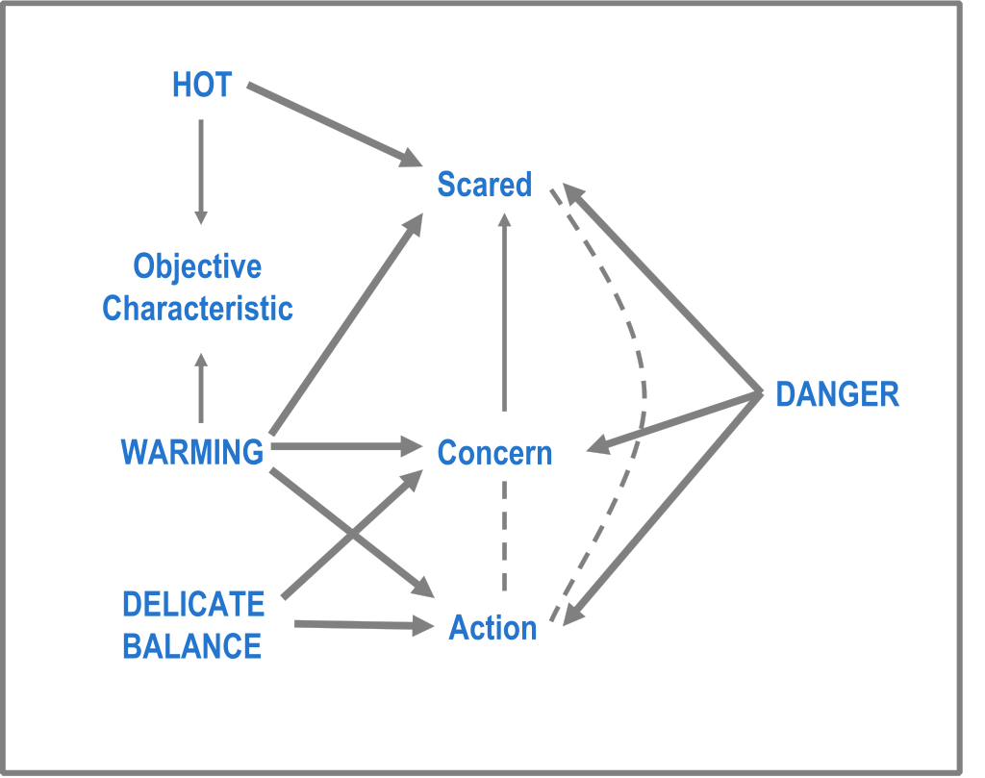
Cognitive structure for ‘Climate Change’ as a problem

Slide 19
Cognitive structure for ‘Climate Change’
Regardless of the schema involved, for these people ‘climate change’ is linked in memory with concern, fear, and need to do something about it

Slide 20
Cognitive structure for ‘Climate Change’
In communication, climate change should be discussed at the secondary level, not in terms of the ‘problem’ because there is no interrelationship among the perceived problems

Slide 21
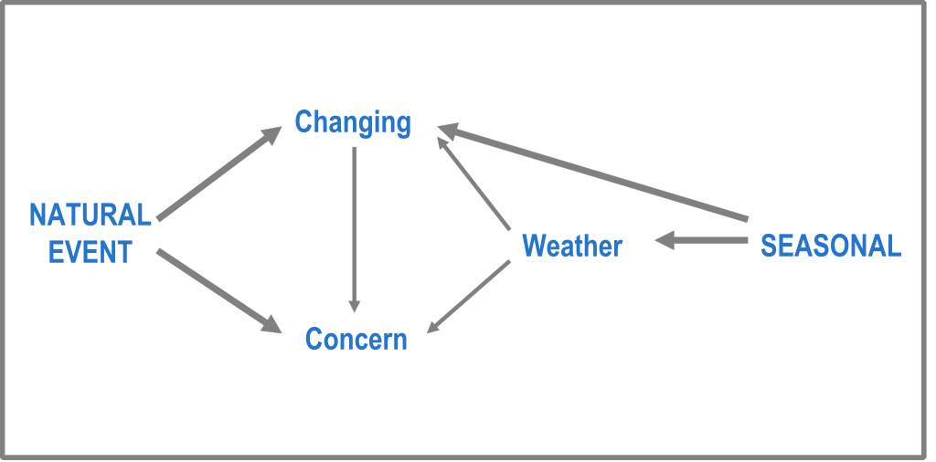
Cognitive structure for ‘Climate Change’ as benign

Slide 22
Cognitive structure for ‘Climate Change’
While there is some suggestion of low-level concern among a few, basically for these people climate change simply means changing seasons

Slide 23
Emotion
Modern neuroscience tells us that humans use emotion to help guide their rational decisions and behavior

Slide 24
The Amygdala: Where it Happens
The idea of a separate brain system for emotions was perhaps first suggested by James Papez in 1937
The importance of the amygdala to emotions was identified in 1939 by Klöva and Bucy

Slide 25
The Amygdala: Where it Happens
The amygdala plays a central role in the basic emotional system, and
Neuroscience research increasingly shows the amygdala-centered neural system of emotion interacts extensively with those underlying cognitive processes

Slide 26
The right and left ventromedial parts of the prefrontal cortex are essential for the integration of emotions into decision making
Bechara et al., 2000

Slide 27
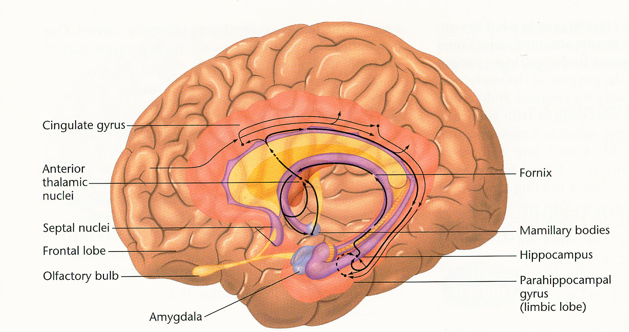
Limbic System

Slide 28
The Amygdala: Where it Happens
Emotion, via the amygdala, influences cognition by mediating the long-term retention and awareness of emotional events, as well as
Immediate stimulus processing by modulating attention and perception

Slide 29
The Amygdala: Where it Happens
Amygdala influence on attention and perception suggests that relative to neutral stimuli, processing emotional stimuli will be enhanced
This should lead to greater memory encoding, resulting in both greater immediate and later awareness

Slide 30
Accessing Correct Emotional Memories
The amygdala is at the heart of a specific memory system that mediates the learning and expression of emotional response to stimuli of learned significance
This can occur even in the absence of conscious memory for the events associated with the learning experience

Slide 31
Immediately Present Stimuli
Immediate Conscious
Experience
(Working Memory)
Amygdala-DependentEmotional Arousal
Hippocampal-DependentExplicit Memory

Slide 32
Emotion
Stronger emotional associations are more likely to be verbalized
Given the high arousal levels in the media, the paucity of emotional involvement with ‘environment’ and ‘climate change’ is surprising

Slide 33
Emotion
When discussing specific ‘concerns’ about the environment and climate change, only 9 of 34 people included an emotional association

Slide 34
Emotion
When specifically asked for emotional associations with the environment and climate change, half did not provide one

Slide 35
Emotion
Among those who did, most were negative
  environment: fear, sadness, some anger
  climate change: mild anxiety, some sadness

Slide 36
Emotion
These are primary emotions, not secondary or social emotions, suggesting that at least these people may be aroused
But because it followed specific probing, it is unlikely to be energizing

Slide 37
Some implications for communication
The paucity of emotional responses and the descriptive nature of most of the discussion suggests that while topical, the subject has not been given much real consideration
There is a need and opportunity for education

Slide 38
Some implications for communication
Messages must be very carefully framed, defining explicitly what is meant, and
Messages should be positioned against secondary levels of cognition, linking them to an appropriate, clearly defined anchor

Slide 39
Some implications for communication
This will be a challenge
But, the lack of consistent, focused memories or established cognitive structure provides an opportunity to build appropriate associations in memory

Slide 40
Key: Identify the appropriate links

