Slide 1
RHIC Collimation
Ray Fliller
and
Angelika Drees
RHIC Retreat '03

Slide 2
Outline
This talk IS about:
Effect on Experiment backgrounds.
Crystal Collimation
Plan for the New Collimation System
This talk IS NOT about:
Why these backgrounds hurt the experiments
Vacuum related backgrounds
Gap Cleaning
Anything else we have heard this morning

Slide 3
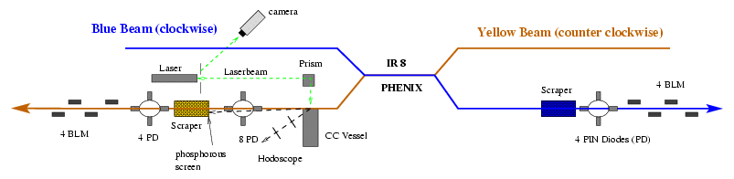
Collimator Layout
During operations, the crystal collimator was not used (more
on this later!)

Slide 4
Problems we could "fix"
PHENIX MuID system background
BRAHMS background during dAu when PHOBOS β*=4m
STAR yellow halo background (and caused some!)
STAR blue halo background
Problems we couldn't...
PHOBOS backgrounds (Ubaldo's talk...)
Pressure rise around blue collimator

Slide 5
Collimator Operational Issues
Collimators needed to be inserted "by hand". Operators don't like moving collimators around out of fear of killing a store. Sometimes backgrounds where not minimized.
Steering at PHENIX requires collimator retraction. "Lost time" after steering due to high backgrounds. Also affect vernier scans.
Sometimes STAR and PHENIX were coupled. STAR and PHENIX had to decide who would live with some extra background. Reducing backgrounds at PHENIX could raise STAR backgrounds.

Slide 6
Collimator Performance - dAu Run
Reduction
Optics
BRAHMS
STAR Blue
STAR Yellow
PHOBOS 4m
2-3 x
0 x
2-3 x
PHOBOS/ BRAHMS 3m
<2 x (usually 0)
4 x
0 x
Reduction
Optics
PHENIX Blue
PHENIX Yellow
PHOBOS 4m
0 x
5 x
PHOBOS/ BRAHMS 3m
9 x
9 x
During initial Physics running (all IR's at 2m) collimators were not really
used, but collimating PHENIX sometimes increased STAR's background.
PHOBOS never benefited from collimation.
BRAHMS was affected by Yellow horizontal mostly .
PHENIX benefitted from vertical collimation (both rings).
STAR blue halo reduction was from blue horizontal.

Slide 7
Collimator Performance - pp Run
Reduction
Optics
PHENIX Blue
PHENIX Yellow
all IRs
0 x
3 x
STAR & PHENIX
8 x
>10 x
Reduction
Optics
STAR Blue
STAR Yellow
all IRs
1.5 to 10 x
1.5 to –2 x
STAR & PHENIX
5 x
1.5 to –1.1 x
PHOBOS and BRAHMS saw no effects of collimation.
Collimator preformance independent of rotator configuration.
Yellow collimator could increase STAR background!
Blue collimator was always helpful.

Slide 8
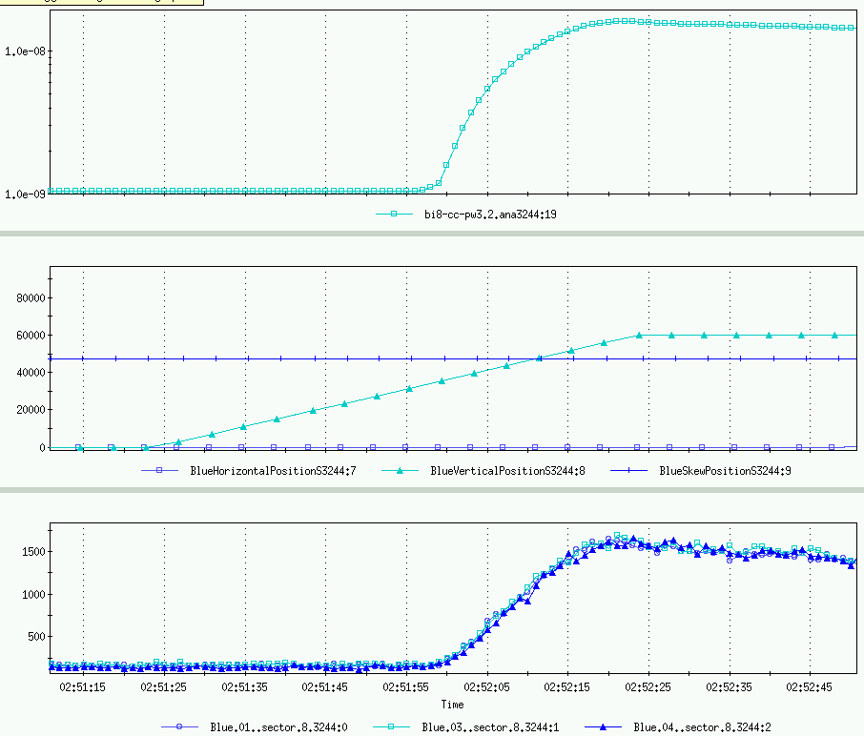
Collimator Pressure Rise
Collimators touch beam (PIN Diodes go up ~1.6 kHz)
Pressure
Collimator Position
PIN Diodes
Store 3244, Pressure in Blue collimator section increases as soon as the collimator touches the beam. It was never enough to trip the machine,
but large enough to worry. Does not happen all of the time (next store rise not seen), but did happen with d and p. Never seen in yellow.

Slide 9
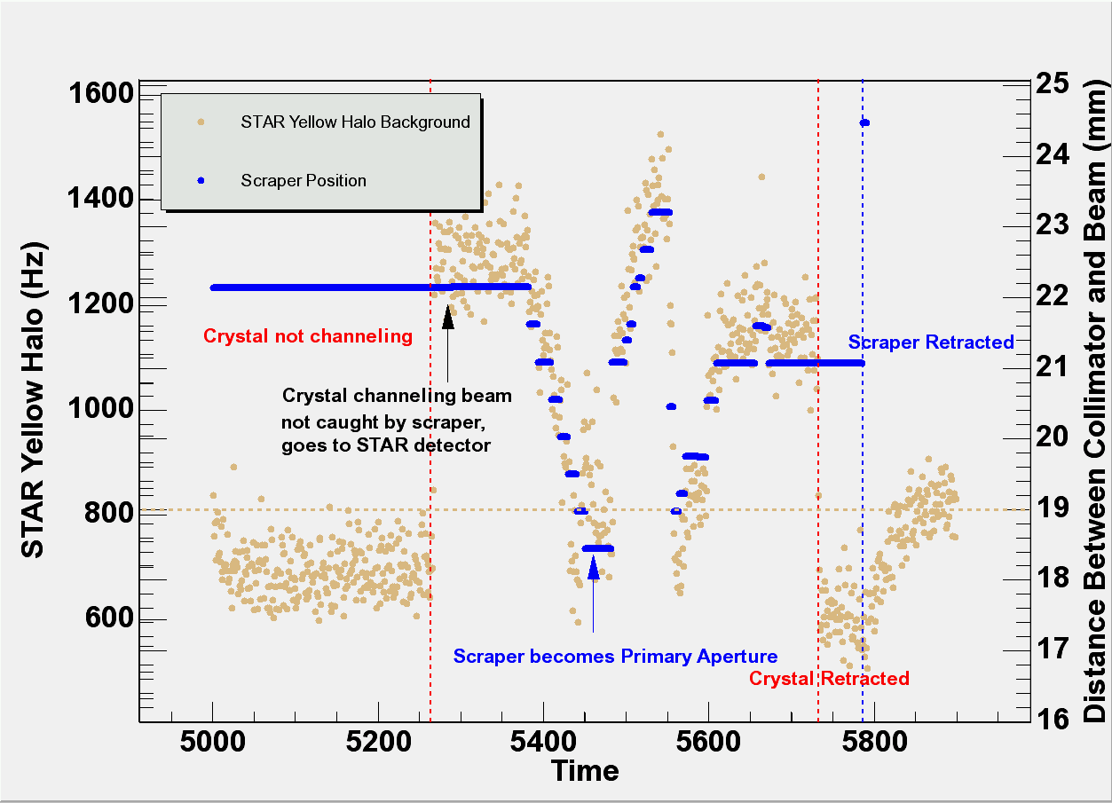
Crystal Collimation
As the crystal channels, it sends channeled beam into the STAR detector. The background is minimized when the scraper becomes the primary aperture!

Slide 10
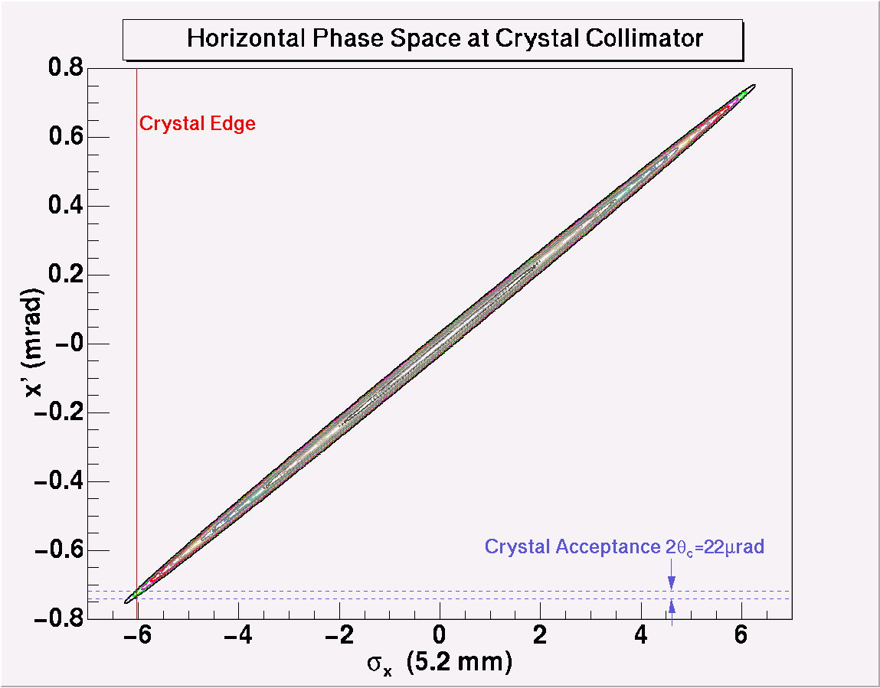
Because of the tilt of the ellipse
Moving the crystal...
...Means rotating it!
And the angular spread on the crystal
is too big!

Slide 11
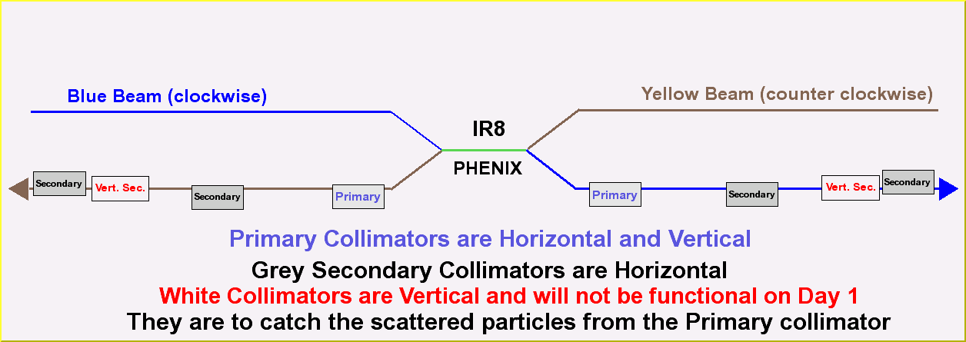
New Collimation System

Slide 12
Collimator Issues This Fixes (we hope!)
Sometimes STAR and PHENIX were coupled. It is hoped that the secondary collimators will reduce "background coupling" between experiments by reducing secondary halo.
Collimators needed to be inserted "by hand". An system is planned to use PIN Diodes, BLM's, backgrounds and DCCT to insert collimators automatically. Sounds scary but The Tevatron already uses such a system, and they are VERY happy with it.
Steering at PHENIX requires collimator retraction. Because the collimators are planned to be in the same area, this is still an issue.
Collimator Pressure Rises. Whole new ball game.

Slide 13
Conclusions
The collimators were helpful during the dAu and pp runs for reducing backgrounds at most of the experiments.
The crystal collimator worked, but not well enough
New collimators will be installed in the 8 o'clock warm straights downstream on PHENIX

