Slide 1
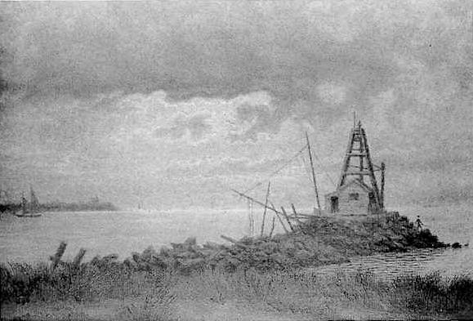
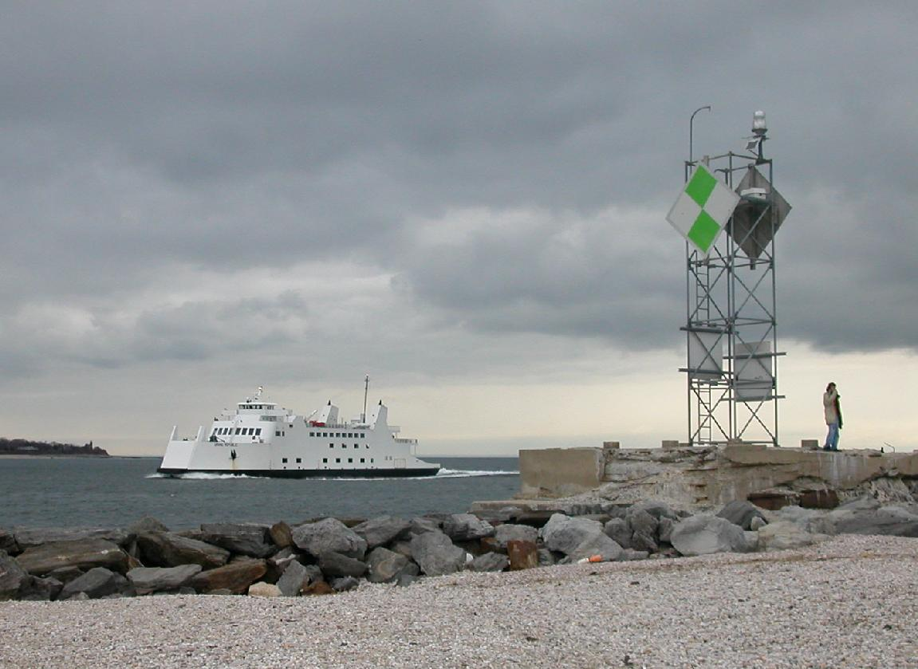
Collaboration Meeting Goals
Steve Peggs
Goal: Technical, Cost, & Schedule plan for FY06 & 07
to be reviewed June 1 & 2

Slide 2
  Strategy
  Calendar & Milestones
  (Hardware) Commissioning
  Junior Workforce Pipeline
  Magnet Program
  Budget

Slide 3
Strategy

Slide 4
Challenge chronology
LHC faces 4 (identified) challenges. In rough chronology:
Challenge Luminosity LARP
1) Snap-back small TF, LM, BC, ...
2) Stored energy medium RC, BC, ...
3) Beam-beam nominal IRBB, RC, BC, ...
4) Debris power upgrade Magnet R&D, ...
Early LARP success is tightly linked to Tune Feedback, Luminosity Monitor, and Beam Commissioning activities
Later come Rotating Collimators, and IR & Beam-Beam, etc
Magnet R&D must proceed now, to be ready then.
Early perceptions are prejudiced by the Construction Programs success – LARP does R&D, not production!

Slide 5
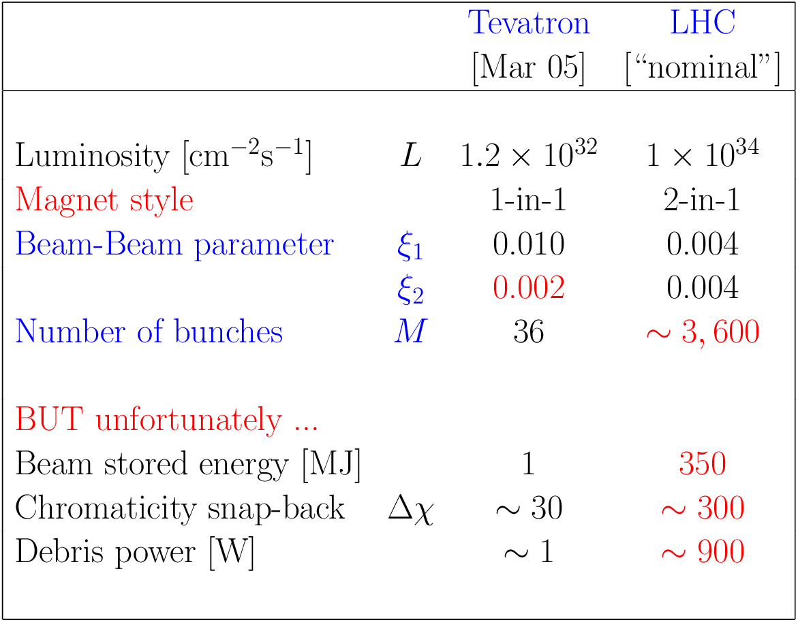
From Tevatron to LHC
9 kW !?

Slide 6
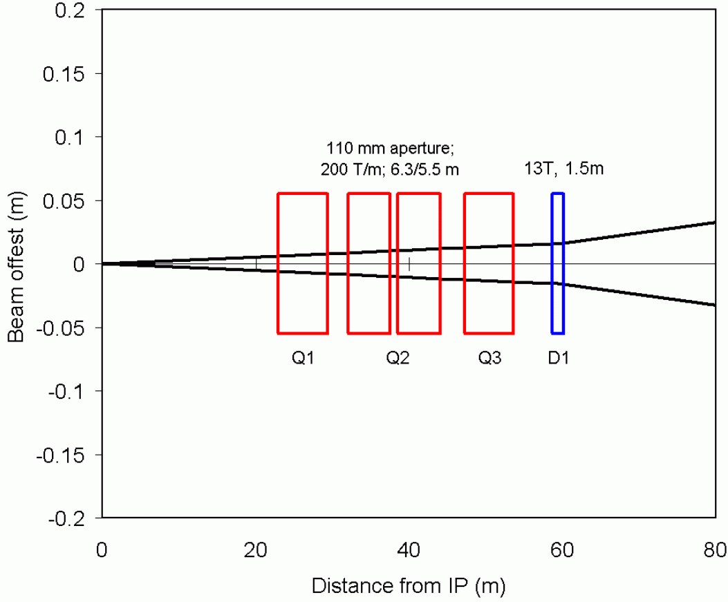
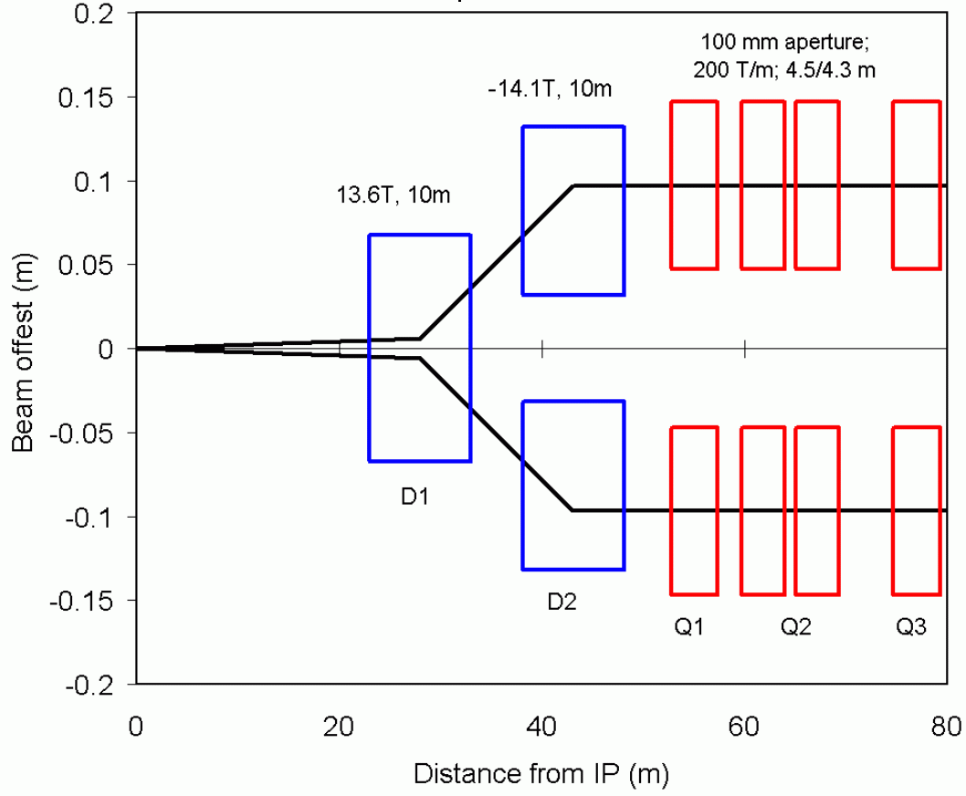
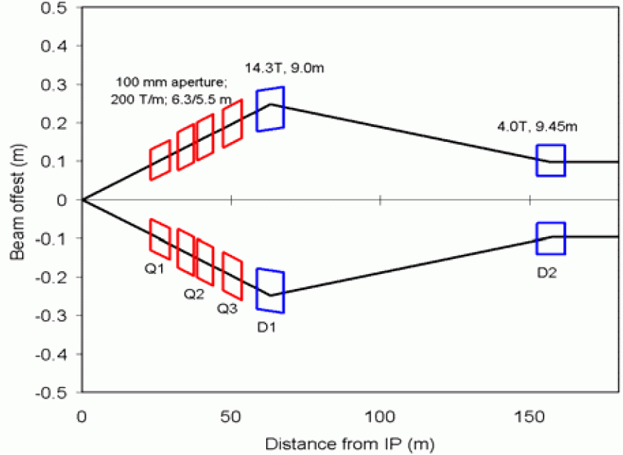
IR upgrade - 2012?
“Quad first” “Dipole first” “Large crossing angle”
All scenarios incorporate state-of-the-art IR quads
Some also use new-concept beam separation dipoles
Other potential sub-system upgrades: beam-beam compensators, crab cavities, accelerating cavities, cryogenics, beam dumps, ....
Need real operating experience to make optimal decisions!

Slide 7
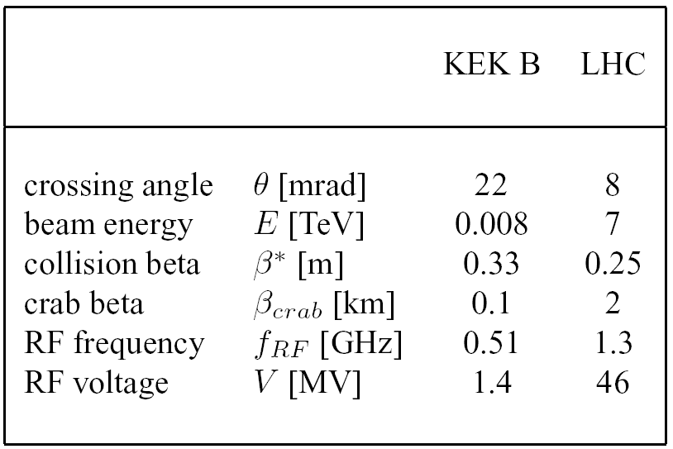
Ruggiero: "if the KEKB test with Crab cavities in 2006 is successful, we recommend the installation and test of Crab cavities in a hadron machine to validate a level of RF noise compatible with emittance preservation."
Raises the possibility of additional institutional involvement: KEK, JLAB, Cornell, [NSF], .....

Slide 8
Calendar & Milestones

Slide 9
Calendar
Apr 4-5 Tune Feedback review, Port Jeff
Apr 6-8 Collaboration meeting 4, Port Jeff
Apr 11-12 Luminosity Monitor review, LBNL
Apr 15 Quarterly Report deadline
May 16-20 PAC05, Knoxville
May 23-27 WAO 2005, Bloomington
May ?? US executive committee meeting, FNAL
May ?? DOE Review dry run, ??
Jun 1-2 DOE Review, FNAL
Jun 6-8 DIPAC, Lyon
Jun ?? LARP Advisory Committee, LARPAC, ???
Jul ?? CERN-US Exec. comm meeting, CERN
Aug 31- 3 CARE "Upgrade scenarios”, Arcidosso
Sep 19-23 Magnet Technology MT-19, Genova
Sep ?? CARE “RC Synchs. & LE injectors”, ??
Oct ?? IR & Beam-Beam mini-workshop, FNAL
Oct ?? Collaboration meeting 5, near FNAL
Oct ?? CARE “SC pulsed magnets”, Frascati??

Slide 10
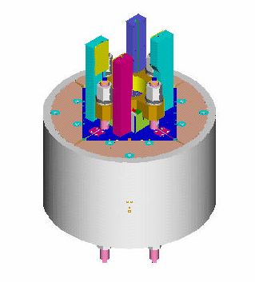
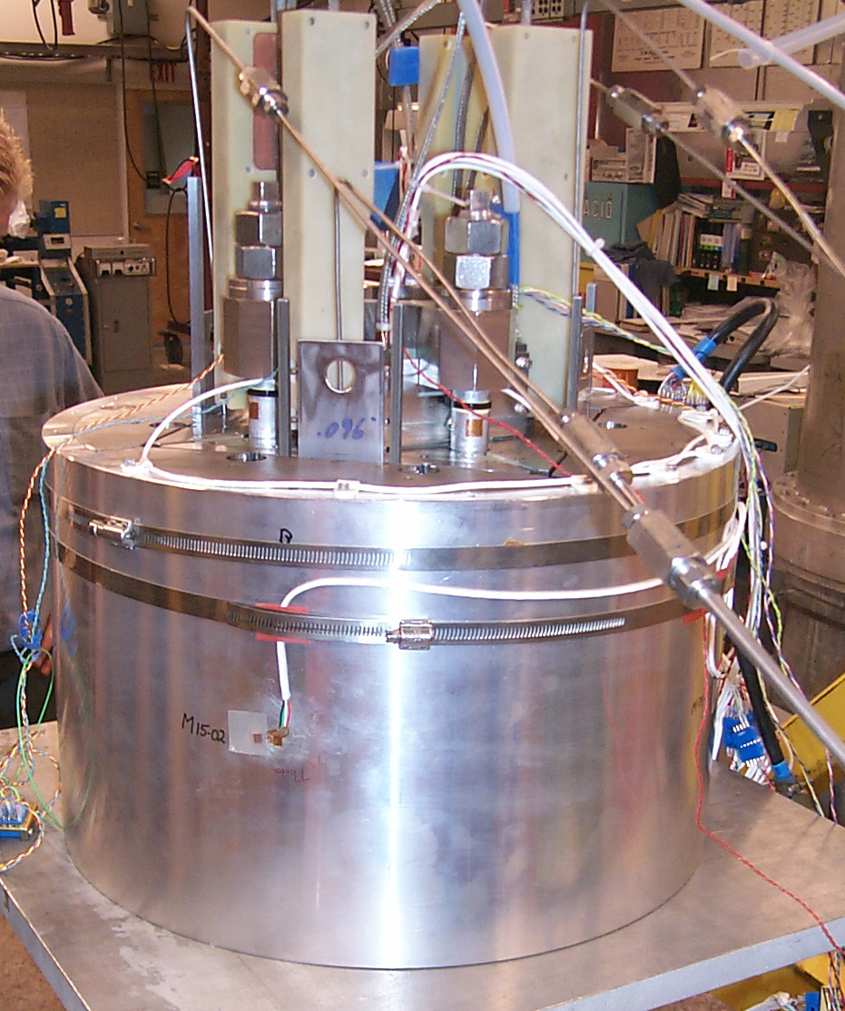
Oct 04: Collaboration Meeting 3
Short “bladder and key” construction racetrack quadrupole

Slide 11
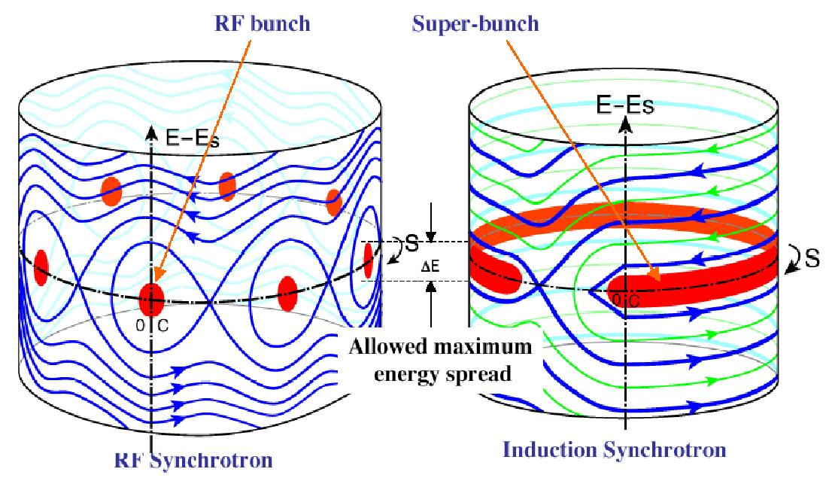
Nov 04: CARE – IR Upgrades
Super-bunches – very long ones – are now eliminated as delivering too many events per interaction
Intermediate length “longitudinally flat” bunches?

Slide 12
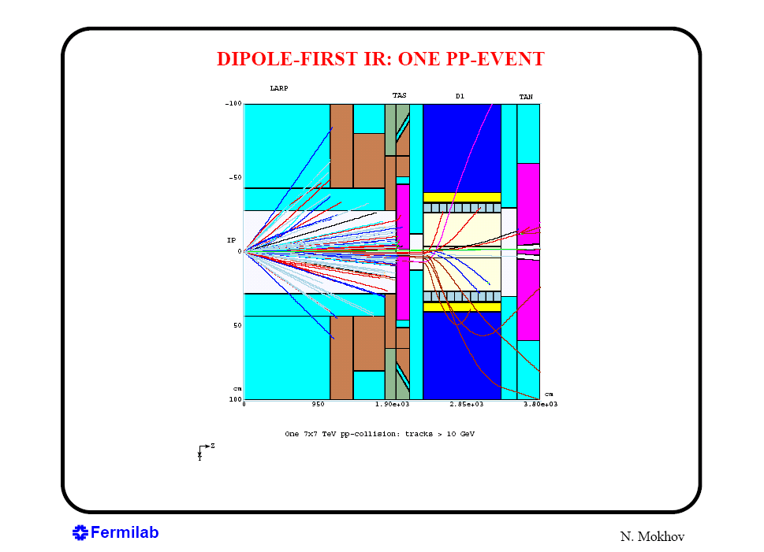
Dec 04: Open Midplane Dipole review
TAS
TAN
Question:
“Could a magnetic TAS help limit the flux hitting the first dipole?”
Most debris particles (many kW?) are swept into the first dipole in a “dipole first” scheme

Slide 13
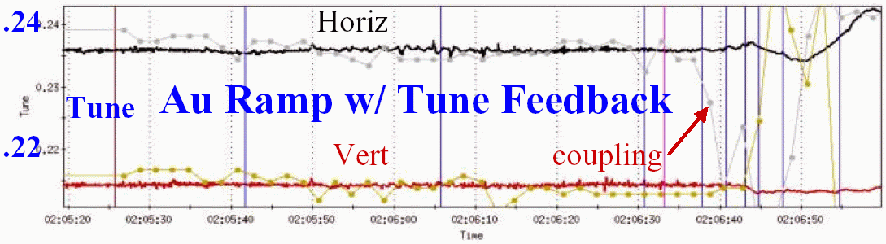
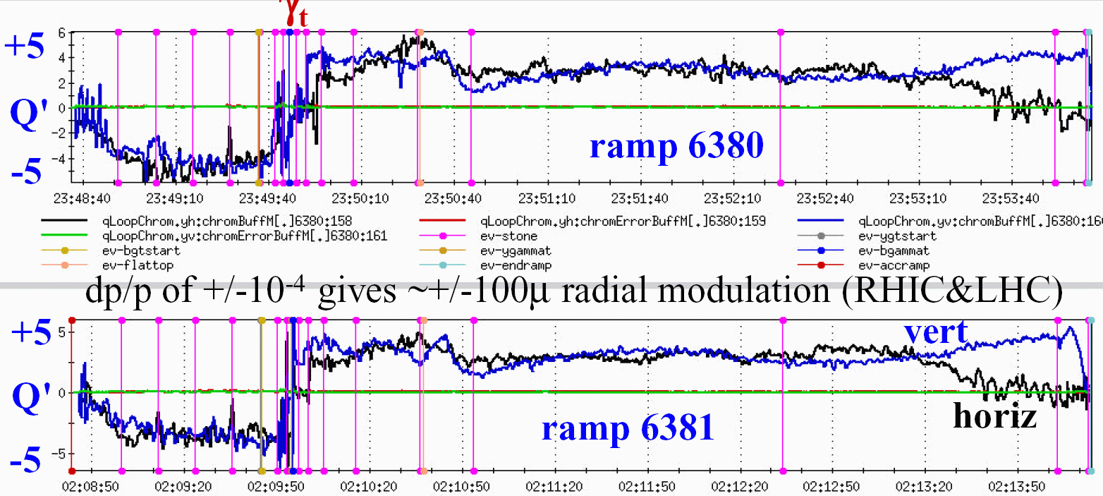
Mar 05: Tune Feedback Workshop
Tune feedback demonstration using a similar system
(not routine)
Chromaticies tracked through two ramps
(feedback not yet attempted)

Slide 14
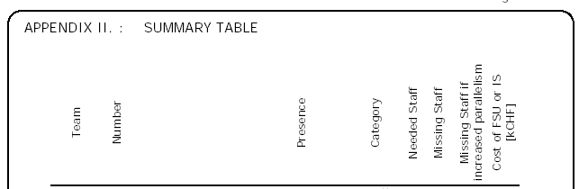
Jan 05: Chamonix XIV
Schedule slippage: some missing engineers & super-techs – 45 out of 143 – proposed to come from National Institutes
LHC seeks a “nucleus of experienced people” in magnet, cryo, & quench protection systems – 5 or 6 ? – from U.S. labs

Slide 15
(Hardware) Commissioning

Slide 16
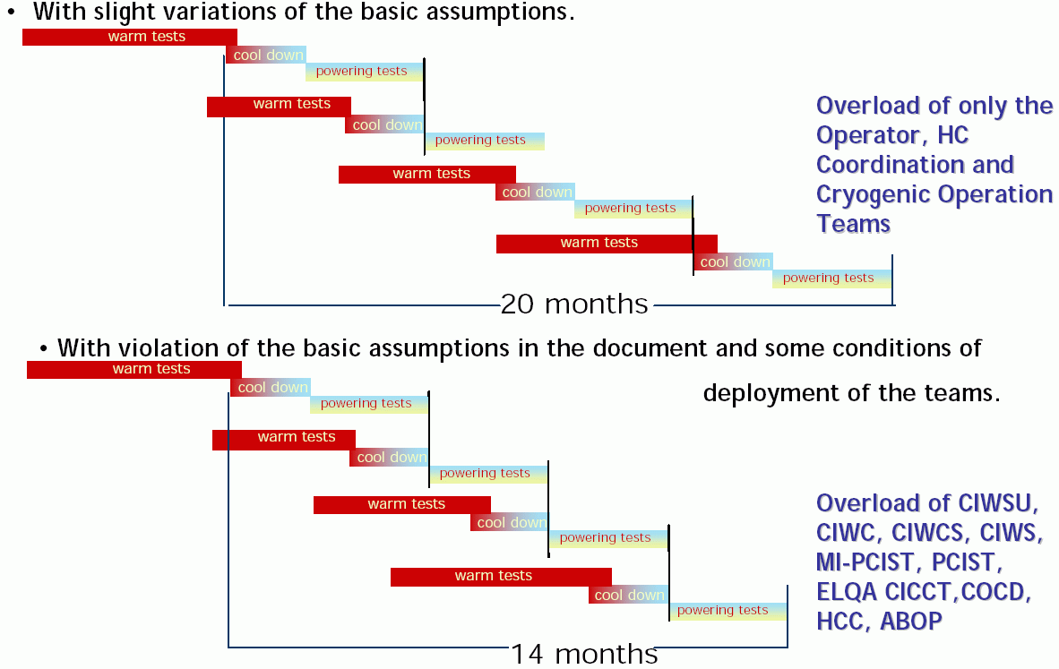
Schedule update - March 05

Slide 17
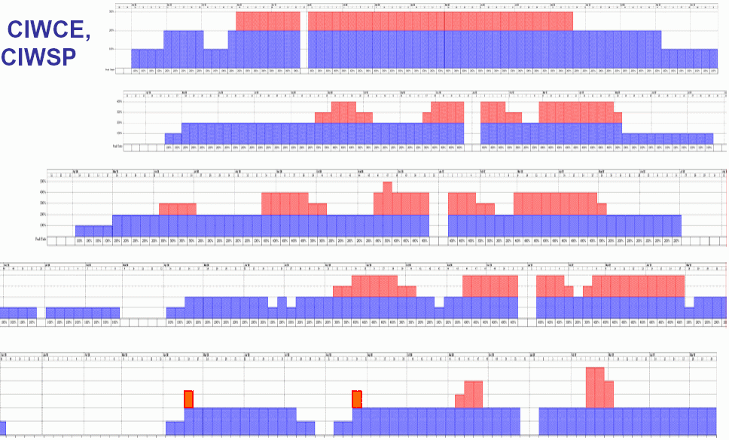
Additional teams required
Cryogenic
instrument.
Cryo instr., cool-
down & power
Cryogenic
operation
Hardware
comm. co-ord.
Electrical QA
New schedule, maintaining first beam in 2007 is more extreme - 45 staff for 20 months becomes 90 for 14 (?)

Slide 18
Additional U.S. support?
There is general agreement (DOE, Lab directorates, CERN) that providing additional Hardware Commissioning support
- is the right thing to do
- LARP is a potential vehicle for its organization
Current LARP scope includes only Interaction Region (U.S. built deliverables), Beam, and Instrumentation commissioning
But LARP has no mandate from DOE, CERN, or U.S. Labs.
Response: seek a formal request letter from CERN to DOE & U.S. Labs.
March 21: wordsmithing was almost complete, when ..

Slide 19
Commissioning Task Force
LARP has created a Commissioning Task Force, chaired by Vladimir Shiltsev (FNAL), to look at ALL potential LARP commissioning roles
Deliverable is a white paper, ready before this summers CERN-U.S. Executive Committee meeting
This includes a head count based on a preliminary survey of potential names
Information exchange and development at the LARP collaboration meeting (April)
Vladimir's white paper presentation to CERN-U.S. committee may be the most significant next step in the Hardware Commissioning story
Until then (basically) “wait and see” ...

Slide 20
Junior Workforce Pipeline

Slide 21
Junior workforce pipeline
The junior workforce (accelerator science & engineering) needs a national strategy on par with SRF and Superconducting Magnets
Accelerator R&D has historically been performed by HENP (not BES), with ILC participation by NSF – accept and embrace this!
LARP swims upstream against post-doc perceptions and realities:
- visas
- dollar decline (“wage cuts”)
- lack of new accelerator projects
LARP junior workforce will help build the ILC – beware the pipeline bubble!
Consider potential university, Japanese, and NSF roles in LARP by analogy with ATLAS, CMS, and ILC?
- (eg crab cavities)

Slide 22
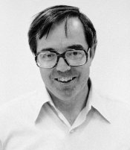

Toohig Fellowships
to work in LARP
Beginning in 2006, the U.S. LHC Accelerator Research Program (LARP) is looking for candidates with recent PhD's in Accelerator Physics or Accelerator Engineering to participate in:
1) LHC commissioning, and/or
2) an Interaction Region upgrade.
Toohig Fellowships last 2 years, extendible by 1 year,
with approximately equal time spent at a U.S. lab (BNL, FNAL, LBNL, or SLAC) and at CERN.
If you are interested, please send a resume or contact Peter Limon
(pjlimon@fnal.gov) or Steve Peggs (peggs@bnl.gov)
See http://www.rhichome.bnl.gov/LARP for LARP information

Slide 23
Father Tim Toohig
1928 Born, Lawrence Massachussetts
1962 PhD in HEP, Johns Hopkins (& LBNL)
1965 Ordained as Jesuit priest, Boston College
1966 BNL Accelerator Department
1970 Founding member of Fermilab
1978-79 Sole American resident at Dubna
internationalist at height of the Cold War
1988 SSC Central Design Group (LBNL)
Deputy Dir. of Conventional Facilities (SSCL)
199n DOE Office of High Energy Physics
helped create “LHC Construction Project”
enabled LARP as we know it
2001 Dies, at LHC PAC meeting, SLAC

Slide 24
Quotes
N. Mokhov: "In the 80s, Tim was twice my guest at IHEP (Protvino). I remember our disputes on scientific, political and religious issues. He spoke Russian rather well but with a terrible Boston accent."
T. Toohig: “Being a Jesuit priest, if I see people playing
games, I can get righteous; being Irish, I can shoot 'em in the knees.”
T. Toohig: “Scientific knowledge is incompatible with a lazy faith. If you're going to be a believer, the props are gone. You really have to come face to face with the question of God. It's more scary on one hand and richer on the other hand.”

Slide 25
Magnet Program

Slide 26
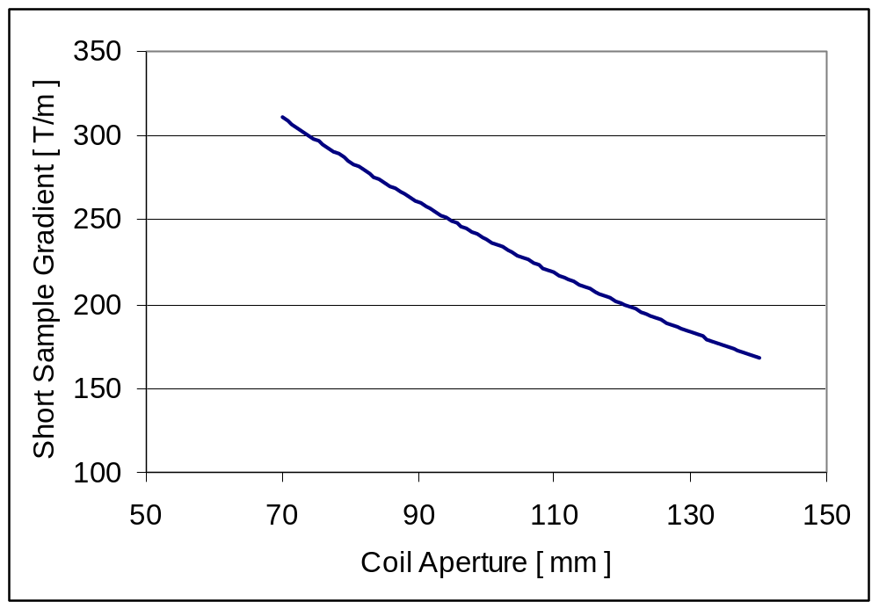
Nb₃Sn quadrupole parameter space
Sen et al.
Higher Performance
1st gen.
IR
(NbTi)
Zlobin et al.
TQ
?
2nd gen. IR
(NbTi)
Ruggiero et al.
All upgrade scenarios require state-of-the-art quads, but final parameters will only be established with beam experience

Slide 27
Quadrupoles
Ruggiero, Taylor, et al - EPAC 04
“The choice of the coil aperture is driven more by the power density limit than by the beam acceptance”
“An estimate of the radiation parameters of the magnets requires extensive simulations based on detailed knowledge”
LARP External Review - June 2004
“LAPAC suggests that the main issue is demonstration that (Nb₃Sn) quads can be made in both long and short lengths.”
“... demonstration of a working long quadrupole, the first of its kind in the world, will be a key element in the decision to start … the LHC luminosity upgrade.”

Slide 28
Beam separation dipoles
Open Mid-plane Dipole review – Dec 04
“While the 'dipole first' scenario may not be implemented in the first IR upgrade, it remains a viable option for later upgrades.”
"The 'open mid-plane dipole' developed at BNL is a novel concept with several features well suited to face the challenges of the separation dipole (D1) in the 'dipole first' scenario.”
“We suggest continuing and expanding this development to include the aspects not yet covered .... in order to achieve a complete conceptual design ...”

Slide 29
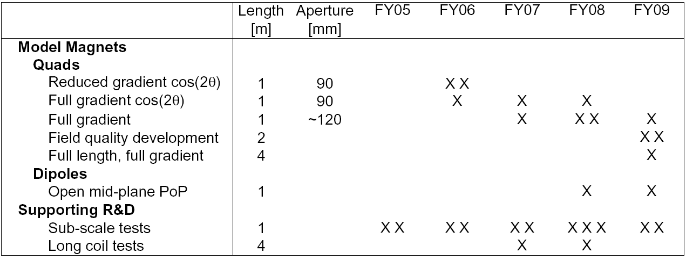
Strawman goals & timeline
1) High gradient large aperture quad
2) Long magnet scale-up
3) Proof-of-principle open midplane dipole
06 Full gradient cos(2θ) quad
07 Wind & React full length racetrack coil
08 Proof-of-Principle open midplane dipole
09 Full length full gradient quad

Slide 31
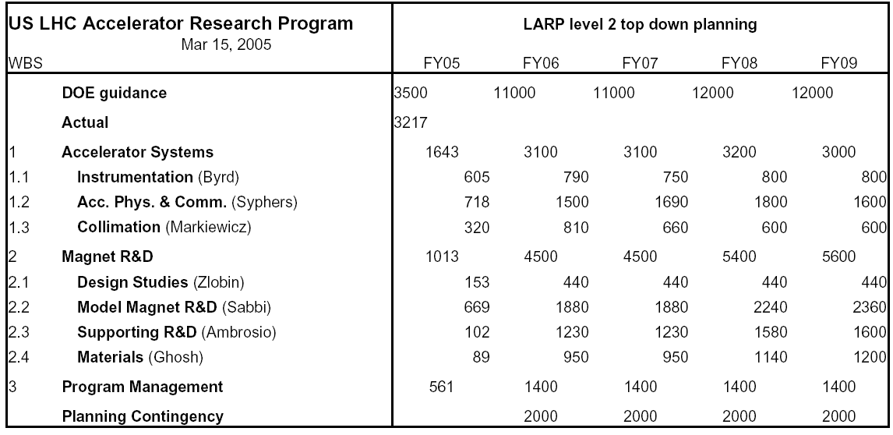
Top down exercise...
Constrained to match DOE guidance
Prog. Mgmt. includes 25% L2 labor, program travel, post-docs, ...
Planning Contingency reduces to $0k on October 1

Slide 32
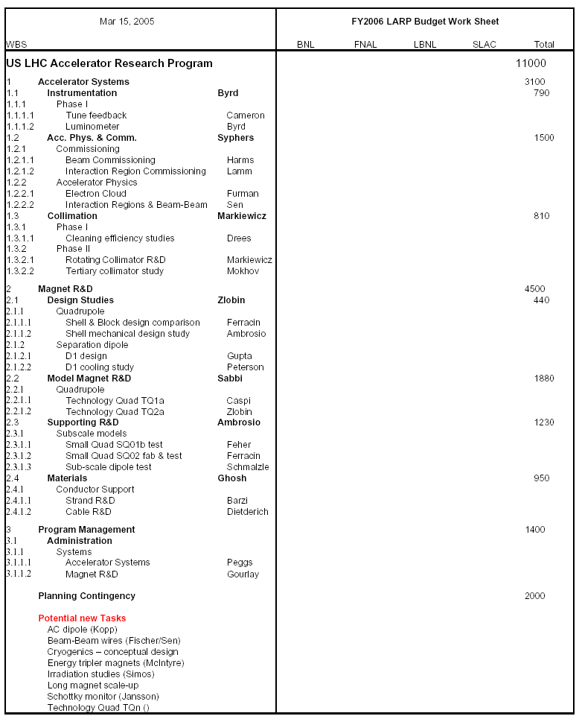
.. bottom up
at Port Jeff
“Enable” L2 co-ordinators to resolve their plans & budget requests for FY06 & FY07 at the collaboration meeting, April 6-8.
Level 4 “Task sheet” plans are already in place for 05 -> 06 -> 07
Evaluate / prioritize /defer potential new tasks ...

