Slide 1



J/ψ production in
PHENIX
Raphaël Granier de Cassagnac
LLR – École polytechnique / IN2P3
For the PHENIX collaboration
Hot Quarks 2006
Villasinius, Sardinia, May 20th
Notes:
« I will report on the Jpsi production that has been observed by the phenix experiment. »

Slide 2

J/ψ in nucleus-nucleus
(phenix preliminary = QM05)
Notes:
Nothing new on data since QM05
A bit more on their (non) interpretation

Slide 3
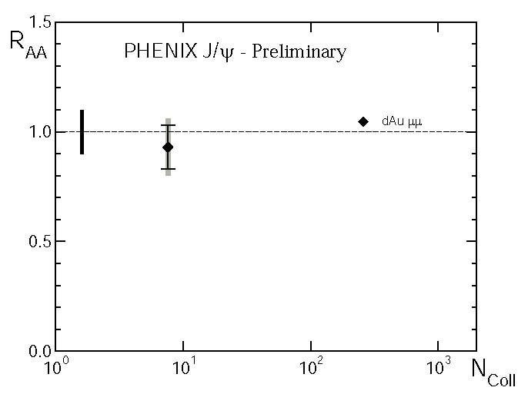
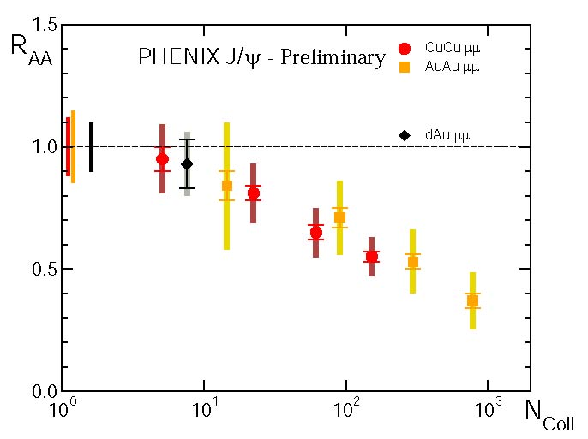
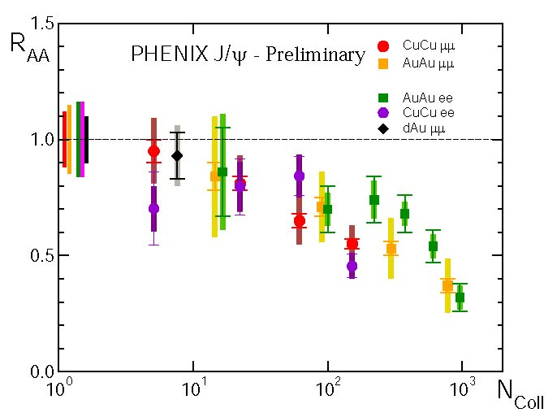
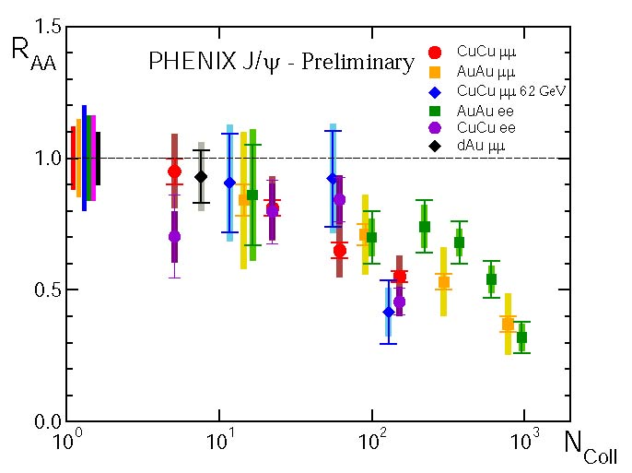
R_{AA} versus N_{coll}
J/ψ → μμ
Muon arm
1.2 < |y| < 2.2
J/ψ → ee
Central arm
-0.35 < y < 0.35
N_{ψ}^{AB}
R_{AB} =
N_{ψ}^{PP}
x
<N_{coll}>
dAu
μμ
200 GeV
AuAu
μμ
200 GeV
CuCu
μμ
200 GeV
AuAu
ee
200 GeV
CuCu
ee
200 GeV
CuCu
μμ
62 GeV
Hugo Pereira da Costa, for PHENIX, QM05, nucl-ex/0510051
Notes:
Versus Ncoll !

Slide 4
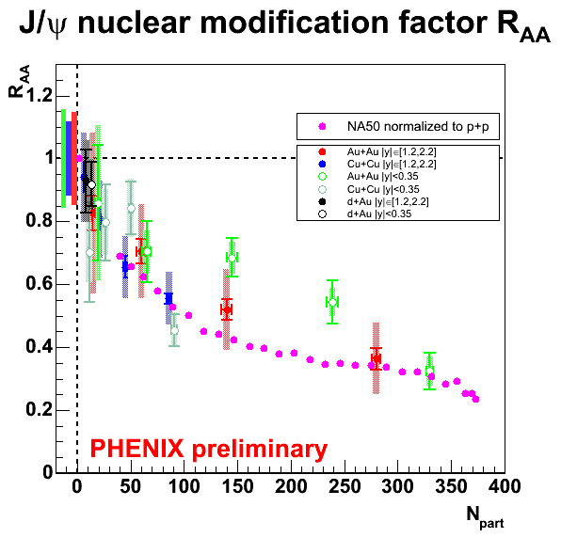
Quick comparison to NA50
Same magnitude
  30% survival prob.
No fundamental reason
Differences:
  Higher energy density
    (x10 beam energies)
  Balance between cold & hot nuclear effects ?

Slide 5
J/ψ in deuteron-gold
PRL96 (2006) 012304

Slide 6


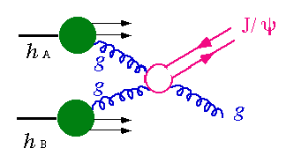
Cold nuclear matter effects
Various “cold” effects:
  Shadowing or anti-shadowing
    (gluon saturation, Color Glass Condensate…)
  Energy loss of initial parton
  p_{T} broadening (Cronin effect)
  J/ψ (or cc ) absorption
  Something else ?
¯
Notes:
“ The goal is to disentangle normal nuclear effects. And indeed, you can think of many of them. First, you have to pick up partons in your projectiles, and thus you are sensitive to parton distribution functions in the nuclei, the so called antishadowing, shadowing and maybe you can even reach the gluon saturation region. Then, the initial partons can suffer energy loss or pt broadening. Finally, the produced Jpsi can be absorbed by the nuclear matter.
The tool we use to investigate these effects is d+Au collisions, and we have to study them over the broadest range ot transverse momentum, rapidity and centrality we can achieve. And actually, this is the order I have chosen to present our results.
There are to interests in doing this study. The first is to gather some information on the nuclear effect mechanism. The second is to serve as a baseline for Au+Au collision. Because hopefully, we’ll soon have to answer the burning question : why do Jpsi appear / disappear in Au+Au collisions.”

Slide 7
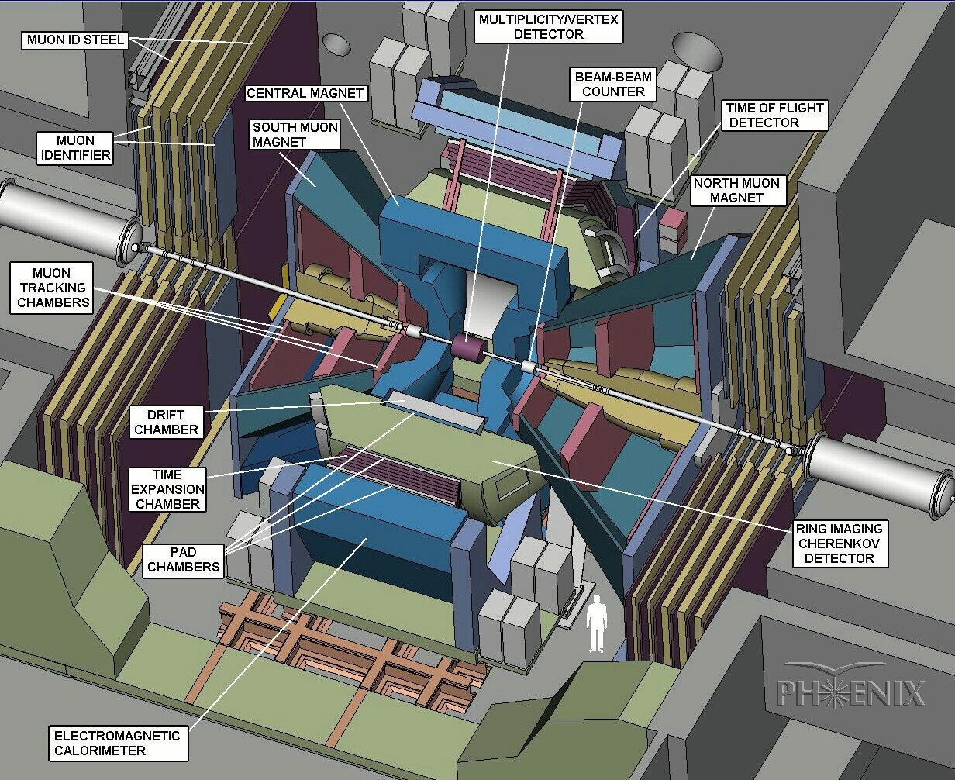
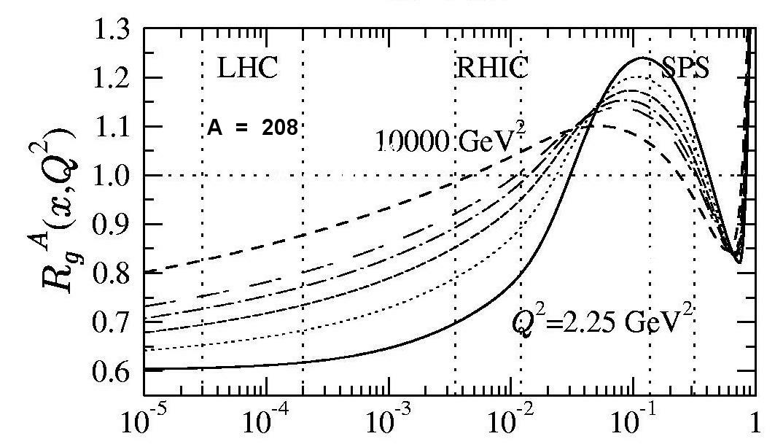
Deuteron → ← Gold
In PHENIX, J/ψ mostly produced by gluon fusion, and thus sensitive to gluon pdf
Three rapidity ranges probe different momentum fraction of Au partons
  South (y < -1.2) : large x₂ (in gold) ~ 0.090
  Central (y ~ 0) : intermediate x₂ ~ 0.020
  North (y > 1.2) : small x₂ (in gold) ~ 0.003
d
Au
An example of gluon shadowing prediction
x₂
rapidity y
gluons in Pb / gluons in p
x₁
J/ψ at
y < 0
Shadowing
Anti
Shadowing
x₁
x₂
J/ψ at
y > 0
x
Eskola, Kolhinen, Vogt
NPA696 (2001) 729
Notes:
…
“ If we see a Jpsi at negative rapidity, it has to come from a high x in the gold. Indeed our average X in the south is 0.09. On the contrary, if we see a northern psi, is has to come from a low X in the gold, and our average is 3.10 ^ -3. The midrapidity measurement is around 0.02. Here is a example of theoretical prediction of shadowing. This is the ratio of the gluon pdf in a lead nucleon to the gluon pdf in a proton versus X. You can see that our forward measurement is sitting in shadowing-land, while the backward should see anti-shadowing. ”
Shadowing diffère d’un facteur trois entre modèles…

Slide 8
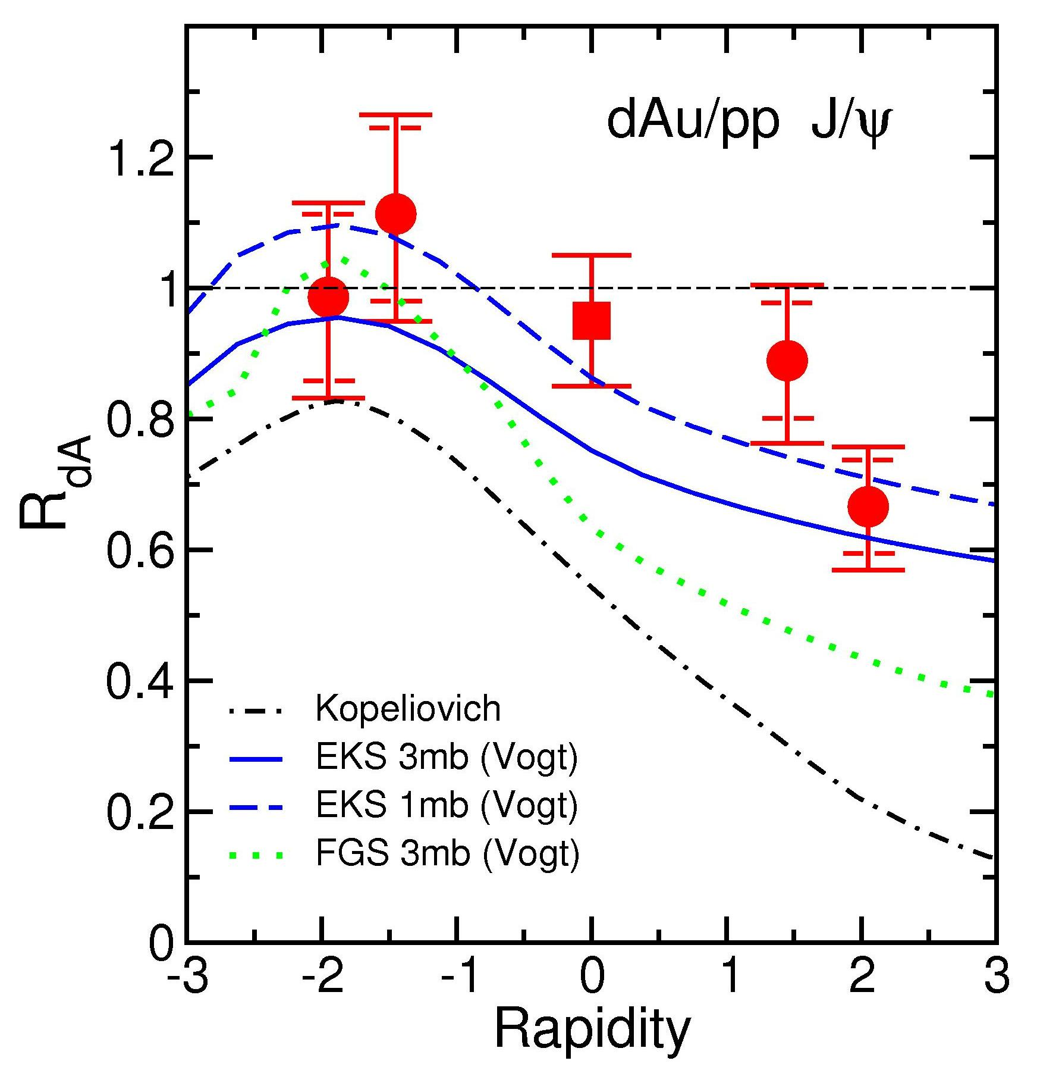
R_{dAu} versus rapidity
R_{dA}
Data favours
  (weak) shadowing
    Eskola, Kolhinen, Salgado
    prescription matches better
  (weak) absorption
    σ_{abs} ~ 1 to 3 mb
    (4.18 ± 0.35 mb @SPS)
But with limited statistics difficult to disentangle nuclear effects !
Low x₂ ~ 0.003
(shadowing region)
PHENIX, PRL96 (2006) 012304
Klein,Vogt, PRL91 (2003) 142301
Kopeliovich, NPA696 (2001) 669
Notes:
Define RdAu !
Drop is energy loss ! (Mike’s cartoon)
3 millions of Jpsi !
Let’s take a closer look to the comparison with lower energy…
1) COHERENCE PHENOMENA IN CHARMONIUM PRODUCTION OFF NUCLEI AT THE ENERGIES OF RHIC AND LHC.
By Boris Kopeliovich, Alexander Tarasov (Heidelberg, Max Planck Inst. & Regensburg U. & Dubna, JINR), Jorg Hufner (Heidelberg, Max Planck Inst. & Heidelberg U.),. Apr 2001. 50pp.
Published in Nucl.Phys.A696:669-714,2001
e-Print Archive: hep-ph/0104256

Slide 9
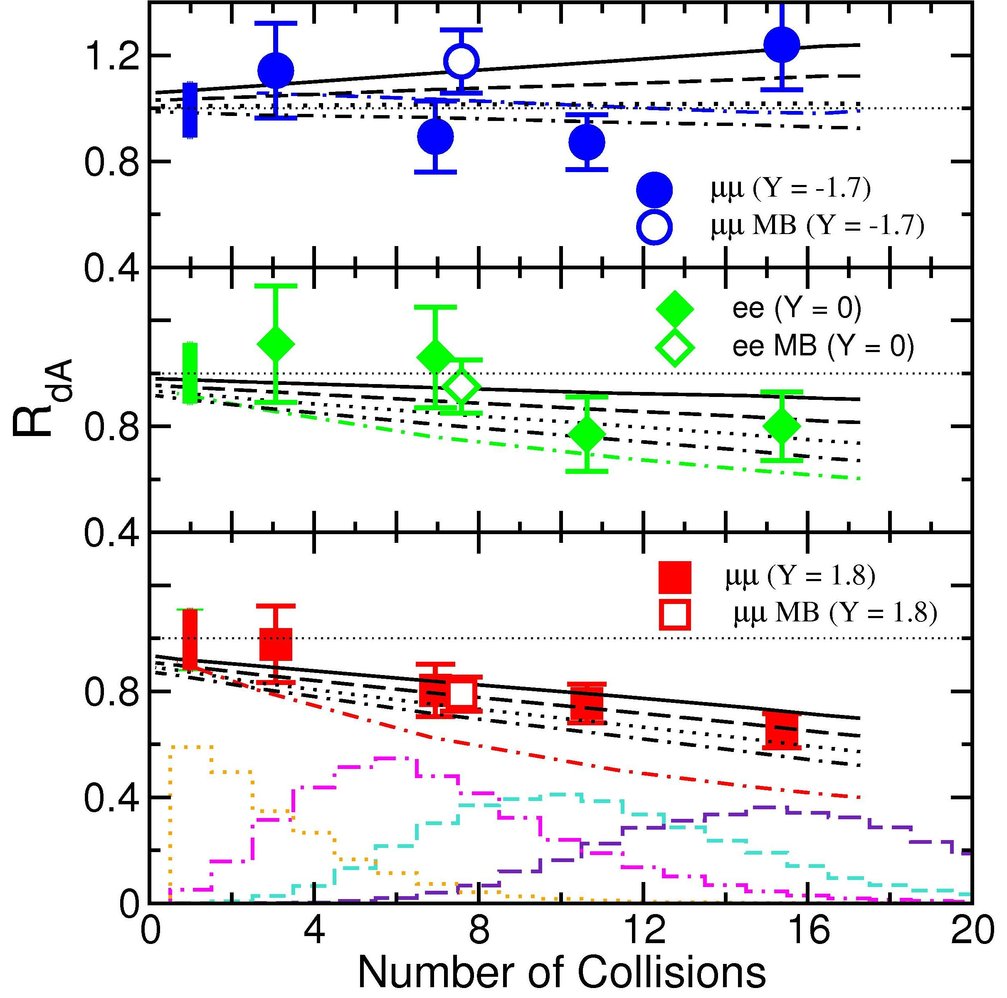
R_{dAu} versus N_{coll}
R_{dA}
High x₂ ~ 0.09
Black lines:
  EKS98 from 0 to 3 mb
Colored lines:
  FGS for 3 mb
Slopes consistent with shadowing models
  Especially low x₂
Low x₂ ~ 0.003
Notes:
…
“ in fact, it almost look as a soft process ” ?

Slide 10
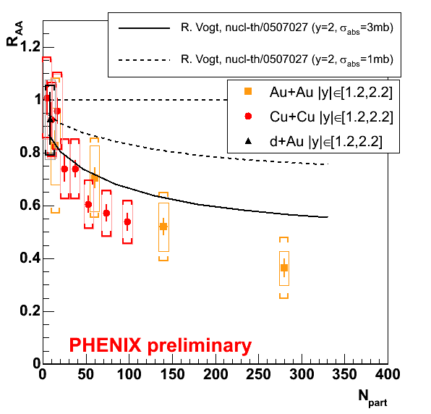
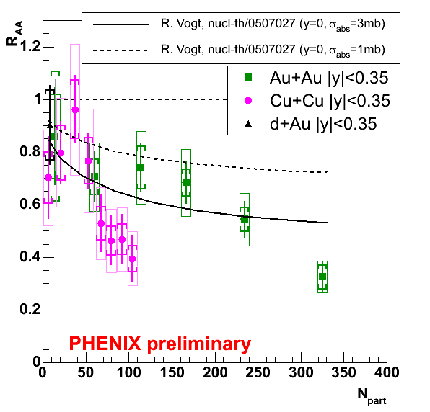
Cold nuclear matter effects
Shadowing + nuclear absorption (crucial !)
Normal
suppression
Uncertainty
Anomalous
suppression
≥ 1/3
1.2 < |y| < 2.2
-0.35 < y < 0.35
Error bar code : bars = statistical,
bracket = systematic, box : global.
PHENIX, QM05, nucl-ex/0510051
Vogt, nucl-th/0507027
Notes:
Back to AuAu !
Error bar code : bars = statistical, bracket = systematic, box : global.
Notice the difference between forward and mid rapidities !

Slide 11
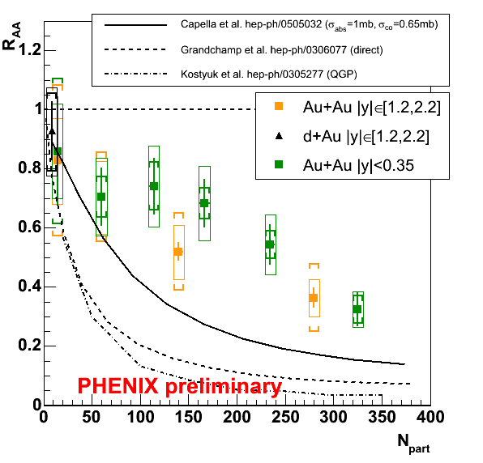
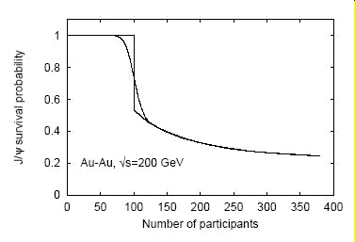

“NA50 only” effects
Cold effects + …
  Comovers (hadrons/partons?)
  Kinetic model (J/ψ → c c )
  Thermal plasma
All overestimate suppression !
So does parton percolation
  Onset at N_{part} ~ 90
  Simultaneous J/ψ + χ_{c} + ψ’
(AuAu only)
(no cold effect)
Capella, Ferreiro, EPJC42 (2005) 419
Grandchamp et al, PRL92 (2004) 212301
Kotstyuk et al, PRC68 (2003) 041902
Digal, Fortuno, Satz, EPJC32 (2004) 547
+ Private communications +
Notes:
“ First, let’s give a chance to the models that did a good job in explaining the NA50 data. Here, I pick up the AuAu data only, at both rapidities… ”
“ If you wonder what percolation means, it is when partons overlap in space and recombine ”
Grandchamp Phys.Rev.Lett.92:212301,2004
Capella Eur.Phys.J.C42:419-424,2005
Kotstyuk Phys.Rev.C68:041902,2003
Digal, Fortunato & Satz. Eur.Phys.J.C32:547-553,2004
(j’ai tous les pdf)

Slide 12
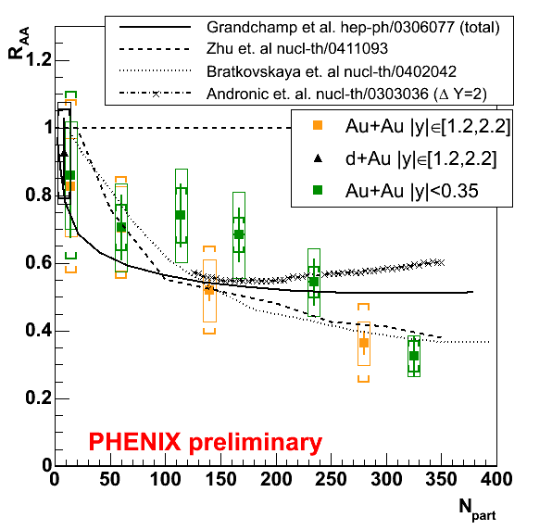
RHIC “new” effects
1st. Variety of recombination & coalescence models
c c → J/ψ (at freeze-out)
goes as N_{cc}² (poorly known)
(other models not displayed)
2nd. One detailed QGP hydro + J/ψ transport (Zhu et al)
(here without cold nuclear effects, see later…)
Look at y, p_{T}…
(AuAu only)
Grandchamp et al, PRL92 (2004) 212301
Bratkoskaya et al, PRC69 (2004) 054903
Andronic et al, PLB571 (2003) 36
Zhu, Zhuang, Xu, PLB607 (2005) 107
+ Private communications +
Notes:
+ régénération
Zhu Phys.Lett.B607:107-114,2005
Bratkoskaya Phys.Rev.C69:054903,2004
Andronic Phys.Lett.B571:36-44,2003
Hadron string dynamics
+ statistical coalescence
+ statistical hadronization

Slide 13
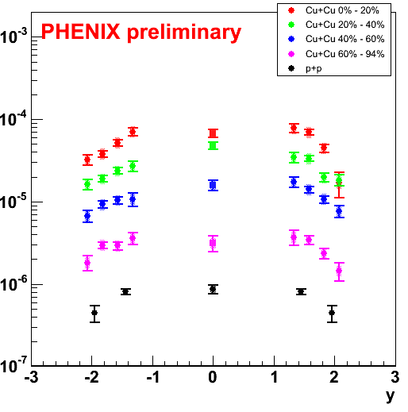
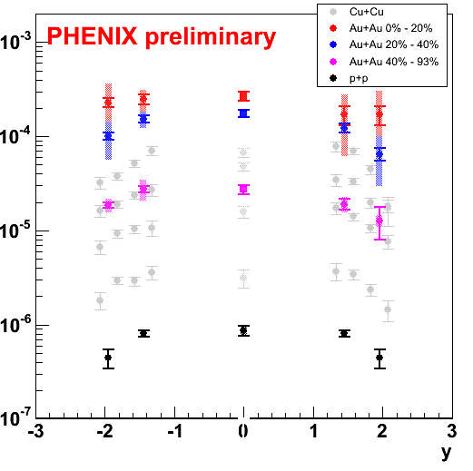
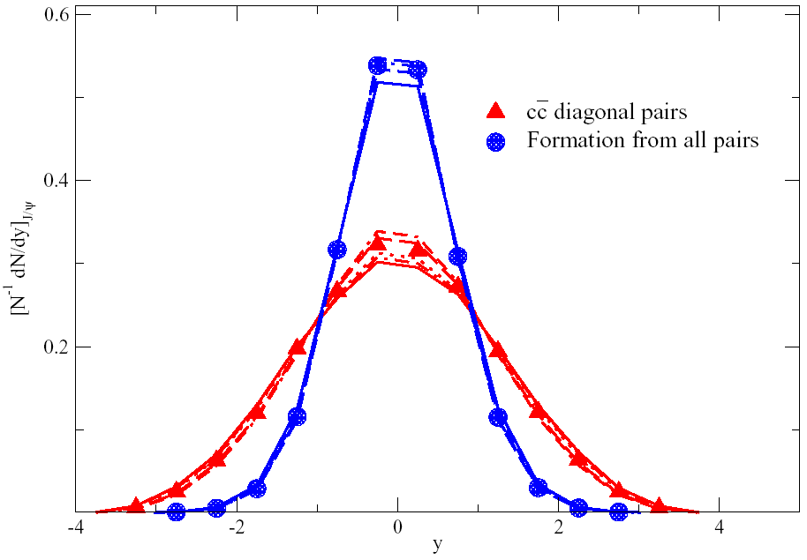
y shape (vs recombination)
Recombination emphasizes quark y-distribution
Quark (open charm) y-distribution unknown
No significant change in rapidity in data…
Recombined only !
← Thews & Mangano, PRC73 (2006) 014904c
Notes:
Thews, Phys.Rev.C73:014904,2006

Slide 14
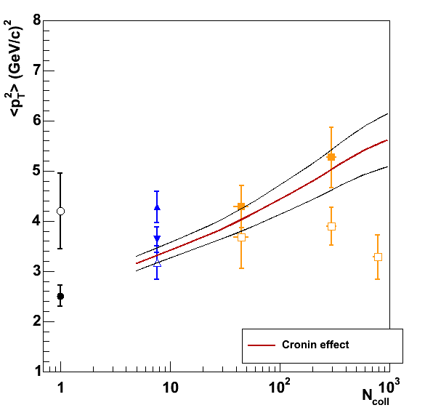
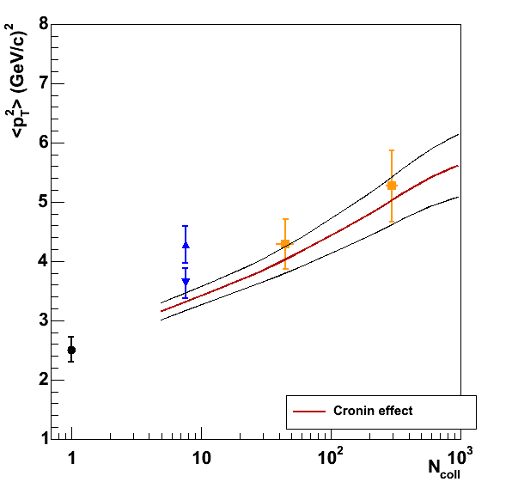
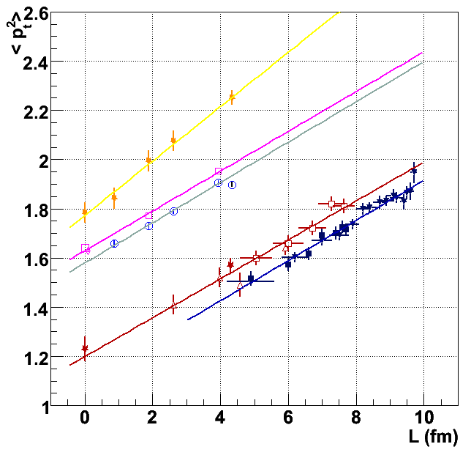
<p_{T}²> (vs Cronin effect)
<p_{T}²>_{AA} = <p_{T}²>_{pp} + ρ σ Δp_{T}² x L [nuclear matter thickness]
  (random walk of initial gluons)
ρ σ Δp_{T}² from pp and dA →
L <-> N_{coll} conversion
Negligible broadening @ y=0 !?...
  (open symbols)
p+p d+Au Au+Au
(lower energy survey)
Open symbol: y ~ 0
Full & Curve: y ~ 2
<p_{T}²> = 2.51 + 0.32 L
VN Tram, Moriond 2006 & PhD thesis

Slide 15
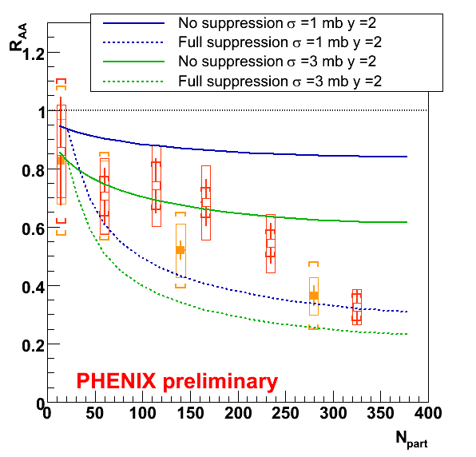
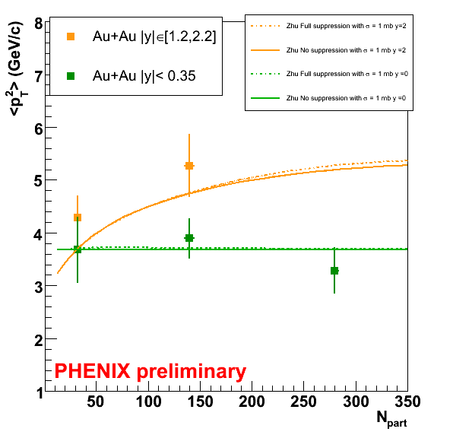

2nd. Zhu et al (updated)
(dominated by Cronin
determined on dA data)
Predicted R_{AA} (y=0) ~ (y=2)
+ Nuclear absorption (1 or 3 mb)
+ Cronin effect from our dAu
Zhu, Zhuang, Xu,
PLB607 (2005) 107
+ private communication
Notes:
Y=0 is very close !

Slide 16
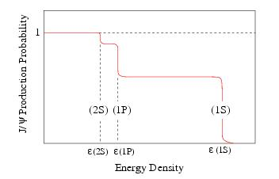
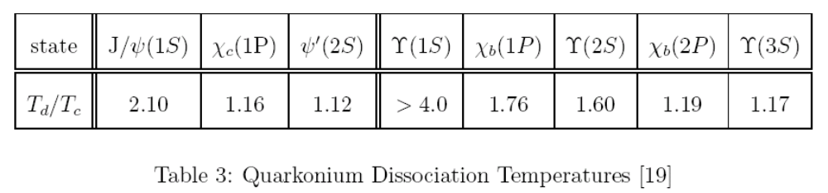
3rd (simple) explanation
Amount of anomalous suppression depends on cold nuclear effects amplitude
But could as low as 30 to 40%
Compatible to feed-down ratio
  J/ψ ~ 0.6 J/ψ + 0.3 χ_{c} + 0.1 ψ’
Recent lattice T_{d}^{ψ} ~ 1.5 - 2.5 T_{c}
  ε x (T_{d}^{J/ψ} ~ 2T_{c})⁴ = 2 ε_{c}→ ε_{d}^{J/ψ} ~ 32 ε_{c} !
Wait for LHC ?
We may still be here
Datta & al, hep-lat/0409147
Alberico & al, hep-ph/0507084
Wong, hep-ph/0408020
← Satz, hep-ph/0512217

Slide 17

Conclusions (1)
For now, 3 models to “explain” the data:
1st Recombination ?
  But no sign of y or p_{T}² modifications…
  J/ψ α (N_{cc})² (but how much is N_{cc} ?)
2nd J/ψ detailed transport in hydro QGP
3rd Sequential melting ?
  J/ψ may still survive @ RHIC…
All assume a QGP…

Slide 18
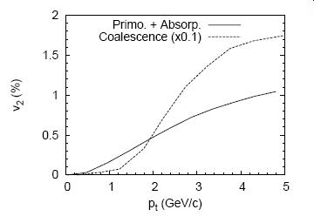
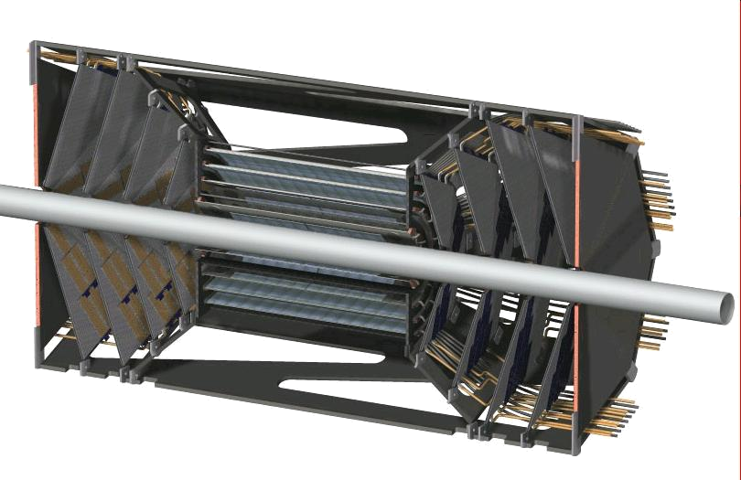
Conclusions (2)
What do we need to answer ?
Final AA analysis
  A bit more data & more bins !
  With a better pp ref (run 5)
  With J/ψ elliptic flow ? →
More dA ! Better handle cold nuclear effects…
More AA ! With open charm, ψ’,…
First look at ψ’ and upsilons
  Going on with run 5 pp…
Better open charm measurements
  Si VTX upgrade →
LHC !
Zhu, Zhuang, Xu, PLB607 (2005) 107
Notes:
17 bins en CuCu
?? en AuAu !
“ In case of coalescence, the J/psi should inherit the flow of charm quarks ” (+ un plot pour HP06)

Slide 19
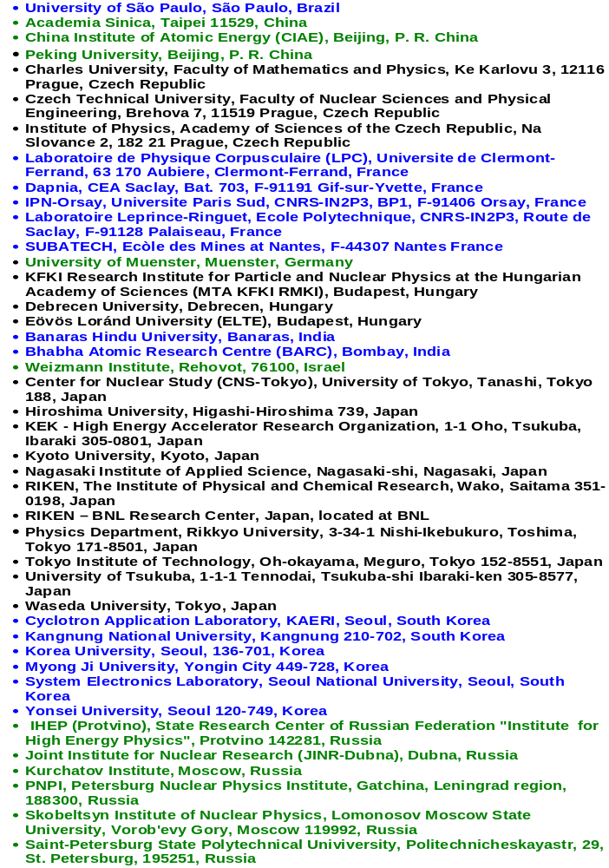

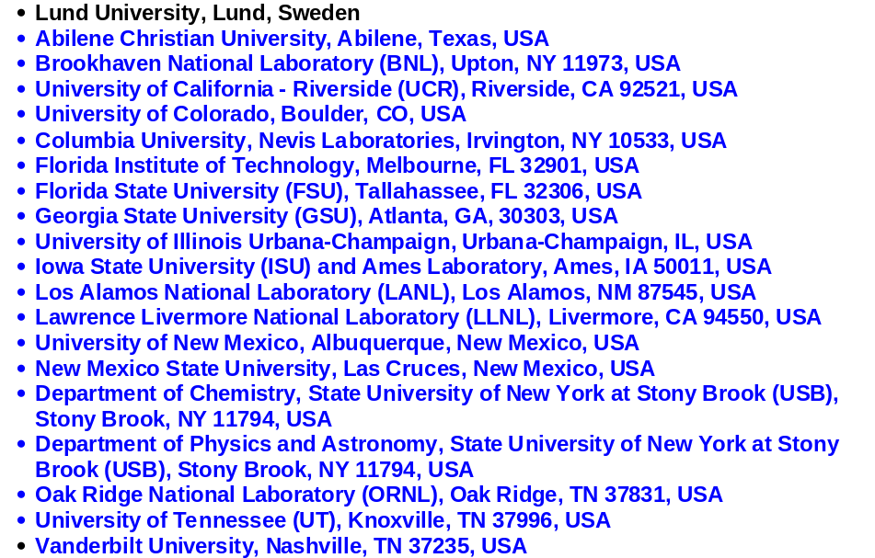
13 Countries; 62 Institutions; 550 Participants*
*as of March 2005

Slide 20
Back up slides

Slide 21
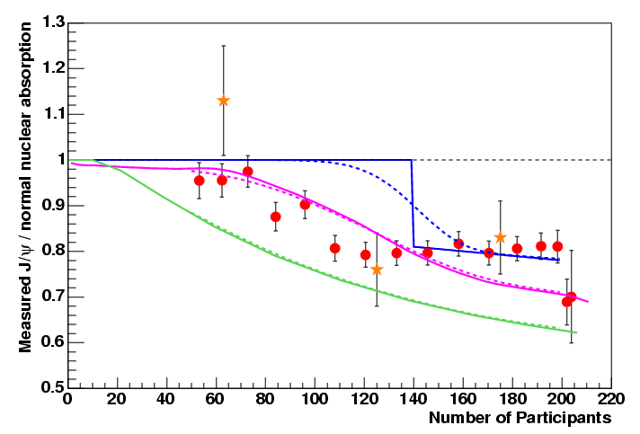
Quick look at NA60
In In-In collisions, preliminary plateau also rules out percolation, comovers and available plasma
Roberta Arnaldi, QM05
Satz, Digal, Fortunato
Rapp, Grandchamp, Brown
Capella, Ferreiro
Percolation
Plasma
Comovers
NA60 preliminary

Slide 22
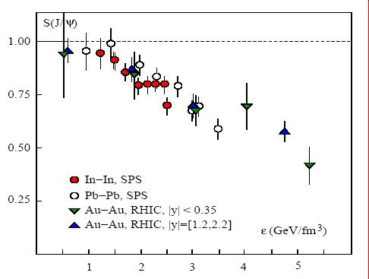
3rd Sequential melting
Sequential melting
  J/ψ survival only
Cold nuclear matter effects derived from dAu data for RHIC
Axis cannot be energy density since same τ⁰ (1fm/c) is assume for SPS and RHIC !
  Larger at SPS
  Smaller at RHIC
Karsch, Kharzeev & Satz hep-ph/0512239

Slide 23
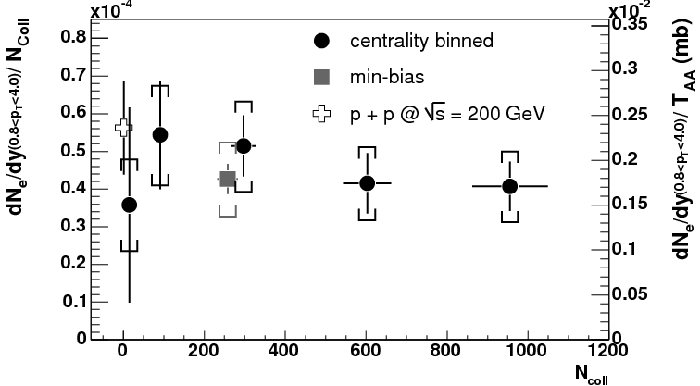
Quick look to open charm
Through semileptonic decays (D → e)
10 to 20 cc pairs !
(→ 40 acc. STAR)
N_{coll} scaling
~25% systematic uncertainties
(without Silicon vertex
detector upgrade)
PHENIX, PRL94 (2005) 082301
Notes:
14 paires dans les événements les plus centraux !

Slide 24
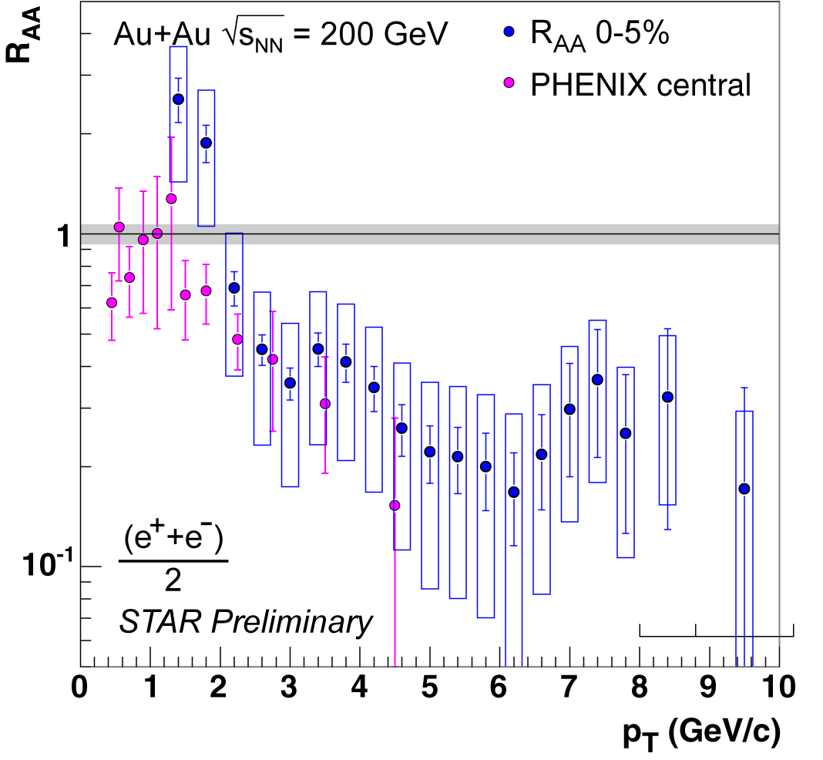
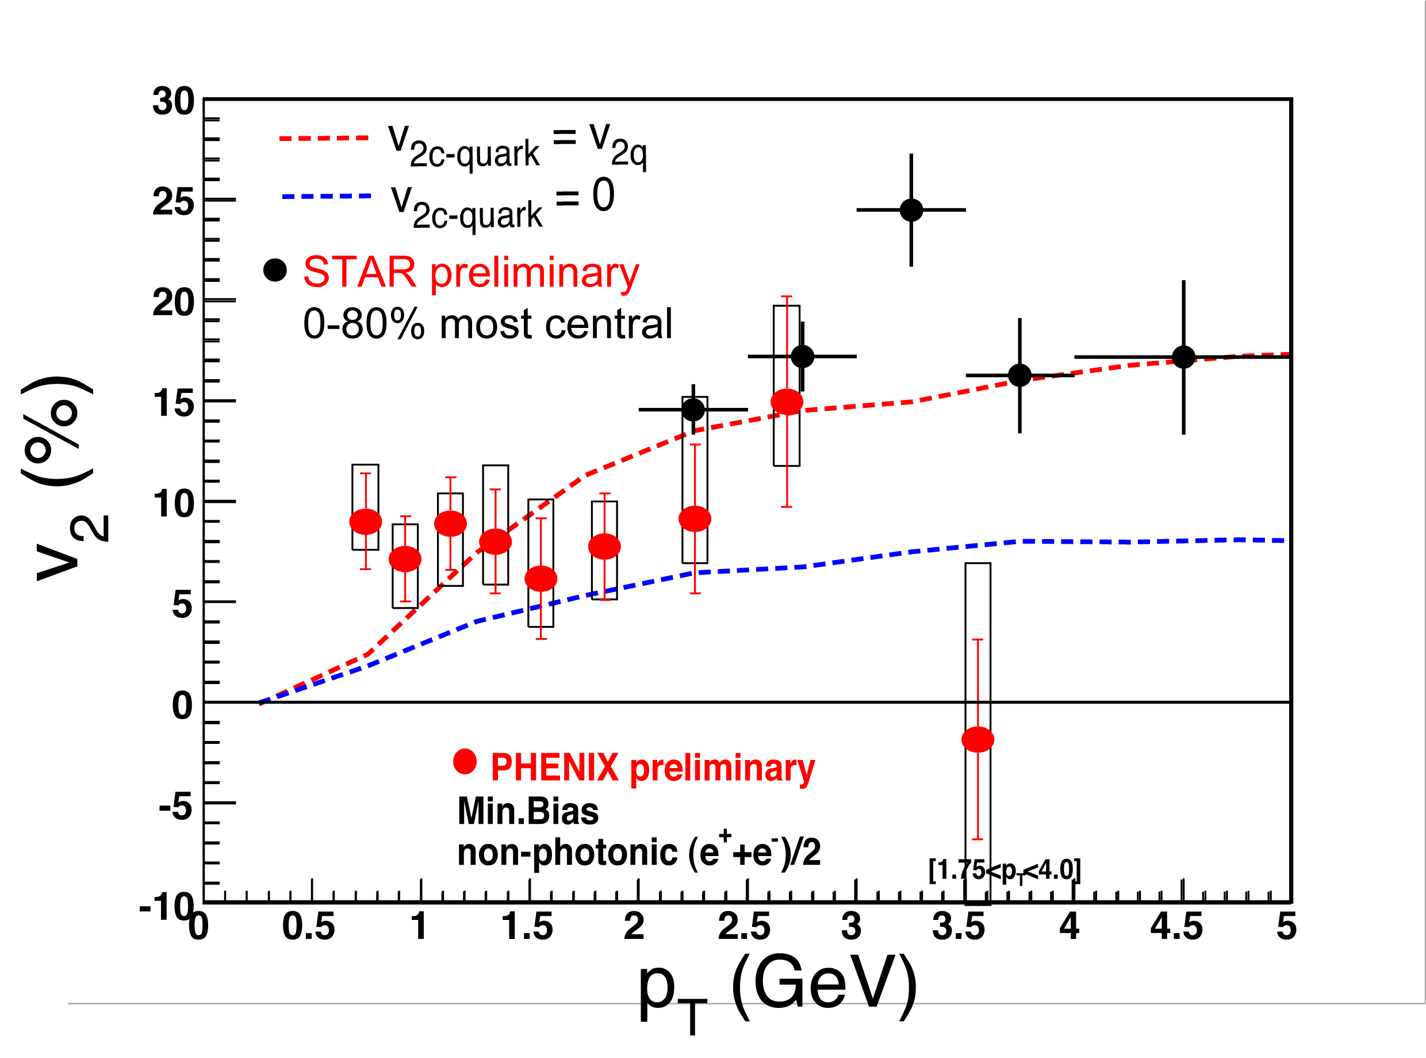
Charm quench & flow

Slide 25
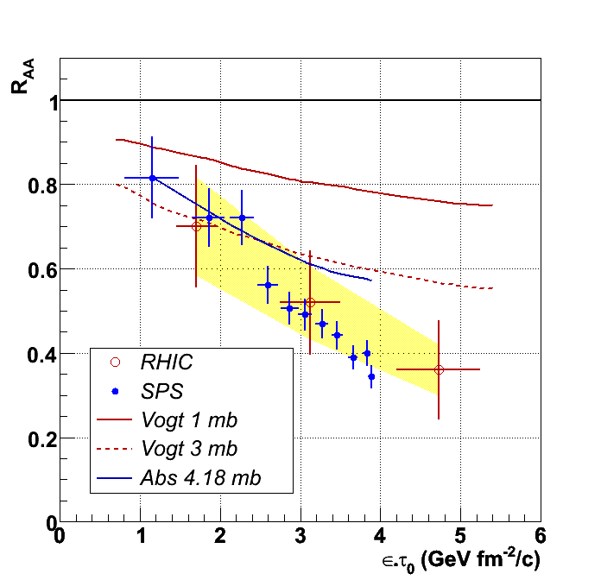
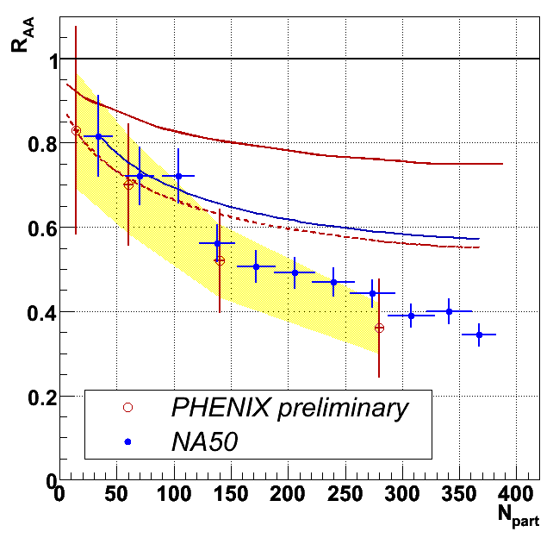
Na50/Phenix comparisons
PHENIX expected
PHENIX expected
1mb
1mb
NA50 expected 4.18 mb
NA50 expected 4.18mb
3mb
3mb
Consistent suppression amplitude observed
but cold nuclear effects may be different
Notes:
Le problème de ces plots, c’est qu’il n’y a pas les points à mi rapidité…

Slide 26
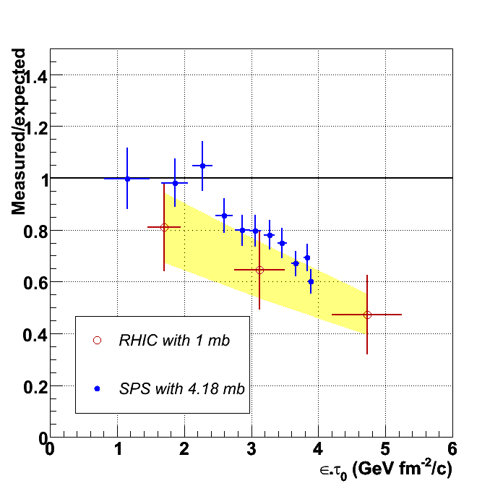
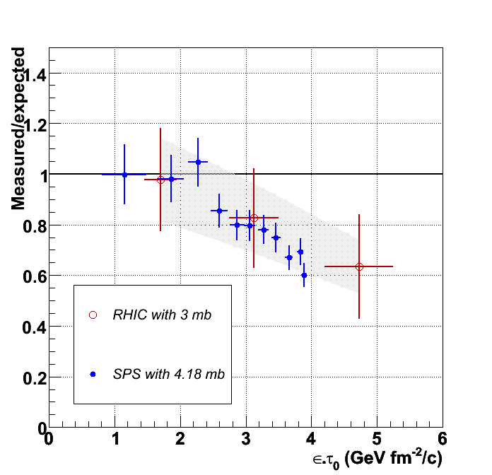
measured/expected vs ε_{Bj}
(x τ₀) !
σ_{abs} = 1 mb
σ_{abs} = 3 mb
Below unity !
Suppression amplitude consistent within error bars

Slide 27
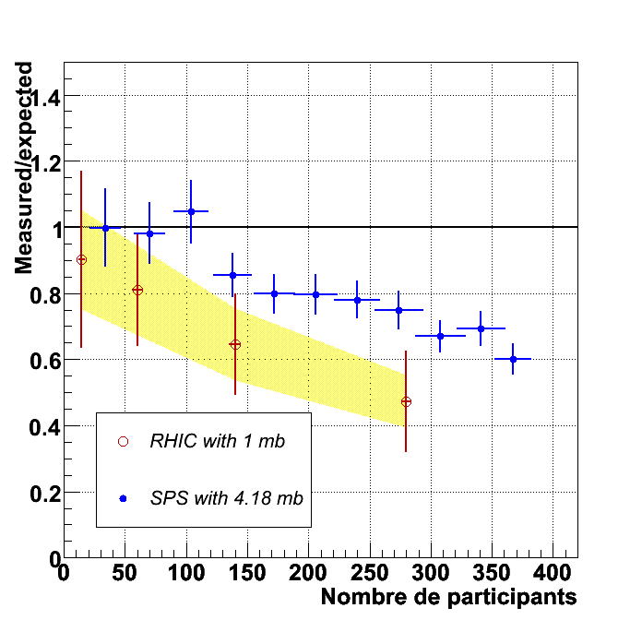
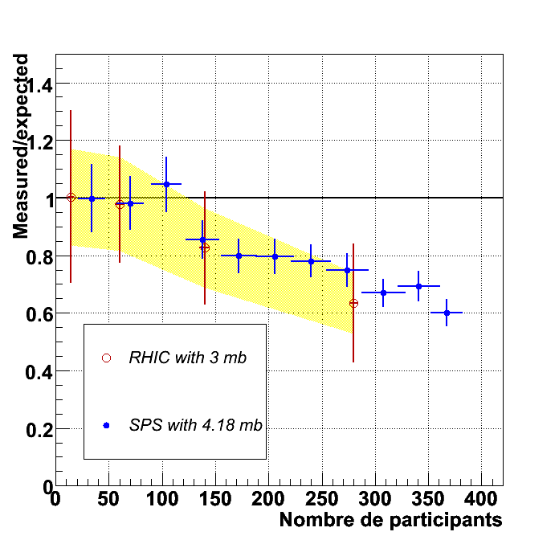
measured/expected vs N_{part}
σ_{abs} = 1 mb
σ_{abs} = 3 mb
Under unity
Larger difference when 1mb but compatible within error bars

Slide 28
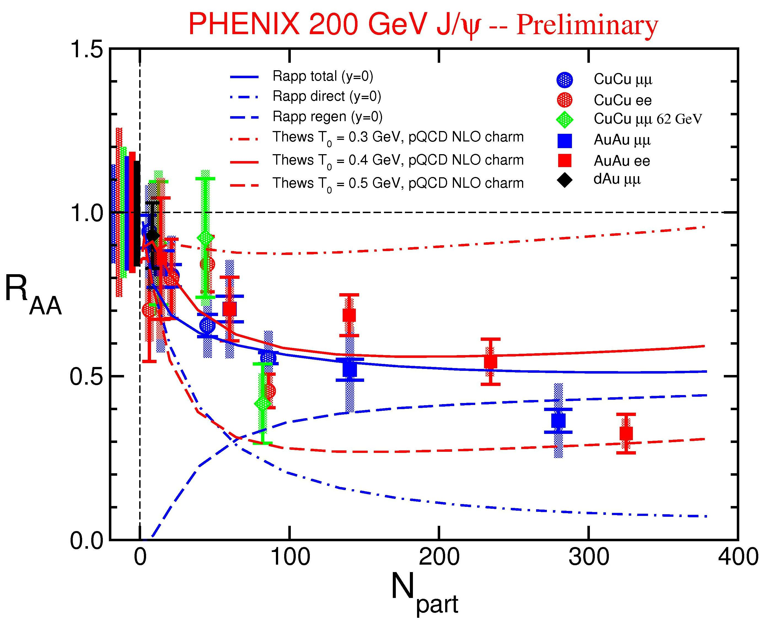
recombination/suppression
Thews, hep-ph/0504226
Grandchamp, Rapp, Brown
hep-ph/0306077

Slide 29
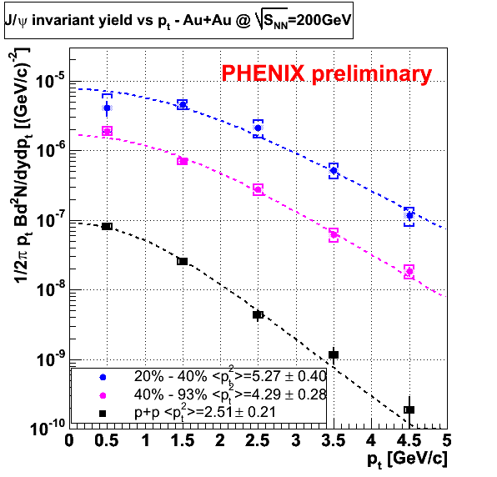
p_{T} spectra
In pp:
  <p_{T}²> = 2.5 GeV ²
In AuAu & CuCu:
  <p_{T}²> = 3 → 5.3 GeV ²
Au+Au (|y|∈[1.2,2.2])

Slide 30
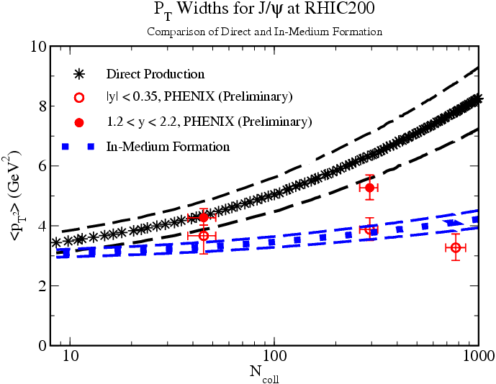
<p_{T}²> (vs recombination)
Robert Thews, SQM06

Slide 31
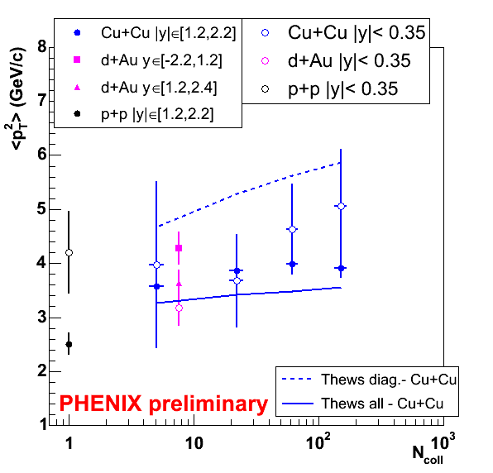
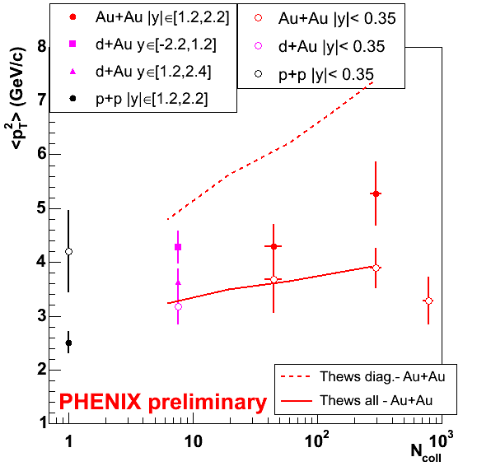
<p_{T}²> (vs recombination)
Au+Au
Cu+Cu
100% pQCD + k_{T}
100% recombined
Lines from Thews & Mangano, PRC73 (2006) 014904
Seems to favor recombination scenario
But Cronin effect not under control…
Notes:
Attention ! Y a un bug sur le plot AuAu…

Slide 32
Cronin effect
Scattering of initial gluons of nucleon before ccbar formation random walk : <p_{t}²>_{AA} = <p_{t}²>_{pp} + ρσΔ(<p_{t}²>) L_{AA}
√ s =17.3 GeV : NA50/60 Pb+Pb, In+In
√ s = 19.4 GeV : NA3 p+p, NA38 p+Cu, p+U,O+U, S+U
√ s = 27.4 GeV : NA50 p+Be, p+Al, p+Cu, p+W
√ s = 29.1 GeV :NA51 p+p, p+d, NA50 p+Al, p+W
√ s = 38.8 GeV : E866/789/771
nuclear density, σ elastic gluon-nucleon scattering cross section, Δ(<p_{t}²>)
kick given by each scattering and L average thickness of nuclear matter

Slide 33
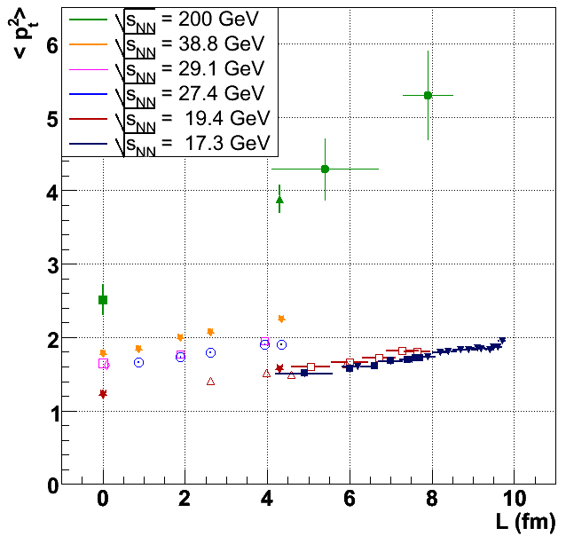
Cronin effect
Cronin : <p_{t}²>_{AA} = <p_{t}²>_{pp} + ρσΔ(<p_{t}²>) L_{AA}
Extrapolation curve from PHENIX J/ψ results in p+p and d+Au

Slide 34
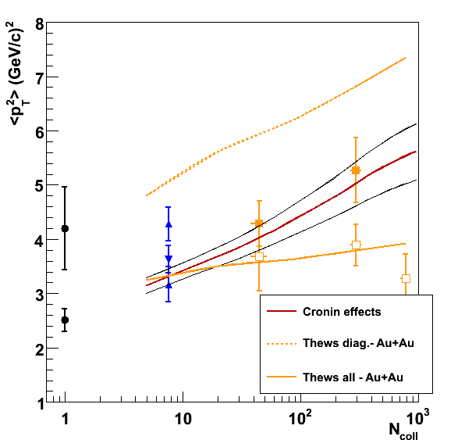
Cronin effect
Cronin : <p_{t}²>_{AA} = <p_{t}²>_{pp} + ρσΔ(<p_{t}²>) L_{AA}
Extrapolation curve from PHENIX J/ψ results in p+p and d+Au
p+p d+Au Au+Au
At forward rapidity, <p_{t}²> variation compatible with this Cronin extrapolation
At mid rapidity, measurements in p+p and d+Au indicate a weak Cronin effect

Slide 35
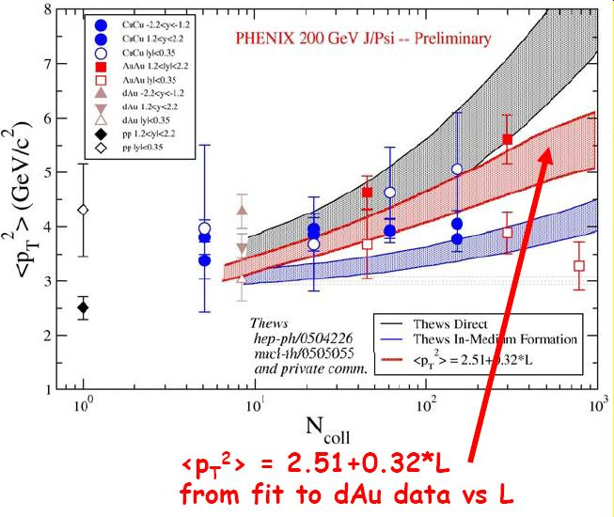
A busy plot about <p_{T}²>
( curves to be compared with AA @ 1.2<|y|<2.2 )

Slide 36
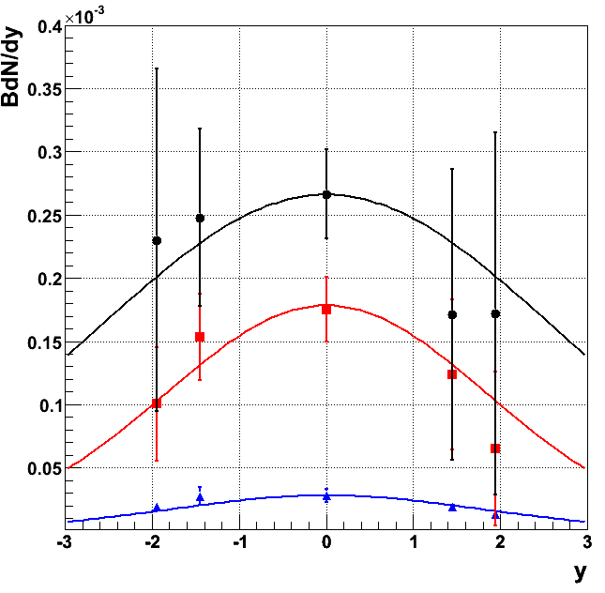
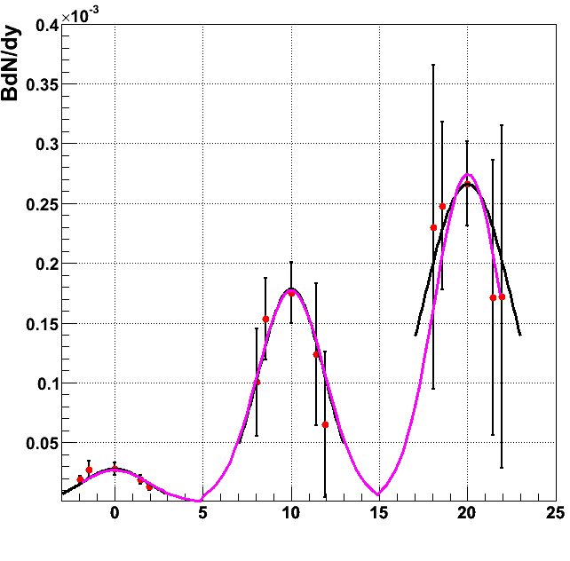
Rapidity width
Separated fits
Simultaneous fit
Width = 1.90 ± 0.32
χ²/ndl = 0.55
= 2.61 ± 2.54 χ²/dof = 0.21
= 1.85 ± 0.53 χ²/dof = 0.41
= 1.82 ± 1.00 χ²/dof = 1.39
Width pp = 1.75 ± 0.21
No noticeable change in rapidity width
VN Tram thesis

Slide 37


More on transport model…
2+1D hydro
Boltzman-type transport
Local equilibrium
  (0.8 & 0.6 fm/c)
  Normal to anomalous
T_{c} = 165 MeV
T_{fo} = 60 MeV
g+Ψ → cc
40% feeddown
No in-medium mod.
No absorption @RHIC (here)
Zhu, Zhuang, Xu,
PLB607 (2005) 107

Slide 38
How does PHENIX see the J/ψ ?
J/ψ → e⁺e– identified in RICH and EMCal
  |η| < 0.35
  p_{e} > 0.2 GeV
J/ψ → μ⁺μ–
identified in 2 fwd spectrometers
  1.2 < |η| < 2.4
  p_{μ} > 2 GeV
Centrality and vertex given by
BBC in 3<|η|<3.9
and ZDC
Notes:
“ First, let me explain how phenix is looking for Jpsi’s. At mid-rapidity, we have a cerenkov and an electromagnetic calorimeter which allow us to identify electrons and thus reconstruct the dielectron decay of the psi’s. At higher rapidities, we can look for Jpsi’s decayng to two muons, in a backward [click] and a forward spectrometer. The last apparatus we use in this analysis is the beam beam counter which provide a centrality and a vertex measurement. ”

Slide 39
J/ψ in PHENIX
[1] PRL92 (2004) 051802
[2] PRC69 (2004) 014901
[3] PRL96 (2006) 012304
[4] QM05, nucl-ex/0510051
Year | Ions | √s_{NN} | Luminosity | Status | J/Ψ (ee + μμ)
2000 | Au-Au | 130 GeV | 1 μb⁻¹ | Central (electrons) | 0
2001 | Au-Au | 200 GeV | 24 μb⁻¹ | Central | 13 + 0 [1]
2002 | p-p | 200 GeV | 0.15 pb⁻¹ | + 1 muon arm | 46 + 66 [2]
2002 | d-Au | 200 GeV | 2.74 nb⁻¹ | Central | 360 + 1660 [3]
2003 | p-p | 200 GeV | 0.35 pb⁻¹ | + 2 muon arms | 130 + 450 [3]
 | Au-Au | 200 GeV | 240 μb⁻¹ | preliminary | ~ 1000 + 5000 [4]
2004 | Au-Au | 63 GeV | 9.1 μb⁻¹ | analysis | ~ 13
 | p-p | 200 GeV | 324 nb⁻¹
 | Cu-Cu | 200 GeV | 4.8 nb⁻¹ | preliminary | ~ 1000 + 10000 [4]
2005 | Cu-Cu | 63 GeV | 190 mb⁻¹ | analysis | ~ 10 + 200
 | p-p | 200 GeV | 3.8 pb⁻¹ |  | ~ 1500 + 10000
2006 | p-p | 200 GeV | ?? | Running… | ??
Notes:
“ This table reflect the short history of rhic. [rhic] All data I’m going to show are from the run 3. For the first time, we had the three spectrometers operational. And together with the delivered luminosities, this allowed us to collect a couple thousands Jpsi’s. Let me also mention that all the results we will debate are preliminary ”
[erreur de couleur]
Run5pp d’après talk Wei & note Mike

Slide 40



First upsilons…
Run 5 pp (3 pb⁻¹)
Hie Wei, Quark Matter 2005

Slide 41

Centrality analysis
Au breaks up in our south beam counter
Define 4 centrality classes
Relate centrality to <N_{coll}>
through Glauber computation
<N_{coll}> = 8.4 ± 0.7
BBC South
Spectator nucleons
BBC North
Au
d
d and Au participant nucleons
Counts
<N_{coll}> = 3.2 ± 0.3
Peripheral
<N_{coll}> = 15.0 ± 1.0
Central
^{MB}
South BBC Charge

Slide 42


Centrality analysis
BBC charge versus ZDC energy
Most peripheral
80 – 92.2%
< N_{part} > = 6.3 ± 1.2
< N_{coll} > = 4.9 ± 1.2
20-25%
Most central
0 - 5 %
< N_{part} > = 351 ± 2.9
< N_{coll} > = 1065 ± 105
15-20%
10-15%
5-10%
0-5%

Slide 43


Cross section versus p_{T}
Δ<p_{T}²> = <p_{T}²>_{dAu} – <p_{T}²>_{pp}
Backward: 1.77 ± 0.37 GeV ²
Mid: (-1.28 ± 0.94 GeV ² )
Forward: 1.12 ± 0.35 GeV ²
PHENIX, PRL96 (2006) 012304
Some p_{T} broadening
Notes:
Draw the electron points on the same graphs as muons !
pp dielectron point is close to old pp dimuon point…
Clear that this are muons !!!

Slide 44



R_{dAu} versus p_{T}
R_{dA}
High x₂
Low x₂
Broadening comparable to lower energy (√s = 39 GeV in E866)

Slide 45
d+Au perspectives
We have seen small nuclear effects !
  Weak shadowing / antishadowing
  Weak absorption (~ 1 to 3 mb)
  p_{T} broadening similar to lower energies
Difficult to disentangle given statistics
  Need more luminosity !
But, no large nuclear effect !
  Good news to see J/ψ suppression in Au-Au !

Slide 46
J/ψ in proton-proton

Slide 47

Cross section vs rapidity
Total cross section
σ (pp → J/ψ)
2.61 ± 0.20 ± 0.26 μb
  Error from fit (incl. syst and stat)
  Error on absolute normalization
PHENIX, PRL96 (2006) 012304
Notes:
RUN2 = 234 +/- 36 +/- 34 +/- 24 ! 1.3 sigma appart
« Measure both rapidity »

Slide 48
Cross section versus p_{T}
Fit the function
<p_{T}²> = 2.51 ± 0.21
( GeV² )
A
(1+(p_{T}/B)²)⁶
PHENIX, PRL96 (2006) 012304
Notes:
Draw the electron points on the same graphs as muons !
pp dielectron point is close to old pp dimuon point…
Clear that this are muons !!!

Slide 49

p+p perspectives
Production mechanism
  Color Octet Model does the job
In AA (or dA)
  Large combinatorial background
  Low physics background
    (Drell-Yan or dileptons from open charm)
p+p is our baseline
  Nuclear modification factor
Run5 pp analysis going on
  > 10 times statistics
PRL96, 012304 (2006)
N_{ψ}^{AB}
R_{AB} =
N_{ψ}^{PP}
x
<N_{coll}>

Slide 50


NA50 versus NA60 (QM05)
No overlap…
Good agreement !

Slide 51

Dielectron pp and dA

Slide 52

α versus X compared to lower √s
E866, PRL 84, (2000) 3256
NA3, ZP C20, (1983) 101
PHENIX, PRL96 (2006) 012304
X₂ (in gold)
X_{F} = X_{d} - X_{Au}
Not universal versus X₂ : shadowing is not the whole story.
Same versus X_{F} for diff √s. Incident parton energy loss ? (high X_{d} = high X_{F})
Energy loss expected to be weak at RHIC energy.
Notes:
Définir X_F et X_2 !!! Initial state energy loss !!!

Slide 53

How to get x_{F} scaling ?

Slide 54

J/ψ transverse momentum (run2)
Color Singlet Model
Color Octet Model
(from Nayak et al.
hep/ph 0302095)
COM contribution is
dominant, as for high
p_{T} J/Ψ @ Tevatron
Phenomenological + exponential fits of dimuon and dielectron data give mean p_{T} :
<p_{T}> = 1.80 ± 0.23 (stat) ± 0.16 (sys) GeV/c
Notes:
Phenomenological : 1/(2 pi pt) dsigma/dpt = 1 (1+(pt/B)^2)^(-6)

Slide 55

J/Ψ cross section from run 2
Results consistent
with shapes from
various models and
PDF.
Take the PYTHIA
shape to extract
our cross-section
μ⁺μ–
e⁺e–
Error from absolute
normalization
Integrated cross-section :
RUN2 234 ± 36 (stat) ± 34 (sys) ± 24(abs) μb
RUN3 159 nb ± 8.5 % (fit) ± 12.3% (abs)
Consistent
(1.3 sigma
difference)

Slide 56


Naive picture
Less absorption
Shadowing
Energy loss
(3) anti-shad
E866 J/Ψ data
(1) quark-shad
+ FS absorp.
(2) gluon
shadowing
(4) Full calculation
(+ dE/dx & Chi->J/Ψ)
(Kopeliovich)

Slide 57


Tuchin & Kharzeev
Hard probes 2004
  hep-ph/0504133
Coherent production of charm (open or closed)
  (y<0 production time to low to make computation)
  Shadowing from CGC computation…
Tuchin

Slide 58

Tuchin & Kharzeev…
+ absorption for
SPS & fermilab

Slide 59

… gold+gold extrapolation …

