Slide 1
FreeLoader: Scavenging Desktop Storage Resources for Scientific Data
Sudharshan Vazhkudai,¹ Xiaosong Ma,^{1,2} Vincent Freeh,² Jonathan Strickland,² Nandan Tammineedi,² and Stephen Scott ¹
¹ Oak Ridge National Laboratory
² North Carolina State University
SC|05 Technical Paper Presentation
Session: Storage and Data
November 17, 2005
Seattle, WA

Slide 2
Outline
Problem space
Desktop storage scavenging for scientific data
FreeLoader architecture
FreeLoader performance in a user’s HPC setting
Philosophizing…
Wrap up on a funny note!

Slide 3
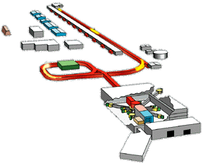
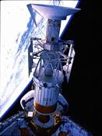
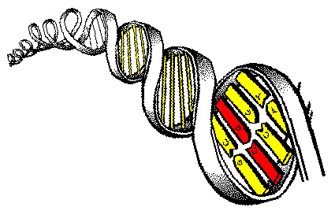
Problem Domain
Data Deluge
  Experimental facilities: SNS, LHC (PBs/yr)
  Observatories: sky surveys, world-wide telescopes
  Simulations from NLCF end-stations
  Internet archives: NIH GenBank (serves 100 gigabases of sequence data)
Typical user access traits on large scientific data
  Download remote datasets using favorite tools
    FTP, GridFTP, hsi, wget
  Shared interest among groups of researchers
    A Bioinformatics group collectively analyze and visualize a sequence database for a few days: Locality of interest!
  Often times, discard original datasets after interest dissipates

Slide 4
So, what’s the problem with this story?
Wide-area data movement is full of pitfalls
  Sever bottlenecks, BW/latency fluctuations
  GridFTP-like tuned tools not widely available
  Popular Internet repositories still served through modest transfer tools!
User applications are often latency intolerant
  e.g., real-time viz rendering of a TerraServer map from Microsoft on ORNL’s tiled display!
Why can’t we address this with the current storage landscape?
  Shared storage: Limited quotas
  Dedicated storage: SAN storage is a non-trivial expense! (4TB disk array ~ $40K)
  Local storage: Usually not enough for such large datasets
  Archive in mass storage for future accesses: High latency
Upshot
  Retrieval rates significantly lower than local I/O or LAN throughput

Slide 5
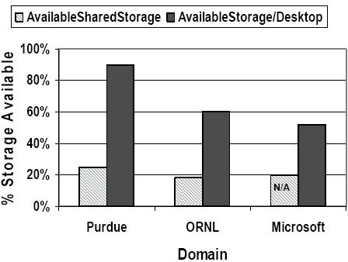
Is there a silver lining at all? (Desktop Traits)
Desktop Capabilities better than ever before
Space usage to Available storage ratio is significantly low in academic and industry settings
Increasing numbers of workstations online most of the time
  At ORNL-CSMD, ~ 600 machines are estimated to be online at any given time
  At NCSU, > 90% availability of 500 machines
Well-connected, secure LAN settings
  A high-speed LAN connection can stream data faster than local disk I/O

Slide 6
Desktop Storage Scavenging?
FreeLoader
  Imagine Condor for storage
    Harness the collective storage potential of desktop workstations ~ Harnessing idle CPU cycles
  Increased throughput due to striping
    Split large datasets into pieces, Morsels, and stripe them across desktops
Scientific data trends
  Usually write-once-read-many
  Remote copy held elsewhere
  Primarily sequential accesses
Data trends + LAN-Desktop Traits + user access patterns make collaborative caches using storage scavenging a viable alternative!

Slide 7
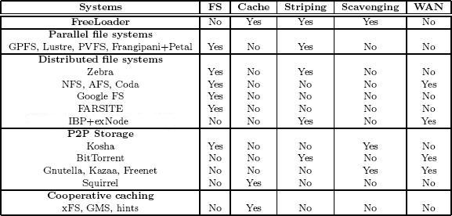
Old wine in a new bottle?
Key strategies derived from “best practices” across a broad range of storage paradigms…
  Desktop Storage Scavenging from P2P systems
  Striping, parallel I/O from parallel file systems
  Caching from cooperative Web caching
And, applied to scientific data management for
  Access locality, aggregating I/O, network bandwidth and data sharing
  Posing new challenges and opportunities: heterogeneity, striping, volatility, donor impact, cache management and availability

Slide 8
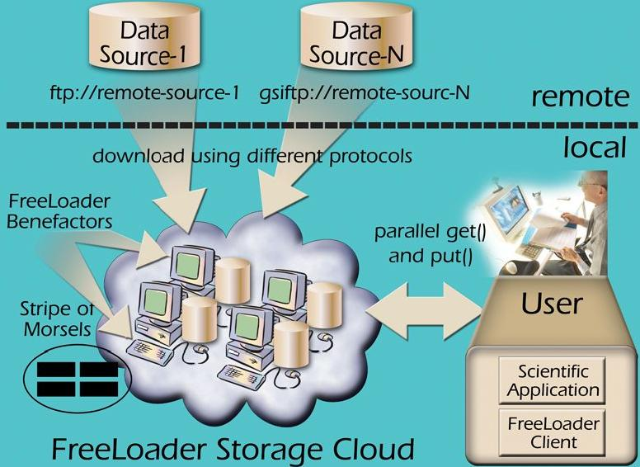
FreeLoader Environment

Slide 9
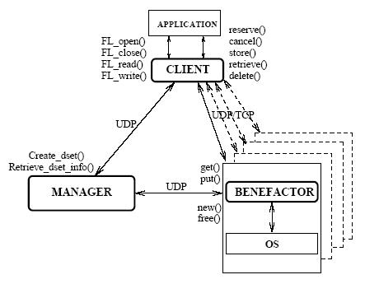
FreeLoader Architecture
Lightweight UDP
Scavenger device: metadata bitmaps, morsel organization
Morsel service layer
Monitoring and Impact control
Global free space management
Metadata management
Soft-state registrations
Data placement
Cache management
Profiling

Slide 10
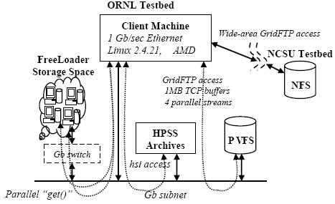
Testbed and Experiment setup
FreeLoader installed in a user’s HPC setting
  GridFTP access to NFS
  GridFTP access to PVFS
  hsi access to HPSS
    Cold data from tapes
    Hot data from disk caches
  wget access to Internet archive

Slide 11
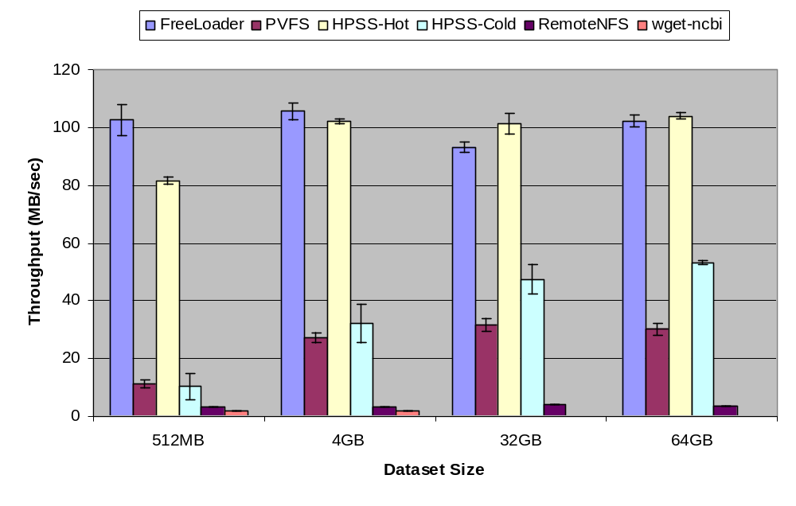
Comparing FreeLoader with other storage systems

Slide 12
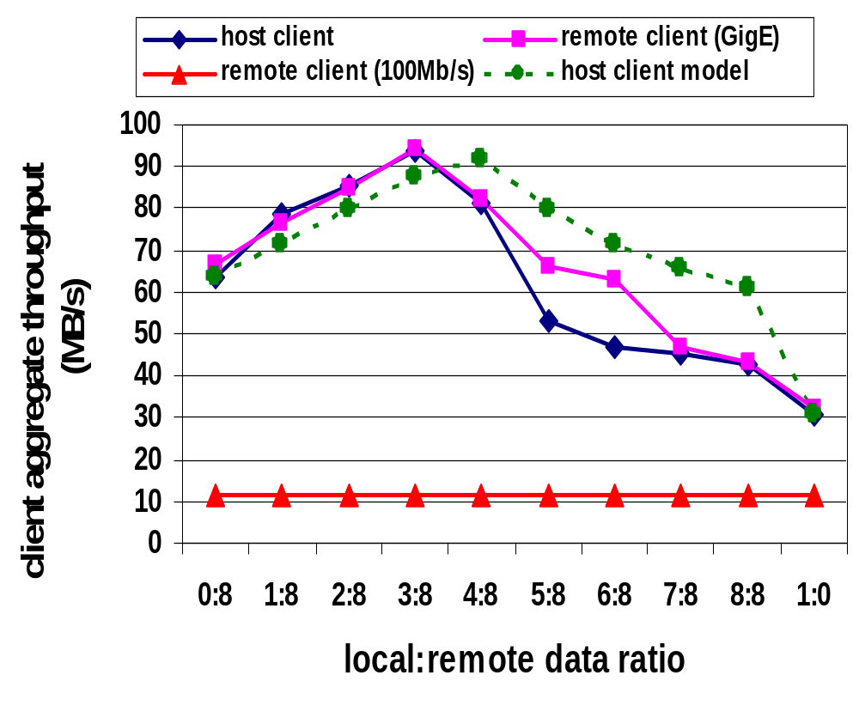
Client Access-pattern Aware Striping
Uploading client likely to access more frequently
  So, let’s try to optimize data placement for him!
Overlap network I/O with local I/O
What is the optimal local:remote data ratio?
Model

Slide 13
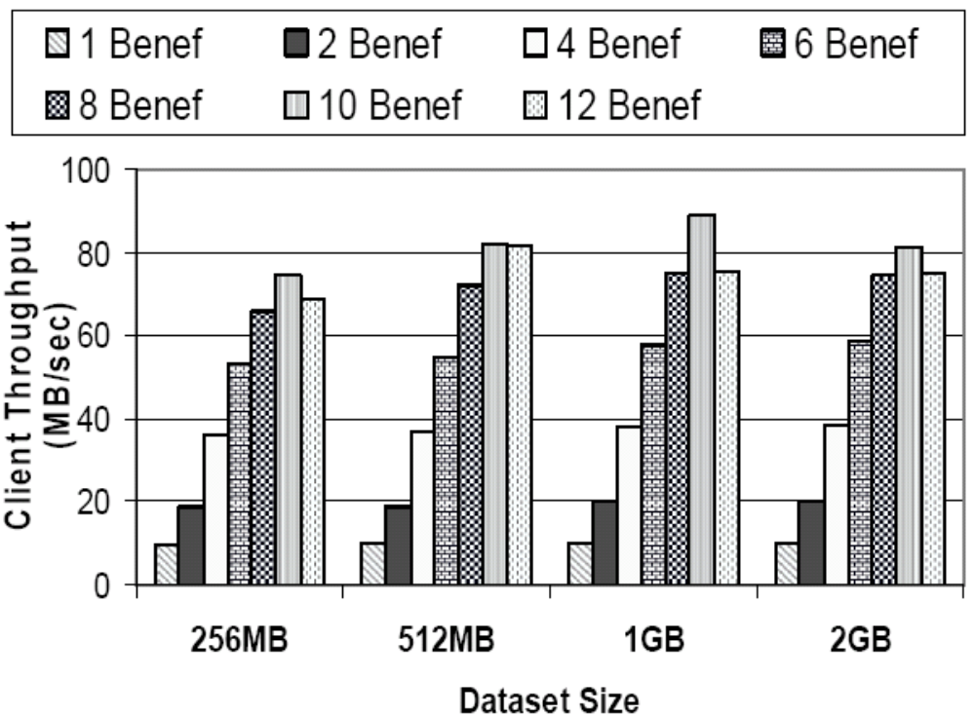
Striping Parameters

Slide 14
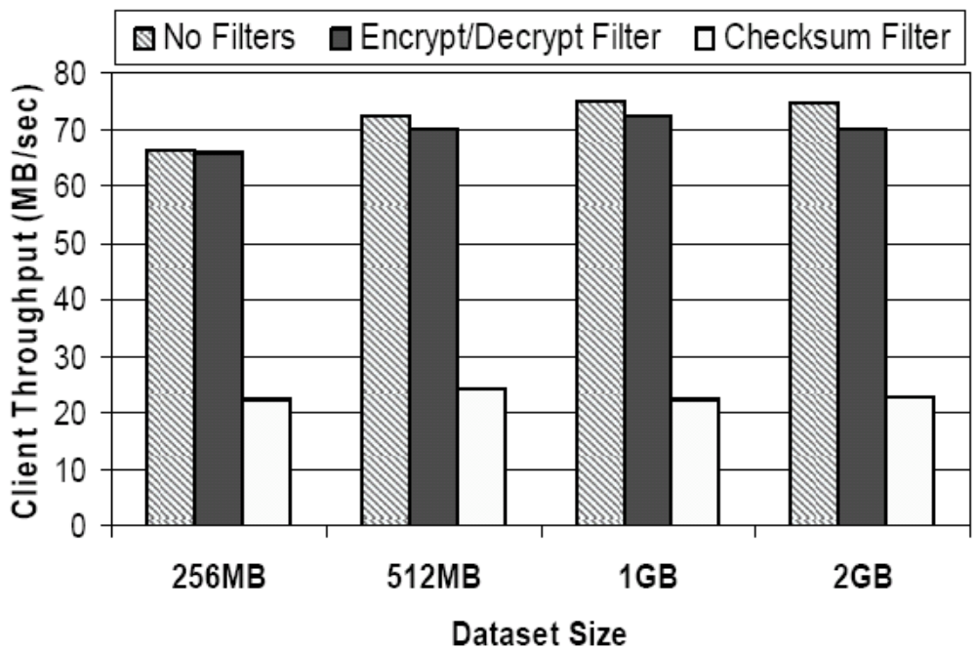
Client-side Filters

Slide 15
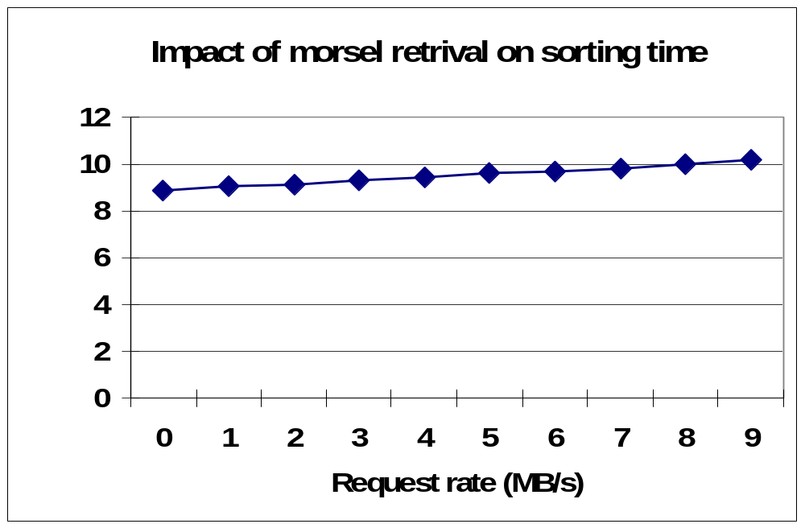
Computation Impact

Slide 16
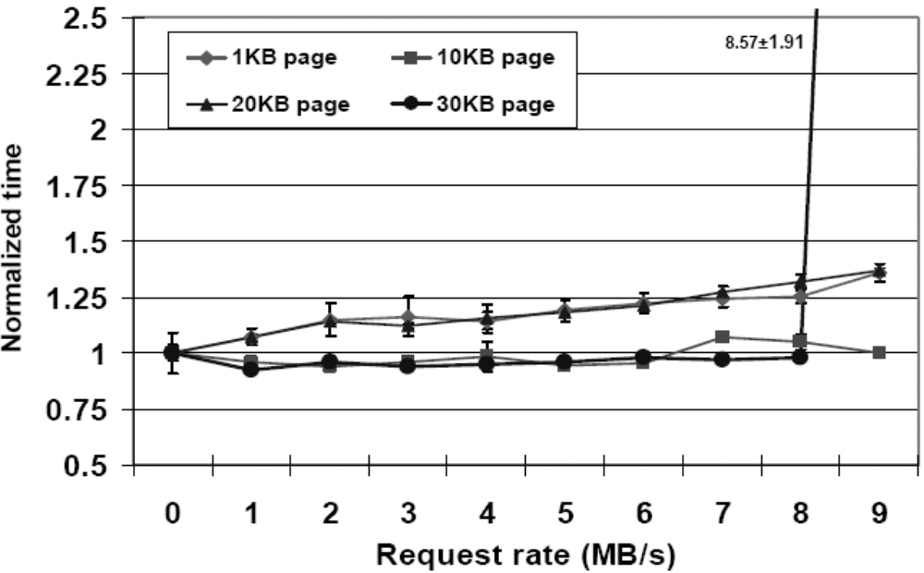
Network Activity Test

Slide 17
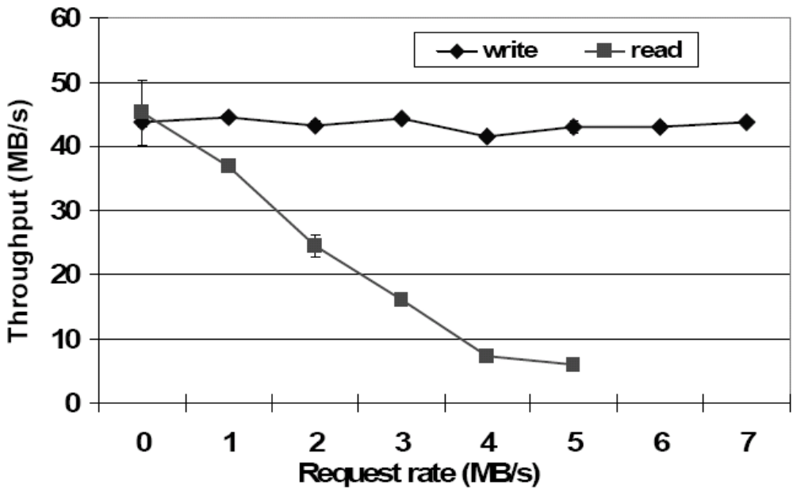
Disk-intensive Task

Slide 18
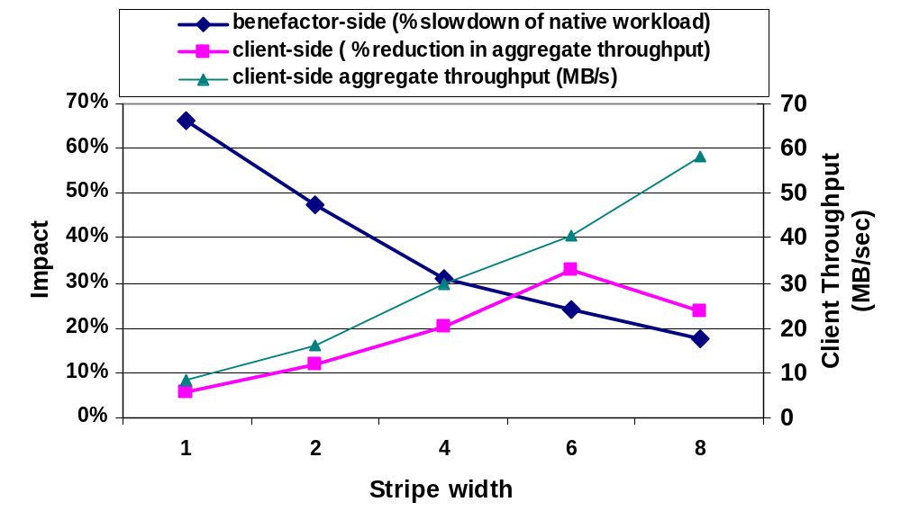
Impact Control

Slide 19
Philosophizing…
What the scavenged storage “is not”:
  Not a file system, not a replacement to high-end storage
  Not intended for wide-area resource integration
What it “is”:
  Low-cost, best-effort storage cache for scientific data sources
  Intended to facilitate
    Transient access to large, read-only datasets
    Data sharing within administrative domain
  To be used in conjunction with higher-end storage systems

Slide 20
