Slide 1

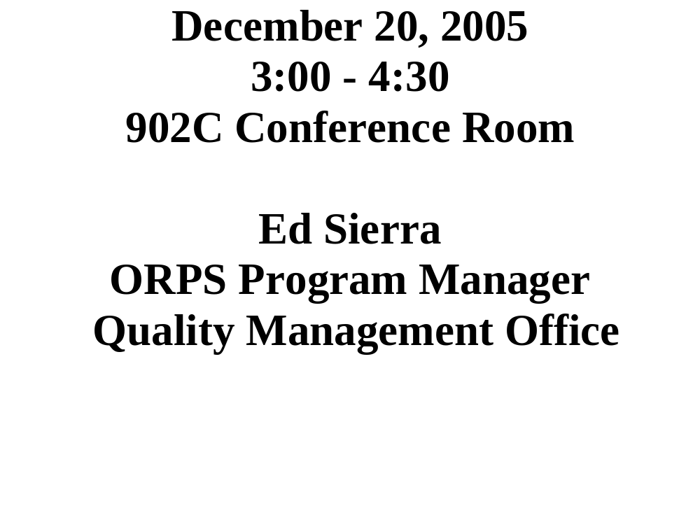
Categorizers (CAT) Team Workshop #2005-04

Slide 2

OUR AGENDA!
Workshop Goals
Point to Ponder
ORPS Trending
CAT Form Entries
Programmatic Bins
Meeting Evaluation and Wrap-up

Slide 3

CAT Team Workshop
Workshop Goals:
  To EVALUATE and CONTINUOSLY IMPROVE the BNL Occurrence Reporting Program.
  To MAINTAIN a baseline categorization process such that reportability decisions are both VALID and CONSISTENT.
  To PROMPT (via categorization) deep and lasting value-added CHANGE, which results in new ways of thinking and acting.
    CAT

Slide 4

Point to Ponder
“When anyone asks how I can best describe my experience in nearly 40 years at sea, I merely say: uneventful. I never saw a wreck and have never been wrecked nor was I in any predicament that threatened to end in disaster of any sort.”
- Titanic Captain, Edward J. Smith in 1907
The Titanic sank on April 14, 1912

Slide 5

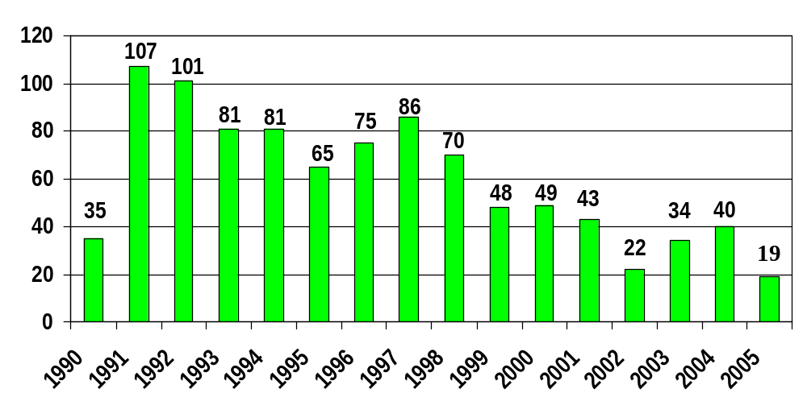
BNL ORPS by Calendar Year Report Submitted
As of 12/20

Slide 6
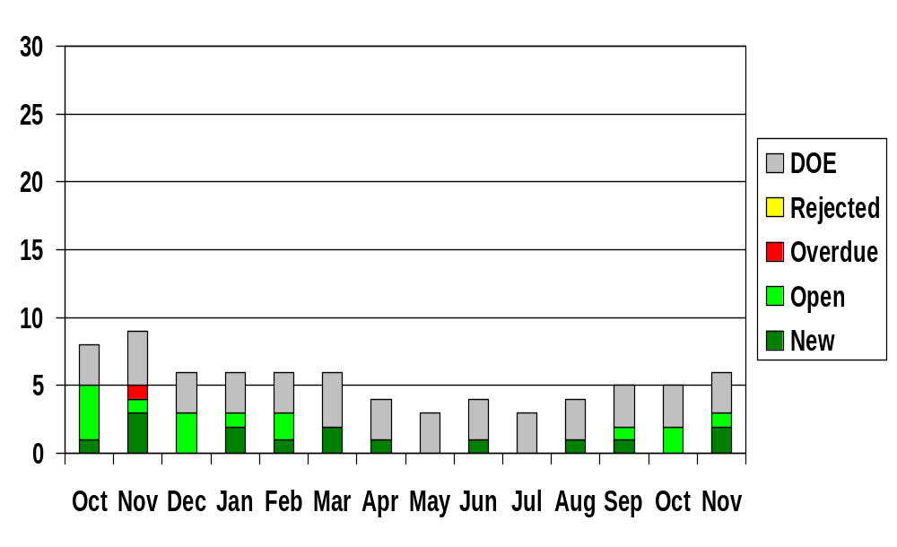
BNL ORPS Report Status
FY 2005/2006 (End of Month)

Slide 7

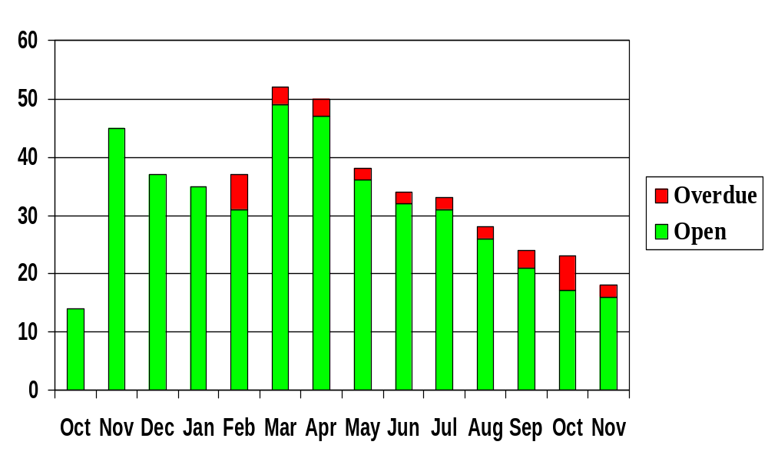
ORPS Corrective Action Status
FY 2005/2006 (End of Month)

Slide 8

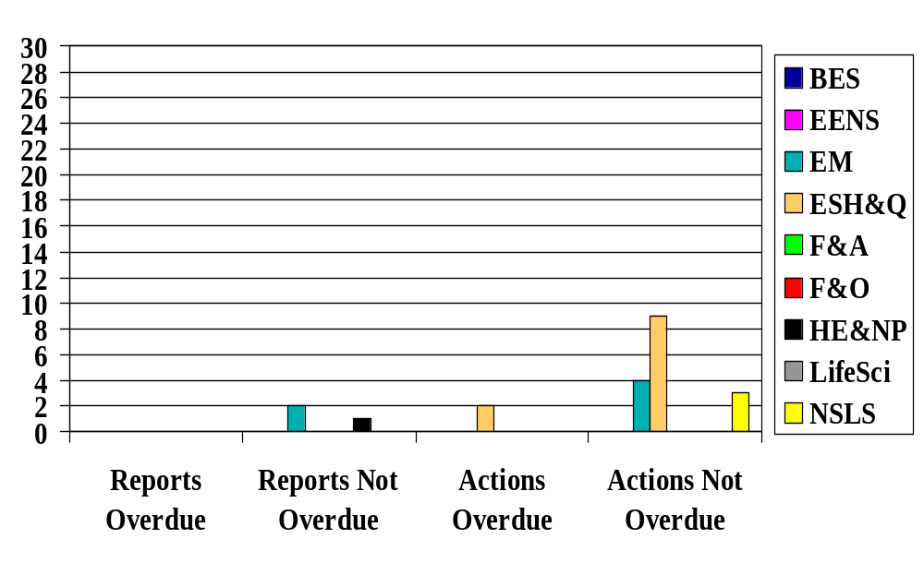
ORPS Reports and Actions
November 30, 2005
ALD

Slide 9

CAT Electronic Entries
10/10 – RK, Forklift spills ~5 gallons of hyd oil between B933 to B912
10/11 – RK, < 1 gal hyd leak from PE truck by B528
10/14 – RK, Rainwater (deluge) causing electrical shorts/smoke in B912
10/14 – RK, Smoldering particles in large belt sander at B479
10/14 – RK, Suspicious package in B510 P Lot = bag with two light bulbs
10/14 – RK, OL (smoke) roll-up door cont caused by rainwater @ B912
10/17 – RK, Crack in tip of finger bone from mallet strike @ B905
10/17 – RK, Cont. discovered (95,000 dpm/100cm2) within Rad Buffer Area and on shoe covers during RBA friskout @ B801
10/19 – KK, Tree grinding ops @ the CFN construction site results in a piece of wood striking and damaging the rear window/trunk of an unoccupied vehicle
10/20 – KK, Update to 10/19 entry upon further discussion, SC4
10/18 – KK, < 1 gal hyd leak from electrical boom truck by B725
10/24 – KK, < 1 gal gas spill in parking lot of B488
10/26 – SM, Tritium Detection in Sr-90 Extraction Well SR-2

Slide 10
CAT Electronic Entries
10/28 – SM, AGS door interlock works but "Area Secure" light not lit
10/31 – MD, Low level rad cont (2K – 5K dpm) under floor tiles @ B527
10/31 – MD, Air Compressor Failure in B902
10/31 – ES, S/C bolts identified at the STAR 20-Ton crane (existing report)
11/02 – ES, Inert gas removed from HFBR vessel, (Update SC3)
11/02 – MD, Energized wire discovered during RF power amp repair, SC3
11/02 – MD, ~1.5 gal antifreeze spilled to the pavement @ B479
11/07 – MD, < 1 gal spill (tar/asphalt) along north street in wooded area
11/07 – MD, 2 gal of stripper on pavement/flower bed reported to NYS DEC and Suffolk, SC4
11/11 – ES, Minor Cryogenic Injury to Visiting Scientist at NSLS
11/17 – ES, Oil Leak from compromised 55 Gal Drum
11/21 – KK, Contract Worker ejected from site after dropping a gas cylinder from the second floor of the RSB to the ground below
11/21 – PB, Gov vehicle strikes tree in off-road area on-site
11/28 – MB, 1/2 quart of motor oil on pavement behind B-488

Slide 11

CAT Electronic Entries
11/28 – MB, An adult female experiencing arrhythmia trans to hospital
11/29 – MB, Contractor incurs 1 inch laceration to wrist working @ RSB
11/30 – MB, 10 gal bio-based hydraulic oil spill @ B423
12/02 – MB, Legacy Soil activity identified in the woods N&S of the FHWMF
12/05 – RK, Inadequate Work Control (ERD at former waste management facility) Change Review
12/08 – RK, Fire truck backed into door @ FH causing minor damage
12/12 – RK, <1 gal oil spill on pavement & contained by B480
12/12 – RK, Partially Disabled (Inadvertent) fire alarm syst @ B321, 326, 339, 421, 423, 651
12/17 – RK, < 10 gal crude oil spill from delivery truck
12/19 – SM, LL rad contamination event at B650
12/20 – RK, (Update to 12/17 entry) > 10 gal crude oil spill from delivery truck, SC4

Slide 12

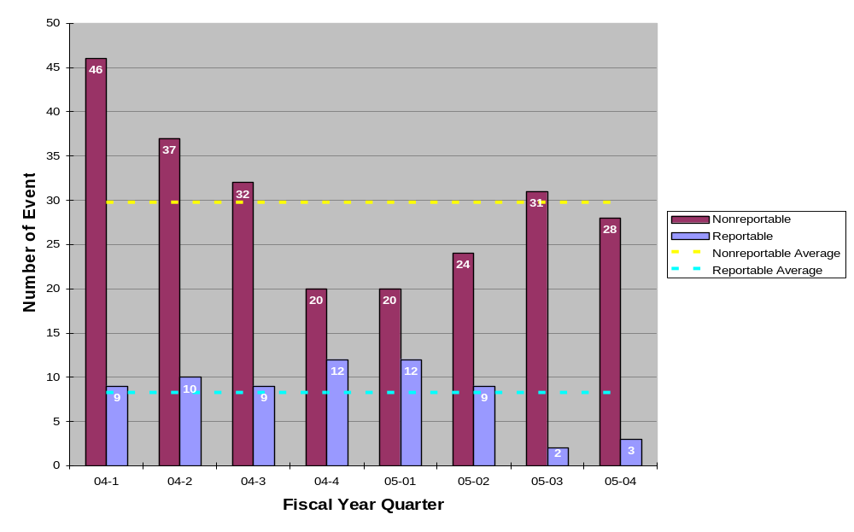
ORPS Reportable and Nonreportable Cat Entries

Slide 13

Programmatic Bins
Personnel Contamination
Medical Department
NSLS
Physics
CA-D
BGRR Project
Plant Engineering
Utilities Struck
Material Transportation
Electrical Shock Hazards
Material Handling Issues
Waste Management
Chemistry
Environmental Restoration
Railroad Tracks
New Construction (New)

Slide 14

Programmatic Review
Personnel Contamination – 2004
  04/14 – 5,000 dpm on top of worker’s shoe at BGRR (RAR)
  05/21 – <50,000 dpm cont on experimenters at AGS
  08/31 – ~ 200 dpm/100cm2 on experimenter at PET
Personnel Contamination – 2005
  02/02 – Personnel Contamination at Cyclotron
  02/08 – Radioisotope Production Lab Cont Identified @ 901
  03/30 – 14,000 dpm of beta/gamma on sneaker at PET
  09/07 – Contractor - 4K dpm skin cont on neck @ B650 (SC3)
  09/16 – 500 dpm alpha cont on hand @ B650
  10/17 – Cont. discovered (95,000 dpm/100cm2) within Rad Buffer Area and on shoe covers during RBA friskout @ B801
  12/19 – LL rad contamination event @ B650

Slide 15

Programmatic Review
Medical department, 2004
  01/27 – MEL hot cell filters not replaced at age of 66 months
  02/03 – Water leak floods 490 with 150 gallons
  02/03 – Slip and fall on slick floor
  03/10 – Failed HEPA filter efficiency test at B-801
  03/12 – 20ml leak from D-waste storage tank in B-801
  04/08 – Chill water spill at 801 during seasonal flushing
  04/28 – BLIP target shaft leaks water to secondary containment
  05/09 – New target window at BLIP leaking
  05/25 – Herpes-B Virus Precautions in Animal Facility (SC3)
  07/30 – Minor leak from “D” waste valve in B-801
  08/10 – Minor I-135 spill in B-490 (RAR)
  08/16 – Carpenter drills into water line in B-490
  10/29 – RWP and Trans Safety Violations in B-490 (SC3)

Slide 16
Programmatic Review
Medical department, 2005
  01/17 – Steam Leak in Basement of Building 490
  01/26 – Meth Chloride Spill and Overexposure @ 490 (SC3)
  04/21 – Post-doc faints when taking blood samples @ 490
  06/07 – Researcher transport Rad experiment in private vehicle
  10/17 – Cont. discovered (95,000 dpm/100cm2) within Rad Buffer Area and on shoe covers during RBA friskout @ B801

Slide 17

Programmatic Review
NSLS, 2004
  01/16 – Pre-action SS spurious trip
  02/07 – Unapproved work in laser hutch (Bldg. 729)
  04/18 – Unauthorized SDL operation
  05/13 – Window pane falls from second floor
  06/03 – Improper cable connection on exp floor
  07/12 – Worker feels mild electrical tingling in his finger
  07/22 – Hydrofluoric Acid Contamination of Technician
  08/07 – Trace amts. of H-sulfide leaked from gas cylinder
  08/10 – Worker experiences electric shock (SC3)
  09/22 – Voltage leakage through hook on crane at NSLS

Slide 18
Programmatic Review
NSLS, 2005
  03/03 – Suspect Bolts Found in Crane During Inspection @ NSLS (SC4)
  04/20 – Haz concerns associated with energized magnet
  06/28 – Syringes (w/needles) found in Research Laboratory
  Trash Receptacles @ Bldg 725A
  11/11 – Minor Cryogenic Injury to Visiting Scientist

Slide 19

Programmatic Review
Physics, 2004
  07/01 – Laser interlock check overdue by 3 weeks @ ATF
  10/21 – Trimmed tree branch breaks window at physics
Physics, 2005
  04/25 – Smoke alarm from overheated plastic tubing @ Bldg 832

Slide 20

Programmatic Review
CA-D, 2004
  01/13 - Worker breaks ankle while preparing for cable pull (SC3)
  03/22 - Welder’s helper receives minor eye irritation
  05/17 - Damaged detector at STAR after 10 foot drop
  05/21 - <50,000 dpm cont on experimenters at AGS
  07/14 - Fire in a RHIC RF cavity power supply in B1004A
  08/11 - Heating element inside cold box causes burn to hand (SC 3)
  10/15 - Potential fire hazard in AGS cable tray (SC4)
  10/15 - Low voltage leakage through hook on crane at B930
  11/08 - Fire Inside Power Supply Cabinet (SC4)
  12/02 - Unauthorized access into the STAR hall

Slide 21
Programmatic Review
CA-D, 2005
  01/07 – Employee falls while walking (Reason Unknown, SC3)
  02/09 – Slip and Fall Results in Hairline Fracture of Kneecap (SC3)
  03/14 – Cooling Water Leak at LINAC due to stuck open relief valve
  02/22 – High pH detected at recharge basin HTW, Bldg 930
  04/19 – Worker breaks finger while climbing ladder @ AGS
  05/04 – Sparking From ATR Main Magnet Cooling Water Pump
  07/21 – Minor occupational injury (wood splinter) at Bldg 1005R
  08/29 – P/U truck damages wall at B1002B
  09/13 – Tritiated water (2200 pCi/L) leak (30-50 gal) to soil near B930A
  10/14 – Rainwater (deluge) causing electrical shorts/smoke in B912
  10/17 – Crack in tip of finger bone from mallet strike @ B905
  10/28 – AGS door interlock works but "Area Secure" light not lit
  10/31 – S/C bolts identified at the STAR 20-Ton crane (existing report)
  11/02 – Energized wire discovered during RF power amp repair (SC3)

Slide 22

Programmatic Review
BGRR Project, 2004
  04/14 - 5,000 dpm on top of worker’s shoe (RAR)
  05/03 - Leakage of cont water from Sea-Land Container (SC4)
  05/11 - Filter cart sep from resp during work in rad/cont area (SC3)
  09/03 - DSB work performed outside of procedure (SC4)
  10/05 - Injury due to steel plate falling at bldg 701 (SC3)
BGRR Project, 2005

Slide 23

Programmatic Review
Plant Engineering, 2005
  08/01 – Simple Fracture of pinky while working on dump truck
  09/08 – PE truck hung up on berm behind B912
  11/21 – Gov vehicle strikes tree in off-road area on-site
  12/12 – Partially Disabled (Inadvertent) fire alarm syst @ B321, 326, 339, 421, 423, 651

Slide 24

Programmatic Review
Utilities struck, 2004:
  04/19 – Electrical utility conduit strike (SC3)
  07/07 – Domestic water main strike
  09/07 – Comm. cable severed during excavation work
  12/09 – Unexpected discovery of 2.4K deenergized cables during excavation
Utilities struck, 2005:

Slide 25

Programmatic Review
Material Transportation, 2004
- 06/25 - B-52 waste cont support chnl rain water accumulation (SC4)
- 07/26 - Transportation of Solidified Liquid Low-Level Waste (SC1)
Note: “suspected radioactive contamination occurs involving shipment of radioactive materials” = SC1
Material Transportation, 2005
  03/17 – Excessive Drainage from BNL Rail Cars arriving at Envirocare (SC3)

Slide 26

Programmatic Review
Electrical Shock Hazards, 2004
  07/12 - Worker feels mild electrical tingling in his finger @ NSLS
  08/10 - Worker experiences electric shock @ NSLS (SC3)
Electrical Shock Hazards, 2005
  04/01 - Unexpected Discovery of Hazardous Energy Source @ Magnet Division (SC3)

Slide 27

Programmatic Review
Material Handling Issues, 2004
  03/05, Load Falls off Flatbed Truck, (SC3)
  03/24, Recurring Material Handling Problems, (SCR)
  05/17, Damaged detector at STAR after 10 foot drop
  06/11, 500 # steel block falls (3 – 4 feet) from forklift
  10/05, Injury due to steel plate falling at bldg 701 (SC3)
Material Handling Issues, 2005

Slide 28

Programmatic Review
Waste Management, 2005
  01/07 – WMD Worker Enters Controlled Area with Expired Training
  06/30 – ~2 inches (150 -200 gallons) of water flooded the equipment level at the BMRR
  04/21 – Worker injures back while moving drum
  09/16 – 500 dpm alpha cont on hand @ B650
  10/26 – Tritium Detection in Sr-90 Extraction Well SR-2
  12/19 – LL rad contamination event at B650

Slide 29

Programmatic Review
Chemistry, 2005
  02/02 – Personnel Contamination at Cyclotron
  02/08 – Radioisotope Production Lab Cont Identified @ 901
  03/30 – 14,000 dpm of beta/gamma on sneaker at PET
  05/11 – R.A. Cuts Hand/Requires Stitches @ Bldg 555

Slide 30

Programmatic Review
Environmental Restoration Projects, 2005
  05/26 – Technician Cuts Thumb During Cable Repair @ Bldg 811
  06/07 – Personnel Exposure to Excessive Noise (SC-3)
  06/21 – White Powder Substance Found Behind Bldg 657
  08/26 – Hg/Cs-137 laden soil stored at Old HWMF
  09/07 – Contractor - 4K dpm skin cont on neck @ B650 (SC3)
  09/06 – GW treatment system (Sr-90) fitting leak, to sump @ B855
  11/02 – Inert gas removed from HFBR vessel (SC3)
  12/02 – Legacy Soil activity identified in the woods N&S of the FHWMF
  12/05 – Inadequate Work Control (ERD at former waste management facility) Change Review

Slide 31

Programmatic Review
Railroad Tracks, 2003
  08/27 - Rail Car movement while loading (ON)
Railroad Tracks, 2004
  09/03 - Empty railroad car derailed at BNL track switch
  09/04 - Off-site train car derailment (SC4)
  09/14 - Inadequate rail safety procedures (SC4)
Railroad Tracks, 2005
  01/05 - Empty Railroad Car Derailed
  08/08 - Rail Car (Gondola) Derailment (SC3)
  09/29 - (Update of 8/8 entry) Recurring Railcar Events (SCR)

Slide 32

Programmatic Review
New Construction, 2005
  10/19 – Tree grinding ops @ the CFN construction site results in a piece of wood striking and damaging the rear window/trunk of an unoccupied vehicle
  11/21 – Contract Worker ejected from site after dropping a gas cylinder from the second floor of the RSB to the ground below
  11/29 – Contractor incurs 1 inch laceration to wrist working @ RSB

Slide 33


CAT Team Workshop
CAT Team Action Item Review
Meeting Evaluation and Wrap-Up

