Slide 1
Coupling Prefix Caching and Collective Downloads for Remote Scientific Data
Xiaosong Ma,^{1,2} Sudharshan Vazhkudai,¹ Vincent Freeh,² Tyler Simon,² Tao Yang,² and Stephen Scott ¹
¹ Oak Ridge National Laboratory
² North Carolina State University
ICS’06 Technical Paper Presentation
Session: Memory I
June 30, 2006
Cairns, Australia

Slide 2
Outline
Problem space: Client-side caching
The Prefix caching problem
FreeLoader backdrop
Prefix caching
  Architecture
  Model
  Collective downloads
Performance

Slide 3
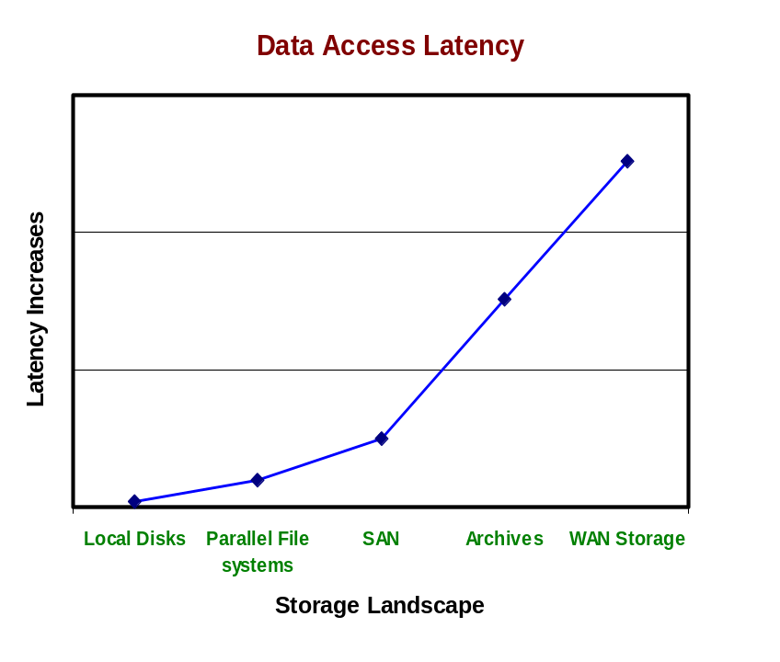

Problem Space: Client-side Caching
HTTP caches
  Proxy caches (Squid), CDNs (Akamai)
  Benefits
    Reduces server bandwidth consumption, load and latency
    Improves client perceived throughput
    Helps exploit locality
  Benefits amplified for large, media downloads
What of scientific data, then?
  Data Deluge!
  User access traits on large scientific data
    Local processing/viz of data
      Implies downloading remote data
      (FTP, GridFTP, HSI, wget)
    Shared interest among groups of researchers
      A Bioinformatics group collectively analyze and visualize a sequence database for a few days: Locality of interest!
    More and more, applications are latency intolerant
    Transient in nature
  Examples: FreeLoader (ORNL/NCSU), IBP (UTK), DataCapacitor (IU), TSS (UND)
Intermediate data cache exploits this area

Slide 4
The Prefix Caching Problem
HTTP Prefix Caching
  Multimedia, streaming data delivery
BitTorrent P2P System: leechers can download and yet serve
Benefits
  Bootstrapping the download process
  Store more datasets
  Allows for efficient cache management
Enabling Trends: Scientific data properties
  Usually write-once-read-many
  Remote source copy held elsewhere
  Primarily sequential accesses
Challenges
  Clients should be oblivious to dataset being partially available
    Performance hit?
  How much of the prefix of a dataset to cache?
    So, client accesses can progress seamlessly
  Online patching issues
    Client access to remote patching I/O mismatch
    Wide-area download vagaries
Can we do something similar for large scientific data accesses?

Slide 5
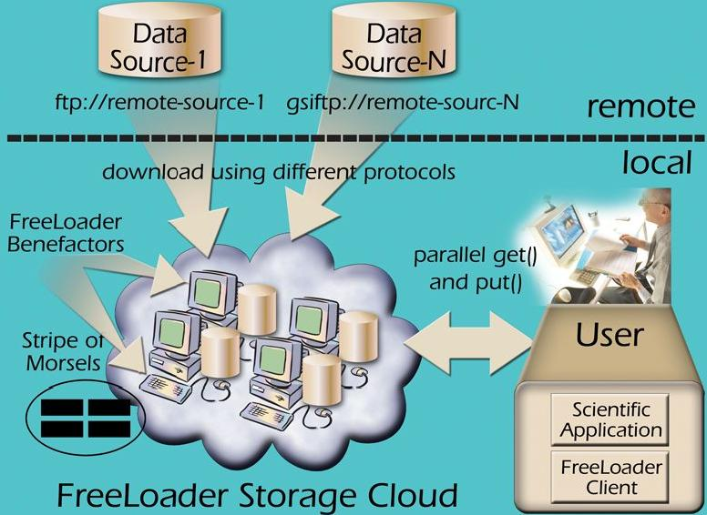
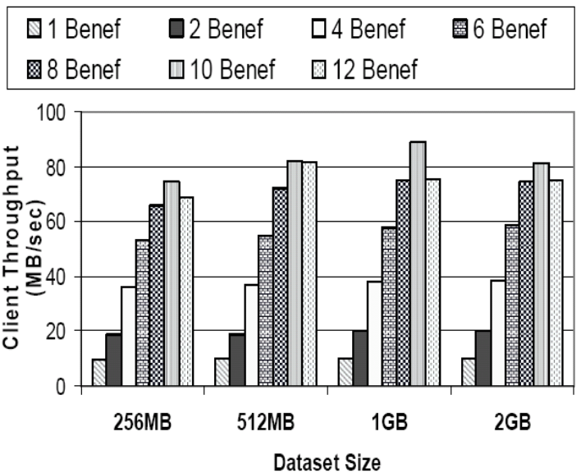
Backdrop: FreeLoader Collaborative Desktop Storage Cache

Slide 6
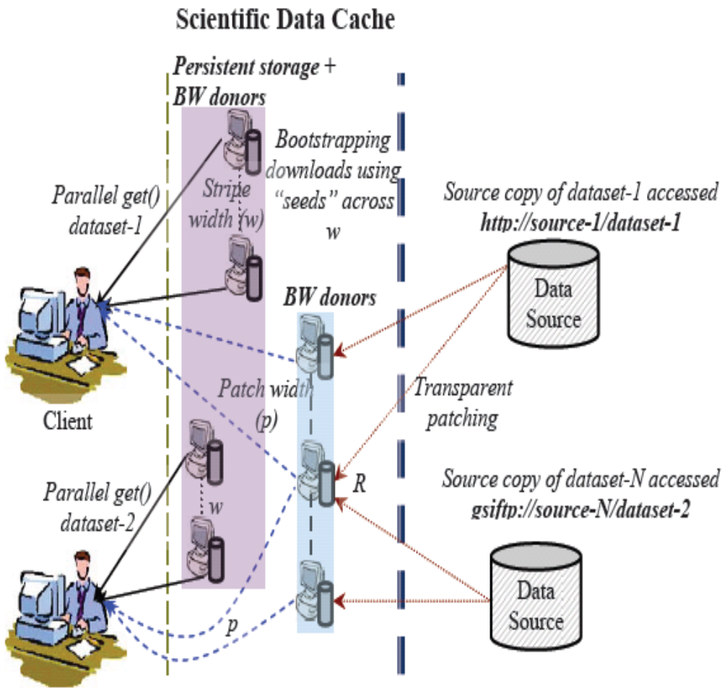
Prefix Caching Architecture
Capability-based resource aggregation
  Persistent storage & BW-only donors
Client serving: parallel get
Remote patching using URIs
Better cache management
  Stripe entirely when space available
  When eviction is needed, only stripe a prefix of the dataset
  Victims based on LRU:
    Evict chunks from the tail until a prefix
    Entire datasets evicted only after all such tails are evicted

Slide 7
Prefix Size Prediction
Goal: Eliminate client perceived delay in data access
What is an optimal prefix size to hide the cost of suffix patching?
Prefix size depends on:
  Dataset size, S
  In-cache data access rate by the client, R_{client}
  Suffix patching rate, R_{patch}
  Initial latency in suffix patching, L
Client access rate indicative of time to patch, S/R_{client} = L + (S – S_{prefix})/R_{patch}
Thus, S_{prefix} = S(1 – R_{patch}/R_{client}) + LR_{patch}

Slide 8
Collective Download
Why?
  Wide-area transfer reasons:
    Storage systems and protocols for HEC are tuned for bulk transfers (GridFTP, HSI)
    Wide-area transfer pitfalls: high latency, connection establishment cost
  Client’s local-area cache access reasons:
    Client accesses to the cache use a smaller stripe size (e.g., 1MB chunks in FreeLoader)
    Finer granularity for better client access rates
Can we derive from collective I/O in parallel I/O

Slide 9
Collective Download Implementation
Patching nodes perform bulk, remote I/O; ~ 256MB per request
Reducing multiple authentication costs per dataset
  Automated interactive session with “Expect” for single sign on
  FreeLoader patching framework instrumented with Expect
  Protocol needs to allow sessions (GridFTP, HSI)
Need to reconcile the mismatch in client access stripe size and the bulk, remote I/O request size
Shuffling
  Patching nodes, p, redistribute the downloaded chunks among themselves according to the client’s striping policy
  Redistribution will enable a round-robin client access
  Each patching node redistributes (p – 1)/p of the downloaded data
  Shuffling accomplished in memory to motivate BW-only donors
Thus, client serving, collective download and shuffling are all overlapped

Slide 10
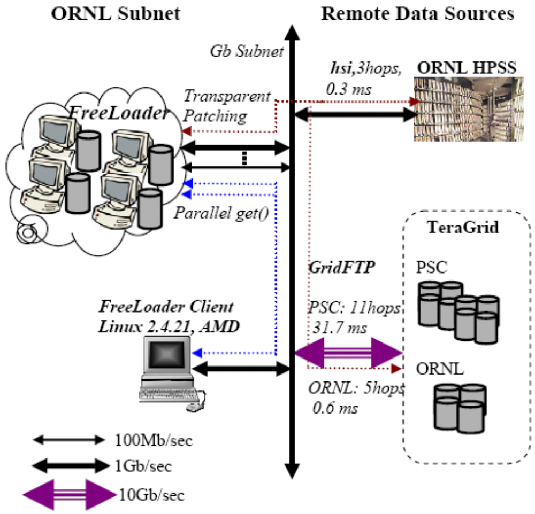
Testbed and Experiment setup
UberFTP stateful client to GridFTP servers at TeraGrid-PSC and TeraGrid-ORNL
HSI access to HPSS
  Cold data from tapes
FreeLoader patching framework deployed in this setting

Slide 11
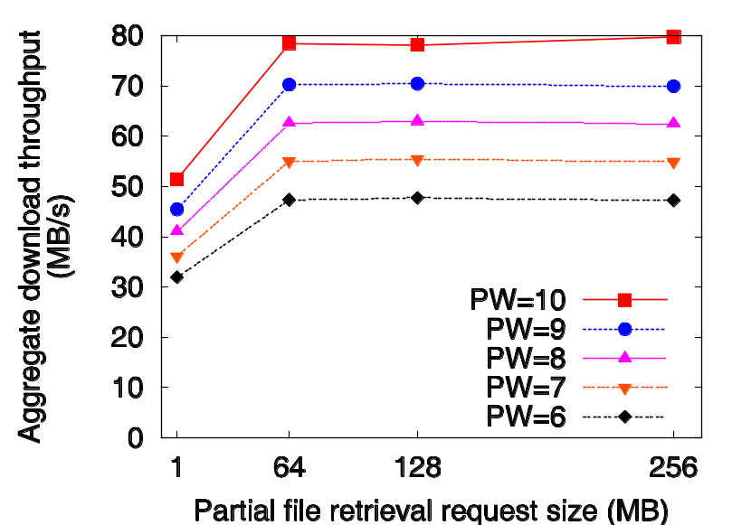
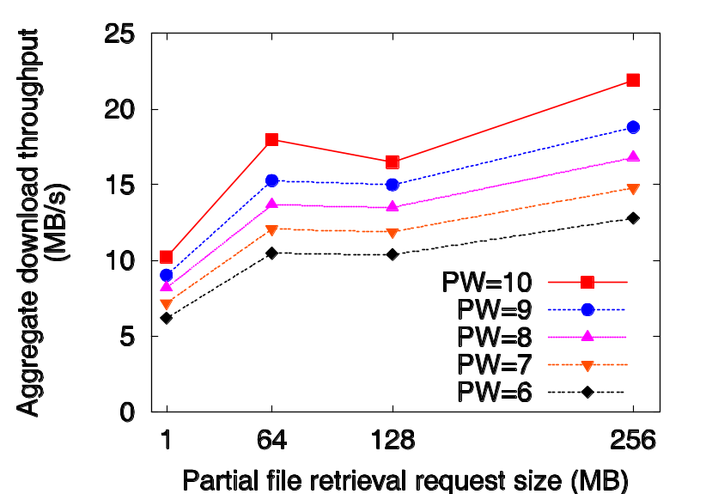
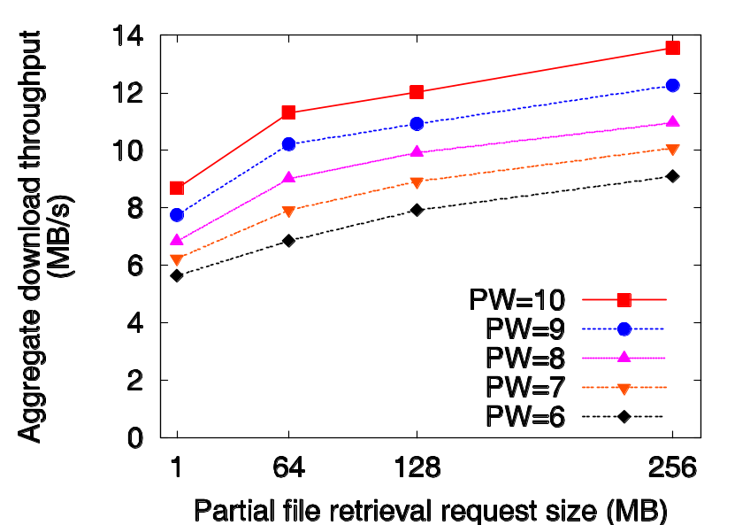
Collective Download Performance
PW=10; I/O=256M | Download | Download + Shuffle | Client access
HPSS | 13.6 | 12.3 -9.6% | 11.7 -4.9%
Tera-ORNL | 79.7 | 75.1 -5.8% | 74.7 -1.3%
Tera-PSC | 21.9 | 20.2 -7.8% | 20 -1.0%

Slide 12
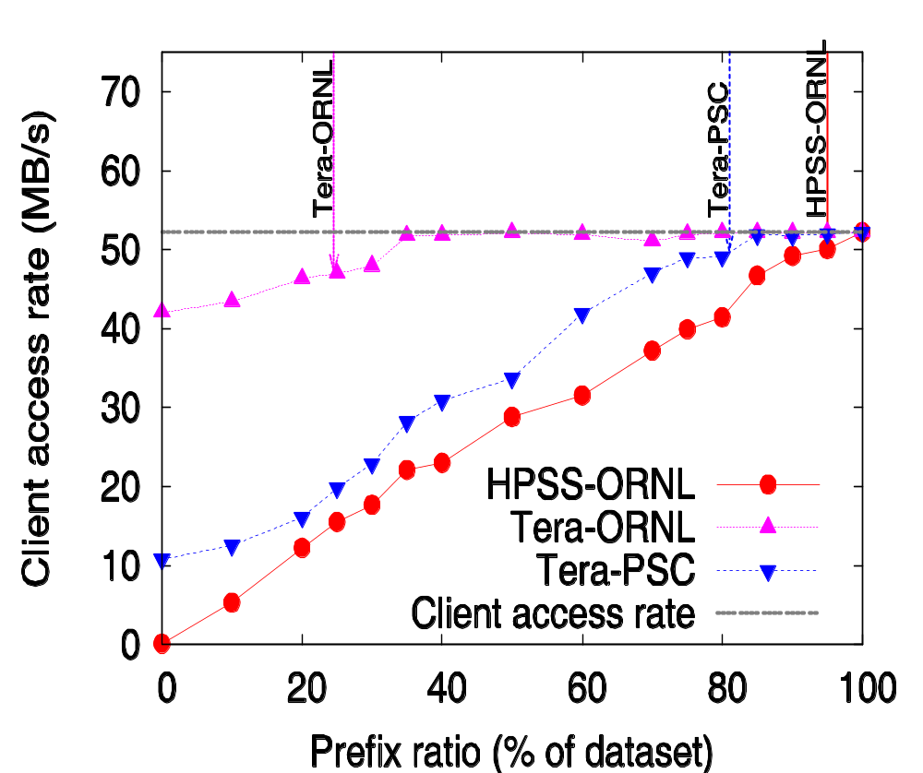
Prefix Size Model Verification
Data sources | HPSS-ORNL | Tera-ORNL | Tera-PSC
R_{client} (MB/s) | 52.2 | 52.2 | 52.2
R_{patch} (MB/s) | 7.6 | 42 | 10.8
L (s) | 31.4 | 3 | 3.9
Predicted ratio | 95% | 24.6% | 81%

Slide 13
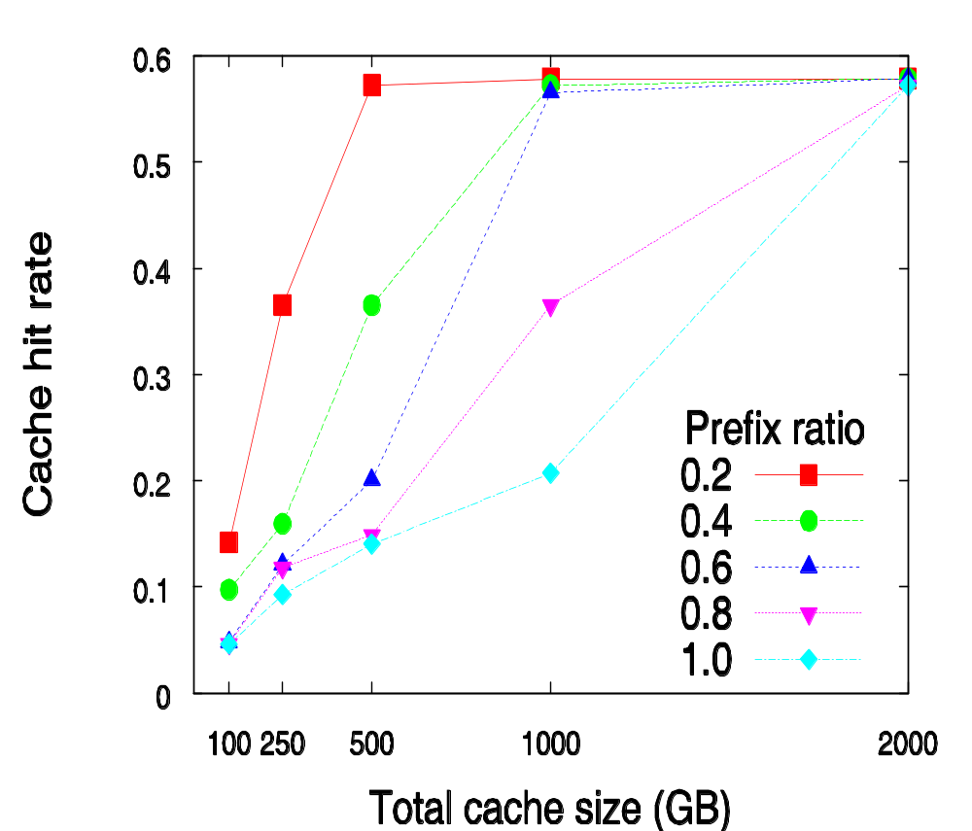
Impact of Prefix Caching on Cache Hit rate
Jefferson Lab Asynchronous Storage Manager (JASMine)
No of days | 19.1
No of accesses | 4000
No of unique datasets | 1686
  Tera-ORNL will see improvements around 0.2 and 0.4 curve (308% and 176% for 20% and 40% prefix ratio)
  Tera-PSC sees up to 76% improvement in hit rate with 80% prefix ratio

Slide 14
Summary
Demonstrated prefix caching for large scientific datasets
  Novel techniques to overlap remote I/O with cache I/O
  A simple prefix prediction model
  Patching with different storage transfer protocols
  Rich resource aggregation model
  Impact on cache hit ratio providing a “virtual cache”
In summary, novel combination of techniques from the fields HTTP multimedia streaming and parallel I/O
Future:
  Use patching cost in conjunction with frequency of accesses to determine which/how much of a dataset to keep in cache: latency-based cache replacement

