Slide 1
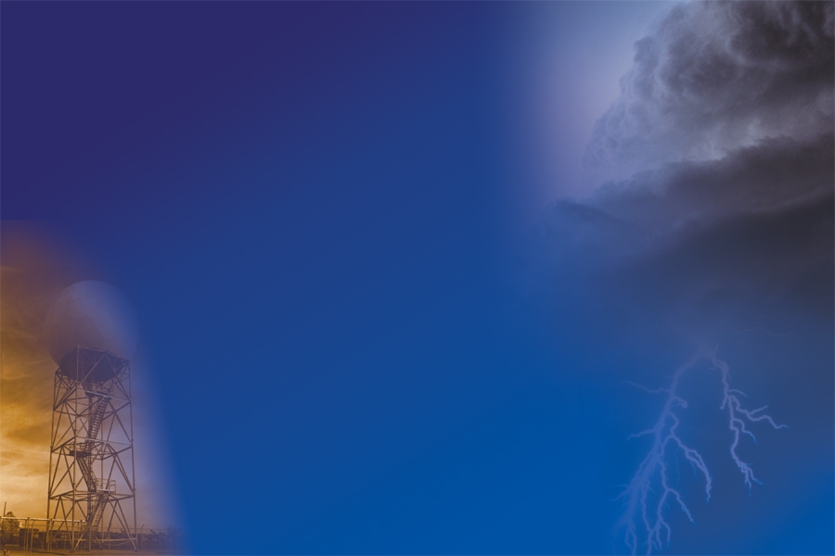
June 16, 2003
Earth Science
Professional Development
How Pressure effects evaporation, condensation and precipitation
Scott Cordero
Warning Coordination Meteorologist
Memphis Weather Forecast Office
National Weather Service
Notes:
Self introduction and introduction of topic.

Slide 2

The Partition Function

Slide 3
What are we going to talk about?
Basic Definitions
Areas of High and Low Pressure
Atmospheric Pressure
Basic Equations to tie it all together

Slide 4
Definitions
Evaporation - summarizes all processes that return water back into water vapor
Condensation - transition from vapor phase to liquid phase
Precipitation - deposition of liquid water droplets and ice particles that are formed in the atmosphere and grow to a sufficient size so that they are returned to the Earth's surface by gravitational settling.

Slide 5
Definitions
Evaporation - the process of a substance changing from a liquid to a gas by exposure to the air and/or heat
Condensation - the physical change of state in which a gas or vapor is transformed into a liquid, as in the formation of water droplets when water vapor cools.
Precipitation - water from the atmosphere that falls to the ground in the form of rain, sleet, snow, or hail.

Slide 6
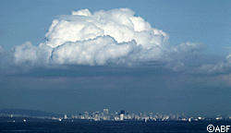
Cloud Formation
Precipitation is one key to the water cycle. Rain comes from clouds, but where do clouds come from?
Through the process of evaporation and transpiration, water moves into the atmosphere. Water vapors then join with dust particles to create clouds. Eventually, water returns to Earth as precipitation in the form of rain, snow, sleet, and hail.

Slide 7
Pressure Areas and the Weather
High Pressure
Low Pressure

Slide 8
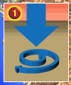
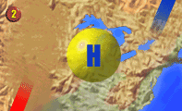
High Pressure
Air tends to sink near high-pressure centers, which inhibits precipitation and cloud formation.
Usually bring bright, sunny days with calm weather
Air flows clockwise around a high-pressure system in the N.H.
regions to the east of a high-pressure center often have northerly winds bringing in relatively cold air while regions to the west of a high-pressure center have southerly winds bringing in relatively warm air.

Slide 9
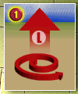
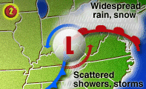
Low Pressure
Low pressure area or cyclone is moving toward your region often when cloudy weather and precipitation usually result as the low pressure area approaches.
Low pressure systems have different intensities with some producing a gentle rain while others produce hurricane force winds and a massive deluge.
Air rises near low pressure areas. As air rises, it cools and often condenses into clouds and precipitation

Slide 10
Low Pressure
A steady rain or snow can fall to the north of the warm front as warm moist air from the south rises up and over the cold air ahead of the warm front.
Showers and thunderstorms often fire up ahead of the cold front in the warm, unstable air.
Usually, showers and thunderstorms ahead of the cold front are much shorter in duration than the precipitation ahead of the warm front.
counterclockwise circulation
cold air will likely be found to the north and west
warm air is most often found to the south and east

Slide 11
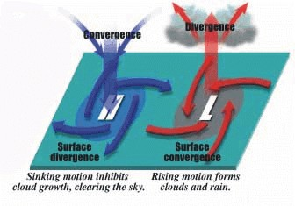
Review of High and Low Pressure
Air slowly descends with high pressure
Rotation around a high pressure is clockwise
Rotation around low pressure is counterclockwise
Air rises, condenses forming clouds and precipitation

Slide 12
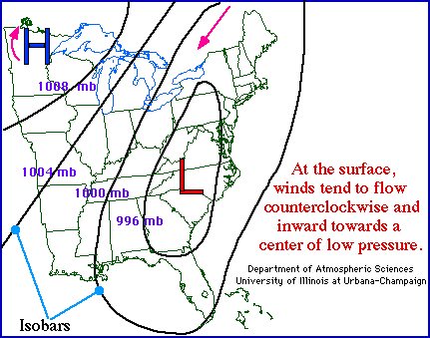
Weather Map

Slide 13

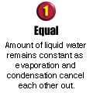
When evaporation equals condensation

Slide 14

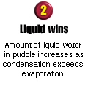
Condensation greater than evaporation

Slide 15
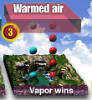
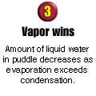
Evaporation greater than condensation

Slide 16
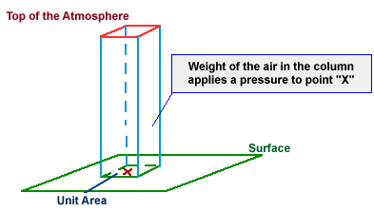
Atmospheric Pressure
Definition - Atmospheric pressure is defined as the force per unit area exerted against a surface by the weight of the air molecules above that surface.
In other words: force exerted by the weight of the air

Slide 17
Air molecules and pressure
If the number of air molecules above a surface increases, there are more molecules to exert a force on that surface, and consequently the pressure increases.
The opposite is also true, where a reduction in the number of air molecules above a surface will result in a decrease in pressure.
Atmospheric pressure is measured with an instrument called a barometer, which is why atmospheric pressure is also referred to as barometric pressure.

Slide 18
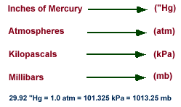
Standard Atmosphere
consider a "unit area" of 1 square inch. At sea level, the weight of the air above this unit area would (on average) weigh 14.7 pounds!
That means pressure applied by this air on the unit area would be 14.7 pounds per square inch. Meteorologists use a metric unit for pressure called a millibar and the average pressure at sea level is 1013.25 millibars.

Slide 19
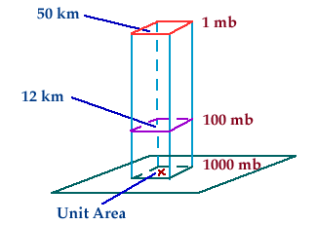
Pressure with height
The pressure at any level in the atmosphere may be interpreted as the total weight of the air above a unit area at any elevation.
At higher elevations, there are fewer air molecules above a given surface than a similar surface at lower levels.

Slide 20
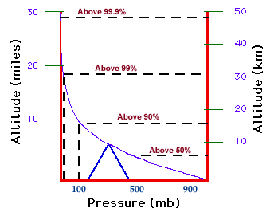
Atmospheric pressure decreases with increasing height
most of the atmosphere's molecules are held close to the earth's surface by the force of gravity.
air pressure decreases rapidly at first, then more slowly at higher levels
more than half of the atmosphere's molecules are located below an altitude of 5.5 km.
atmospheric pressure decreases roughly 50% (to around 500 mb) within the lowest 5.5 km

Slide 21


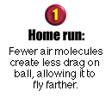
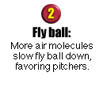
Practical example

Slide 22
Equations to tie things together
PV = NRT (ideal gas law)
dp/dz = - ρ g (hydrostatic equation)

Slide 23
What we talked about
Basic Definitions – Evaporation, Condensation, and Precipitation
Areas of High and Low Pressure
Atmospheric Pressure
Basic Equations to tie it all together

Slide 24
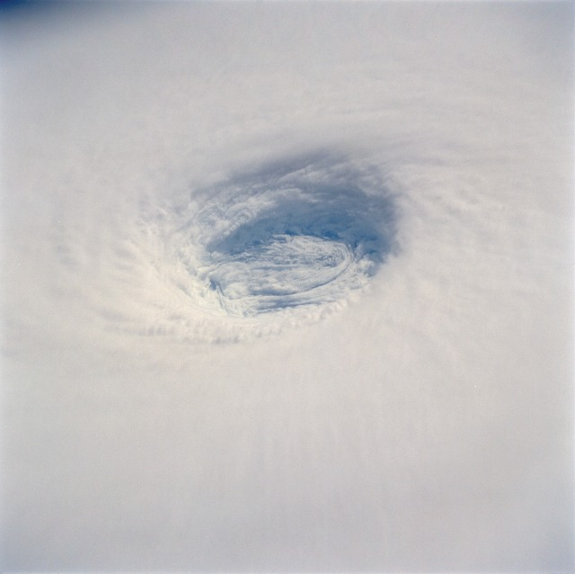
National Weather Service
7777 Walnut Grove Road
Suite 1
Memphis, TN 38120
(901) 544-0411
internet site:
http://www.srh.noaa.gov/meg
Scott Cordero
Warning Coordination Meteorologist
Memphis Weather Forecast Office
National Weather Service
Thank You!!

