Slide 1
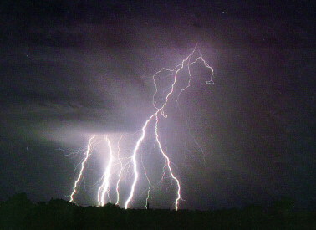
Preparing for the Storm
Presented by Pat Cooper and Mike Hudson
Pleasant Hill, MO WFO – EAX
March 1, 2006

Slide 2
Surprisingly little has been written about pre-event planning for severe weather… yet…it is one of the easiest ways to increase office performance for severe weather events.

Slide 3
Pre-event planning is more than just “making a staffing plan”.
It is preparing the office and our customers for the event.

Slide 4
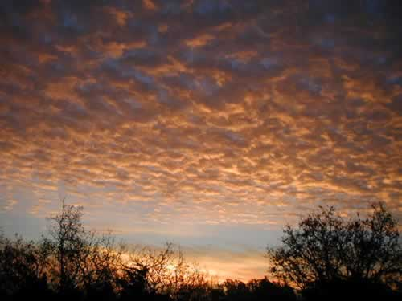
Thinking ahead…
For big events we may have a good idea of what to expect 1 to even 3 days ahead.
For most events you may only have a good handle 12 hours out.
And there are those that don’t show their hand until they are almost upon us.
Bottom line…a Continuous Weather Watch during a shift is extremely important in the convective season.

Slide 5
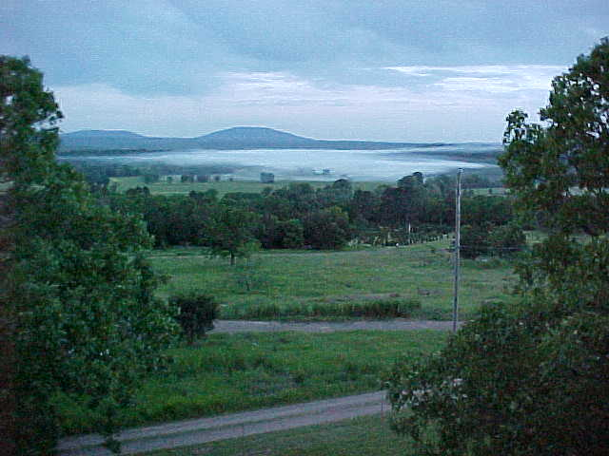
It is the responsibility of the
SHIFT LEADER
(i.e. the person with the “LO” after their name on the schedule)
to ensure a Weather Watch is being done.

Slide 6
And…it is the shift leader’s responsibility to prepare the office for the upcoming event.
To do this well, it is imperative that you have a grasp of the BIG PICTURE.
In other words…
- What type of event are we expecting?
- What is the likely time period for this event?
What is the most likely impact on our partners and the public?

Slide 7
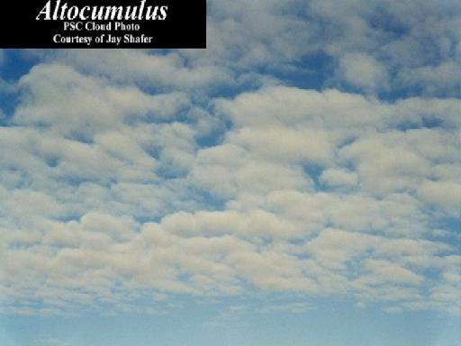
How do you acquire the big picture?
Briefings from fellow forecasters and technicians on the weather and equipment status.
Self-briefing using current conditions, model data and discussions for the weather, and perusing shift logs and looking at staffing availability for potential office problems.
Community awareness…i.e. would the weather be happening when large outdoor events are occurring, or when people are sleeping?

Slide 8
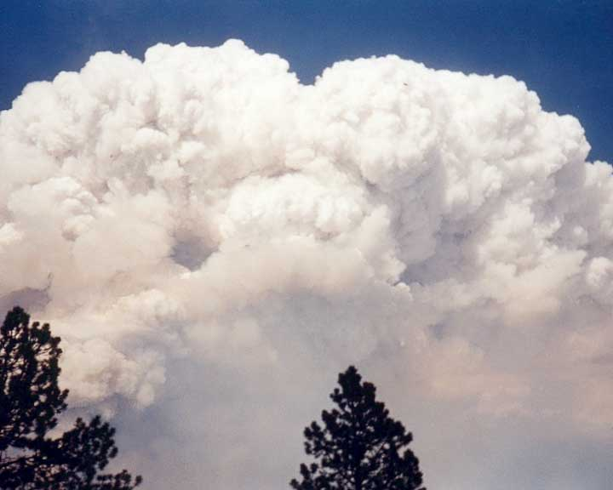
When severe weather is anticipated…it is the responsibility of each shift to work on preparing the office and our customers.
It is imperative that each shift fully briefs the next shift as to what has been done toward preparing for the event.

Slide 9
How do you prepare?
Use the Severe Weather Preparation Checklist.
Start using our various products to convey our latest thinking to our partners and the public (this can begin days in advance). Do they understand our level of confidence, or the range of possibilities that may occur?
Keep the staff, including Management, El Techs, IT, Admin, SH, HMT/MITs, and Forecasters informed of the latest thinking and what roles they may play.

Slide 10
What products can you use to keep
our partners and the public informed?
Text products such as the HWO, AWU, Nowcasts (STF’s)
Ensure the Grids/TAFS reflect our thinking.
Broadcasting on MERS and the NWR
Posting information to the Web Page
Conference calls with emergency managers and media partners, and phone calls to sheriff offices.

Slide 11
Within the critical hours leading up to the event what can you, as a shift leader, do to prepare the office?
Make sure the Severe Weather Checklist has been done.
Start thinking of what positions will need to be filled and by whom. Make heads-up phone calls early in the day.
Get a MARS assigned early…and let the person who will be Coordinator know of your initial staffing plans.
Get the ops area ready (make notepads, logs, maps, forms, pens, etc. handy; have areas free of clutter), and plan ahead on workstation availability.

Slide 12
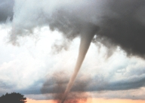
Don’t hesitate to have staff briefings as the event approaches.
Ensure the MARS is providing weather updates to our partners.

Slide 13
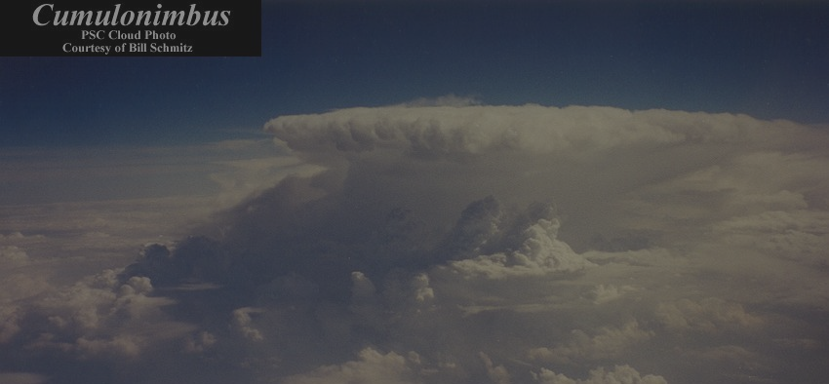
In the hour or two before the event begins the Shift Leader needs to get the
Coordinator in place if they themselves are not going to take on that role.
Fully brief the Coordinator on the status of the weather, office, and personnel.

Slide 14
The Coordinator should then start calling in staff, keeping in mind how long it will take for them to arrive and set up.
Don’t forget about the Skywarn staff!

Slide 15
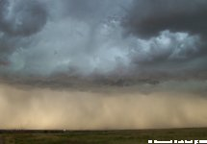
Role of the Coordinator
He/she is there to oversee office operations, making sure the staff is operating as a team and information is being properly passed among team members.
He/she monitors the staff and equipment during the operation.
  Are staff becoming fatigued or struggling in their position?
  Are the duties evenly distributed or is someone getting overloaded?
  Do we need to look at sectorizing or handing off duties to other offices?
  Is the proper person taking care of equipment problems?

Slide 16
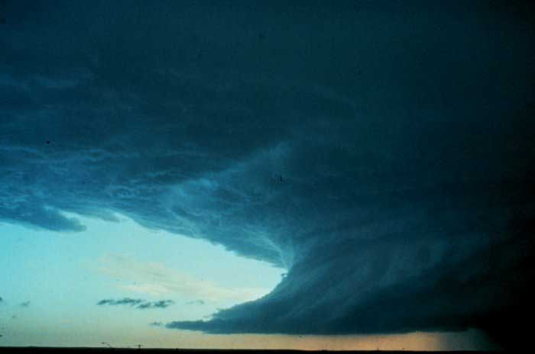
Role of the Coordinator
Are events verifying? If not, is it lack of information or changing conditions?
Are the public and our partners being kept well informed? (AWU’s, LSR’s, timely statements)
Are events and problems being properly logged? DOCUMENT…DOCUMENT!
Are post event duties being performed?

Slide 17
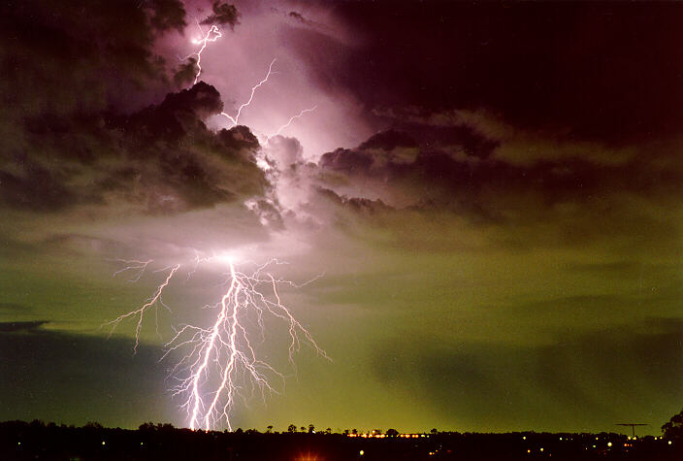
New for this year…moving away from the deluge of paper!
The Coordinator program.

Slide 18
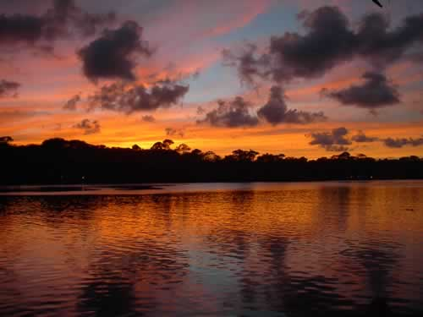
Post-event wrap-up
Documentation is crucial!
Thorough wrap-up includes:
  Event folder & its organization
  Identify post-event verification needs
  Complete post-event staff checklist
  Back up the CRS transmission logs

Slide 19
Event folder
The event folder should be organized, and everything pertinent to the event contained therein:
  Staple warnings with applicable statements (match the VTEC ETN #’s).
  Gather all paper logs (going away…)
  Co-locate LSR’s, SPS’s, call logs and staple/paper clip them together.
  Do not include NOW’s!

Slide 20
Event folder (con’t)
Event folder should be clearly labeled at the top (not on the side) with the date and watch (if applicable)
Once post-event checklists are completed by all staff members, place the event folder on the center table:
  Keep warnings that need verification on top for high visibility
  Next shift with “daytime” hours should pursue verification.
When all verification work is done, place completed folder on WCM’s desk.
  QA/QC
  Metrics (including Panda QA)

Slide 21
Event folder (con’t)
Coordinator should complete PANDA QA in as close to real-time as possible.
One can enter or remove events through the Coordinator, or through the PANDA web interface.
If you don’t feel comfortable, make note of what needs changed for the WCM.

Slide 22
Post-event checklist
Complete after *any* event
  Event = anything for which we issue a warning, a Significant Weather Alert, or anything for which we issue an LSR
Found on the Intranet
Standardized questions for the 1” hail initiative
No polygon initiative questionnaire this year

Slide 23
CRS
After each event (only those where we issue warnings), back up the CRS transmission logs to floppy.
Keep floppies in case near 0MP, in case they are needed for a post-mortem.
** We need to do this after every event where warnings are transmitted!! **

Slide 24
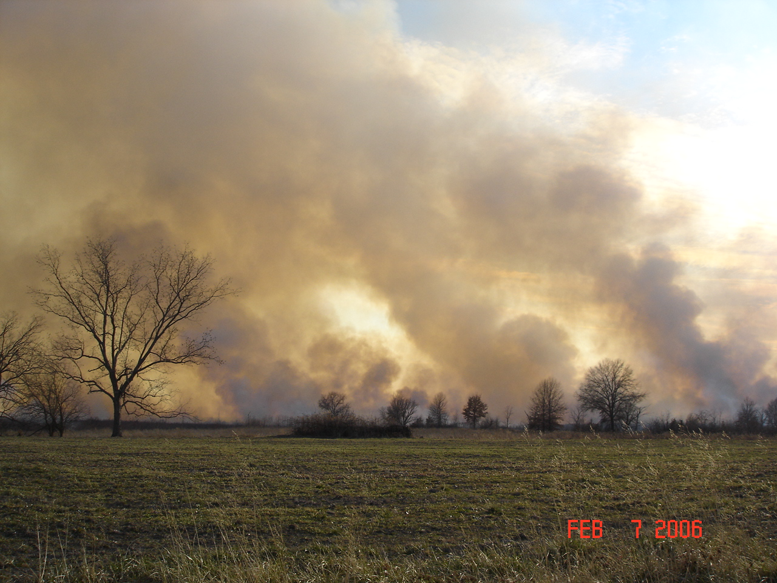
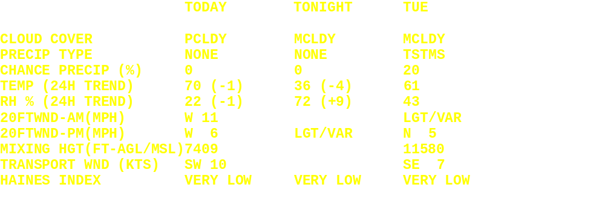
Fire Weather Planning Forecasts

Slide 25
Red Flag Conditions
A critical weather pattern that could lead to the occurrence of extreme fire behavior or numerous fires starts.
Any weather conditions that pose a danger to firefighter safety.
Requires the combination of receptive fuels and a critical fire weather pattern.
  Low RH and Gusty Winds
  Dry Lightning

Slide 26

Fire Weather Watch
Used to alert fire management agencies for the possible development of a Red Flag Event.
Issued when the forecaster has reasonable confidence that the critical weather conditions will develop.
Watch issued between 24-72 hours in advance of the expected onset of the event.
Watch may be issued within 12-hours for possible Dry Lightning events only.

Slide 27
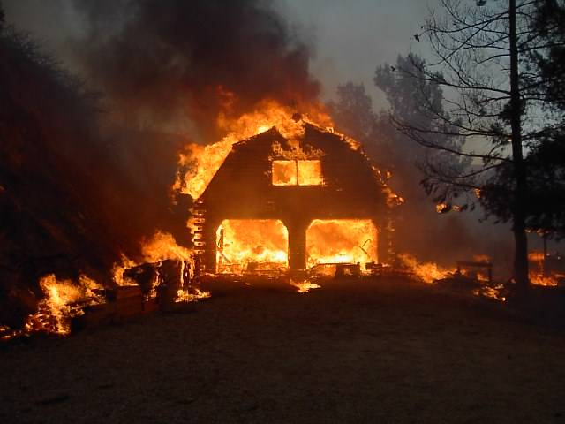
RED FLAG WARNING
Upgrade of a Watch or issued as is.
Issued when Red Flag conditions are occurring or when there is a high degree of confidence that Red Flag conditions will occur within 24-hours.

Slide 28
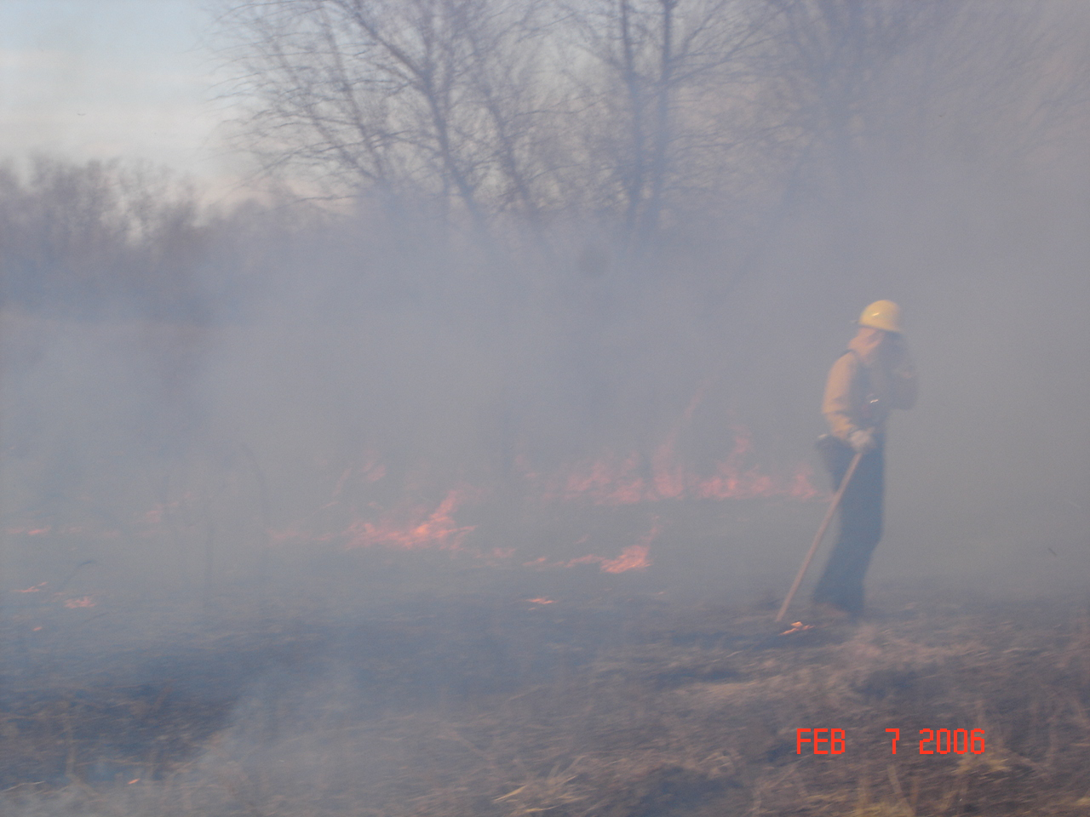
Before spring green-up or after fall color. Or during the late spring...summer to early fall season when area has been in a dry spell such that drought monitoring maps such as the Drought Monitor (including the experimental short term blend Drought Monitor) is showing area going into a severe, or worse, drought situation...
Sustained winds of 15 to 20 mph with minimum RH of less than 25% for at least an hour. Or sustained winds of greater than 20 mph with a minimum RH of less than 35% for at least an hour.
Ten hour fuel moisture expected to be at or below 7 percent.
Daytime temperatures reaching above 50 degrees in winter or above 60 degrees in early spring or in the fall.
Also, SPC's fire weather outlook maps day 1 and day 2 should be consulted for critical areas.
Input from area wildlife managers as to their local conditions should also be used. Fire officials will be encouraged to call the office if they feel they are needing a Red Flag Warning.

