Slide 1

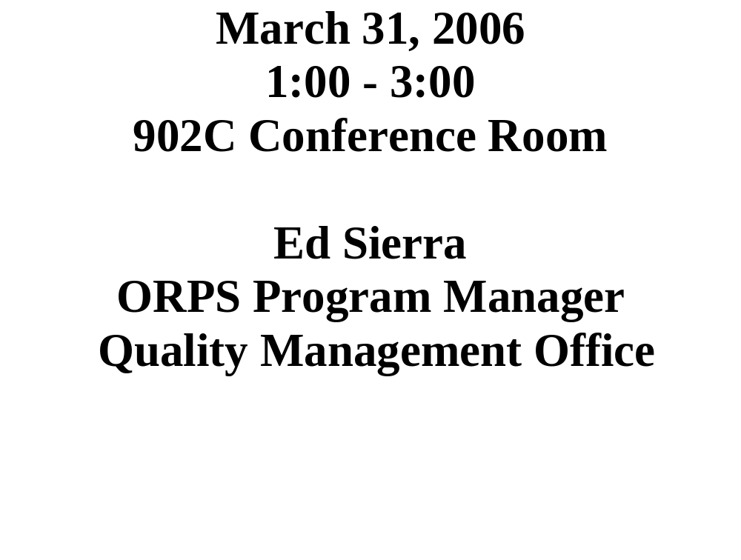
Categorizers (CAT) Team Workshop #2006-01

Slide 2

OUR AGENDA!
Workshop Goals
Point to Ponder
Guest Speakers/Topics
  Bob Selvey
    Noise & ORPS
  Joe Levesque
    Precautionary Evacuations: A Working Definition (provide input to DOE)
    Biologics and the Effects on Iron Piping
ORPS Trending
Categorizer Work (Cat Form Entries)
Cat Chat!
  Possible Changes to ORPS
Programmatic Bins
  Potential Recurring Issues on Sonar
    Chemistry contaminations
    Noise
Meeting Evaluation and Wrap-up

Slide 3

CAT Team Workshop
Workshop Goals:
  To EVALUATE and CONTINUOSLY IMPROVE the BNL Occurrence Reporting Program.
  To MAINTAIN a baseline categorization process such that reportability decisions are both VALID and CONSISTENT.
  To REVIEW/ EVALUATE data to determine if repeat events should be identified as potentially RECURRING occurrences.
  To PROMPT (via accurate categorization) DEEP and LASTING value-added CHANGE, which results in new ways of THINKING and ACTING.
    CAT

Slide 4

Point to Ponder
“The more we stress only what we can measure in school, the more we need to remember that not everything that is measurable matters, and not everything that matters is measurable.”
- Elliot Eisner

Slide 5

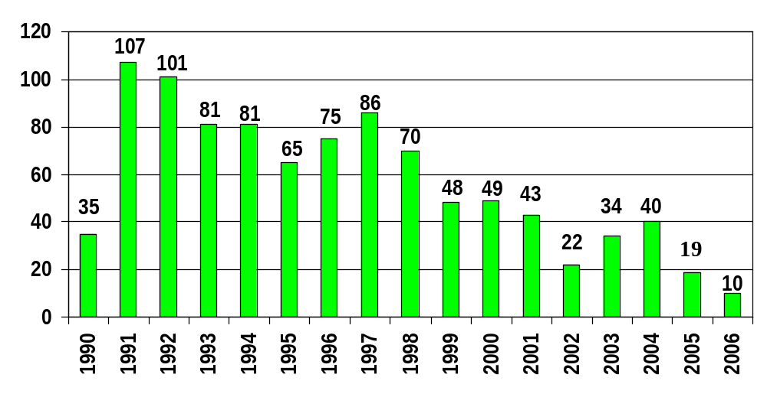
BNL ORPS by Calendar Year Report Submitted
As of 3/31

Slide 6

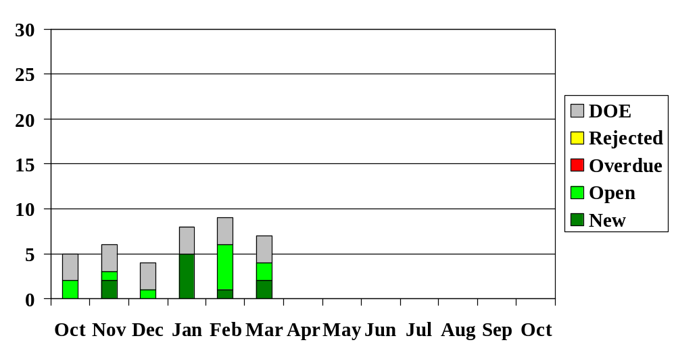
BNL ORPS Report Status
FY 2006 (End of Month)

Slide 7

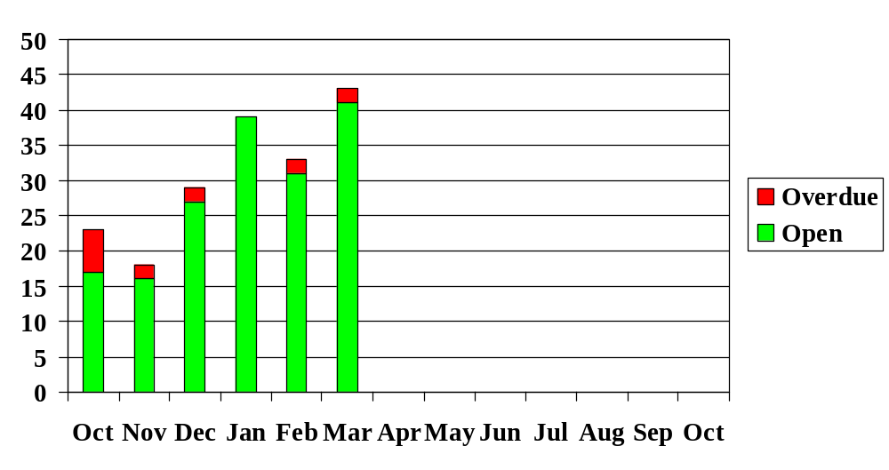
ORPS Corrective Action Status
FY 2006 (End of Month, 3/30)

Slide 8

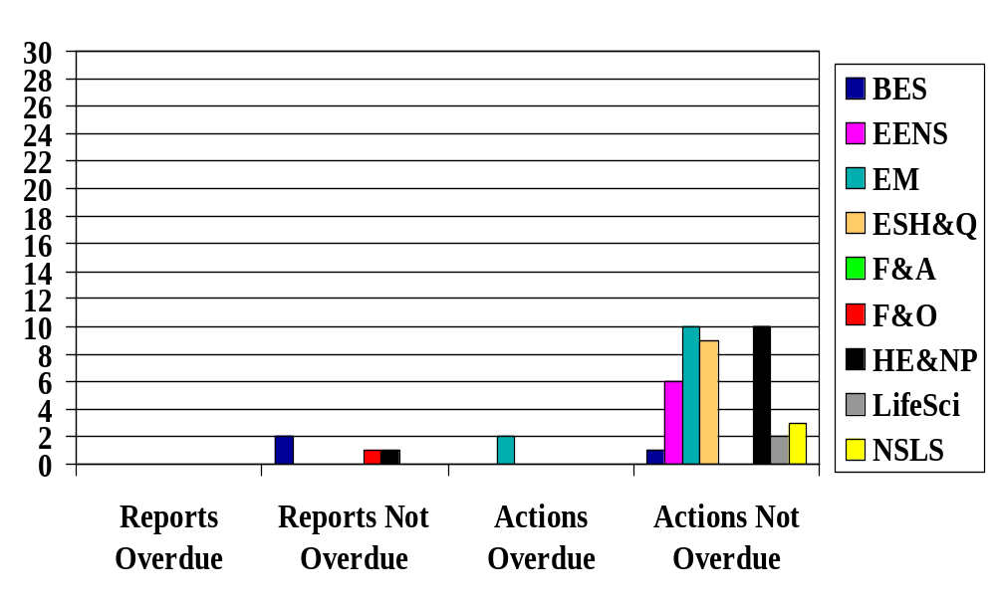
ORPS Reports and Actions
March 30, 2006
ALD

Slide 9

CAT Electronic Entries
12/21 – SM, S/CI Grade 5 Bolt in ratchet assembly @ B855, (SC4)
12/22 – SM, Overflow of Domestic Water Inside Bldg 855 Sr-90 Treatment System Area
12/23 – KK, Employee falls @ Berkner Hall, minor facial injuries
--------------------------------------------------------------------------------------------------------------------------------
01/06 – PB, Fire in BNL Step Van
01/17 – AL, Tennelec smear counter falls during transport, (SC3)
01/17 – PB, Energized circuit found in cut conduit in floor slab @ B555, (SC3)
01/18 – PB, Nuclear Safety Basis USQ on rusting HEPA exhaust stack @ B860
01/18 – PB, Noise over exposure per ACGIH TLV @ B902, (SC3)
01/20 – PB/ES, (Update) NSB USQ on rusting HEPA exhaust stack @ B860, (SC3)
01/27 – MB, Burning Cotton Apron In PPE/Tool Bag Causes Evac @B197, (SC3)
01/31 – RK, Slip off RADTEC Test Vehicle Results in Hip Fracture, (SC3)
02/06 – KK, Odor Detected in Building 725-B
02/07 – KK/ES, Rad Cont in Roadbed Near Main Gate, (SC4) [cancelled on 3/31]
02/21 – SM, X17C Laser Procedure Violation (Door left open while laser in operation)
02/22 – MD, Lapse in USQ training qualification at waste management
02/23 – MD, Wheel Falls off Personal Vehicle after Repairs at Site Service Station
02/23 – MD, Personnel Contamination at Building 901
02/27 – AL, < 1 gallon of antifreeze on pavement near the main gate

Slide 10
CAT Electronic Entries
03/02 – AL/ES, Transport to Hospital from gym due to non-occupational illness
03/06 – KS, < 6 gallons of motor oil spilled to pavement outside south gate
03/06 – AL, Discovery of Radiation Monitor in Interlock-Bypass-Mode (SC3)
03/07 – KS, Safety Hotline Call in regard to steam leaking from manhole No. 48
03/07 – KS, Over-exposure to noise hazard @ Motor Pool Repair Facility (SC3)
03/07 – KS, Rad Cont Outside a Controlled Area at B-490 (SC3)
03/07 – KS, Minor oil spill (approx. 8 oz.) from transformer fitting outside B-958
03/10 – KS, Survey Meter / Frisker Taken Outside Controlled Area at B-490
03/13 – PB, Exposed electrical terminal in legacy installed light timer (SC4)
03/18 – PB, Discovery of fixed legacy contamination at B-527
03/21 – MB, 1 pint of a rad liquid (Cs) on black top due to weeping leak from oos tanker
03/22 – MB, Contamination Detected on Employee's Shoes at PET
03/28 – RK, Contamination of two workers at B-801 during removal of BLIP target filter
03/29 – RK, Lack of admin approval (non-safety related) for NASA NSRL experiment
03/30 – RK, Minor hydraulic oil spill to pavement outside B-86

Slide 11

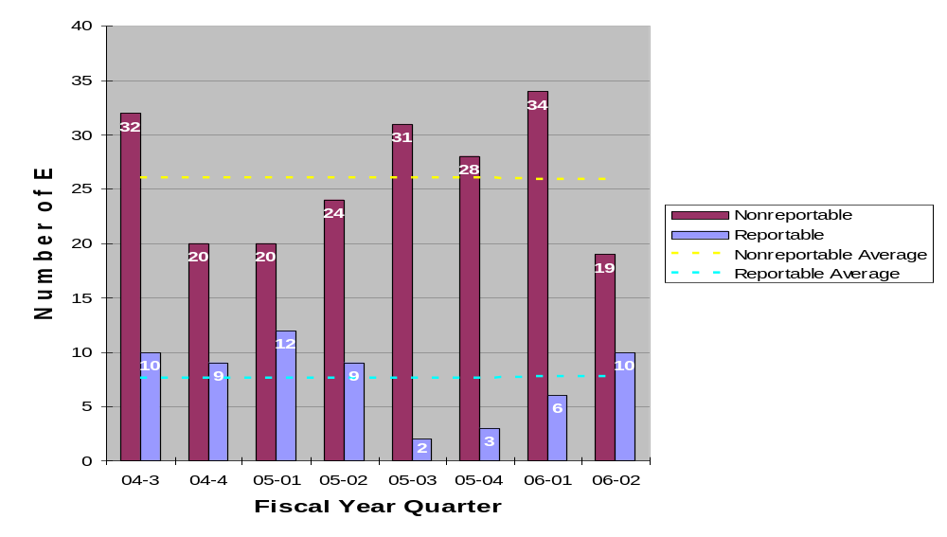
ORPS Reportable and Nonreportable Cat Entries

Slide 12

CAT CHAT!
Faction of DOE HQ not happy with quality of some “complex” issued occurrence reports (BNL has an overall reputation of submitting excellent reports)
  DOE proposal - Facility Rep approval of all reports?
  Causal Analysis for SC4 reports? (back to notification & U/F Reports)
  DOE HQ asking for BNL input on thoughts to improve reports
E. Sierra to attend ORPS meeting in NM on 4/26.

Slide 13

Programmatic Bins
Personnel Contamination
Medical Department
NSLS
Physics
CA-D
BGRR Project
Plant Engineering
Utilities Struck
Material Transportation
Electrical Shock Hazards
Material Handling Issues
Waste Management
Chemistry
Environmental Restoration
Railroad Tracks
New Construction
Noise (New)

Slide 14

Programmatic Review
Personnel Contamination – 2005
  02/02 – Personnel Contamination at Cyclotron
  02/08 – Radioisotope Production Lab Cont Identified @ 901
  03/30 – 14,000 dpm of beta/gamma on sneaker at PET
  09/07 – Contractor - 4K dpm skin cont on neck @ B650 (SC3)
  09/16 – 500 dpm alpha cont on hand @ B650
  10/17 – Cont. discovered (95,000 dpm/100cm2) within Rad Buffer Area and on shoe covers during RBA friskout @ B801
  12/19 – LL rad contamination event @ B650
Personnel Contamination – 2006
  02/23 – Personnel Contamination at Building 901
  03/22 – Contamination Detected on Employee's Shoes at PET
  03/28 – Cont of two workers at B-801 during removal of BLIP target filter

Slide 15

Programmatic Review
Medical department, 2005
  01/17 – Steam Leak in Basement of Building 490
  01/26 – Meth Chloride Spill and Overexposure @ 490 (SC3)
  04/21 – Post-doc faints when taking blood samples @ 490
  06/07 – Researcher transport Rad experiment in private vehicle
  10/17 – Cont. discovered (95,000 dpm/100cm2) within Rad Buffer Area and on shoe covers during RBA friskout @ B801
Medical department, 2006
  03/07 – Rad Cont Outside a Controlled Area at B-490 (SC3)
  03/10 – Survey Meter/Frisker Taken Outside Controlled Area at B-490
  03/13 – PB, Shock from terminal in legacy installed light timer (SC4)
  03/28 – Cont of two workers at B-801 during removal of BLIP target filter

Slide 16

Programmatic Review
NSLS, 2005
  03/03 – Suspect Bolts Found in Crane During Inspection @ NSLS (SC4)
  04/20 – Haz concerns associated with energized magnet
  06/28 – Syringes (w/needles) found in Research Laboratory
  Trash Receptacles @ Bldg 725A
  11/11 – Minor Cryogenic Injury to Visiting Scientist
NSLS, 2006
  02/21 – SM, X17C Laser Procedure Violation (Door left open while laser in operation)

Slide 17

Programmatic Review
Physics, 2005
  04/25 – Smoke alarm from overheated plastic tubing @ Bldg 832
Physics, 2006

Slide 18

Programmatic Review
CA-D, 2005
  01/07 – Employee falls while walking (Reason Unknown, SC3)
  02/09 – Slip and Fall Results in Hairline Fracture of Kneecap (SC3)
  02/22 – High pH detected at recharge basin HTW, Bldg 930
  03/14 – Cooling Water Leak at LINAC due to stuck open relief valve
  04/19 – Worker breaks finger while climbing ladder @ AGS
  05/04 – Sparking From ATR Main Magnet Cooling Water Pump
  07/21 – Minor occupational injury (wood splinter) at Bldg 1005R
  08/29 – P/U truck damages wall at B1002B
  09/13 – Tritiated water (2200 pCi/L) leak (30-50 gal) to soil near B930A
  10/14 – Rainwater (deluge) causing electrical shorts/smoke in B912
  10/17 – Crack in tip of finger bone from mallet strike @ B905
  10/28 – AGS door interlock works but "Area Secure" light not lit
  10/31 – S/C bolts identified at the STAR 20-Ton crane (existing report)
  11/02 – Energized wire discovered during RF power amp repair (SC3)
CA-D, 2006
  03/06 – Discovery of Radiation Monitor in Interlock-Bypass-Mode (SC3)
  03/29 – Lack of admin approval (non-safety related) for NASA NSRL experiment

Slide 19

Programmatic Review
BGRR Project, 2004
  04/14 - 5,000 dpm on top of worker’s shoe (RAR)
  05/03 - Leakage of cont water from Sea-Land Container (SC4)
  05/11 - Filter cart sep from resp during work in rad/cont area (SC3)
  09/03 - DSB work performed outside of procedure (SC4)
  10/05 - Injury due to steel plate falling at bldg 701 (SC3)
BGRR Project, 2005
BGRR Project, 2006

Slide 20

Programmatic Review
Plant Engineering, 2005
  08/01 – Simple Fracture of pinky while working on dump truck
  09/08 – PE truck hung up on berm behind B912
  11/21 – Gov vehicle strikes tree in off-road area on-site
  12/12 – Partially Disabled (Inadvertent) fire alarm syst @ B321, 326, 339, 421, 423, 651
Plant Engineering, 2006
  01/27 – Burning Cotton Apron In PPE/Tool Bag Causes Evac @B197, (SC3)

Slide 21

Programmatic Review
Utilities struck, 2004
  04/19 – Electrical utility conduit strike (SC3)
  07/07 – Domestic water main strike
  09/07 – Comm. cable severed during excavation work
  12/09 – Unexpected discovery of 2.4K deenergized cables during excavation
Utilities struck, 2005
Utilities struck, 2006

Slide 22

Programmatic Review
Material Transportation, 2004
- 06/25 - B-52 waste cont support chnl rain water accumulation (SC4)
- 07/26 - Transportation of Solidified Liquid Low-Level Waste (SC1)
Note: “suspected radioactive contamination occurs involving shipment of radioactive materials” = SC1
Material Transportation, 2005
  03/17 – Excessive Drainage from BNL Rail Cars arriving at Envirocare (SC3)
Material Transportation, 2006

Slide 23

Programmatic Review
Electrical Shock, 2005
  04/01 - Unexpected Discovery of Haz Energy Source @ Magnet Division (SC3)
Electrical Shock, 2006
  03/13 - Shock from terminal in legacy installed light timer (SC4)

Slide 24

Programmatic Review
Material Handling Issues, 2004
  03/05, Load Falls off Flatbed Truck, (SC3)
  03/24, Recurring Material Handling Problems, (SCR)
  05/17, Damaged detector at STAR after 10 foot drop
  06/11, 500 # steel block falls (3 – 4 feet) from forklift
  10/05, Injury due to steel plate falling at bldg 701 (SC3)
Material Handling Issues, 2005
Material Handling Issues, 2006
  01/17, Tennelec smear counter falls during transport, (SC3)

Slide 25

Programmatic Review
Waste Management, 2005
  01/07 – WMD Worker Enters Controlled Area with Expired Training
  06/30 – ~2 inches (150 -200 gallons) of water flooded the equipment level at the BMRR
  04/21 – Worker injures back while moving drum
  09/16 – 500 dpm alpha cont on hand @ B650
  10/26 – Tritium Detection in Sr-90 Extraction Well SR-2
  12/19 – LL rad contamination event at B650
Waste Management, 2006
  01/20 – USQ on rusting HEPA exhaust stack @ B860 (SC3)
  02/22 – Lapse in USQ training qualification

Slide 26

Programmatic Review
Chemistry, 2005
  02/02 – Personnel Contamination at Cyclotron
  02/08 – Radioisotope Production Lab Cont Identified @ 901
  03/30 – 14,000 dpm of beta/gamma on sneaker at PET
  05/11 – R.A. Cuts Hand/Requires Stitches @ Bldg 555
Chemistry, 2006
  01/17 – Energ ckt disc in cut conduit in floor slab @ B555, (SC3)
  02/23 – Personnel Contamination at Building 901
  03/22 – Contamination Detected on Employee's Shoes at PET

Slide 27

Programmatic Review
Environmental Restoration Projects, 2005
  05/26 – Technician Cuts Thumb During Cable Repair @ Bldg 811
  06/07 – Personnel Exposure to Excessive Noise (SC-3)
  06/21 – White Powder Substance Found Behind Bldg 657
  08/26 – Hg/Cs-137 laden soil stored at Old HWMF
  09/07 – Contractor - 4K dpm skin cont on neck @ B650 (SC3)
  09/06 – GW treatment system (Sr-90) fitting leak, to sump @ B855
  11/02 – Inert gas removed from HFBR vessel (SC3)
  12/02 – Legacy Soil activity identified in the woods N&S of the FHWMF
  12/05 – Inadequate Work Control (ERD at former waste management facility) Change Review
Environmental Restoration Projects, 2006

Slide 28

Programmatic Review
Railroad Tracks, 2003
  08/27 - Rail Car movement while loading (ON)
Railroad Tracks, 2004
  09/03 - Empty railroad car derailed at BNL track switch
  09/04 - Off-site train car derailment (SC4)
  09/14 - Inadequate rail safety procedures (SC4)
Railroad Tracks, 2005
  01/05 - Empty Railroad Car Derailed
  08/08 - Rail Car (Gondola) Derailment (SC3)
  09/29 - (Update of 8/8 entry) Recurring Railcar Events (SCR)
Railroad Tracks, 2006

Slide 29
“TapRoot For Seven”
“R”ecurring Railcar TapRoot Causal Factors
1. Partial Derailment at BNL Dirt Road Overpass, 9/04/02 | 2. Traversing railcars in an unsafe Manner, 8/12/03 | 3. Railcar Movement While Loading, 8/27/03 | 4. Empty Railcar Derailed at BNL Track Switch, 9/03/04 | 5. Inadequate Rail Safety Procedures, 9/14/04 | 6. Empty Railcar Derailed, 1/5/05 | 7. Unplanned Railcar Movement/Derailment, 8/8/05
Significance of soil build-up on tracks not appreciated Significance of derailment (as “event”) not appreciated | All supervisors at a morning meeting Workers rewarded for getting the job done fast i.e. they can leave for the day | Wheel chocks were not installed on cars 1 – 4 (not required by procedure) | No criteria for successful track switch operation No periodic maintenance performed on switch | The Supervisor (of the Laborers) did not know that the railcars were in motion The Laborers did not park a safe distance from the tracks | Significance of soil build-up on tracks not appreciated | The wheels were not chocked and the hand brake was not applied

Slide 30
“TapRoot For Seven”
“R”ecurring Railcar TapRoot & (ORPS) Causes
1. Partial Derailment at BNL Dirt Road Overpass, 9/04/02 | 2. Traversing railcars in an unsafe Manner, 8/12/03 | 3. Railcar Movement While Loading, 8/27/03 | 4. Empty Railcar Derailed at BNL Track Switch, 9/03/04 | 5. Inadequate Rail Safety Procedures, 9/14/04 | 6. Empty Railcar Derailed, 1/5/05 | 7. Unplanned Railcar Movement/Derailment, 8/8/05
No SPAC (Job perform standards not adequately defined) | No supervision during work (Appropriate level of in-task supervision not determined prior to task) | Confusing or Incomplete SPAC (Unclear/complex wording or grammar & Incomplete/situation not covered ) | No SPAC (Job perform standards not adequately defined) | No SPAC (Job perform standards not adequately defined) | No SPAC (Job perform standards not adequately defined) | Confusing or Incomplete SPAC (Unclear/complex wording or grammar)
Comm of SPAC NI (Management policy guidance/expectations not well-defined, understood or enforced) | Sch of work needs imp (Emphasis on schedule exceeded emphasis on methods/doing a good job) |  | Comm of SPAC NI (Man policy guidance/expectations not well-defined, understood or enforced) | Pre-job briefing needs improvement (Job scoping did not identify special circumstances and/or conditions) | C/A NI (C/A for previously identified problem or event was not adequate to prevent recurrence) | Employee Comm NI (Comm between work groups LTA) --------------------------- Team Selection NI (Personnel selection did not assure match of worker mot/job descriptions)

Slide 31

Programmatic Review
New Construction, 2005
  10/19 – Tree grinding ops @ the CFN construction site results in a piece of wood striking and damaging the rear window/trunk of an unoccupied vehicle
  11/21 – Contract Worker ejected from site after dropping a gas cylinder from the second floor of the RSB to the ground below
  11/29 – Contractor incurs 1 inch laceration to wrist working @ RSB
New Construction, 2006

Slide 32

Programmatic Review
Noise, 2005
  06/07 – Personnel Exposure to Excessive Noise Lab ground water treatment plants (SC-3)
Noise, 2006
  01/18 – Noise over exposure per ACGIH TLV @ B902 (SC3)
  03/07 – Over-exposure to noise hazard @ Motor Pool Repair Facility (SC3)

Slide 33


CAT Team Workshop
CAT Team Action Item Review
Meeting Evaluation and Wrap-Up

