Slide 1

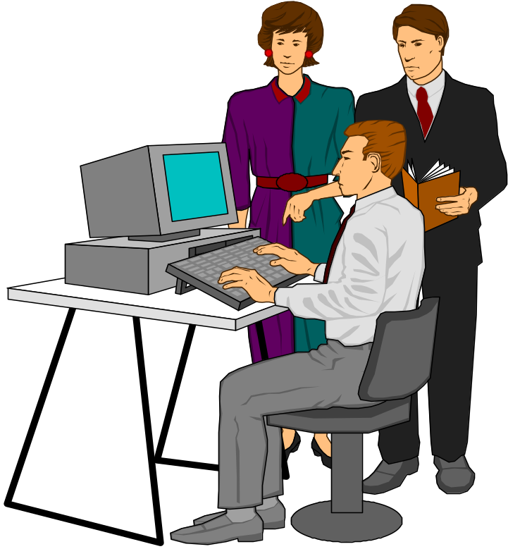
The Cybersecurity Story;
Show As You Tell
Bill Neugent
11 March 2004
The views expressed are those of the author and boy do they
not reflect the official policy or position of The MITRE Corp.

Slide 2
Outline
Cyberterrorism!
Who is to blame?
What’s really happening?
The simple solution
National strategy
Conclusion

Slide 3

The Situation
Computer-controlled networks empower and enable modern society
Networks bring us together

Slide 4

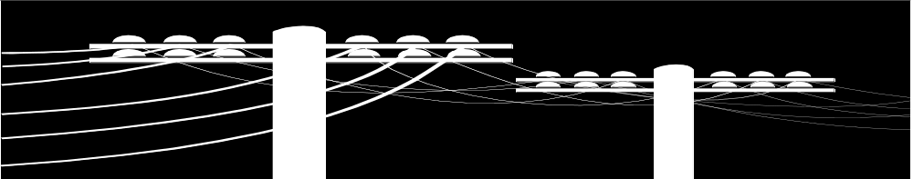
World is Interconnected
Cyber assets sit on rug of communications
    Global Internet
    Global Public Switched Network
We’re at risk
  Rug can be pulled out from under us
  Cyberterrorists are seconds away

Slide 5
The Dilemma
Power travels at light speed
  Power networks are controlled by computers
Communication signals travel at light speed
  Communication networks are controlled by computers
Remote control makes it possible
to ruin a complex network

Slide 6
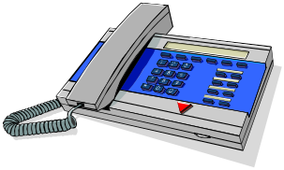

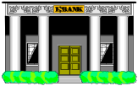




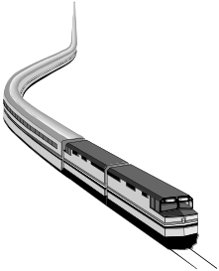


What’s At Risk?
Emergency Services
Banking & Finance
Telecommunications
Water & Sewer
Gas & Oil
Electric Power Distribution
Transportation
Government Services

Slide 7
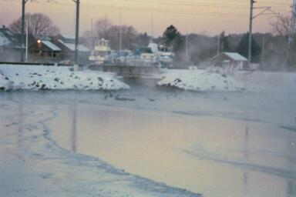
SCADA On Thin Ice*
3 million SCADA systems in use
Increased use of Windows, UNIX
Utilities connecting SCADA to corporate networks, Internet, wireless networks
Stratum8 Networks, “New Layer of Internet Security is Required to Protect Critical Systems that Manage Oil, Natural Gas, and Electricity Resources,” 30 October 2002

Slide 8
So You Say You’re Not On The Internet
“Nearly every bank in the United States runs its operations on an internal network that connects to the Internet.”*
Maybe your front door isn’t
* Sandeep Junnarkar, CNET News, 1 May 2002

Slide 9
Shouts of Warning
“Electronic Pearl Harbor” – Winn Schwartau
“Digital Waterloo”
– Center for Strategic and International Studies
“Digital Armageddon”
– Sen. Charles Schumer, D-N.Y.

Slide 10
Outline
Cyberterrorism!
Who is to blame?
What’s really happening?
The simple solution
National strategy
Conclusion

Slide 11

Users

Slide 12

Bullies

Slide 13

What Motivates Bullies?
“The reason the software you buy isn’t secure is that companies don’t care.”
“The reason is there is no liability for producing a shoddy product.”
      Bruce Schneier
“COMDEX: Panel: Accept the Net is vulnerable to attack,” IDG News Service, 19 November 2002

Slide 14
Software Complexity
Software more complex than any other human construct*
  No two parts alike
  Software differs profoundly from computers, buildings, or automobiles, where repeated elements abound
Rapid time to market
Armies of programmers work independently
Complex legacy software carried forward
Feature-rich software asks for trouble
* Frederick Brooks

Slide 15
Industry Complexity*
Example: freight information systems involve changing mix of companies
  Carriers, shippers, distributors, freight forwarders, government agencies, e.g., Customs
No integration; hard to establish:
  Consistent security baseline
  Security standards, e.g., e-documents
  Identity of users and systems
800,000 hazmat shipments/day in U.S.
* Transportation Research Board Special Report 274, Cybersecurity of Freight
Information Systems, A Scoping Study, National Research Council, 2003

Slide 16
Market Forces Made Us Do It*
Competition forced cost-cutting
  Lead to dependency on Internet
Freight information systems efficient, reliable
Freight customers have lower inventories, just-in-time inbound material strategies
Market forces
Computer-enabled efficiencies
Critical dependencies
* Transportation Research Board Special Report 274, Cybersecurity of Freight
Information Systems, A Scoping Study, National Research Council, 2003

Slide 17

Deregulation
“We’ve delegated public safety and national security to market forces”*
* Scott Charney, “Cyberwar!”, PBS Frontline, April 2003

Slide 18

Competition
Got to drop this extra security weight

Slide 19
Cutting Software Development Costs
Products that include software developed in Beijing:
  Microsoft
  IBM
  Sun
  Etc.
Beijing
Inside

Slide 20
The Issue: Closing The Gap
Security needed against state-sponsored attacks
}
Security provided by market-based solutions
Where should it be closed?
How?

Slide 21

The Inescapable Conclusion:
We’re Toast

Slide 22
Outline
Cyberterrorism!
Who is to blame?
What’s really happening?
The simple solution
National strategy
Conclusion

Slide 23


Terrorist Know-How, Resources
We train the world
  Try to find an American in an American grad school
Funding

Slide 24


Terrorist Requirement
Make headline news
“What’s the visual?”*
After a bomb
After a cyberattack
* TV news producer, judging whether to include coverage of a fire

Slide 25
Prognosis For Cyberterrorism
Not top terrorist priority
Definitely on their to-do list
  Much terrorist research and preparation for cyberterrorism*
Col Bradley K. Ashley, USAF, “Anatomy of Cyberterrorism--Is America Vulnerable?”
IA Newsletter, Vol. 5., No. 4., IA Technology Analysis Center (IATAC), Winter 2002/2003

Slide 26
Computer Crime; We’re Being Robbed
Credit card fraud
  5.2 percent of online shoppers*
Identity theft!!!
  Top consumer complaint in U.S., per FTC**
  27.3M American victims in last five years; 9.9M in last year***
  $48B losses last year to business, financial institutions***
  $5B losses to consumers***
Spyware
  40% of companies infected
*Greg Sandoval, “War on cybercrime--we're losing,” ZdNet News, 14 May 2002
**Robert Moritz, “When Someone Steals Your Identity,” Parade Magazine, 6 July 2003

Slide 27
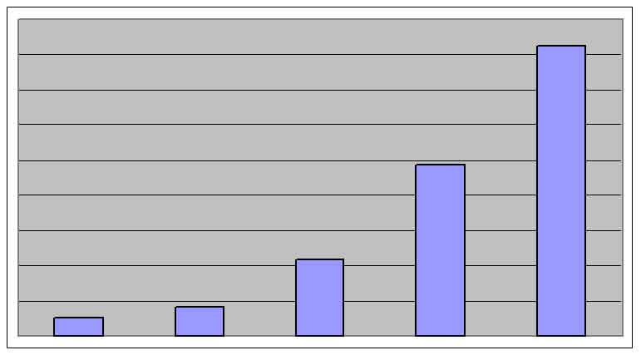
Vulnerabilities Reported*
4,000
3,000
2,000
1,000
1998
262
1999
417
2000
1,090
2001
2,437
2002
4,129
* CERT/CC

Slide 28
Vulnerabilities Costed
“We’re fast approaching the point at which we’re spending more money to find, patch, and correct vulnerabilities than we pay for the software”
      John Gilligan
      USAF CIO
      (formerly DOE CIO)
Washington Monthly, “The Myth of Cyberterrorism,” November 2002

Slide 29

Are You On The Patch?
We’ve treated this as housekeeping problem
Lack of automatic patching, e.g., virus signature updates, is a fatal weakness

Slide 30
How Bad Is It Really?
Sanctum broke into 98 percent of 350 corporate sites it audited*
  Average attack took two hours
Government Red Teams succeed “every single time”**
* PC World Communications, “Cyberterrorism Scenarios Scrutinized,” 23 August 2002
** Richard Clarke, “Cyberwar!”, PBS Frontline, April 2002

Slide 31
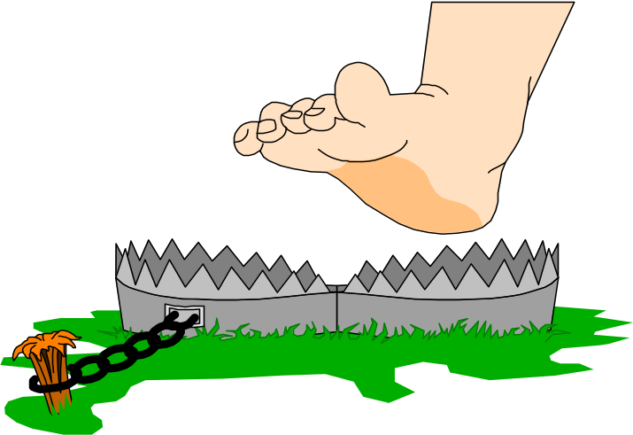
Security on the Internet
PSINet set up unprotected server
Was attacked 467 times within 24 hours
Graham Hayday, “Exposed server—magnet for hack attacks,”
Silicon.com, 29 January 2003

Slide 32
What Can Happen*
Code Red
To see an animation, go to:
http://www.caida.org/analysis/security/code-red/coderedv2_analysis.xml#animations
Slammer
To see an animation, go to:
http://www.caida.org/analysis/security/sapphire/sapphire-2f-30m-2003-01-25.gif
* http://www.caida.org/

Slide 33

Slammer
250 times faster than Code Red
  Within ten minutes, most of systems hit had been infected
  Traveled in 404-byte packet
Crippled sensitive systems, including banking operations and 911 centers*
Prevented many ATM withdrawals*
Disabled safety monitoring system at Ohio nuclear power plant**
* Ted Bridis, “Internet attack's disruptions more serious than many thought possible,”
Associated Press, 27 January 2003
** Kevin Poulsen, “Slammer worm crashed Ohio nuke plant net,” SecurityFocus, 20 August 2003

Slide 34

Implications
Slammer infected few systems -- 120,000
What if vulnerability existed on millions of systems?

Slide 35

There is no current defense against such a threat

Slide 36
Opportunity
August 2003 Windows of vulnerability
  RPC vulnerability
  Affected Windows NT 4.0, Win2K, Windows XP, Windows Server 2003

Slide 37
Attack of the Worms
Blaster
Welchia
Sobig.F

Slide 38
Why No Intentionally Destructive Attacks?
Hackers, criminals, spammers want to use Internet, not destroy it
Terrorists not yet active in cyber domain
To most adversaries, our nets are worth more up than down
The Big One Is Coming
  We live in a straw house
  Too many people have matches
But

Slide 39
Ultimate Disaster Scenario?
AMERICAN ECONOMY STRUCK BY BUSINESS FAILURES
  Loss of confidence in U.S. goods
Dartmouth study of business failures shows many could have been induced by cyber means*
  Could focus on confidentiality and denial of service be misplaced?
* Scott Borg

Slide 40
It’s Not Always Bad
When Security and Secrecy Fail
“At the Iraqi Intelligence Service, a man walked up with a grimy sack of documents and tapes. ‘Tell the world what happened here,’ he said.”*
* Melinda Liu, Rod Nordland and Evan Thomas, “The Saddam Files”
NEWSWEEK™, 28 April 2003

Slide 41
Hackers Wanted
Instead of defacements, leave a signature worthy of your deed; create your own mark of Zorro
Tyrants and dictators still keep detailed records of their atrocities, except now they’re using computers
Do we need a Robin Hood
in cyberspace?

Slide 42
Most Likely Outcome: Cyberstroke
Maybe paired with physical terrorism

Slide 43
Outline
Cyberterrorism!
Who is to blame?
What’s really happening?
The simple solution
National strategy
Conclusion

Slide 44
Consider A Managed Security Service
If you can’t do the job yourself, hire someone who can
This is a job for trained professionals

Slide 45
Get Money
Show vulnerability
  Scan for vulnerabilities
  Map network!
  Red team as outsider!
  Red team as authorized insider!
Show threat
  Deploy intrusion detection system
  Scan for unauthorized wireless!
  Monitor Internet usage!
Prove threat is real
Produce near-term results

Slide 46
Get People
Empower engineers
  Provide challenge, authority, resources
  Approaches explored in labs
Build partnerships
  Internal security committee
    Business units
    Infrastructure, service providers
    Legal, human resources
  External
    Infrastructure, service providers
    Software vendors
    Business partners, e.g., critical infrastructure sector
    Law enforcement, counterintelligence, counterterrorism

Slide 47
A Defense-in-Depth Consideration
Poor security often due to lack of qualified people
Layered security creates more work, not more people

Slide 48
Simplify Architecture (Pg 1 of 2)
Firewall enterprise
  Castle walls and gates enable control
  Firewall desktops*
Manage enterprise security
  Network management centers
  Identity management, policy and access management, and provisioning, e.g., Netegrity
  Server-based architectures
    E.g., thin clients, Citrix Secure Gateway
* Applies to home computers

Slide 49
Simplify Architecture (Pg 2 of 2)
Manage configurations
  Get it secure*
    Configuration management: configuration guidance and tools, best practices
  Keep it secure*
    Compliance management, including patch management
* Applies to home computers

Slide 50
CIO’s Choice
Chaos
  Diverse hardware and software
    Applications testing
    Staff training
  Non-interoperable applications
Assimilation by The Borg
  Homogeneous hardware and software
  Applications and infrastructure part of a coherent, holistic whole

Slide 51

The More Integrated And Interoperable You Are,
The Easier You Fall
Defense-in-depth
becomes more critical

Slide 52
Secure Architecture (Pg 1 of 3)
Ensure resilient foundation
  Programmed to respond automatically
    Power networks “trip offline” for self-protection
  Partitioned
    Domains separated by filtering routers
  Able to sustain emergency operation
  Not fully Internet-dependent

Slide 53
Secure Architecture (Pg 2 of 3)
Create risk domains
  DMZ for sharing with outsiders
  Castle keep for crown jewels
    Strengthen systems, e.g., Host Intrusion Prevention Systems (HIPS) such as StormWatch, Entercept
    Protect data, e.g., Digital Rights Management (DRM)-like technology such as Authentica, Liquid Machines
Deploy strong authentication
  Such as Public key infrastructure, e.g., VeriSign; access tokens

Slide 54
Secure Architecture (Pg 3 of 3)
Deploy automatic malware protection*
  Email gateway, e.g., Trend VirusWall
    eManager plug-in to block installer patches, registry files, etc.
  Desktop, e.g., Symantec AntiVirus, HIPS, TripWire
  Detect, automatically react to internal propagation
Deploy automatic backup infrastructure*
  E.g., Veritas NetBackup
Monitor and respond
  Security Information Management System (SIMS)
    Harness deluge of event data, e.g., ArcSight, netForensics, GuardedNet, Intellitactics
    Integrate with operations, configuration management
* Applies to home computers

Slide 55
We’re Now Secure Against Some Threats
What about professionals?
  Honeytokens, tripwires, homing beacons

Slide 56
From Desktops to Belt-Tops
Laptop
Personal Digital Assistant (PDA)/Palm PC
Cell phone
  Display of alerts, messages
All wireless
All will include microphones

Slide 57
Confront
Ultimate Threats

Slide 58
Nanotechnology
Past
Future
.
(smart dust)

Slide 59
Users*
75% immediately gave passwords when asked
  15% more required social engineering
  “password” 12%, name 16%, football team 11%
75% knew coworkers passwords
67% used same password for everything
  Personal banking, Web site access
91% of men circulated dirty pictures or jokes
  40% of women did same
If discovering a salary file, 75% would read it
  38% would pass file around office
* User Survey--Infosecurity Europe 2003

Slide 60
Two Things To Count On
Users will click on attachments
Users will hit Reply All

Slide 61

User-Based Security
Picture a vehicle with an independent steering wheel on each tire.

Slide 62
Build Culture Of Secure Behavior
Eliminate passwords--go to tokens, biometrics
Train users in what is sensitive
Train users against social engineering
Monitor user activities
Enforce secure behavior
Train, Monitor, Enforce

Slide 63
It’s Who You Know
80 percent of murder victims killed by someone they knew*
  22 percent killed by people with whom they had romantic involvement
* “Murder in Large Urban Counties,” The Bureau of Justice Statistics Study, 1988

Slide 64


Separation of Power In Government
Humans don’t deal well with absolute power

Slide 65
Separation of Power In Systems
Study of over 100 espionage cases showed 55% of spies were network or system administrators*
* Data is from the Espionage Database Project of the Defense Personnel Security Research Center

Slide 66
Outline
Cyberterrorism!
Who is to blame?
What’s really happening?
The simple solution
National strategy
Conclusion

Slide 67
National Strategy to Secure Cyberspace
Create cyberspace security response system
Establish threat and vulnerability reduction program
Improve training and awareness
Secure government systems
Work internationally

Slide 68
Outline
Cyberterrorism!
Who is to blame?
What’s really happening?
The simple solution
National strategy
Conclusion

Slide 69
Think In Advance
Team with others
  Community partnerships (trust everyone)
Innoculate against Insider attacks
  Minimize trust on users (trust no one)
  Safeguard treasures
  Architect for resilience, emergency operation
Automate responses
TIA

