Slide 1
TDC and ADC Implemented Using FPGA
Wu, Jinyuan
Fermilab, PPD/EED
Feb. 2007

Slide 2
Introduction
FPGA devices are considered belonging to digital world while ADC is an analog measurement function.
ADC can be implemented directly with FPGA plus a few passive (resistors and capacitors) components.
Bench tests are done for ADC 6-bit@22.5 MHz and 9-bit@2MHz. Other speed/resolution combinations are possible.
The ADC is based on ramp & compare with TDC implemented inside FPGA with 0.69 ns LSB (200ps RMS).
More than 32 channels of TDC are tested in Altera Cyclone (EP1C6Q240C6, $20) devices.

Slide 3
ADC Using FPGA
FPGA
AMP &
Shaper
ADC
AMP &
Shaper
ADC
Analog signals from AMP & Shapers are directly fed to FPGA pins.
FPGA output and passive RC network are used to generate ramping reference voltage V_{REF}.
The input voltages and V_{REF} are compared using FPGA differential input receiers.
The times of transitions representing input voltage values are digitized by TDC blocks in FPGA.
AMP &
Shaper
ADC
AMP &
Shaper
ADC
FPGA
AMP &
Shaper
TDC
AMP &
Shaper
TDC
AMP &
Shaper
TDC
AMP &
Shaper
TDC
V₁
V_{REF}
V₂
V₃
R1
R1
V₄
C
T₁
T₂
T₃
T₄
R2

Slide 4
TDC Using FPGA (LSB 1ns+-)
Data In
QF
Q3
c0
c0
QE
Q2
c90
QD
Q1
4x Sampling:
250 MHz: 1ns(LSB), 288ps(RMS)
400 MHz: 625ps(LSB), 180ps(RMS)
c180
Q0
c270
c90
Multiple
Sampling
Clock
Domain
Changing
DV
T0
T1
Trans. Detection
& Encode
Coarse Time
Counter
TS

Slide 5
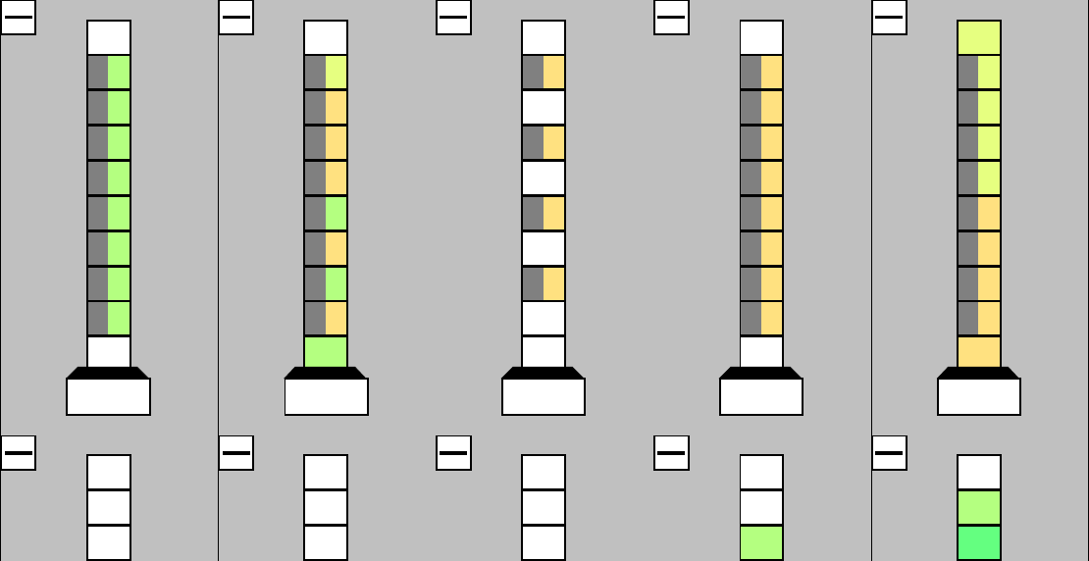
TDC Inside FPGA
Clock
Domain
Changing
Multiple
Sampling
QF
Q3
Sampling rate: 360 MHz x4 phases = 1.44 GHz.
LSB = 0.69 ns.
Logic elements with critical timing are assigned as shown.
c0
c0
QE
Q2
c90
QD
Q1
c180
Q0
c270
c90
DV
T0
T1
4Ch
Trans. Detection
& Encode
Coarse Time
Counter
TS
Logic elements with non-critical timing are freely placed by the fitter of the compiler.

Slide 6
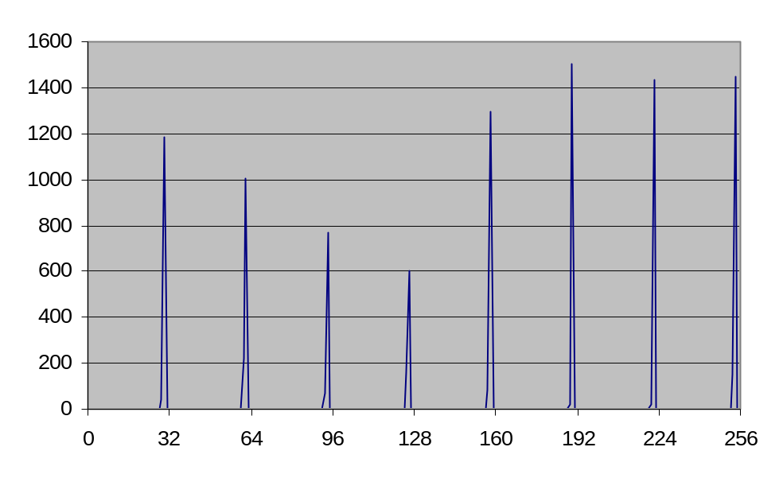
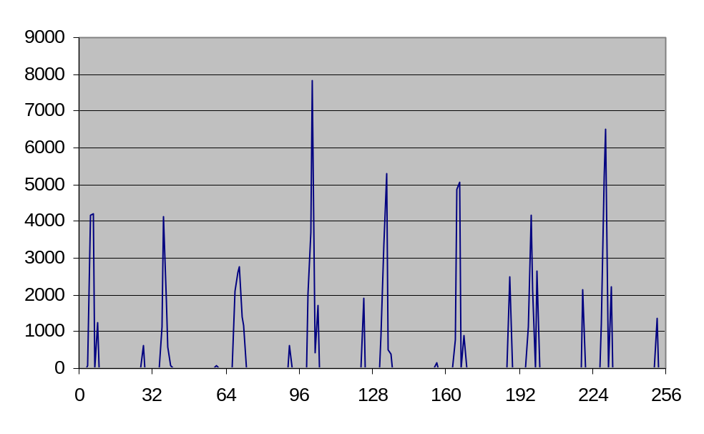
Bench Test of TDC
FPGA
RAM
Flash
RAM
eZ80
TDC
45MHz
Micro-processor address line driven by
45 MHz clock.
32 TDC bin = 1 clock cycle (0.69ns LSB)
FPGA
RAM
Flash
RAM
eZ80
TDC
45MHz
Micro-processor data line.
Data out from different sources.

Slide 7
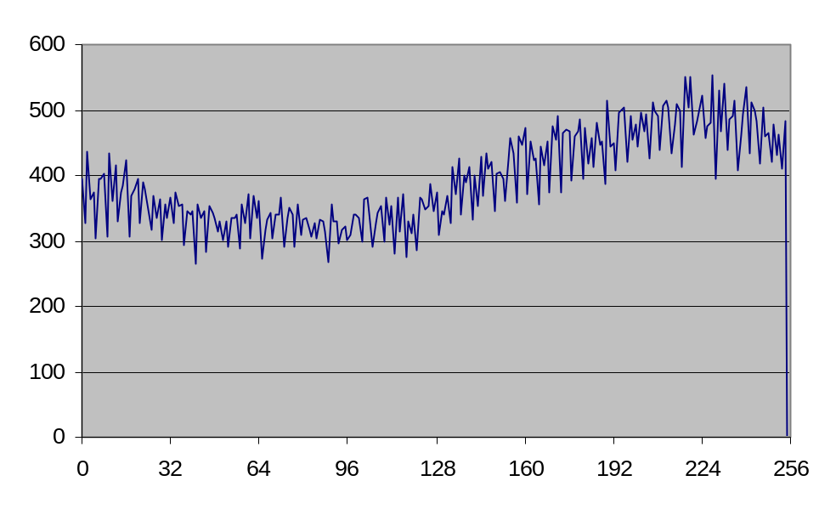
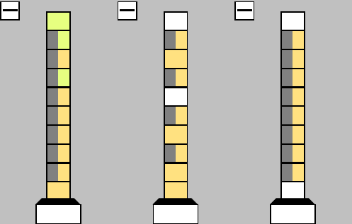
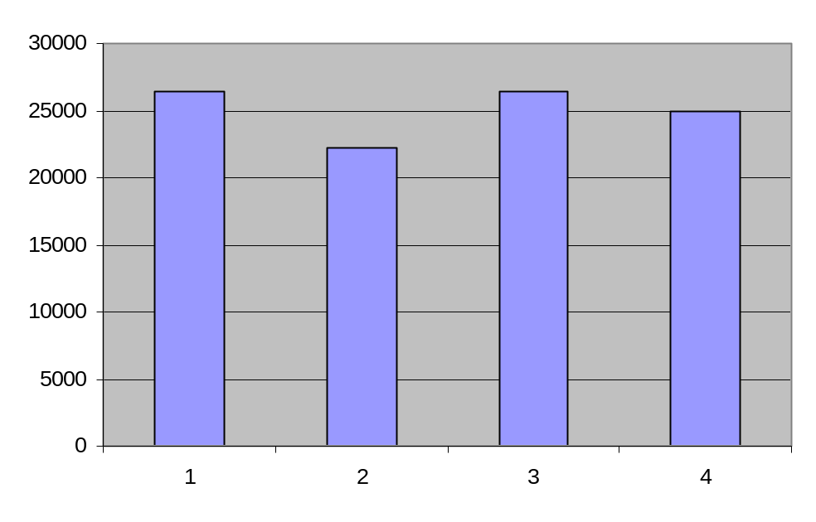
Differential Nonlinearity
FPGA
Quasi-random
Input
TDC
The “beat” between input and 45MHz.
45MHz
The placement above gives even bin width.
Occupancy for each bin should 25%.
The residual DNL < 690*(26-22)/25 = 110ps

Slide 8
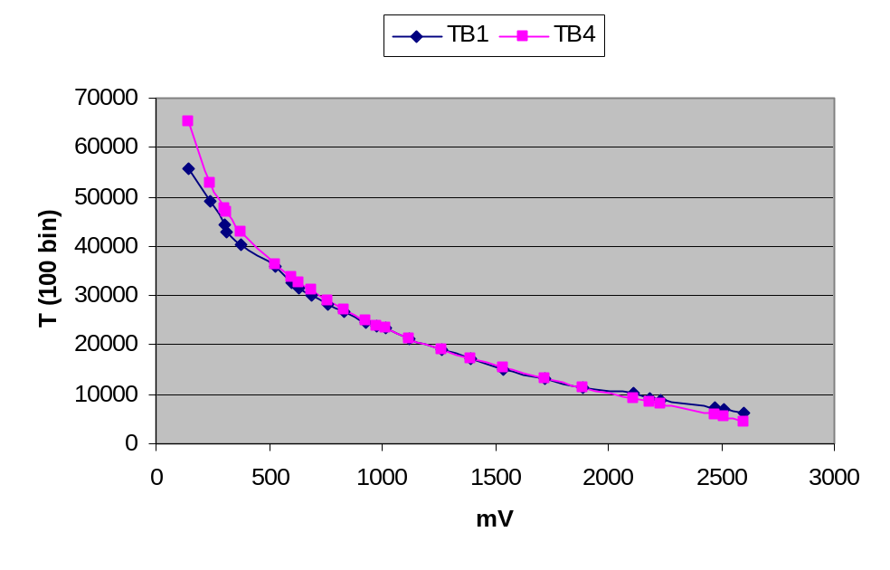
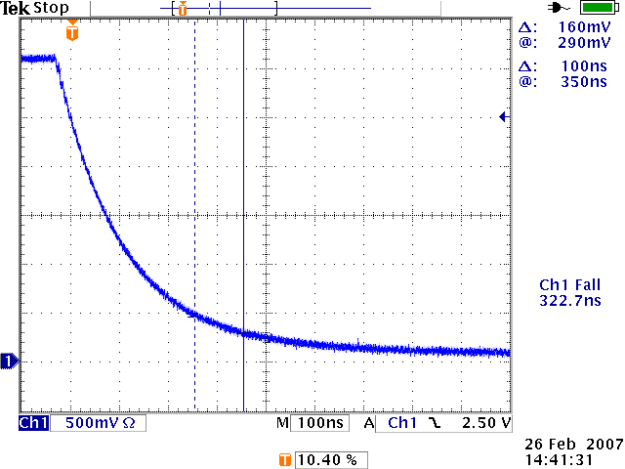
ADC: Discharge Curve Reference: V-T Curve
FPGA
TDC
TDC
The differential receivers are nearly rail-to-rail comparators, but perform best from 0.5-2.2V.
Measurement range: 9 bits:
  Ramping time 512x0.69ns = 353ns.
  >2MHz sampling rate.
Dynamic range: about 12 bits:
  1.6mV/ns or 1.1mV/LSB @ 350ns.
  2.2V/1.1mV ~ 2¹².
V_{REF}
50
511
270pF
τ = 146 ns

Slide 9
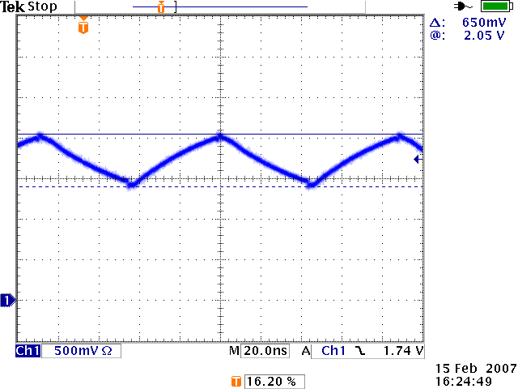
ADC Test: Reference on BD3_19
FPGA
TDC
TDC
V_{REF}
50
50
τ = 59 ns
1000pF
100
Longer time constant causes the V-T curve to be nearly linear.
Sampling rate: 22.5MHz (2/88ns).
Measurement range: 6 bits.
Sensitivity: 10mV/LSB.

Slide 10
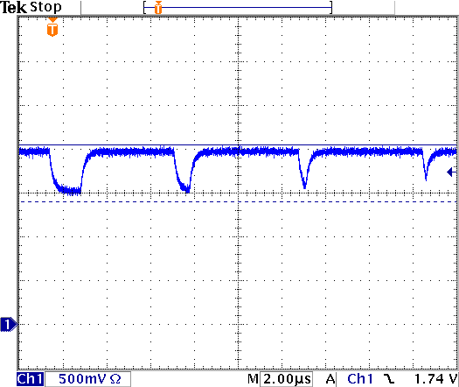
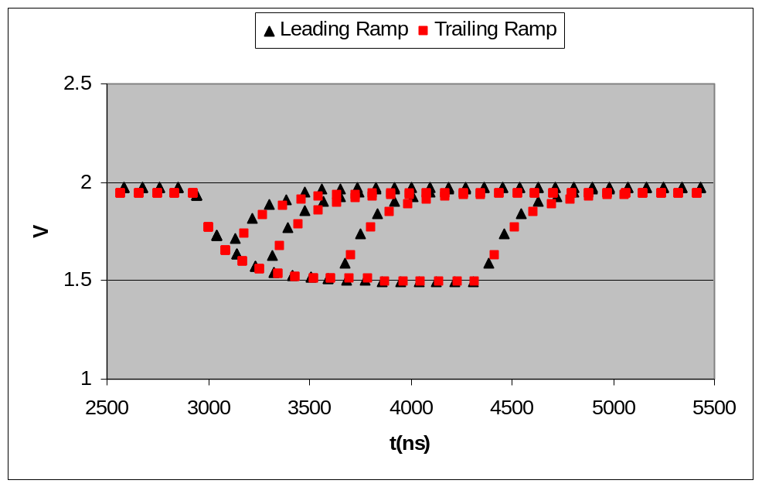
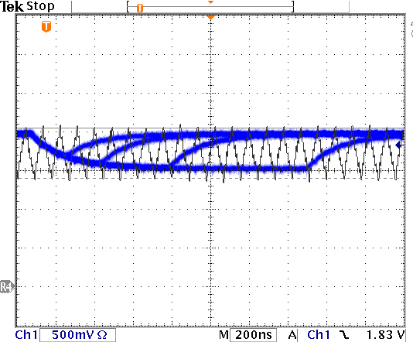
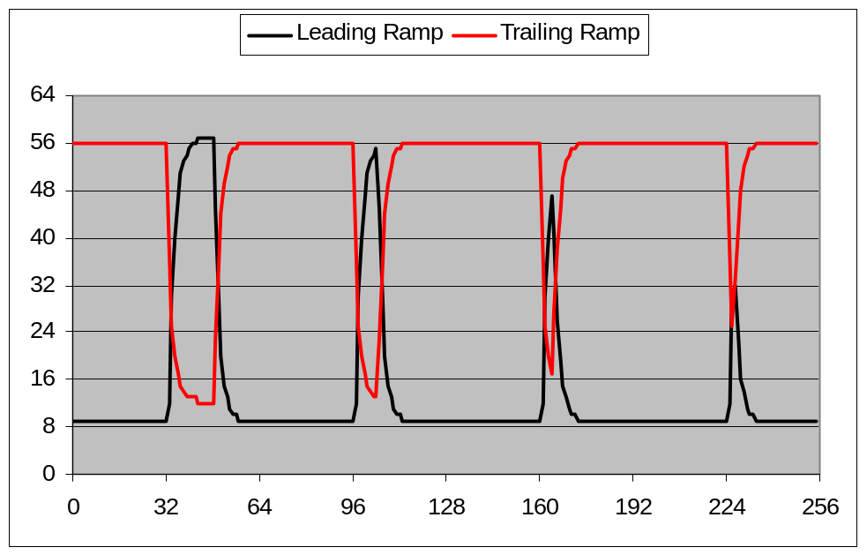
ADC Test: Waveform Digitization on BD3_19
Input Waveform
Converted
Raw Data
Input Waveform, Overlap Trigger

Slide 11
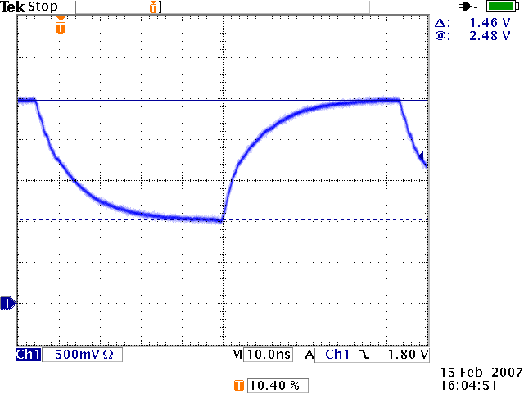
ADC Test: Reference on BD4_22
FPGA
TDC
TDC
V_{REF}
50
50
150pF
τ = 7.5 ns
100
Shorter time constant causes the V-T curve to be exponential.
Sampling rate: 22.5MHz (2/88ns).
Measurement range: 6 bits.
Sensitivity < 6mV/LSB.
Dynamic Range: ~8 bits.

Slide 12
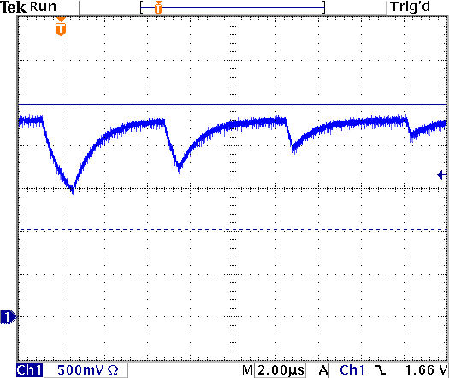
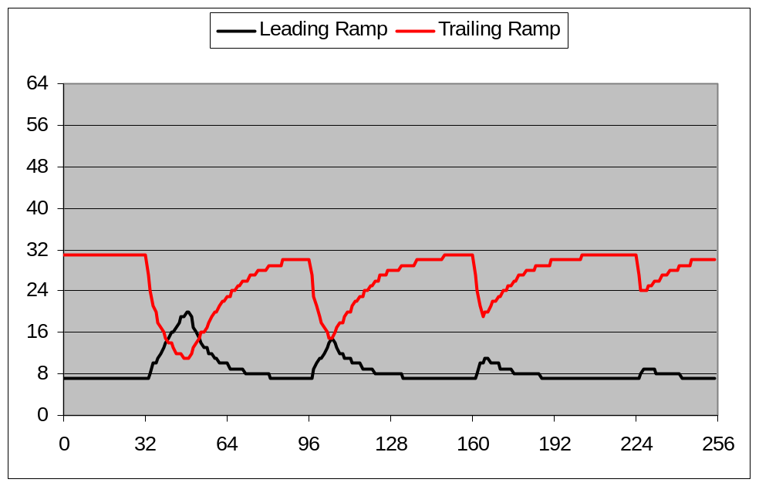
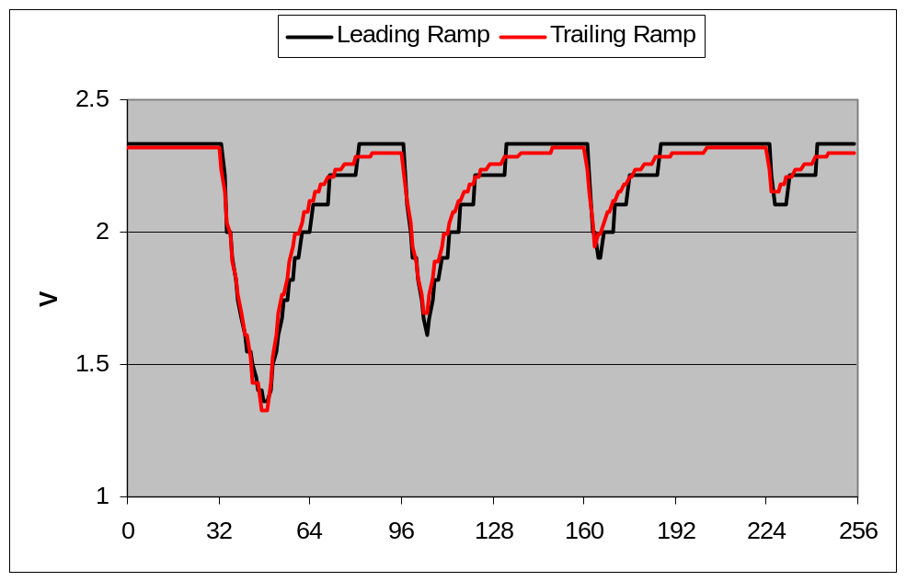
ADC Test: Waveform Digitization on BD4_22
Raw Data
Small pulses are emphasized by the trailing ramp measurement.
Input Waveform
The data measured by trailing ramp is much more smoother than the leading ramp for small pulses.
Converted

Slide 13
ADC Test: Summary
 | Time Constant | Ramping Time & Sampling Rate | Sensitivity | Full Scale Range | Measurement & Dynamic Range
BD4 Discharge | 146 ns | 353 ns > 2MHz | 1.1mV /LSB (@ 0.3V) | .25-2.7V | 9 bits & ~12 bits
BD3_19 | 59 ns | 44 ns 22.5MHz | 10mV /LSB | 1.4-2.05V | 6 bits
BD4_22 | 7.5 ns | 44ns 22.5MHz | <6mV /LSB (@1.02V) | 1.02-2.48V | 6 bits & ~8 bits

Slide 14
Notes
Like in any analog circuits, noise reduction is the key to reach good resolution. Two primary measures are taken:
  Appropriate arrangement of the grounding for analog signals.
  Microprocessor are put in “wait” state during ramping and comparing.
Large noise due to single ended TTL are bad. But small and random noise from differential outputs can be good for “dithering”. This is to be studied.
Being non-linear, the RC exponential charging curve is bad. But it allows expansion of dynamic range, which is good. The conversion to linear scale in FPGA is very simple.

Slide 15
Remarks
The ADC functions tested have met requirements of many applications in high energy physics and accelerator instrumentation.
The FPGA ADC will not completely replace commercial ADC or ASIC. But it is appealing for sake of convenience (like for slow control/monitoring) or for low cost with large channel count (like for straw tube or TPC chambers).

Slide 16
Beyond
The TDC-readout system has excessive capabilities. Don’t hastate to ask more if you need.
TDC: Arrival time + pulse width.
Chamber info in trigger.

Slide 17
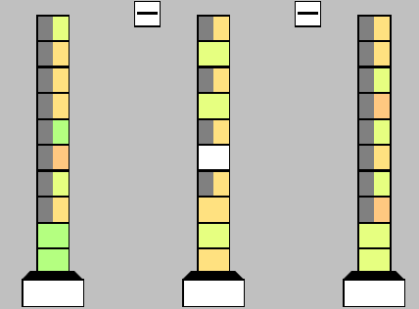
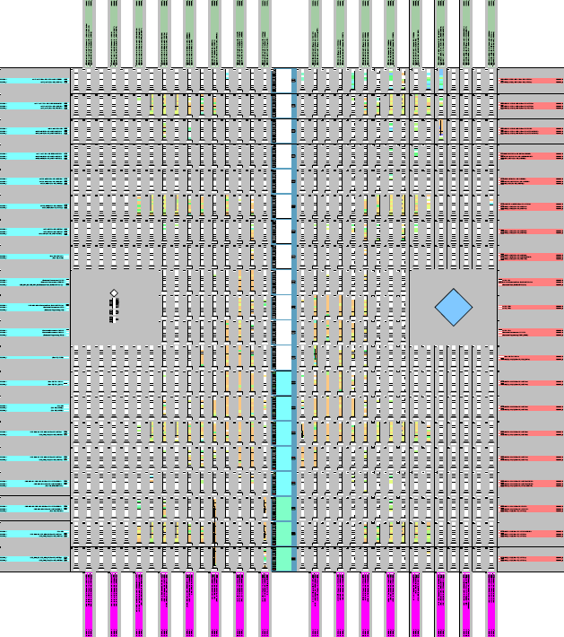
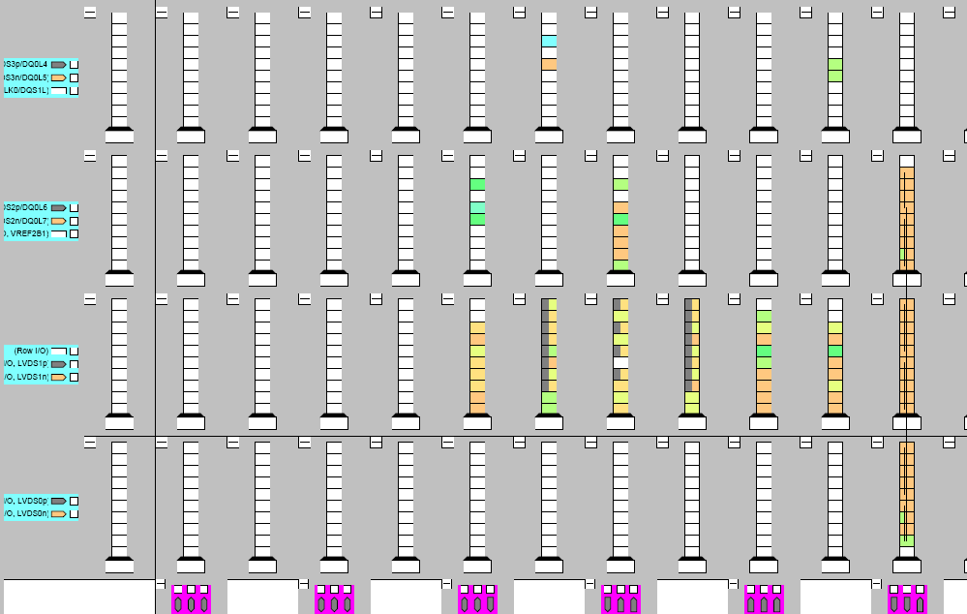
TDC FPGA (32 Ch)
4Ch

Slide 18
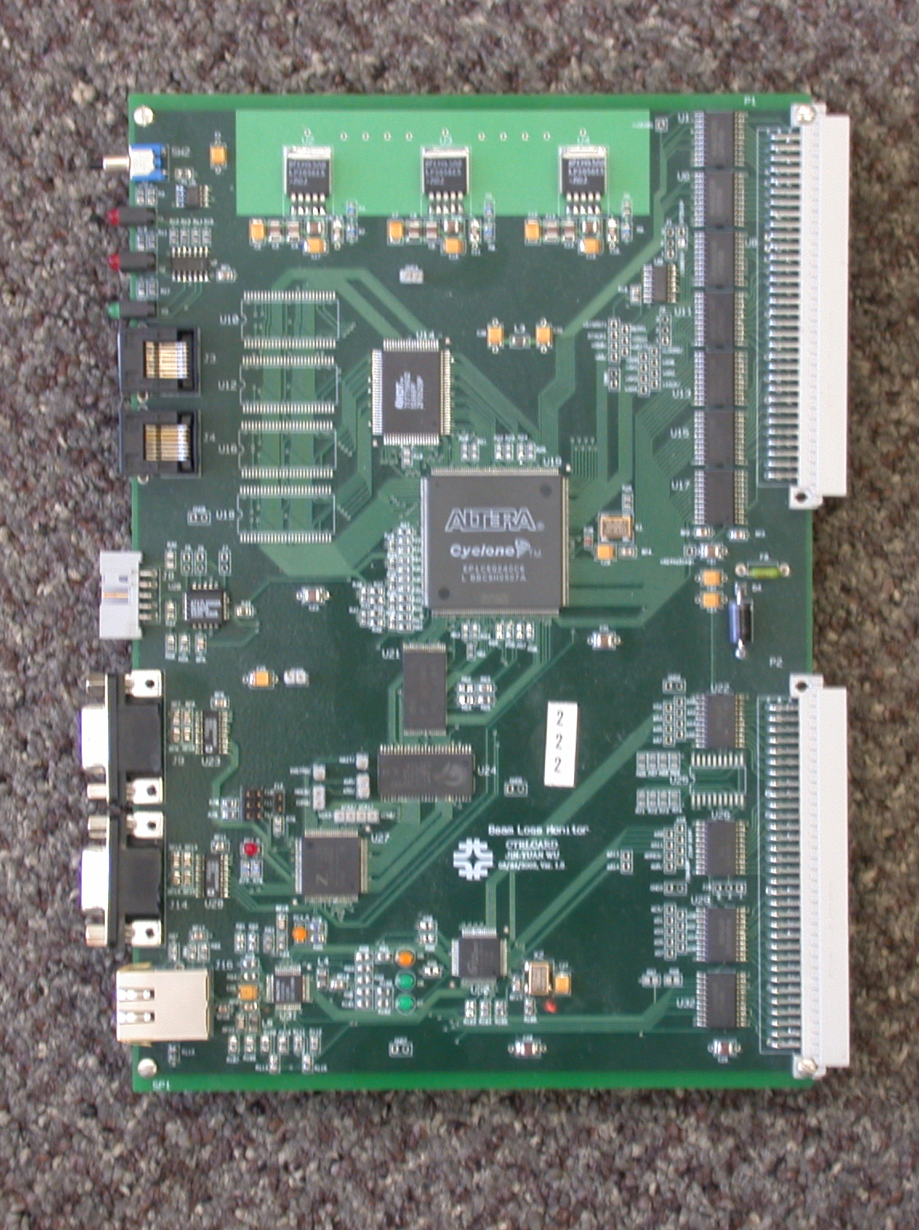
The FPGA TDC Test Card
Shown here is Fermilab Beam Loss Monitor (BLM) Control Card
VME Interface
(As hit input)
FPGA
Serial Port
Microprocessor

Slide 19
TDC-Readout System
AMP Cards
TDC Cards
Readout Cards

Slide 20
Readout
Card
TDC
TDC
TDC
TDC
TDC
TDC
TDC
TDC
CC
DD
SD
SC
RJ45
A
A7
A6
A5
A4
A3
A2
A1
A0
TDC
TDC
TDC
TDC
TDC
TDC
TDC
TDC
CC
DD
SD
SC
RJ45
B
B7
B6
B5
B4
B3
B2
B1
B0

Slide 21
CC = plain 26.5MHz clock most of time.
On start, send marker D0 to reset TS and EV counters.
For L1 trigger, send D1, TS and EV are stored into header.
TS is mod 294 (super bunch?).
Every 294 cycles, send D1 for TS error checking.
The header contains TS and EV so that EV errors can be detected offline.
D0
D1
Error
Detect
TS
Header
CCx1
clr
Decoder
D1
load
EV
CC
inc
D0
clr
CCx4

