Slide 1
Session 3 Exercises

Slide 2
Session 3 Exercises
View the surrogate screen shot of the page of the resource as it appears to you at the time of copy cataloging.
View the selected portion of the existing MARC record as created when the original cataloger viewed a past iteration of the resource
Update that part of the MARC record to reflect the current iteration, and note the data elements of the previous iteration as required or considered important.

Slide 3
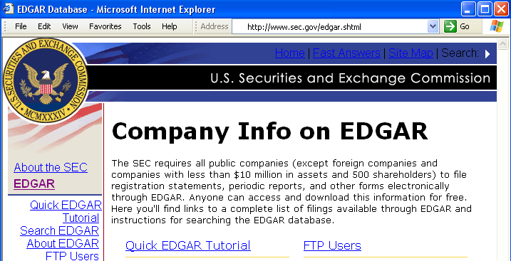
Exercise A. Change in title proper
Resource as it appears when you view it on May 4, 2001:

Slide 4
Exercise A. Change in title proper
Existing record has:
245 00 EDGAR database of corporate information $h [electronic resource].
500 Title from title screen (viewed Nov. 13, 2000).

Slide 5
Exercise A. Change in title proper
Record updated for title change:
245 00 EDGAR database $h [electronic resource].
246 1_ $i Title on home page: $a Company info on EDGAR
247 10 EDGAR database of corporate information $f <Nov. 13, 2000>
500 Title from HTML header (viewed on May 4, 2001).
or:
245 00 Company info on EDGAR $h [electronic resource].
246 1_ $i Title in HTML header: $a EDGAR database
247 10 EDGAR database of corporate information $f <Nov. 13, 2000>
500 Title from home page (viewed on May 4, 2001).
Notes:
When the title proper has changed, the cataloger may also re-assess the source of title proper.
The two possibilities on this slide reflect the two possible choices.
In either case, however, the former title proper is what had been selected by the previous cataloger on Nov. 13, 2000 and had appeared in the 245 $a of the existing record.

Slide 6
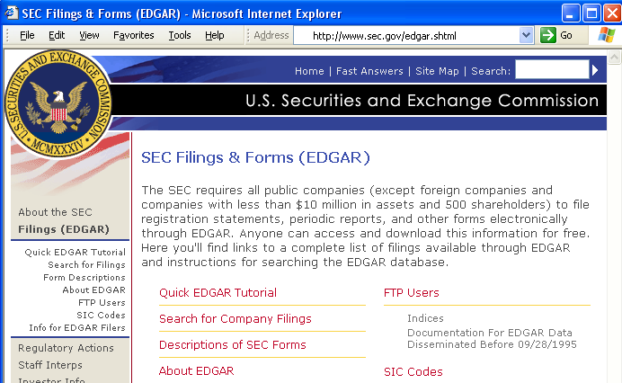
Exercise B. Second change in title proper
Resource as it appears when you view it on January 24, 2002:

Slide 7
Exercise B. Second change in title proper
Existing record has:
245 00 EDGAR database $h [electronic resource].
246 1_ $i Title on home page: $a Company info on EDGAR
247 10 EDGAR database of corporate information $f <Nov. 13, 2000>
500 Title from HTML header (viewed on May 4, 2001).
or:
245 00 Company info on EDGAR $h [electronic resource].
246 1_ $i Title in HTML header: $a EDGAR database
247 10 EDGAR database of corporate information $f <Nov. 13, 2000>
500 Title from home page (viewed on May 4, 2001).
Notes:
These, again, are the two possibilities for title proper that could have been selected in Exercise A. Either could be the new existing record.

Slide 8
Exercise B. Second change in title proper
Record updated for second title change:
245 00 SEC filings & forms (EDGAR) $h [electronic resource].
246 3_ SEC filings and forms
246 3_ Securities and Exchange Commission filings and forms
246 1_ $i Former title on home page: $a Company info on EDGAR
$f <May 4, 2001>
247 10 EDGAR database of corporate information $f <Nov. 13, 2000>
247 10 EDGAR database $f <May 4, 2001>
500 Title from home page (viewed on Dec. 2, 2002).
or:
246 1_ $i Former title in HTML header: $a EDGAR database $f <May 4, 2001>
247 10 Company info on EDGAR $f <May 4, 2001>
Notes:
There are now two 247 fields in the updated record: one for each former title proper.
The second option shows the alternative forms of 246 and 247 if the existing record were the second of the two possibilities shown on the previous screen.
This exercise demonstrates not only how to do two updates for title proper for the same Web site, but also the variations that can occur because different catalogers could quite legitimately make different decisions about title proper vs. variant form of title.
It may also show that there is some artificiality between 246s and 247s for former title for Web sites when there are two or more equally valid possibilities for former and/or current title proper for the site.
But in the end it doesn’t really matter much as long as all the significant variants by which catalog users might search are included in one indexed field or another.

Slide 9
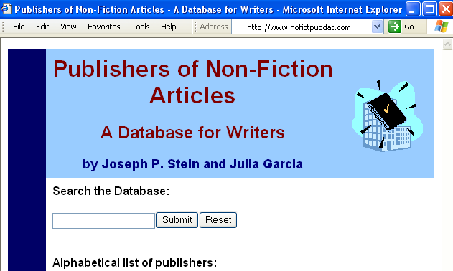
Exercise C. Change in statement of responsibility and main and added entries
Resource as it appears when you view it on December 15, 2002:

Slide 10
Exercise C. Change in statement of responsibility and main and added entries
Existing record has:
100 1_ Morton, Susan E., $d 1955-
245 10 Publishers of non-fiction articles $h [electronic resource] : $b a database for writers / $c by Susan E. Morton and Joseph P. Stein.
500 Title from home page (viewed on Jan. 22, 2001).
700 1_ Stein, Joseph P., $d 1953-

Slide 11
Exercise C. Change in statement of responsibility and main and added entries
Record updated:
100 1_ Stein, Joseph P., $d 1953-
245 10 Publishers of non-fiction articles $h [electronic resource] : $b a database for writers / $c by Joseph P. Stein and Julia Garcia.
500 Title from home page (viewed on Dec. 15, 2002).
500 Co-authored by Susan E. Morton <Jan. 22, 2001>.
700 1_ Garcia, Julia M., $d 1961-
700 1_ Morton, Susan E., $d 1955-
Notes:
The changes:
Different statement of responsibility.
Entails different main entry because new name is given first in the resource. Former added entry moved to main entry.
Note on previous co-author, if considered important for description/identification.
Former main entry moved to added entry if considered important for continued access.

Slide 12
Optional Exercise D. Final iteration of updating loose-leaf
Existing record has:
008 Type: a ELvl: I Srce: d GPub: s Ctrl: Lang: eng
BLvL: i Form: Conf: Freq: a MRec: Ctry: miu
S/L: 2 Orig: EntW: Regl: r Alph:
Desc: a SrTp: l Cont: b DtSt: c Dates: 1989,9999
245 00 Guidelines for typewriting doctoral dissertations.
260 Ann Arbor, MI : $b University of Michigan Press,
$c 1989–
300 v. (loose-leaf) ; $c 26 cm.
310 Updated annually, $b 1997-
321 Updated semiannually, $b 1989-1996
Notes:
INFORMATION [given in Trainee manual]: This loose-leaf resource is now completed; you have the final iteration, Update 22, dated January 2002, which consists of two volumes that are both 28 cm. high. Presume that the beginning date of publication in the catalog record was based on the first iteration of the loose-leaf.
[A note printed on the this final iteration says that a new loose-leaf publication, to be titled “Guidelines for word-processing doctoral dissertations,” will be forthcoming to replace this now defunct publication.]

Slide 13
Optional Exercise D. Final iteration of updating loose-leaf
Record updated:
008 Type: a ELvl: I Srce: d GPub: s Ctrl: Lang: eng
BLvL: i Form: Conf: Freq: a MRec: Ctry: miu
S/L: 2 Orig: EntW: Regl: r Alph:
Desc: a SrTp: l Cont: b DtSt: d Dates: 1989,2002
245 00 Guidelines for typewriting doctoral dissertations.
260 Ann Arbor, MI : $b University of Michigan Press,
$c 1989–2002.
300 2 v. (loose-leaf) ; $c 28 cm.
310 Updated annually, $b 1997-2002
321 Updated semiannually, $b 1989-1996
Notes:
The changes:
The record is “closed off”
Ending dates of publication are entered in 260 $c (because you have the final iteration) and 008 Dates fields.
The number of volumes is entered in 300 $a
The dimensions are changed to reflect the latest iteration.
The range of dates applying to the last frequency of updates may be added.

