Slide 1
Exploring Mars
.
Part 1
Beginnings
        Mr. K. NASA/GRC/LTP
        Edited: Ruth Petersen
Notes:
The series, “Exploring Mars,” is a six-part series that begins in human antiquity then advances through the ages to the 20th century and the remarkable discoveries made since the advent of space travel. Included in the six lessons is information about the planet and its explorers, human and robotic, past, present, and future. There is, occasionally, special focus on the Pathfinder Mission (landed July 4, 1997), in which I played a role as participating scientist.

Slide 2

Preliminary Activities
Use a dictionary to look up Mars and March. Use the word etymologies to find a connection between these two words. Also, look up September, October, November, and December. What does this information tell you about our calendar?
Etymology: That part of a definition that gives word roots and histories.
Notes:
Word etymologies are found in most dictionaries. They give the origins and historical development of words. The study of word etymologies can be fun and enlightening, often turning up the most unexpected results. For example: the month names shown above derive from the Latin “septem” (seven), “octa” (eight), “novem” (nine), and “decem” (ten), yet these numbers do not correspond to the positions of the respective months on the modern calendar. You are challenged to find out why, and, from such a simple beginning, encouraged to do a little study on the history of the calendar. I did such a study years ago and acquired enough information to develop an entire lecture on the topic!

Slide 3
2. Look up Giovanni Schiaparelli and Percival Lowell in an encyclopedia or on the Internet (use keywords Schiaparelli, +Lowell+Mars.) What role did these individuals play in Mars exploration?
3. Look up the Mariner, Viking, and Pathfinder missions to Mars on the Internet (web references are given at the end of this lesson) When did they occur? What did they accomplish?
4. What about life on Mars? Is there any known? If not, what do you think?
Notes:
Schiaparelli and Lowell were pivotal figures in the history of modern Martian astronomy, one for his solid approach to his subject as a science, the other for his imaginative flights that laid the groundwork for much good science fiction and a lasting popular interest in Mars. You are encouraged to find the human face behind the science. This face is often completely lost in the mystifying language and lengthy technical developments encountered in technical papers. Science is, first and foremost, a human enterprise. The student who does not have and/or take the opportunity to see this aspect of science specifically is missing a great deal.
The Mariner and Viking missions to Mars were the first of their kind in human history. You are encouraged to see these missions as major landmarks in the advancement of science (in general) and human exploration of Mars (in particular).
While Viking was equipped to search for life on Mars, the presence or absence of life remains undetermined. Recent discoveries tend to encourage positive thinking about the reality of past Martian life. Whether Mars is alive today remains to be seen, if not by robotic landers and rovers, then by the humans who will surely set foot on the Red Planet one day.

Slide 4
  Activity 1:
Let’s begin by describing the role that Mars plays in our calendar . . .
.
Who wants to begin?
Notes:
The people of ancient civilizations did not understand the sky as we do. For them, the Earth was a stationary platform in the ‘center’ of the universe. The sky and all other things revolved around the Earth, more specifically, around humankind. The sky was a heavenly realm, unchanging, an abode of gods and legendary figures. Ares (Greek) or Mars (Roman), the fearsome god of war, reigned among these gods. So vital was Mars’ goodwill that the ancient Romans actually started their calendar with a month of ‘Mars,’ our ‘March.’ (Check the etymology of the word March). It was only later, when the calendar underwent its first major reform (Julius Caesar, 46 B.C.), that Mars (March) moved to the position it now occupies, and September (and all the rest) moved along with it. Because of a lack of precise knowledge of the length of the tropical year (365.2422 days), calendar reform was necessary at various times in Western history.

Slide 5
Ancient Roman Calendar Months
March (Mars)
.
.
.
Septem (7)
Octa (8)
Novem (9)
Decem (10)
Notes:
Here is a cartoon showing the framework of the ancient Roman calendar. The ancient Romans took the tropical year to be exactly 365 days long. Their calendar was not very accurate, slipping out of synch with times and seasons by more than 24 days per century. Julius Caesar, out of necessity, reformed the calendar (with the help of Egyptian astronomers) using a tropical year of 365.25 days. This new calendar introduced the ‘leap year’ and was accurate to about one day in every 128 years. It took much longer for the Julian calendar noticeably to slip, but slip it did, requiring the Gregorian reform late in the 16th century. The tropical year used by Pope Gregory is close to 365.2425 days. The Gregorian calendar, which is the one in use today, is accurate to one day in over 3,000 years.

Slide 6
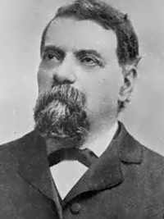
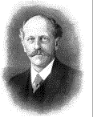
  Activity 2:
Giovanni Schiaparelli
(1835 - 1910)
.
Percival Lowell
(1855 - 1916)
Notes:
After Galileo introduced the telescope in Venice in the 17th century, its use as an astronomical instrument spread across Europe, and astronomy made remarkable advances. In the 19th century, among many varied discoveries, the planet Mars came into prominence as having two moons (A. Hall) and a surface marked by dark, linear features (G. Schiaparelli). A poor literary translation of Schiaparelli’s Italian ‘canali’ to the English ‘canals’ rather than to ‘linear features’ lead the American, P. Lowell, to conclude that Mars must be inhabited by a race of highly intelligent beings who were desperately trying to save their dying world. He believed the Mars beings were building a massive irrigation system to move water from the Martian poles to the mid and equatorial regions where, according to Lowell, there were great metropolitan areas succumbing to advancing Martian deserts. Lowell went on to build an observatory near Flagstaff, Arizona, to observe Mars, and to write about its inhabitants in ever greater detail for the rest of his life. Lowell’s conclusions were flawed, of course, but his florid style and vivid imagination have added much to our 20th century heritage of science fiction and lasting pubic enthusiasm about Mars.

Slide 7
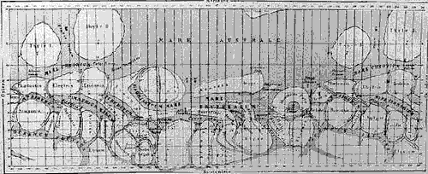
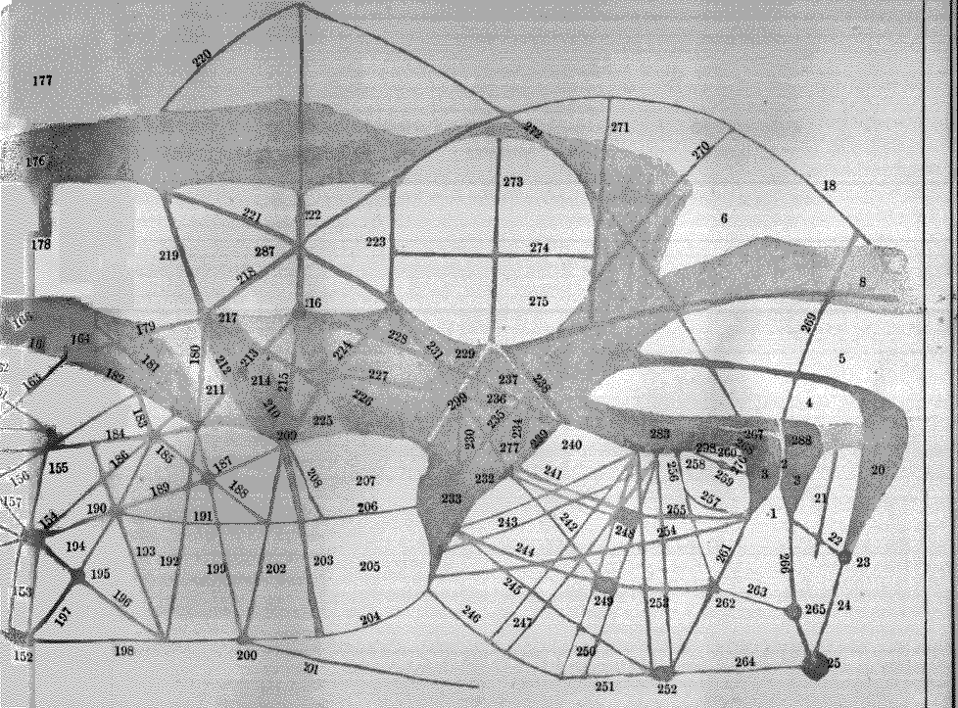
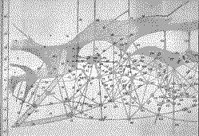
Schiaparelli
Two Maps of Mars
Lowell
Notes:
Here are two maps of the Martian surface, one drawn by Schiaparelli, the other by Lowell. You can easily see the similarities in linear perspective between the two!

Slide 8
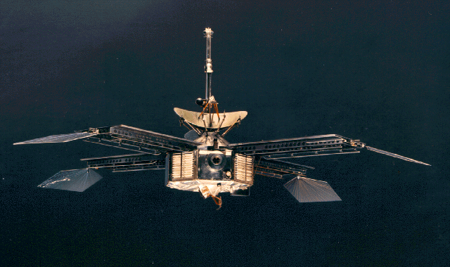
  Activity 3:
        MARINER
Notes:
The Mariner missions to Mars provided humanity with its first detailed surface images of the Red Planet. While the cratered landscapes initially discovered were already familiar enough from having seen similar features on the moon, Mariner went on to discern many other features, the likes of which might never have been anticipated without an actual presence at Mars. These features included the Mariner’s Valley, greater than 10 times the length of our own Grand Canyon and more than 3 times its depth, and the Tarsus volcanoes, which dwarf the largest mountains on Earth. Mount Olympus, the largest of the Tarsus volcanoes, in fact the largest volcano in the solar system, is more than 3 times the height of Mount Everest with a base that would more than cover the entire state of Arizona. The Mariner missions to Mars flew in 1964 (Mariner 4, flyby) and 1971 (Mariner 9, orbiter).

Slide 9

Mariner Photo Showing Craters on Mars
Notes:
Mariner’s discovery of craters on Mars was only the beginning of an exciting series of Martian discoveries that continues even to the present day!

Slide 10
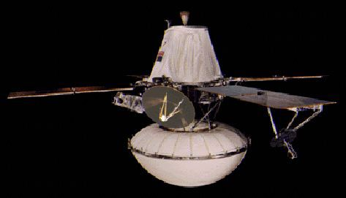
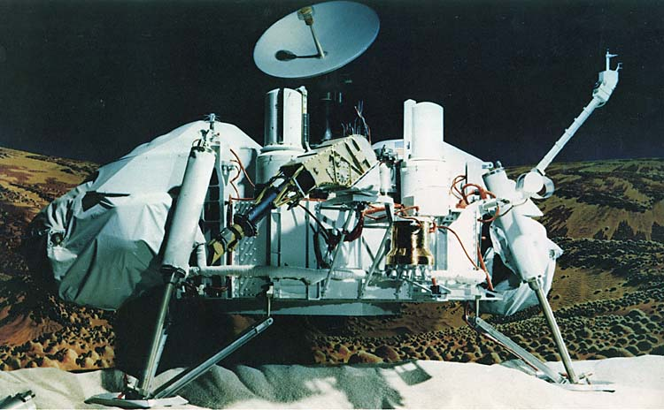
        VIKING
Notes:
The Viking missions to Mars carried Martian exploration further by providing more detailed orbital reconnaissance of Mars, along with two surface landers. The landers were equipped to analyze Martian surface material that was obtained via mechanical scoops for the presence of living organisms. But peculiarities of Martian surface chemistry left the results shrouded in doubt. Most scientists today agree that Viking found no evidence of life, but they also point out that this lack does not imply the absence of life on Mars, only the inadequacy of Viking’s onboard experiments. The Viking missions (two orbiters and two landers) flew in 1975.

Slide 11
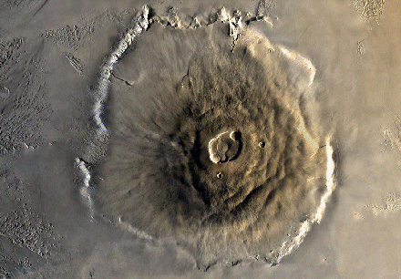
ORBITER VIEW
Notes:
The greatest volcano in the solar system, Mount Olympus (formerly Olympus Mons) looms below the spacecraft in this vertical view of the Tarsus region, looking down into the volcano. Its summit stands clear of the appreciable Martian atmosphere.
Mount Olympus is now believed to be dormant. When active, it must have been nothing short of spectacular. It is a shield volcano, and volcanologists have compared it to the shield volcanoes in Hawaii and the Line Islands in the Pacific Ocean on Earth. Its diameter exceeds 300 miles; its summit height exceeds 17 miles. The vertical cliffs at the edge of the shield may be more than a mile in height.

Slide 12
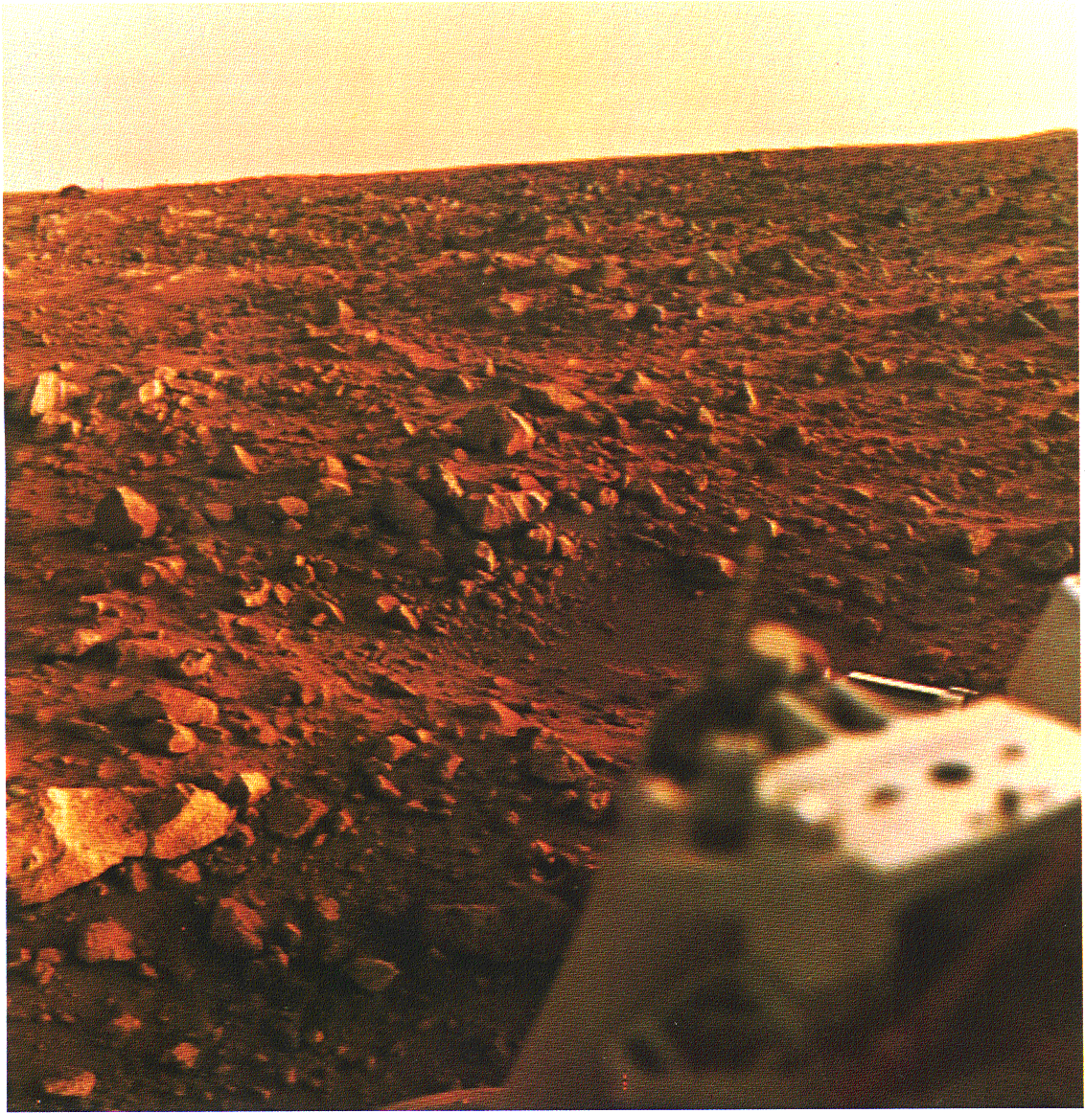
LANDER VIEW
Notes:
The landscape seen by the Viking landers was variable on a sol-to-sol* basis, and over the succession of Martian seasons. In this view, the sun is low in the sky casting shadows behind the rocks that are strewn everywhere across the plane. The sky is colored by airborne dust particles that are finer than talcum powder and lofted by thin, cold Martian winds. At various times throughout the Martian year, fierce dust storms arise filling the atmosphere with considerably more material than is evident in the photograph. It is my opinion that tribo-electrostatic (caused by friction between two objects) charging of the Martian dust occurs during such storms, and that this charging might provide a basis for Martian lightning, although actual lightning on Mars has not yet been seen.
Occasionally, ground frosts were recorded by the Viking lander cameras, substantiating the fact that Mars still has water, though sparse. Ice crystal clouds were also recorded on occasion.
* A sol on Mars is the Martian equivalent of a day on Earth.

Slide 13
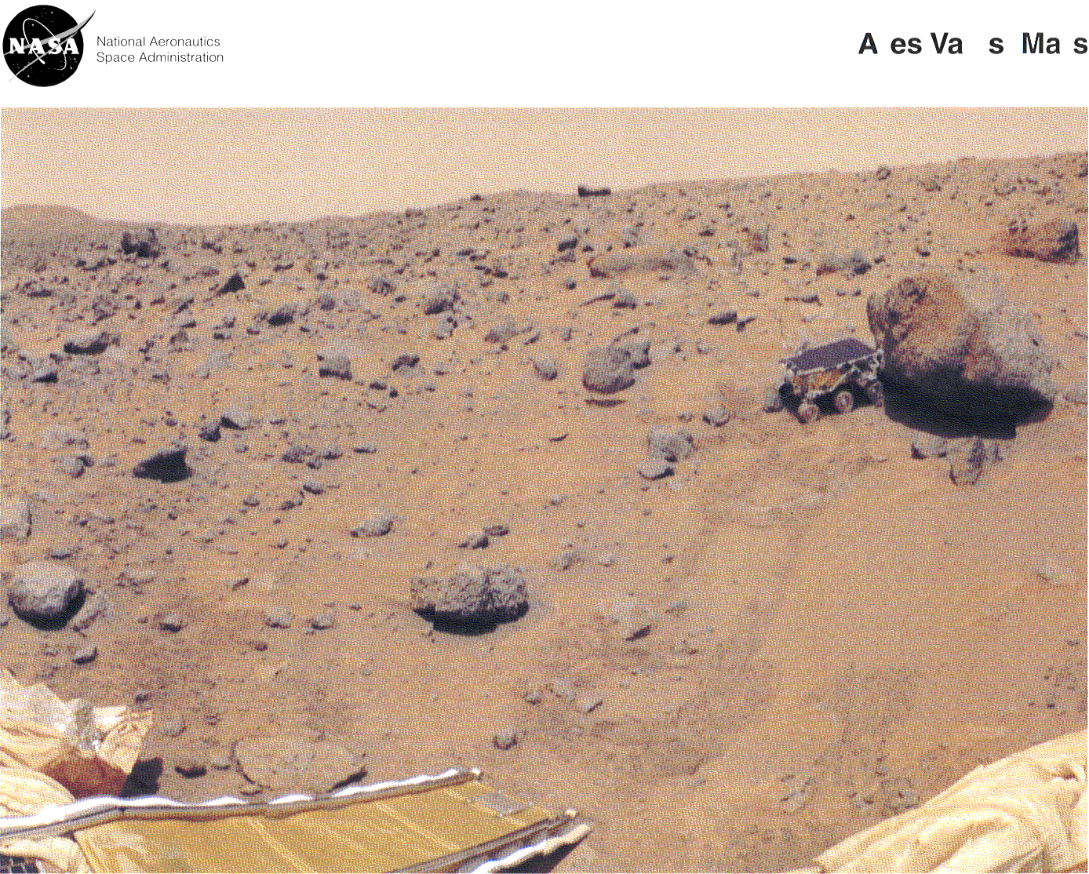
PATHFINDER
Notes:
Approximately 20 years after Viking, the Pathfinder spacecraft and rover ‘dropped in’ out of the Martian night sky. Another first-of-a-kind mission, Pathfinder employed innovative thinking, from its method of landing, through the ingenious little surface rover, “Sojourner Truth,” which affectionately become known among the Pathfinder team members as, “Our little geologist on Mars [H. Moore].” Pathfinder landed near the Martian equator in an out-wash region rich in geology, both local and not-so-local, due to the transport of material in the water of a disastrous flood ages ago. Pathfinder returned a wealth of geological data, meteorological data, magnetic data, dust wear and atmospheric dust settling data, over 16,000 photographs, and the first real evidence of electrostatic charging phenomena associated with dry, cold surface dust. Many of the results obtained from the Pathfinder are being used to plan future robotic missions to Mars in preparation for an eventual human landing.

Slide 14
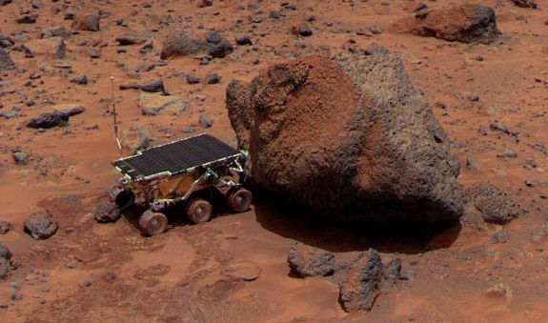
Evidence of electrostatic charging?
“Our little geologist on Mars…”
The late Dr. Henry ( “Hank” ) Moore
Notes:
In Memoriam: Dr. Henry (Hank) Moore (1928-1998), Viking geologist, Pathfinder geologist, our team leader.
Rarely in life does one have the opportunity to meet a great man. We are all enriched by having known you, Dr. Moore. Thank you.

Slide 15
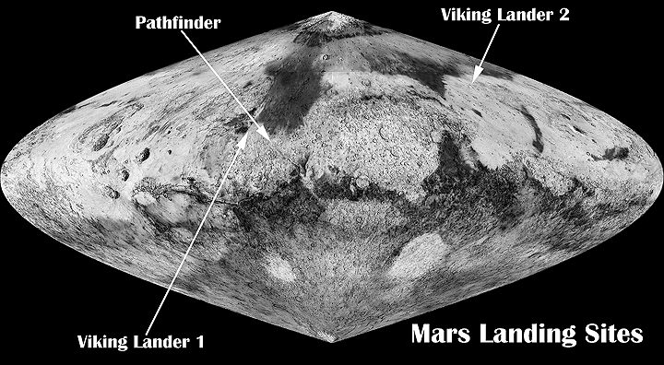
Can you find the Mariner’s Valley?
Olympus Mons
Mariner’s Valley
Can you find Olympus Mons?
Notes:
Mars’ Tarsus Region, showing Mount Olympus, the Mariner’s Valley, and three other major dormant volcanoes (east of Mount Olympus, west of the Mariner’s Valley). The Pathfinder spacecraft and rover landed northeast of the Valley’s easternmost end.

Slide 16
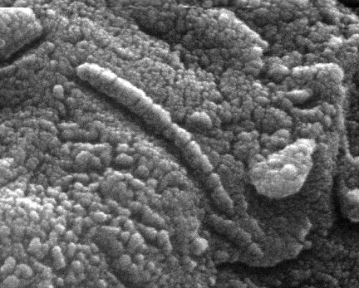
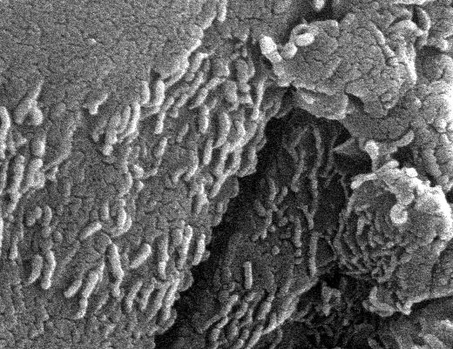
  Activity 4:
Biological?
or
Mineralogical?
How can we find out?
Notes:
Martian rocks have been found on Earth, perhaps thrown clear of the planet in past disastrous events, such as the one that may have formed the Tarsus region. The rock in which the features shown above were discovered (D. McKay, NASA/JSC, circa 1996) was retrieved from Allen Hills, Antarctica, in 1984. The small, elongated objects may be fossil nano-bacteria, similar to those found in the oldest rocks on Earth. If so, then they represent the first Martians seen by human eyes!
A considerable amount of evidence has been gathered from this specimen to strongly suggest a biological origin. However, it is also arguable that biology played no role in their formation and that the features are merely the result of ‘ordinary’ geological/mineralogical processes. Since the rock was heated on its brief but rapid (in the order of 30,000 mph) flight through the Earth’s atmosphere before coming to rest in the Antarctic ice, scientists will have to await the return of pristine rock samples from the Martian surface to make a final determination.

Slide 17
Is there life on Mars?
  How much water is there today?
      Was there ever a magnetic field?
        Are there crustal plates?
???
.
There are many unanswered questions...
Notes:
The questions above remain unanswered at the time of this writing. The story of Mars’ exploration is still unfinished, progressing with its elements of human success and human failure. You are challenged to think about how these questions might be answered, and the role that you might play in doing so. Professionally, the field is wide open. Before it is finished, the exploration and eventual colonization of Mars will involve every type of human endeavor known, from science and engineering to medicine and law and philosophy …
Our future in space is ours to write.

Slide 18
Follow-Up Activities
1. Why do we explore? Why should we explore? Why Mars?
2. How would you answer the questions on the previous chart?
3. What other questions do you most want answered about Mars?
4. Design a mission (or missions) to get the answers to some of these questions!
5. Is it easier to explore by sending robots or by sending people? Why?

Slide 19
Web Sites for Further Exploration
http://www.grc.nasa.gov/WWW/PAO/html/marspath.htm
http://marsnt3.jpl.nasa.gov
http://antwrp.gsfc.nasa.gov/
http://nssdc.gsfc.nasa.gov/
http://mars.sdsc.edu/mgs/index.html
Web Site for Lowell’s Book “Mars”
http://www.bibliomania.com/NonFiction/
Lowell/Mars/index.html

Slide 20
joseph.c.kolecki@grc.nasa.gov
Notes:
Feel free to contact me at the above address!

