Slide 1

Science and Science Fiction
Robert Scherrer
Department of Physics and Astronomy
Vanderbilt University

Slide 2
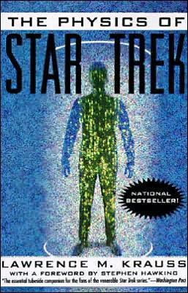

Slide 3
How are ideas used and presented in science (theoretical physics) and science fiction?
The “ground rules” for introducing unproven ideas
The predictive power of science fiction vs. science
How are ideas presented?
Should scientists try to write science fiction?

Slide 4
Both SF writing and theoretical physics are a form of “disciplined daydreaming.” Both involve the development of new ideas, but within tightly-constrained boundaries.

Slide 5
Types of Theoretical Physics
Data analysis
Comparison of models with data
Model building
“What if?”
The last of these is closest to the process of doing science fiction.

Slide 6
What if the speed of light is constant in all frames of reference?
What if the energies in a blackbody gas can be only discrete multiples of the frequency?
What if the universe entered a phase of exponential expansion at early times?

Slide 7
A New Idea in Theoretical Physics
Must be consistent with known experimental results
Should fit into the pre-existing theoretical framework of physics (even quantum mechanics and relativity)
But, must go beyond what is already known/proposed

Slide 8
Trying to hit the “sweet spot”
CRAZY
EXCITING
BORING

Slide 9
Can only invoke the Tooth Fairy Once
This places a limit on the progress of physics – theory cannot get very far ahead of experimental data. Invoke multiple tooth fairies, and no one will believe you, even if you are correct!
Example: 19th century explanation of the source of the sun’s power
But we have a modern counterexample, which will be interesting to watch to see how it turns out in the end.
STRING THEORY

Slide 10
Much (but not all) of Science Fiction also uses the “What If” model.
What if our evolution had been guided by superior beings? (2001 A Space Odyssey, Arthur C. Clarke)
What if all living things on the planet suddenly experienced increased intelligence? (Brainwave, Poul Anderson)
What if dreams could change reality? (The Lathe of Heaven, Ursula K. Le Guin)

Slide 11
Science fiction, while obviously open to more speculative ideas than is theoretical physics, operates under similar constraints.
New ideas must be plausible, even if they are not rigorously scientific (must “sound like” science)
Only naturalistic explanations are acceptable
New ideas should be rationalized in some scientific way, but detailed explanation will slow down the story
However, some very implausible ideas have become part of the “fabric” of SF, to the extent they no longer require justification (time travel, faster-than-light travel)
Many of the strongest stories/novels invoke the tooth fairy only once

Slide 12
Even fantasy literature operates under a
(much looser) set of constraints
While supernatural events are allowed,
and no explanations/apologies are required,
normal rules of logic, and psychological
consistency, still apply. The train of events
must be coherent, and the characters must
display understandable motivations. The latter
is often more restrictive in fantasy
than in science fiction. (This was not always
the case – see the 19th century, Gogol,
Hoffmann, for “dream-like” fantasy).

Slide 13
A series of types of fiction, with
progressively fewer constraints
FANTASY
SCIENCE FICTION
MAINSTREAM
FICTION

Slide 14
The essential characteristic of new ideas in
physics is their predictive character.
Is science fiction similarly predictive?

Slide 15
Successful predictions
Jules Verne (1865): Americans launch the first moon rocket, with a three-man crew, from a point in Florida
Numerous authors (1930’s-1940’s): Nuclear power
Cleve Cartmill (1944): Atomic bomb (Astounding offices visited by U.S. security)
Arthur C. Clarke (1945): Communications satellites (but this was non-fiction)
Irwin Allen (1966)

Slide 16
On the other hand….
Nuclear power: electricity too cheap to meter
Long distance phone calls too cheap to meter
Everyone connected to a large central computer
Everyone with a desk-top computer
Everyone connected to a large distributed computer
The Social Security bomb
The population bomb
Robots as cooks and maids
Robots as auto workers

Slide 17
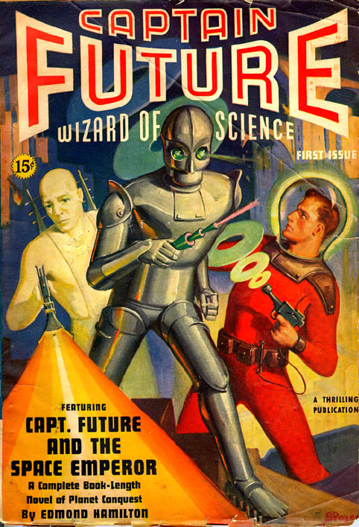
Other yesterday’s tomorrows that never arrived
Colonization of the solar system
Contact with extraterrestrial life
Personal autogyros/helicopters/ rocket packs/airplanes
Death rays

Slide 18


Slide 19
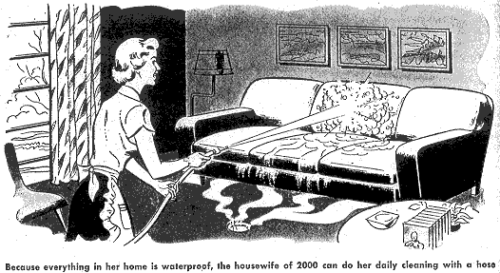
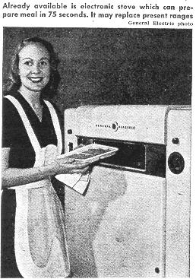
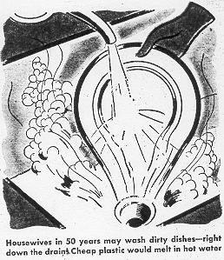

Slide 20
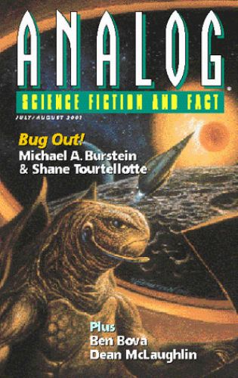
Sometimes it’s better when
SF predictions don’t come true
The Chtarri Institute huddled among the remains of a defunct particle accelerator out in the western suburbs. Long prairie grass had reclaimed most of the lab, although I could make out the circular scar of the accelerator ring on a slight plateau next to the road. The Institute occupied the central high-rise building, a curved, concrete monolith looming above the Illinois plains like a modern Stonehenge.
“Happy Deathday”, Analog, Jul/Aug 2001

Slide 21
Science fiction is NOT predictive, nor
does it pretend to be. The function of
science fiction is to provide interesting
stories – to entertain. Ideas are important
insofar as they serve this purpose.
Although science fiction has been called
“The Literature of Ideas”, ideas are in
fact secondary to this primary purpose.

Slide 22
Physics class joke: if you come up with an idea on unifying quantum mechanics and general relativity, let me know – I’ll help you write it up.
Science fiction joke: I have this great idea. Why don’t you write a story about it and we’ll share the credit.
Science: Idea is everything; development is secondary, and writing/presentation is tertiary
Science Fiction: Writing/presentation is primary; idea is secondary

Slide 23
The exposition of a new idea does NOT make a science fiction story.
Need characters/plot/something to keep the reader interested. Idea by itself is almost always insufficient to maintain interest.
“Need to predict not the car, but the traffic jam” – in reality neither is sufficient to make a story.

Slide 24
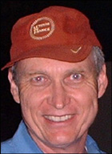
Another limit to the predictive power of science fiction:
The NSF Effect

Slide 25
How are ideas presented?
In science, very straightforward:
Discuss background and motivation for the project
Discuss previous work (especially the author’s)
Present results
Summarize conclusions
Abstract at the beginning

Slide 26
In science fiction, it’s not so simple…

Slide 27
s
Joe Waltham burst into the ship’s control room. Klaxons wailed, and the neutrino gauges flickered wildly. “Bill,” he shouted, “the solar neutrino detectors have gone crazy.”
The sun produces neutrinos in the course of its fusion reactions. Two protons bind to form deuterium, producing a positron and an electron neutrino. The electron neutrino can escape from the sun’s core.
Bill rushed over to check the detector feeds. “I don’t see anything wrong at this end.”
INFODUMP

Slide 28
s
Joe Waltham burst into the ship’s control room. Klaxons wailed, and the neutrino gauges flickered wildly. “Bill,” he shouted, “the solar neutrino detectors have gone crazy.”
Bill rushed over to check the detector feeds. “I don’t see anything wrong at this end.” He turned to Joe. “As you know, Joe, the sun produces neutrinos in the course of its fusion reactions.”
“Yes,” said Joe, “I know that.”
“And you also know that two protons bind to form deuterium, producing a positron and an electron neutrino.”
Joe nodded. “Yes, I know that too. But why are you telling me all of these things that I already know?”
As you know, Bob

Slide 29
Exposition is tricky. Need to introduce new information without interrupting the flow of the story. Usually done in bits and pieces, with an occasional expository chunk.

Slide 30

Jimmy Dyson pushed his bicycle through the sun-baked field behind Benny Krauss’s house, spraying clouds of dandelion seeds into the air and jostling the precious cargo in the basket mounted on the handlebars. Withered thistles caught on the scratchy wool socks his mom always made him wear, even in the St. Louis summer.
“Benny, it came yesterday!” Jimmy shouted, lifting a brick-red box from the basket and waving it in the air. “It has Bob Gibson on the cover!”
“Extra Innings,” Analog, Nov. 2004

Slide 31
In science fiction (especially) it is important to establish setting and characters at the very beginning of the story, because the choices are so large: are we on Earth, or the moon, or some other planet? Is it the present day, the near future, or the far future. Is our protagonist human, or a slimy multi-tentacled creature?
But this has to be done without interrupting the flow of the story.

Slide 32
“So Ben, what have you been up to?” asked Jim, bouncing three-year old Evan on his knee, while Laura cleared the dishes from the dinner table. “We haven’t seen you in, how long, two years?”
“Been pretty busy at work,” said Ben, settling into a frayed armchair. “It took a long time to set up the Neuro-AI Institute, and I’ve got to write grant proposals every year just to keep it going. MIT loves us, but they don’t give us much money.”

Slide 33
Jim Dyson dragged himself up the hospital steps, wheezing and stopping every three steps to catch his breath. Each time he put weight on his left leg, his knee burned like someone had driven a hot knife under the knee-cap. At least the knee pain took his mind off of his constant backache. What was the point of living to 94 if you felt like death warmed over? But damned if he was going to discarnate until Laura did.
You don’t always want to explain everything immediately.

Slide 34
My deathday is July 18th. I spent it this year as I have
every year for the past ten: at home in bed, with my wife
nearby. I can’t afford a private doctor, and I’ve heard too
many iatrogenic horror stories to check into the hospital for
the day. So I just lay quietly, imagining all of the different ways
it could happen. A sudden squeezing pain in my chest? Or
maybe a jackhammer headache, announcing a burst blood
vessel in my brain.
“Happy Deathday”, Analog, Jul/Aug 2001

Slide 35
In science fiction, must strike a balance between giving too much information up front (BORING) and too little (INCOMPREHENSIBLE)
In science, ALL the information goes up front (in the abstract). All terms are defined as soon as they are introduced (or should be).
BORING is OK, INCOMPREHENSIBLE is not.
But both types of writing have one goal in common:
READ ME!

Slide 36
Writing Styles
In Science writing:
Passive voice
Qualify everything
Numerous parenthetical clauses
Compound nouns (a relic of German?)
In science fiction:
Avoid passive constructions at all costs
Emphasize vivid verbs/adjectives; avoid adverbs

Slide 37
Jimmy Dyson pushed his bicycle through the sun-baked field behind Benny Krauss’s house, spraying clouds of dandelion seeds into the air and jostling the precious cargo in the basket mounted on the handlebars. Withered thistles caught on the scratchy wool socks his mom always made him wear, even in the St. Louis summer.
A bicycle was pushed by Jimmy Dyson through the sun-baked-Benny-Krauss-house field. Thus, dandelion seeds were dispersed into the air, and the cargo in the handlebar- mounted basket was somewhat jostled. Thistles (fairly withered: see discussion in Part II, below) were caught on Dyson’s socks. This story takes place in St. Louis, in the summer.

Slide 38
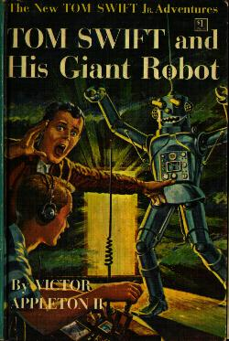
Preferred writing styles can change
Tom Swifties

Slide 39
“Then go ahead, you absurd feathered
fool!” grumbled the King…
“Don’t go, Billina,” said Dorothy, earnestly. “It isn’t easy to guess those orn’ments, and only luck saved me from being one myself. Stay with me and we’ll go back to the Land of Ev together….”
“Indeed I will,” said Evring, with much dignity.
“Don’t worry, my dear,” cried Billina, with a cluck that was meant for a laugh. “I may not be human, but I’m no fool, if I AM a chicken.”
“Oh, Billina!” said Dorothy, “you haven’t been a chicken in a long time. Not since you—you’ve been—grown up.”
“Perhaps that’s true,” answered Billina, thoughtfully.
Ozma of Oz, L. Frank Baum (1907)

Slide 40
Do Scientists have an advantage in writing Science Fiction?
Science Fiction authors with a science background:
Isaac Asimov, Ph.D. in Chemistry
Robert Heinlein, graduate work in physics
Arthur C. Clarke, B.Sc. Physics and Math
Larry Niven, B.A. in Math
Michael Crichton, M.D.
Scientists who have dabbled in science fiction:
John Cramer, U. Washington
Don Clayton, Clemson
Craig Wheeler, U. Texas

Slide 41
Very few active research scientists have contributed significantly to Science Fiction
Fred Hoyle, “Nobel-class” scientist, author of 10 influential SF novels
Gregory Benford, (U.C. Irvine plasma
physics)

Slide 42
Do Scientists have an advantage in writing Science Fiction?
Yes, but not the advantages everyone thinks.
Difficulties:
It is actually HARDER to write about your own area of research, because you apply very high standards on what is “plausible”. Easier to speculate about things you know less about.
Writing styles of science and science fiction are diametrically opposed: need to fight your natural writing tendencies.

Slide 43
But there are advantages…
A mundane, but important advantage: basic writing skills.
Scientists have mastered the skills of extrapolating new ideas from known facts.
Can be more realistic in writing about the process of doing science (if that’s what the story is about) [e.g., scientists give “talks”, not “speeches”]

Slide 44
Should you try it?
SF short story market is one of the few
(perhaps only) outlet that still accepts, reads,
and publishes unsolicited manuscripts.
One last difference: credentials and previous
performance count for very little – you’re only as
good as your last performance….

Slide 45
Conclusions
Both theoretical physics and science fiction involve the development of new ideas within well-established constraints
Science fiction is not predictive
New ideas are central to theoretical physics; they are only of secondary importance in science fiction
Writing styles of science and science fiction are diametrically opposed
Scientists have an advantage in writing science fiction, but not the one everyone assumes

