Slide 1

Kindergarten Cohort
Chris Chapman
National Center for Education Statistics
Institute of Education Sciences
IES Research Conference
June 2006

Slide 2
Agency Collaborators
U.S. Department of Education
Office of Special Education and Rehabilitation Services
Planning and Evaluation Service
Office of English Language Acquisition, Language Enhancement, and Academic Achievement for Limited English Proficient Students
U.S. Department of Agriculture
Economic Research Service
U.S. Department of Health and Human Services
National Institute for Child Health and Human Development
Administration for Children, Youth and Families

Slide 3
Major Areas of Interest
School readiness
Transition to kindergarten, first grade, and beyond
Relationship between kindergarten experience and later school performance
Growth in cognitive and non-cognitive domains

Slide 4
Study Design
Base year sample included more than 21,000 children and families attending more than 1,200 public and private schools
Data are collected at multiple points in time
    Fall 1998 and Spring 1999: Kindergarten
    Fall 1999 and Spring 2000: First Grade
    Spring 2002: Third Grade
    Spring 2004: Fifth Grade
    Spring 2007: Eighth Grade
Data are collected from children, their families, their teachers, and their schools

Slide 5
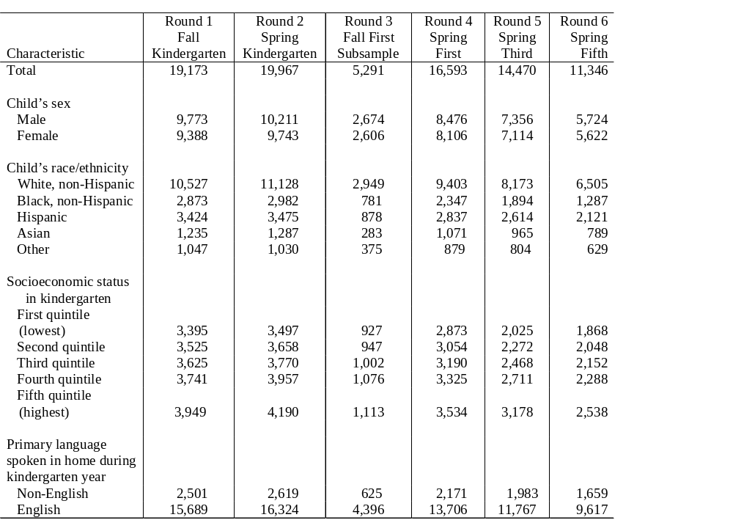
Sample counts for cases with child assessment data, by survey round and child and family characteristics: 1998–99, 1999–2000, 2001–02, and 2003-04
SOURCE: U.S. Department of Education, National Center for Education Statistics, Early Childhood Longitudinal Study, Kindergarten Class of 1998–99, Public-Use Base Year File, Restricted-Use First Grade and Third Grade Files, and the Public-Use Fifth Grade File. Unpublished table; please do not cite or circulate.

Slide 6
ECLS-K Sample Design
Nationally representative of kindergartens, kindergartners, and kindergarten teachers
Nationally representative sample of first graders
Clustered PSU multi-stage sample design
Oversampling of private schools and private school children
Oversampling of Asian and Pacific Islander children

Slide 7
Across Wave Changes in the Sample
Freshened in 1st grade only
Sample size gets smaller for a variety of reasons
The number of children who have changed schools comprises an increasingly larger percentage of the sample
Cluster sizes in schools and classrooms decrease

Slide 8
Mean number of children per school, by data collection wave
Mean number of children per school
14
13
12
10
8
8
6
5
5
4
2
0
Spring kindergarten
Spring 1st grade
Spring 3rd grade
Spring 5th grade
Data collection wave
SOURCE: U.S. Department of Education, NCES, Early Childhood Study, Kindergarten Class of 1998-99 (ECLS-K), Kindergarten – Third Grade Longitudinal Public-Use, and Fifth Grade Restricted-Use Data Files.

Slide 9
ECLS-K Components
Child
Parent
Teacher
School
Developmental
Parent and Child
Teacher
School
Status
Demographics
Background
Demographics
Cognitive
Language
Child and Family
Classroom
School
Health
Environment
Climate
Expectations
Socioemotional
Family
School
School
Physical
Characteristics
Climate
Programs
Parent-Child
Student
Educational
Interactions
Profile
Goals and
Objectives

Slide 10
Core Data Collection Methods
Direct and indirect assessments of children
Parent interviews
Teacher questionnaires (including special education)
School administrator questionnaires
School records abstracts
School facilities checklist
Student questionnaire

Slide 11
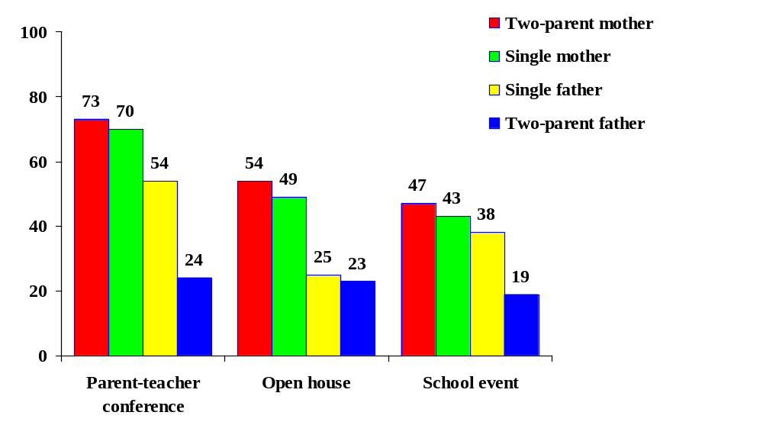
Parent involvement for kindergarten children in poverty, by parent type: Spring 1999
Percent
SOURCE: Prakash, N., West, J. and Denton, K. (2002). Differences in parental involvement in their children’s school, among families in poverty. Presentation at the annual meeting of the American Education Research Association, New Orleans, LA.

Slide 12
Special Studies and Data
Head Start verification
Kindergarten teacher and school administrator salary and benefits
Geocode Data

Slide 13
What is Different About Grade 3?
Children provide information on their perceptions of socials skills and interest in school subjects (SDQ).
Social Rating Scale (SRS) is not collected from parents.
Direct child assessment includes science (instead of the previous general knowledge assessment), in addition to reading and mathematics.

Slide 14
What is Different About Grade 5?
New data collection design for teacher questionnaires
Teachers report on the sample child’s instruction
Information about children’s food consumption was collected from children and also from school administrators

Slide 15
The ECLS-K Assessment
Multiple Domains
Cognitive
  Reading
  Mathematics
  General Knowledge (K-1)
  Science (3-5)
Socioemotional
  Social skills
  Approaches to Learning
  Externalizing and Internalizing Problem
  Behaviors
  Self-Control
  Self-Concept (3-5)

Slide 16
Multiple Domains
(Continued)
Physical
  Height and weight
  Gross and fine motor skills
(Fall kindergarten only)

Slide 17
Cognitive Scores
Broad-based scores (overall performance)
  Number right “raw” scores (routing scale scores)
  IRT-based scores (scale scores)
  Standardized scores (T-scores)

Slide 18
Cognitive Scores
Targeted scores (acquisition of specific knowledge and skills)
  Proficiency level scores (pass/fail)
    Reading
    Mathematics
  Proficiency probability level scores (IRT-based)
    Reading
    Mathematics

Slide 19
Cognitive Assessment
Reading Proficiency Scores (K – 5th)
  Level 1: Letter recognition
  Level 2: Beginning sounds
  Level 3: Ending sounds
  Level 4: Sight words
  Level 5: Words in context
  Level 6: Literal inference
  Level 7: Extrapolation
  Level 8: Evaluation
  Level 9: Evaluating non-fiction

Slide 20
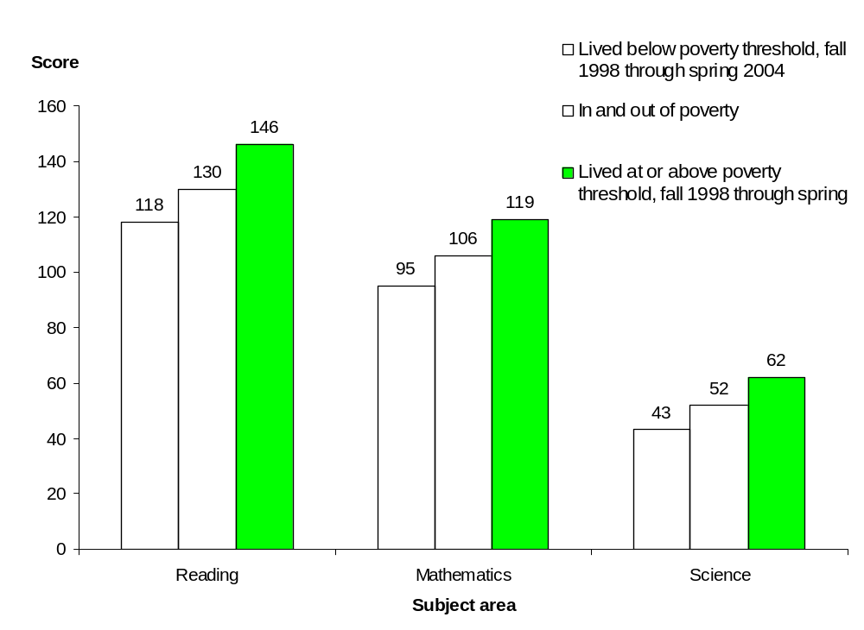
Mean fifth-grade reading, mathematics, and science scores, by poverty status over time: Fall 1998 through spring 2004
SOURCE: Princiotta, D., Flanagan, K.D., and Germino Hausken, E. (2006). Fifth Grade: Findings from the ECLS-K. NCES Publication 2006-038.

Slide 21
Cognitive Assessment
Mathematics Proficiency Scores (K-5th)
  Level 1: Number and shape
  Level 2: Relative size
  Level 3: Ordinality, sequence
  Level 4: Additional and subtraction
  Level 5: Multiplication and division
  Level 6: Place value
  Level 7: Rate and measurement
  Level 8: Fractions
  Level 9: Area and Volume

Slide 22
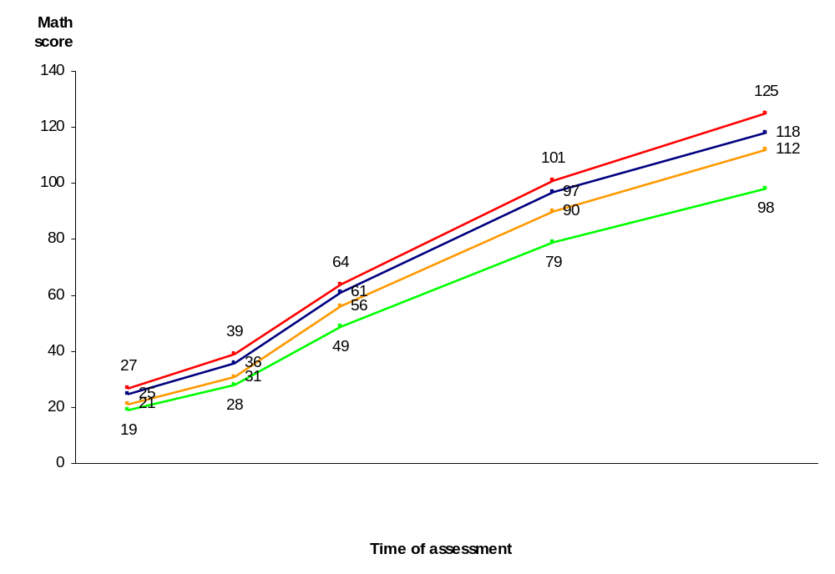
Mean mathematics scores for fall 1998 first-time kindergartners, by children’s race/ethnicity and time of assessment: Fall 1998 through spring 2004
Asian, non-Hisp.
White, non-Hisp.
Hispanic
Black, non-Hisp.
Fall
1998
Spring
1999
Spring
2000
Spring
2002
Spring
2004
NOTE: Estimates are based on children assessed in English at all rounds of data collection.
SOURCE: U.S. Department of Education, National Center for Education Statistics, Early Childhood Longitudinal Study, Kindergarten Class of 1998-99 (ECLS-K), fall 1998 through spring 2004 data. Unpublished tables.

Slide 23
Direct Assessment
Socioemotional and
Self-Description Questionnaire (SDQ)*
Feelings about self, school, reading and mathematics (grades 3 & 5)
Peer Relations
Externalizing Problem Behaviors
Internalizing Problem Behaviors
Feelings About School
Feelings About Reading
Feelings About Mathematics
*Adapted with permission from the Self-Description Questionnaire-I (Marsh 1990)

Slide 24
The Direct Assessment
Physical and Motor Specifications
Physical
  Height
  Weight
Motor Skills
Fall Kindergarten only:
    Fine Motor Skills
      copy basic figures
      construct forms with wooden blocks
    Gross Motor Skills
      balance on each foot
      hop on one foot
      skip
      walk backward in a straight line

Slide 25
The Indirect Assessment
Academic Rating Scale (ARS)
  Teacher report
  Children’s cognitive knowledge and skills
Social Rating Scale (SRS)*
  Teacher and parent reports
  Children’s social skills
* Adapted with permission from the instrument Social Skills Rating System: Elementary Scale A (Gresham, F. M. and Elliott, S.N., 1990).

Slide 26
Academic Rating Scale (ARS): Domains
Language and Literacy (K – 5th grade)
Mathematical Thinking (K – 5th grade)
General Knowledge (K – 1st grade)
Social Studies (3rd grade)
Science (3rd – 5th grade)

Slide 27
Social Rating Scale*: Parent Subscales
K- 1
Approaches to Learning
Self-control
Social Interaction
Impulsivity/Over activity
Sadness/Loneliness
* Adapted with permission from the instrument Social Skills Rating System: Elementary Scale A (Gresham, F. M. and Elliott, S.N., 1990).

Slide 28
Social Rating Scale*: Teacher Subscales
K- 5
Approaches to Learning
Self-control
Interpersonal Skills
Externalizing Problem Behaviors
Internalizing Problem Behaviors
Peer Relations (3rd and 5th: Self-control & Interpersonal Skills Combined)
* Adapted with permission from the instrument Social Skills Rating System: Elementary Scale A (Gresham, F. M. and Elliott, S.N., 1990).

Slide 29
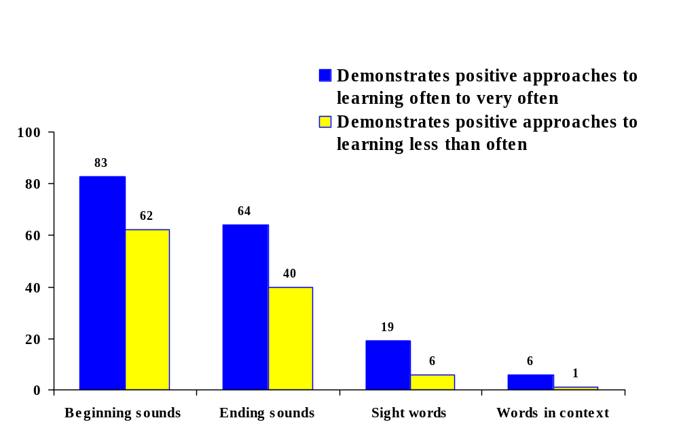
Children’s fall kindergarten approaches to learning relate to their spring kindergarten reading ability
Percent
proficient
Spring kindergarten, specific reading skills
SOURCE: Denton, K. and West, J. (2002). Children’s Reading and Mathematics Achievement in Kindergarten and First Grade. NCES Publication 2002-125.

Slide 30
Data Training Opportunities
Future Data Training Seminars
  SRCD Pre-conference Training Seminar (March 28, 2007)
  AERA Professional Development Seminar (April 2007)
  ECLS-K Data Users Training Seminar (Summer 2007)

Slide 31
For more information:
ECLS website
http://nces.ed.gov/ecls/
ECLS email address
ecls@ed.gov

