Slide 1

Energy Outlook:
Forecasting Diesel Fuel Prices
Guy F. Caruso
Administrator
Energy Information Administration
American Trucking Association
Diesel Fuel Conservation Strategies Workshop
Arlington, VA
June 19, 2008

Slide 2
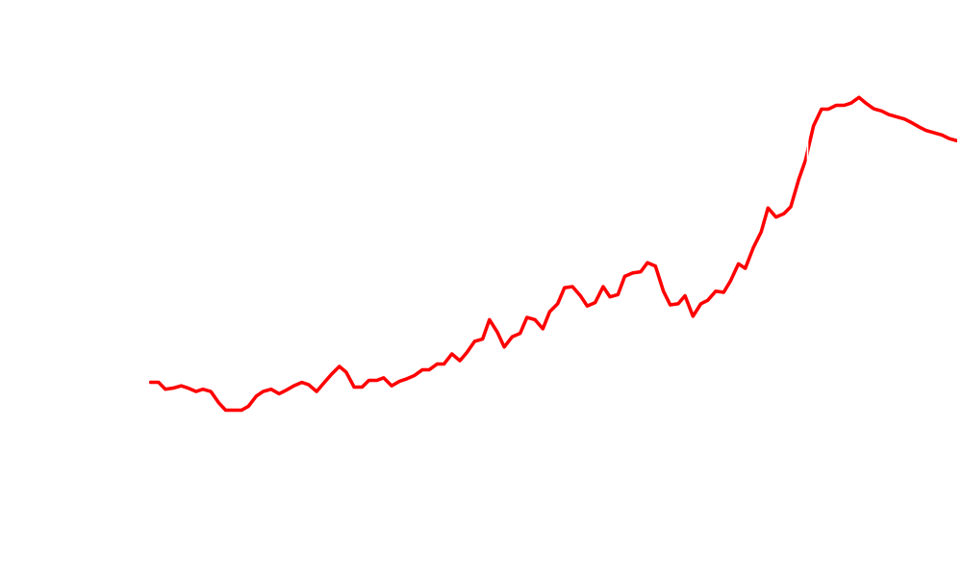
WTI crude oil prices are expected to remain high
dollars per barrel
History
Projections
Short-Term Energy Outlook, June 2008

Slide 3
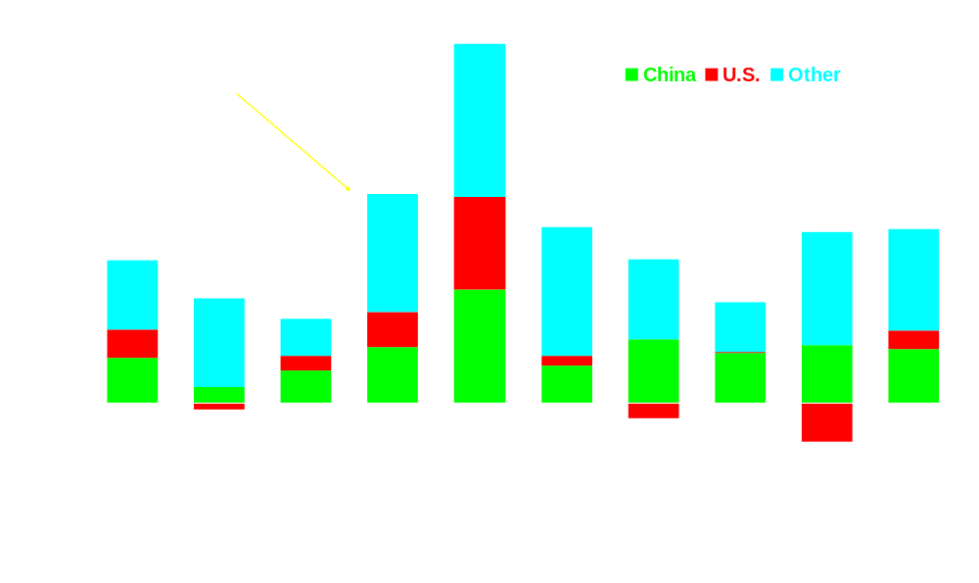
World oil consumption growth expected to accelerate in 2008 and 2009
annual growth, millions of barrels per day
Short-Term Energy Outlook, June 2008

Slide 4
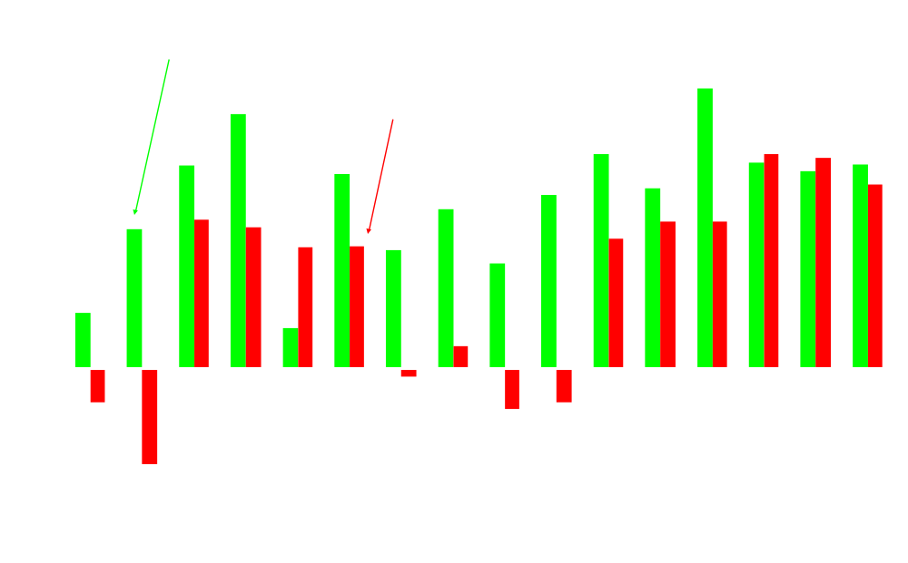
Global oil market balance is expected to loosen slightly in 2009
annual growth, millions of barrels per day
History
Projections
Short-Term Energy Outlook, June 2008

Slide 5
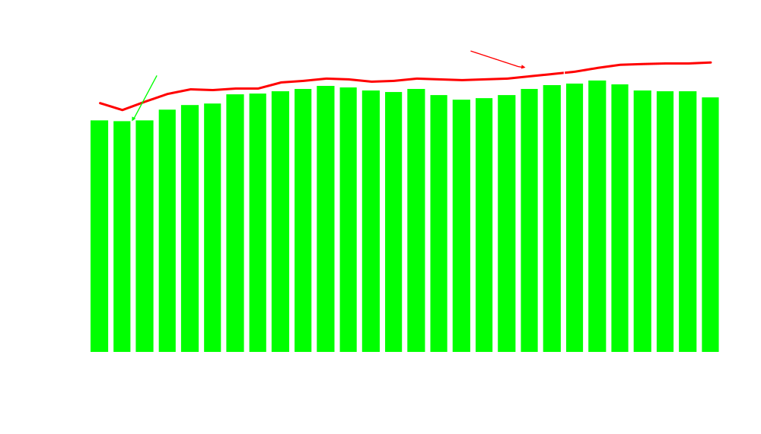
OPEC spare capacity has remained low, with most OPEC countries producing at capacity
millions of barrels per day
History
Projections
Short-Term Energy Outlook, June 2008

Slide 6
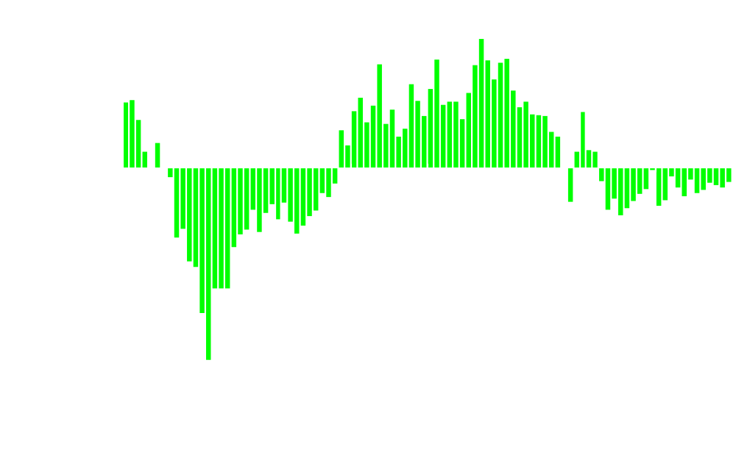
OECD commercial stocks decline from record highs to near-normal levels
Change from 5-year average, million barrels
History
Projections
Short-Term Energy Outlook, June 2008

Slide 7
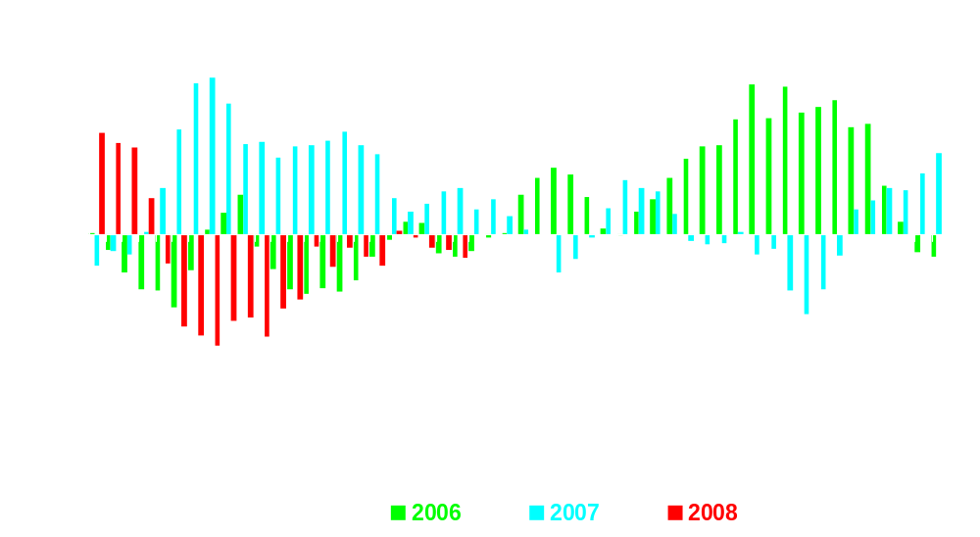
U.S. 4-week average total distillate demand growth has been negative
Year-to-year 4-week average growth
Weekly Petroleum Status Report

Slide 8
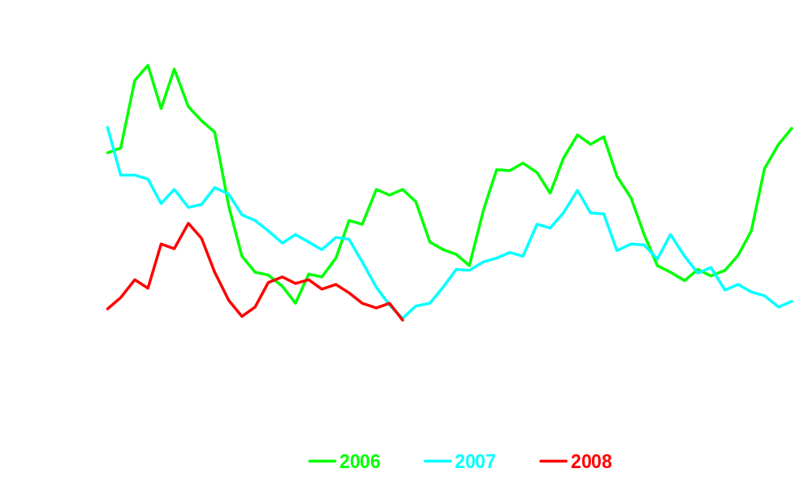
U.S. 4-week average total distillate imports are lower this year than the past 2 years
thousand barrels per day
Weekly Petroleum Status Report

Slide 9
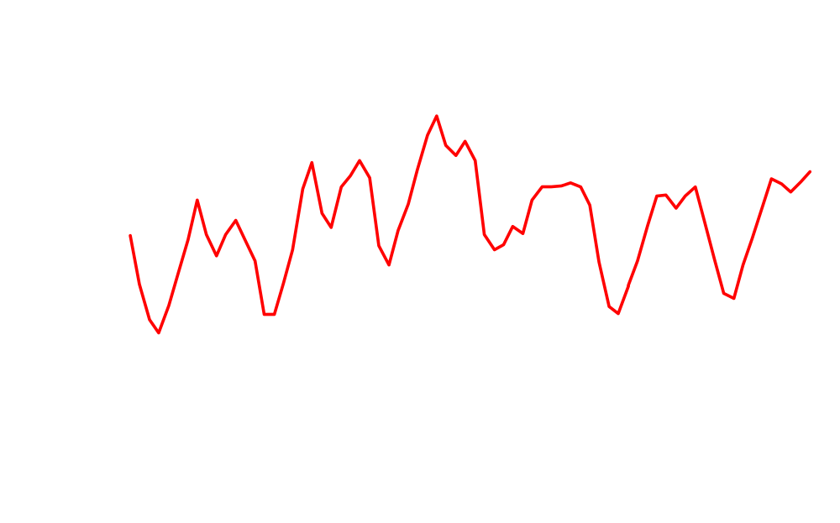
Distillate stocks are currently at the bottom of the average range
History
Projections
million barrels
normal inventory range
Short-Term Energy Outlook, June 2008

Slide 10
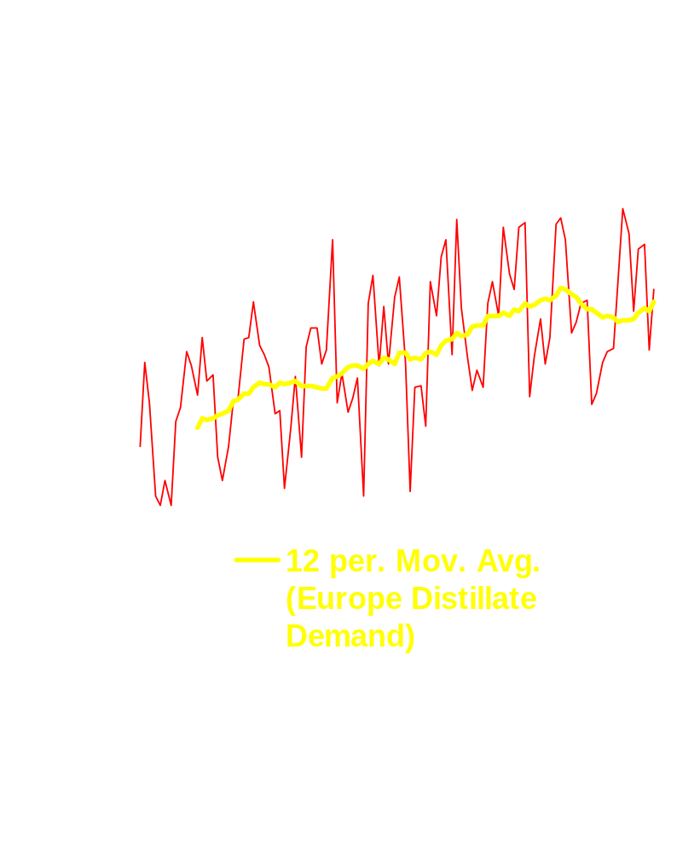
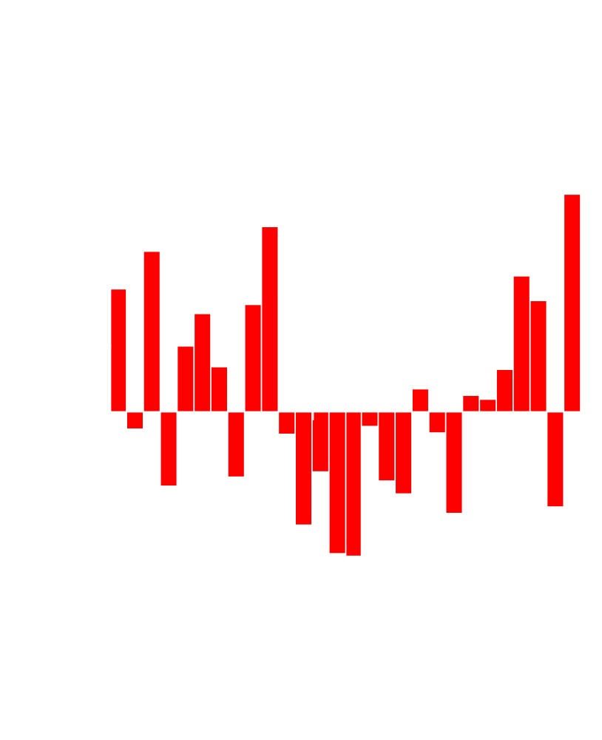
European distillate demand continues to grow
thousand barrels per day
thousand barrels per day
International Energy Agency, June 2008

Slide 11
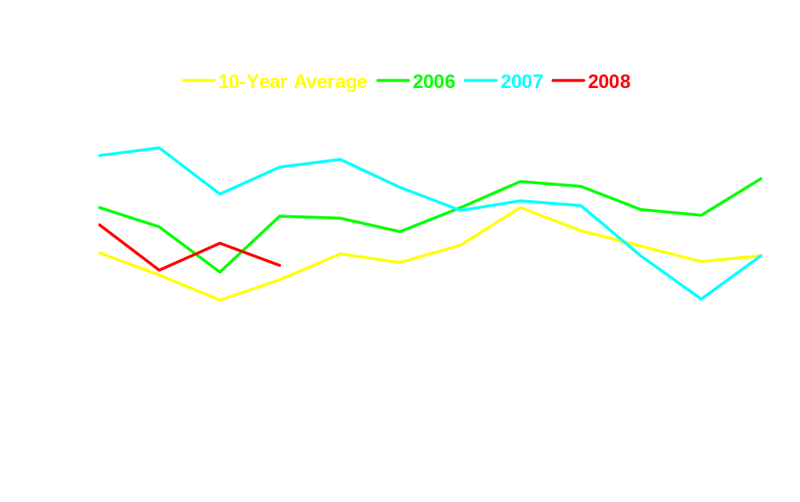
OECD European commercial distillate stocks are at above-average levels
million barrels
normal inventory range
International Energy Agency, June 2008

Slide 12
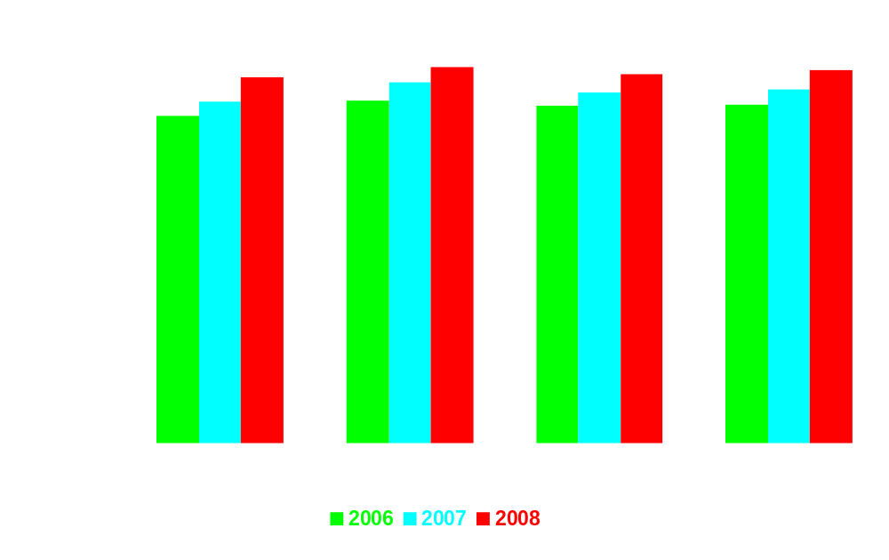
Chinese oil demand shows strong yearly growth in recent years
million barrels per day
Projection
International Energy Agency, June 2008

Slide 13
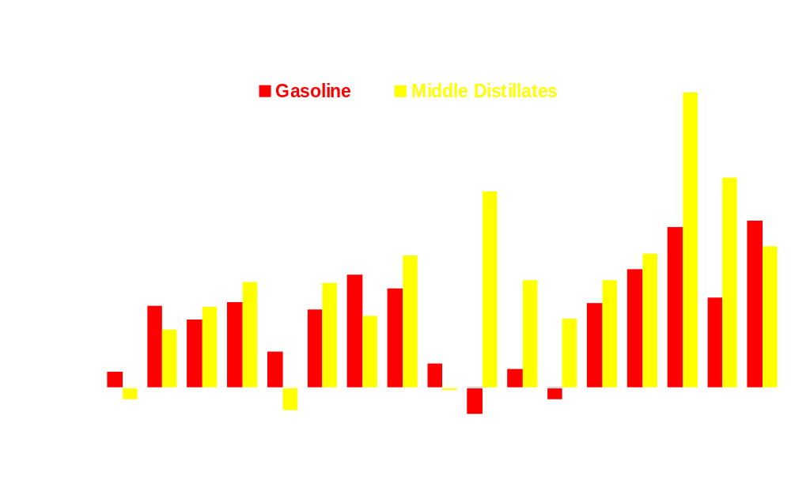
Much of China’s oil demand growth in the last 2 years has come from gasoline and diesel
annual growth, millions of barrels per day
BP World Statistics 2007

Slide 14
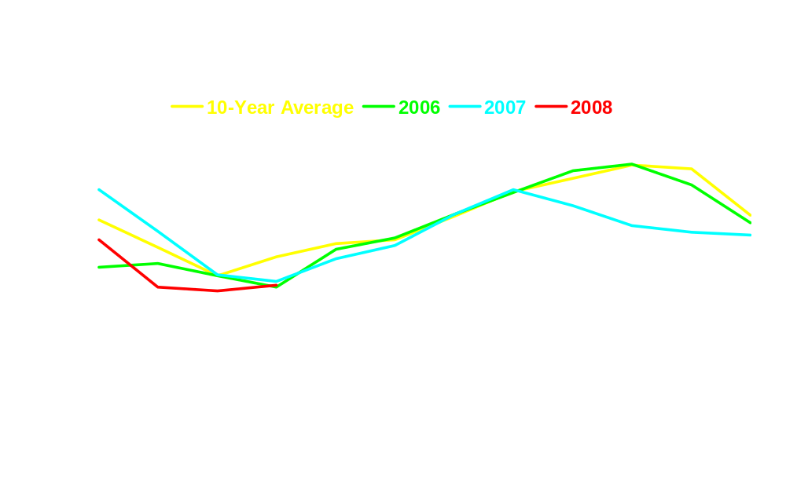
OECD Pacific commercial distillate stocks are at below-average levels
million barrels
normal inventory range
International Energy Agency, June 2008

Slide 15
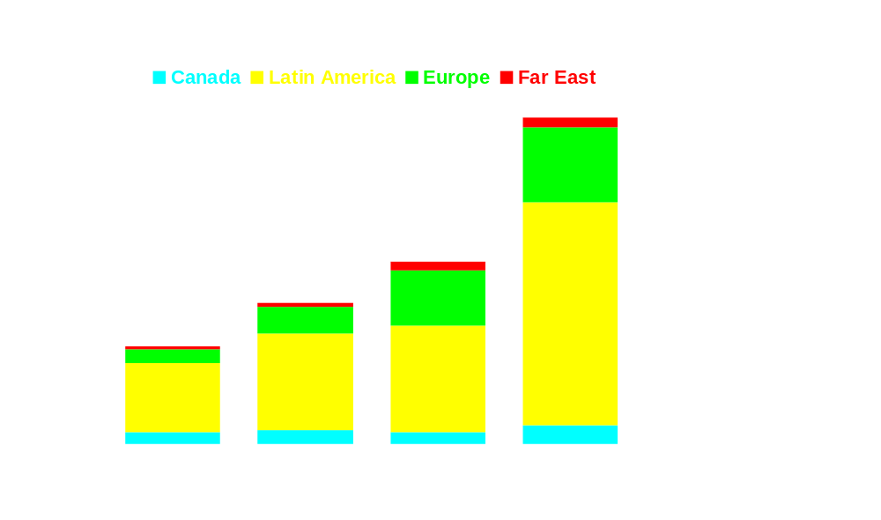
2008 first quarter U.S. distillate exports are unusually high
thousand barrels per day

Slide 16
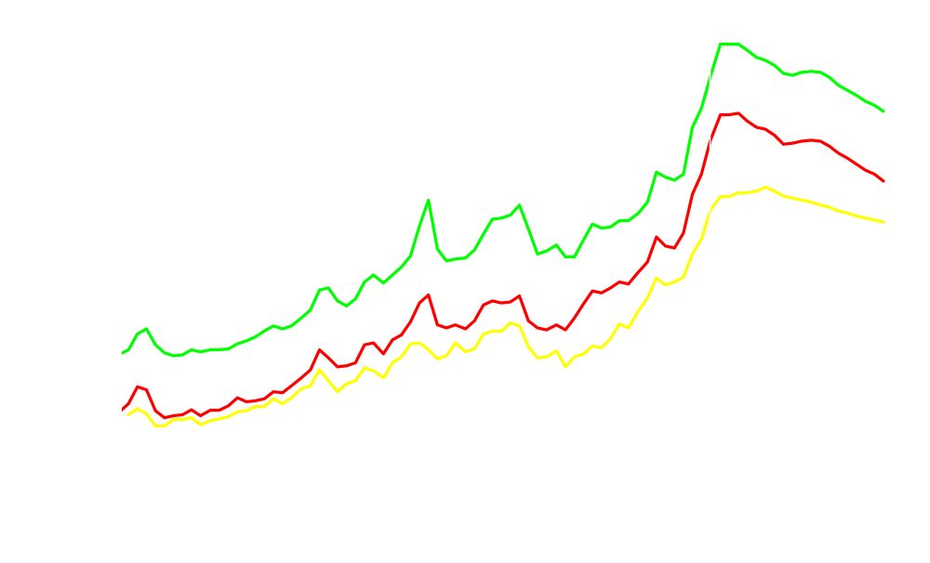
U.S. diesel prices are expected to decline, but remain high
thousand barrels per day
History
Projections
On-Highway Diesel
Wholesale
Diesel
Crude Oil
Short-Term Energy Outlook, June 2008

Slide 17
Conclusions
Crude oil prices are expected to remain very high for the foreseeable future
Strong growth in the global demand for diesel fuel have added to retail diesel price pressures
Retail diesel fuel prices are expected to remain well above $4 a gallon through at least 2009

Slide 18
Periodic Reports
Petroleum Status and Natural Gas Storage Reports, weekly
Short-Term Energy Outlook, monthly
Annual Energy Outlook 2008, March 2008, full report, June 2008
International Energy Outlook 2007, May 2007, next update June 2008
Examples of Special Analyses
“Economic Effects of High Oil Prices,” Annual Energy Outlook 2006
Analysis of Crude Oil Production in the Arctic National Wildlife Refuge,
May 2008
The Global Liquefied Natural Gas Market: Status and Outlook, December 2003
“Impacts of Increased Access to Oil and Natural Gas Resources in the Lower 48 Federal Outer Continental Shelf,” Annual Energy Outlook 2007
Energy Market and Economic Impacts of S.2191, the Lieberman-Warner Climate Security Act of 2007, April 2008
www.eia.doe.gov
Guy F. Caruso
guy.caruso@eia.doe.gov

