Slide 1

WELCOME
Industry Day

Slide 2
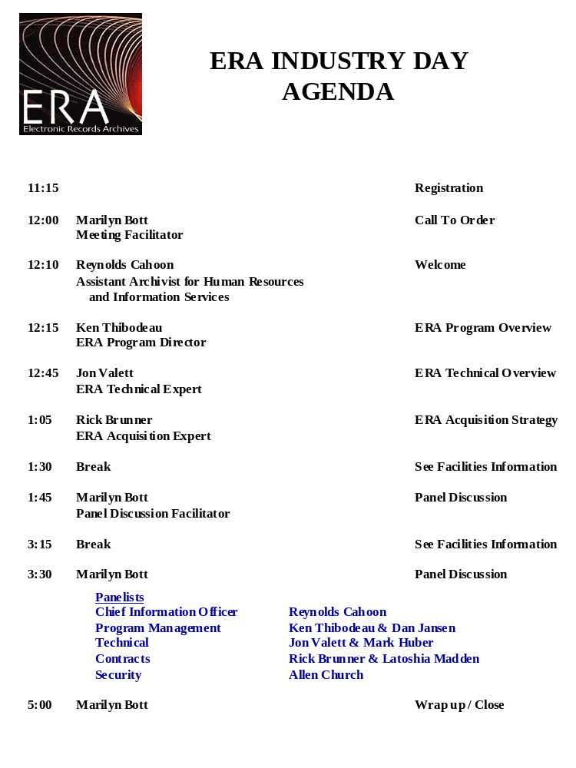

Slide 3
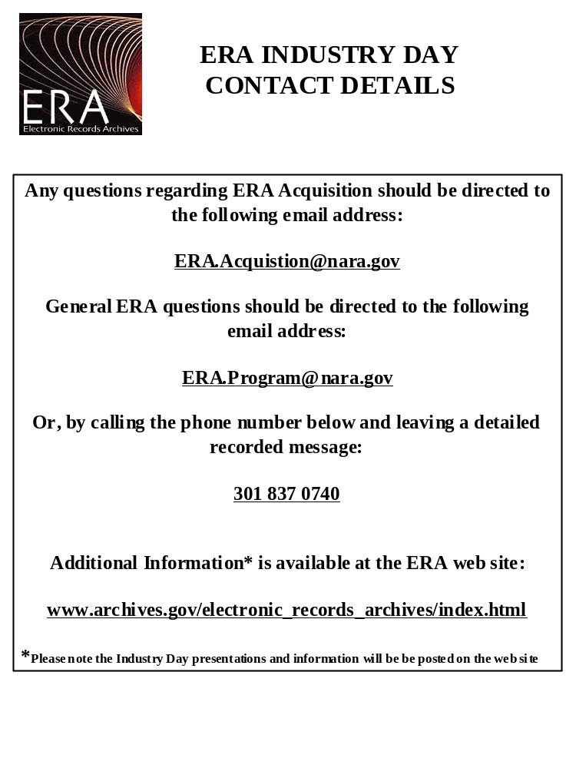

Slide 4
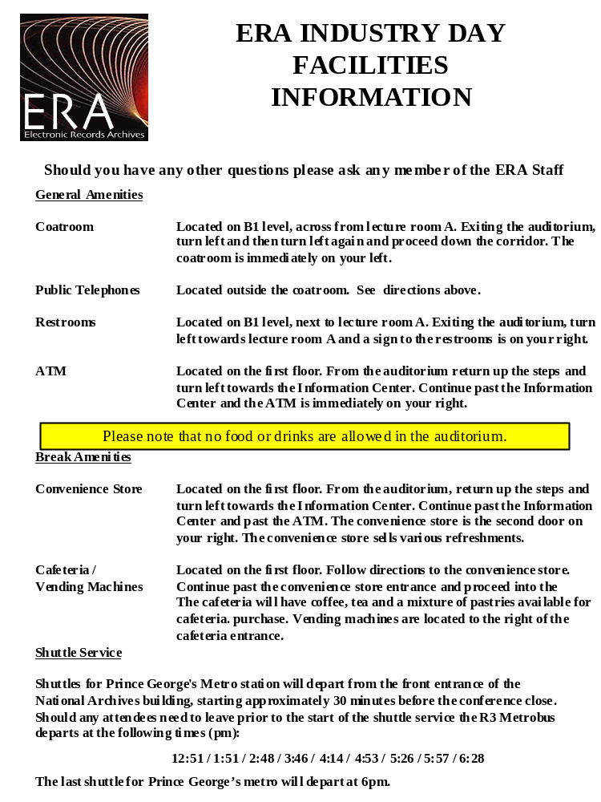

Slide 5
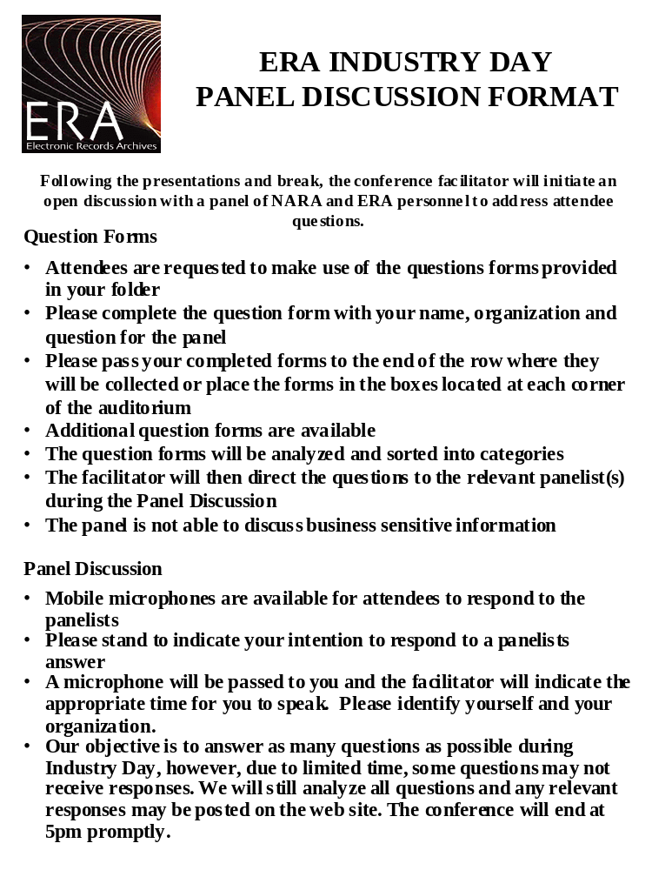

Slide 6
Welcome Message
Mr. Reynolds Cahoon
Chief Information Officer

Slide 7
Program Overview
Dr. Kenneth Thibodeau
Program Director

Slide 8
National Archives & Records Administration
Mission Statement
“The National Archives …. is a public trust on which our democracy depends. It enables people to inspect for themselves the record of what government has done. It enables officials and agencies to review their actions and helps citizens hold them accountable. It ensures continuing access to essential evidence that documents:
  the rights of American citizens
  the actions of federal officials
  the national experience”
Notes:
This is NARA's mission statement. It tell you, in crisp and succint terms, what we are all about.

Slide 9
NARA Strategic Goals
1: Essential evidence will be created, identified, appropriately scheduled, and managed for as long as needed.
2: Essential evidence will be easy to access regardless of where it is or where users are for as long as needed.
3: All records will be preserved in an appropriate environment for use as long as needed.
4: NARA's capabilities for making changes necessary to realize our vision will continuously expand.
Notes:
NARA has examined in depth what it will take to accomplish our mission. We have set out the results of that examination in our Strategic Plan. We have set 4 strategic goals for ourselves, which you see here.
All of these goals apply to electronic records, and electronic records create some significant problems for achieving these goals.

Slide 10
NARA’s Vision of the Electronic Records Archives
“The Electronic Records Archives will authentically preserve and provide access to any kind of electronic record, free from dependency on any specific hardware or software, enabling NARA to carry out its mission into the future.”
Notes:
The electronic records challenge is formidable, but as an agency we are committed to addressing this challenge head on. We've stated what we want to accomplish in a single sentence:

Slide 11
Record
Documentary material of any form
Made or received in the course of business or under law, and
Kept because it
    provides evidence of organization, functions, policies, decisions, procedures, operations, or other activities of their creators, or
    contains valuable information
Electronic Record
    A record in a form that requires the use of a computer for access.
Notes:
NARA is in the records business. So, let's be clear about what records are, how they differ from other forms of information.
First and foremost, we should note that a record is not any specific type of information. It can be any type: Any way you can write, inscribe, or capture information can be a record. To paraphrase, "You can't tell a book by its cover," you can't tell a record by looking at it. To tell a record, you need to know its context. You need to know whose record it is; the activity in which it was created and used; and its relationship to other records of that creator and activity.

Slide 12
NARA’s Electronic Records Challenge
Preserve any type of record,
Created using any type of application,
On any computing platform
From any entity in the Federal Government and any donor
Provide discovery and delivery to anyone with an interest and legal right of access
Now and for the life of the republic
Notes:
So, in considering what's involved in getting access to electronic records, you can see there are significant challenges. NARA faces a major, multifaceted challenge in trying to accomplish its mission in the digital era. We can sum up this challenge:
Now and for the life: not just delivering the records being created on computers today, but new types of records that will be created on computers that haven't been produced yet.

Slide 13
NARA’s Electronic Records Challenge
Diversity
Complexity
Open-ended Growth
Obsolescence
Continuing change
Durability
Notes:
So, in considering what's involved in getting access to electronic records, you can see there are significant challenges. NARA faces a major, multifaceted challenge in trying to accomplish its mission in the digital era. We can sum up this challenge:
Now and for the life: not just delivering the records being created on computers today, but new types of records that will be created on computers that haven't been produced yet.

Slide 14



What is the ERA system?
An Open Archival Information System
Producer
OAIS
Query
Submission
Information
Packages
Archival
Information
Packages
Response
Order
Consumer
Dissemination
Information
Package
Notes:
The ERA project was launched in 1998. We spent the first 3 years essentially doing research; research in order to understand the problems better, and to see what might be possible. Our research activities have all been collaborative: with other agencies in the FG, with counterparts in state governments and other national archives, with academics, and private industry.
One of these collaborations was in the development of the OAIS standard.
ERA will be an OAIS, but the OAIS standard addresses any kind of information kept for any length of time. It doesn't say anything specific about records. We have to add the requirements for records and archives.

Slide 15
ERA Scope
Producers
  All agencies of the Federal Government
  The President
  The Congress
  The Supreme Court
  Private Donors
Consumers
  The producers themselves
  Any member of the public
  Businesses
  Other governments

Slide 16
Lines of Business
National Archives
Presidential Libraries
Federal Records Centers

Slide 17
Lines of Business
National Archives
  Permanent preservation & sustained access
  Open ended clientele
Presidential Libraries
  Permanent preservation & sustained access
  Open ended clientele
  Presidential Records Act provisions
  Donated Materials
Federal Records Centers
  Finite time preservation
  Services required by federal agencies
  Access controlled by agencies
  National Personnel Records Centers

Slide 18
Customer Services
Store electronic records for producers and provide access and other services they require for specified periods of time
Bring electronic records into the National Archives and the Presidential Libraries, preserve them and provide access, respecting legal restrictions, forever
Help customers discover and access holdings
Provide authentic copies of electronic records which will support exercise of property and other rights and hold up in court, if needed.
Guide and assist federal agencies in lifecycle management of their records
Support the transition to e-government

Slide 19
Realizing NARA’s Vision
1. We will be a leader in innovation in electronic records archiving.
2. In coordination with our Federal partners we will develop policy and technical guidance to enable responsible electronic records creation and management.
3. With help from our research partners, we will develop and maintain the technical capability to capture, preserve, describe, access and appropriately dispose of any government electronic record.
4. We will manage a coherent, nationwide, and sustainable system for permanent electronic records of the Federal Government.
Notes:
There are a lot of things we have to do to realize this vision. NARA's leadership has spelled out what this vision means:

Slide 20
Realizing the Vision
5. We will develop the capability to manage Federal agency electronic records within the NARA records center system.
6. We will ensure that anyone, at anytime, from any place, has access to the best tools to find and use the records we preserve.
7. Our staff will be capable and consistent users of the electronic tools at every point of the life cycle.
8. We will sustain widespread support from all our stakeholders and customers by listening to their needs, meeting their requirements, and seeking their feedback.
Notes:
With respect to statement # 8, today is a major step starting an open discussion on how to improve ERA. Today is an opportunity for you to tell us your interests, your concerns, your questions. And today is an opportunity for us to obtain insights that will be very valuable in helping us to developing ERA that responds to your interests and needs.
This will not be the only opportunity you have. There is a form in your package that can be used to provide written comments, and we welcome your input at any time. You can send them to: ERA.Comments@nara.gov

Slide 21
Knowledge Base: Computer Science & Information Technology
National Science Foundation
  National Computational Science Alliance
  National Partnership for Advanced Computational Infrastructure
U.S. Army Research Laboratory
  Computational and Information Sciences Directorate
    Georgia Tech Research Institute
National Institute of Standards and Technology
  Information Technology Laboratory
Defense Technical Information Center
  Corporation for National Research Initiatives
National Aeronautics & Space Administration
  National Space Science Data Center
    Consultative Committee on Space Data Systems

Slide 22
Knowledge Base: Archival Science, Records Management, & Information Science
International Research on Preservation of Authentic Records in Electronic Systems (INTER PARES) project
  11 National Archives, 8 state, provincial, and city archives
  34 Universities
  8 corporations, 6 institutes, 3 associations
  Africa, Asia, Australia, Europe, North America
ISO TC 46, SC 11, Archives/Records Management
Library of Congress
  National Digital Information Infrastructure and Preservation Program
Digital Library Federation
Defense Information Systems Agency
  Joint Interoperability Test Command

Slide 23

“Strategies to assure long-term preservation of digital records constitute another particularly pressing issue for research…”

Slide 24
Action Base
The Administration and the Congress
NARA
  Leadership Team
  Committee on Archival Requirements
  Integrated Product Teams
  ERA Program Management Office
    Program Office Support Team
Stakeholders
General Accounting Office, Information Technology Team
  “Identifying the challenges associated with managing and preserving electronic records to help the government improve development of an advanced electronic records archive”
Notes:
INFORMATION TECHNOLOGY
“Accomplishments”
“identifying the challenges associated with managing and preserving electronic records to help the government improve development of an advanced electronic records archive;”
http://www.gao.gov/

Slide 25
Technical Overview
Mr. Jon Valett
Technical Expert

Slide 26
Agenda
Challenges and Constraints
OAIS System Features
Other System Features
Characteristics and Criteria

Slide 27
Technical Challenges of ERA
Receives, stores, preserves, and provides access to electronic records, regardless of type, format, or media.
Receives, preserves, and stores electronic records in a manner and environment appropriate to their sensitivity level.
Stores electronic records in a manner that allows for maximum possible independence from specific hardware and software infrastructures.
Supports high availability.
Provides viable long-term storage for electronic records.

Slide 28
Critical System Constraints
ERA must be policy neutral
ERA must be in compliance with NARA’s Target Architecture
ERA’s architecture must be adaptable to changes in hardware, software, and communications technology
ERA’s electronic holdings must be preserved in a state that is independent of specific hardware and software
ERA’s design must balance the use of COTS, NDI, and newly developed software

Slide 29
Open Archival Information System (OAIS) Features

Slide 30
ERA Context - OAIS Reference Model
Preservation Planning
P
Descriptive
Data
Descriptive
C
R
Info
Management
Info
O
O
queries
N
D
Ingest
result sets
S
U
Access
orders
U
C
Archival
M
E
Storage
E
R
R
Administration
MANAGEMENT

Slide 31
Preservation Planning
Use of templates
Transfer of sample records
Determine preservation characteristics

Slide 32
Ingest
Disposition agreements
Transfer of records
Verification of transfer
Archival descriptions
Transform records into persistent formats

Slide 33
Archival Storage
Reliable storage of records - media, copying, inventory…

Slide 34
Data Management
Information about records
Disposition of electronic records
Relationships among electronic records

Slide 35
Access
Review for sensitive information
Redaction of electronic records
Search
Output

Slide 36
Administration
User accounts
User assistance
Communications with users
Event logs
Reporting

Slide 37
Other System Features

Slide 38
User Interface
Electronic access to ERA services
User interface - workbenches, customization,…

Slide 39
Security
Security of the electronic records
Security of the system

Slide 40
Workflow
Workflow management tools - forms, customization,…

Slide 41
System Characteristics
Subscriptions to services
Service management
Performance requirements
  Response times
  Volumes
  Access
  Loads
Comply with NARA’s Target Architecture

Slide 42
Characteristics & Criteria

Slide 43
Ingest Characteristics
Expect Wide Variety of Formats (dbs, audio, maps, office automation, …)
Expected yearly ingest volume
  50 TeraBytes in 2005
  5,000 TeraBytes in 2014
Total archive volume
  50 TeraBytes in 2005
  11,000 TeraBytes in 2014

Slide 44
Architectural Evaluation Criteria
Scalable
  Adding hardware horizontally
Evolvable
  Technology insertion through standard APIs
Extensible
  New record types, data types, and services on these various types can be added to the system without redesign or extensive software engineering

Slide 45
Acquisition Strategy
Mr. Rick Brunner
Acquisition Expert

Slide 46
Agenda
Objective of Briefing
Acquisition Approach
Program Milestones
Contractor Requirements
Request for Proposal - Prime Contractor Proposal Requirements
Selection Criteria
Contracting Process & Schedule
Questions

Slide 47
Objective of Briefing
Bring Bidders up to speed on the Current ERA Acquisition Approach :
DRAFT - Subject to change
  Present the current Acquisition Approach
  Inform Bidders of Key Evaluation Criteria
  Inform Bidders of Scheduled Events

Slide 48
Acquisition Approach

Slide 49
General Acquisition Approach
Early and Frequent Industry Involvement
Full and Open Competition
Government provided with a Statement of Objectives (SOO) and Requirements Document
Contractor provides Performance Work Statement (PWS), which will be incorporated into the contract
Contractor provides first Award Fee Plan integrated with their PWS
Notes:
BULLET 1: The primary purpose (or objective) to the presentation today
To provide you with a basic understanding of the ERA program
BULLET 2: We seek your help in making the ERA Program successful because the benefits will are the ERA will allow:
NARA to be regarded as an expert in Electronics Archiving worldwide strengthening our role in the Federal Government
NARA to become more efficient and we will be able to provide a wider scope of services to our customers.
ERA to automate many of the now paper driven processes freeing our people to focus in on the important tasks that computers can’t replace
ASK: What are your concerns or worries regarding the ERA Program?
Enhance the services offered by NARA to other agency records managers.

Slide 50
General Acquisition Approach (cont’d)
Award 1 or 2 Base Contracts for System Analysis/Design
Based on Performance and Price Down-select to one Contractor to Develop ERA
Procure through contract options included in contract five Optional Increments
Intend to use Fixed Price + Award Fee

Slide 51
Incremental Approach/
Program Milestones
CY
2004
2005
2006
2007
2008
2009
2010
Analysis/
Design
Inc 1
Inc 2
Inc 3
Inc 4
Inc 5
CA
DS
I1
I2
I3
I4
I5
Development
(1 or 2 Contracts)
(Downselect to Single Contract)
IOC
FOC
KEY
= NARA Milestone = Other Milestone
Decision
CA = Contract Award DS = Design Select
IOC = Initial Operational Capability FOC = Full Operational Capability
Notes:
BULLET 1: The primary purpose (or objective) to the presentation today
To provide you with a basic understanding of the ERA program
BULLET 2: We seek your help in making the ERA Program successful because the benefits will are the ERA will allow:
NARA to be regarded as an expert in Electronics Archiving worldwide strengthening our role in the Federal Government
NARA to become more efficient and we will be able to provide a wider scope of services to our customers.
ERA to automate many of the now paper driven processes freeing our people to focus in on the important tasks that computers can’t replace
ASK: What are your concerns or worries regarding the ERA Program?
Enhance the services offered by NARA to other agency records managers.

Slide 52
The ERA Incremental
Contracting Process
Overall Design
Increment 1
Design
Develop
Test
Increment 2
Design
Develop
Test
.…
Increment N
Design
Develop
Test
Operations & Support Contract
Notes:
BULLET 1: The primary purpose (or objective) to the presentation today
To provide you with a basic understanding of the ERA program
BULLET 2: We seek your help in making the ERA Program successful because the benefits will are the ERA will allow:
NARA to be regarded as an expert in Electronics Archiving worldwide strengthening our role in the Federal Government
NARA to become more efficient and we will be able to provide a wider scope of services to our customers.
ERA to automate many of the now paper driven processes freeing our people to focus in on the important tasks that computers can’t replace
ASK: What are your concerns or worries regarding the ERA Program?
Enhance the services offered by NARA to other agency records managers.

Slide 53
Prime Contractor -
Terms and Conditions
Government Purpose Data Rights
Progress Payments
SW CMM Level 3 for the unit performing the work

Slide 54
Performance Based Management
NARA will ask Bidders to extend NARA’s supplied Work Breakdown Structure (WBS) and incorporate hours and cost distributed over scheduled performance activities and milestones.
NARA will ask Bidders to supply Bases of Estimates, Ground Rules, and Assumptions used for pricing and scheduling.

Slide 55
Performance Based Management
(cont’d)
Contractor will implement a Performance Based Management System (Earned Value Management System)
Bidders will propose Key Metrics in their PWS. NARA will monitor Program Performance against these Key Metrics.
Notes:
BULLET 1: The primary purpose (or objective) to the presentation today
To provide you with a basic understanding of the ERA program
BULLET 2: We seek your help in making the ERA Program successful because the benefits will are the ERA will allow:
NARA to be regarded as an expert in Electronics Archiving worldwide strengthening our role in the Federal Government
NARA to become more efficient and we will be able to provide a wider scope of services to our customers.
ERA to automate many of the now paper driven processes freeing our people to focus in on the important tasks that computers can’t replace
ASK: What are your concerns or worries regarding the ERA Program?
Enhance the services offered by NARA to other agency records managers.

Slide 56
Award Fee Plan (AFP)
Award Fee
  Cost, Schedule, Performance
Fee Determination Every 6 Months
Proposers Submit 1st Award Fee Plan with proposal to integrate with their PWS
  Government will provide weightings
  Looking for an effective non-complex plan

Slide 57
Evaluation Criteria

Slide 58
Source Selection in Accordance with FAR 15
Best Value Competition
All evaluation factors other than price, when combined, are significantly more important than price.
Technical competition where price will be integrated into the award decision.
Notes:
BULLET 1: The primary purpose (or objective) to the presentation today
To provide you with a basic understanding of the ERA program
BULLET 2: We seek your help in making the ERA Program successful because the benefits will are the ERA will allow:
NARA to be regarded as an expert in Electronics Archiving worldwide strengthening our role in the Federal Government
NARA to become more efficient and we will be able to provide a wider scope of services to our customers.
ERA to automate many of the now paper driven processes freeing our people to focus in on the important tasks that computers can’t replace
ASK: What are your concerns or worries regarding the ERA Program?
Enhance the services offered by NARA to other agency records managers.

Slide 59
Evaluation Criteria
Mission Capability (Technical/Management)
Past Performance
Proposal Risk
Price

Slide 60
Mission Capability Criteria
Key Personnel
Project Management Methodology
Architecture
Design
Systems Engineering Methodology
Understanding of the Problem
  Cost realism

Slide 61
Past Performance Criteria
Prior success on similar programs
Successful record of addressing and resolving issues/problems
Successful record of clear, effective, and cooperative communications with the government
Successful accomplishment of program phase transitions

Slide 62
Proposal Risk Criteria
NARA will evaluate the risk associated with each Bidder’s proposal.

Slide 63
Contracting Process
& Schedule

Slide 64
Contracting Process
Released RFI #1 and #2
Conduct Industry Conference
Release Draft RFP for Industry Comments (1 week later Vendor’s Conference) - 3rd quarter FY03
Release Final RFP (1 week later Bidder’s Conference) - 4th quarter FY03
Conduct Orals with Vendors in Competitive Range - 1st quarter FY04
Negotiation with Apparent Winner(s)
Award of Contract - 2nd quarter FY04
Notes:
BULLET 1: The primary purpose (or objective) to the presentation today
To provide you with a basic understanding of the ERA program
BULLET 2: We seek your help in making the ERA Program successful because the benefits will are the ERA will allow:
NARA to be regarded as an expert in Electronics Archiving worldwide strengthening our role in the Federal Government
NARA to become more efficient and we will be able to provide a wider scope of services to our customers.
ERA to automate many of the now paper driven processes freeing our people to focus in on the important tasks that computers can’t replace
ASK: What are your concerns or worries regarding the ERA Program?
Enhance the services offered by NARA to other agency records managers.

Slide 65
Next Steps
1 on 1 COTS SW Vendor Discussions, presentations to be scheduled on the following categories:
  XML Products
    Translators, Viewers, Management Tools/Repositories, Authoring Tools
  Web Services and Middleware Integration Products
  Storage Management Systems
  Database Management System (DBMS)
    Relational, XML, Object Oriented
  Workflow
  Searching/Indexing Schemes and Products
NARA will allow up to the release of Draft RFP
First come, first serve - as it applies to the NARA’s need
NARA will call vendors as well
Contact name and phone number will be available after Industry Day

Slide 66
Break
Panel discussion will begin in 15 minutes.
Please return promptly.

