Slide 1


Major Components of FDA’s Action Plan for Acrylamide
Richard Canady, PhD DABT
US Food and Drug Administration
Center for Food Safety and Applied Nutrition
www.cfsan.fda.gov
Public meeting: September 30, 2002

Slide 2

FDA assessment after press release by Sweden last April
Preliminary FDA assessment using
  Swedish acrylamide occurrence data
  US consumption rates and
  Existing FDA dose-response evaluations developed for food contact issues
Our preliminary assessment indicates
  Further action is needed
    The hazard is not clearly below concern
  Our confidence in Swedish occurrence data is sufficient
    for decision that further action is needed
  Our confidence in the toxicology is sufficient
    for decision that further action is needed

Slide 3
Questions raised
Are US foods likewise affected?
What causes formation or occurrence?
Are the risks sufficient to warrant changing food processing techniques or diet?

Slide 4
Important to keep in mind
Acrylamide has not suddenly appeared in food
It appears to be a result of cooking, and so has probably been present in cooked foods for thousands of years
What’s new is
  Detection of acrylamide in food, and
  Knowledge that cooking can create acrylamide

Slide 5
Overview of this presentation: Major components of the plan
Testing foods
  Methods development
  Occurrence and exposure estimation
Acrylamide Formation
Toxicology
Education
Meetings and collaborative projects
Notes:
1 Where it is, how much we eat
2 How it gets there, what can we do
3 What is the hazard
4 What can we do about it now
5 Process

Slide 6
Testing foods:
General issues
Are we using an appropriate method to test for acrylamide?
What is the goal of the sampling?
  Exposure estimation (need occurrence information first)
  Help the formation research by describing variation related to
    Ingredients
    Processing
Where to start and where to end?
What foods contribute the most to exposure?
What approach should have higher priority now?
  Exposure assessment leading to regulatory actions?
  Occurrence variation leading to process improvements?
  Find out where it is to be sure we don’t miss the big picture?

Slide 7
1. Testing foods:
Methods development
CFSAN has developed an analytic method for acrylamide in foods
  LC/MS/MS = liquid chromatography, tandem mass spectrometry
We have tested the method’s performance relative to other methods by other laboratories
  Performs very well
Formal inter-laboratory validation planned
CFSAN will update the method as needed
CFSAN will evaluate new methodologies for more rapid and less expensive detection of acrylamide in foods
Notes:
Method is posted on our website

Slide 8
1. Testing foods:
Sampling plan development
Started with foods identified by Sweden
  To confirm occurrence
We are now expanding the sampling set based on food chemistry and processing similarities, and we will
  Probe the scope of acrylamide occurrence in food
    To “diminishing return” (or mechanistic understanding)
    Need for exploration does not necessarily preclude taking action
  Include foods based on consumption rates
Next, we will evaluate
  Variability within foods (products and food types)
  Exposure using Total Diet Study
Notes:
Does not mean we will wait to take action
Does mean that full understanding will need either mechanistic understanding or an end to finding new foods with acrylamide

Slide 9
Testing foods:
Overall level of sampling
Occurrence
  ~600 food samples (about one quarter done)
  Exploring additional sampling needs (could add more)
  Does not count samples done for process evaluations
  Additional ~300 from National Food Processors Association?
    Available through JIFSAN clearinghouse
Exposure estimation
  ~1000 samples planned for FY03

Slide 10
1. Testing foods:
Occurrence
FY02: Exploratory survey of locally purchased foods
  Confirmed occurrence in US foods
  Informed processing research and sampling scope for exposure estimates
  Roughly 150 foods so far analyzed, multiple analyses
FY03: Analysis of foods from across the country
  On the order of 400 more samples for survey work (possibly more, depending on interagency collaboration)
  National Food Processors Association has indicated they will do ~300 additional samples, made available through JIFSAN
FY04, etc
  Sampling as needed

Slide 11
1. Testing foods:
Exposure
FY02: Exploratory survey of locally purchased foods
  We have confirmed the general level of exposure estimated by WHO/FAO in June
FY03: Analysis of foods from across the country
  Start Total Diet Study (TDS)
    ~800 market basket samples
    ~200 additional targeted food samples to capture foods with highly variable acrylamide levels
FY04, etc
  Exposure monitoring TDS will continue

Slide 12
Total Diet Study component of FDA’s acrylamide action plan
General purpose of TDS is to determine levels of various substances in an average national diet
Involves analysis of foods representing all components of the diet
The foods are prepared as eaten and then the acrylamide levels are determined
Intake is estimated using national food intake surveys
Focus is on the average diet for age and gender groups
Part of an ongoing, well established dietary exposure program for contaminants

Slide 13
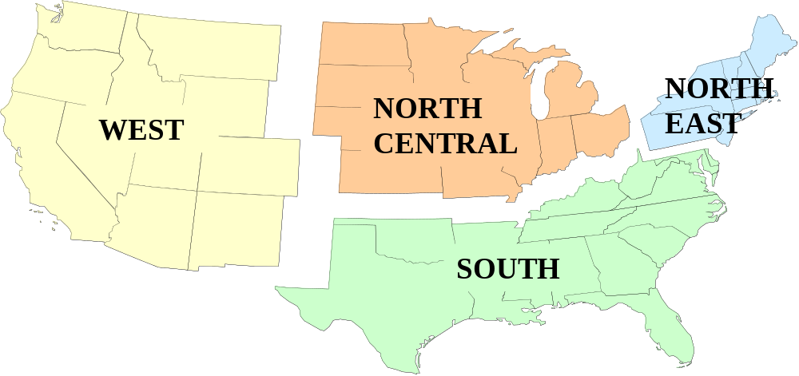
Collection Sequencing for TDS
4 market baskets yearly, one from each region
Foods collected in 3 cities per region
Cities vary from year to year

Slide 14
FDA’s Occurrence Data: Status
Range similar to that reported previously (at WHO/FAO)
Cooking time and temperature make a difference
Still surveying occurrence
  Variability evaluation next
  Then sample for exposure (Total Diet Study, supplemented as needed)
Not enough data to adequately explore exposure variability yet

Slide 15
Recap: Testing for acrylamide
FDA is collecting occurrence data to identify the scope and nature of the issue, and to inform process evaluations
CFSAN will use Total Diet Study to assess exposure of US consumers to acrylamide from food
This exposure information will help us evaluate the risk of acrylamide in food
Notes:
---Analytical results from foods will also help us learn about mechanisms of formation, by identifying foods with high levels of acrylamide

Slide 16
2. Acrylamide formation:
Research and outreach
National Center for Food Safety and Technology (NCFST) and CFSAN are investigating:
  Mechanisms of acrylamide formation
  Processes for reducing formation
  NCFST is an FDA-Academia-Industry consortium
FDA is working with the Joint Institute for Food Safety and Applied Nutrition (JIFSAN) to foster
  Data needs discussions and data sharing relevant to formation mechanism and effects of processing
FDA will interact with industry to:
  Conduct research on acrylamide formation and reduction
  Adapt processes that safely reduce acrylamide
Notes:
NCFST, an FDA-industry-academia consortium, will invesitgate

Slide 17
3. Toxicology:
State of Knowledge
Current situation is part of ongoing assessment of the knowledge base for acrylamide
  For prior decisions - EPA, IARC, WHO, EC, Australia, FDA
Example: FDA food contact decisions
  Ten thousand-fold lower exposures than we now know about
  Decision is “use or don’t use”
Our knowledge has changed with regard to
  How we are exposed
    Was thought to be primarily occupational or water exposures
  The levels to which we are exposed
More toxicology data may be needed to make decisions under this newly discovered scenario.

Slide 18
FDA’s National Center for Toxicological Research (NCTR) short-term studies
Compare “bioavailability” of acrylamide in drinking water to that in the diet
  These studies should
    Clarify how much acrylamide is absorbed from food and
    Shed light on the significance of previous toxicology information
Identify DNA and protein “adducts” caused by acrylamide
  Adducts are reaction products between a chemical and either DNA or proteins
  Adducts can tell us
    How much exposure occurs and
    Help us understand the toxicology
  Adducts may be particularly useful in relating animal toxicity studies to potential risks for humans from acrylamide

Slide 19
FDA’s National Center for Toxicological Research (NCTR) longer-term studies
FDA plans to nominate acrylamide to the National Toxicology Program
FDA will request subchronic toxicity studies, chronic carcinogenicity studies, and mechanistic studies
NCTR will conduct these studies through interagency agreement with the National Institute for Environmental Health Sciences (NIEHS)
FDA will participate in all experimental protocol designs to assure regulatory needs are met

Slide 20
3. Toxicology:
Evaluation of noncancer endpoints
In addition to evaluation of cancer potential
FDA will continue to evaluate non-cancer endpoints for acrylamide toxicity
  Germ cell mutation
  Neurotoxicity
US Environmental Protection Agency’s chemical reference dose (RfD)
  based on peripheral neuropathy in rats

Slide 21
4. Education
FDA will develop educational material to
  Inform and educate consumers and processors about the potential risks of acrylamide in foods
  And, as knowledge is gained, provide options on how to reduce the risks
FDA will solicit participation by stakeholders in the framing of the messages
Notes:
This information will take into account the need to balance other potential risk factors for consumers, such as the risk of microbial contamination with reductions in cooking time

Slide 22
5. Meetings and collaborative projects: FDA-sponsored
Federal interagency roundtable, September 24, 2002
Public meeting, September 30, 2002
Food Advisory Committee and subcommittee meetings
  December 2002
  March 2003
Notes:
--Meeting of federal PH agencies involved in acrylamide research Participants include NCTR, EPA, CDC (including NIOSH), and NIEHSTopics include the results of the WHO consultation, plans for toxicology studies at NCTR, EPA’s reevaluation of its IRIS file on acrylamide, the potential use of biomarkers to monitor acrylamide exposure (CDC—subagency name like niosh available?), epidemiological studies and occupational exposures (NIOSH), and heritable mutagen assays (NIEHS)
--Today’s public meeting, as mentioned before, is an opportunity to get public comment, which we will take into account when revising the plan
--FDA will convene a meeting of the Subcomm on Contaminants and Natural Toxins of the Food Advisory Committee in early Dec FDA will prevent its draft action plan, revised based on comments from the public meeting

Slide 23
5. Meetings and collaborative projects: Consortia and symposia
JIFSAN workshop,
  October 28-30, 2002, Chicago, Illinois
  Data needs and responses, for topics covered at WHO/FAO
Emerging Issues in Neurotoxicology
  November 2002, Little Rock, Arkansas
  Neurotoxicity data needs
Society for Risk Analysis
  December 2002, New Orleans, Louisiana
  Case-study for risk/benefit analysis

Slide 24
5. Meetings and collaborative projects: International
WHO/FAO
  June 2002 WHO/FAO consultation
  JIFSAN clearinghouse
  JECFA meeting (tentative), early 2004
  Codex Committee on Food Additives and Contaminants, March 17-21, 2003, and in 2004
European Union
  Inter-laboratory collaborative analysis project
  Results now available
Notes:
---We will then take the input from that plan and revise again, before taking the acrylamide issue to the full committee ( note to think about what our rationale is for going through two committee meetings other than the fact that we were trying to get a schedule that Crawford would approve
--already mentioned planned workshop on germ cell mutagens, for considering other noncancer endpoints for acrylamide
--Codex : FDA will seek to take the lead on Codex action on acrylamide in food
_--JECFA: FDA will participate in an assessment of acrylamide by the WHO/FAO Joint Expert Committee on Food Additives tentatively planned for winter or spring 2004

Slide 25
Recap: Overall Goal
Through scientific investigation and risk management decision making,
  prevent and/or reduce potential risk of acrylamide in foods
  to the greatest extent feasible.
Notes:
Remind people about our projected outcomes

Slide 26
Interagency meeting on acrylamide toxicity/biomarker research
Held September 24, 2002
At FDA’s Center for Food Safety and Applied Nutrition
College Park, MD

Slide 27
Agencies participating
Department of Health and Human Services
  Food and Drug Administration
    Center for Food Safety and Applied Nutrition
    National Center for Toxicological Research
    Office of Regulatory Affairs
  National Institute of Environmental Health Sciences
  Centers for Disease Control and Prevention (CDC)
    National Center for Environmental Health
    National Institute for Occupational Safety and Health
Environmental Protection Agency
  Office of Prevention, Pesticides and Toxic Substances
  Office of Research and Development
Department of Agriculture
  Food Safety Inspection Service
  Agricultural Research Service

Slide 28
Topics addressed
What research is needed to improve the risk characterization of acrylamide relevant to food exposures?
What are the priority needs: what sequencing of research is needed?
Identify any areas of overlap and potential coordination between the agencies or with outside parties (where such research efforts are known to exist) for planned research

Slide 29
Additional goals of the meeting
Identify and clarify the status of unpublished or ongoing research
Identify key individuals for collaborations
Start collaboration in support of FDA’s decision needs for acrylamide

Slide 30
Multiple collaborations and potential synergies identified
Ongoing NIOSH occupational studies
  Collaborations: biomarkers, reproductive endpoints
Mechanistic studies in development
  Collaborations: biomarker analysis methods
Mutation research
  Public health implications evaluation needed
Biomarker analytical methods-development workgroup
Overall workgroup to share expertise in the development of data

Slide 31
Next steps
Edit/finalize the outcome document
  Solicit more interaction/buy-in from the agencies
Update the plan as appropriate
  Add specifics on research plans and collaborations
Establish interagency workgroups to continue and aid the collaboration

