Slide 1
BTeV’s Staged Detector & Some Physics Reach Comparisons with LHCb
S. Stone
June, 2004

Slide 2
BTeV Collaboration
Belarussian State- D .Drobychev,
A. Lobko, A. Lopatrik, R. Zouversky
UC Davis - P. Yager
Univ. of Colorado at Boulder
J. Cumalat, P. Rankin, K. Stenson
Fermi National Lab
J. Appel, E. Barsotti, C. Brown,
J. Butler, H. Cheung, D. Christian,
S. Cihangir, M. Fischler,
I. Gaines, P. Garbincius, L. Garren,
E. Gottschalk, A. Hahn, G. Jackson,
P. Kasper, P. Kasper, R. Kutschke,
S. W. Kwan, P. Lebrun, P. McBride,
J. Slaughter, M. Votava, M. Wang,
J. Yarba
Univ. of Florida at Gainesville
P. Avery
University of Houston –
A. Daniel, K. Lau, M. Ispiryan,
B. W. Mayes, V. Rodriguez,
S. Subramania, G. Xu
Illinois Institute of Technology
R. Burnstein, D. Kaplan,
L. Lederman, H. Rubin, C. White
Univ. of Illinois- M. Haney, D. Kim, M. Selen, V. Simatis, J. Wiss
Univ. of Insubria in Como-
P. Ratcliffe, M. Rovere
INFN - Frascati- M. Bertani, L. Benussi, S. Bianco, M. Caponero, D. Collona, F. Fabri, F. Di Falco, F. Felli, M. Giardoni, A. La Monaca, E. Pace, M. Pallota, A. Paolozzi , S. Tomassini
INFN - Milano – G. Alimonti, P’Dangelo, M. Dinardo, L. Edera, S. Erba, D. Lunesu, S. Magni, D. Menasce, L. Moroni, D. Pedrini, S. Sala , L. Uplegger
INFN - Pavia - G. Boca, G. Cossali, G. Liguori, F. Manfredi, M. Maghisoni, L. Ratti, V. Re, M. Santini, V. Speviali, P. Torre, G. Traversi
IHEP Protvino, Russia - A. Derevschikov, Y. Goncharenko, V. Khodyrev, V. Kravtsov, A. Meschanin, V. Mochalov, D. Morozov, L. Nogach, P. Semenov K. Shestermanov,
L. Soloviev, A. Uzunian, A. Vasiliev University of Iowa
C. Newsom, & R. Braunger
University of Minnesota J. Hietala, Y. Kubota, B. Lang, R. Poling, A. Smith Nanjing Univ. (China)- T. Y. Chen, D. Gao, S. Du, M. Qi, B. P. Zhang, Z. Xi Xang, J. W. Zhao
New Mexico State - V. Papavassiliou
Northwestern Univ. - J. Rosen
Ohio State University- K. Honscheid, & H. Kagan Univ. of Pennsylvania
W. Selove Univ. of Puerto Rico A. Lopez, H. Mendez, J. Ramierez, W. Xiong
Univ. of Science & Tech. of China - G. Datao, L. Hao, Ge Jin, L. Tiankuan, T. Yang, & X. Q. Yu Shandong Univ. (China)- C. F. Feng, Yu Fu, Mao He, J. Y. Li, L. Xue, N. Zhang, & X. Y. Zhang
Southern Methodist –
T. Coan, M. Hosack
Syracuse University-
M. Artuso, C. Boulahouache,
S. Blusk, J. Butt, O. Dorjkhaidav, J. Haynes, N. Menaa, R. Mountain,
H. Muramatsu, R. Nandakumar, L. Redjimi, R. Sia,
T. Skwarnicki, S. Stone, J. C. Wang, K. Zhang
Univ. of Tennessee
T. Handler, R. Mitchell Vanderbilt University
W. Johns, P. Sheldon,
E. Vaandering, & M. Webster
University of Virginia M. Arenton, S. Conetti, B. Cox, A. Ledovskoy, H. Powell, M. Ronquest, D. Smith, B. Stephens, Z. Zhe
Wayne State University G. Bonvicini, D. Cinabro,
A. Schreiner
University of Wisconsin M. Sheaff
York University - S. Menary

Slide 3
Some Significant Events in B Physics
Year | Item | Theory Prediction | ~Value | # B’s
1983 | τ_{b} | Too small to be observed ~ < 0.1 ps | 1 ps | 2x10⁴
1987 | Bº-Bº mixing | Too small to see (~ < 1%) as m_{top} is believed to be ~30 GeV | 20% | 2x10⁵
1989 | V_{ub}/V_{cb} | No direct prediction | 0.1 | 2x10⁵
1994 | b→sγ | (2.8±0.8) x10⁻⁴ | 2.3x10⁻⁴ | 4x10⁶
2001 | sin(2β) | No direct prediction, but consistent with other measurements | 3/4 | 10⁷
B physics is an experimentally driven field with exciting discoveries, many not predicted.
There is much much more physics to do.
Notes:
Belle b->s l+ l- ( 6.1+/-1.4 {+1.4, -1.1}) x 10-6 compared with theory (4.2+/-0.7) x 10-6 does not yet constrain new physics

Slide 4
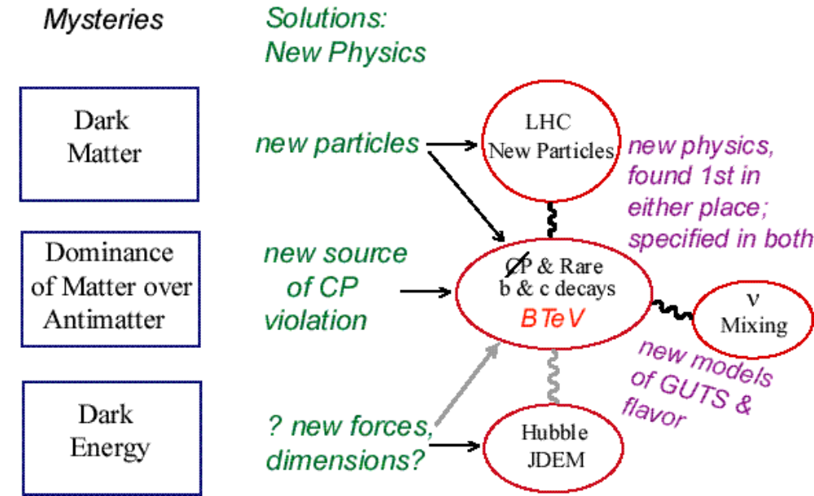
The Physics: General

Slide 5
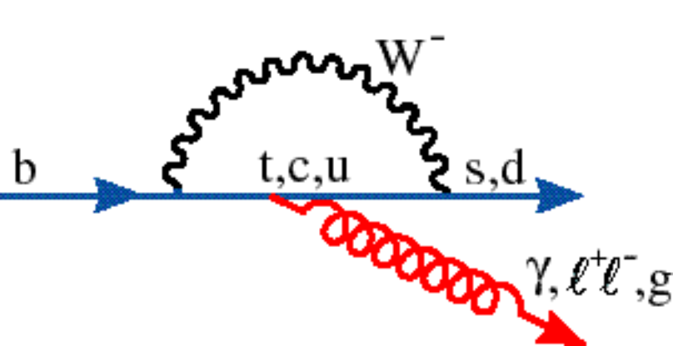
The Physics: More Specific
CP Violation: Particles behave differently than antiparticles
  Demonstrated in B decays by BaBar & Belle (one ∠ measured, β)
  But there are 4 different angles to determine: α, β, γ, χ
  Different incarnations of New Physics affect these angles in different ways. New Physics can show up as inconsistencies between/among CP measurements and other quantities.
Rare Decays
  New Particles can appear in the loop & interfere – Phases of the new physics can be investigated
New

Slide 6
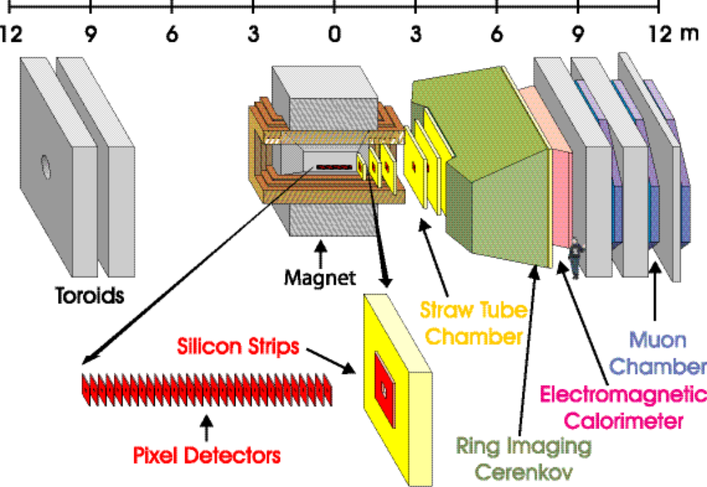
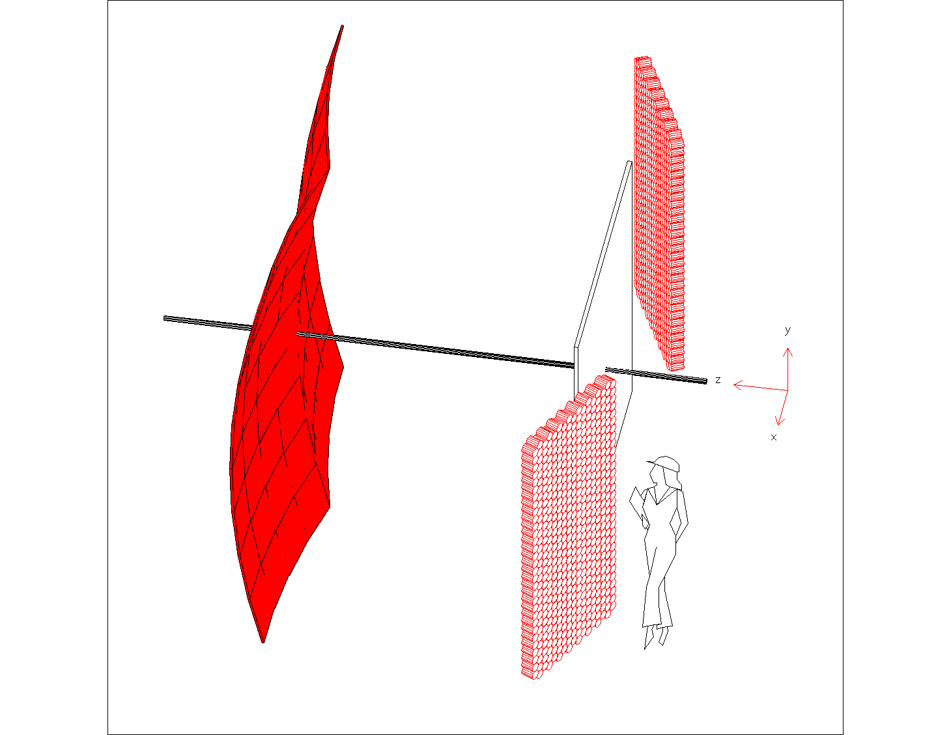
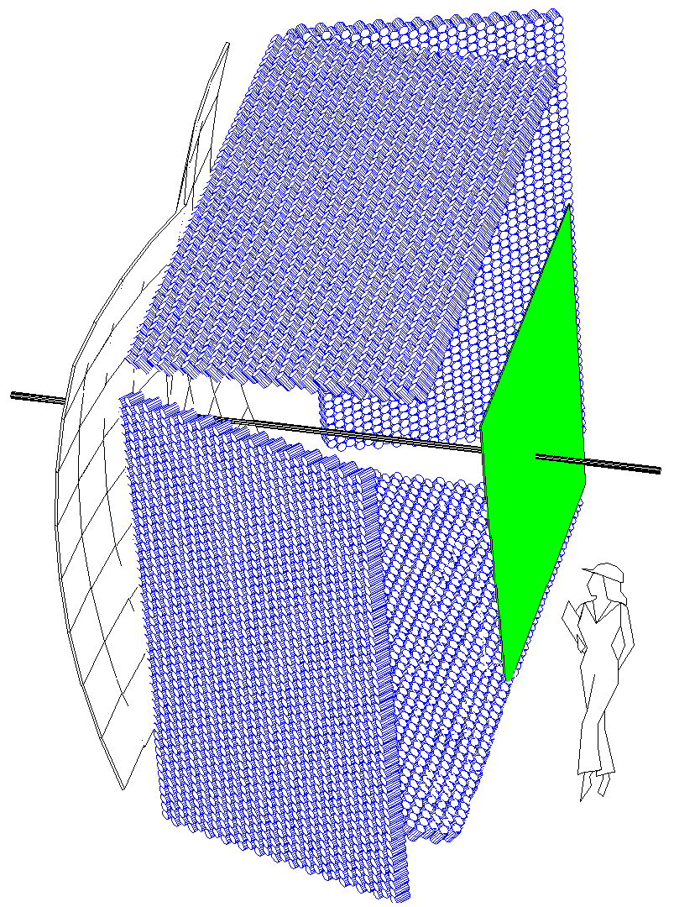
BTeV’s Staged Detector
Two-component RICH
Mirror
Array
MAPMTs
Gas
Radiator
C₄F₈O
beam
pipe
γs
Liquid
Radiator
C₅F₁₂
Electromagetic
Calorimeter
R=120 cm
R=160 cm
Only Top
PMTs in
Stage I
Stage 1
Stage 2
PMTs

Slide 7
BTeV’s Staged Detector - Details
Stage I detector
  50% of EM cal - we retain 60% of the rate on neutrals
  No liquid radiator system - we retain 75% of flavor tagging rate
  Straw stations 3 & 4 are missing, as are Silicon stations 3, 4 & 7 - no real physics effects, these are for redundancy
  No dimuon trigger & only 2 muon tracking stations - no real effects, the dimuon trigger is a useful systematic check but can come later
  50% of the trigger & DAQ highways - no real effects on b’s as there is alot of “head room” in the system and we can give up some charm initially
Stage II detector adds in all the missing components

Slide 8
BTeV’s Schedule
Stage I starts August 1, 2009
Then we run until July 1, 2010
  Expect about 1 month to commission IR
  Then its up to us to produce physics
Summary of Stage 1
  Estimate 6 months running time
  Lab says that we will run 10 months a year and get 1.6 fb⁻¹
  Thus this is a 1 fb⁻¹ run
  We have 75% of our “normal” rate on all charged flavor tagged modes
  We have 75% x 60% = 45% of our “normal” rate on flavor tagged modes with neutrals
Some Commissioning done before on wire target or at end of stores and during the 1 month IR commissioning – New IR has 2.5 x ☹ than when BTeV was approved by P5!

Slide 9
LHC & LHCb’s Schedule
LHC running in steady state
  In steady state mode, after a few years, they are scheduled to run 160 days a year for physics MINUS running for Heavy Ions - estimate 139 days on pp (see Collier, Proc. Chamonix XII, March 2003, CERN-AB-2003-008 ADM)
  LHCb will start running at 2.8x10³²; this gives using the formula in Collier 0.8 fb⁻¹ per calendar year
LHCb initial running constraints
  Initially plan to set β* 100 x ATLAS/CMS, to avoid multiple interactions/crossing as 1st runs will be with 1632 ns bunch spacing to avoid necessity of crossing angle (Here LHCb needs special set up to see collisions since they are displaced by 11.2 m from interaction region center)
  First year will see limited running at 75 ns bunch spacing; LHCb will run at 2/3 x10³² to avoid multiple int/xing. Second year will switch from 75 ns to 25 ns “when possible”

Slide 10
LHCb’s Schedule
LHC schedule (LHCb-1)
  Nominal: start April 1, 2007
  We predict LHCb 2007 integrated luminosity to be 0.1 fb⁻¹
  Since the 1st quarter of 2008 is still in the 1st year of tuning they will collect 0.6 fb⁻¹
  They get the full 0.8 fb⁻¹ in 2009
But - this schedule has no contingency

Slide 11
LHCb’s Schedule 2
Therefore we choose to set up an alternate schedule similar to the one that we have that has lots of float. A defensible schedule has ~ 12 months of float implying:
  0 fb⁻¹ in 2007
  0.1 fb⁻¹ in 2008
  0.6 fb⁻¹ in 2009
  0.8 fb⁻¹ in 2010 and beyond
Neither for BTeV or LHCb is detector commissioning considered in what follows: we assume it will factor out of the comparisons
  BTeV has some commissioning on wire target etc…
  LHCb has limited accesses due to interference with ATLAS, CMS, etc..

Slide 12
Yearly Integrated Luminosity Assumptions
fb⁻¹
 | 2007 | 2008 | 2009 | 2010 | 2011 | 2012 | 2013 | 2014 | Sum
LHCb-1 | 0.1 | 0.6 | 0.8 | 0.8 | 0.8 | 0.8 | 0.8 | 0.8 | 5.5
LHCb-2 |  | 0.1 | 0.6 | 0.8 | 0.8 | 0.8 | 0.8 | 0.8 | 4.7
BTeV |  |  |  | 1.5 | 1.6 | 1.6 | 1.6 | 1.6 | 7.9

Slide 13
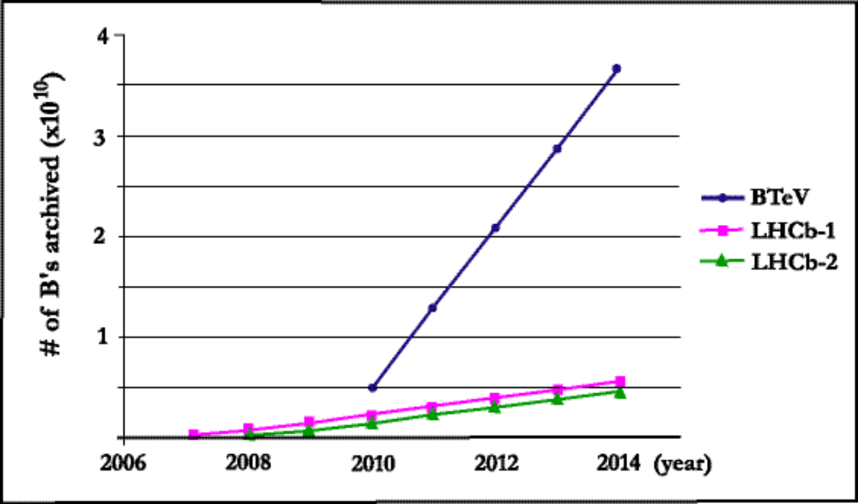
Comparison I - Total number of B’s to “tape”
For BTeV we take 1/2 the nominal rate in 2010 due to the staged detector
BTeV is better by 5x from Trigger-DAQ & 2x from running time, giving a factor of 10 bb’s to tape
e⁺e⁻ at 1000 fb⁻¹ would have 0.1 x10¹⁰ bb’s

Slide 14
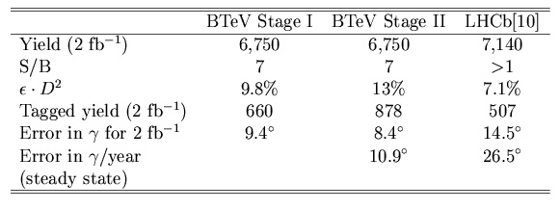
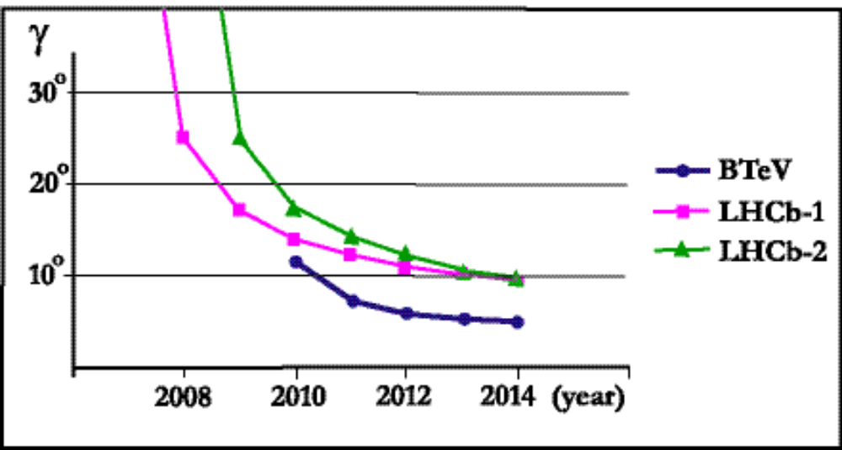
Measuring γ Using B_{s}→D_{s}K⁻
From LHCb
Light TDR

Slide 15
Conclusion on Measuring γ in B_{s}→D_{s}K⁻
What is a meaningful measurement of a CP violating angle?
  Example Bº→φK_{s} CP Asymmetry = sin2β Babar: 0.47±0.34±0.07, Belle: -0.96±0.50±0.10
  in J/ψ K_{s} sin2β = 0.74±0.05. Thus both measurements are not definitive and both have an error in β ~14º. Need δβ < 10º or better!
Thus LHCb will not likely have a meaningful measurement of γ in either of their turn on scenarios before BTeV, nor will they ever make a measurement as good as BTeV’s

Slide 16


Measuring α using Bº→ρπ
LHCb
  Shaslik-style Pb-scintillating fiber device, energy resolution BTeV's is
  The LHCb detector segmentation is 4x4 cm² up to 90 mr, 8x8 cm² to 160 mr and 16x16 cm² at larger angles. (The distance to the interaction point is 12.4 m.) Thus the segmentation is comparable to BTeV only in the inner region. (BTeV has 2.8 x 2.8 cm² crystals 7.4 m from the center of the interaction region.)
  In 2 fb⁻¹ 7260 events, S/B <1/7.1, no estimate from LHCb of δα, we find 11.7º from these #’s compared to BTeV Stage I 6.3º
Since LHCb will accumulate only half the integrated luminosity of BTeV per year, it is clear that they will not be able to make a definitive measurement of α, in fact, it is likely that they will not be able to make one at all, not surprising because of the poor energy resolution and segmentation of their calorimeter.

Slide 17
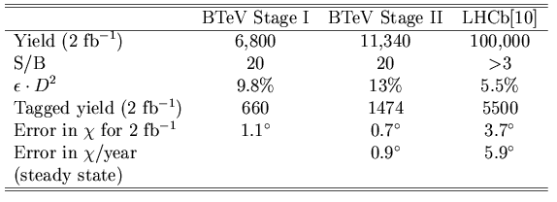
Measuring χ in B_{s} decays
Modes
  BTeV uses CP eigenstates: J/ψ η⁽′⁾
  LHCb uses J/ψ φ, VV mode so they must do a transversity analysis
CDF & D0 get 1 J/ψ φ each per pb⁻¹ ⇒ δχ~13º in Run II, if B_{s} mixing is also measured (sets a floor on ∫L)

Slide 18
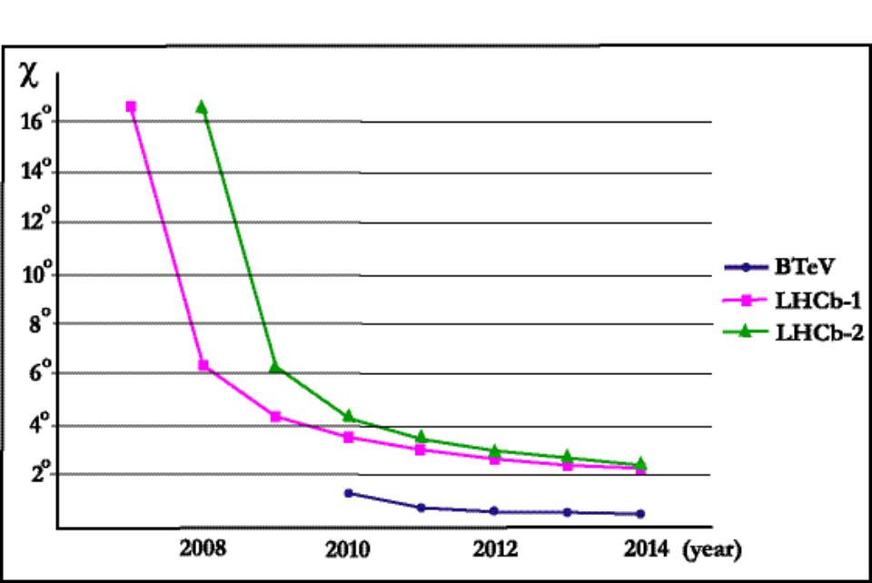
Conclusions on χ
LHCb will have a chance in 2009 of making a significant measurement of χ, if it is in excess of ~20º and they collect sufficient integrated luminosity to improve over the combined CDF & DO measurement. At the end of 2010 BTeV will have the best measurement of χ and the error will eventually be less than 0.5º.
Thus BTeV has the best chance of making a significant measurement if new physics is present and is the only detector that can measure χ if new physics doesn't make a very large contribution.

Slide 19
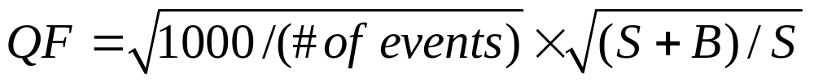
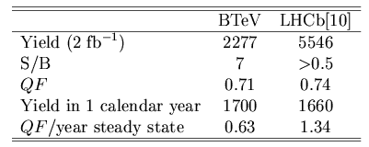
The Rare Decay Bº→K*ºμ⁺μ⁻
Want to measure the polarization
No flavor tagging here
Define
BTeV eventually overtakes LHCb

Slide 20
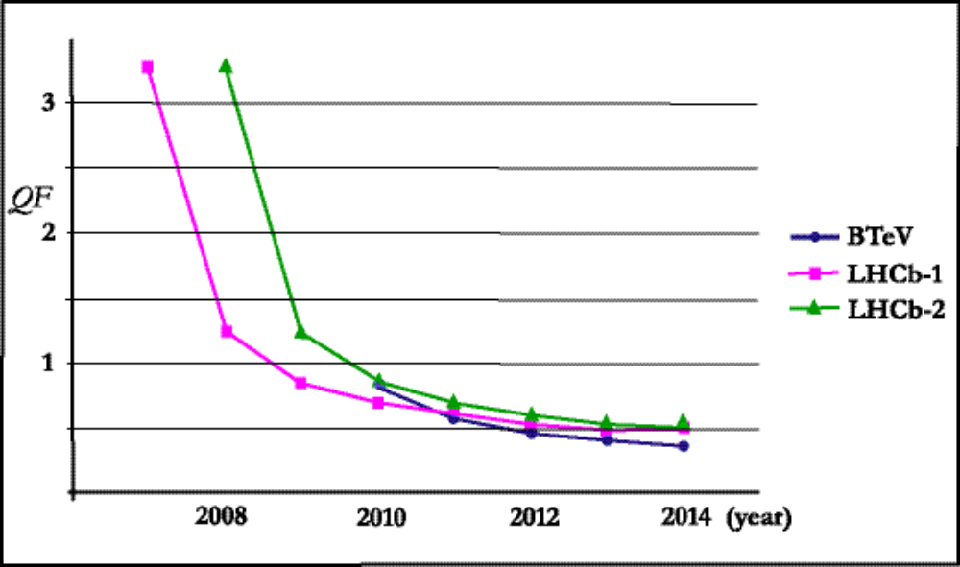
Time dependence of Bº→K*ºμ⁺μ⁻
This is LHCb’s best case: They trigger on dimuons, there is no flavor tagging, and yet BTeV eventually has smaller errors

Slide 21
Conclusions
The LHC turn on will be a long process by their own projections. Latest information (CMS May review), it will not start before August 2007
LHCb will have trouble dealing with initial 75 ns running
LHCb may get lucky and measure something “easy” like B_{s} mixing, if CDF & D0 don’t do it but they will have to overcome what both CDF & D0 do with Bs & what the B factories do with Bº & B⁻
In the slightly longer term, BTeV will dominate measurements of α, γ, & χ
After 2010 BTeV’s physics reach will dominate in all areas

