Slide 1
Deuteron Polarimetry
for an EDM Search:
Ideas and Concepts
Ed Stephenson
Indiana University Cyclotron Facility
Bloomington, IN
Other talks have discussed producing an EDM effect.
Here I will discuss measuring that effect.
for the EDM/g-2 Workshop
RHIC/AGS Users’ Meeting - 2006

Slide 2
What is the effect in a “resonant” storage ring?
Polarization is initially along the momentum direction.
v × B generates E-field in frame of particle.
spin
E
velocity
B

Slide 3
What is the effect in a “resonant” storage ring?
Polarization is initially along the momentum direction.
v × B generates E-field in frame of particle.
An EDM will precess the spin out of the orbit plane.
spin
E
velocity
B

Slide 4
What is the effect in a “resonant” storage ring?
Polarization is initially along the momentum direction.
v × B generates E-field in frame of particle.
An EDM will precess the spin out of the orbit plane.
spin
But spin precesses in plane due
to magnetic moment in B-field.
velocity
E
B
B

Slide 5
What is the effect in a “resonant” storage ring?
Polarization is initially along the momentum direction.
v × B generates E-field in frame of particle.
An EDM will precess the spin out of the orbit plane.
spin
But spin precesses in plane due
to magnetic moment in B-field.
velocity
E
B
B
At some later time, the
spin is pointing backward.
spin
E
v
B

Slide 6
What is the effect in a “resonant” storage ring?
Polarization is initially along the momentum direction.
v × B generates E-field in frame of particle.
An EDM will precess the spin out of the orbit plane.
spin
But spin precesses in plane due
to magnetic moment in B-field.
velocity
E
B
B
At some later time, the
spin is pointing backward.
spin
E
During this part of the
cycle, an EDM will
precess the spin back
into the plane.
v
B

Slide 7
What is the effect in a “resonant” storage ring?
Polarization is initially along the momentum direction.
v × B generates E-field in frame of particle.
An EDM will precess the spin out of the orbit plane.
spin
But spin precesses in plane due
to magnetic moment in B-field.
velocity
E
B
B
At some later time, the
spin is pointing backward.
spin
E
The EDM precession on these
two parts of the cycle cancel,
leaving no net effect from an EDM.
During this part of the
cycle, an EDM will
precess the spin back
into the plane.
v
B

Slide 8
What is the effect in a “resonant” storage ring?
Polarization is initially along the momentum direction.
v × B generates E-field in frame of particle.
An EDM will precess the spin out of the orbit plane.
spin
Add a synchrotron oscillation
that is in phase with the in-plane
spin precession.
velocity
E
B
spin
E
During this part of the
cycle, an EDM will
precess the spin back
into the plane.
v
B

Slide 9
What is the effect in a “resonant” storage ring?
Polarization is initially along the momentum direction.
v × B generates E-field in frame of particle.
An EDM will precess the spin out of the orbit plane.
spin
Add a synchrotron oscillation
that is in phase with the in-plane
spin precession.
velocity
E
B
This increases the velocity
and precession here.
spin
E
During this part of the
cycle, an EDM will
precess the spin back
into the plane.
v
B

Slide 10
What is the effect in a “resonant” storage ring?
Polarization is initially along the momentum direction.
v × B generates E-field in frame of particle.
An EDM will precess the spin out of the orbit plane.
spin
Add a synchrotron oscillation
that is in phase with the in-plane
spin precession.
velocity
E
B
The spin starts
higher here.
This increases the velocity
and precession here.
spin
E
During this part of the
cycle, an EDM will
precess the spin back
into the plane.
v
B

Slide 11
What is the effect in a “resonant” storage ring?
Polarization is initially along the momentum direction.
v × B generates E-field in frame of particle.
An EDM will precess the spin out of the orbit plane.
spin
Add a synchrotron oscillation
that is in phase with the in-plane
spin precession.
velocity
E
B
The spin starts
higher here.
This increases the velocity
and precession here.
spin
E
But the velocity is now lower,
so the EDM precession is less.
During this part of the
cycle, an EDM will
precess the spin back
into the plane.
v
B

Slide 12
What is the effect in a “resonant” storage ring?
Polarization is initially along the momentum direction.
v × B generates E-field in frame of particle.
An EDM will precess the spin out of the orbit plane.
spin
Add a synchrotron oscillation
that is in phase with the in-plane
spin precession.
velocity
E
B
The spin starts
higher here.
This increases the velocity
and precession here.
spin
E
But the velocity is now lower,
so the EDM precession is less.
Now there is a net
precession from the
EDM on each cycle.
During this part of the
cycle, an EDM will
precess the spin back
into the plane.
v
B
Repeat 10⁹ times and measure vertical polarization!

Slide 13
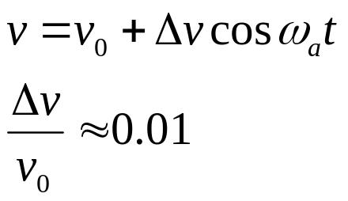
How big is the effect?
For d = 10^{–29} e·cm,
average rate of rise is
Suppose:
ω_{EDM} = 5.7 × 10^{–10} rad/s.

Slide 14
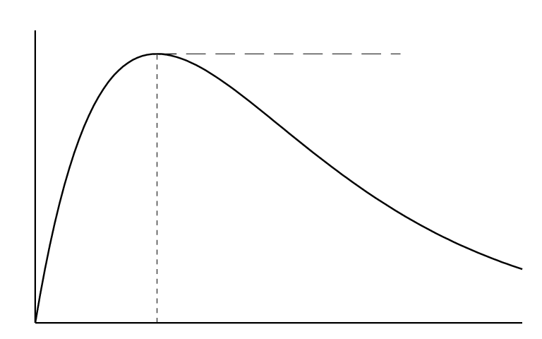

How big is the effect?
For d = 10^{–29} e·cm,
average rate of rise is
Suppose:
ω_{EDM} = 5.7 × 10^{–10} rad/s.
In-plane polarization is inherently unstable, so the polarization will decay
with a characteristic lifetime τ (consistent with a Gaussian spread of spins).
Time dependence
of EDM signal
p
p_{max} = 1.3 × 10⁻⁷
for p₀ = 0.6
and τ = 1000 s.
t
Do not extend store
much beyond τ.
Fit shape to data.
τ
Similar sensitivities are obtained
in hadronic parity violation experiments.

Slide 15
Polarimeter requirements:
High efficiency
High spin sensitivity
Continuous measurement
Vertical and in-plane components
Bunch timing resolution (<<4 ns)

Slide 16
Best choice:
Polarimeter requirements:
deuteron scattering from
a thick carbon target
High efficiency
High spin sensitivity
Continuous measurement
Vertical and in-plane components
Bunch timing resolution (<<4 ns)
Forward angle elastic
cross sections are large.
Spin-orbit forces make
substantial spin dependence.

Slide 17

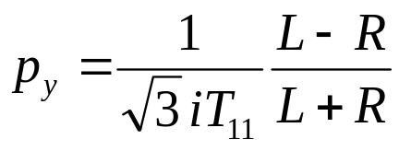
Best choice:
Polarimeter requirements:
deuteron scattering from
a thick carbon target
High efficiency
High spin sensitivity
Continuous measurement
Vertical and in-plane components
Bunch timing resolution (<<4 ns)
Forward angle elastic
cross sections are large.
Spin-orbit forces make
substantial spin dependence.
How does it work?
detectors:
Relative rates (left/right)
depend on degree of polarization.
Left
spin up
●
θ
beam
spin sensitivity
target
Asymmetries:
L/R – EDM signal
D/U – g-2 precession
Right

Slide 18
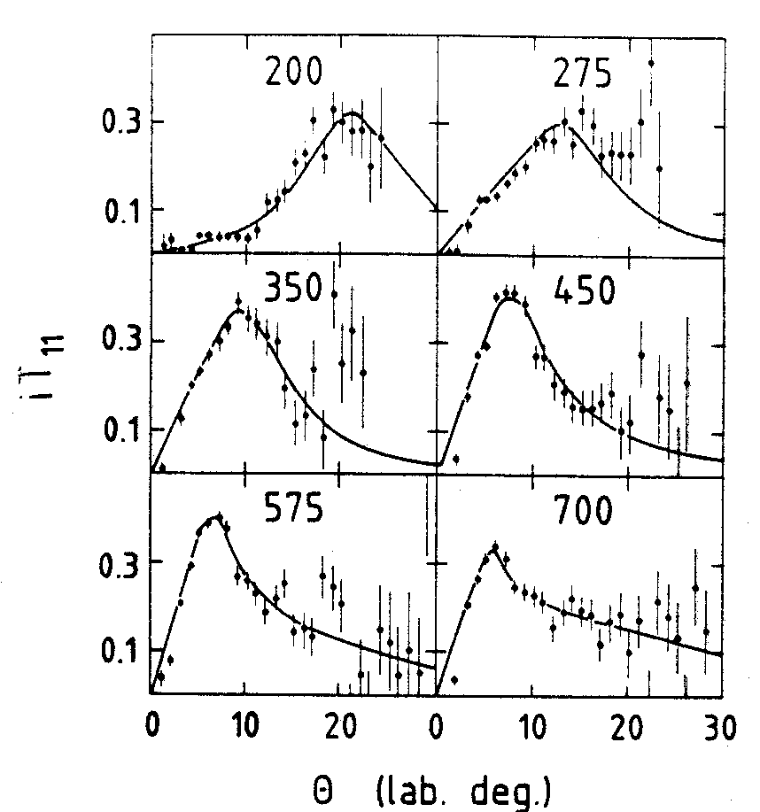
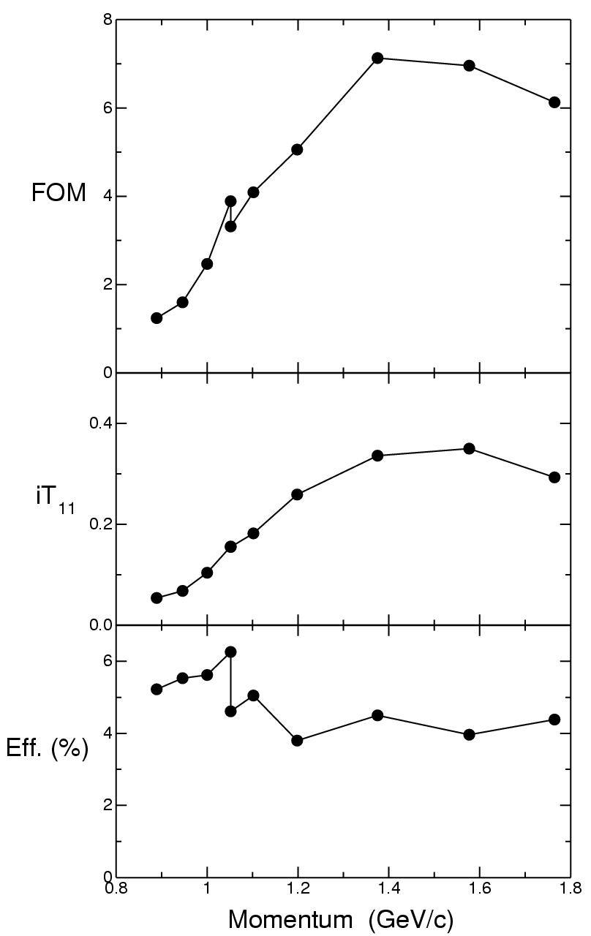


Data from Saturne show a
significant value of iT₁₁(θ)
at small laboratory angles.
Data across energies is used to
optimize polarimeter performance.
Points correspond to acceptance
ranges of about 5°.
best spot
number of
deuterons used
to measure
polarization as
a fraction of all
deuterons in
the beam
The range of
momenta covering
p = 1.0 – 1.5 GeV/c
is 250 – 526 MeV.
work
here
Bonin et al., NIM A288, 389 (’90)

Slide 19
EDM polarimeter
IDEA:
make thick target defining aperture
scatter into it with thin target
lost to ring
acceptance
(2 kb)
40 MeV: 10⁻⁵
1 GeV: 6x10⁻⁴
cross
section
(POMME efficiency
several percent)
Coulomb
useful for
spin (17 mb)
detector
system
L, R, D, and U
functional
subdivisions
nuclear
“defining aperture”
primary target
U
angle
“extraction”
target - gas
L
R
D
Δ
R
D
Target could be
Ar gas (higher Z).
Hole is large
compared to
beam. Every-
thing that goes
through hole
stays in the
ring. (It may
take several
orbits to stop
scattered
particle.)
Detector is far enough
away that doughnut
illumination is not an
acceptance issue:
Δ < R.
Events must imbed far
enough from hole to
not multiple scatter out
of primary target, thus
Δ << D. Δ, which is a
large fraction of the
deuteron range, sets
scale for polarimeter.
Target “extracts” by
Coulomb scattering
deuterons onto thick
main target. There’s
not enough good
events here to
warrant detectors.
Primary target may
need to be iris to
allow adjustment of
position and inner
radius. It may also
need to be removed
during injection.

Slide 20
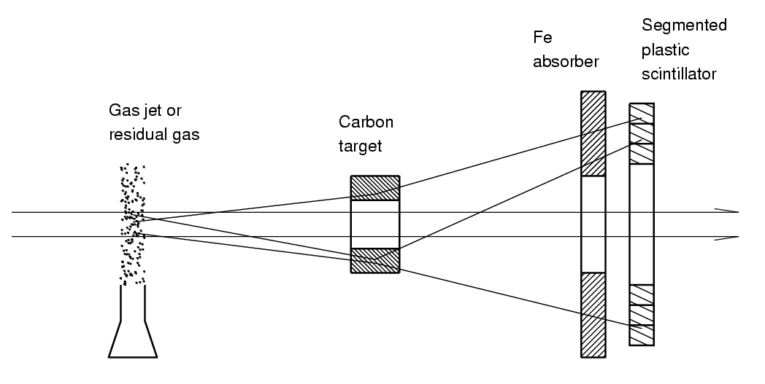
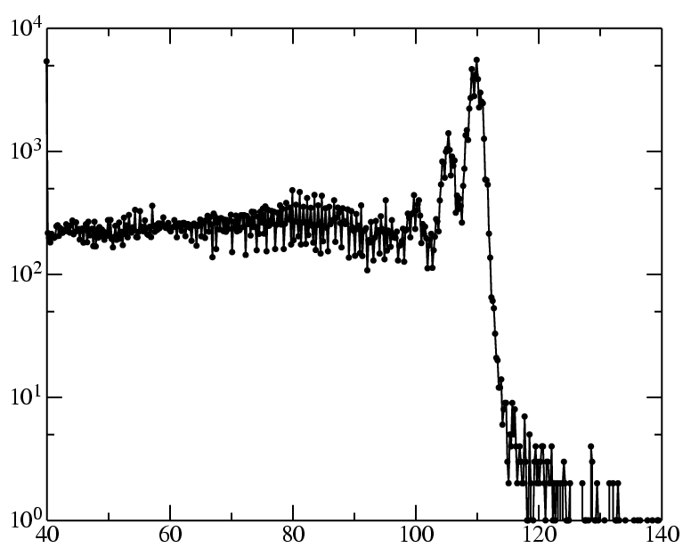
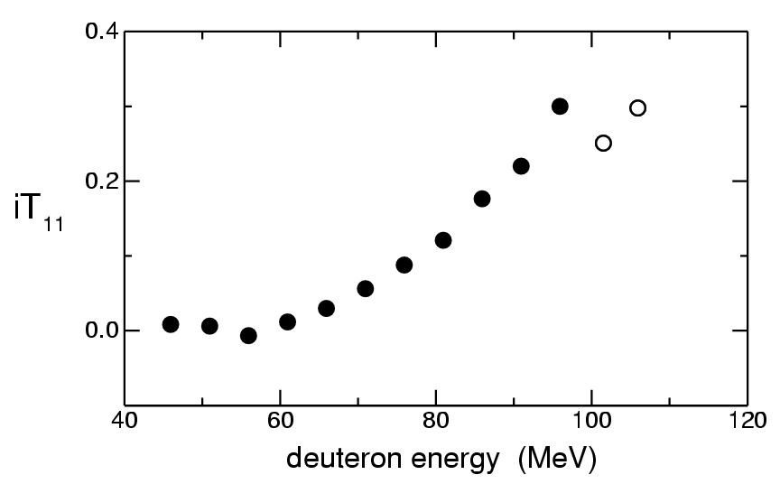
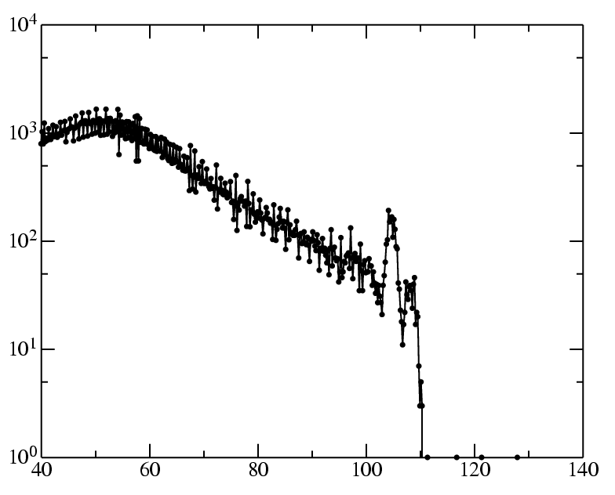
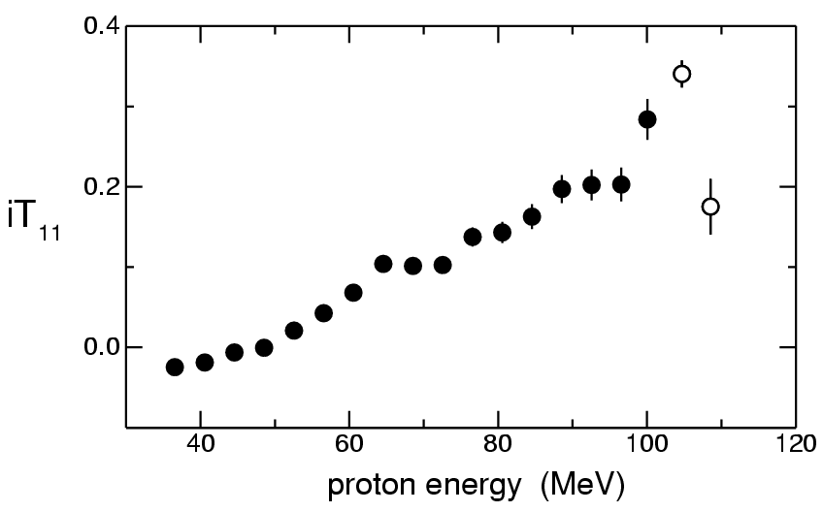
Optimization of polarimeter performance
Sample spectra, 110 MeV, 27°
rates (50 elements) ~ 2e7 /s
DEUTERON
1
Adjust target thickness to
maximize useful rate without
degrading performance.
iT₁₁
PROTON
Adjust Fe absorber to
remove breakup protons
(no spin dependence)
and leave elastic
deuterons.
2
Segment scintillator
to yield two transverse
asymmetries and
check systematics.
3
detected particle energy (MeV)

Slide 21

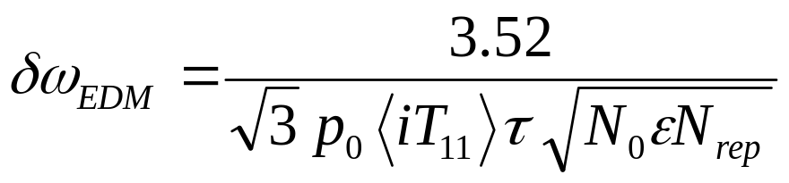

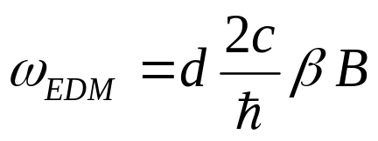




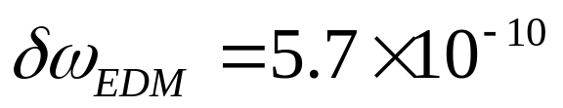




Statistical Precision
Polarimeter properties
estimated error in EDM precession
efficiency
target: 15 cm C at 1.7 g/cm³
θ range = 3.5° – 8.5°
NOTE:
Measurement time is polarization lifetime.
Extraction rate is constant.
s
For
e·cm
momentum
GeV/c
rad/s
Reaching the 1σ limit requires 1.7 years.
Data acquisition time
N_{rep} = 5.2 × 10⁴
T

Slide 22
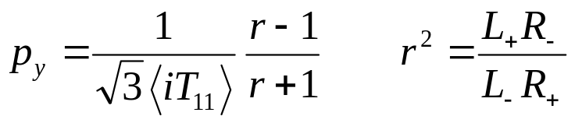
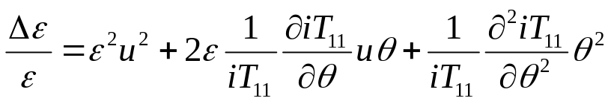
Dealing with systematic errors
The Toolbox:
spin reversal (at source, in different bunches)
combined with cross-ratio calculations
correct time dependence
depolarization confirmed from in-plane values
An illustration:
Fix problem with spin-flip and cross ratio:
angle error
θ
Systematic effects come at higher order
and constrain allowed size of θ.
position error
θ
asymmetry
~ 0.01
(residual p_{y})
~0.1
~ –0.07
requires θ < 0.02°
difference + to –
both represented by θ
u = p₊ + p–

Slide 23
R&D Issues
better elastic scattering data
Bonin data contains much proton contamination, iT₁₁ too low
run at RIKEN/COSY and/or optical model analysis
better model of polarimeter (Monte Carlo simulation)
explore target/absorber thickness
explore acceptance (statistics and systematics)
develop systematic error strategies
develop suitable fast detectors
test prototype for beam/polarimeter interactions

