Slide 1
Gamow HFB description of loosely bound and resonant medium and heavy nuclei
Nicolas Michel (Kyoto University)
Kenichi Matsuyanagi (Kyoto University)
Mario Stoitsov (ORNL – University of Tennessee)

Slide 2
Plan
Scientific motivation: drip-line nuclei
Gamow states, Berggren completeness relation
Gamow quasi-particle states and HFB densities
Applications: Nickel chain and one proton emitters (spherical)
Pöschl-Teller-Ginocchio (PTG) basis for loosely bound systems
Resonant structure with PTG basis
Applications: Nickel chain (spherical)
Zirconium and Magnesium (deformed)
Conclusion and perspectives

Slide 3
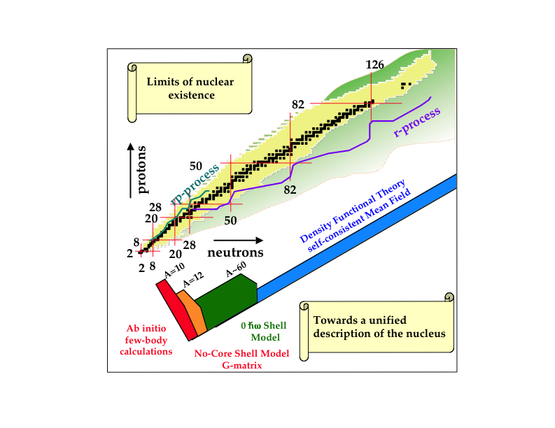
Scientific motivation

Slide 4
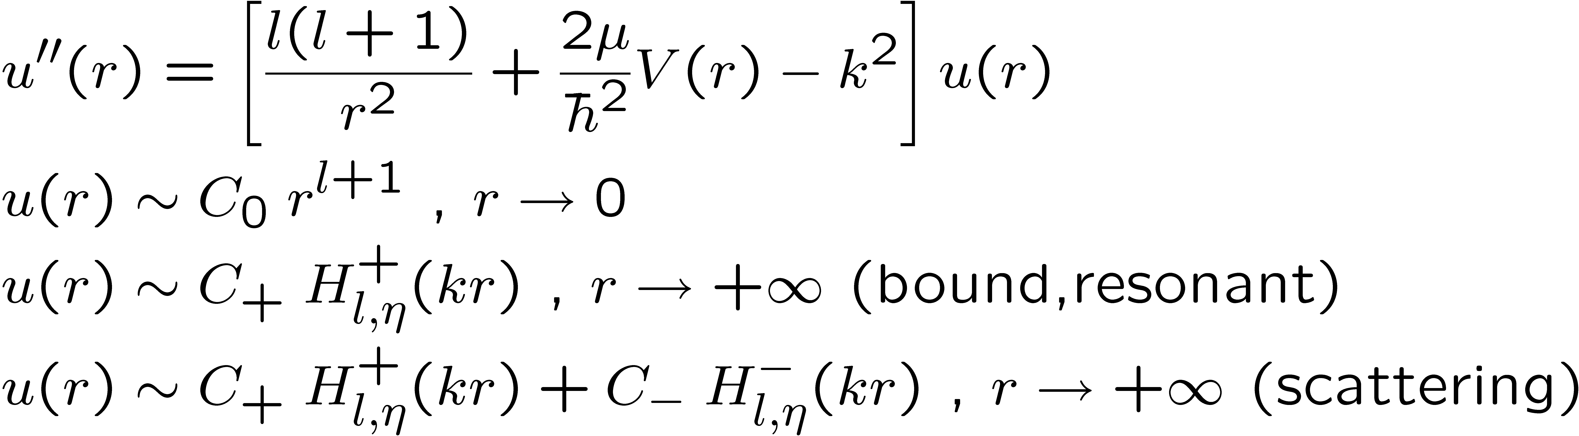
Gamow states
Georg Gamow : α decay
G.A. Gamow, Zs f. Phys. 51 (1928) 204; 52 (1928) 510
Definition :

Slide 5
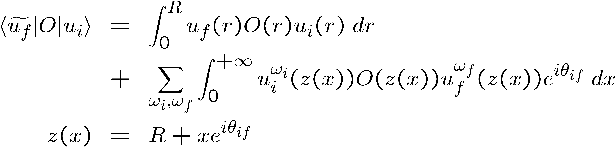
Complex scaling method
Radial integral calculation : complex scaling
Analytic continuation : integral independent of R and θ

Slide 6
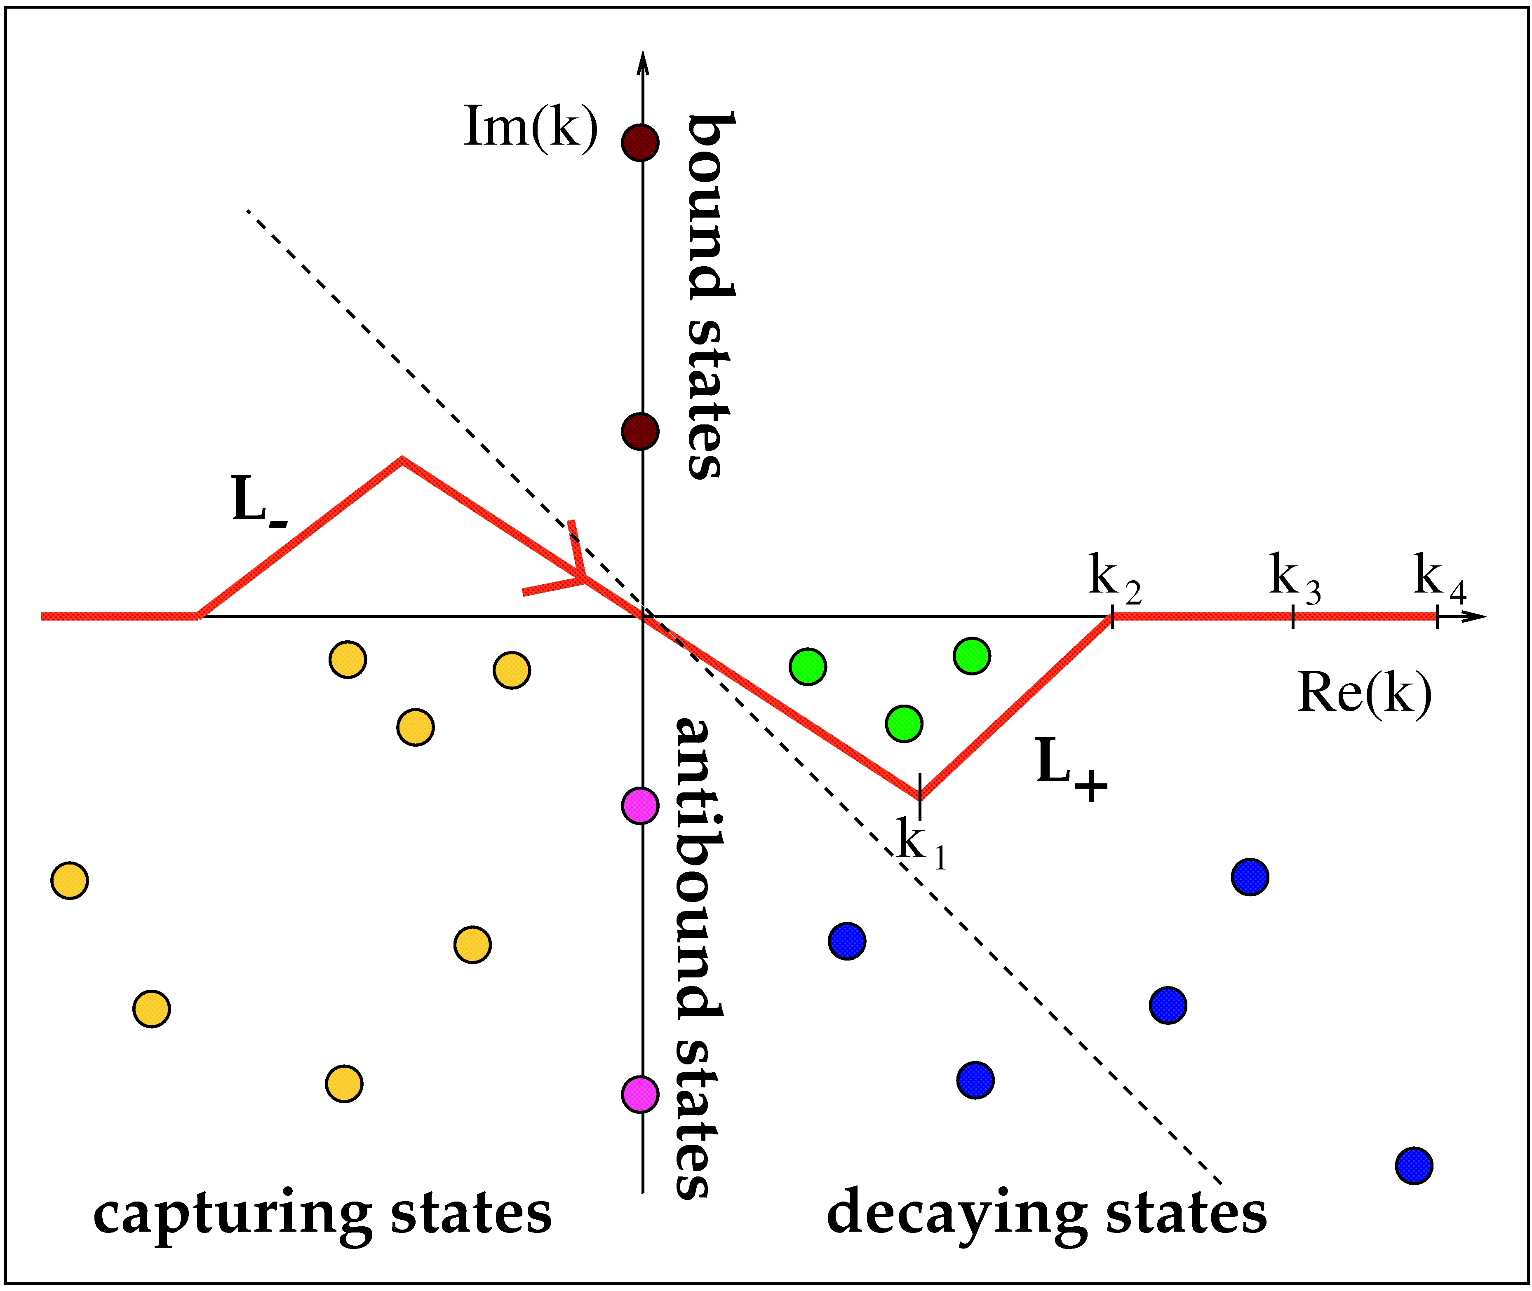
Gamow states location
Choice of contour
arbitrary
narrow
broad

Slide 7
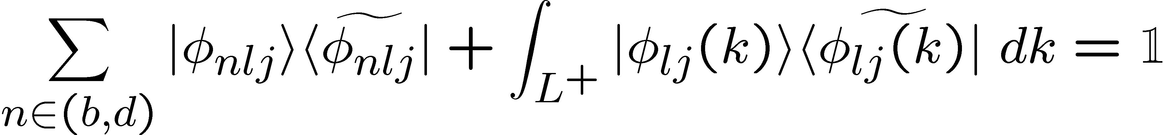
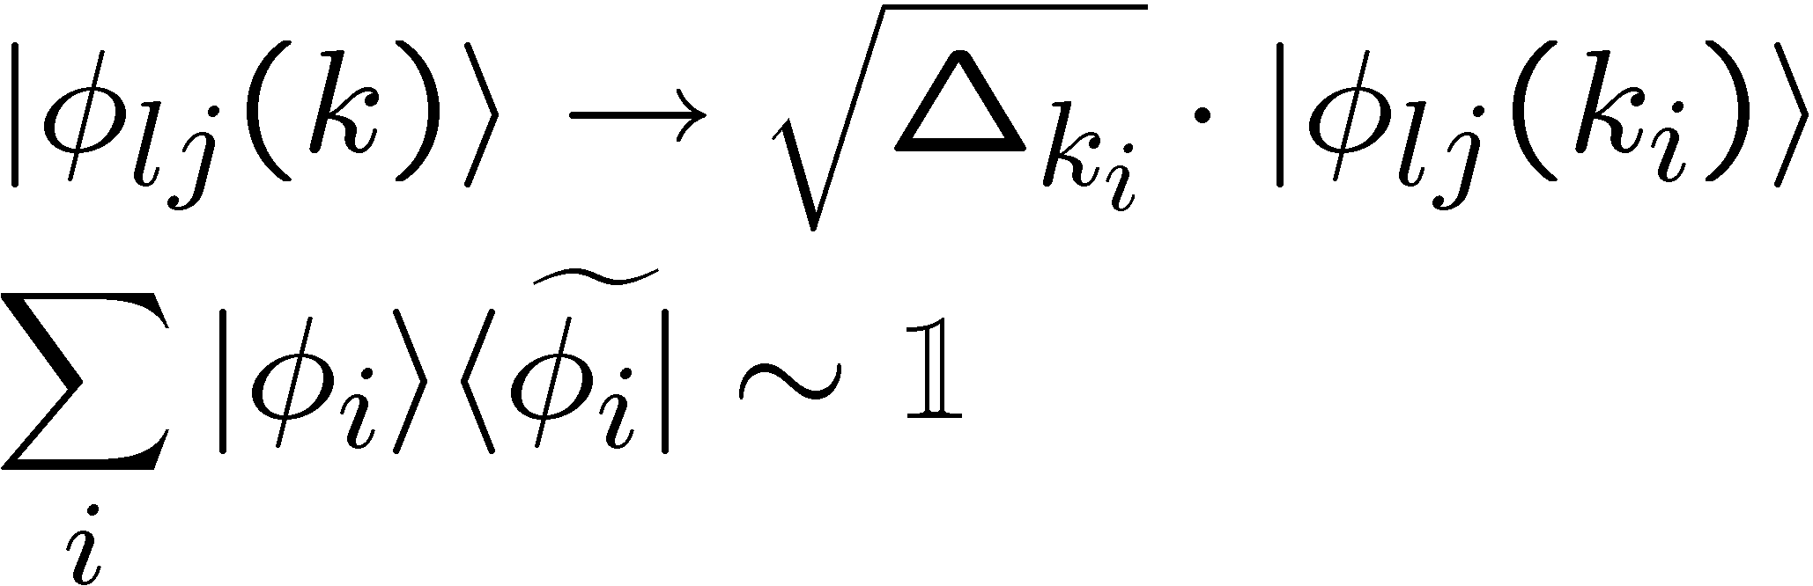
Completeness relations with Gamow states
Berggren completeness relation (l,j) :
T. Berggren, Nucl. Phys. A 109, (1967) 205
Continuum discretization :

Slide 8

Gamow HFB space
bound (λ < 0)
HF bound, resonant

Slide 9
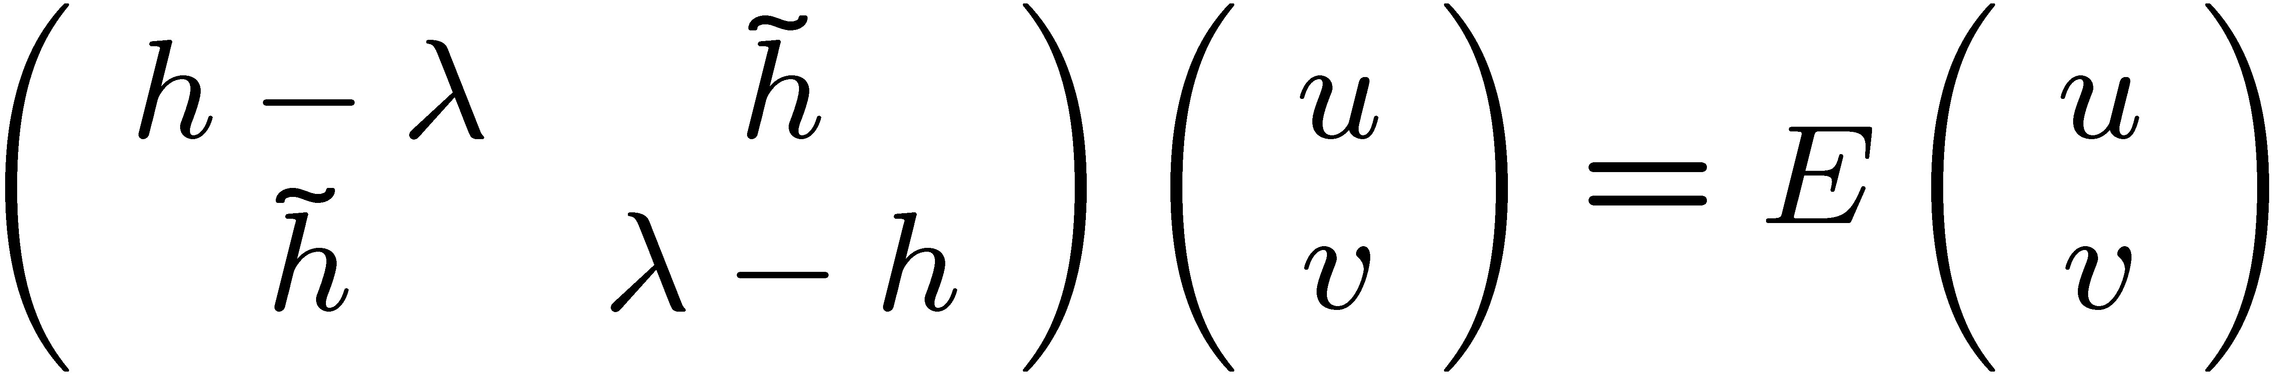
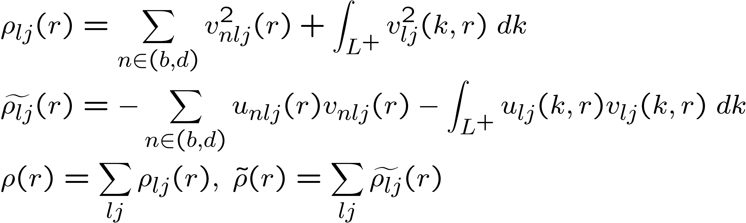
Densities with Gamow HFB
HFB equations:
Complex particle and pairing densities:
HF associated bound and narrow resonant states in discrete sum

Slide 10
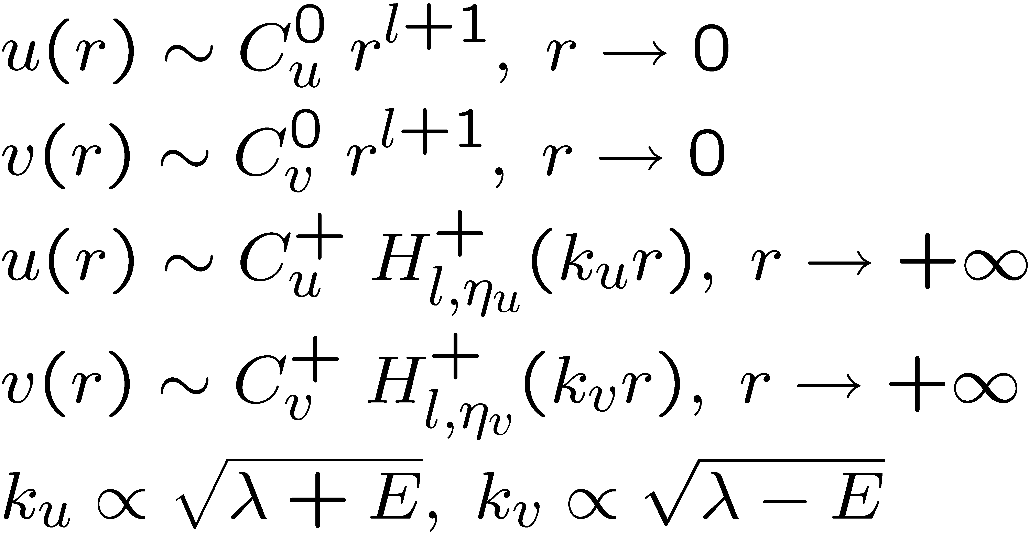
Quasi-particle pole states
Bound, resonant states:
S matrix poles => outgoing wave function behavior

Slide 11
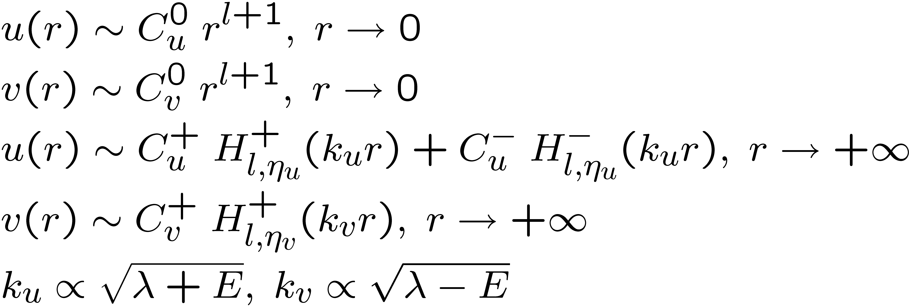
Quasi-particle scattering states
Scattering states:
u(r): incoming and outgoing components
v(r): outgoing wave function behavior

Slide 12
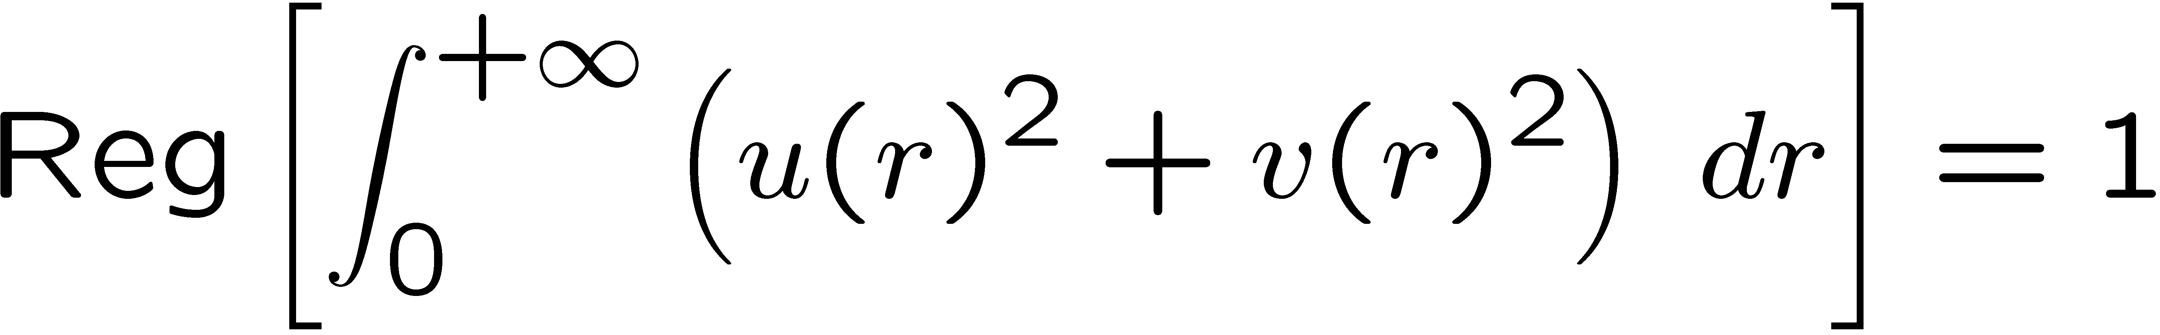
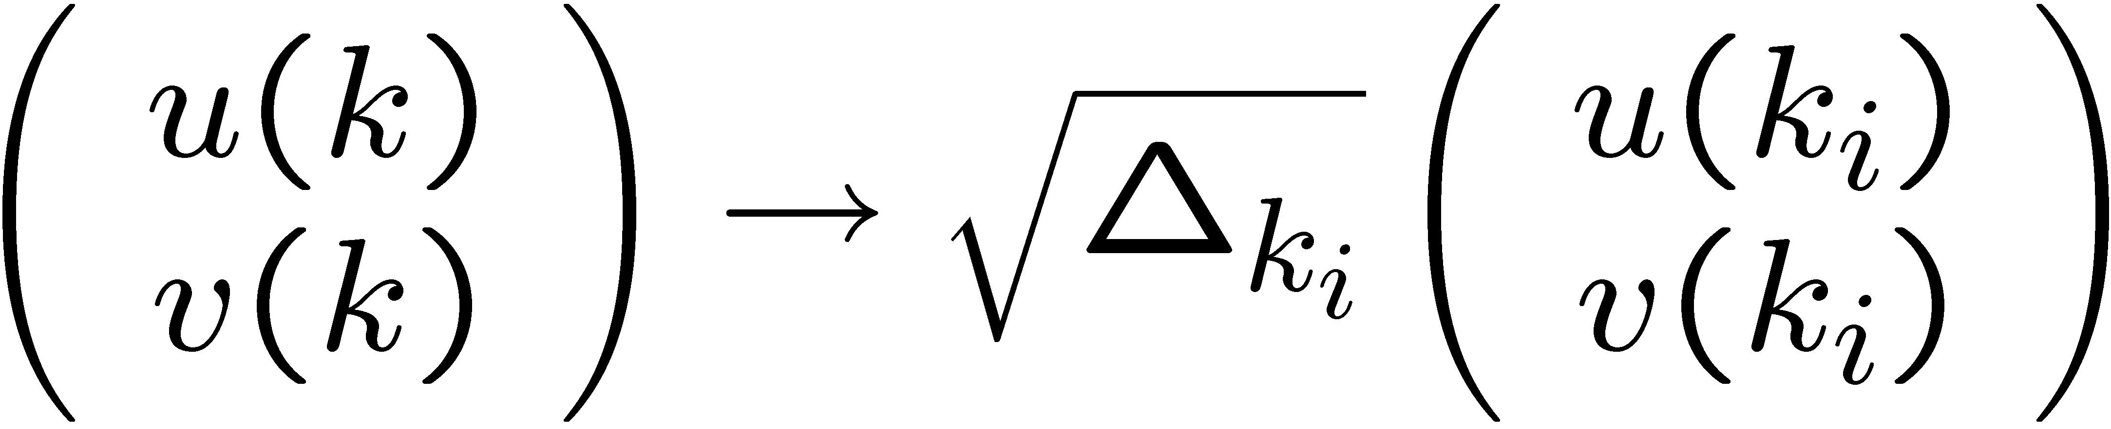
Gamow quasi-particle states norm
Normalization:
S-matrix poles: complex scaling
Scattering states: Dirac delta normalization
Continuum discretization:

Slide 13
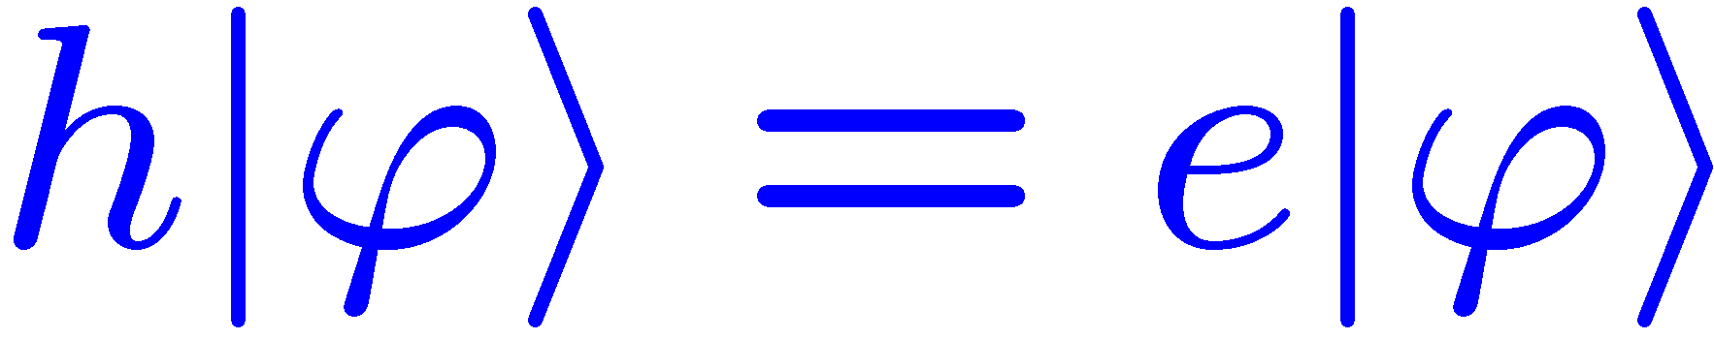
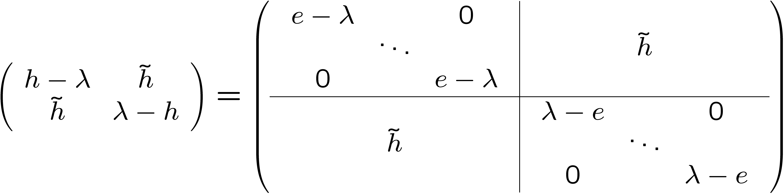
Gamow Hartree-Fock diagonalization method
Two-basis method
Basis generated by ph part of HFB hamiltonian:
B. Gall et al., Z. Phys. A348 183 (1994)
HFB matrix structure:
Diagonalization of HFB matrix in Gamow HF basis

Slide 14
Description of Nickel calculations
Considered nuclei: ⁸⁴Ni, ⁸⁶Ni, ⁸⁸Ni, ⁹⁰Ni
Interaction and space:
Skyrme interaction: Sly4, E_{cut} = 60 MeV, l: 0 ! 10
R_{cut} = 20 fm, k_{max} = 4 fm⁻¹, N_{scat} (l,j) = 100 for GHF basis.
Interest: Resonant structure directly put in HFB basis

Slide 15
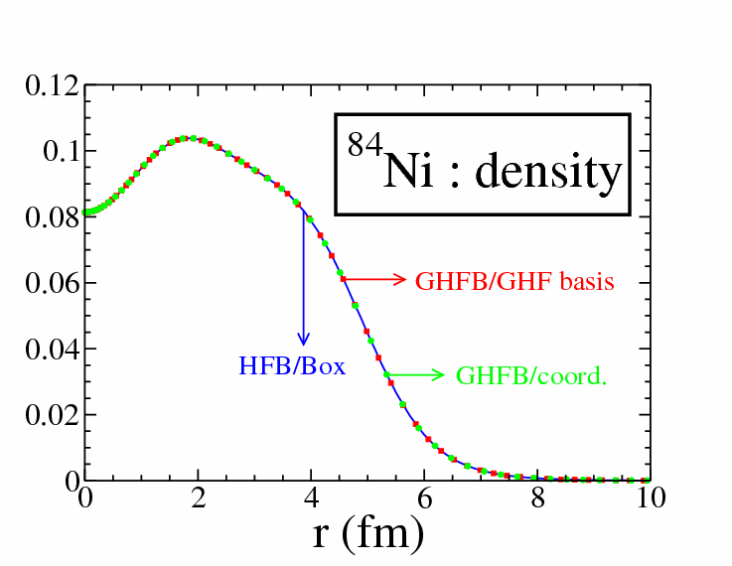

Slide 16
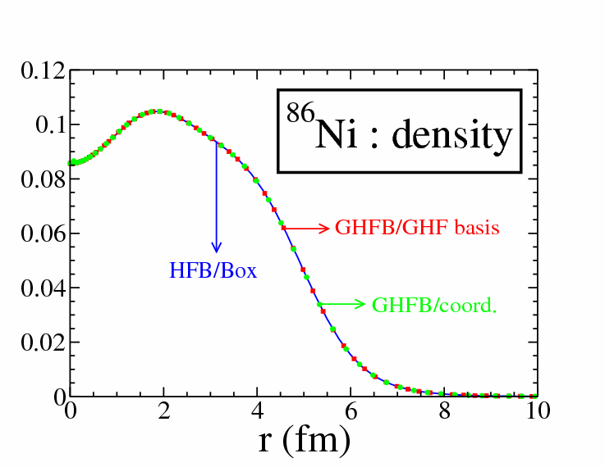

Slide 17
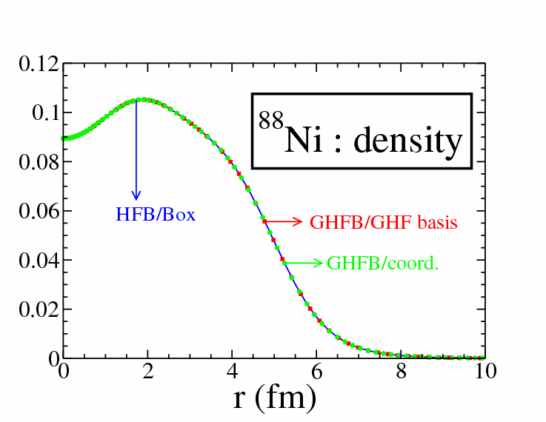

Slide 18
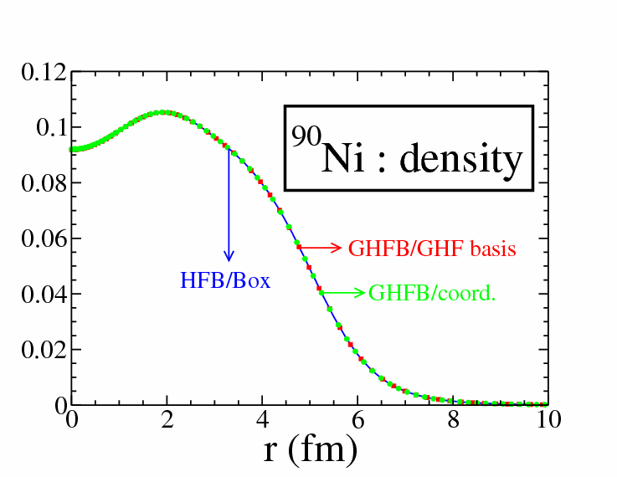

Slide 19
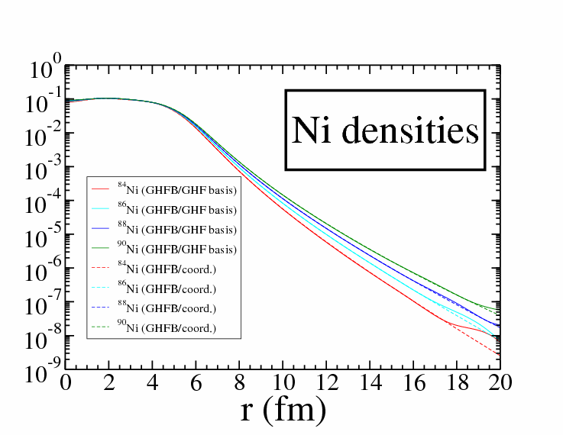

Slide 20
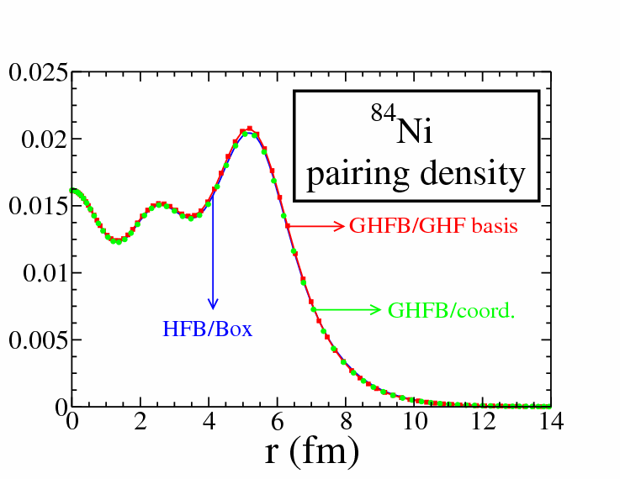

Slide 21
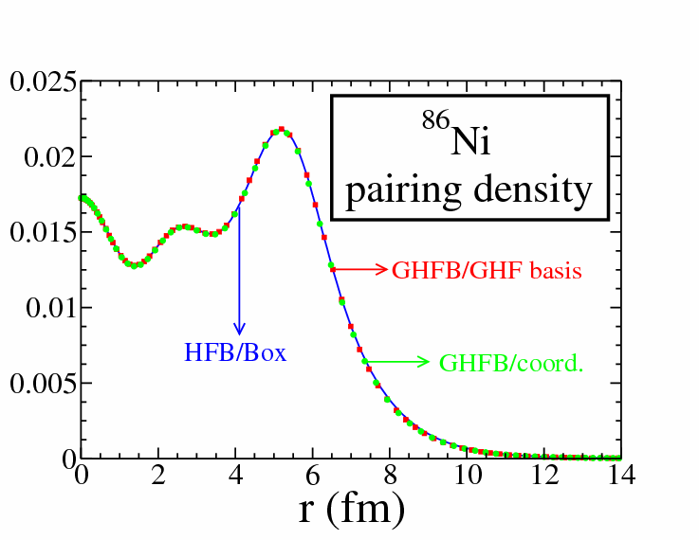

Slide 22
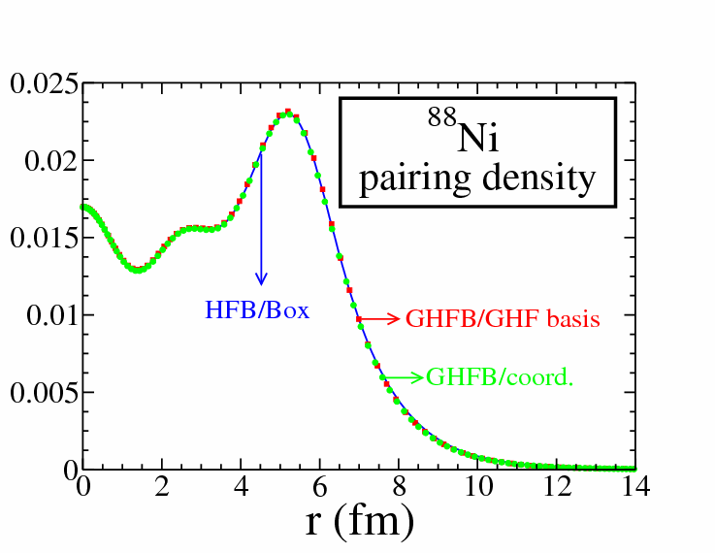

Slide 23
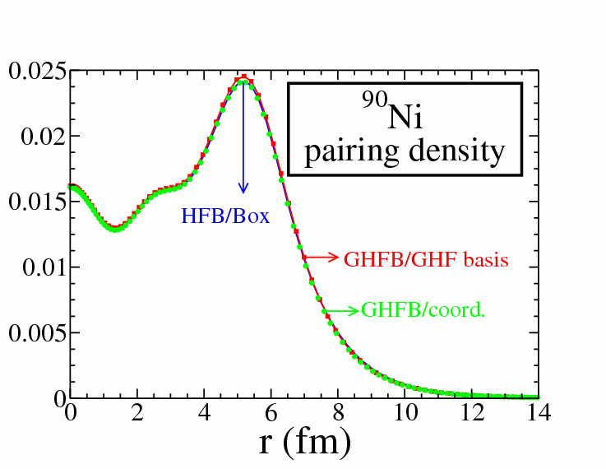

Slide 24
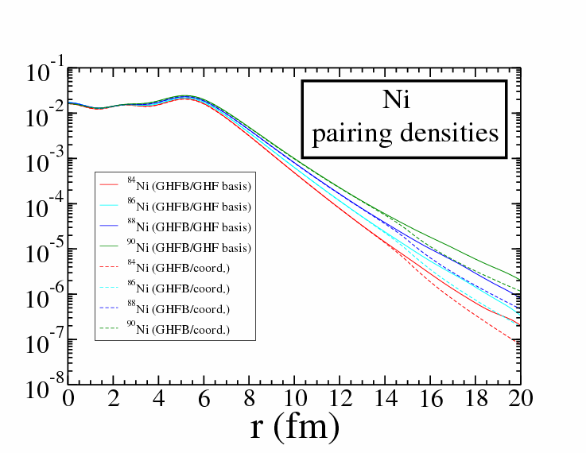

Slide 25
Spherical proton emitters with Skyrme density functional
Simple case: ¹⁸⁵Bi. Pairing for neutrons only, protons ~ Gamow HF
Imaginary part of HF proton potential removed.
Real bound states, positive width for resonant states
Sly4 interaction, pairing window of 60 MeV
¹⁸⁵Bi: HFB/Skyrme: E = 2.720 MeV, Γ = 9.228 10⁻¹¹ keV (0h_{9/2})
Experimental: S_{p} = 1.540 MeV, Γ ~ 10⁻¹⁷ keV (Phys. Rev. Lett., 76 (1996) 592)
Proton emitters: Fit of density functionals with respect to resonant s.p. levels

Slide 26
PTG basis for HFB calculations
Gamow HF(B) basis:
Advantages: good asymptotics, smoothly varying continuums
Inconvenients: complex arithmetic, long calculations
Weakly bound systems: real continuous bases sufficient
Real Gamow HF basis: problematic due to resonant structure in continuum
PTG basis: resonances replaced by bound states
No resonant state in (l,j) partial wave: Hankel/Coulomb functions
Smooth continuums for all partial waves
Weakly bound systems asymptotics well described

Slide 27
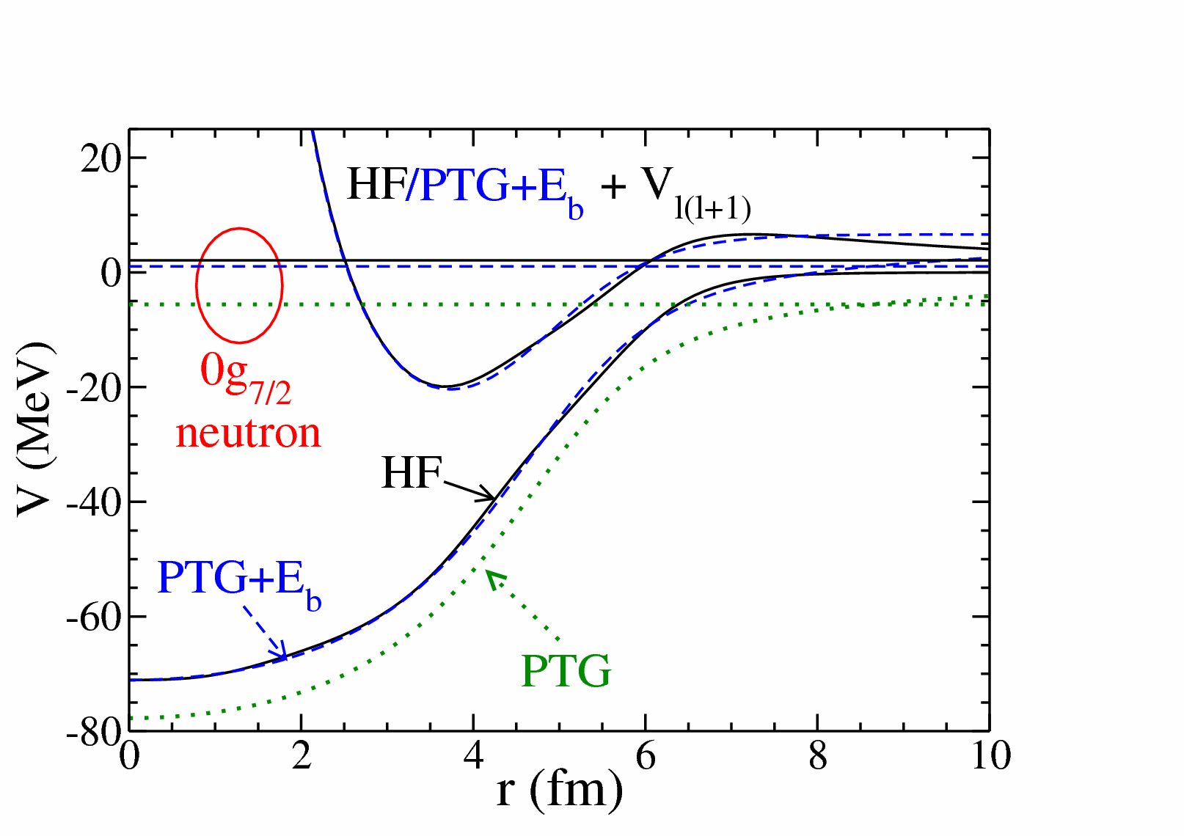
HF/PTG potentials
Submitted to Phys. Rev. C

Slide 28
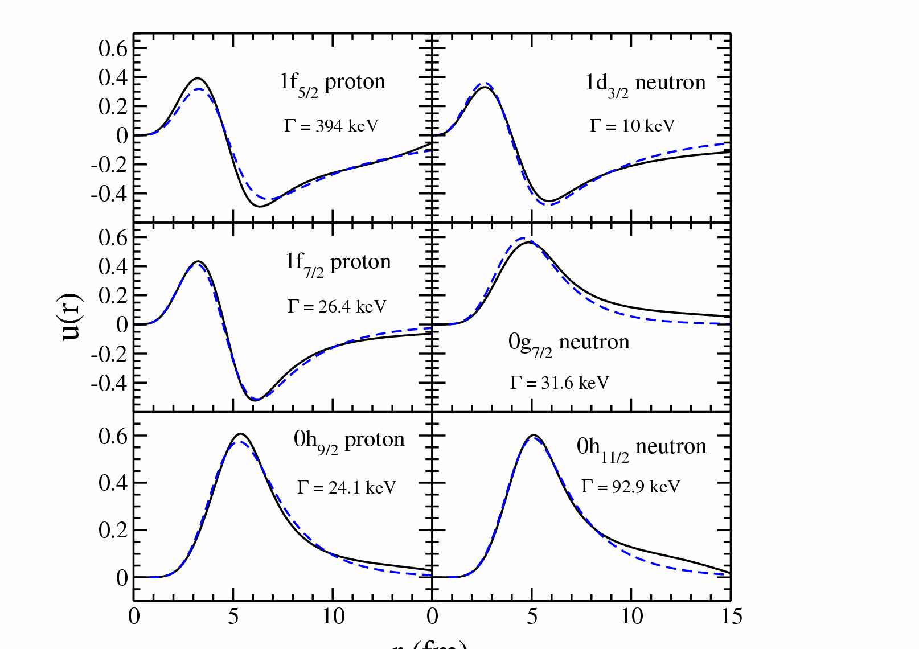
HF/PTG wave functions
---- : PTG
: HF
r (fm)
Submitted to Phys. Rev. C

Slide 29
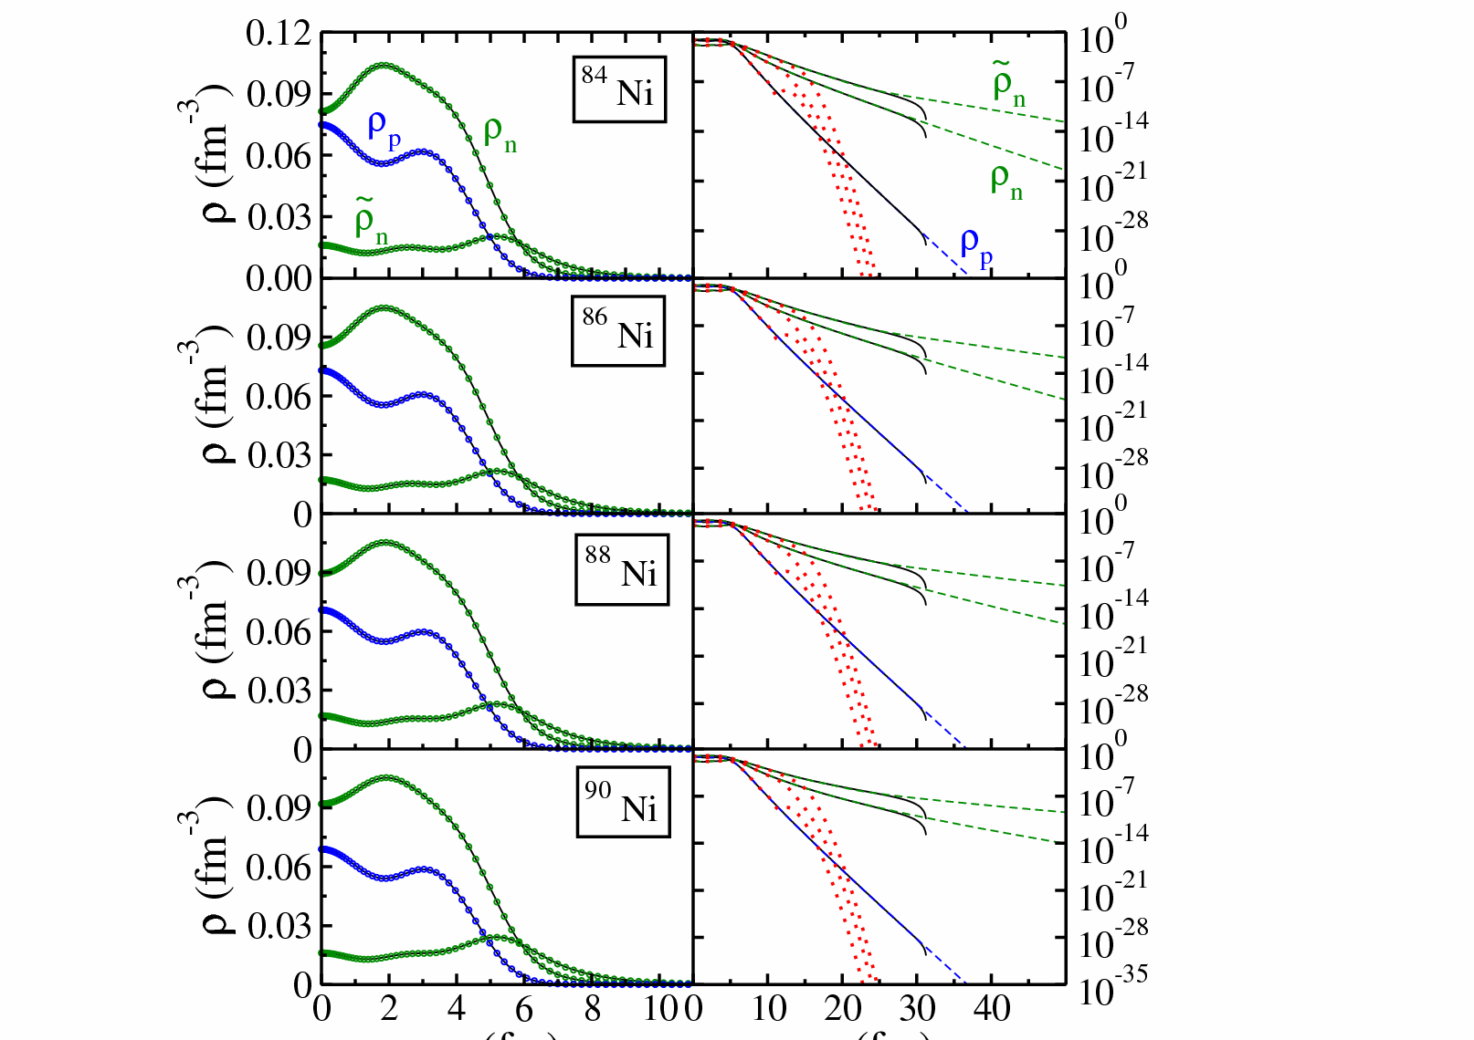
---- : PTG p
---- : PTG n
: Box p
: Box n
.… : HO
r (fm)
r (fm)
Submitted to Phys. Rev. C

Slide 30
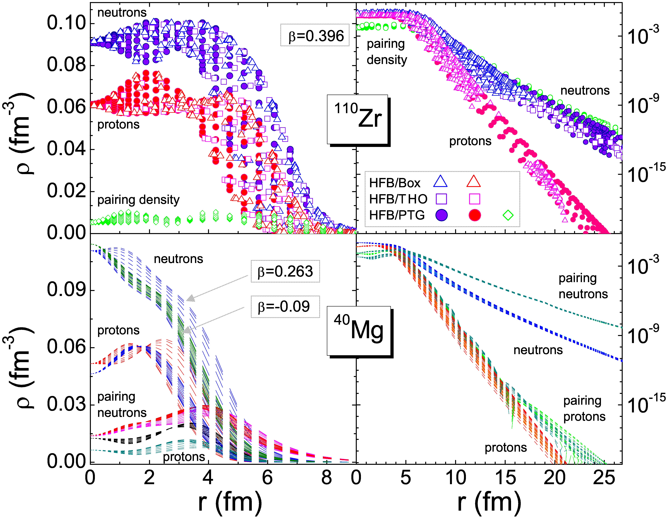
Submitted to Phys. Rev. C

Slide 31
Conclusion and perspectives
HFB expansions with Gamow and PTG bases:
Precise tool to study dripline heavy nuclei
Continuum fully taken into account
PTG basis near-optimal for weakly bound systems
First applications
Nickel chain close to neutron dripline
Proton emitter without proton pairing : ¹⁸⁵Bi
Deformed nuclei with Mg and Zn, prolate and oblate deformation
Conclusions and perspectives
Weakly bound nuclei : fast and stable method with PTG basis
Problems remain for unbound nuclei

