Slide 1
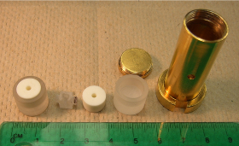
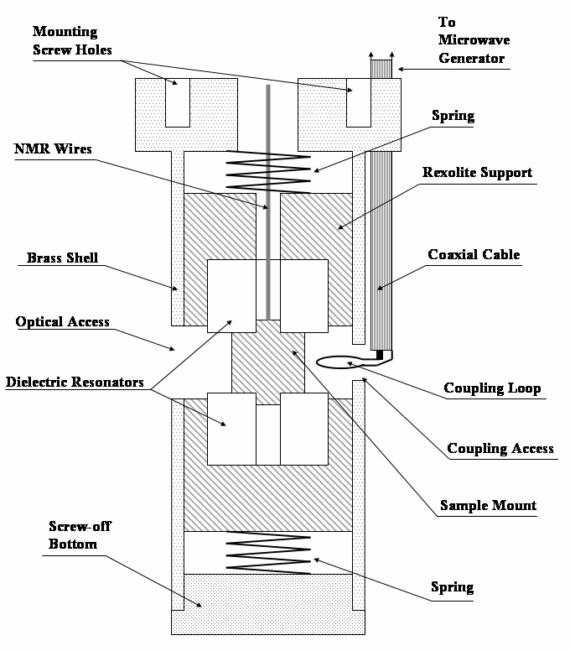
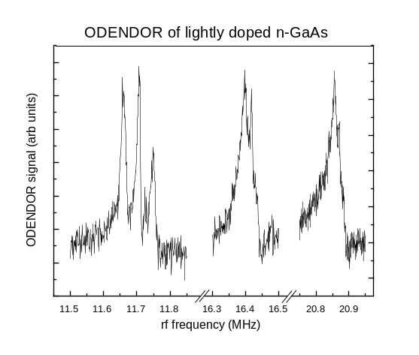
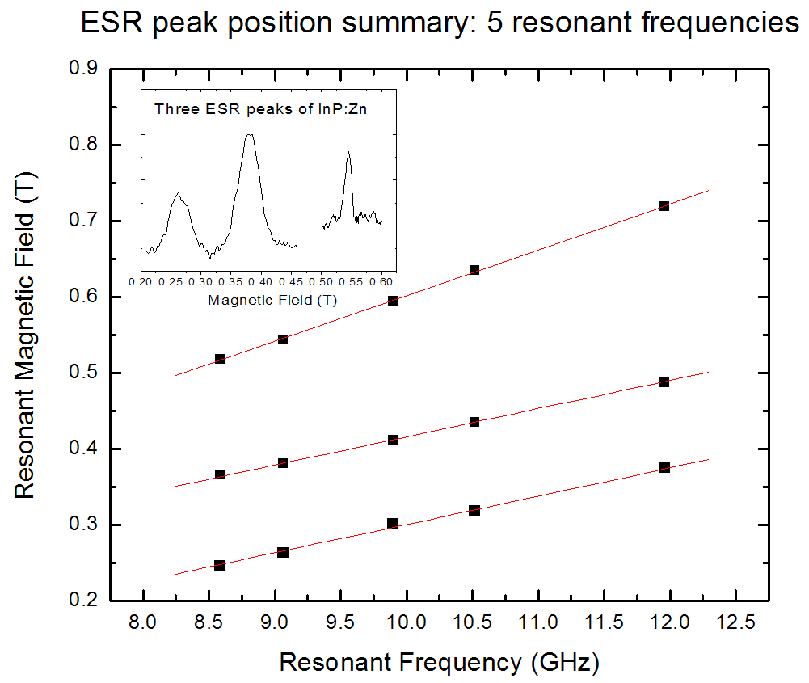
A microwave resonant cavity for simultaneous electron and nuclear resonance in GaAs
John S. Colton, Brigham Young University*, DMR 0456074
Our group has constructed a novel resonant cavity for microwave experiments around around 10 GHz. The cavity has the following features:
A quasi-TE011 mode, to concentrate B-field at sample
A resonant frequency of ~10GHz, to allow for probing of g-factors down to g≈0.1 (such in as alloyed or QW samples) within a 7T magnet
High-dielectric resonators, to allow the cavity to fit in a 1” bore
Optical access for exciting/probing spins
NMR coils for simultaneous control of nuclear spins
Interchangeable dielectrics, to allow five resonant freqs. between 8 and 12 GHz
This cavity will allow the study of spin lifetimes through resonance techniques, and the investigation of nuclear effects on the electron spins.
* Formerly of University of Wisconsin-La Crosse
Notes:
Spin resonance is a well-established technique for probing spin properties of electrons in semiconductors. In order to resonate the electrons at the desired magnetic fields, a resonant frequency of ~10 GHz was chosen for this design. The cavity design is shown on the lower right; the cavity itself (with the parts from the inside removed) is shown in the upper right.
The lower left graph describes a set of test experiments with an InP:Zn reference sample, that had been well-studied previously. The characteristic three ESR peaks are shown; the position of the peaks depends on the resonant frequency. Through the interchangeable dielectric frequency feature, we were able to get those three electron resonances at five difference frequencies between 8.5 and 12 GHz.
The lower middle graph shows the optically detected electron-nuclear double resonance (ODENDOR) of a lightly-doped n-GaAs sample. In this experiment, the electrons were resonated, then changes in the electron resonance signal were measured as the nuclei were passed through resonance.

Slide 2
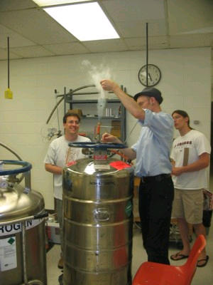
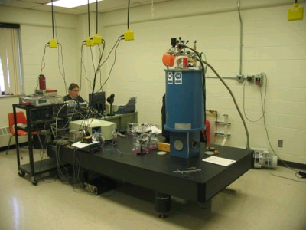
Spin Lifetime Measurements in n-type GaAs
John S. Colton, Brigham Young University,* DMR 0456074
Research:
This research in spin properties of electrons in semiconductors, headed by Dr. Colton, also serves a an undergraduate research opportunity for undergraduate students. Eight undergraduate students have been involved with this project since 2005: Susie Allemann, Andrew Gierke, Mike Heeb, Joseph Lanska, Lindsey Oestreich, Paul Schroeder, Andy Stokes, and Lee Wienkes. A webpage containing information about the research has been established, and can be found here:
http://www.uwlax.edu/faculty/colton/research.htm
The Lab:
Information about our laboratory set-up and equipment can be found here:
http://www.uwlax.edu/faculty/colton/lab.htm
* Formerly of University of Wisconsin-La Crosse

