Slide 1

Soft x-ray resonant scattering in manganites:
from bulk crystals to thin films
Jessica Thomas
Physics Department, Brookhaven National Lab

Slide 2
Outline
I: Probing orbital and spin correlations in half-doped manganites with SXRD
— Why are we interested in orbital physics?
— Advantage of tuning to the Mn L-edge (~650 eV)
— Experimental results and modeling the ground state
in a half-doped manganite
— Future projects
II: Ferroelectrically doped manganite thin films
— X-ray magnetic resonant scattering studies
— Projects on the horizon

Slide 3
Why study “orbitals”?
Active degree of freedom in manganites and correlated electron materials
— How do orbital correlations drive magnetism (or vice versa)?
— Role in magneto-resistance?
Mn 3d levels
y² – z²/x² – z²
e_{g}
3x² – r²/3y² – r²
O²⁻
t_{2g}
Mn³⁺
Mn⁴⁺
Mn³⁺

Slide 4
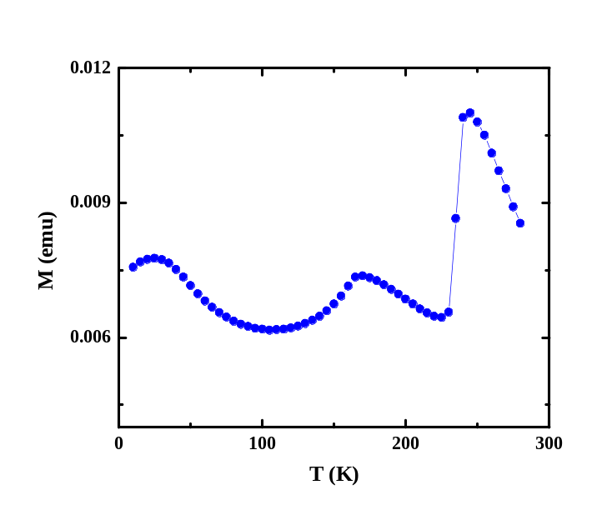
CE type charge, orbital and magnetic order in half-doped manganites
Pr_{0.6}Ca_{0.4}MnO₃
Magnetic susceptibility
PI
T_{OO}/T_{CO}
T
T_{OO}/T_{CO} (240 K)
charge/orbital order
T_{N}
T_{N} (170 k)
antiferromagnetic
insulator
AFI
FMI
0
0.1
0.3
0.5
0.7
x
-
-
Fundamental questions
To what extent is the ground
state charge ordered?
What drives charge/orbital
order?
- Coupling between orbital and
magnetic correlations?
Mn⁴⁺
+
Mn³⁺
+
-
-
+
-
-
+
-
+
-
Goodenough (1955)

Slide 5
How do you “see” orbital order with x-ray diffraction?
Resonant diffraction at a Mn aborption edge
K-edge: sensitive
to oxygen distortions
Q
L-edge: sensitive
to 3d orbital
and spin structure
k_{i}
k_{f}
4p_{x,z}
4p_{y}
E = Eε
-
+
-
3d
3d
+
-
-
+
-
~ 650 eV
~ 6.5 keV
-
+
-
-
2p
+
1s
C. W. M. Castleton and M. Altarelli
Phys. Rev. B 62 1033 (2000).
S. Grenier et al. Phys. Rev. B 69 134419 (2004).

Slide 6
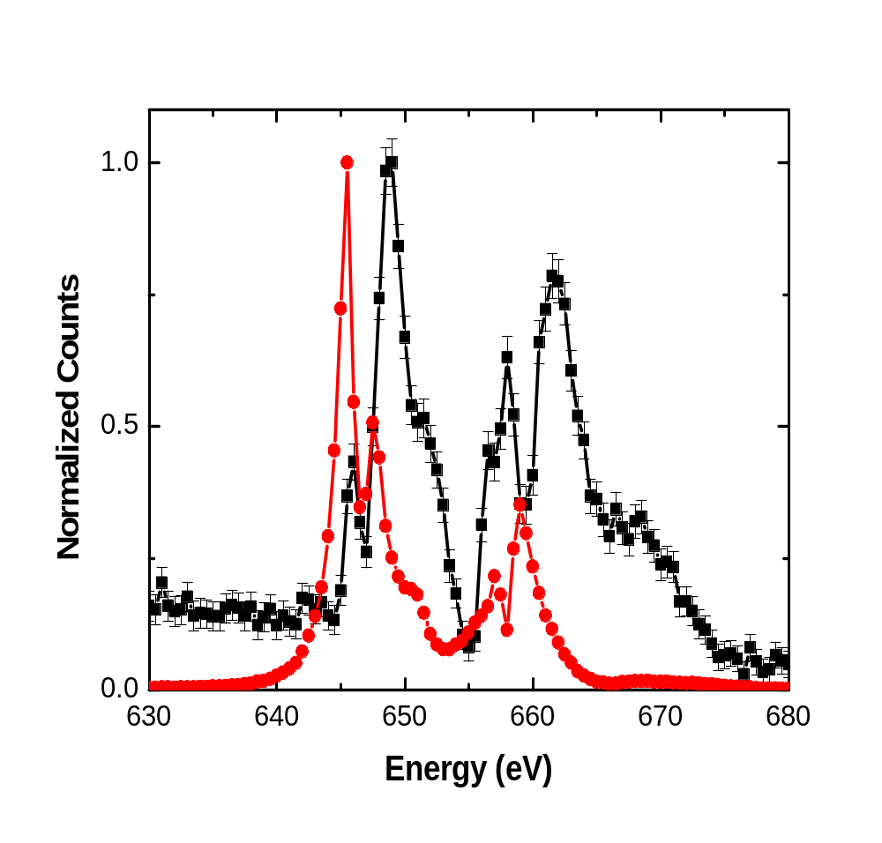
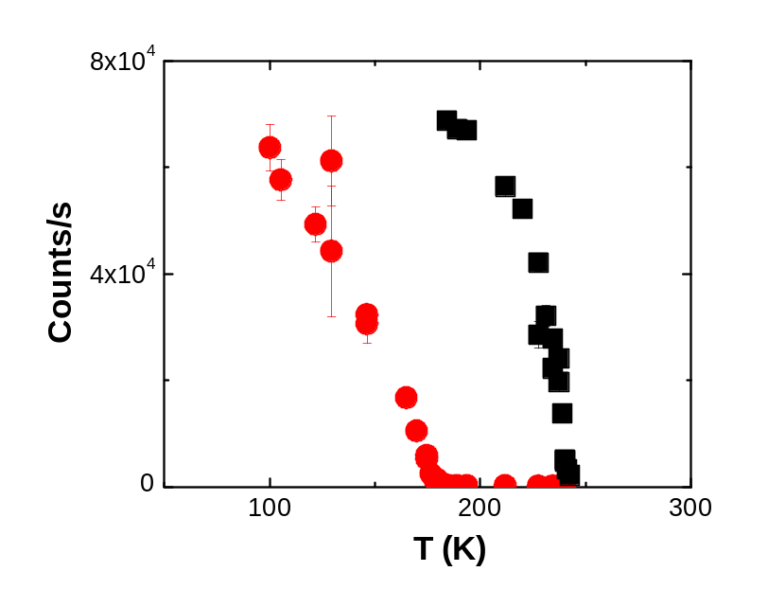
Magnetic and orbital resonant line shapes: NSLS X1B
Diffracted intensity at Q = (½,0,0)/(0,½,0)
Orbital scattering
(x 100)
Magnetic scattering
3 eV shift in spectral
weight between the
magnetic and orbital spectra
T_{OO}
(x 100)
T_{N}
J. Thomas, J. Hill, S. Grenier, P. Abbamonte, M. v. Veenendaal, G. Sawatzky et al.
PRL 92, 237204 (2004)

Slide 7
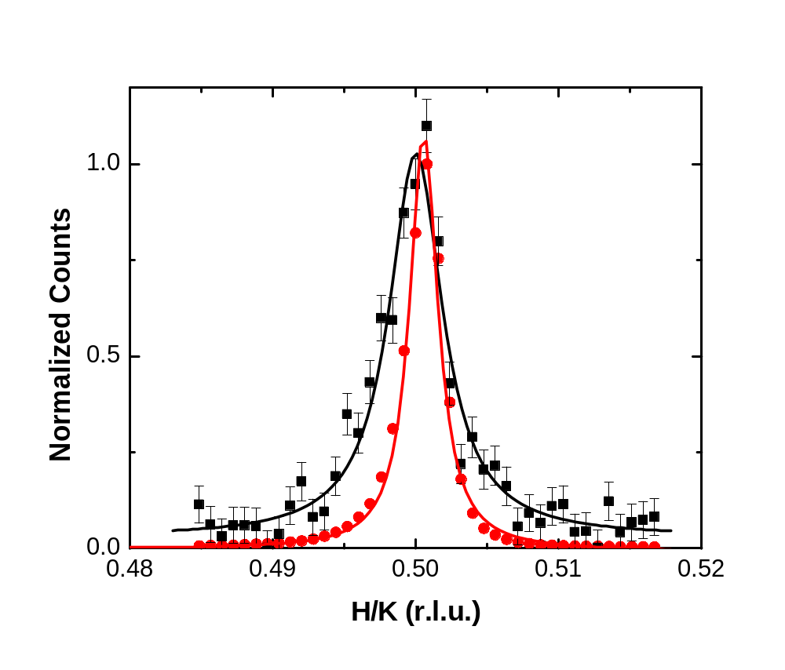
Orbital correlations are shorter ranged than magnetic correlations
Orbital
Magnetic
E = 645 eV
ξ_{orb} ~ 370 Å
ξ_{mag} > 720 Å

Slide 8
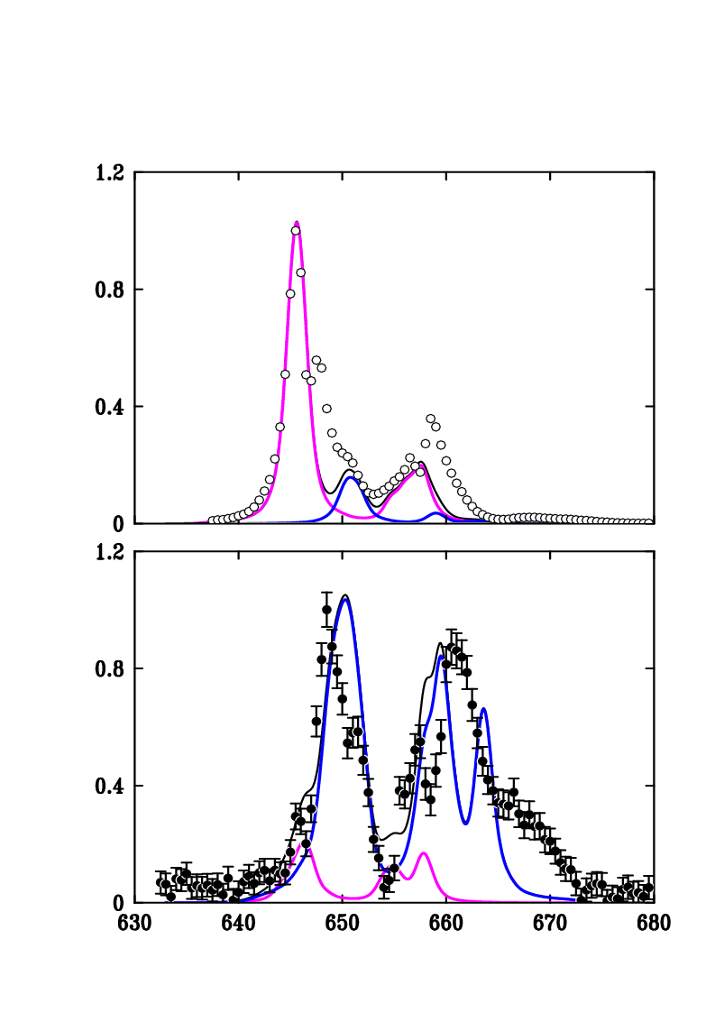
Relaxed charge-order model
Calculated spectra
Mn⁴⁺
Magnetic spectrum (T < T_{N})
Mn³⁺
total
Mn⁴⁺
Mn³⁺
Orbital spectrum
(T_{N} < T < T_{OO})

Slide 9
Relaxed charge-order model
Calculated spectra
Mn⁴⁺
Magnetic spectrum (T < T_{N})
Mn³⁺
total
Mn⁴⁺
Mn³⁺
Orbital spectrum
(T_{N} < T < T_{OO})

Slide 10
Relaxed charge-order model
Calculated spectra
Mn⁴⁺
Magnetic spectrum (T < T_{N})
Mn³⁺
total
Mn⁴⁺
Mn³⁺
- 3 eV spectral weight shift
between orbital and magnetic
resonant diffraction spectra
- Difference in intensity
Orbital spectrum
(T_{N} < T < T_{OO})

Slide 11
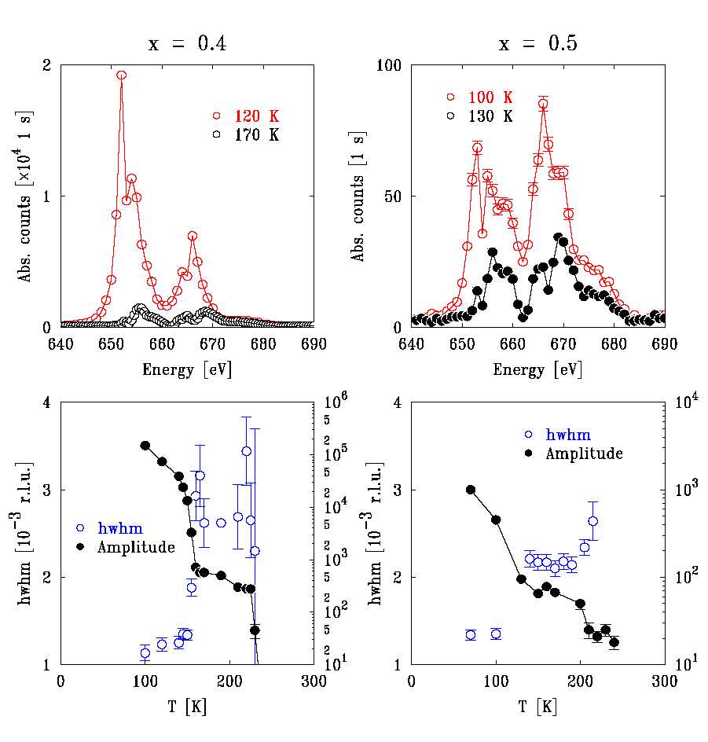
PCMO (x=0.4 and 0.5)

Slide 12
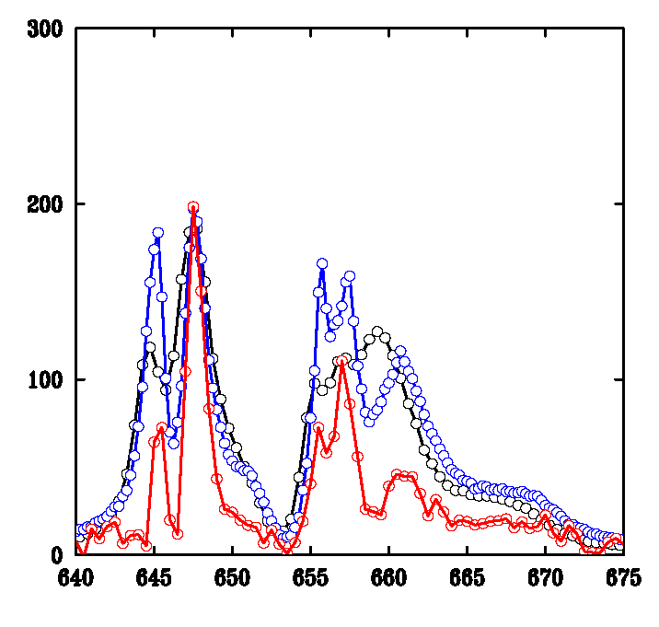
Characteristic orbital scattering in half-doped manganites
Pr_{0.6}Ca_{0.4}MnO ₃
Pr_{0.5}Ca_{0.5}MnO ₃
Nd_{0.5}Sr_{0.5}MnO ₃
Energy (eV)

Slide 13
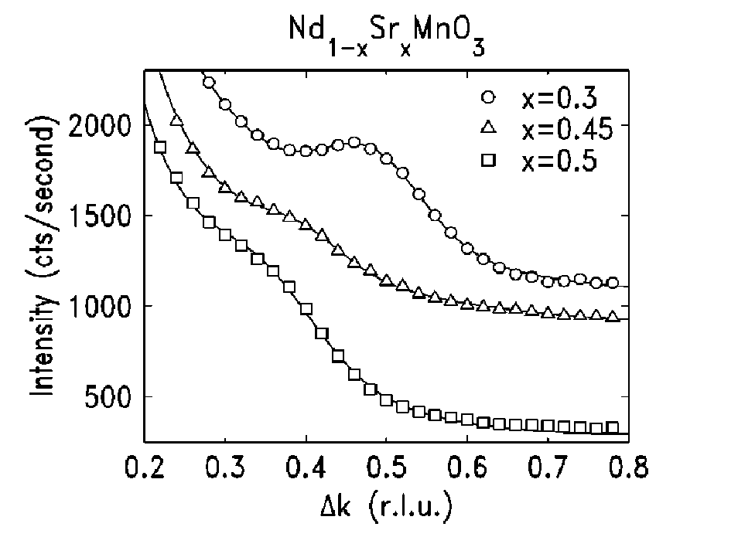
Nanoscale structural correlations in a half doped manganite
∆k
H
(4,6,0)
K
Nd_{0.5}Sr_{0.5}MnO₃
nanoscale
structural correlations
(orbital/spin order?)
CE AF/
orbital
order
FM
T
T

Slide 14
Summary
Soft x-ray resonant diffraction in manganites
Direct probe of magnetic and orbital correlations
reveals shorter ranged orbital than magnetic order
Spectroscopy of 3d states + calculations:
test of ground state models
Importance of orbital correlations in other materials?
- Orbital liquids
- Role in frustrated spin systems

Slide 15
II
Ferroelectric doping of manganite thin films

Slide 16
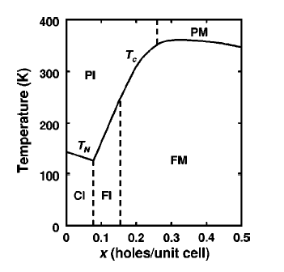
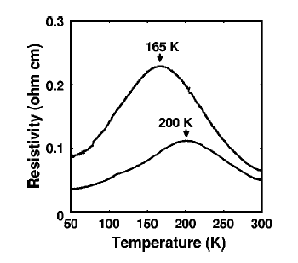
Ferroelectric doping of ferromagnetic manganite films
(Collaboration with Charles Ahn, Yale University)
AFM
La_{1-x}Sr_{x}MnO₃
Pb(Ti,Zr)O₃
La_{0.67}Sr_{0.33}MnO₃
SrTiO₃
X. Hong et al Phys. Rev. B 68 (2003)

Slide 17
Preliminary questions
How does the ferroelectric doping modulate the magnetism?
To what extent does the doping penetrate the LSMO film?
Comparison between structural and magnetic roughness.
Mechanism for Tc shift?
How do magnetic correlations in the manganite
evolve with PZT geometry and spacing?

Slide 18
Probing ferromagnetism with
Magnetic Circular Dichroism (MCD) at the Mn L_{II,III}-edges
MCD measured in reflectivity mode: Wiggler beamline X13-A NSLS
Right CPL
M
k_{i}
Left CPL
k_{f}
H < 1 kG
22 Hz flipping of photon polarization
Lock-in technique
separates sum and difference (MCD)
Intensity_{MCD} ~ M_{FM}

Slide 19
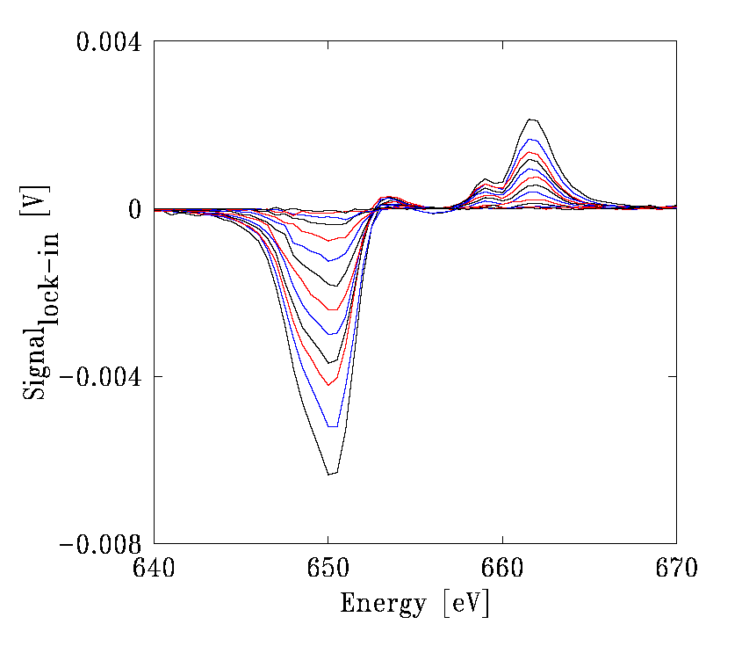
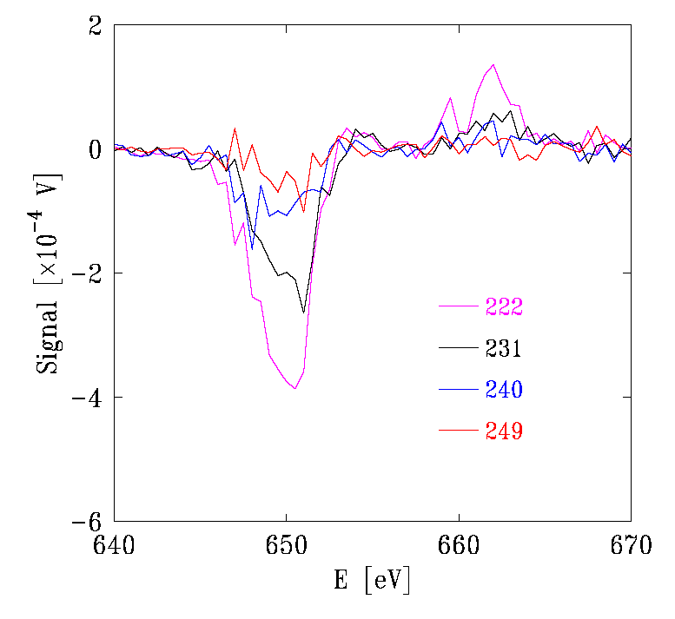
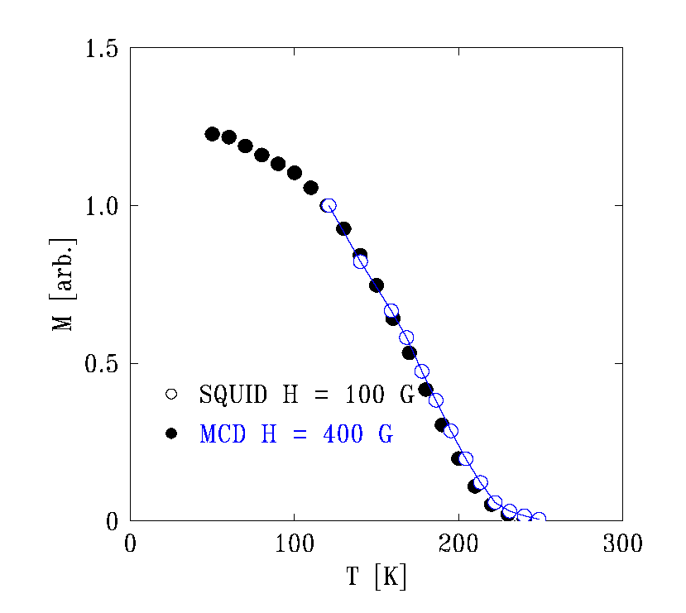
MCD detection of ferromagnetism in bare 3 nm LSMO films
MCD signal
Near Tc
decreasing
T
V
PZT
LSMO
J. Thomas, J. P. Hill, X. Hong, C. Ahn, C. Sanchez-Hanke (unpublished)

Slide 20
Looking into the future: manipulating magnetic inhomogeneity
La_{1-x}Ca_{x}MnO₃
charge/
orbital order
PZT
FM
La_{1-x}Ca_{x}MnO₃: x ~ 0.5
T
FM
AF
AFI
CI
FMI
SrTiO₃
0
0.1
0.2
x
0.5
0.7
- Effects of “doping” on formation of the ferromagnetic phase (MCD)
- Correlations between the doped regions (Diffraction)

Slide 21
Suggestions for development of soft x-ray end-station
Cooling (~10 K)
Electronic feed-thrus
Azimuthal degree of freedom (rotation of sample about Q)
Polarization analysis (at the detector)
Calibration method
Linear and circularly polarized light
Dialogue/development of analytical tools to understand the spectra

Slide 22
Collaborators
John Hill Physics. Dept, Brookhaven National Laboratory
Stephane Grenier Physics. Dept, Brookhaven National Laboratory
Peter Abbamonte NSLS, Brookhaven National Laboratory
Andrivo Rusydi NSLS, Brookhaven National Laboratory
Young-June Kim Physics. Dept, Brookhaven National Laboratory
Y. Tokura University of Tokyo, Japan
Y. Tomioka AIST, Japan
Des McMorrow University College, London
Michel van Veenendaal N. Illinois Univ./Argonne National Lab
George Sawatzky University of British Colombia
Charles Ahn Yale University
Xia Hong Yale University

Slide 23
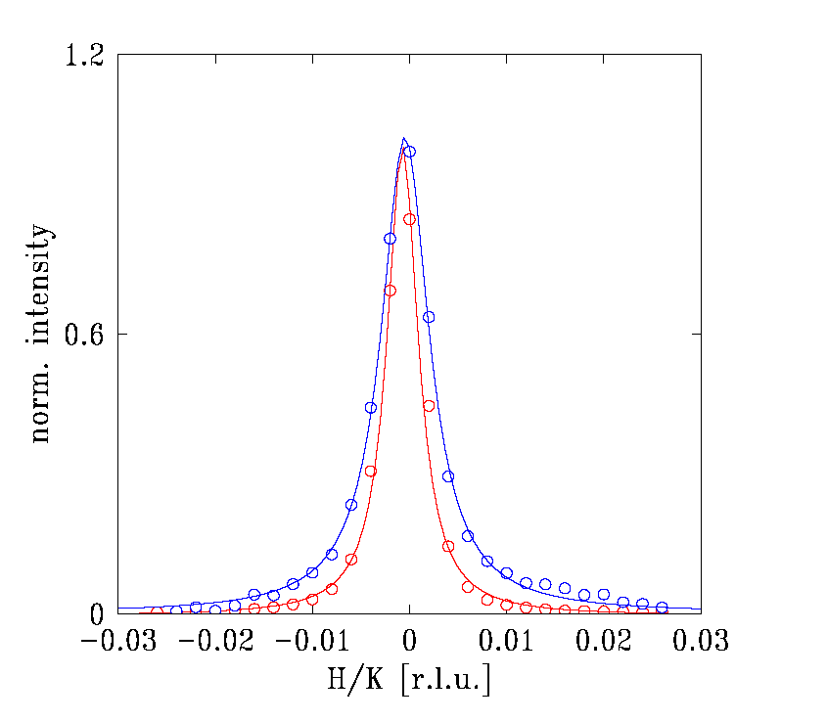
Transverse scans:
Orbital correlations are shorter ranged than magnetic correlations
Transverse scans
645 eV
orbital
magnetic

Slide 24
Orbital/spin order in x > 0.5 manganites
Wigner crystal vs. bi-stripe structure

