Slide 1

Charged current single pion to quasi-elastic cross section ratio in MiniBooNE
Steven Linden
DNP ’08

Slide 2
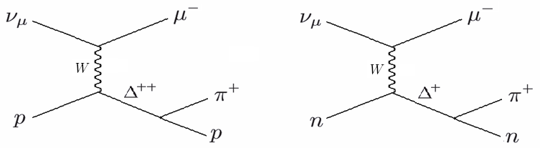
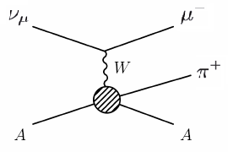
Charged Current Single π⁺ (CCπ⁺ ) Events in MiniBooNE
CCπ⁺ Resonant
In MiniBooNE we don’t have the ability to distinguish resonant and coherent channels on an event by event basis. We thus use a (semi-)inclusive CCπ⁺ sample.
Coherent CCπ+ events are expected to constitute less than 10% of CCπ⁺ events. (Limits from K2K (1))
In MiniBooNE, we have over 46,000 events in our CCπ⁺ sample.
CCπ⁺ Coherent
(1) K2K Collaboration: M. Hasegawa et al., arXiv:hep-ex/0506008v2

Slide 3
Why do we care about CCπ⁺ ?
From a neutrino physics perspective:
CCπ⁺ events are very abundant at energies used in oscillation experiments.
In many detectors CCπ⁺ events can look like CCQE.
Thus CCπ⁺ is a major background in many oscillation studies (e.g., in MiniBooNE).
From a nuclear/hadronic physics perspective:
CCπ⁺ interactions can offer insight into the mechanisms of both resonant and coherent pion production.
For example, using CCπ⁺ data in MiniBooNE we have compared various parameterisations the axial and vector form factors (see J. Nowak’s talk later today).
Cross section results can help to test our modelling of intra-nuclear final state interactions.

Slide 4
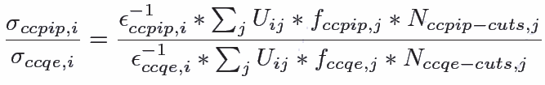
How do we perform the CCπ+ /CCQE measurement?
We perform a measurement of the CCπ⁺ to CCQE cross section ratio rather than the absolute CCπ⁺ cross section in order to eliminate flux uncertainties.
Our method is to use Monte Carlo to predict the cut efficiency and signal fraction as a function of energy for each sample and use these to correct the raw numbers of events passing cuts.
f = signal fraction = (signal events passing cuts)/(events passing cuts)
ε = cut efficiency = (signal events passing cuts)/(signal events)
U = Energy unsmearing matrix (I’ll discuss this in a moment)

Slide 5
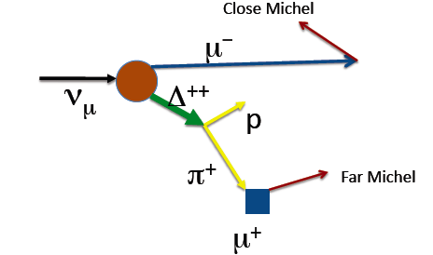
Event Samples
Our event selection is quite simple.
CCπ⁺ events are identified by:
1. The outgoing muon
2. The decay electron at the end of the muon’s track
3. The decay positron at the end of the pion’s track
CCQE events are identified by:
1. The outgoing muon
2. The decay electron at the end of the muon’s track
These simple cuts are very effective at selecting the event samples.
Additional cuts are used to improve purity.
CCπ⁺ event
CCπ⁺: 12% efficiency
46,649 events
CCQE: 26% efficiency
195,482 events

Slide 6
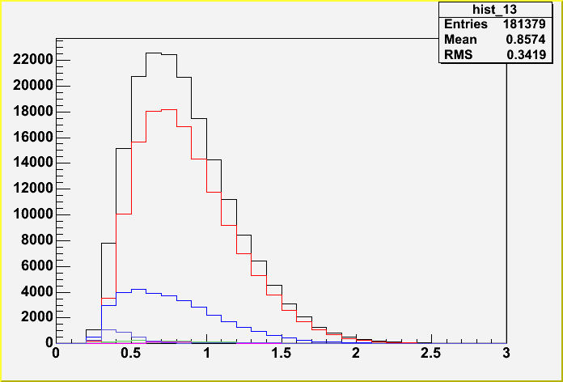
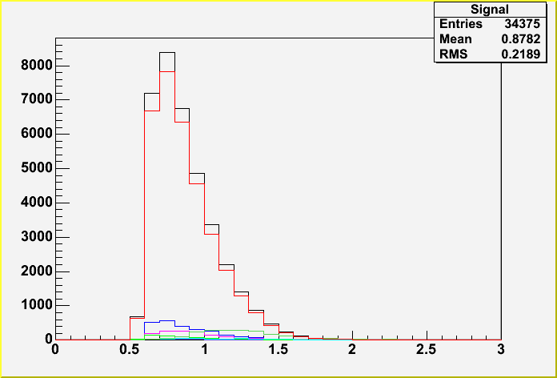
Event Samples
CCQE
CCπ⁺
Reconstructed E_nu
Reconstructed E_nu
CCQE (red) | 72.0 %
CCπ⁺ resonant (blue) | 18.3 %
CCπ⁺ coherent (green) | 1.1 %
NCπ⁰ (dark purple) | 2.0 %
Multi-pion (light purple) | 0.5 %
Other | 6.1 %
CCπ⁺ total | 86.8%
CCπ⁺ resonant (red) | 80.9%
CCπ⁺ coherent (dark blue) | 5.9 %
CCQE (dark green) | 5.2 %
Multi-pion (light purple) | 3.8 %
CCπ⁰ (light green) | 1.5 %
DIS (light blue) | 1.0 %
Other | 1.6 %

Slide 7
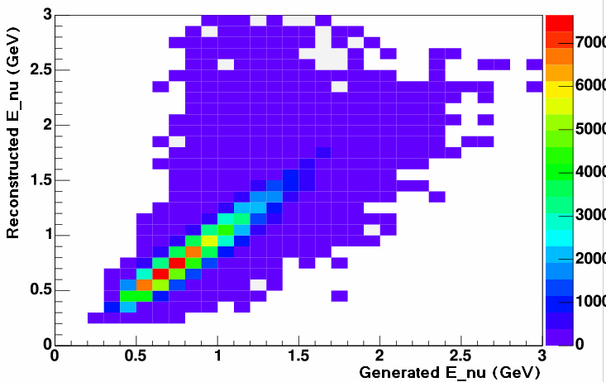
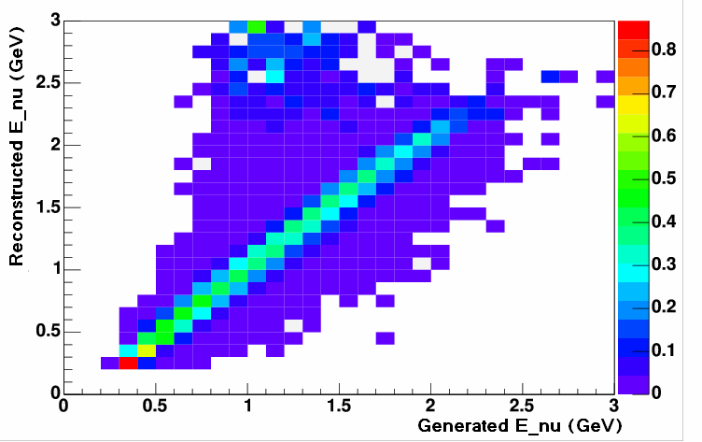
Energy Unsmearing
Our neutrino energy reconstruction is not perfect - we must use Monte Carlo to find a mapping back to true neutrino energy.
Bin events by E_rec and E_true
Normalize each E_rec bin
Migration Matrix (CCQE)
Unsmearing Matrix (CCQE)
Avoids the problems of matrix inversion (which for this analysis was not viable).
Introduces bias from MC true energy distributions - net effect is increased systematic uncertainty.

Slide 8
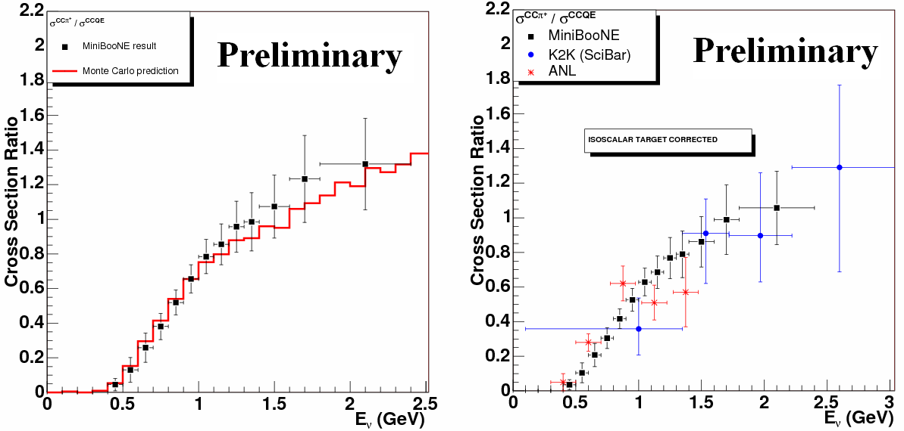
Results
On the left: Our measured CCPiP/CCQE cross section ratio (black) compared with our Monte Carlo prediction based on Rein-Sehgal and Smith-Moniz (red).
On the right: A comparison of our result (black) with measurements from ANL (1) (red) and K2K (2) (blue).
Here the MiniBooNE and K2K ratios have been corrected for an isoscalar target (ANL’s measurement was already on an isoscalar target).
(1) G.M. Radecky et al., Phys. Rev. D 25, 1161 (1982)
(2) K2K Collaboration: A. Rodriguez et al., arXiv:0805.0186

Slide 9
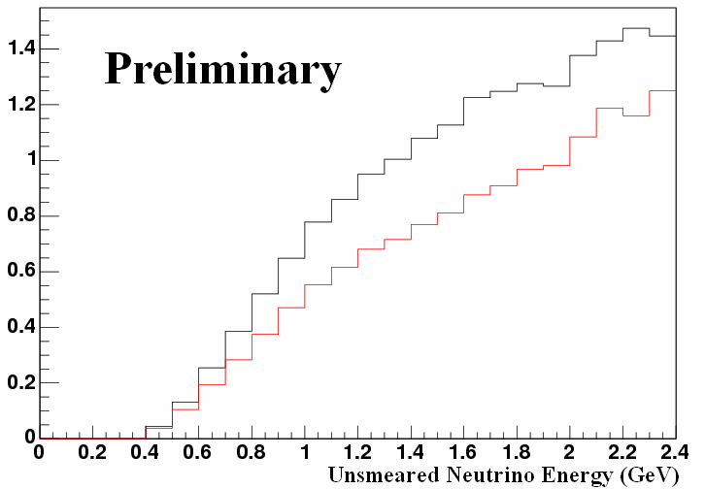
Effective Ratio Measurement
We can also measure the ratio of events with CCπ+ -like final state particles to those with CCQE-like final state particles.
Another way to think of this is as the cross section ratio before corrections for nuclear effects.
This provides a ratio measurement that is independent of the way we model intra-nuclear processes.
Red: Effective measurement
Black: True measurement
The effective ratio is smaller than the true ratio because there is a significant number of CCQE-like CCπ+ events due to pion absorption.

Slide 10
Conclusion
Our measurement is consistent with previous results as well as predictions from the Rein-Sehgal and Smith-Moniz models.
A paper will be submitted soon.
We’re entering the age of high-precision CCπ⁺ cross section measurements.
These measurements will provide valuable input both in future neutrino experiments and in hadronic and nuclear modelling.

