Slide 1



RFA Experiments on the T2R RFP
Open loop control experiments
J.R. Drake 1), D. Gregoratto 2), T. Bolzonella 2), P.R. Brunsell 1),
D. Yadikin 1), R. Paccagnella 2), Y.Q. Liu 3), M. Cecconello 1),
G. Manduchi 2), L. Marrelli 2), S. Ortolani 2), A. Bondeson† 3)
1) Alfvén Laboratory, KTH, EURATOM /VR Association VR, Stockholm, Sweden
2) Consorzio RFX, EURATOM/ENEA Association, Padova, Italy
3) Dept. of Electromagnetics, CTH, EURATOM /VR Association, Gothenburg, Sweden
† Anders Bondeson deceased

Slide 2
Open loop control experiments in EXTRAP T2R RFP
Outline
The theme of the workshop is back to the basics.
Topics aimed at in this talk are:
• Assumption of mode rigidity
• Applicability of the linear model
Data shown:
• “Open loop” constant resonant control harmonic
(qualitative information)
• “Open loop” pulsed resonant control harmonic
(quantitative estimates of transfer functions, mode
growth rates and mode damping rates)

Slide 3
Basics - Resistive- wall mode stability in the RFP
Cylindrical plasma bounded by a thin wall: radius r_{w} and (long) penetration time τ_{w}.
Natural growth rate, γ_{m,n}, of a non-rotating m=1 RWM is then defined by the stability index given by the discontinuity in the logarithmic derivative of the perturbed field at r_{w}.
[ref C G Gimblett, Nuc Fus 26 (1986) p 617].
2γ_{m,n}τ_{w} = r_{w}Δ_{m,n}′.
An important assumption is that the mode structure in the plasma is rigid.
Therefore the plasma can be specified by the single parameter, the growth rate, γ_{m,n}, of the RWM.

Slide 4
Resistive- wall mode stability in the RFP
An externally produced control field or a field error, at
r_{f} > r_{w}, modifies Δ_{m,n}′
and thereby the growth rate for that (m,n)-harmonic.
To compare experiment and theory, examine the time dependence of the RWM radial field perturbation evaluated on the inside surface of the thin wall, which is the location of the sensor coils in the experiment.

Slide 5
Linear model for the (m,n)-harmonic of the RWM
including external error and control field harmonics
d_{t}b_{m,n} = γ_{m,n}b_{m,n} - γ_{m,n,w}(M_{m,n} I_{m,n} + b_{m,n}^{error})
where,
• b_{m,n} is the perturbed field measured at the sensor coil.
• γ_{m,n} is the growth rate of the mode.
• γ_{m,n,w}=(τ_{m.n,w})⁻¹ describes the diffusion rate of the harmonic at the
thin wall and is determined only by the mode number and
the wall parameters.
• b_{m.n}^{error} is that part due to an external inherent field error.
• M_{m,n}I_{m,n} is the saddle-coil-produced control field
(I_{m,n}=current & M_{m,n}=ratio field to current, [Tesla/Amp])

Slide 6
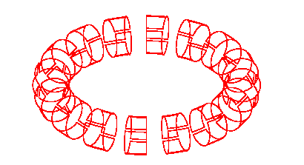
T2R Coil system(s)
toroidal direction
343.125˚ 0˚ 16.875˚ 39.375˚ 61.875˚ 84.375˚
outboard
bottom
poloidal direction
inboard
top
Br sensor coils
4 (poloidal) x 64 (toroidal) positions
full surface coverage (limited acquisition)
Active coils:
twice the width of the sensor coils
4 (poloidal) x 16 (toroidal) positions
50% surface coverage

Slide 7
Control system
Sensors
32x2 one-turn, m=1 flux loops measure radial magnetic flux through shell
16x2 saddle-coil current measurements
Controller
digital controller, 64 sensor inputs, 32 coil current inputs
real-time spatial FFT for toroidal harmonics
Input feedback laws in the form of a matrix of complex gains
16x2= 32 preprogrammed control voltage outputs drive the saddle coil currents
Actuators
m=1 connected saddle coils, L/R time constant 1 ms
coil current 20 A, magnetic field 1 mT ( 1% of equil. poloidal field)
high-bandwidth audio amplifiers, output power 700 Watt

Slide 8
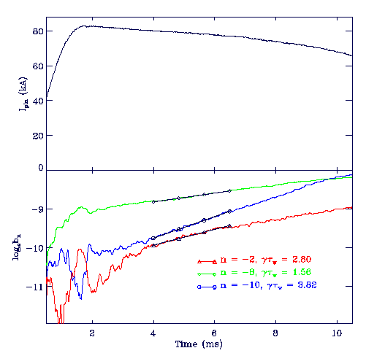
”Natural” mode amplitude and phase traces
for standard discharge
I_{p}
“Error field” mode (e.g. n=-2):
  Linear growth
  Wall locked
  Reproducible phase
RWM (e.g. n=-10):
  Exponential growth
  Wall locked
  Reproducible phase
log_{e}b_{n}
2 4 6 8 10
time (ms)
Time (ms)

Slide 9
Open loop preprogrammed constant external
control field harmonic applied to n=6 unstable mode
What happens if a constant control harmonic is applied
• in phase with the natural mode (i.e. positive feedback orientation)?
• 180 degrees phase difference relative to the natural mode (i.e. negative feedback orientation)?
The data qualitatively demonstrates mode rigidity.

Slide 10
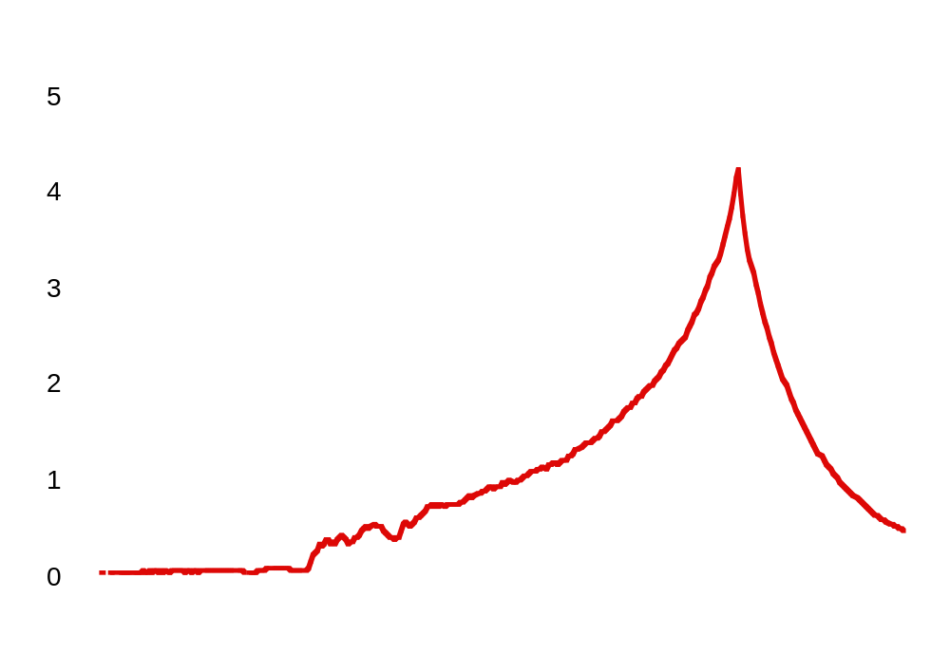
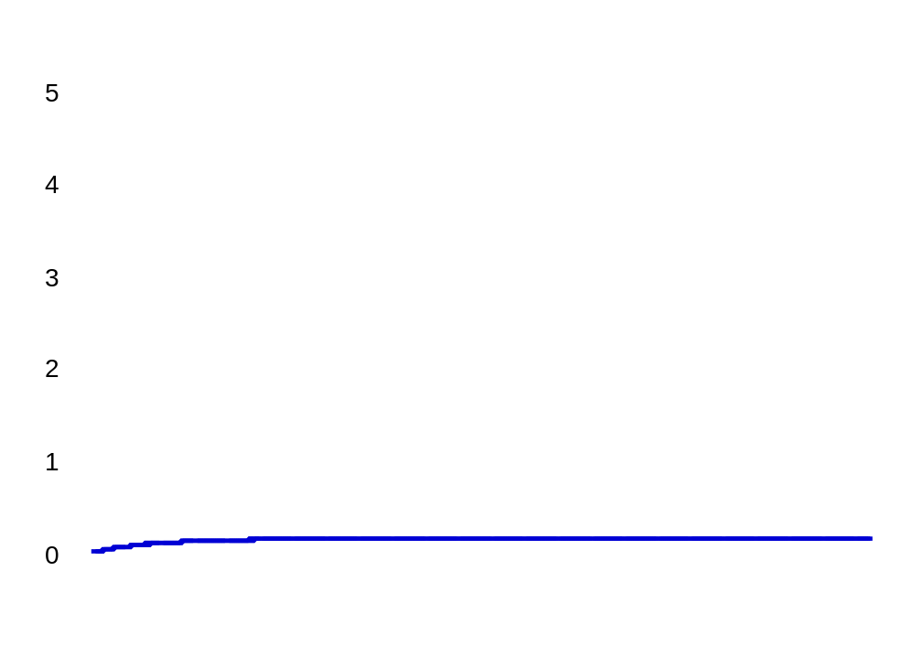
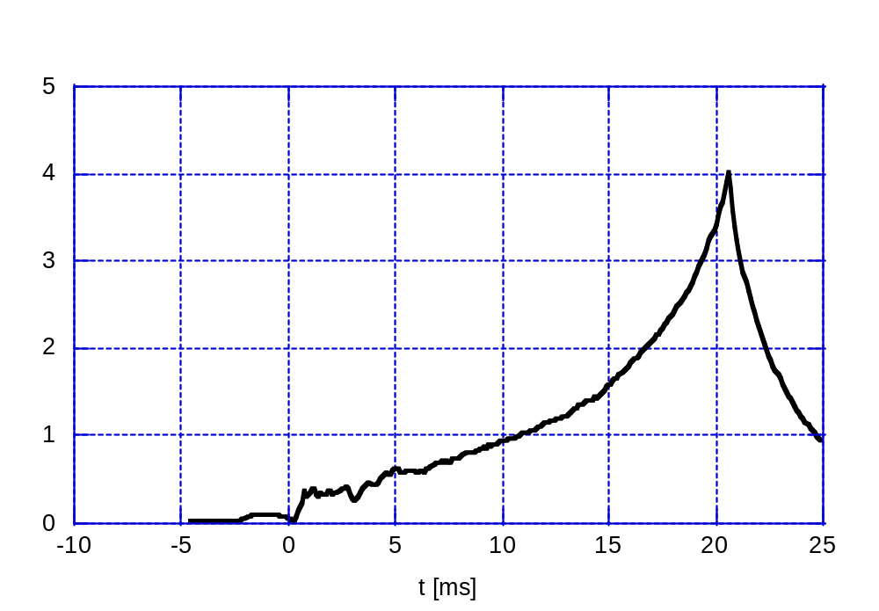
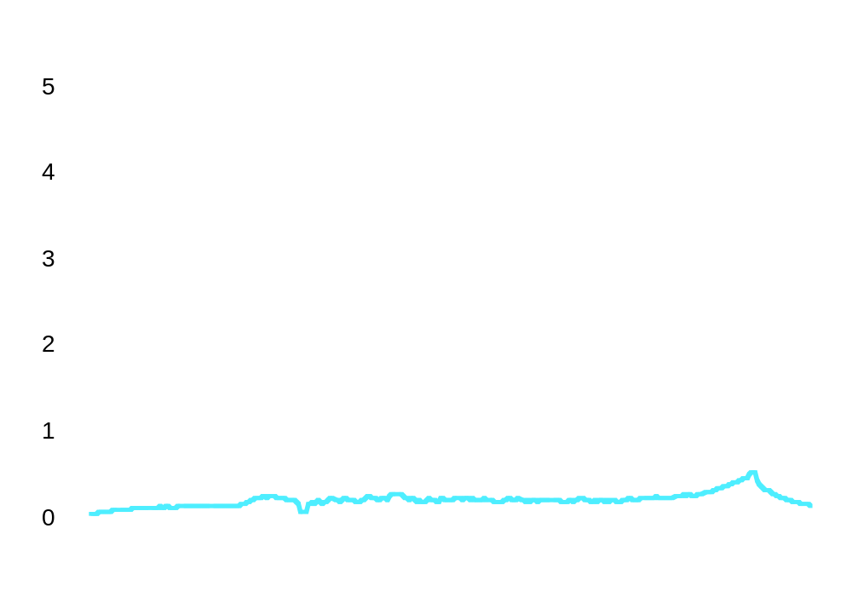
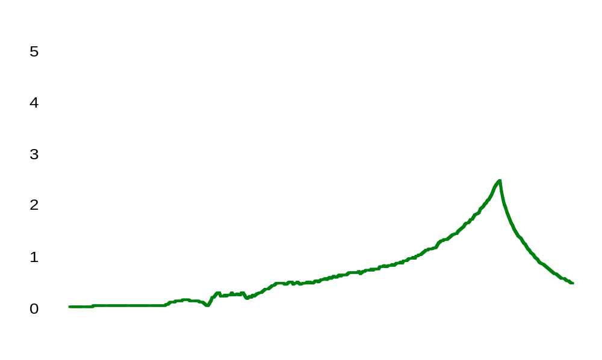
Open loop RWM compensation
n=6
Amplitude [a.u.]
Amplitude of the mode is ≈ 1.0 mT; a. of the external perturbation is ≈ 0.02mT

Slide 11
Open loop preprogrammed constant external
control field harmonic applied to n=6 unstable mode
What happens if the control harmonic is turned on at
a later time when the mode amplitude is larger ?
• The data qualitatively demonstrates mode rigidity.

Slide 12
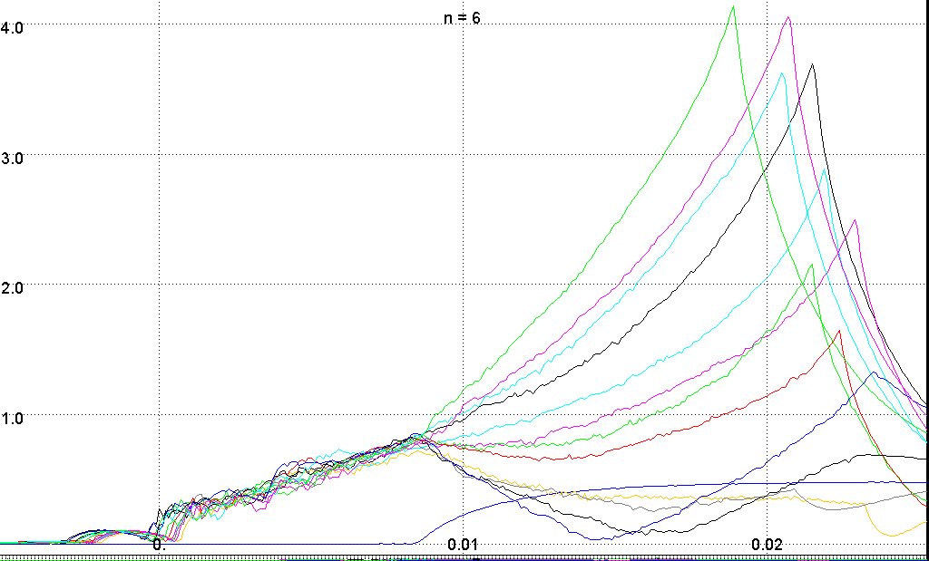
Open loop RWM studies
Amplitude (a.u.)
Time (s)
Compensation can be obtained with a perturbation starting in the middle of the discharge but at the price of a higher amplitude.
This case can be compared with feedback operations

Slide 13
Open loop pre-programmed pulsed external
control field harmonics applied to different modes:
• unstable modes
• marginally unstable modes
• marginally stable modes
• robustly stable
Resonant
field error amplification?
Measure growth and damping rates.
Give indication of applicability of linear model.
Analyze resonant field error amplification.

Slide 14
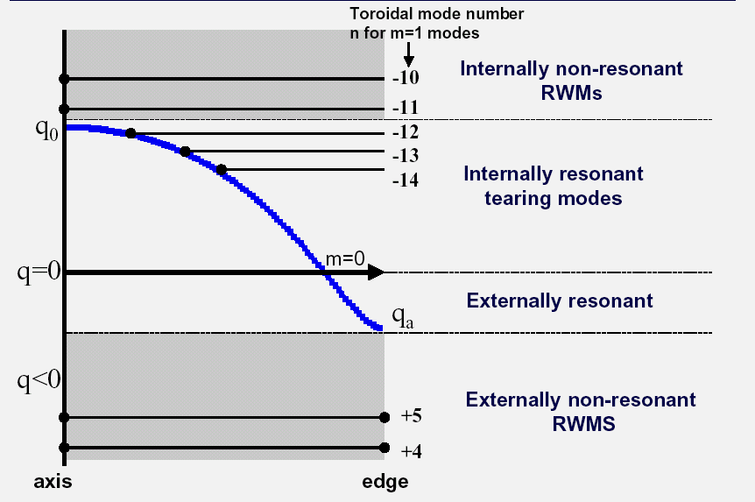
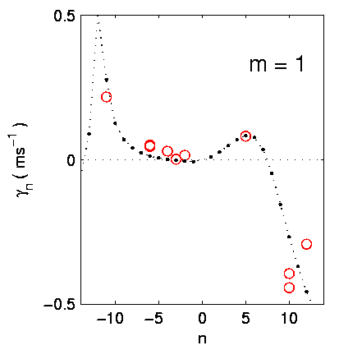
Open loop experiments with a pre-programmed pulsed
external control harmonic
Comment on the spectrum of unstable modes in an RFP
n=-11
n=-4
n=+5
n=+12
n=+10

Slide 15
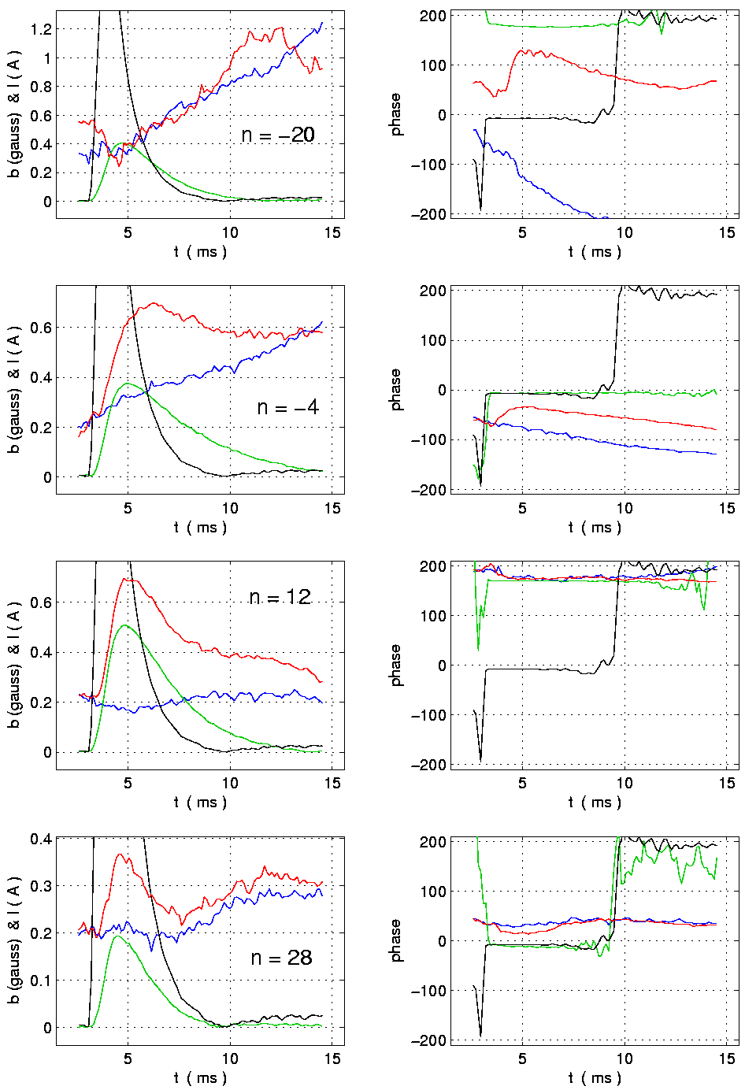
Open loop preprogrammed pulsed external control
field harmonics applied to different modes.
Harmonics for two modes are shown:
n=-4 (marginally unstable)
n=+12 (stable)
Black = current pulse to external saddle coil
(Short pulse with constant phase)
Green = b-external harmonic pulse measured by sensor coil.
Blue = b-plasma harmonic for a reproducible reference discharge
Red = b-plasma harmonic for a discharge with external perturbation applied.
Amplitude Phase
Time (ms) Time (ms)

Slide 16
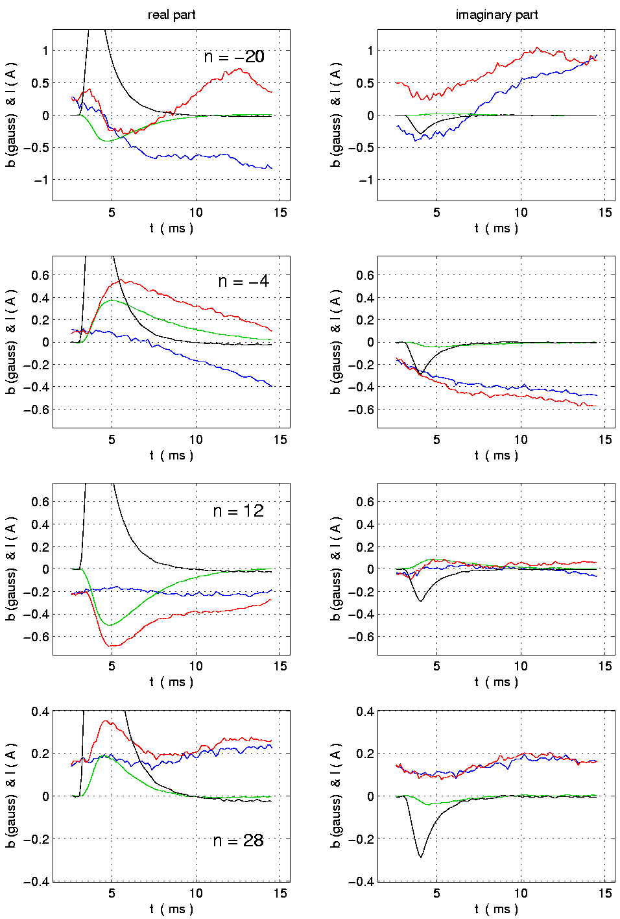
Open loop preprogrammed pulsed external control
field harmonics applied to different modes.
Harmonics for two modes are shown:
n=-4 (marginally unstable)
n=+12 (stable)
Real part Imaginary part
Green = b-external harmonic pulse in vacuum measured by sensor coil.
Blue = b-plasma harmonic for a reference discharge
Red = b-plasma harmonic for a discharge with external perturbation applied.
Time (ms) Time (ms)

Slide 17
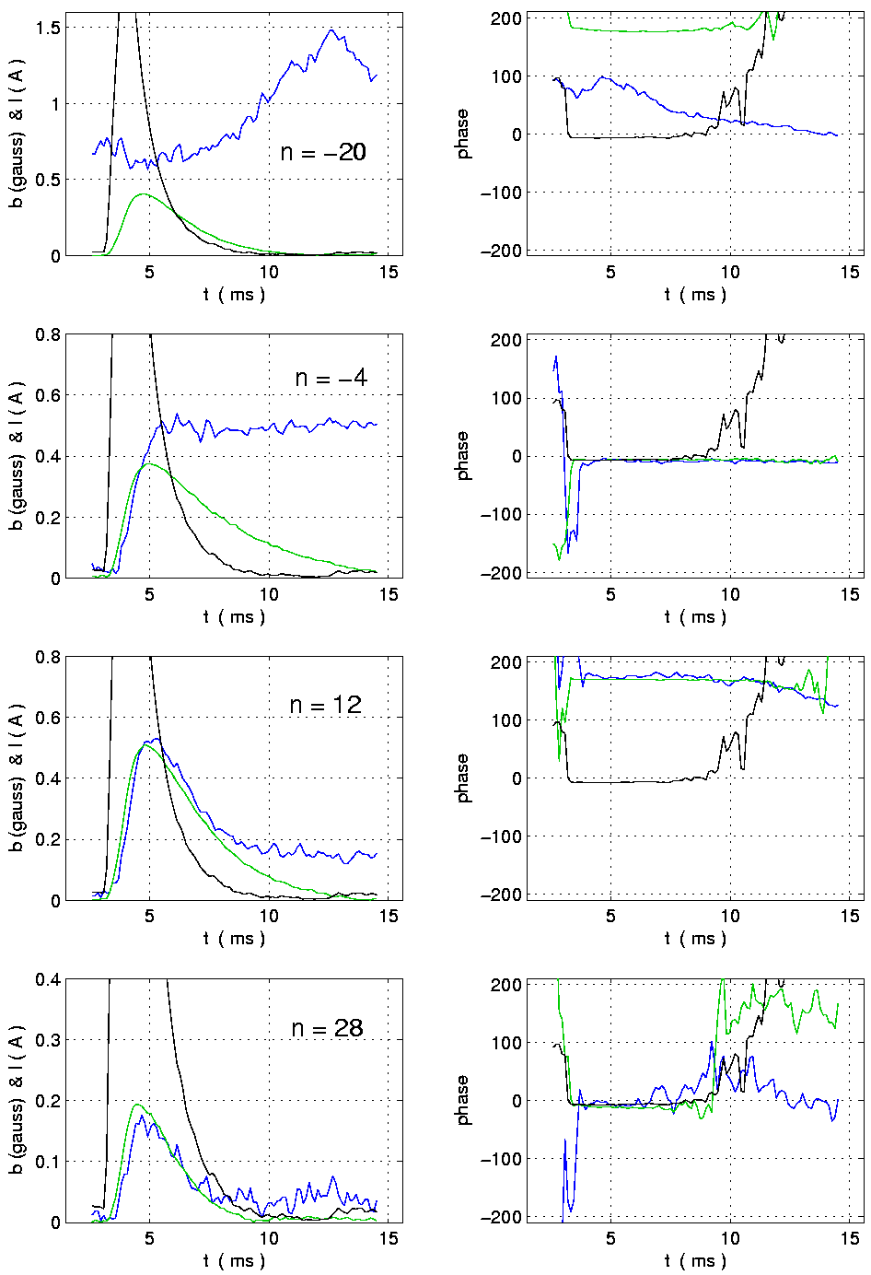
Open loop preprogrammed pulsed external control
field harmonics applied to different modes.
Harmonics for two modes are shown:
n=-4 (marginally unstable)
n=+12 (stable)
Amplitude Phase
Green =
external perturbation
(Short pulse with constant phase)
Blue =
(discharge with external perturbation applied)
minus (reference discharge)
Time (ms) Time (ms)

Slide 18

Open loop experiments
Resistive wall diffusion rate, γ _{m,n,w} = 1/τ_{m,n,w}
Ratio M = field / current
Vacuum shots
Growth & damping rates of RWM
External Error field
Resonant field amplification (RFA) studies
Plasma shots
(Reproducible mode γ_{n,o})
RWM
linear model
d_{t}b_{m,n} = γ_{m,n}b_{m,n} - γ_{m,n,w}(M_{m,n} I_{m,n} + b_{m,n}^{error})
Control field

Slide 19
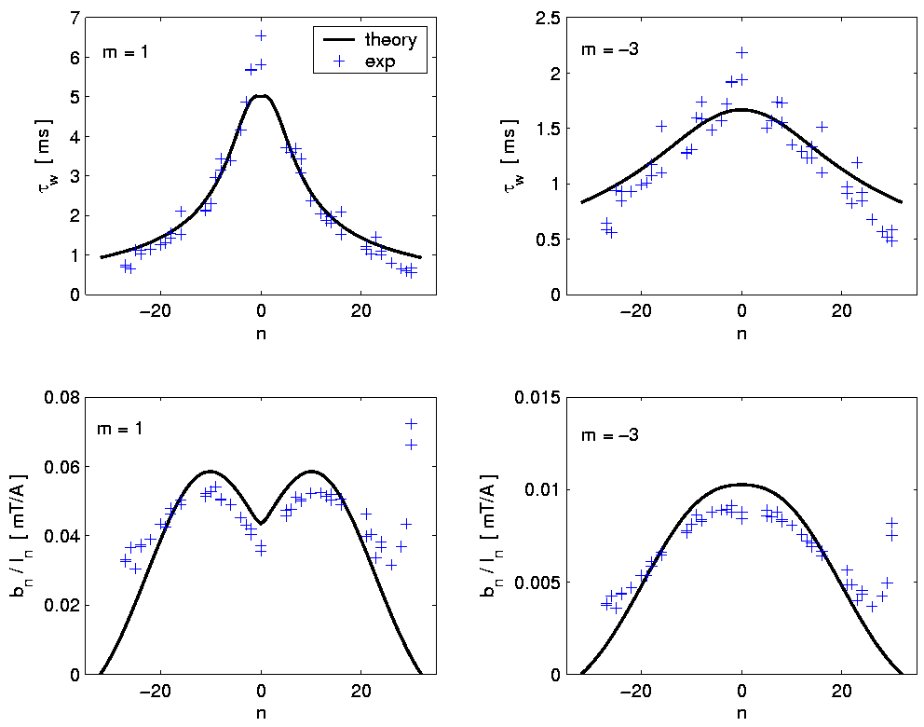
Open loop: Vacuum wall diffusion time, τ_{w}
&
Ratio M_{m,n}, b_{m,n}^{ex}
I_{m,n}^{sc}
m=1
m=-3
6
τ_{w} 4
(ms)
2
0
2
1
0
-20 0 +20
toroidal mode number n
-20 0 +20
toroidal mode number n
0.01
0
m=-3
m=1
0.06
M_{n}
(mT/A)
0
-20 0 +20
toroidal mode number n
-20 0 +20
toroidal mode number n
Theory: Calculations for a thin, smooth resistive cylinder
Experiment(+): Measurements in vacuum using pre-programmed current waveforms for saddle coil currents.

Slide 20
Open loop preprogrammed pulsed external control
field harmonics applied to different modes.
Shell diffusion time of (m=1, n) harmonics
Ratio M = field / current (harmonics)
Vacuum shots
Growth & damping rates of RWM
External Error field
Resonant field amplification (RFA) studies
Plasma shots
(Reproducible mode γ_{n,o})
RWM
linear model
d_{t}b_{m,n} = γ_{m,n}b_{m,n} - γ_{m,n,w}(M_{m,n} I_{m,n} + b_{m,n}^{error})
Control field

Slide 21
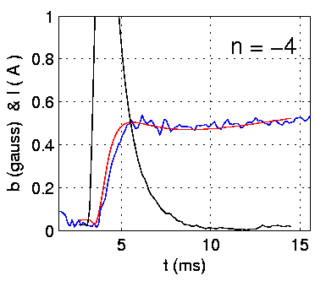
Open loop preprogrammed pulsed external control
field harmonics applied to different modes.
Resonant field error amplifcation can be studied by subtracting the reference plasma shot from the plasma shot with the external resonant perturbation.
• Use the linear model.
• Make a best fit to the data where the fitting parameters are the plasma growth (damping) rates and the ratio M = b_{n}/I_{n}.
d[b_{n,with} - b_{n,ref} ]/dt =
γ_{n} [b_{n,with} - b_{n,ref} ] - γ_{n,w}M_{n} I_{n}
black is I_{n}
blue is [b_{n,with} - b_{n,ref} ]_{(measured)}
red [b_{n,with} - b_{n,ref} ]_{(simulation)}
γ_{n} & M_{n} are fitting parameters

Slide 22
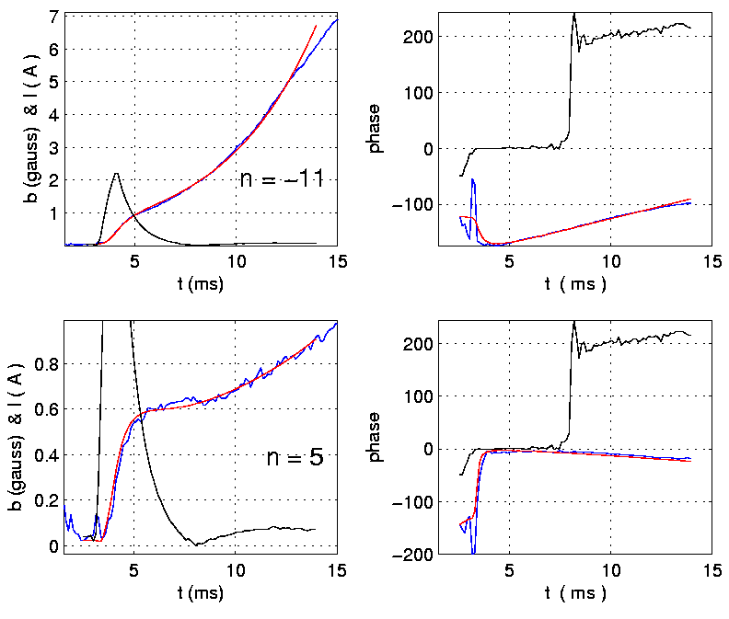
Preprogrammed pulsed external control harmonics applied to different modes.
Harmonics for two unstable modes: n= -11 & n=+5
Amplitude Phase (shifted)
Red =
Best fit simulation with γ_{n} & M_{n} as fitting parameters
Blue =
(discharge with external perturbation applied)
minus
(reference discharge)
Time (ms) Time (ms)

Slide 23
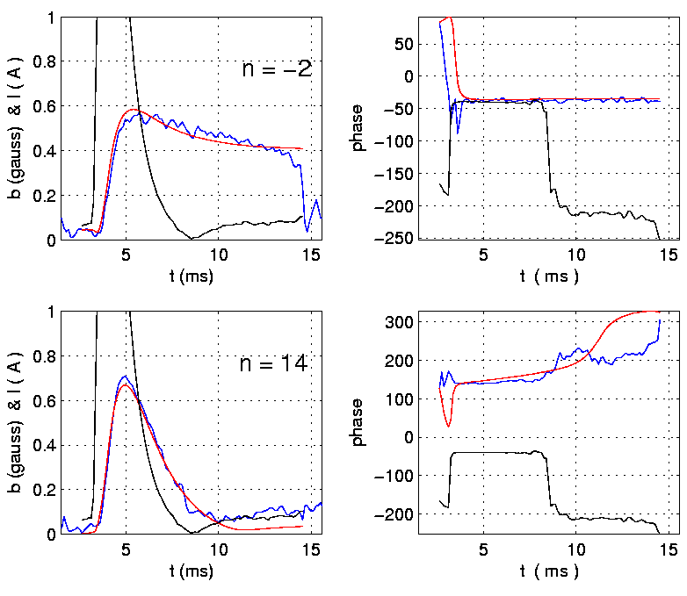
Preprogrammed pulsed external control harmonics applied to different modes.
Harmonics for a marginally stable mode (n= -2) & a stable mode (n=+14)
Amplitude Phase (shifted)
Red =
Best fit simulation with γ_{n} & M_{n} as fitting parameters
Blue =
(discharge with external perturbation applied)
minus
(reference discharge)
Time (ms) Time (ms)

Slide 24
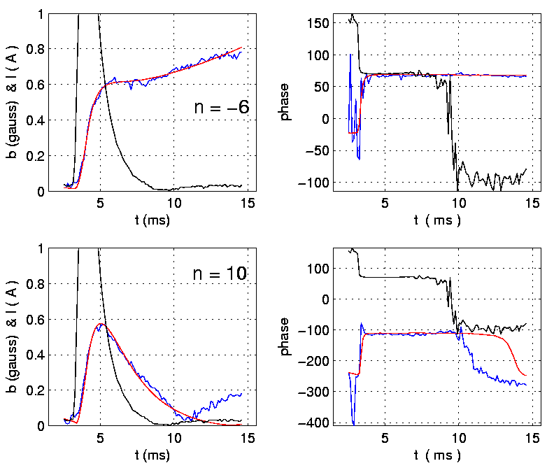
Preprogrammed pulsed external control harmonics applied to different modes.
Harmonics for another unstable mode (n= -6) & a stable mode (n=+10)
Amplitude Phase (shifted)
Red =
Best fit simulation with γ_{n} & M_{n} as fitting parameters
Blue =
(discharge with external perturbation applied)
minus
(reference discharge)
Time (ms) Time (ms)

Slide 25

Preprogrammed pulsed external control harmonics applied to different modes.
Summary of growth (damping) rates and ratio M= b_{n}/I_{n} determined from best fit to measured data.
Note!
Red ”o” are values for cases with plasma & control harmonic
Blue ”+” are values for control harmonic in vacuum
The mutuals,
M_{n}= b_{n}/I_{n},
should be the same for best fit to vacuum data and to plasma data.
(Higher m numbers must be included to model current in saddle coils.)

Slide 26
Summary
Modeling of open loop control experiments in EXTRAP T2R RFP using the well known form:
d_{t}b_{m,n} = γ_{m,n}b_{m,n} - γ_{m,n,w}(M_{m,n} I_{m,n} + b_{m,n}^{error})
With fitting parameters:
• Growth (damping rates)
• Mutuals (field at sensor coil/current in saddle coil
Give the following values for growth (damping) and inherent error fields:
n -11 -6 -4 -3 -2 +5
γ(ms⁻¹) 0.22+i0.15 0.05 >0.02 <0.01 <0.02 0.08+i0.03
b_{err} (mT) 0.013 0.02 <0.01 0.1
b_{err} (phase) 0˚ -145˚ 45˚

